Slide 1



Oscillating Spinor Solitons
The project „Photonic implementations of quantum-enhanced technologies” is realized within the TEAM programme of Foundation for Polish Science, cofinanced from European Union, Regional Development Fund (Programme Innovative Economy 2007-2013)

Slide 2
Oscillating Spinor Solitons
Piotr Szańkowski
Marek Trippenbach
Eryk Infeld

Slide 3
Outline
Bose-Einstein Condensate in the optical trap
Solitons in the spinor BEC
Soliton collisions – creation of the Oscillatons
Mathematical description of the Oscillatons
Collisions of the Oscillatons

Slide 4
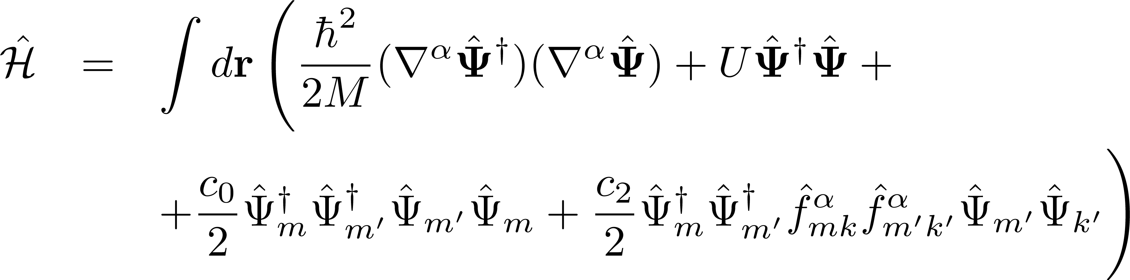
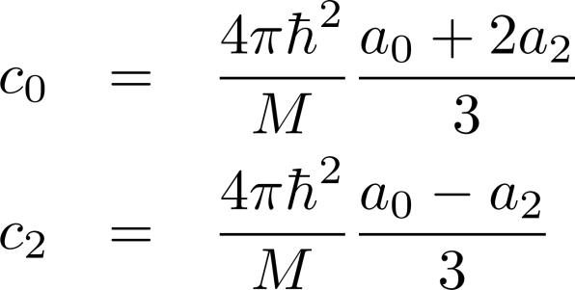
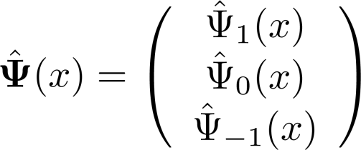


The system
Bose-Einstein Condensate at T=0 confined in the optical trap.
Spins of trapped atoms are not frozen like in the magnetic trap!
The spinor nature of the condensate can be manifested.
The Hamiltonian of the system:
We will consider atoms with hyperfine spin F=1 (e.g. ⁸⁷Rb).
the field operator of each spin component
where a_{f} is s-wave scattering length of total spin f channel
spin 1 operators
trapping potential

Slide 5
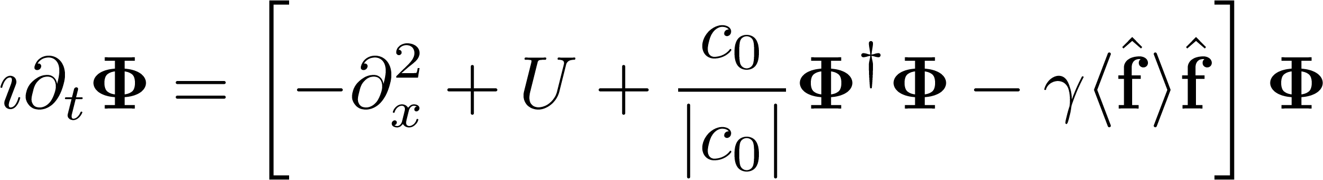
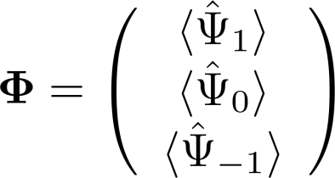
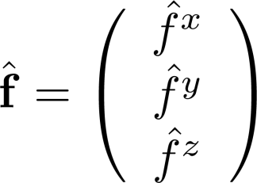
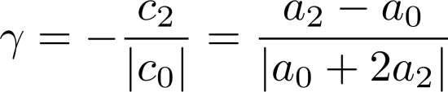
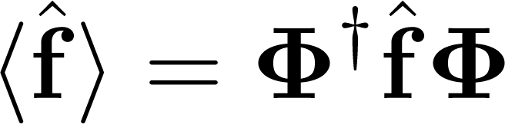
Spinor Gross-Pitaevskii equation
Mean-field approximation and variational principle
leads to the spinor Gross-Pitaevskii equation
where
the order parameter (spinor wave function)
and

Slide 6

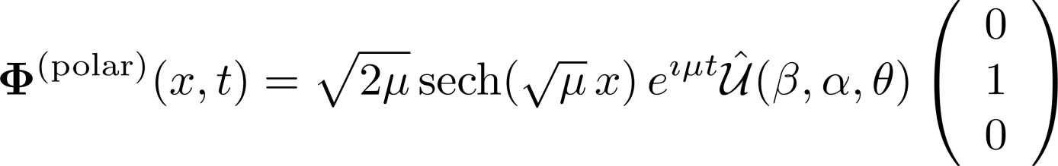
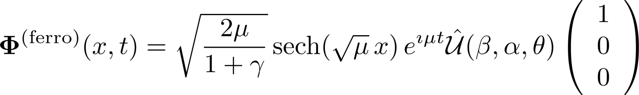
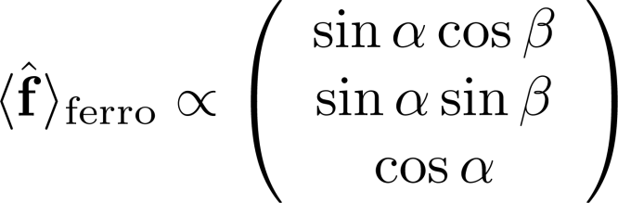

Solitons
Generally, spinor GP equation,
Change the sign of c₀ with Feshbach resonance
Lift trap adiabatically and obtain the soliton
The ground state for c₀ > 0
supports two kinds of soliton solutions:
Polar soliton
Ferromagnetic
soliton
The spin of polar and ferromagnetic solitons
rotation operator

Slide 7
Complete Integrability of the spinor GP equation
For γ = 1 spinor GP equation is Completely Integrable.
Solitons collide with each other elastically:
There is no transfer of spin or momentum.
Solitons retain their character after the collision.
What happens when γ is not equal to 1?
( T. Tsuchida and M. Wadati, J. Phys. Soc. Jpn. 67, 1175 (1998) )

Slide 8
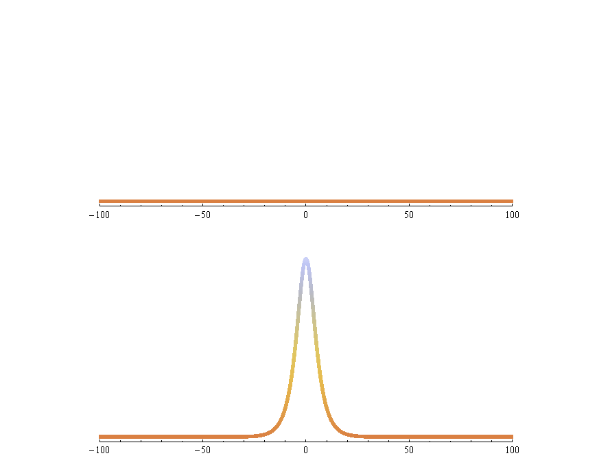
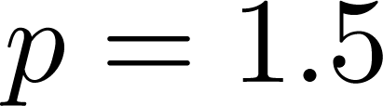
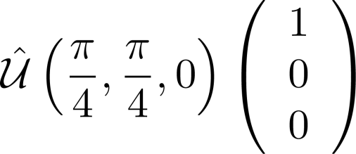
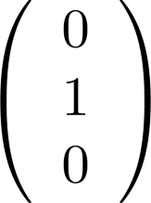
Soliton collision: creation of the Oscillatons
Bullet:
Ferromagnetic Soliton
Target:
Polar Soliton

Slide 9
Spin transfer
Out:
Post - ferromagnetic
Oscillaton
Out:
Post - polar
Oscillaton
Out:
Post - polar
Oscillaton
Out:
Post - polar
Oscillaton
Before the collision:
What is the spin after the collision
of two polar solitons?
What is the spin after the collision?
In:
Polar
Soliton
In:
Ferromagnetic
Soliton
In:
Polar
Soliton
In:
Polar
Soliton

Slide 10
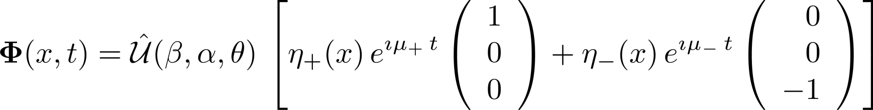
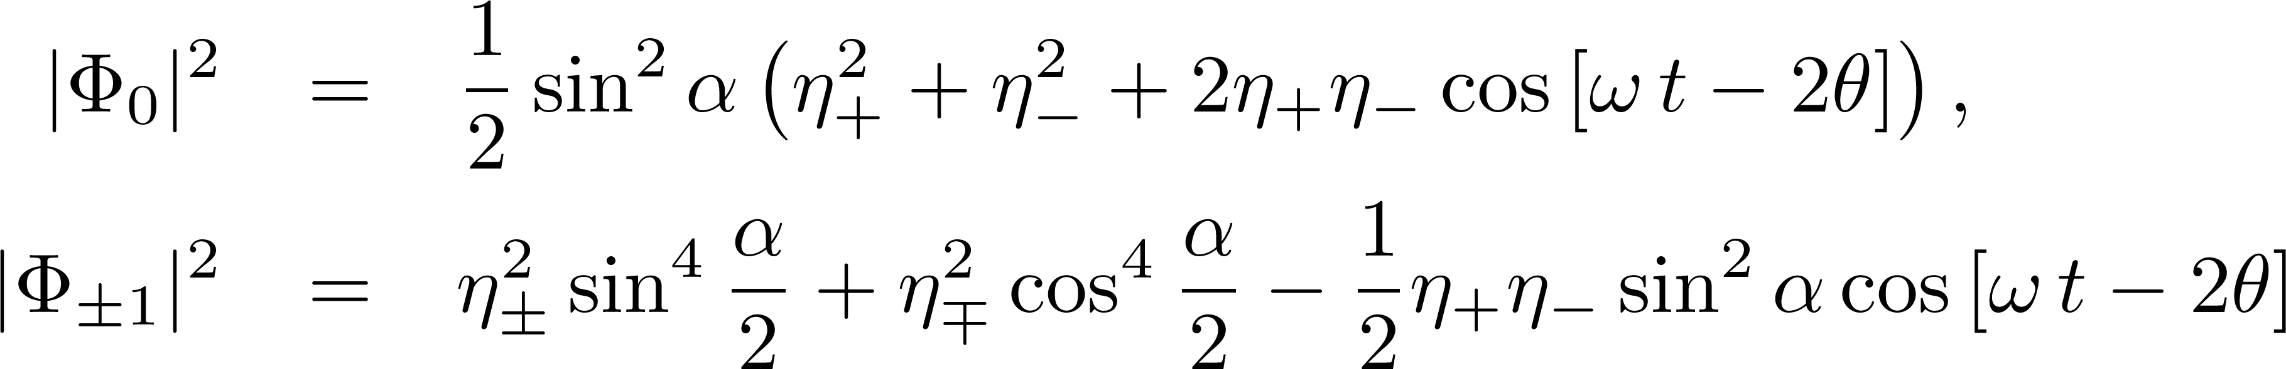
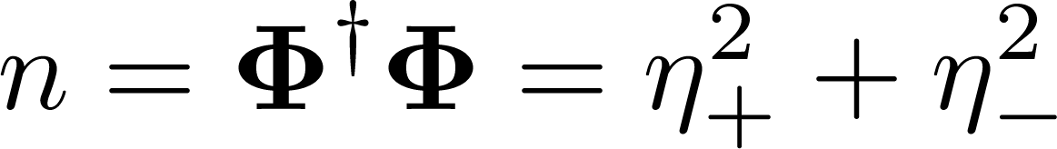
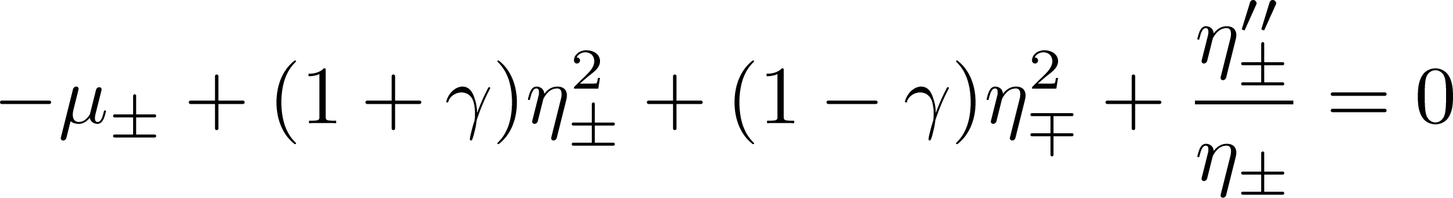
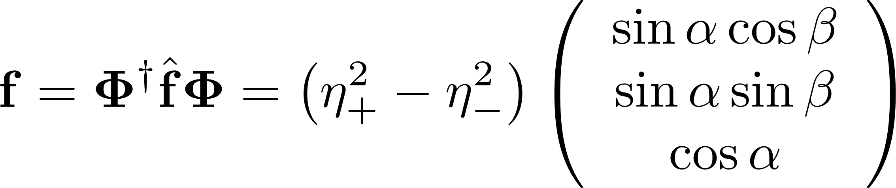

Mathematical model of the Oscillatons
Oscillations of the components:
Density:
The Oscillaton equations:
Spin:
Amplitude of the oscillations depends on α!
The frequency of the oscillations:

Slide 11


Approximate solutions:
Post-polar Oscillatons

Slide 12
Approximate solutions:
Post-ferromagnetic Oscillatons

Slide 13
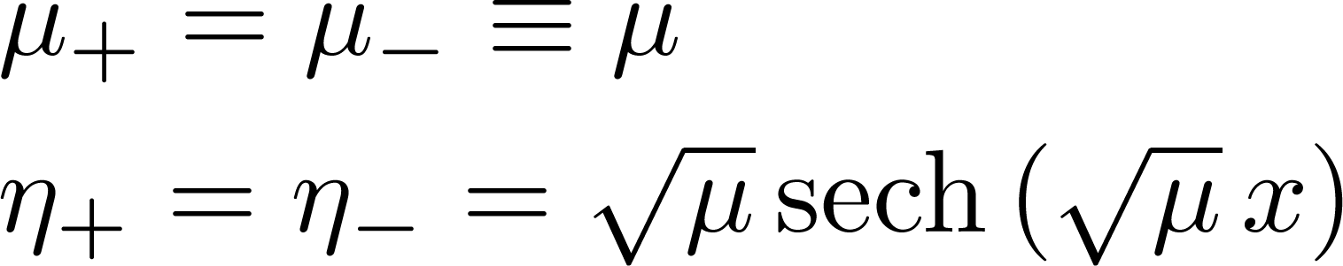
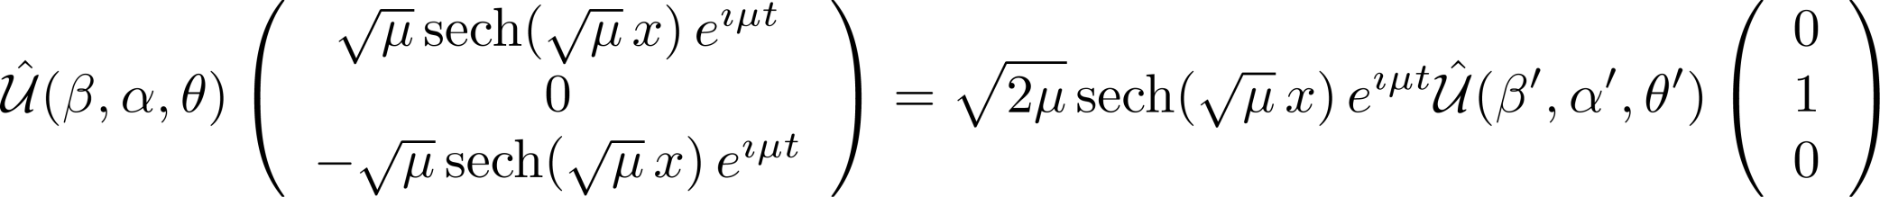
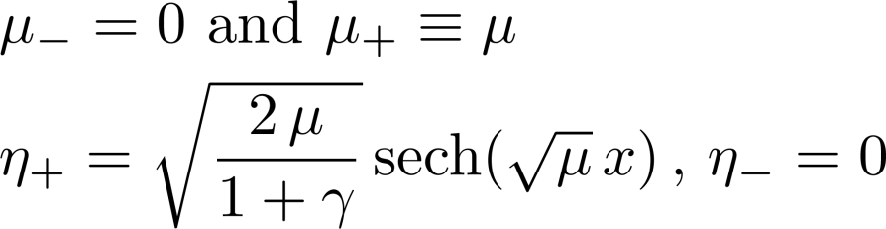
Solitons as the special case of Oscillatons
Polar soliton:
Ferromagnetic soliton:

Slide 14
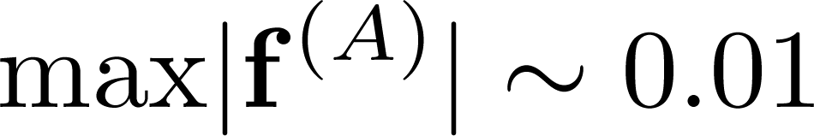
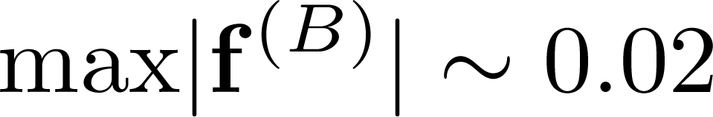
Oscillaton collisions
Alice (lesser spin)
Bob (greater spin)
IN:
Two Oscillatons created in different soliton collisions
Oscillaton Alice
Oscillaton Bob
OUT:
Two, altered Oscillatons!

Slide 15
Summary
Polar and ferromagnetic solitons in spinor Bose-Einstein condensate
Inelastic collisions of solitons leads to creation of new kind of solutions –
the Oscillatons
Solitons are special cases of the Oscillatons
The Oscillatons are similiar to solitons in Completely Integrable systems:
they propagate in time without dispersion and
retain their character after colliding with each other

Slide 16


Oscillations of the wave function components

Slide 17
Radiation

Slide 18
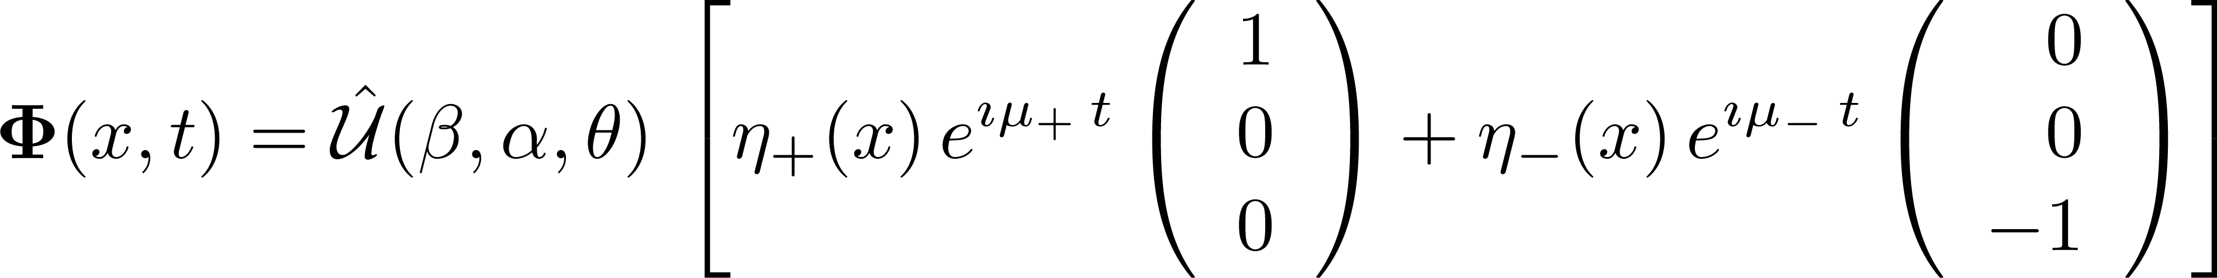
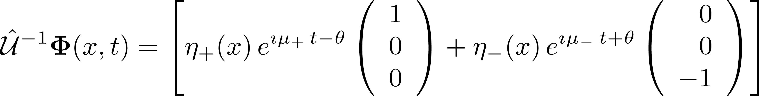
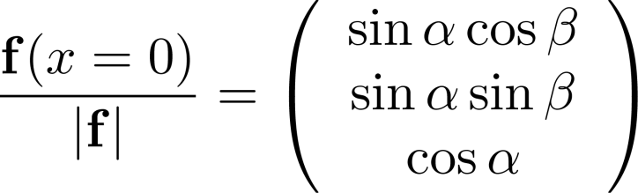
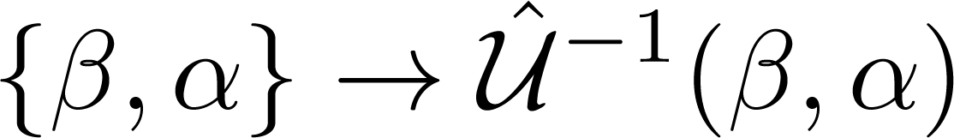
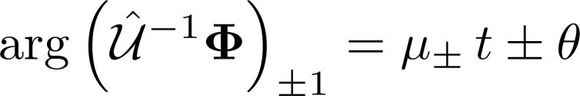
How to describe emerging Oscillatons with the model?
Step I: Find the angles
Step II: Rotate the reference frame
Step III: Find chemical potentials
Step IV: Solve the Oscillaton equations

Slide 19
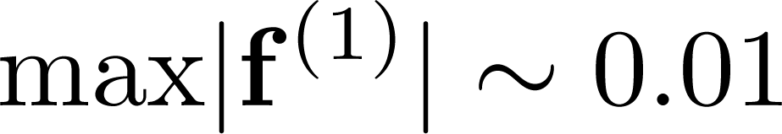
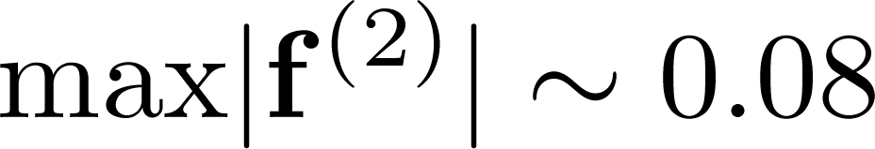
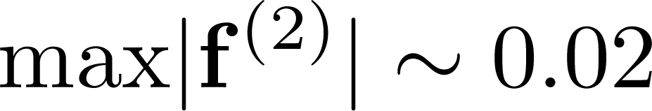
Oscillaton collisions
Post-polar oscillaton (1)
Post-polar oscillaton (2)
Post-polar Oscillaton (1)
Post-ferro Oscillaton (2)
Case II:
post-polar Oscillaton vs. Post-ferro Oscillaton
Case I:
post-polar Oscillaton vs. post-polar Oscillaton
Post-polar Oscillaton (1):
Post-ferro Oscillaton (2):
Oscillaton (1):
Oscillaton (2):

