Slide 1
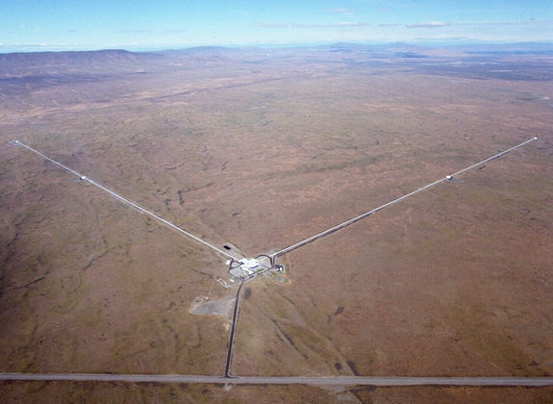
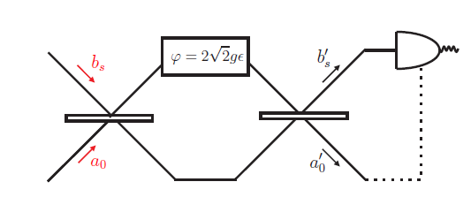
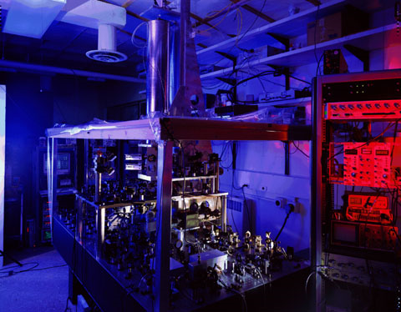
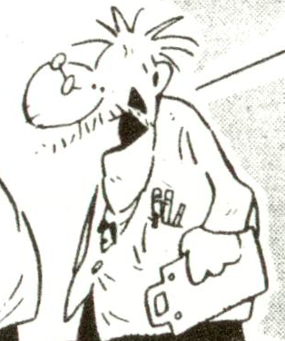







Gravitational wave detectors, atomic clocks
a naive theorist(s) approach
R. Demkowicz-Dobrzański¹, K. Banaszek¹, J. Kołodyński¹, M. Jarzyna¹,
M. Guta², K. Macieszczak^{1,2}, R. Schnabel³, M. Fraas⁴
¹Faculty of Physics, University of Warsaw, Poland
² School of Mathematical Sciences, University of Nottingham, United Kingdom
³ Max-Planck-Institut fur Gravitationsphysik, Hannover, Germany
⁴ Theoretische Physik, ETH Zurich, 8093 Zurich, Switzerland

Slide 2
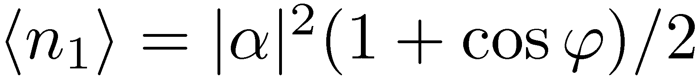

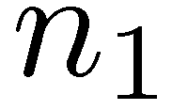
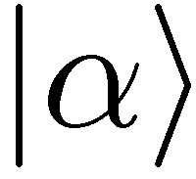
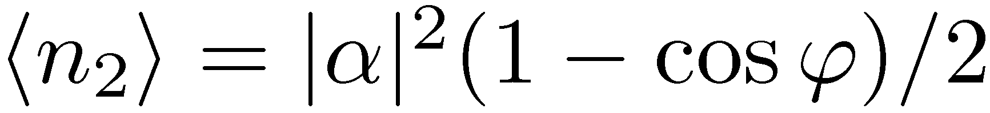
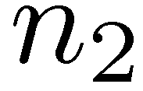
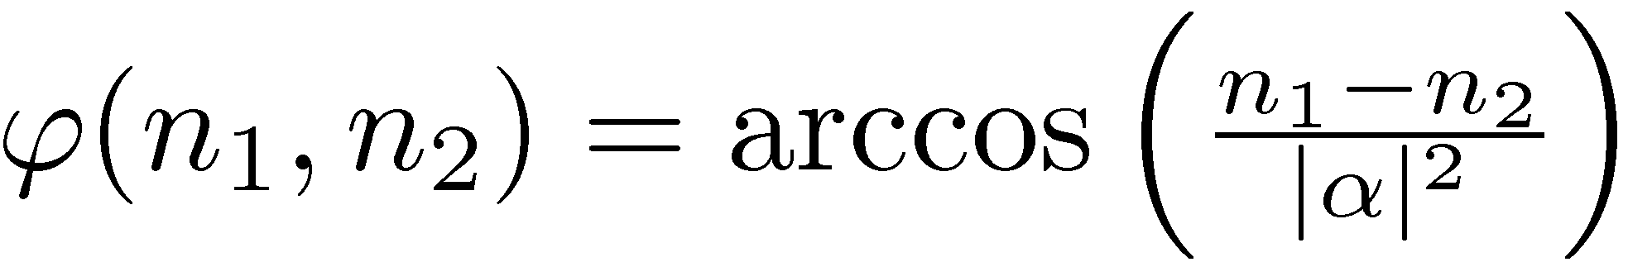
,,Classical’’ interferometry
the best estimator

Slide 3
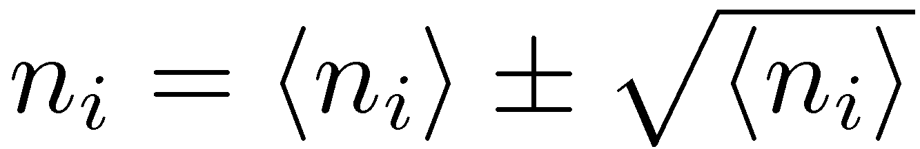
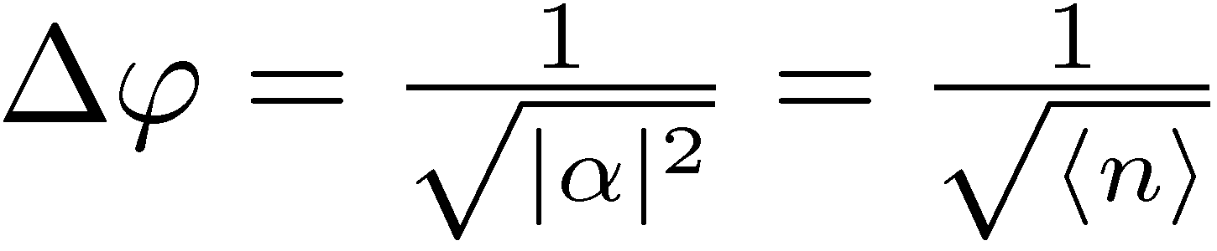
„Classical” interferometry
Each photon interferes only with itself!
the best estimator
Poisson statistics
classical (standard) scaling

Slide 4
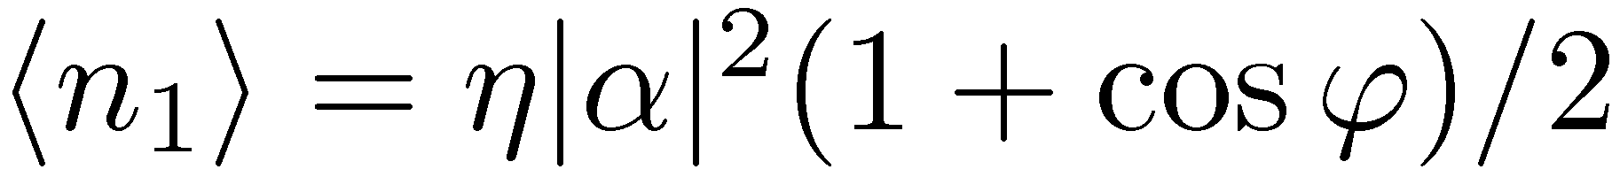
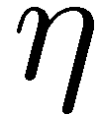
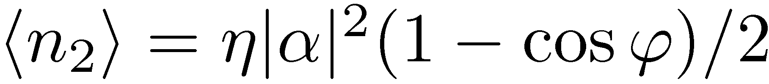
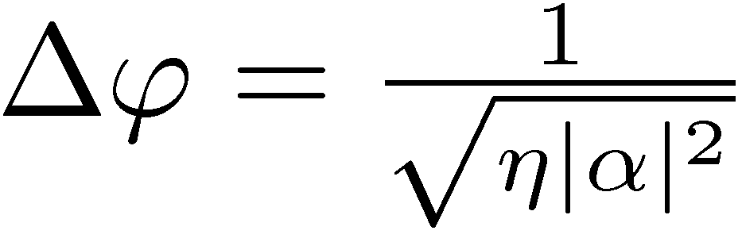
„Classical” interferometry
with loss
classical (standard) scaling

Slide 5
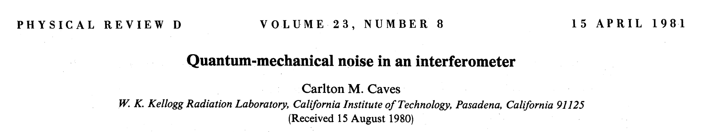


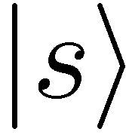
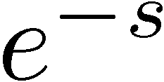
Quantum interferometry experimentalist point of view
Coherent state
Precision enhancement thanks to subpoissonian fluctuations of n₁- n₂!
Squeezed vacuum

Slide 6
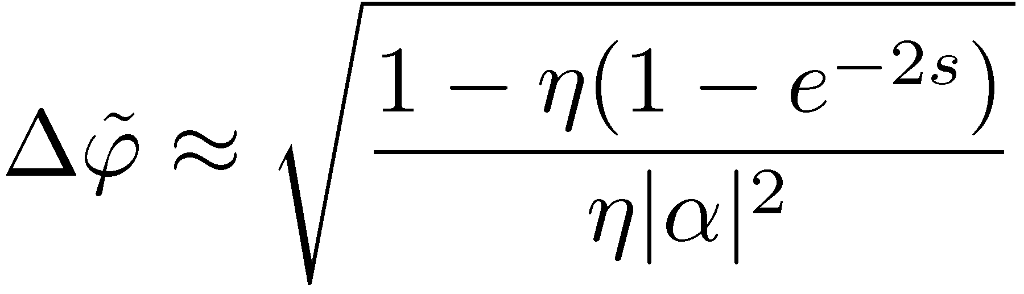
Quantum interferometry experimentalist point of view
Coherent state
Precision enhancement thanks to subpoissonian fluctuations of n₁- n₂!
Squeezed vacuum
For strong coherent beam, weak squeezing and taking into account losses
Quantum precision enhancement factor

Slide 7
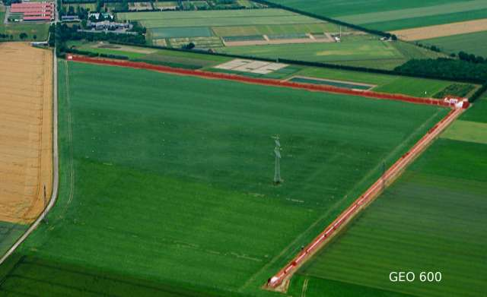
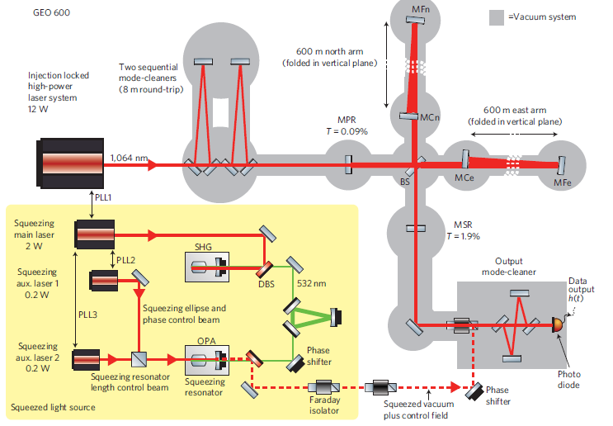
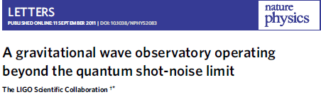
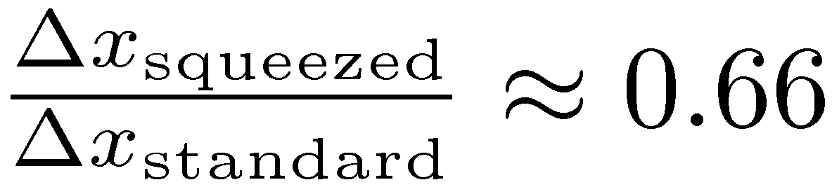
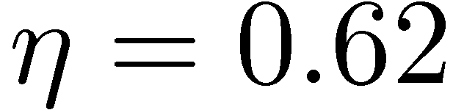

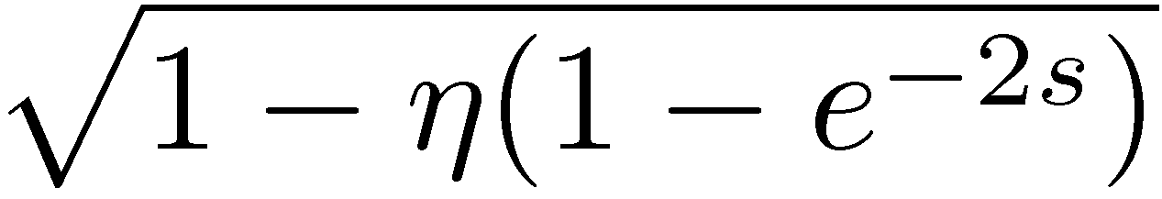
Quantum precision enhancement in the GEO600 interferometer
Can the precision be further improved using better quantum states and better measurements?
=

Slide 8
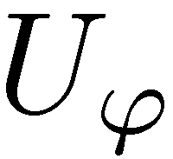
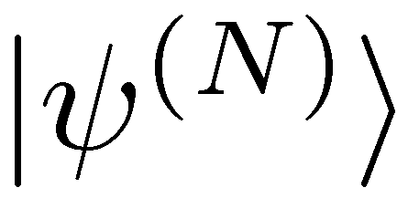
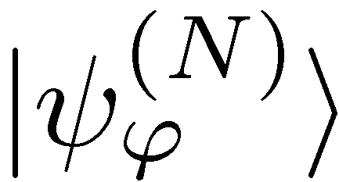
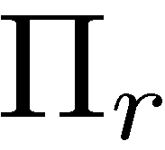
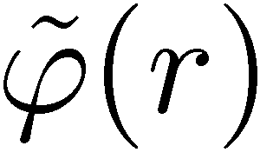
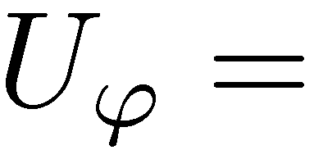
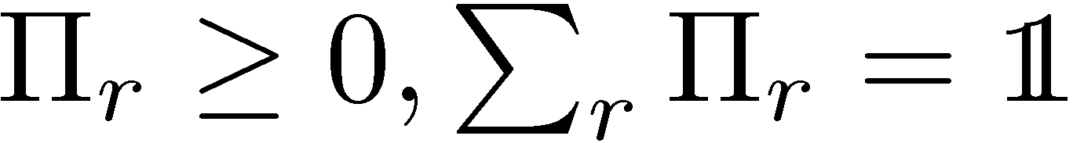
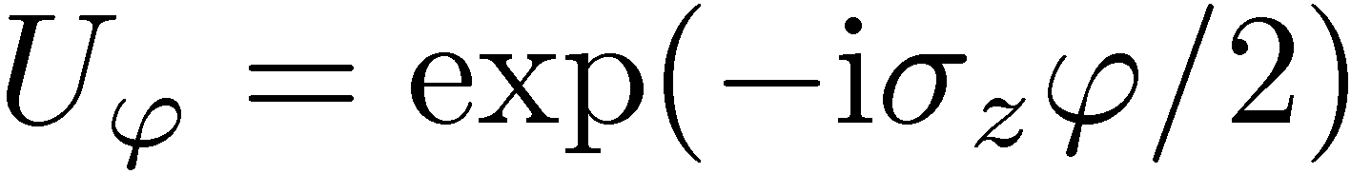
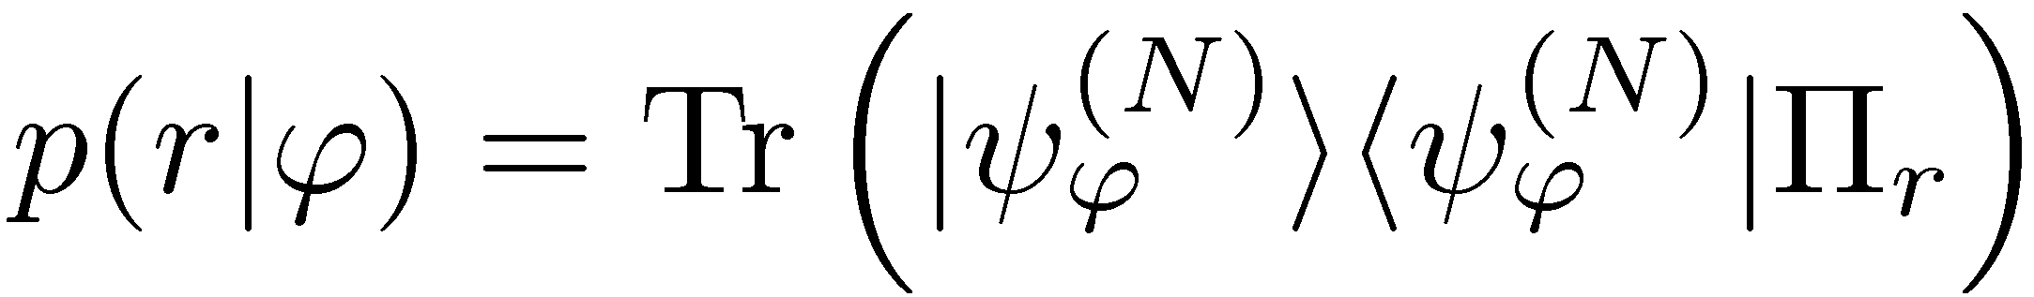
Quantum metrology theorist point of view
general N
photon (probe) state
general measurement
general estimator
What is the advantage over „classical” (no entanglement) strategy?

Slide 9
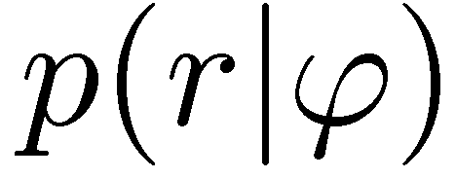
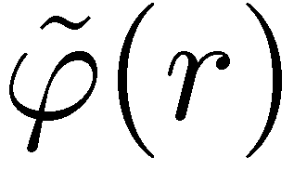
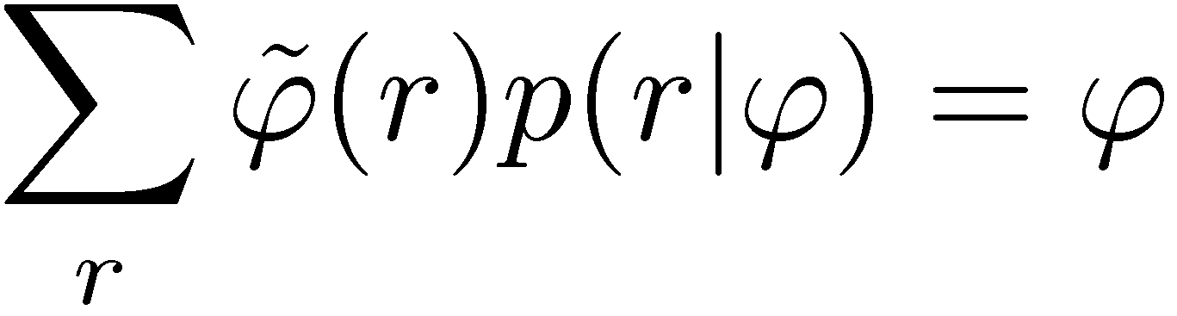
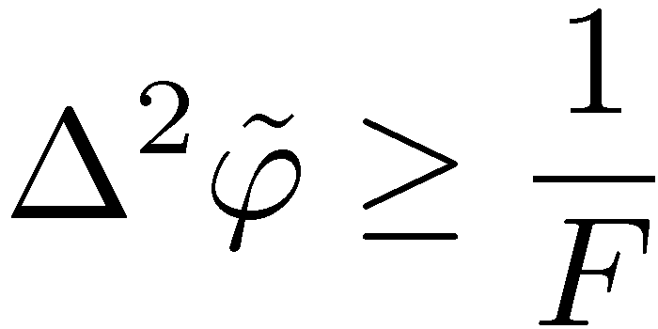
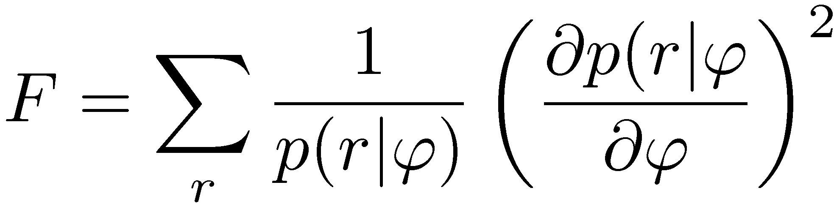
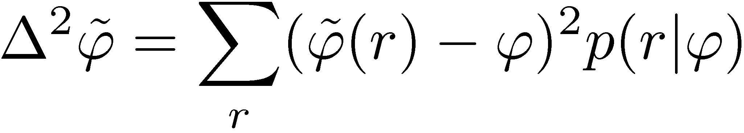
Fisher information
Given a probability distribution
For any unbiased estimator
Cramer-Rao inequality holds:
estimator variance
Fisher information
Fisher information = sensitivity of p(r|ϕ) to parameter changes

Slide 10
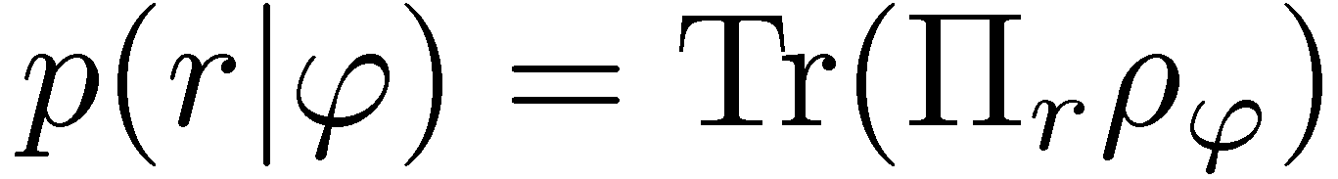
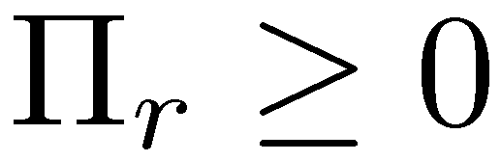
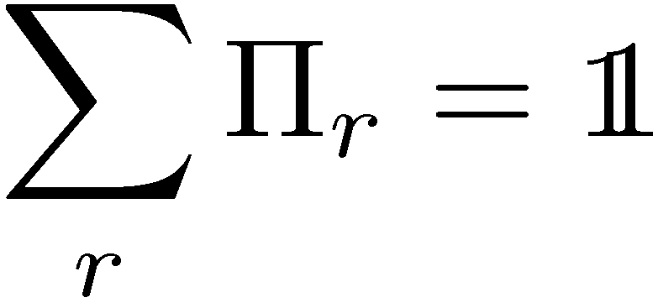
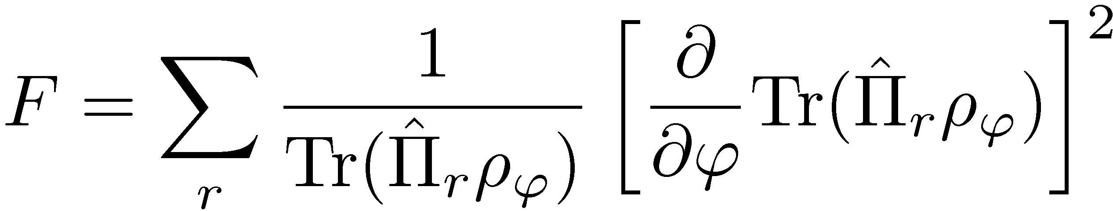
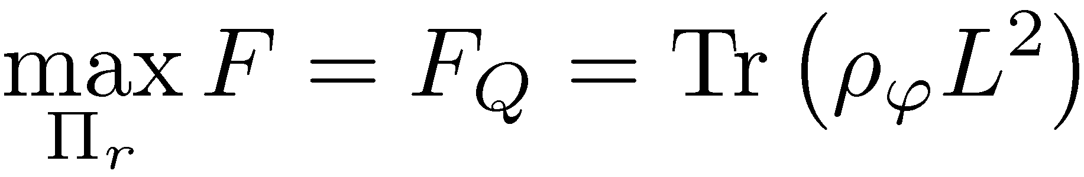
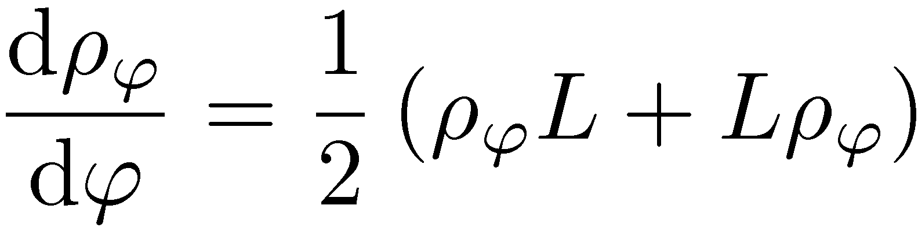
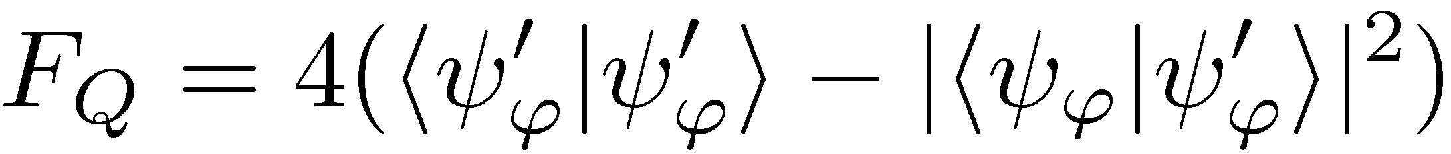
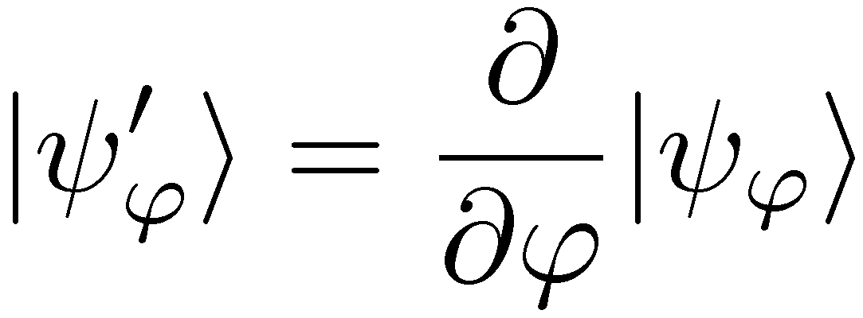
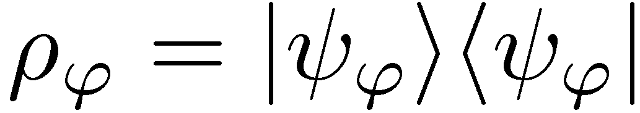
Quantum Fisher information
Quantum Fisher information
L – symmetric log derrivative
For pure states
Quantum Fisher information =
how much a quantum state changes with parameter variation

Slide 11






Quantum metrology theorist point of view
Quantum Fisher information:
Optimal state
eigenstates of H corresponding to largest and smallest eigenvalues
Giovanetti, Lloyd, Maccone,
Phys. Rev. Lett. 96, 010401 (2006)
Heisenbeg scaling

Slide 12


Quantum metrology theorist point of view
Quantum Fisher information:
Optimal state
eigenstates of H corresponding to largest and smallest eigenvalues
Giovanetti, Lloyd, Maccone,
Phys. Rev. Lett. 96, 010401 (2006)
Heisenbeg scaling
,,classical scaling’’

Slide 13



Quantum metrology theorist point of view
Quantum Fisher information:
Optimal state
eigenstates of H corresponding to largest and smallest eigenvalues
No need for collective measurements
Giovanetti, Lloyd, Maccone,
Phys. Rev. Lett. 96, 010401 (2006)
Heisenbeg scaling
,,classical scaling’’

Slide 14





Phase estimation very naive theorist point of view
NOON state
Problems:
- Cramer-Rao bound not guranteed tu be saturated in asingle shot
- May require unresonable a priori knowledge
strict Bayesian approach leads in fact to
- Decoherence not taken into account!
and completely different states
Decoherence (loss of photons) is not taken into account!!!

Slide 15






Quantum metrology a more down-to-earth theorist point of view
Problem: Need to perform eigendecomposition of

Slide 16






Side remark other equivalent formulas for Quantum Fisher Information for mixed states
Minimum over purifications
Relation with fidelity
Convex roof definition
G. Toth and D. Petz D 2013 Phys. Rev. A 87 032324 (2013)
S. Yu ArXiv:1302.5311 (2013)

Slide 17









Optimal phase estimation in presence of decoherence – numerical results
How to find asymptotic scaling of precision analytically?
What is the scaling?
Heiseberg scaling
RDD, et al. Phys. Rev. A 80, 013825 (2009)
U. Dorner, et al., Phys. Rev. Lett. 102, 040403 (2009)
Analogous behaviour for atomic dephasing
S. Huelga, et al. Phys. Rev. Lett 79, 3865 (1997)

Slide 18


Classical simulation of a quantum channel
Convex set of quantum channels
Notes:
For qubit dephasing exact result, for interfereomter unfortunately not possible. Other methods also quite simple but not that geometric

Slide 19




Classical simulation of a quantum channel
Convex set of quantum channels
Parameter dependence moved to mixing probabilities
Before:
After:
By Markov property….
K. Matsumoto, arXiv:1006.0300 (2010)
Notes:
For qubit dephasing exact result, for interfereomter unfortunately not possible. Other methods also quite simple but not that geometric

Slide 20
Classical simulation of N channels used in parallel
Notes:
For qubit dephasing exact result, for interfereomter unfortunately not possible. Other methods also quite simple but not that geometric

Slide 21






Classical simulation of N channels used in parallel
=
Notes:
For qubit dephasing exact result, for interfereomter unfortunately not possible. Other methods also quite simple but not that geometric

Slide 22
Classical simulation of N channels used in parallel
=
Notes:
For qubit dephasing exact result, for interfereomter unfortunately not possible. Other methods also quite simple but not that geometric

Slide 23


Precision bounds thanks to classical simulation
For unitary channels
Heisenberg scaling possible
Generic decoherence model will manifest shot noise scaling
To get the tighest bound we need to find the classical simulation with lowest F_{cl}

Slide 24








Precision bounds thanks to classical simulation
For unitary channels
Heisenberg scaling possible
Generic decoherence model will manifest shot noise scaling
To get the tighest bound we need to find the classical simulation with lowest F_{cl}
RDD, J. Kolodynski, M. Guta, Nature Communications 3, 1063 (2012)

Slide 25







Example: dephasing
dephasing
For „classical strategies”
Maximal quantum enhancment
RDD, J. Kolodynski, M. Guta, Nature Communications 3, 1063 (2012)

Slide 26





Example: loss
Lossy interferometer
photon transmitted
photon lost from
The upper arm
Bound useless
photon lost from
the lower arm
Need to generalize the idea of classical simmulation

Slide 27




Quantum simulation
Classical simulation
=
=

Slide 28
Quantum simulation
Quantum simulation
=
arbitrary state
arbitrary map

Slide 29



Quantum simulation
Fisher information cannot increase under parameter independent CP map
We should look for the ,,worst’’ quantum simulation to get the tightest bounds

Slide 30







Search for the,,worst’’ Quantum simulation
different equivalent Kraus represenations
We require only a quantum simulation up to first order in
h – hermitian matrix
RDD, J. Kolodynski, M. Guta, Nature Communications 3, 1063 (2012)
J. Kolodynski, RDD, New J. Phys. 15, 073043 (2013)

Slide 31




Search for the,,worst’’ Quantum simulation
different equivalent Kraus represenations
We require only a quantum simulation up to first order in
h – hermitian matrix
RDD, J. Kolodynski, M. Guta, Nature Communications 3, 1063 (2012)
J. Kolodynski, RDD, New J. Phys. 15, 073043 (2013)

Slide 32




Search for the,,worst’’ Quantum simulation
dephasing
Lossy interferometer
the same as from classical simulation
RDD, J. Kolodynski, M. Guta, Nature Communications 3, 1063 (2012)
J. Kolodynski, RDD, New J. Phys. 15, 073043 (2013)

Slide 33







Search for the ,,worst’’ quantum simmulation
A semi-definite programm
Lossy interferometer | Dephasing | Depolarization | Spontaneous emission
A variant of the method yields tighter bounds for finite N
RDD, J. Kolodynski, M. Guta, Nature Communications 3, 1063 (2012)
J. Kolodynski, RDD, New J. Phys. 15, 073043 (2013)

Slide 34


Phase estimation uncertainty in lossy interferometer
Heisenberg scaling
Heisenberg scaling lost!
J. Kolodyński, R. Demkowicz-Dobrzański, PRA 82,053804 (2010) – Bayesian approach
S. Knysh, V. Smelyanskiy, G. Durkin , PRA 83, (2011) – Fisher information approach
B. M. Escher, R. L. de Matos Filho, L. Davidovich, Nat. Phys. 7, 406 (2011)
RDD, J. Kolodynski, M. Guta, Nature Communications 3, 1063 (2012)

Slide 35

Saturating the fundamental bound for lossy interferometer is simple!
Fundamental bound
For strong beams:
Simple estimator based
on n₁- n₂ measurement
C. Caves, Phys. Rev D 23, 1693 (1981)
Weak squezing + simple measurement + simple estimator = optimal strategy!

Slide 36


Optimality of the squeezed vacuum+coherent state strategy

Slide 37

How far is GEO600 from the fundamental bound?
Under given energy resources used and given loss can one come up with a better quantum strategy?
?

Slide 38


Michelson interferometer operating at a dark fringe
End mirror (out of phase) oscilations generate sidebands
ω₀±Ω trasmitted to the dark port
Power recycling mirror (T=0.09%)
(2700W inside interferometer)
Signal recycling mirror T=1.9% Fabry-Perrot cavity feeded constantly with sidebands
Squeezed vacuum (10dB squeezing) fed into the other input port

Slide 39




Equivalent quantum model
central frequency mixed with sidebands with enhancement factor g due to signal recycling cavity
total power
transmission
The problem reduces to the search of optimal states in Mach-Zehnder interferometry!

Slide 40


GEO600 is almost optimal
coherent light only
10dB squeezing
fundamental bound
No other quantum states of light not more sophisticated measurements would lead to a significant precision gain
(under given total energy used and loss levels )
RDD, K. Banaszek, R. Schnabel, arXiv:1305.7268

Slide 41

Definite vs. indefinite photon number
bound derrived for N photon states
Typically we use states with indefinite photon number (coherent, squeezed)

Slide 42




Definite vs. indefinite photon number
bound derrived for N photon states
Typically we use states with indefinite photon number (coherent, squeezed)
If no other phase reference beam is used:
no coherence between different total photon number sectors
Thanks to convexity of Fisher information

Slide 43

















Frequency estimation
atomic clocks calibration
Exactly the same as in the Mach-Zehnder
Atomic NOON state (GHZ state)
Decoherence: loss + dephasing
Cs atomic fountain clock (NIST)
clock transition

Slide 44




Quantum metrology frequency estimation
choose the optimal interrogation time t
general N
atom (probe) state
general measurement
general estimator
Time as a resource? Fix the total time T = k t

Slide 45






Frequency vs Phase estimation
frequency prior distribution
phase priori distribution
Larger t = Better precision?

Slide 46



Frequency vs Phase estimation
frequency prior distribution
phase priori distribution
?
Too long t makes frequency estimation ambiguous

Slide 47


Frequency vs Phase estimation
frequency prior distribution
phase priori distribution
?
Too long t makes frequency estimation ambiguous
Too long t increses decoherence effects
Fisher information approach meanigful only if the first effect may be disregarded

Slide 48




Bayesian approach to frequency estimation
Typically:
unitary parameter sensing
decoherence (collective or local)
prior distribution
measurement
estimator
Average cost:

Slide 49

Bayesian approach to frequency estimation
Typically:
unitary parameter sensing
decoherence (collective or local)
prior distribution
measurement
estimator
Average cost:
Relabeling:

Slide 50









Optimal Bayesian estimation strategy
Projective measurements sufficient
Helstrom, Quantum Detection and Estimation Theory, (1976)
RDD, Phys. Rev A 83, 061802 (2011)

Slide 51









Optimal Bayesian estimation strategy
Solution
Reminds something? Symmetric log derrivative?
Optimal states in Bayesian approach = Optimal states in Fisher approach

Slide 52


Optimal Bayesian estimation strategy
numerical results, no decoherene
optimal states
product states
„classical” scaling
Heisenberg scaling
interrogation time too short (low precision)
interrogation time too long (ambiguous estimation)
Very fast iterative method (requires only one eigendecomposition at each step):
random state -> corresponding optimal measurement -> corresponding optimal state etc.
K. Macieszczak, RDD, M. Fraas, in preparation (2013)

Slide 53



Optimal Bayesian estimation strategy
with collective dephasing
For gaussian dephasing process
Decoherence factor (depends on memory effects of the dephasing process).
Optimal estimation:
No need to calculate anything new!!! All information already present in:
Fisher of a state smeared with an effective prior distribution
If this term dominates, optimal strategy will not depend on the prior distribution (simple Fisher approach correct)

Slide 54








Apply to atomic clock operation
initial frequency uncertainty (instability) of the oscillator
during the interrogation the oscilator uncertainty increases
crystal oscillator calibrated to atomic reference
feedback correction
=
stationary operation
?????
Estimation + frequency correction
Look for the optimal state and interrogation time that leads to the smallest stationary
Post-Doc positions available starting spring 2014!
K. Macieszczak, RDD, M. Fraas, in preparation (2013)

