Slide 1


Physics @ University of Warsaw
The basics
The structure
Research
International. collaboration

Slide 2
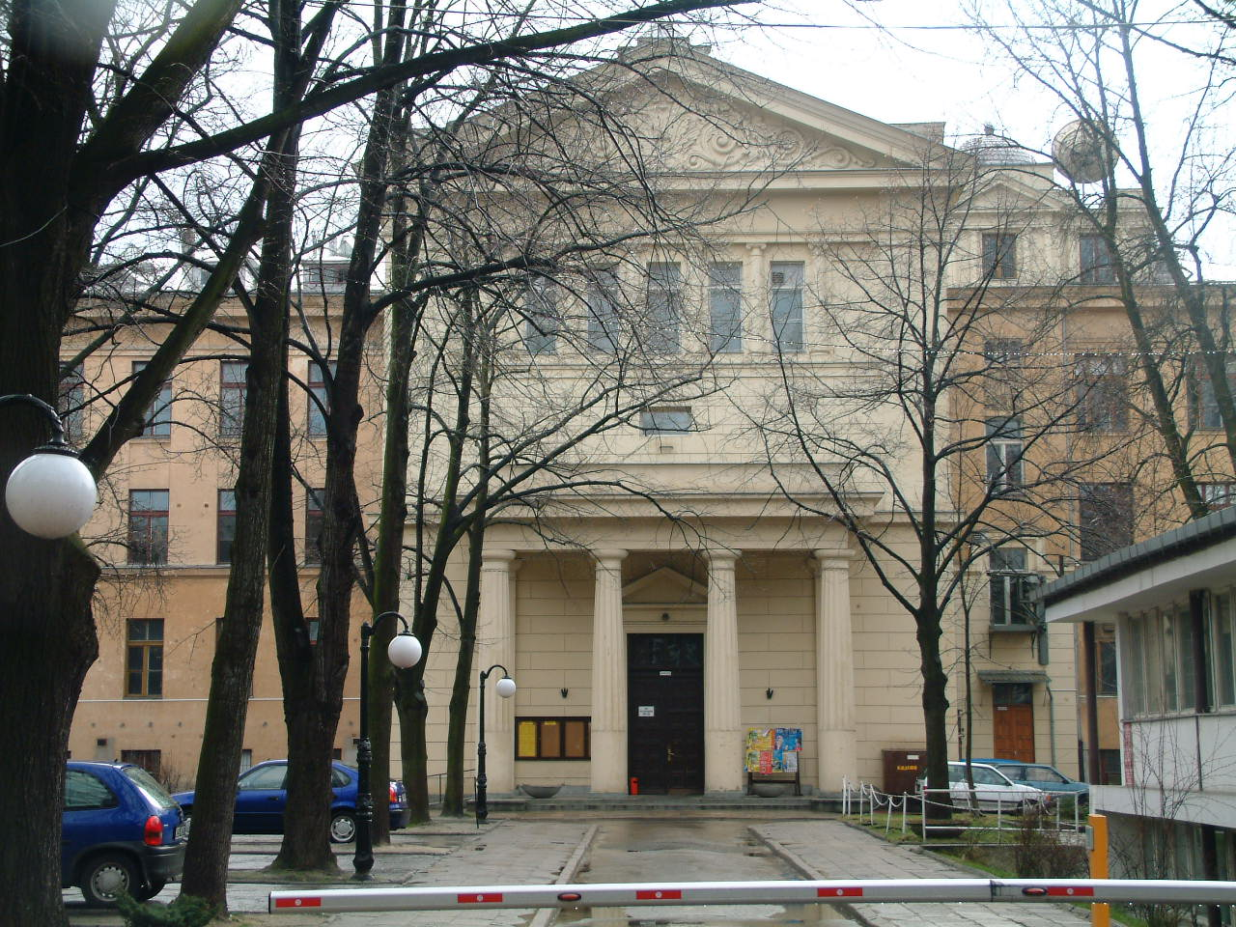
OLD: Physics Department UW
ul. Hoża 69 Warszawa

Slide 3
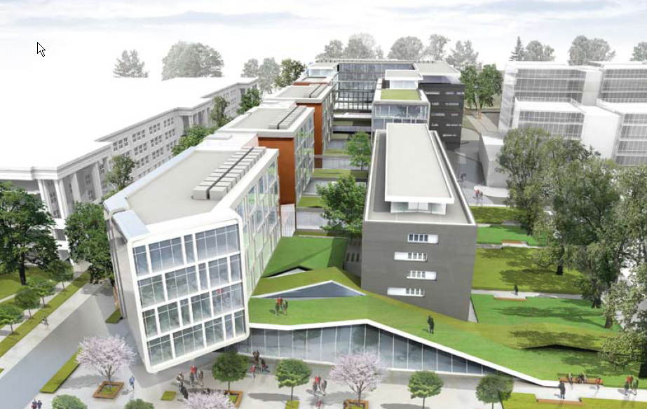
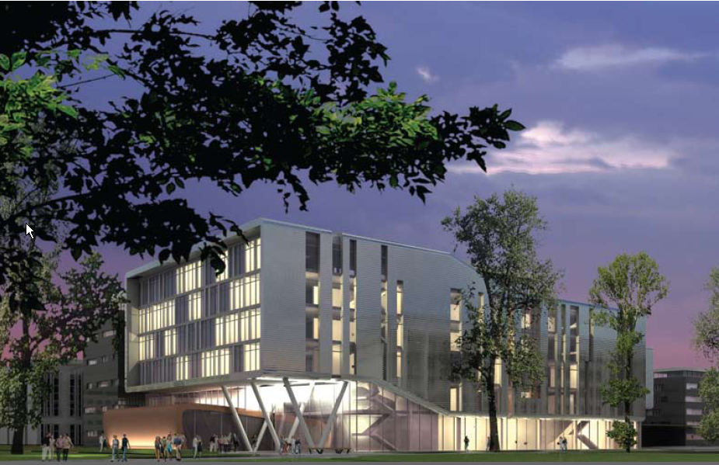
NEW: Physics Department UW
ul. Pasteura Warszawa

Slide 4
Campus Ochota, Warsaw

Slide 5


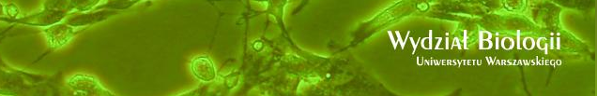


CENT
Center for (Applied) Science and Technology

Slide 6
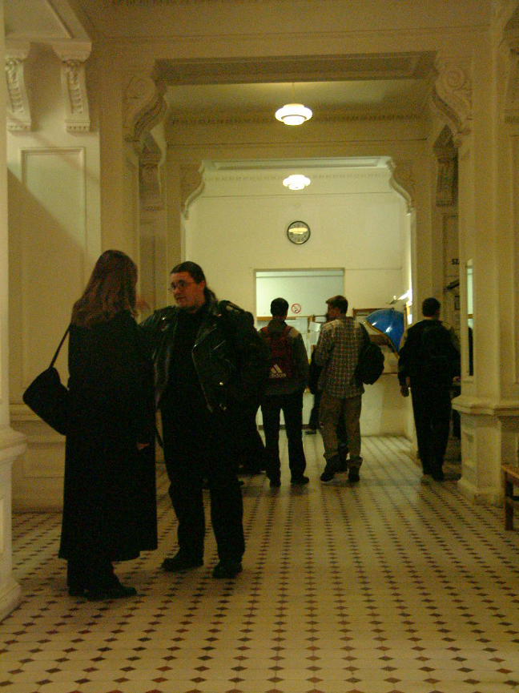
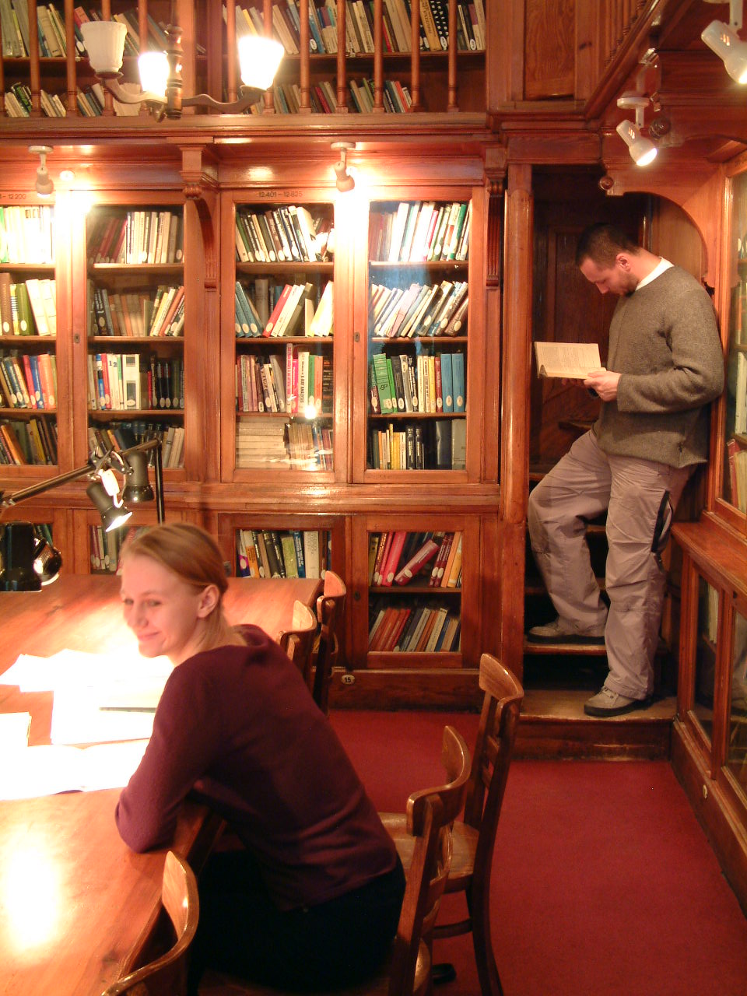


Slide 7
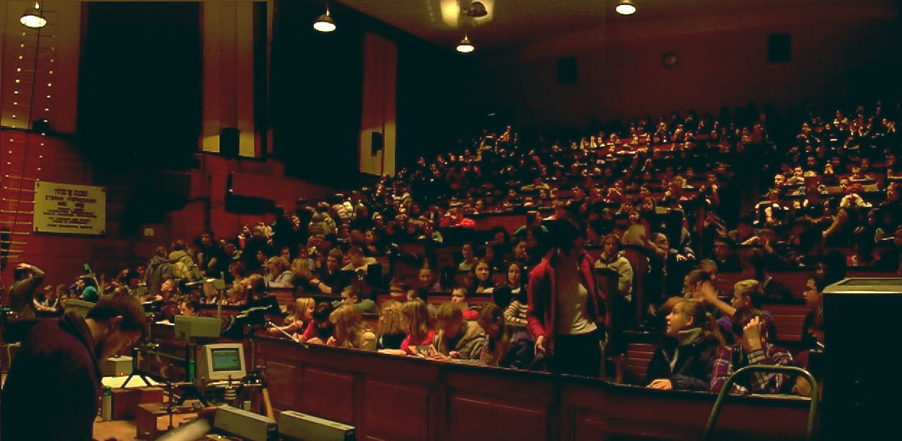
Our Students

Slide 8
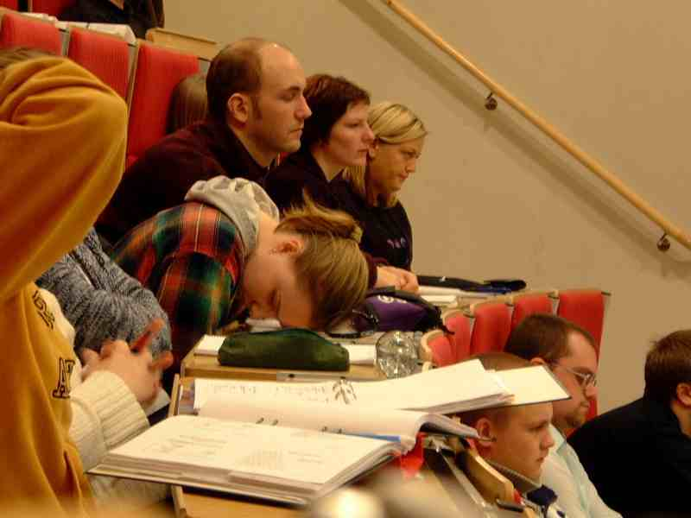
Working hard

Slide 9
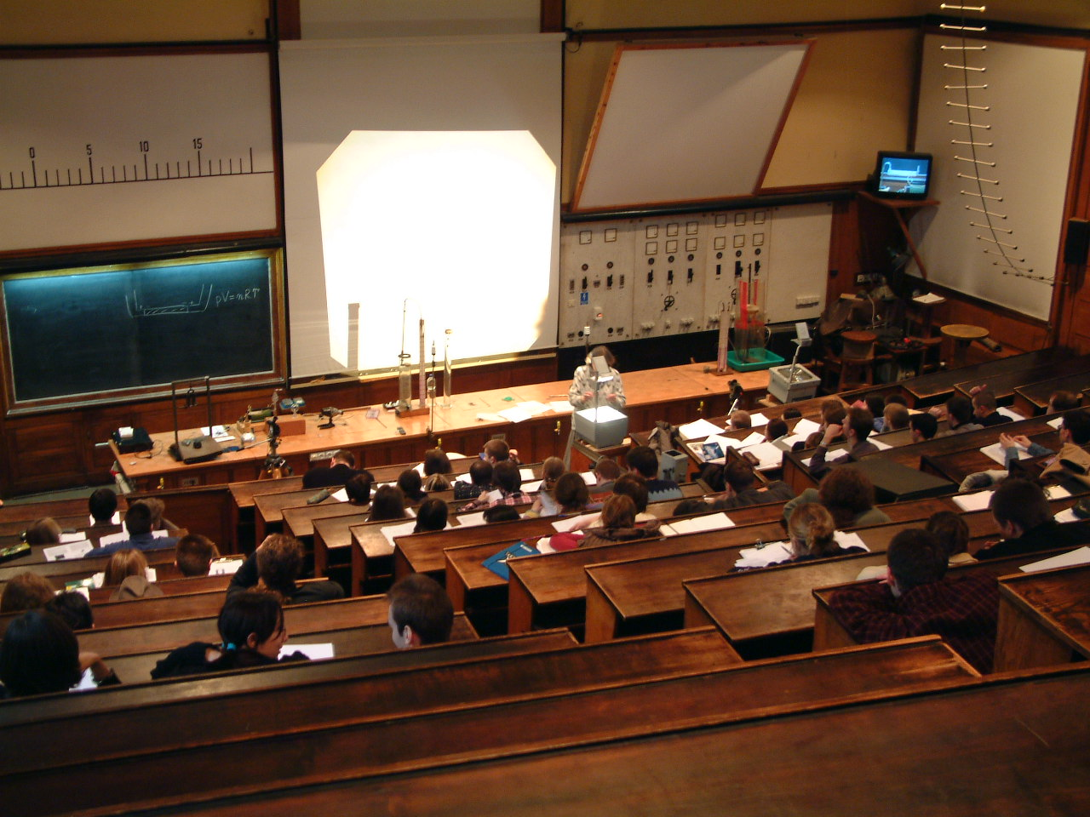

Slide 10
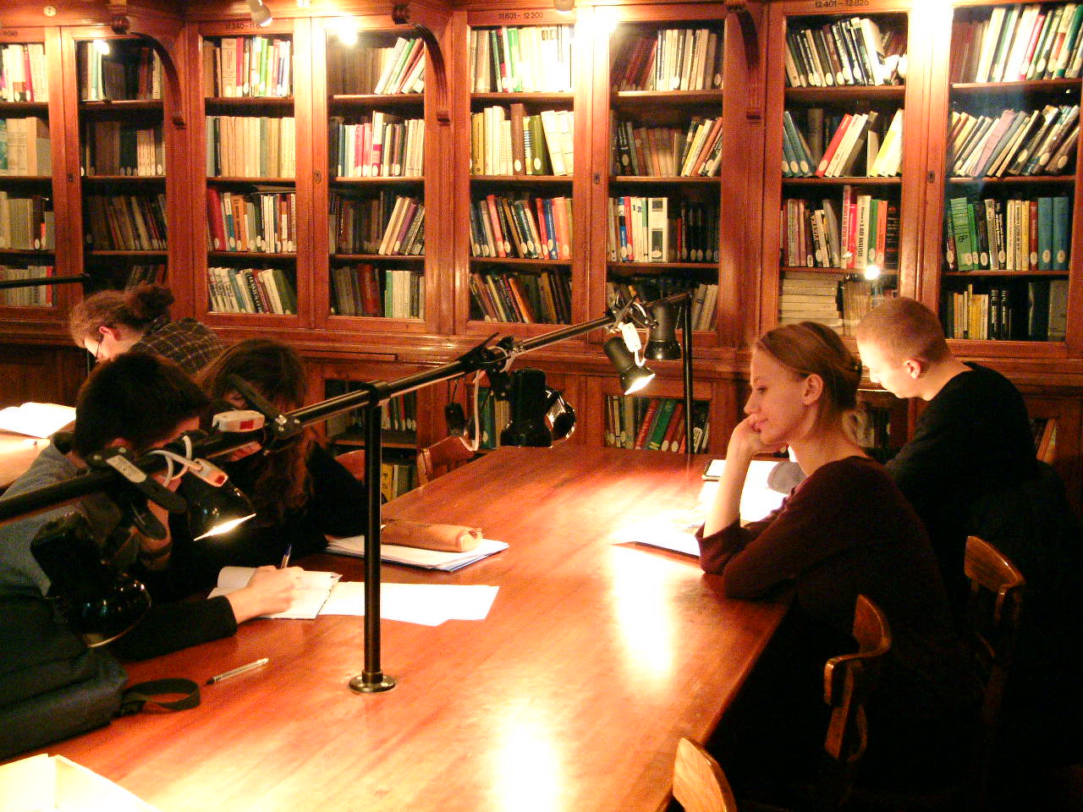

Slide 11

Basic Facts
Students: 650 (350 first year)
PhD students: ~120
Academic staff: ~200
Full Professors: 94
Associate Profesors 92
Readers, Lecturers 16

Slide 12
Output
Publications: 2 573 (5 years)
Books and chapters: 123
Citations:
8 908 in 2007
11 966 in 2008
PhD production : 139
Grants:
Seventh Framework Programme 15
Other Internationa Programs 26

Slide 13
Structure
Institute of Experimental Physics (~50%)
Institute of Theoretical Physics (~25%)
Institute of Geophysics
Astronomical Observatory
Chair of Mathematical Methods in Physics

Slide 14
Theoretical Physics
Departments:
1.Condensed Matter Physics
2. Quantum Optics and Atomic Physics
3. Particles and Fundamental Interactions
4. Strong and Electroweak Interactions
5. Relativity and Gravitation
6. Structure of Atomic Nuclei
Laboratory of Computer Physics
Wojciech Rubinowicz Library.

Slide 15
Experimental Physics
Division:
1. Biophysics
2. Biomedical Physics
3. Elementary Particles and Interaction
4. Atomic Nuclei Physics
5. Optics
6. Solid State Physics
7. Condensed Matter Structure
8. Nuclear Spectroscopy
9. Econophysics
10. Didactics of Physics

Slide 16
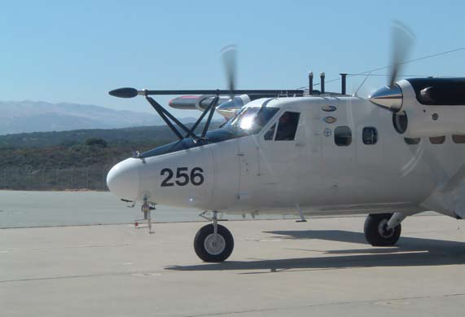
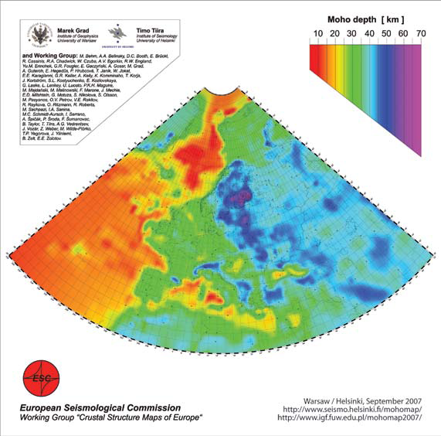
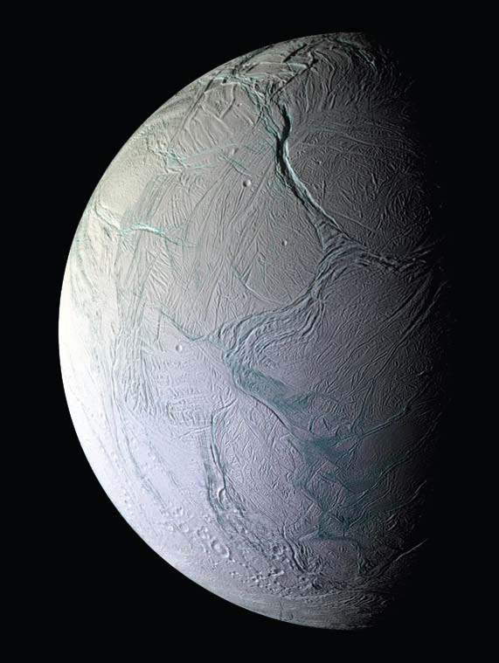
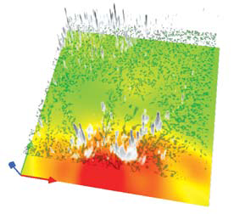
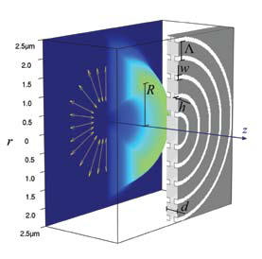
Geophysics
Section of Atmospheric Physics
Section of Information Optics
Section for Physics of the Lithosphere

Slide 17
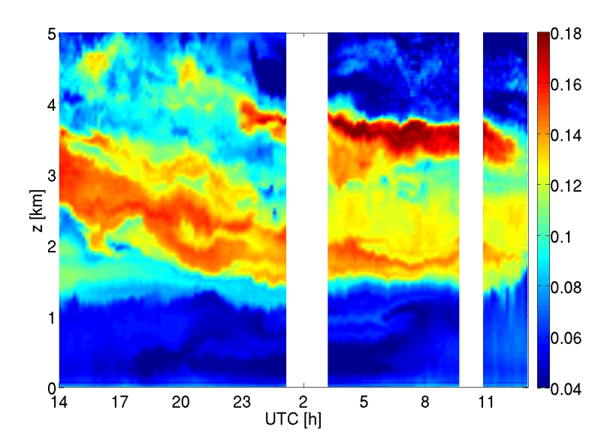

Institute of Geophysics
Section of Atmospheric Physics
Airborne measurements in clouds
and in the free atmosphere.
Investigation of microphysical,
thermodynamical and dynamical cloud
processes and the origins of precipitation.
Analysis of radiative properties of
aerosols and clouds, radiative forcing
and climatic effects.
Remote sensing of the atmosphere.
Numerical modeling of atmospheric processes at various scales, from the millimeters to hundreds of kilometers, multiscale interactions.
General and geophysical fluid dynamics.
Vortex dynamics, turbulence, chaotic and nonlinear processes.
Temporal evolution of Saharan dust episode above Warsaw – lidar profiling of the atmosphere at wavelength of 532 nm

Slide 18
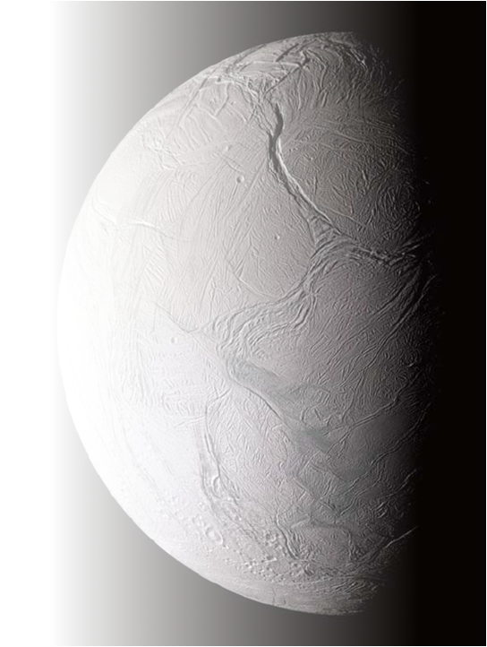
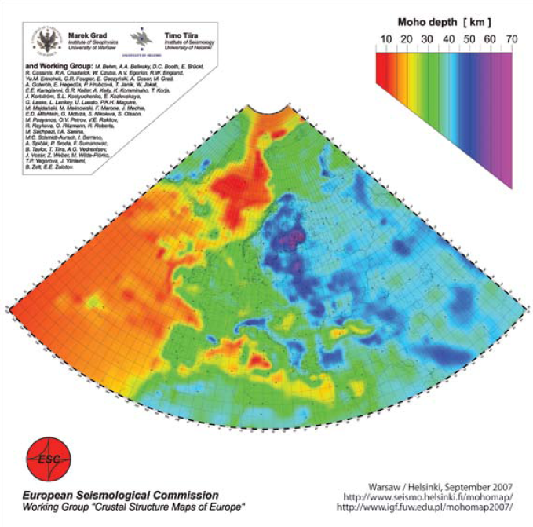
Institute of Geophysics
Section of Lithospheric Physics
The structure of the Earth's crust and upper mantle over Poland's territory (international seismic experiments, 1997-2008).
Studies in the polar regions (framework of the 4th International Polar Year, 2007-2008).
Integrated interpretation of seismic,
gravitational and thermal data explaining
the current makeup of the Earth, its
gravitational field and thermal flow by
modeling the motion of lithospheric
plates driven by the mantle convection.
Numerical simulation of the evolution of
the surfaces and interiors of variety of
celestial bodies, e.g. planets, selected
satellites, comets.
Depth of the Mohorovičić boundary (Moho) between the Earth’s mantle and the crust of the European plate

Slide 19
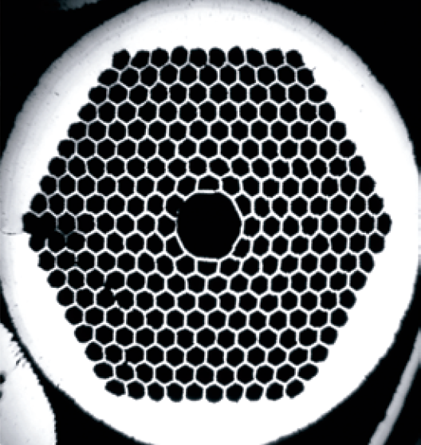
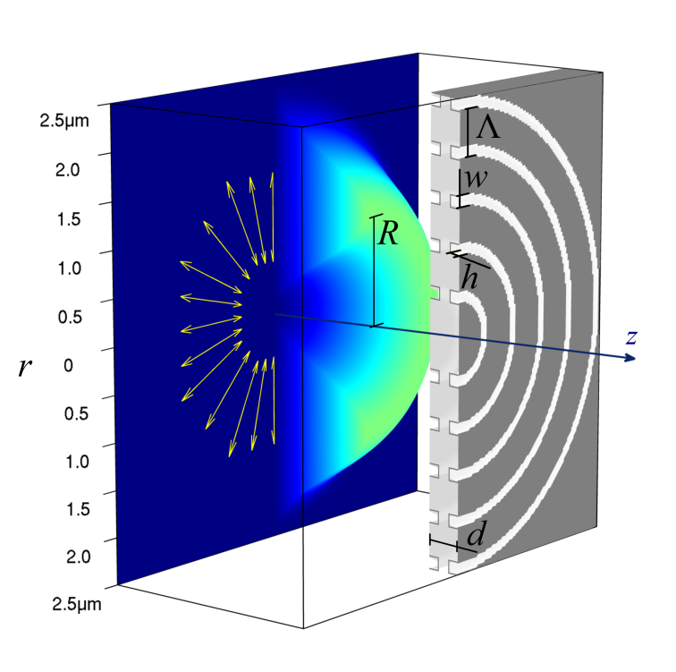
Institute of Geophysics
Section of Information Optics
Metamaterials – man-made materials which display electromagnetic properties not found in natural materials (new devices for information transmission or the cloaking of objects).
Plasmonic nanosystems, built from dielectrics and noble metals lead to nano-lens, able to focus light in an area smaller than the classical diffractive limit, by employing a radially polarized light beam.
New probes for near-field microscopy – determine
the optical properties to a very high resolution,
due to the detection of radiation including
evanescent waves.
Theoretical research and computer simulations of photonic crystals, that are employed as light
guides in micro-and nanosystems (e.g. Super-
continuum generation in photonic crystal fibers).
Image processing, diffraction optics.
Diagram of a plasmonic nano-lens

Slide 20
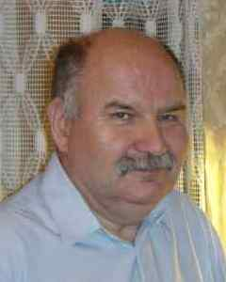
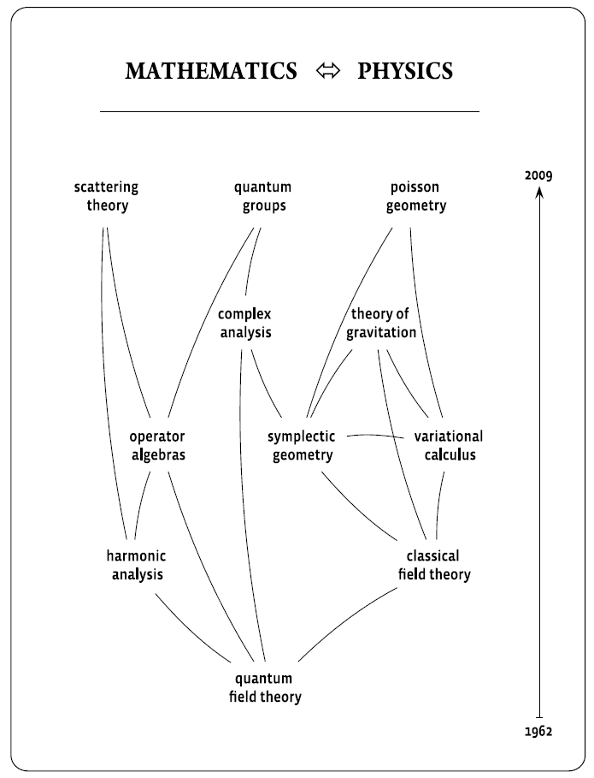
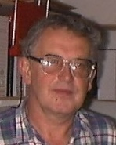
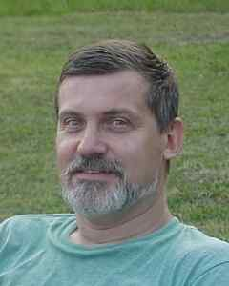
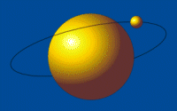

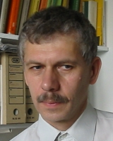
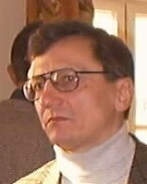

Quantum Groups
Mathematics
Theory of Relativity
Quantum Many
Body Theory
Differential Geometry

Slide 21
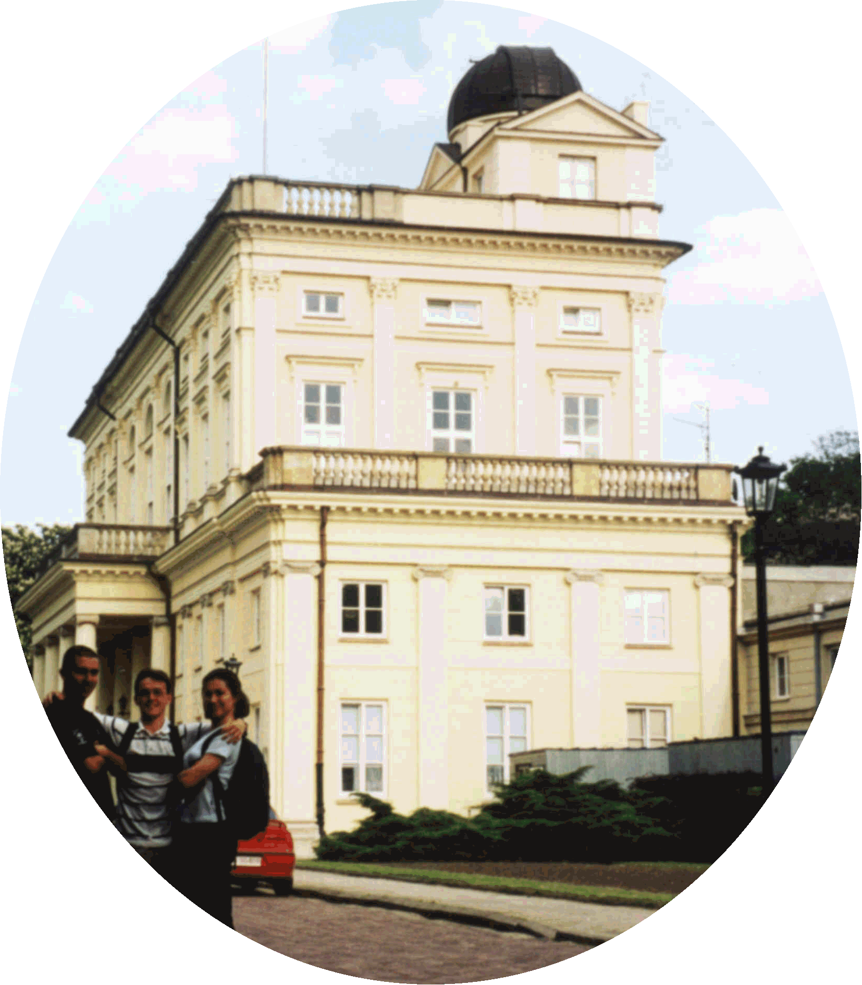
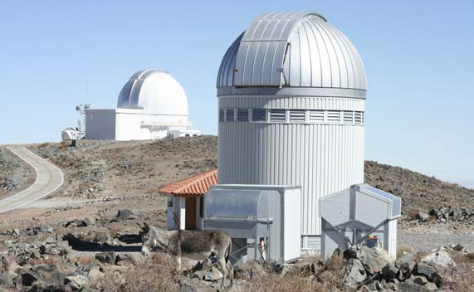
Astronomy
Observatory, Warsaw
Observatory Ostrowik
1.3m Warsaw Telescope - Las Campanas Observatory, Chile

Slide 22


New
Initiatives

Slide 23
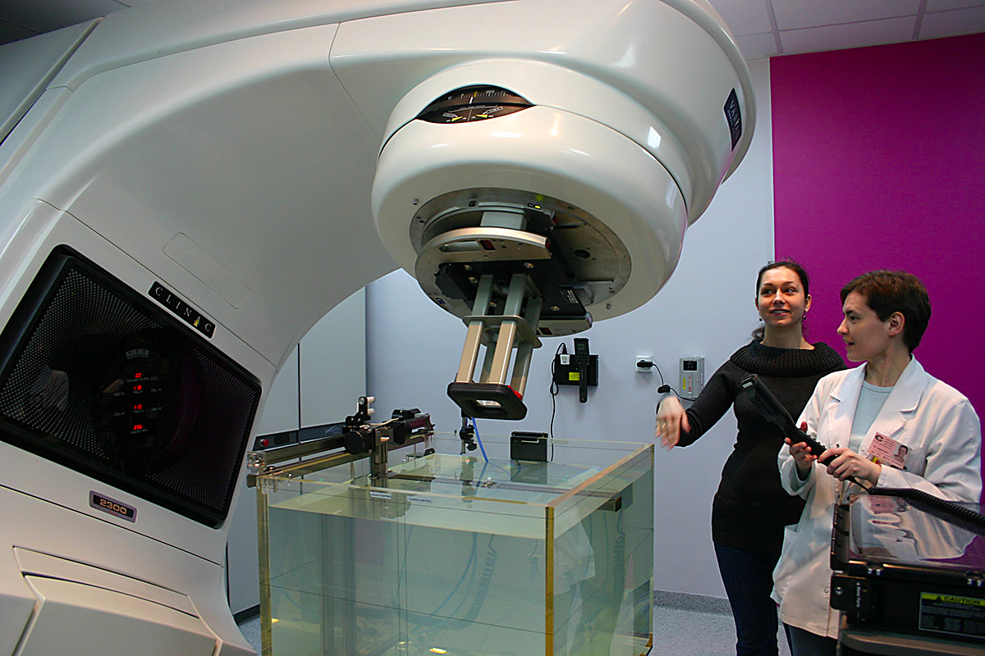
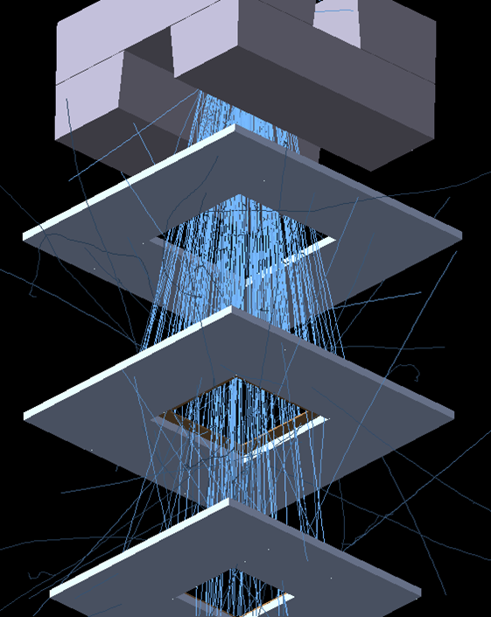
Medical Physics BSc

Slide 24
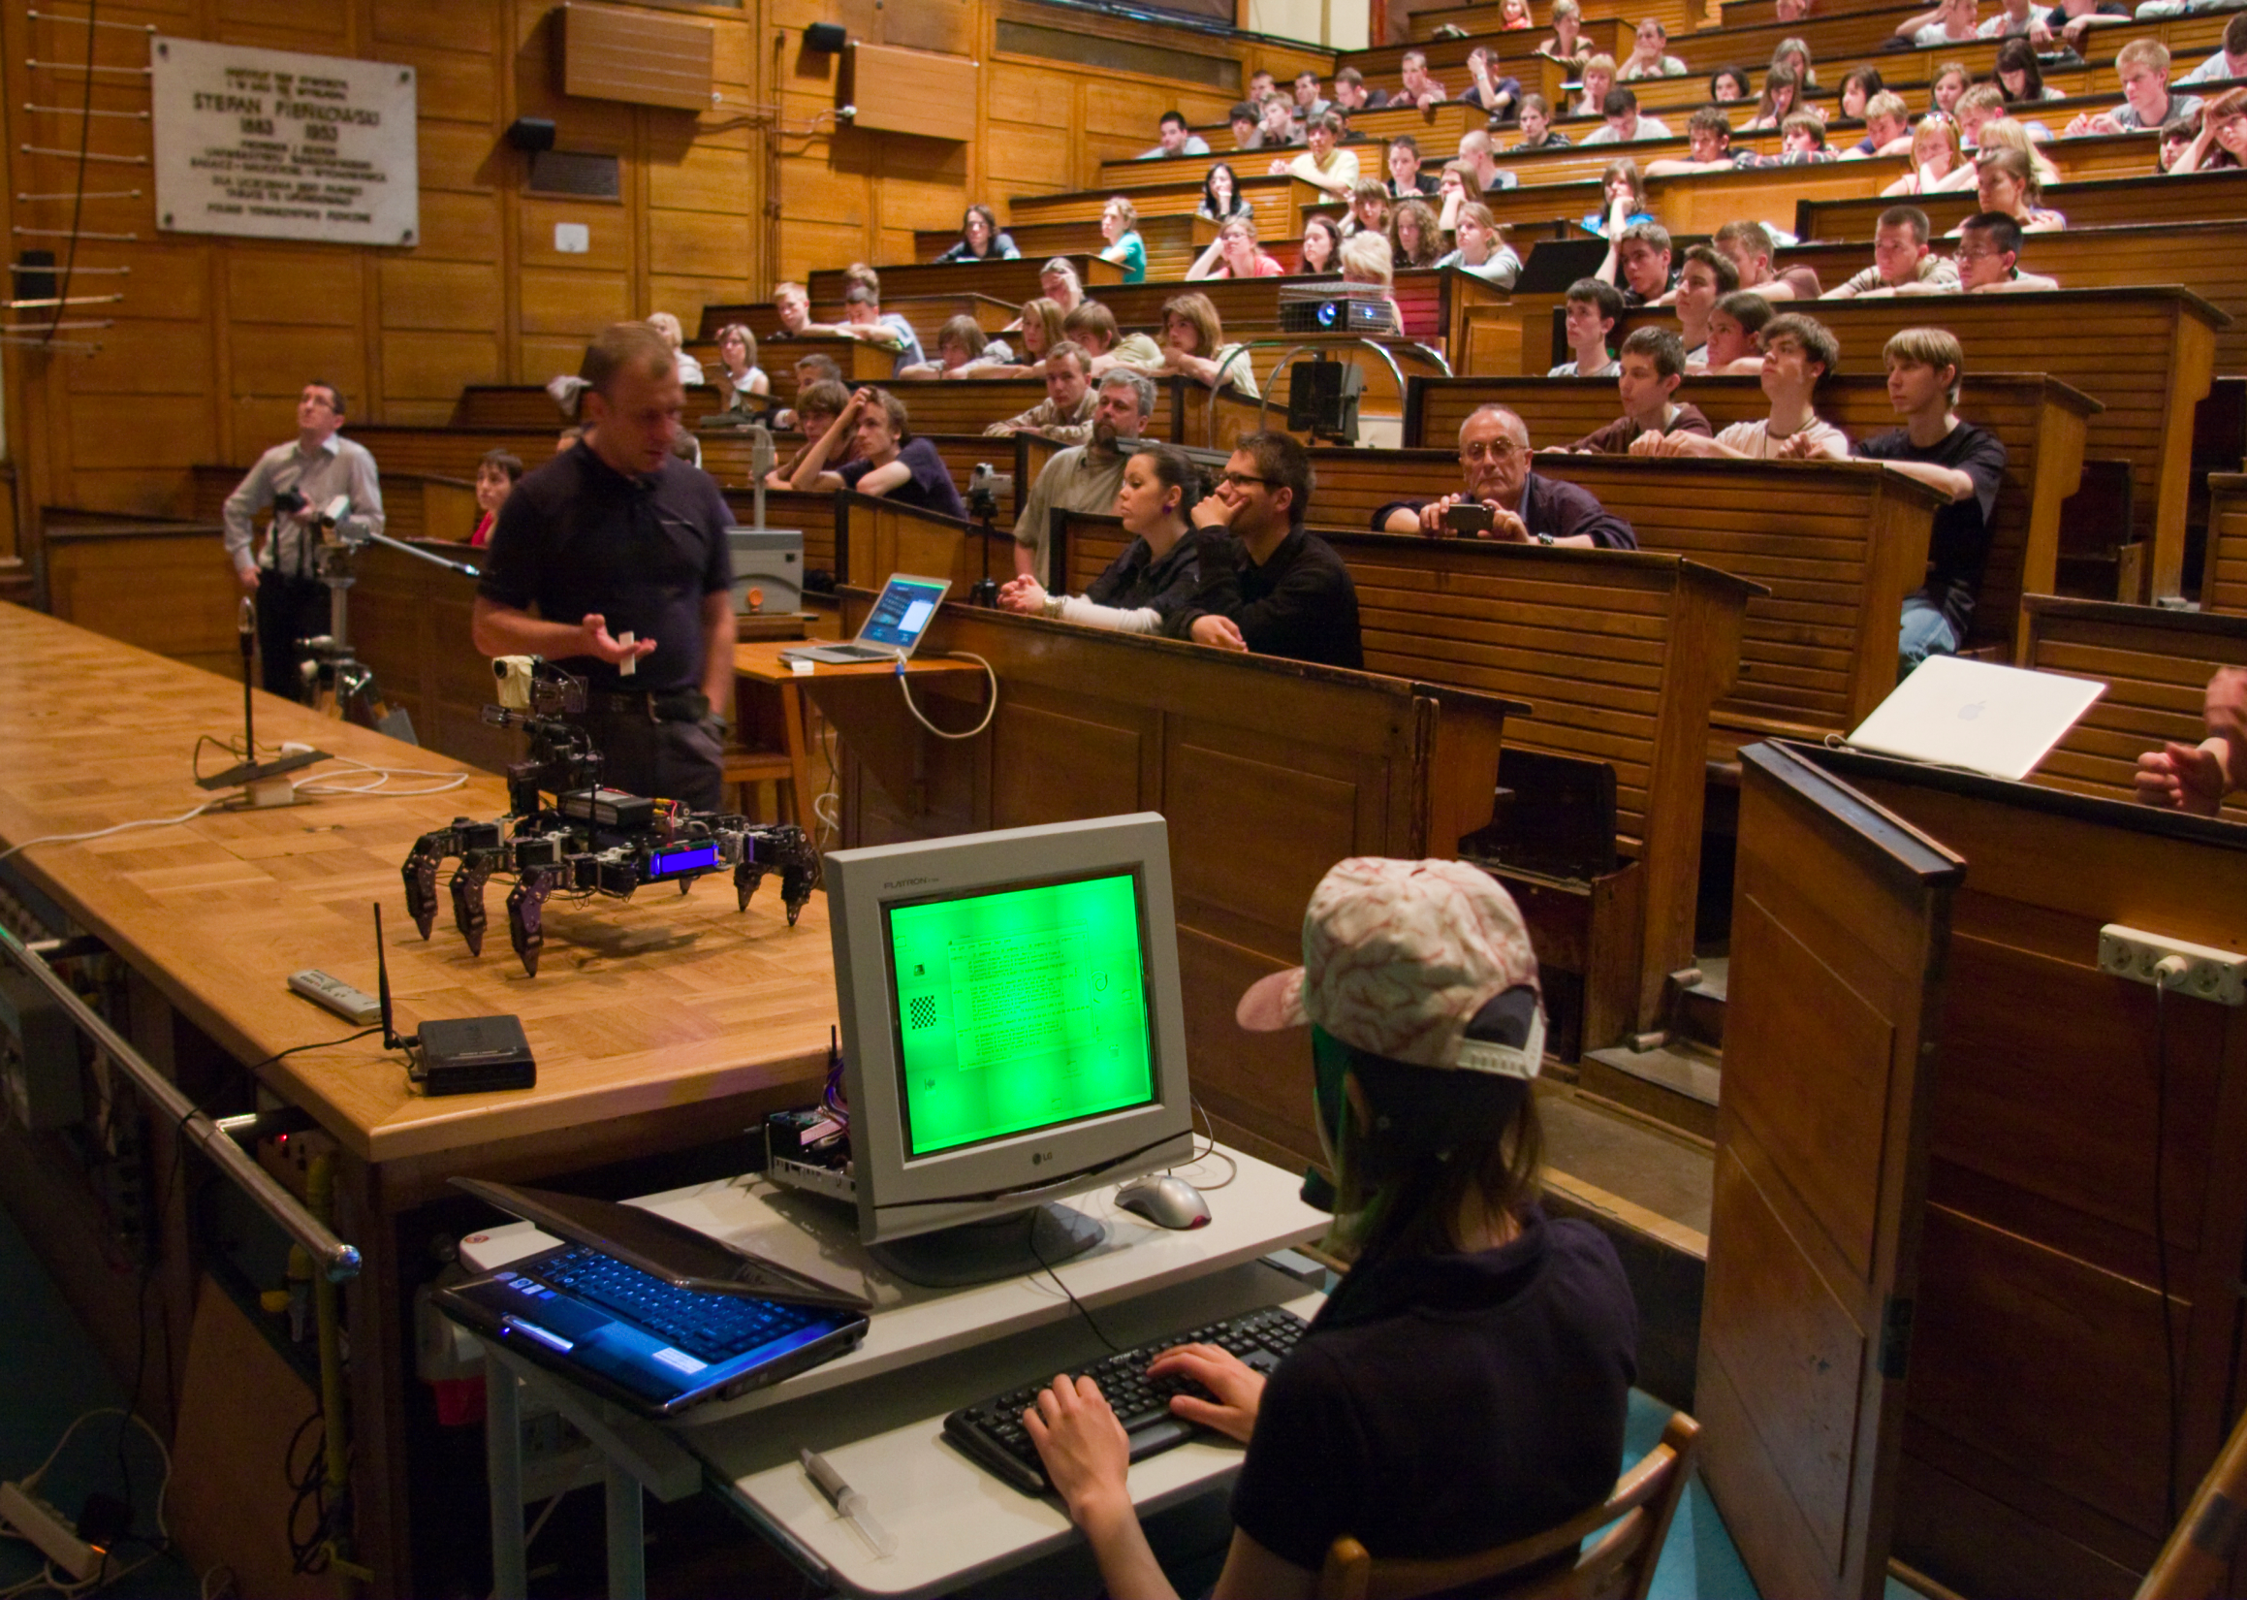
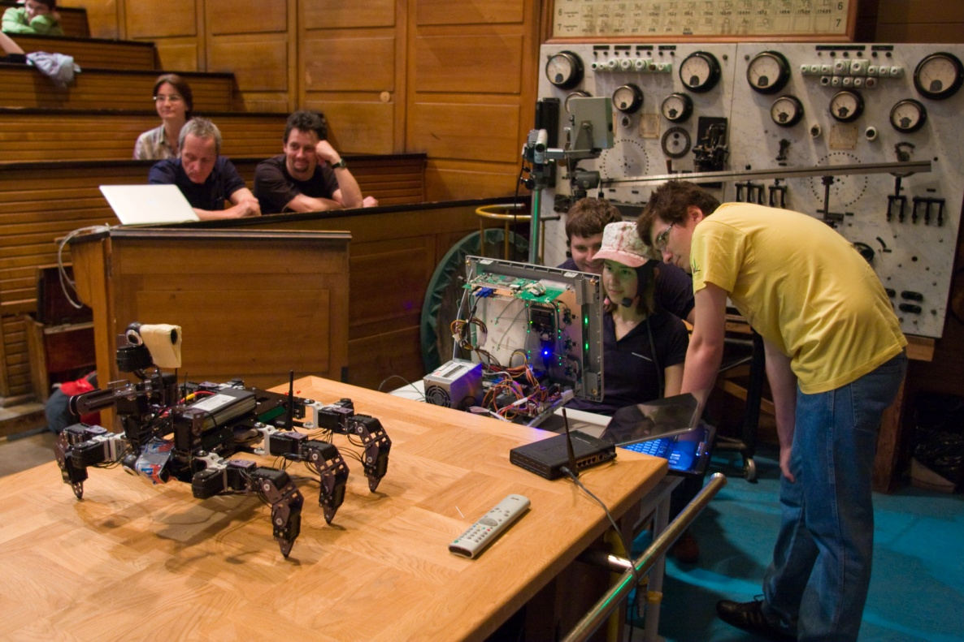
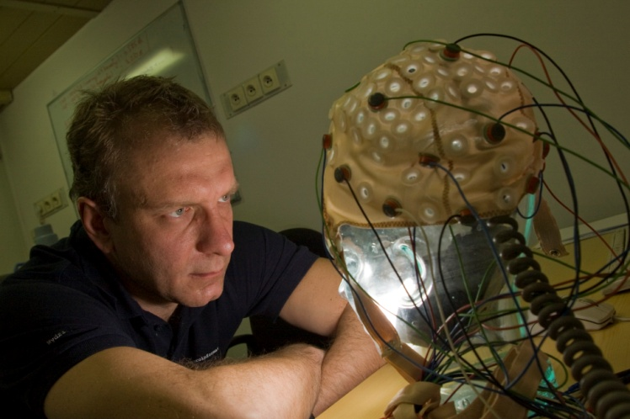
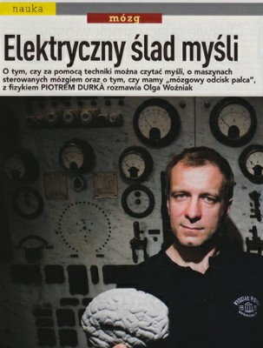

World's first Bsc in
Neuroinformatics,
with INCF

Slide 25
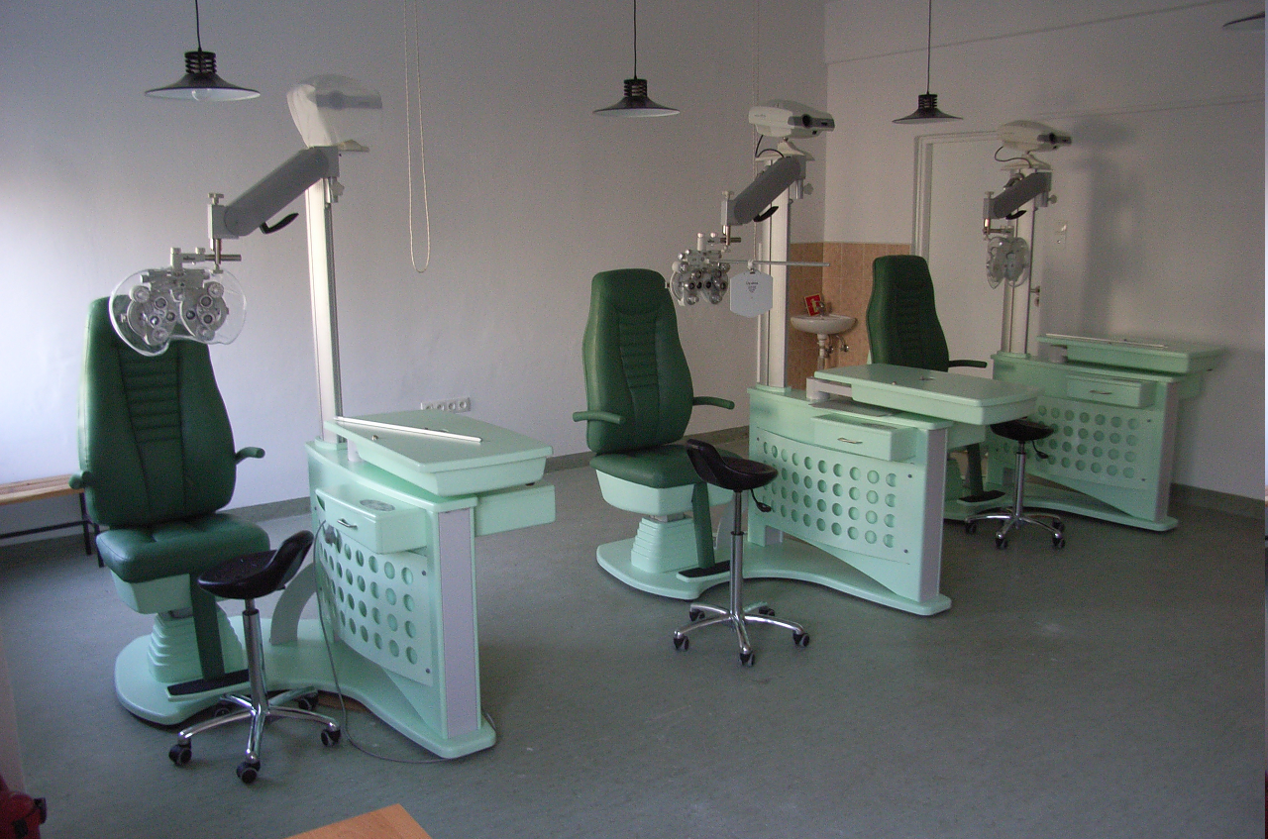
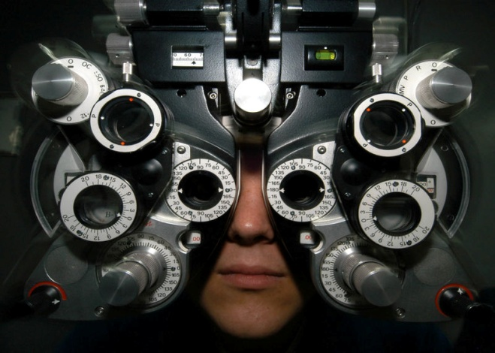
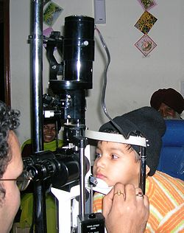
New Initiatives
Ophthalmic Optics

Slide 26
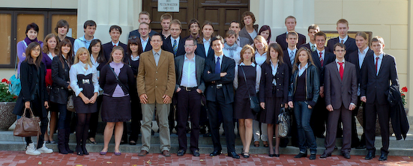





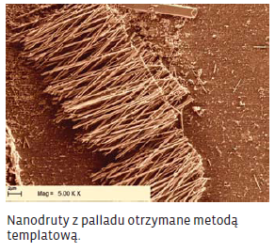
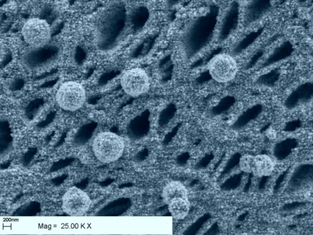
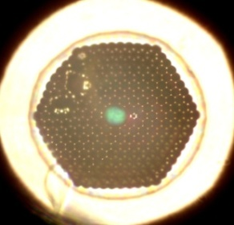
50 students in 2009!
Multidysciplinary faculty
Nanostructure Engineering
Physics + Chemistry
http://nano.fuw.edu.pl
Nanostructuralization
Photonics
Synthesis

Slide 27
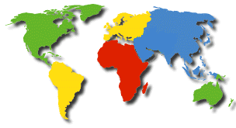
r
International scientific exchange programs

Slide 28
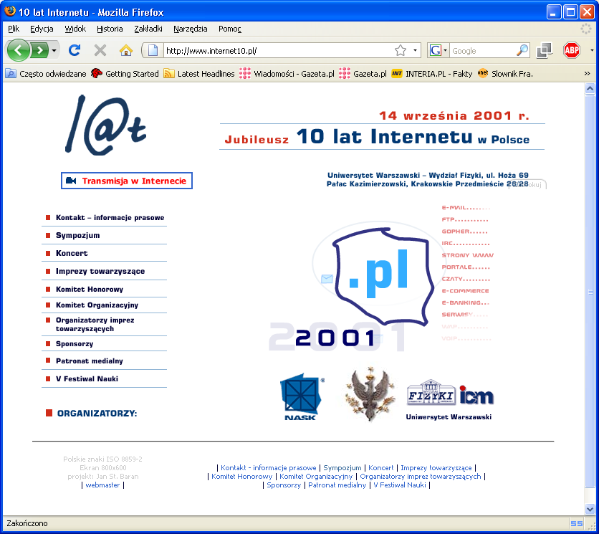

Slide 29

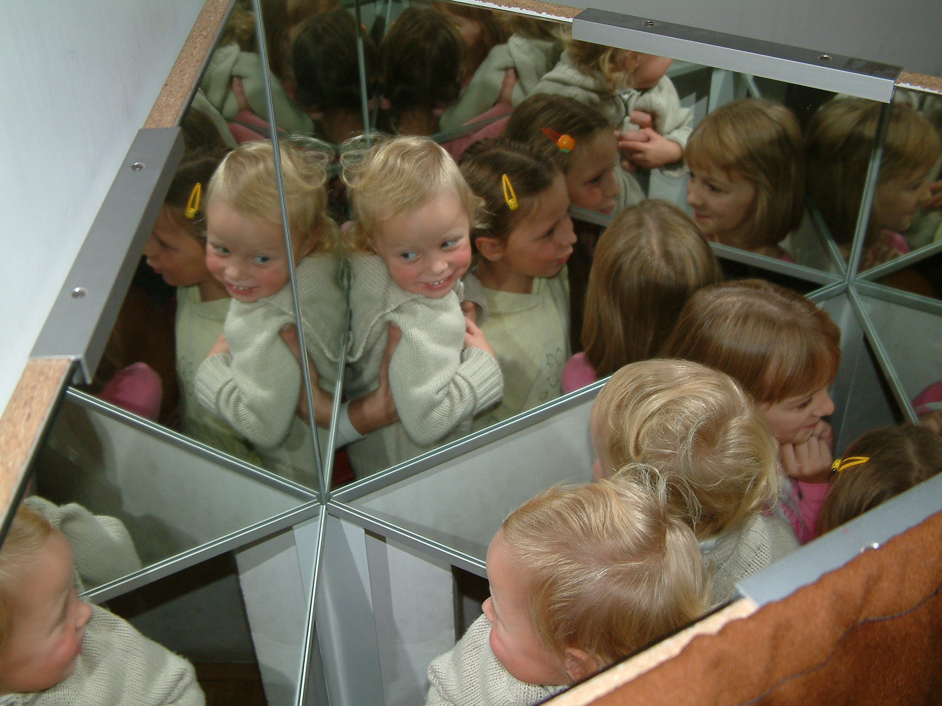
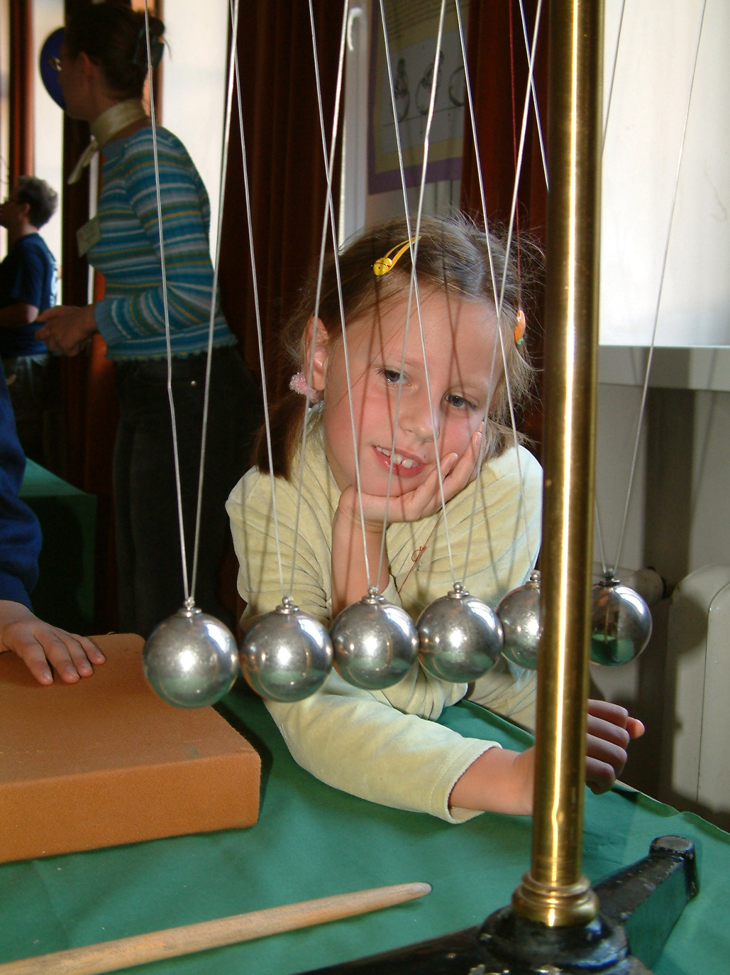
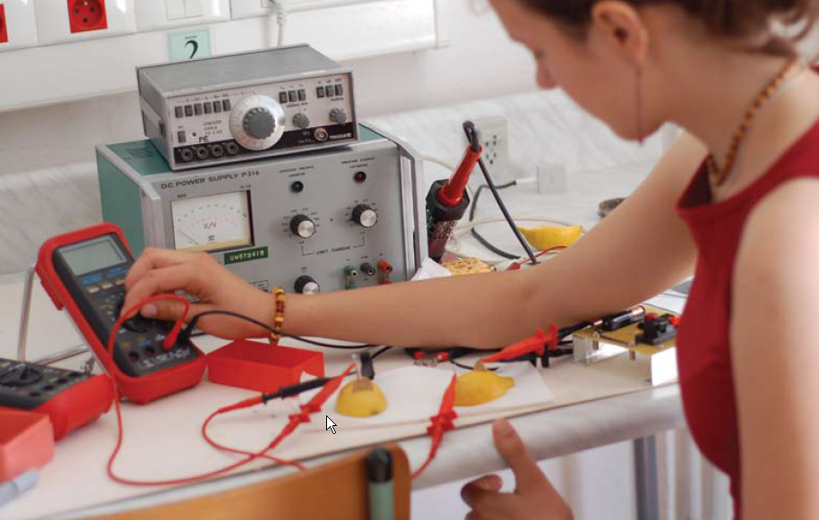
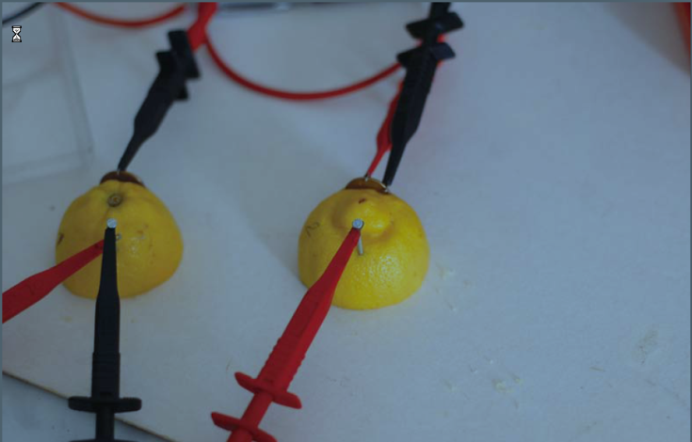
P
O
P
U
L
A
R
I
Z
A
T
I
O
N

Slide 30
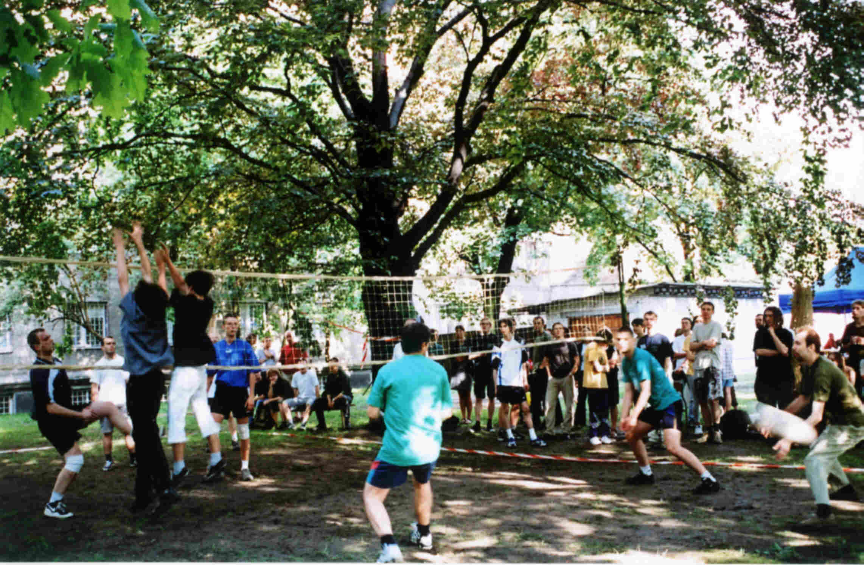
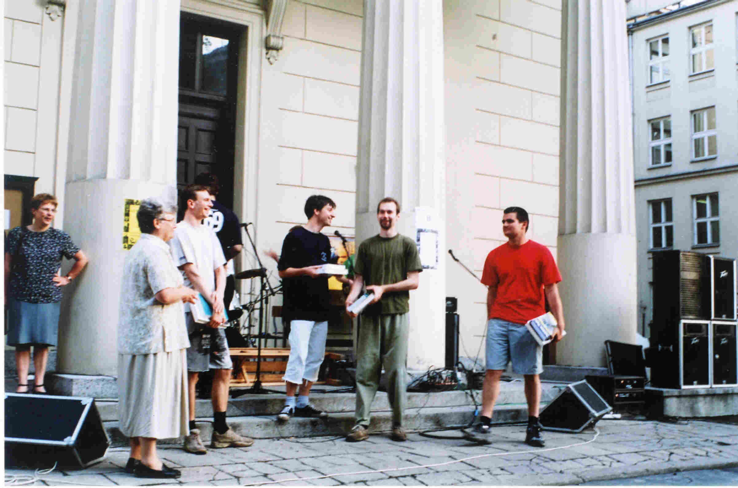
Recreation: Physics Festival

Slide 31



Chorus
Other activities
Graduation
Graduation
Alumni

Slide 32

International PhD studies in Nano and Bio Science at the Faculty of Physics University of Warsaw

Slide 33

Dean’s Office

Slide 34


