Slide 1
The (true) Heisenberg limit in optical interferometry
R. Demkowicz-Dobrzański
Faculty of Physics, University of Warsaw, Poland
W. Gorecki, R. Demkowicz-Dobrzanski, H. M. Wiseman, D. W. Berry, Phys. Rev. Lett 124, 030401 (2020)
W. Gorecki, R. Demkowicz-Dobrzanski, arxiv:2107.10863 (2021)

Slide 2
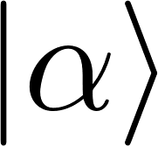
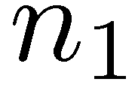
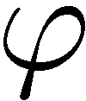
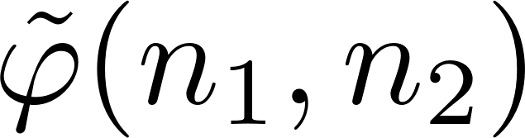

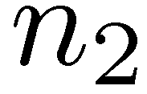
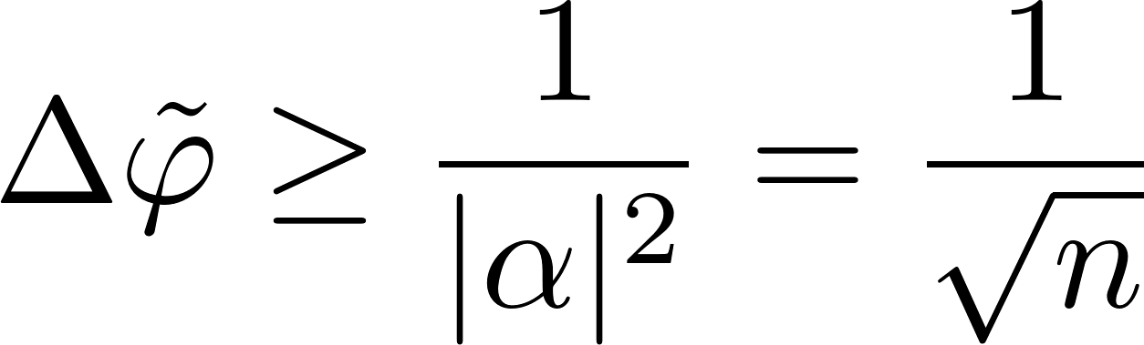
How precisely we can estimate a phase delay in an interferometer?
Poissonian fluctuations of detection counts -> Shot noise limit:

Slide 3
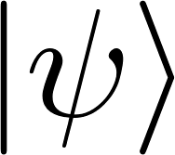
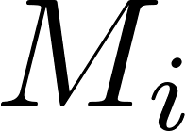
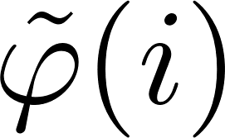
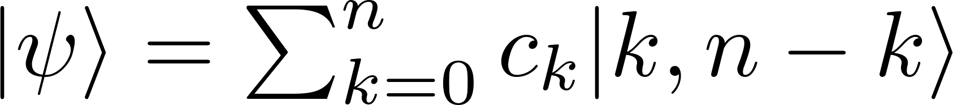
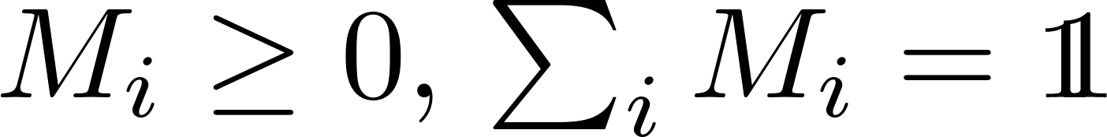

How precisely we can estimate a phase delay in an interferometer?
arbitrary n-photon state
arbitrary measurement
The Heisenberg limit:

Slide 4
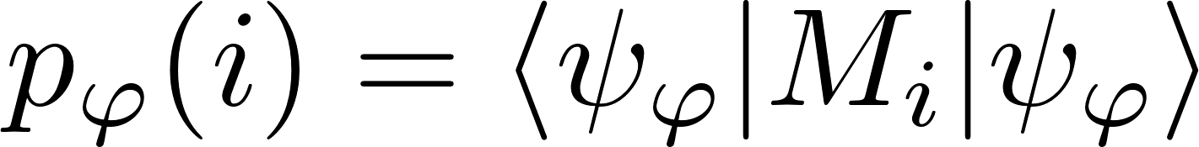
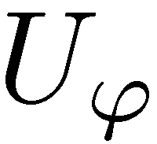
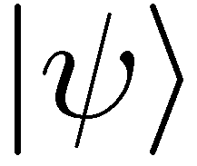
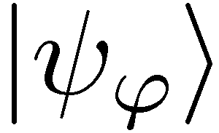


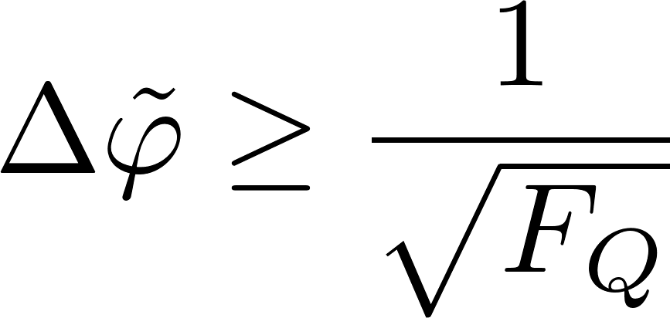
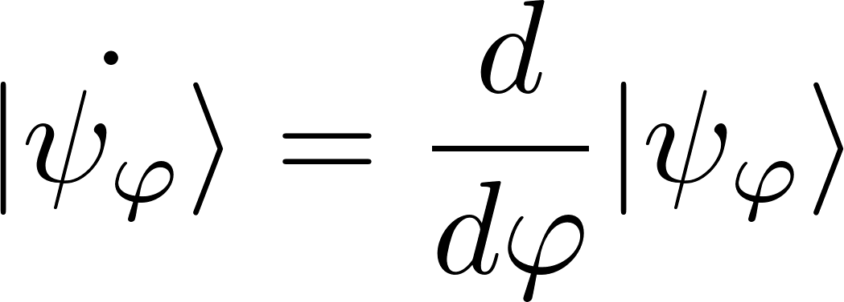
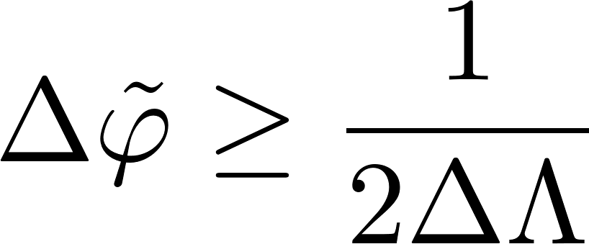
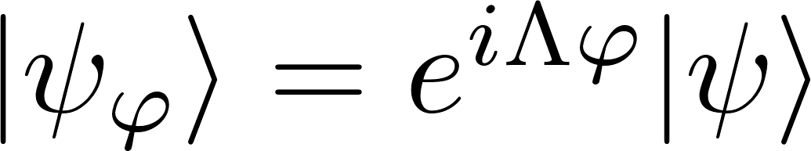
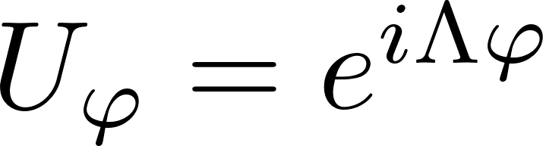
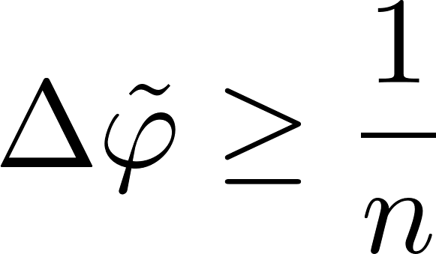
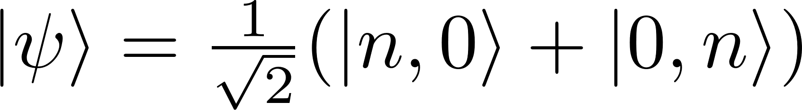
Standard derivation
Quantum Cramer-Rao inequality
valid for any locally unbiased estimator
and arbitrary measurements
Quantum Fisher Information
General unitary parameter encoding
Phase estimation
To maximize the variance of Λ choose:

Slide 5

Saturability of the Heisenberg limit

Slide 6
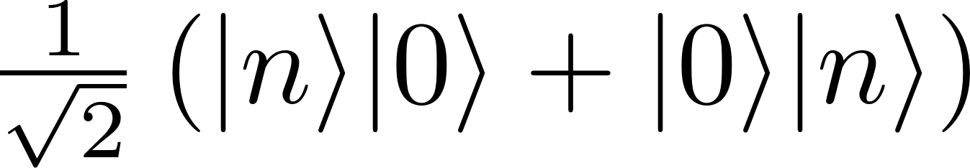
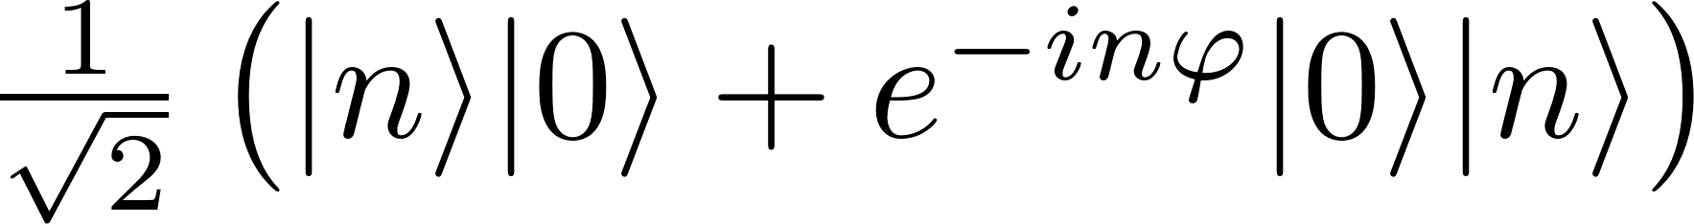
Saturability of the Heisenberg limit
State
preparation
Estimator
Measuremnt
We can only saturate the bound within the range of parameter values which shrinks as 1/n

Slide 7
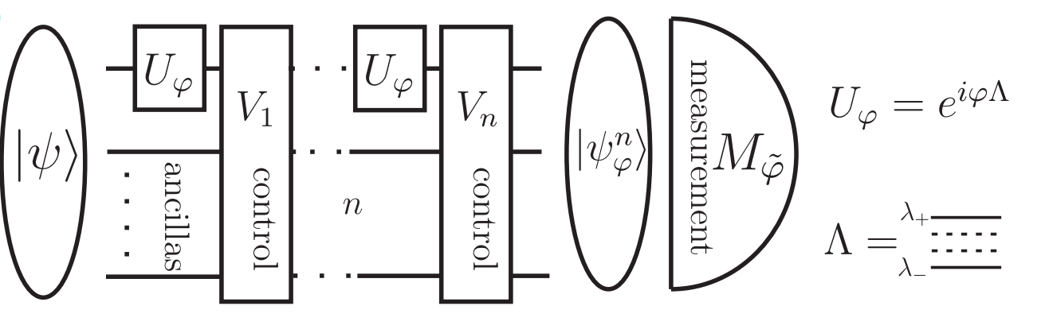
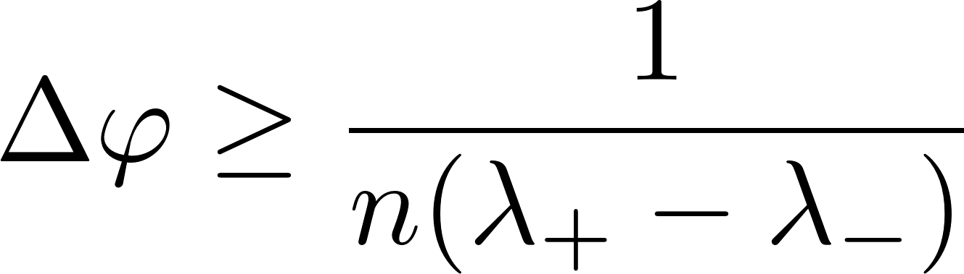
The most general form of the Heisenberg limit
Is this bound saturable even in principle….?
V. Giovannetti, S. Lloyd, and L. Maccone, Phys. Rev. Lett. 96, 010401 (2006).

Slide 8
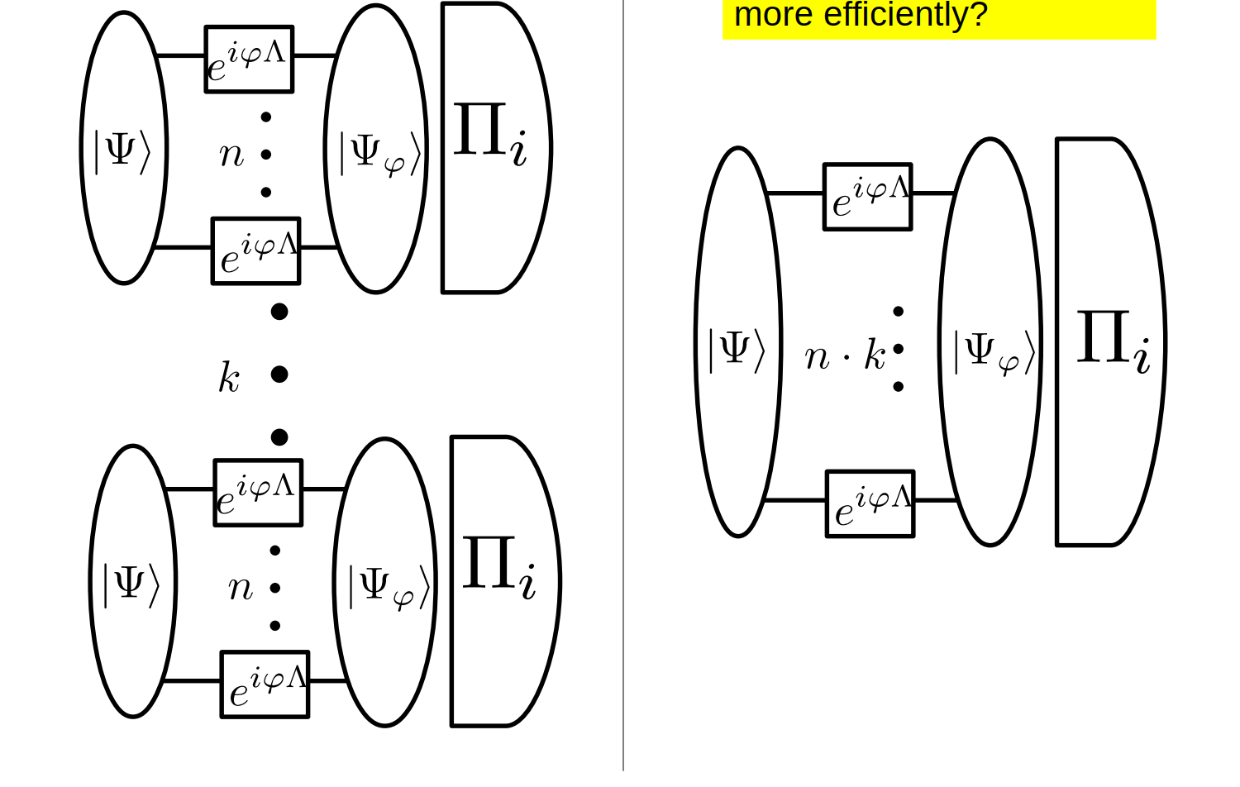
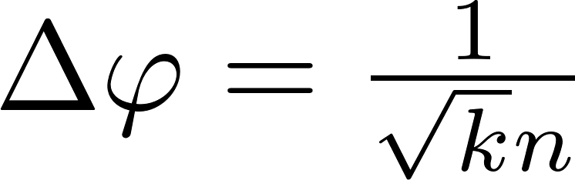
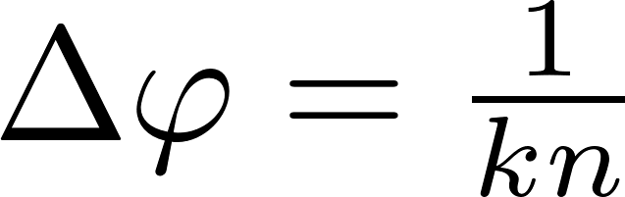
Many repetition scenario guarantees asymptotic saturability of the CR bound
Poor man’s Heisenberg limit
Heisenberg limit in terms of
all the resources consumed

Slide 9
What is the achievable Heisenberg limit in a single shot scenario assuming finite prior knowledge?

Slide 10
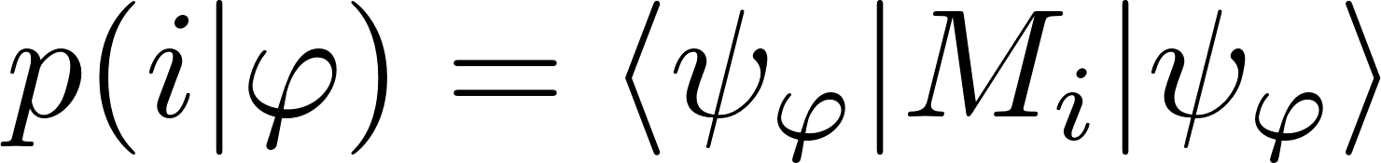
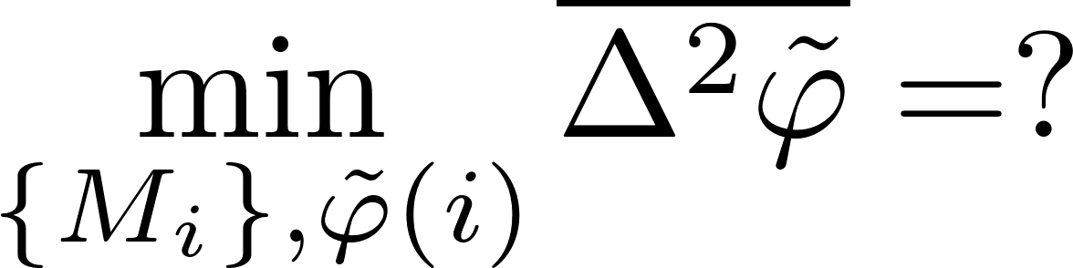
The True Heisenberg limit
The Bayesian approach
The Bayesian variance
prior
no unbiasedness assumption

Slide 11
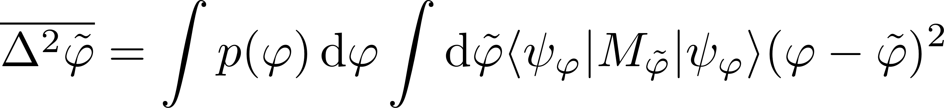
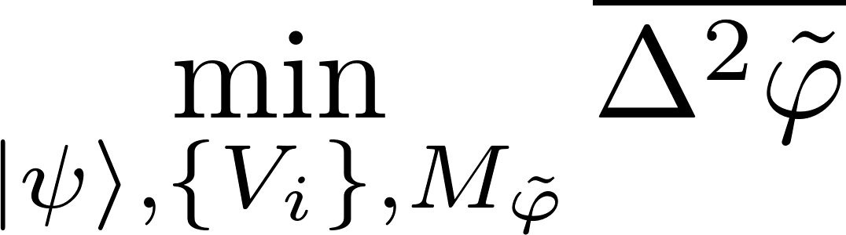
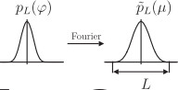
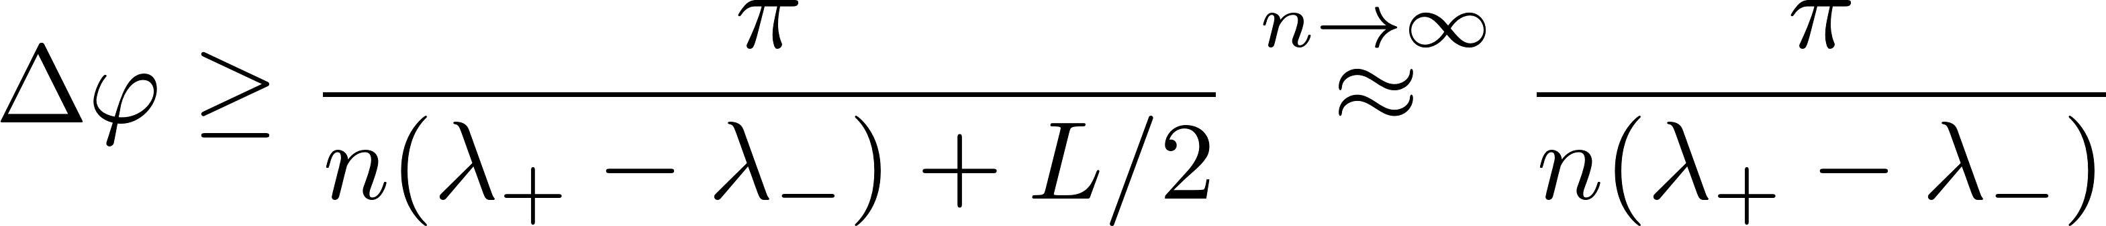
The True Heisenberg limit
For any prior with finite bandwidth L
we have the following bound
Any „reasonable” prior may be efficiently approximated by finite bandwidth priors and the theorem will remain valid, e.g. for arbitrary narrow rectangular prior.
W. Gorecki, R. Demkowicz-Dobrzanski, H. M. Wiseman, D. W. Berry, Phys. Rev. Lett 124, 030401 (2020)

Slide 12
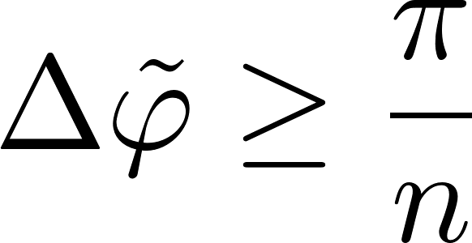
The true Heisenberg limit
arbitrary n-photon state
arbitrary measurement
The asymptotically saturable Heisenberg limit:
W. Gorecki, R. Demkowicz-Dobrzanski, H. M. Wiseman, D. W. Berry, Phys. Rev. Lett 124, 030401 (2020)

Slide 13
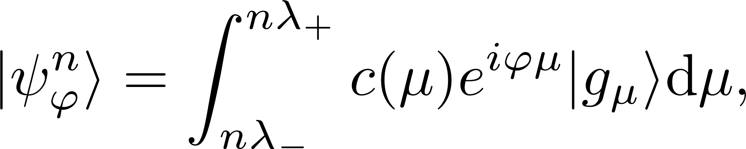
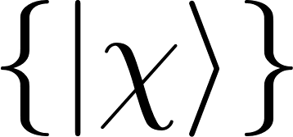
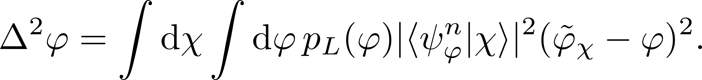
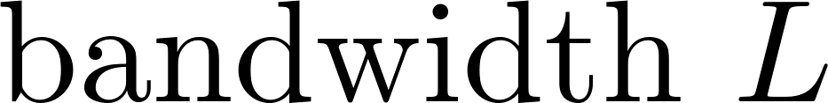
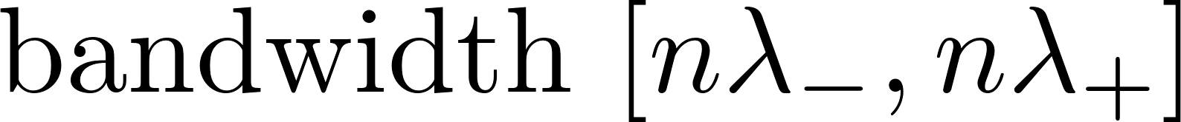
Sketch of the proof
some not necessarily orthogonal vectors…
Consider some fixed measurement basis

Slide 14
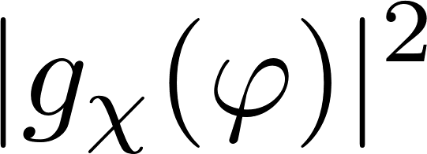
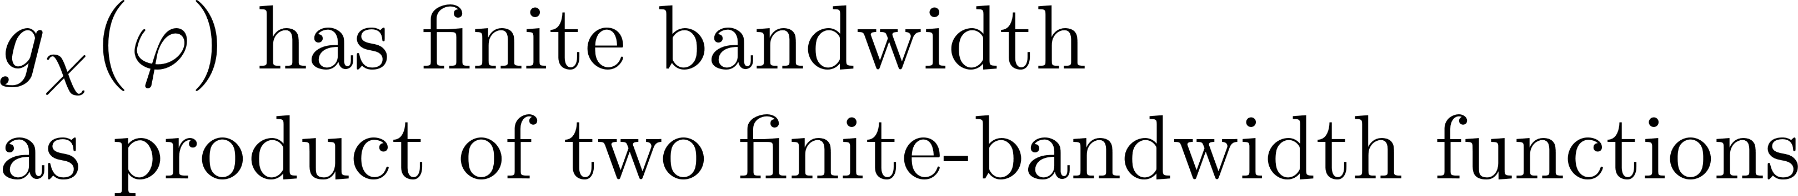
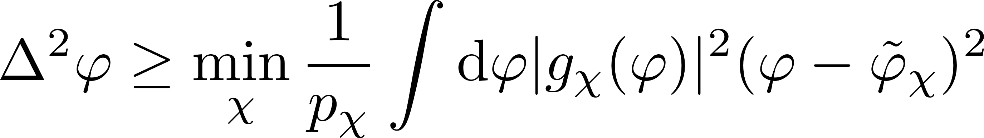
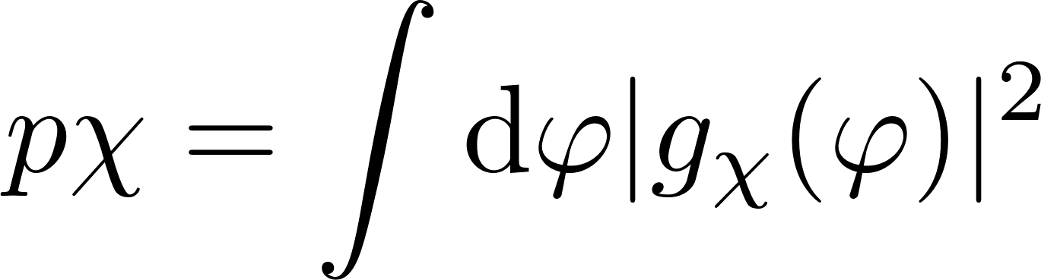
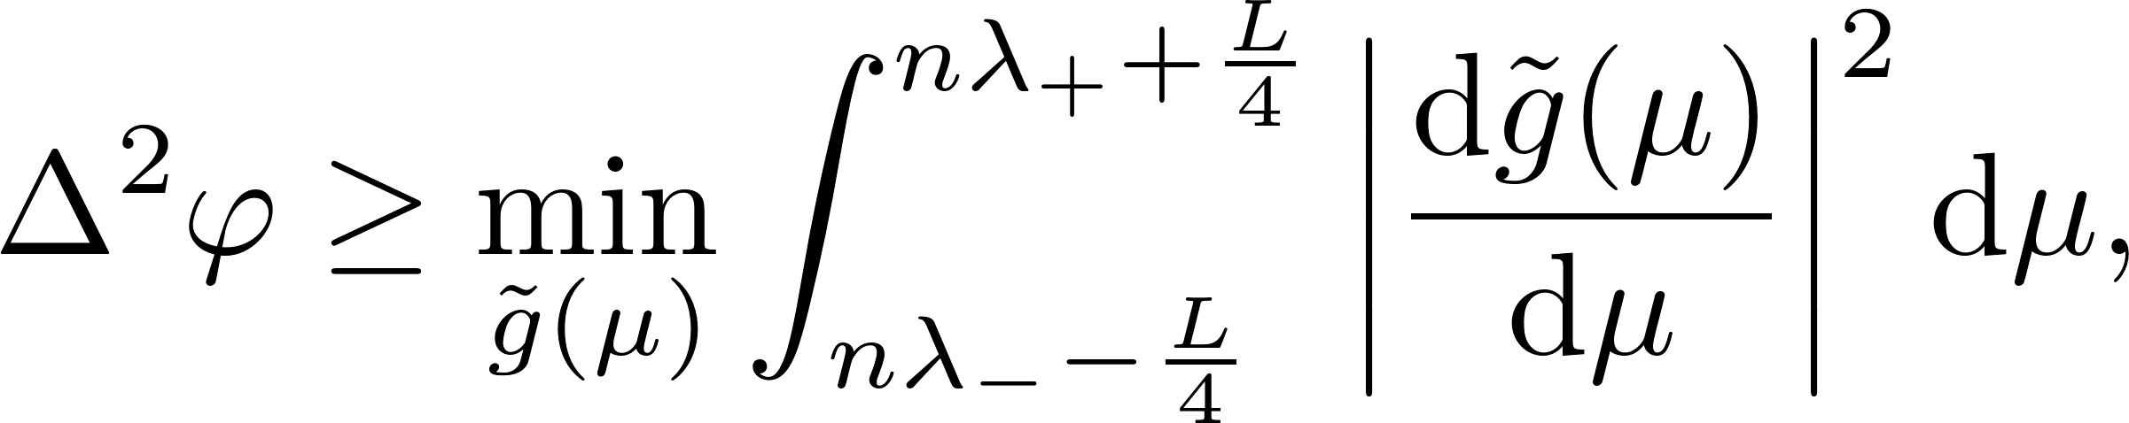
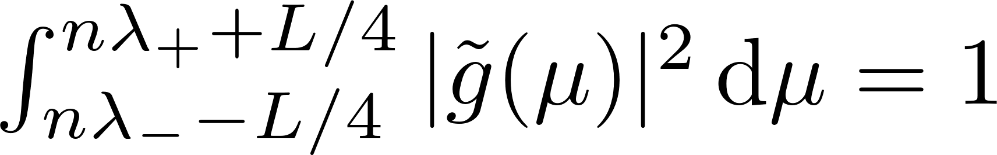
Sketch of the proof
worst case Bayesian cost
Fourier transform + technical details
Subject to:

Slide 15
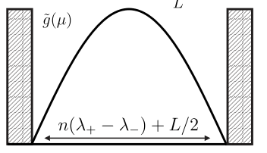
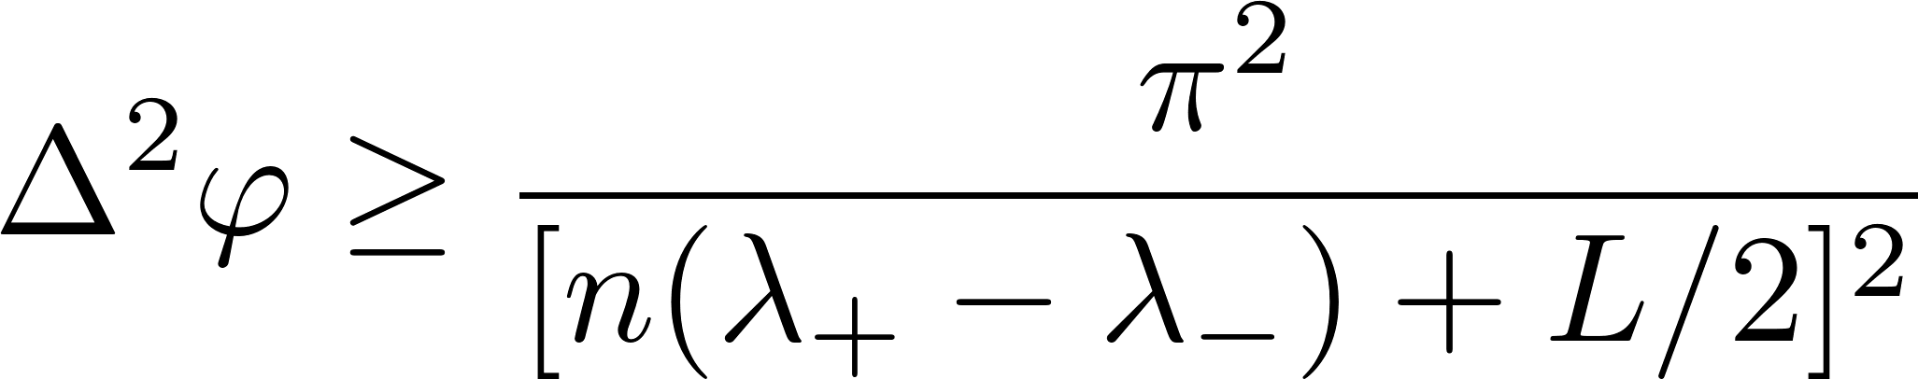
Sketch of the proof
Subject to:

Slide 16
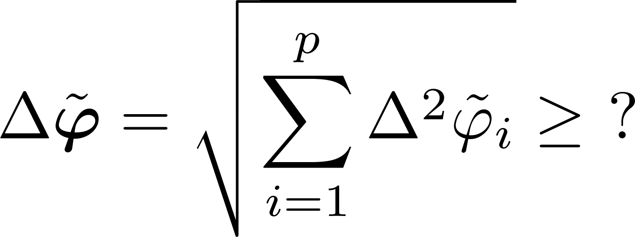
Multiple-arm interferometry
What is the asymptotically achievable Heisenberg limit
in multiple-arm interferometry?

Slide 17


Estimating each phase separately

Slide 18


Optimal joint-phase estimation
Optimal joint strategy gives at most constant factor gain over separate strategies
W. Gorecki, R. Demkowicz-Dobrzanski, arxiv:2107.10863 (2021)

Slide 19




Quantum Fisher information based analysis
Multiparameter quantum Cramer-Rao bound
Quantum Fisher Information matrix
A better scaling of precision in terms of numer of estimated parameters…
Not achievable, unless many-repetition scenario considered!!!
P. C. Humphreys, M. Barbieri, A. Datta, and I. A. Walmsley, Phys. Rev. Lett. 111, 070403 (2013)

Slide 20


Summary
Asymptotically saturable
(True) Heisenberg limit
Quantum Fisher Information based Heisenberg limit
constant factor discrepancy
scaling with the number of parameters discrepancy
W. Gorecki, R. Demkowicz-Dobrzanski, H. M. Wiseman, D. W. Berry, Phys. Rev. Lett 124, 030401 (2020)
W. Gorecki, R. Demkowicz-Dobrzanski, arxiv:2107.10863 (2021)

Slide 21


Why Heisenberg limit?
Try to estimate a position shift of a quantum system
Measure position (complementary observable to the generator of the shift)
Heisenberg uncertainty relation :
uncertainty of the estimated parameter
(RMSD of the position operator)
Root-mean-square deviation (RMSD) of the generator

Slide 22







Why Heisenberg limit
Try to estimate a unitary shift generated by arbitrary hermitian generator
A complementary observable might not exist...
so measure any observable
Linear error propagation formula for estimating
Apply the Heisenberg uncertainty relation:
Estimation uncertainty
(not an RMSD of some operator)
RMSD of the generator

