Slide 1
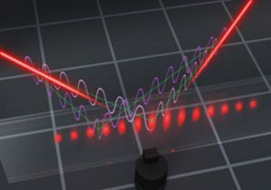
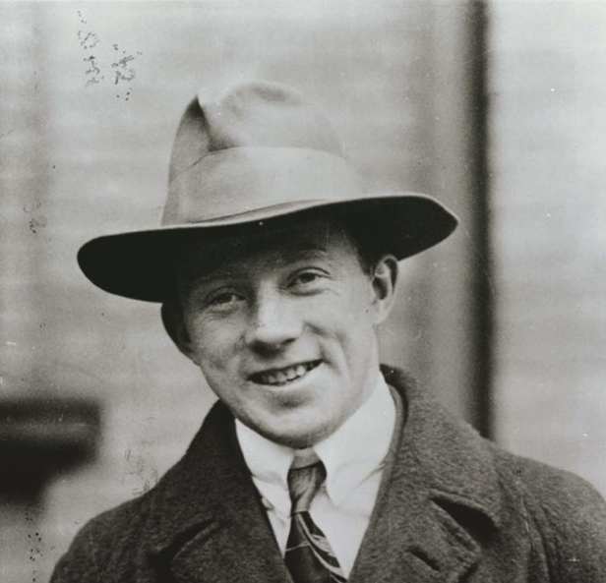
The (true) Heisenberg limit in optical interferometry
R. Demkowicz-Dobrzański
Faculty of Physics, University of Warsaw, Poland
W. Gorecki, R. Demkowicz-Dobrzanski, H. M. Wiseman, D. W. Berry, Phys. Rev. Lett 124, 030401 (2020)
W. Gorecki, R. Demkowicz-Dobrzanski, arxiv:2107.10863 (2021)

Slide 2
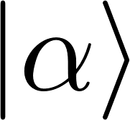
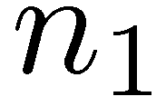

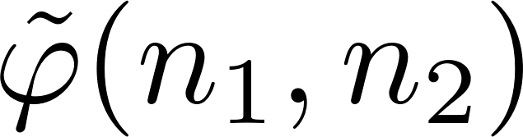

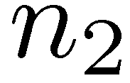
How precisely we can estimate a phase delay in an interferometer?

Slide 3

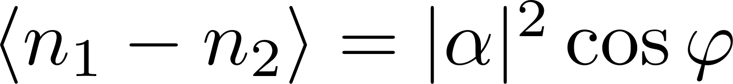
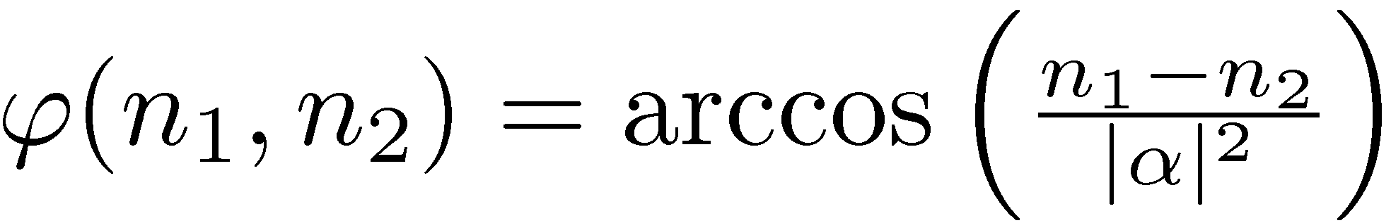
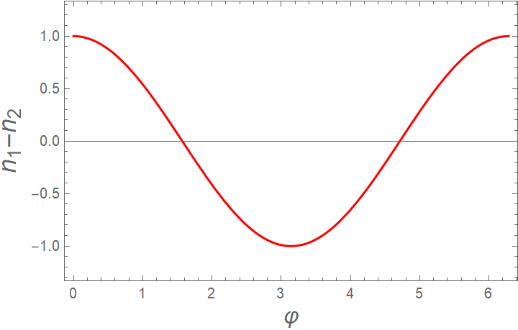
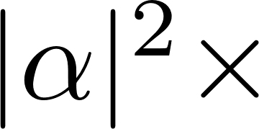
How precisely we can estimate a phase delay in an interferometer?
natural estimator:

Slide 4

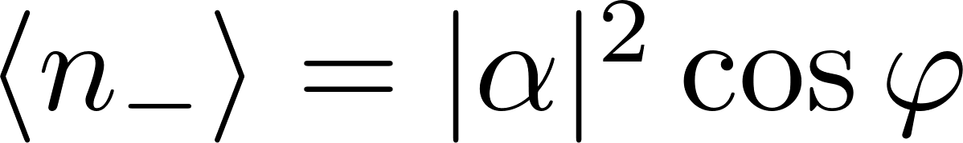
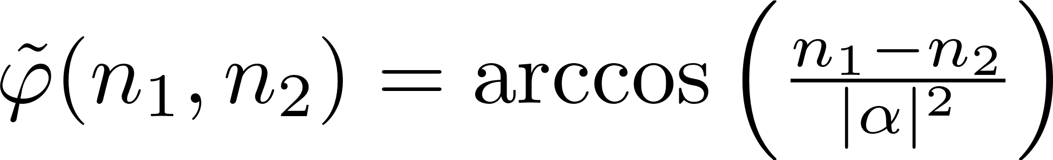
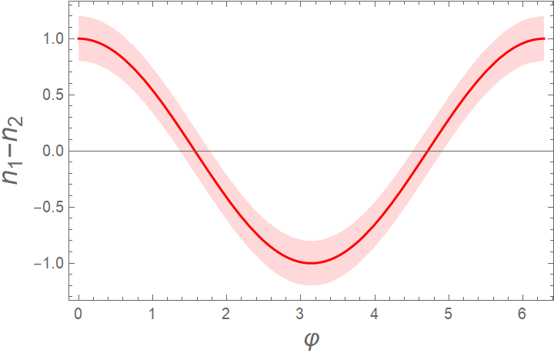

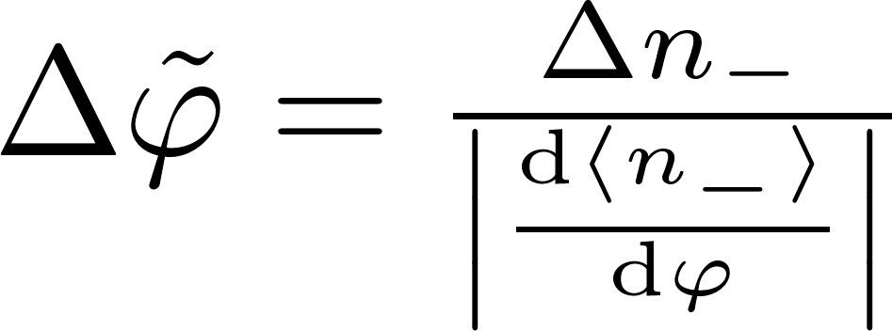
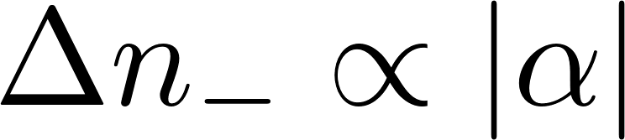
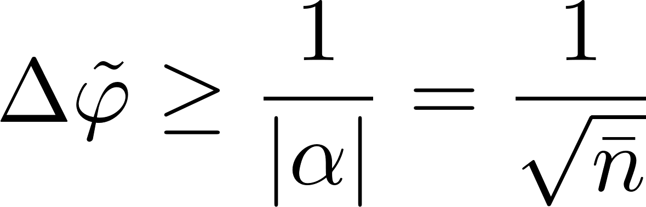
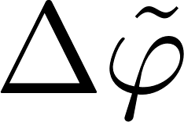
How precisely we can estimate a phase delay in an interferometer?
natural estimator:
linear error propagation formula
Poissonia n fluctuations
Shot noise limit

Slide 5
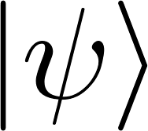
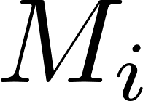
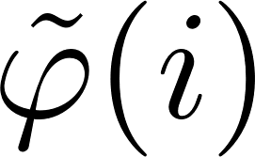
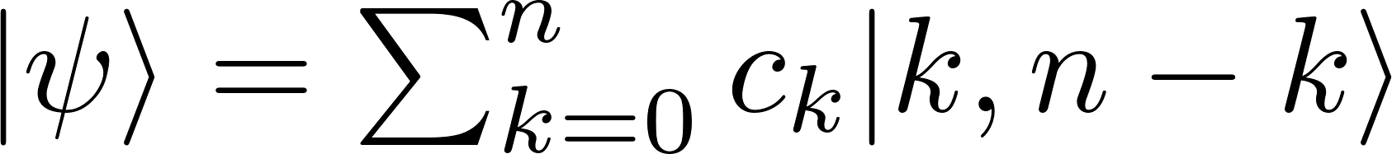
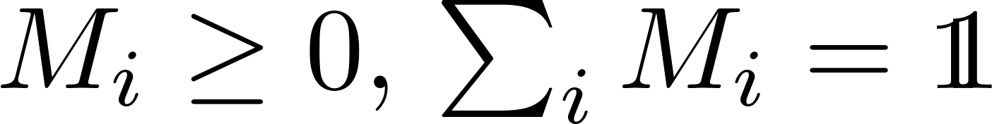

How precisely we can estimate a phase delay in an interferometer?
arbitrary n-photon state
arbitrary measurement
The Heisenberg limit:

Slide 6
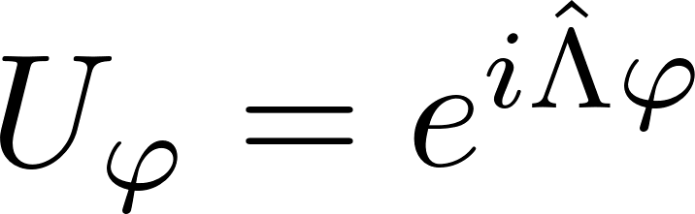
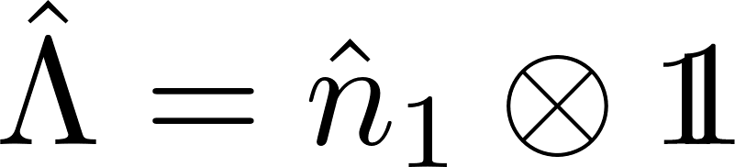
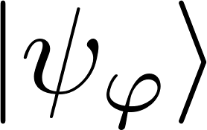

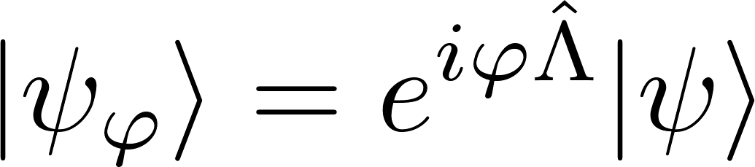
Heisenberg limit a simple intuitive derivation
Evolution
Evolution generator
(numer of photons in the upper arm)
Measurement of observable A
arbitrary n-photon input state
Try to estimate a unitary shift generated by Λ (spectrum between 0 and n)

Slide 7
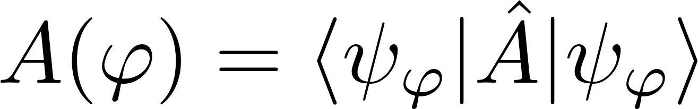

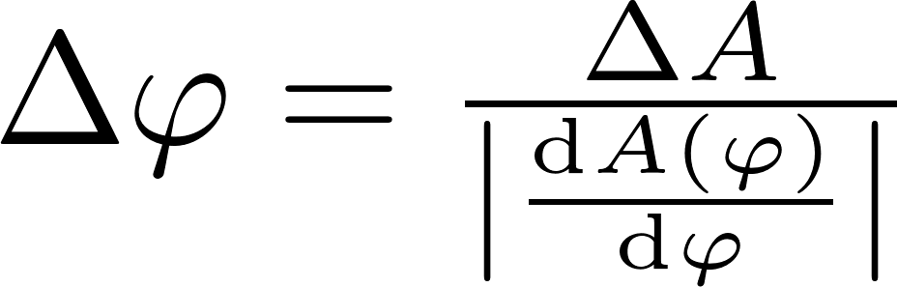
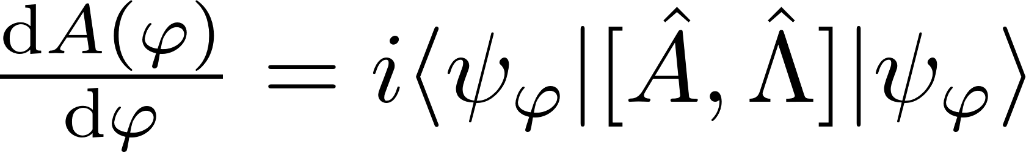
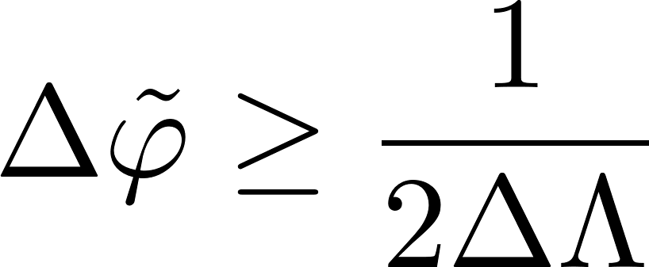
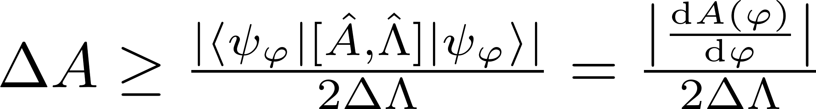
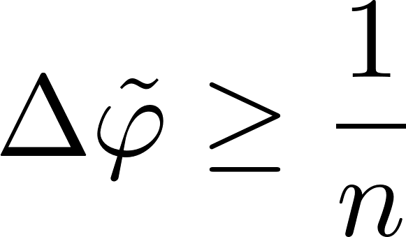
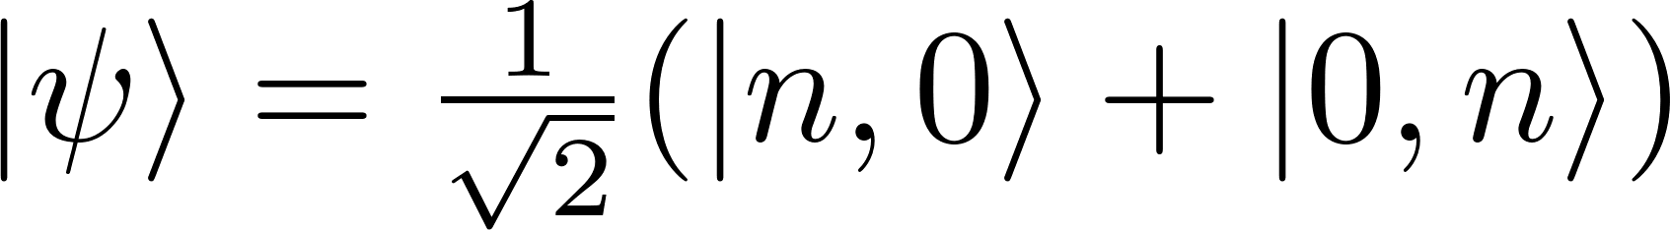
Heisenberg limit a simple intuitive derivation
Try to estimate a unitary shift generated by Λ (spectrum between 0 and n)
We extract information by measuring observable A
Linear error propagation formula for estimating
Apply the Heisenberg uncertainty relation:
Estimation uncertainty
(not an RMSD of some operator)
RMSD of the generator
To maximize the variance of Λ choose:

Slide 8
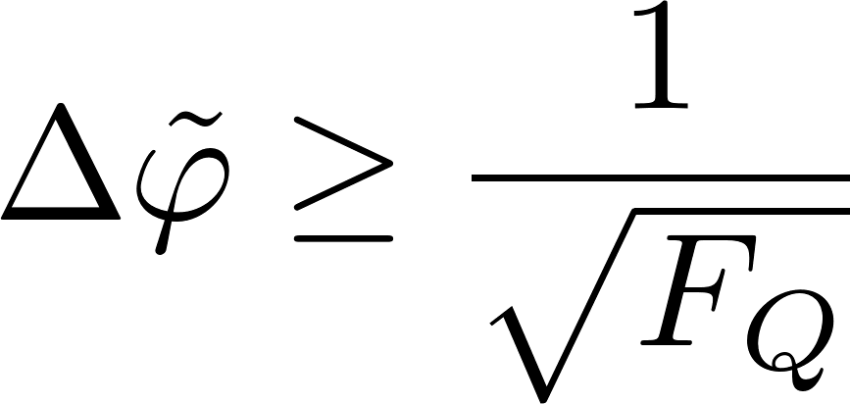
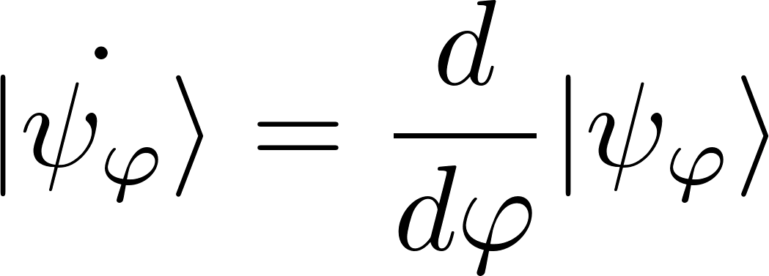

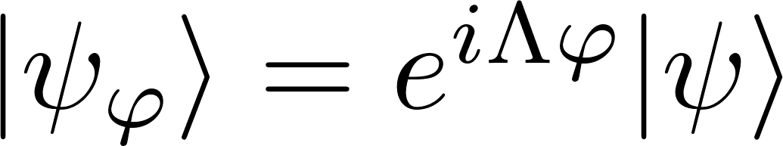
Alternative derivation using
The Quantum Cramer-Rao bound
Quantum Cramer-Rao inequality
valid for any locally unbiased estimator
and arbitrary measurements
Quantum Fisher Information
General unitary parameter encoding
To maximize the variance of Λ choose:
The Heisenberg limit:

Slide 9
The Heisenberg limit
arbitrary n-photon state
arbitrary measurement
The Heisenberg limit:

Slide 10

Saturability of the Heisenberg limit

Slide 11
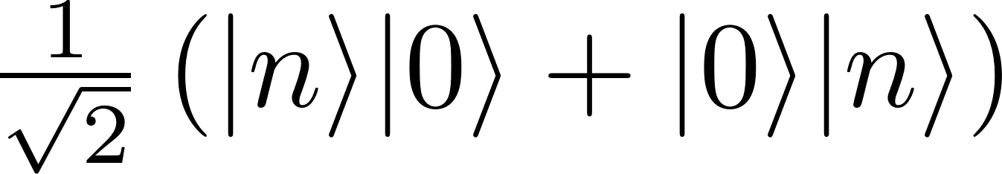
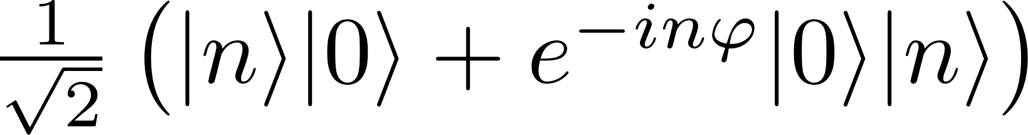
Saturability of the Heisenberg limit
State
preparation
Estimator
Measuremnt
We can only saturate the bound within the range of parameter values which shrinks as 1/n

Slide 12
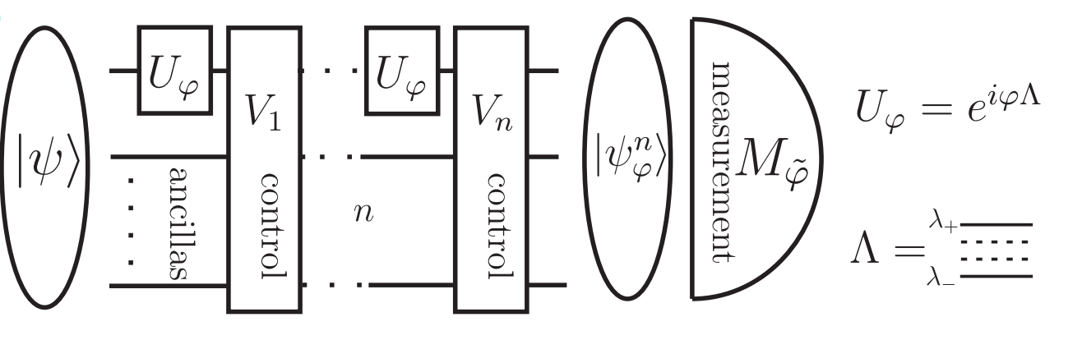
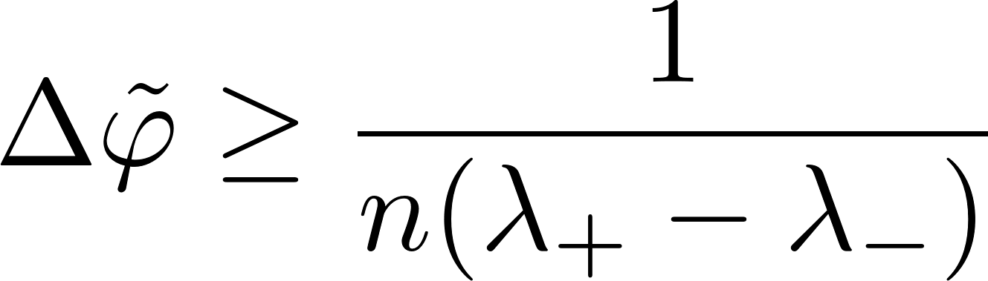
The most general form of the Heisenberg limit
Is this bound saturable even in principle….?
V. Giovannetti, S. Lloyd, and L. Maccone, Phys. Rev. Lett. 96, 010401 (2006).

Slide 13
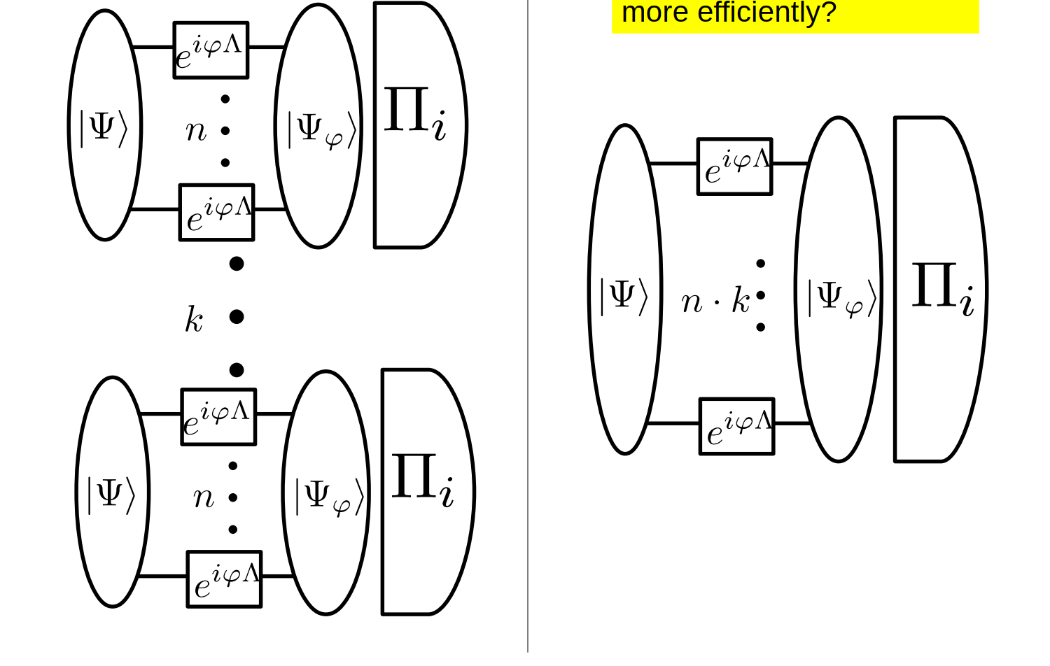
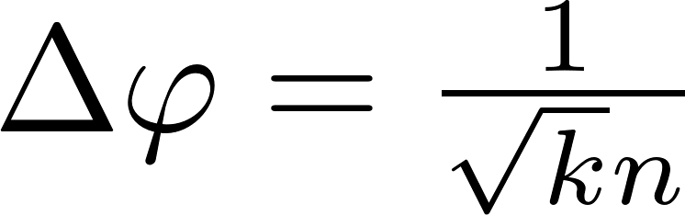
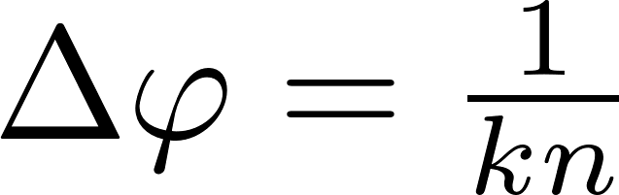
Many repetition scenario guarantees asymptotic saturability of the CR bound
Poor man’s Heisenberg limit
Heisenberg limit in terms of
all the resources consumed

Slide 14
What is the achievable Heisenberg limit in a single shot scenario assuming finite prior knowledge?

Slide 15
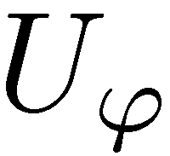
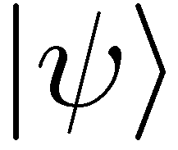
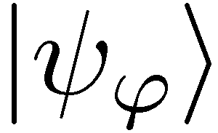


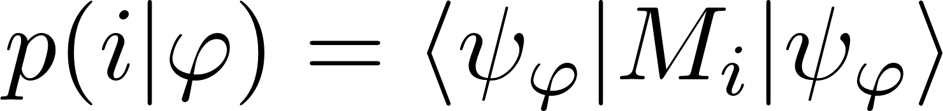
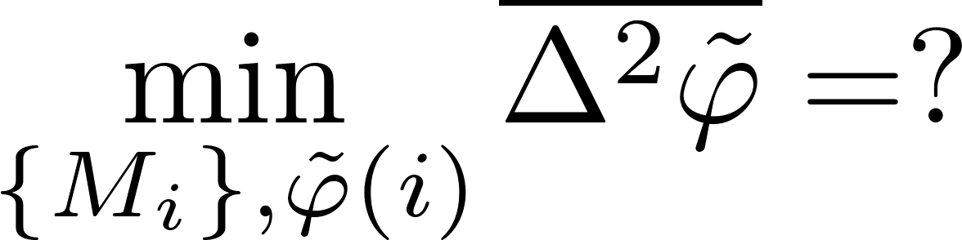
The True Heisenberg limit
The Bayesian approach
The Bayesian variance
prior
no unbiasedness assumption

Slide 16
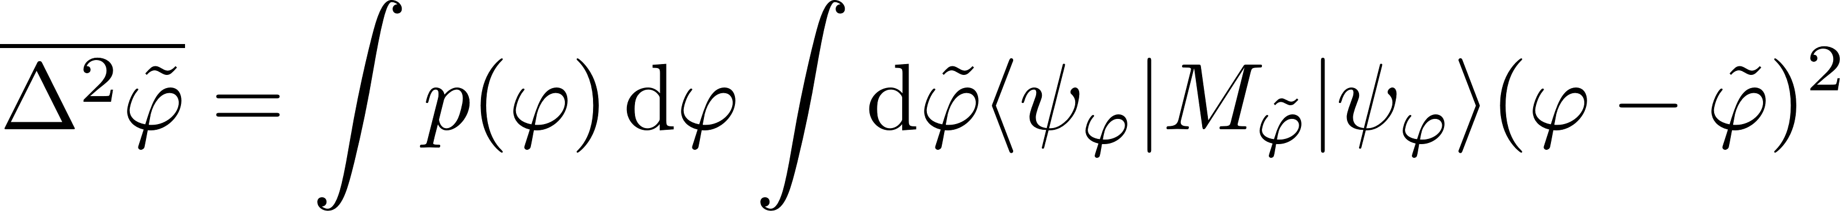
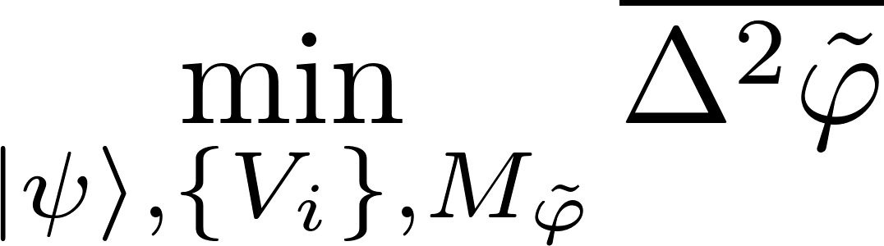


The True Heisenberg limit
For any prior with finite bandwidth L
we have the following bound
Any „reasonable” prior may be efficiently approximated by finite bandwidth priors and the theorem will remain valid, e.g. for arbitrary narrow rectangular prior.
W. Gorecki, R. Demkowicz-Dobrzanski, H. M. Wiseman, D. W. Berry, Phys. Rev. Lett 124, 030401 (2020)

Slide 17

The true Heisenberg limit
arbitrary n-photon state
arbitrary measurement
The asymptotically saturable Heisenberg limit:
W. Gorecki, R. Demkowicz-Dobrzanski, H. M. Wiseman, D. W. Berry, Phys. Rev. Lett 124, 030401 (2020)

Slide 18





Sketch of the proof
some not necessarily orthogonal vectors…
Consider some fixed measurement basis

Slide 19






Sketch of the proof
worst case Bayesian cost
Fourier transform + technical details
Subject to:

Slide 20


Sketch of the proof
Subject to:

Slide 21

Multiple-arm interferometry
What is the asymptotically achievable Heisenberg limit
in multiple-arm interferometry?

Slide 22


Estimating each phase separately

Slide 23


Optimal joint-phase estimation
Optimal joint strategy gives at most constant factor gain over separate strategies
W. Gorecki, R. Demkowicz-Dobrzanski, arxiv:2107.10863 (2021)

Slide 24




Quantum Fisher information based analysis
Multiparameter quantum Cramer-Rao bound
Quantum Fisher Information matrix
A better scaling of precision in terms of numer of estimated parameters…
Not achievable, unless many-repetition scenario considered!!!
P. C. Humphreys, M. Barbieri, A. Datta, and I. A. Walmsley, Phys. Rev. Lett. 111, 070403 (2013)

Slide 25



Summary
Asymptotically saturable
(True) Heisenberg limit
Quantum Fisher Information based Heisenberg limit
constant factor discrepancy
scaling with the number of parameters discrepancy
W. Gorecki, R. Demkowicz-Dobrzanski, H. M. Wiseman, D. W. Berry, Phys. Rev. Lett 124, 030401 (2020)
W. Gorecki, R. Demkowicz-Dobrzanski, arxiv:2107.10863 (2021)
Thank you
(post-doc positions available…)

