Slide 1
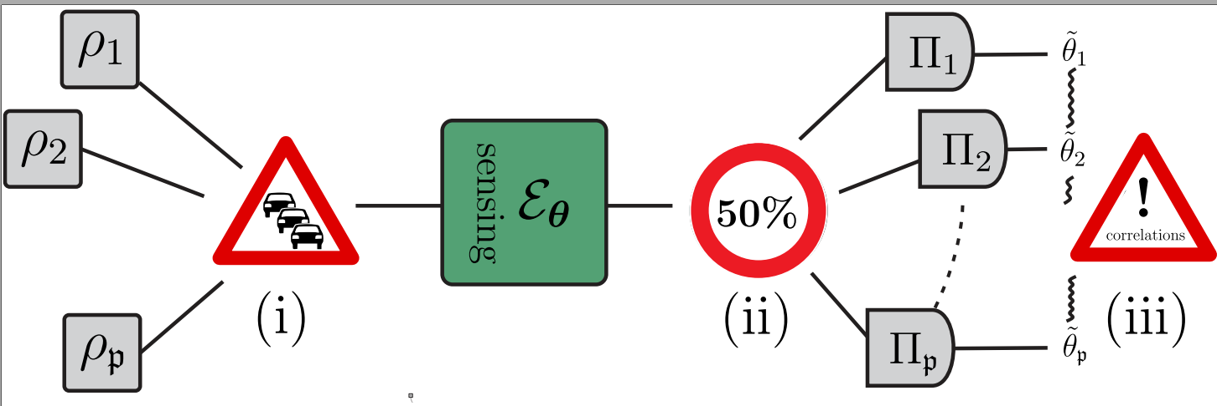
Probe Incompatibility in Multiparameter Noisy Quantum Channel Estimation
R. Demkowicz-Dobrzański, F. Albarelli
Faculty of Physics, University of Warsaw, Poland
arxiv: 2104.11264 (2021)

Slide 2
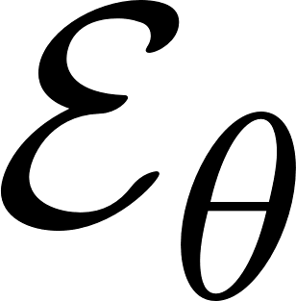
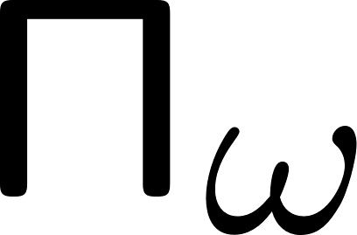
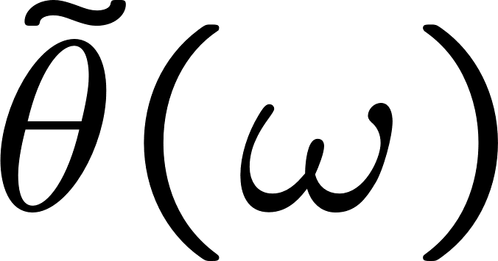
A basic quantum metrology problem
input state
measurement
estimator
input state
a quantum channel
with unknown parameter

Slide 3
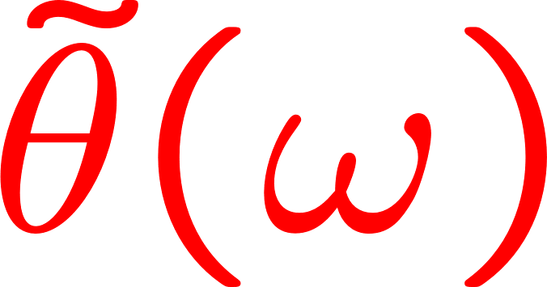
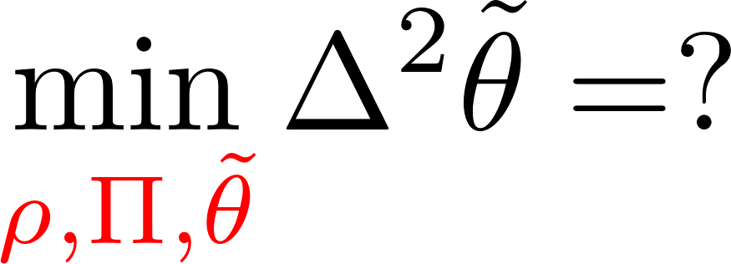
A basic quantum metrology problem
input state
measurement
estimator
input state
a quantum channel
with unknown parameter

Slide 4
Optimal adaptive protocol involving N uses of a channel

Slide 5
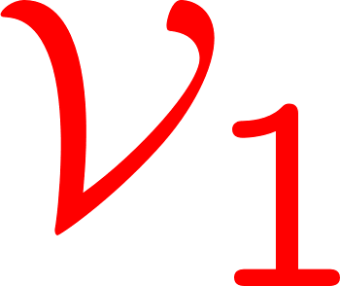
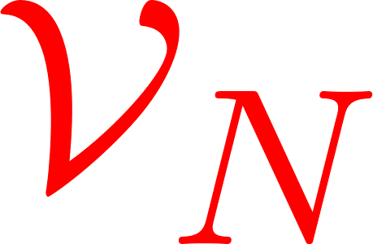
Optimal adaptive protocol involving N uses of a channel

Slide 6
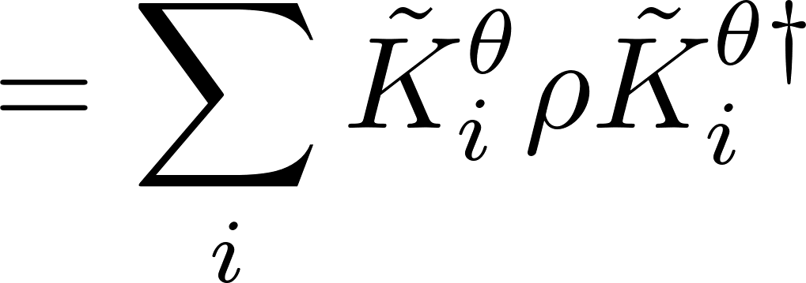
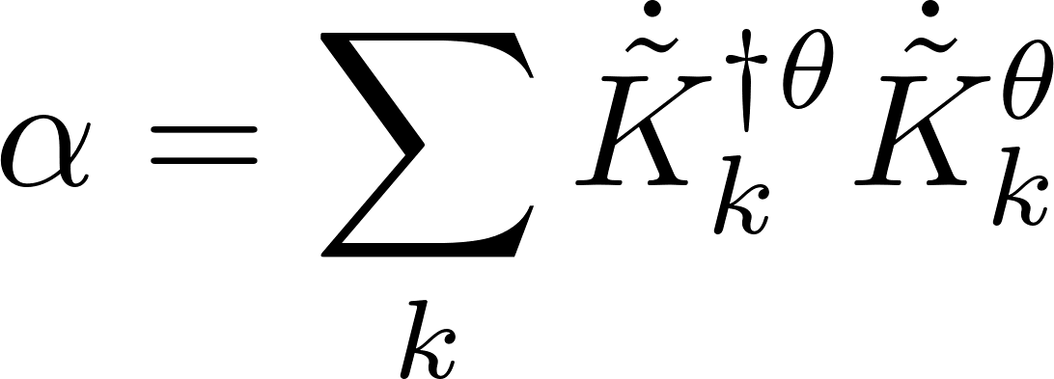
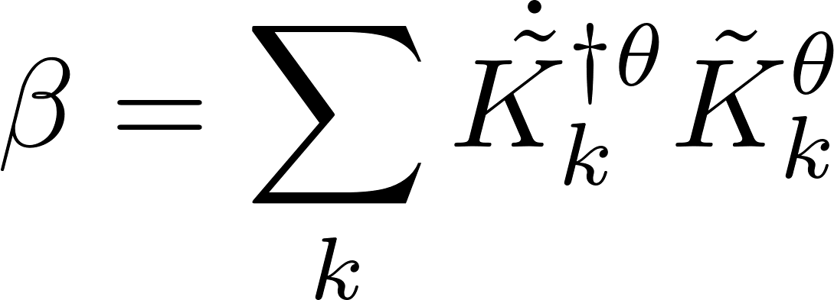
Single parameter case solved completely! using quantum Fisher information approach
single channel optimization!
an efficient SDP programme
can be 0 for generic noisy channels
A. Fujiwara, H. Imai, J. Phys. A 41, 255304 (2008)
B. M. Escher, R. L. de Matos Filho, L. Davidovich Nature Phys. 7, 406–411 (2011)
RDD, J. Kolodynski, M. Guta, Nat. Commun. 3, 1063 (2012)
RDD, L. Maccone, Phys. Rev. Lett. 113, 250801 (2014) [Adaptive schemes included]
S. Zhou, M. Zhang, J. Preskill, and L. Jiang, Nat. Commun. 9, 78 (2018)
S. Zhou, L. Jiang, PRX Quantum 2, 010343 (2021) [Saturability proven using q. error correction ideas]

Slide 7
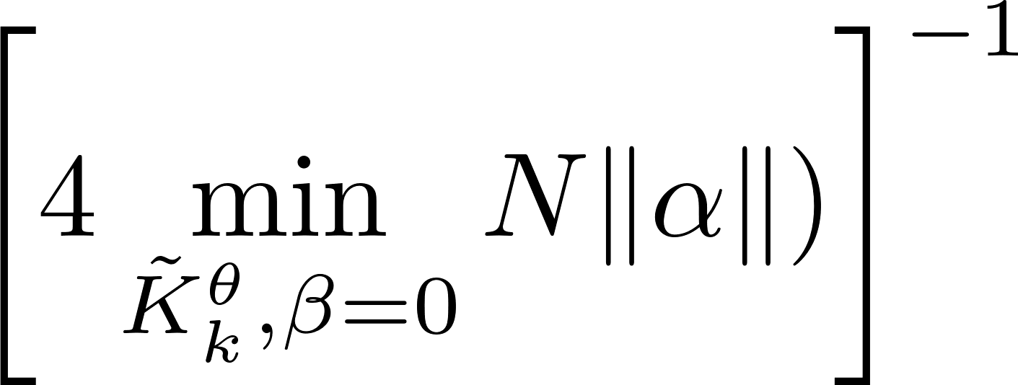
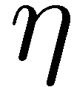
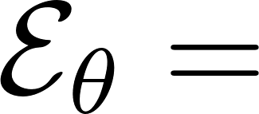
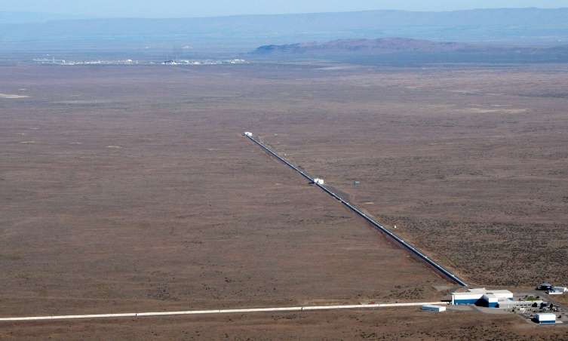
Asymptotic constant factor quantum improvement – Heisenberg scaling lost
Lossy interferometry
quantum enhancement factor
Fundamental bound saturable with squeezed vacuum + coherent state interferometry!
C.Caves, Phys. Rev. D 23, 1693 (1981
RDD, K. Banaszek, R. Schnabel, Phys. Rev. A 88, 041802(R) (2013)

Slide 8
Multiparameter issues!
Input probe incompatibility
Measurement incompatibility
Correlated estimators

Slide 9
Multiparameter issues!
Input probe incompatibility may affect scaling of precision with the numer of parameters involved!
Measurement incompatibility asymptotically at most twice overhead in resources
Correlated estimators problem removed if proper parametrization chosen
S. Ragy, M, Jarzyna, RDD, Phys. Rev. A 94, 052108 (2016)

Slide 10
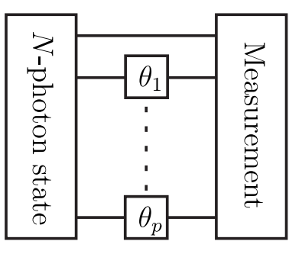
Fundamental multiparameter bound in generic noisy metrology
estimator covariance matrix
cost matrix
cost matrix eigendecompositions
(natural parametrization)
Multiple-phase lossy interferometry (including adaptive schemes)
F. Albarelli, RDD, arxiv: 2104.11264 (2021)

Slide 11
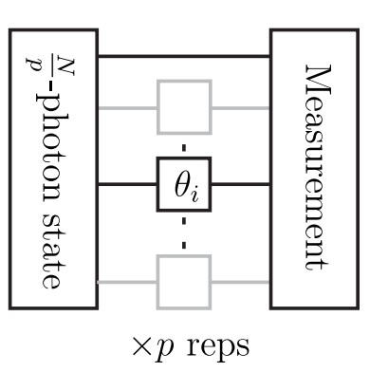
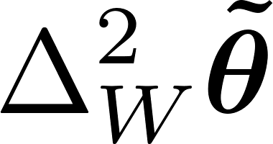
Simultanous vs. Separate estimation
If we perform separate estimation we need to split resources
Simultaenous estimation has an advantage but at most o factor of 4
No scaling advantage due to almost maximal probe incompatibility!
F. Albarelli, RDD, arxiv: 2104.11264 (2021)

Slide 12
Summary
Probe incompatibility, the most relevant feature of multiparameter metrology
Nontrivial bounds in noisy multiple-parameter metrology derrived
It is possible to define channel probe incompatibility measure independent of the actual parametrizationa and the cost matrix
Results may be applied to discrimination tasks -> bounds on noisy Grover algorithm
F. Albarelli, RDD, arxiv: 2104.11264 (2021)

