Slide 1
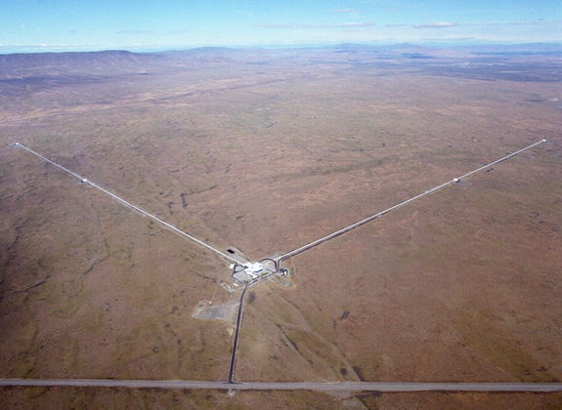
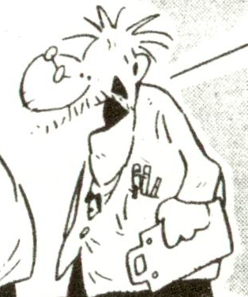
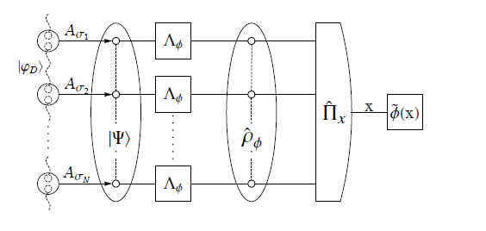
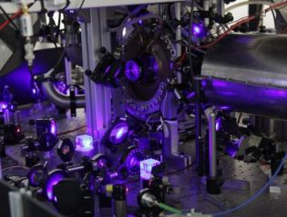
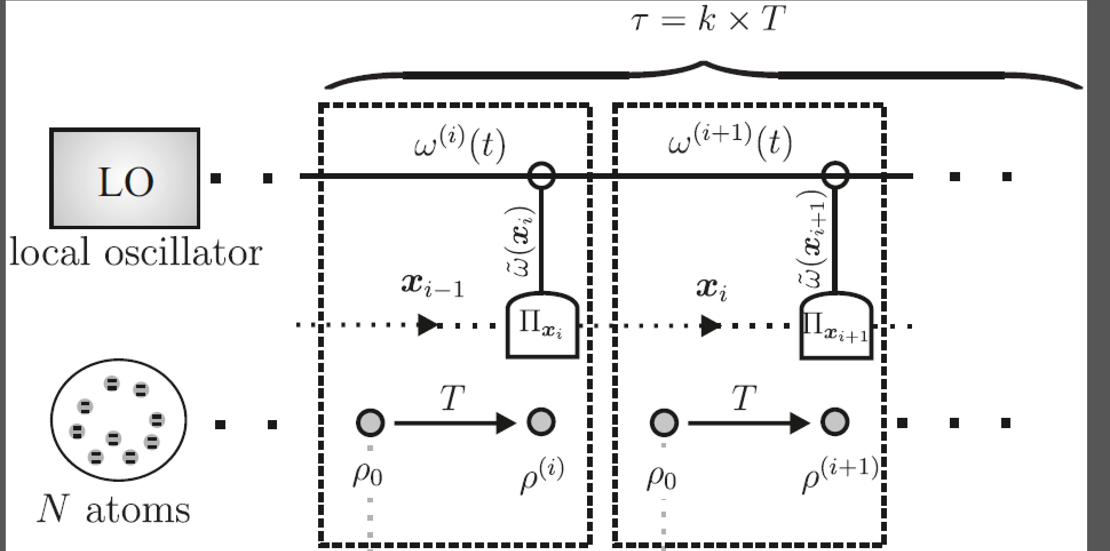







Matrix Product States in Quantum Metrology
R. Demkowicz-Dobrzański,, M. Jarzyna, K .Chabuda
Faculty of Physics, University of Warsaw, Poland

Slide 2

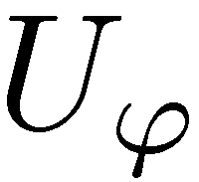
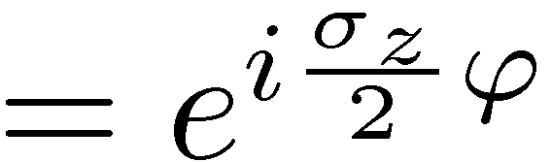
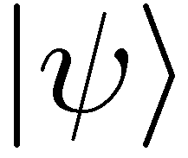
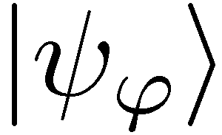
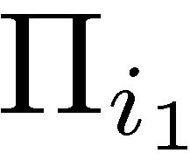


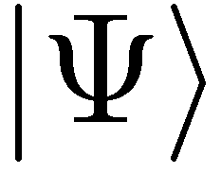
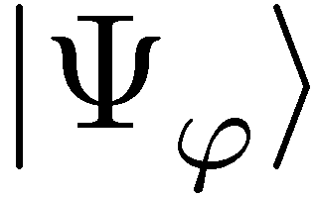
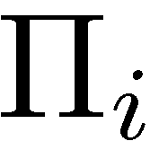
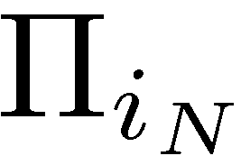
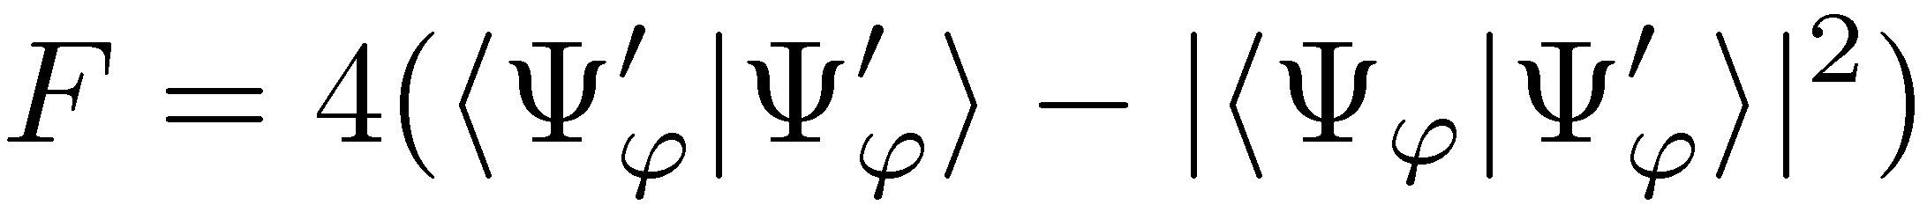
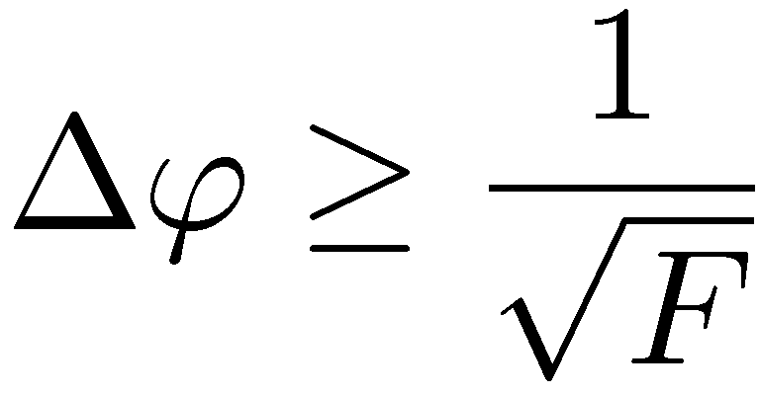
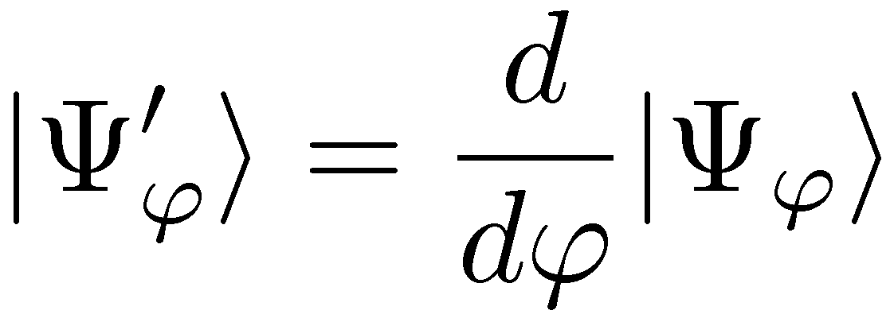
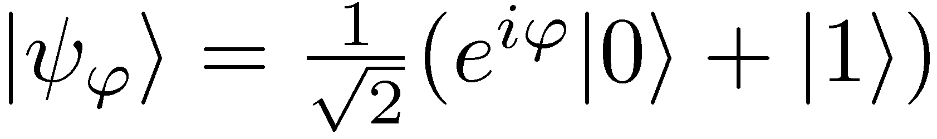
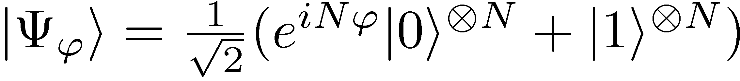
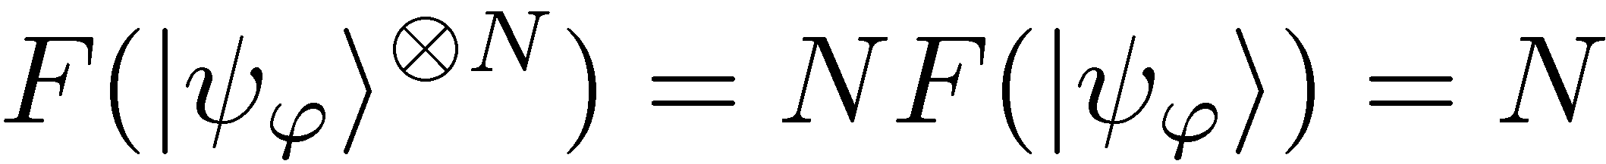
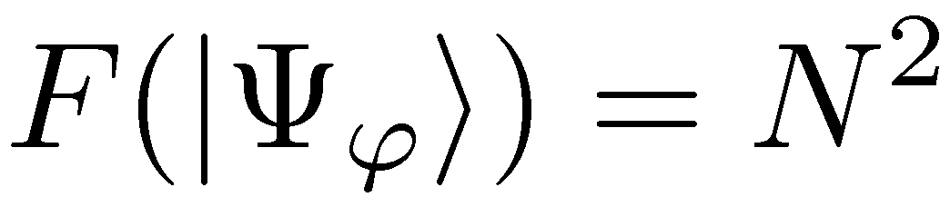
Quantum metrology as quantum channel estimation problem
=
,,Classical’’ scheme
Entanglement-enhanced scheme
Quantum Cramer-Rao bound:

Slide 3
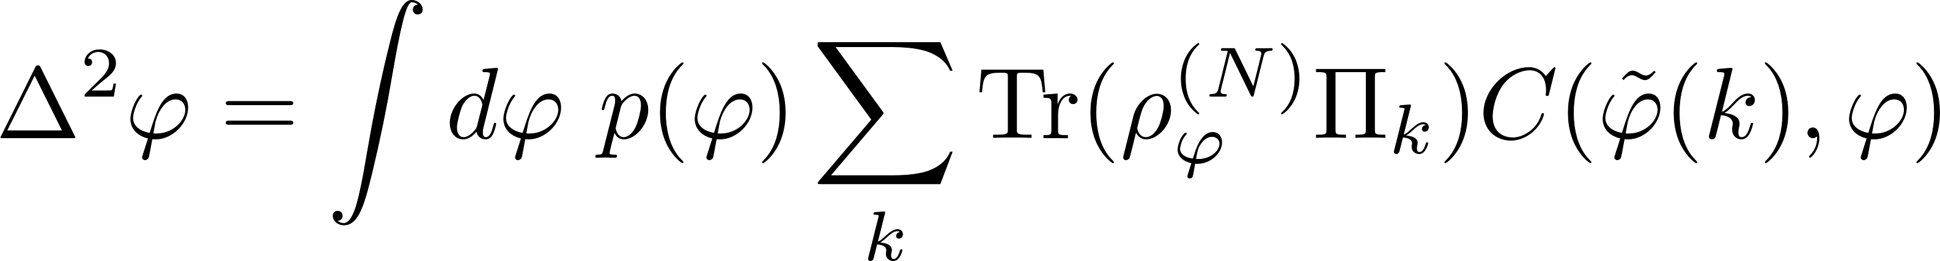
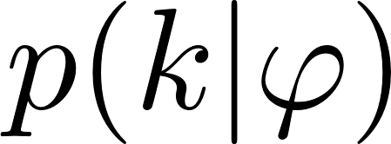
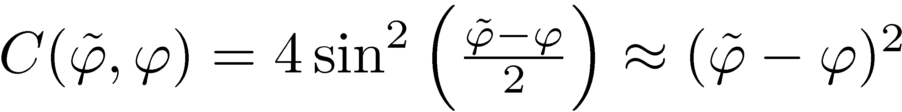
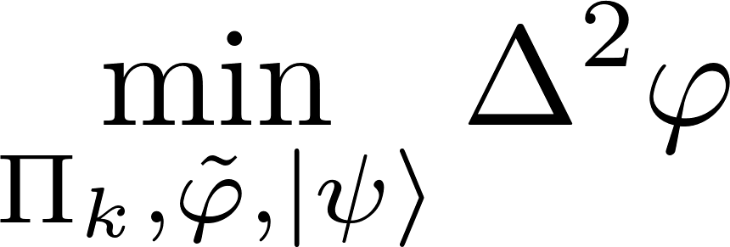
Is Heisenberg limit 1/N saturable?
Cramer-Rao bound not guaranteed to be saturable in a single-shot scenario
Judging only by Fisher information may lead to overoptimistic claims
Bayesian approach:
prior distribution
cost function
Is there a Bayesian strategy yielding the Heisenberg limit?

Slide 4
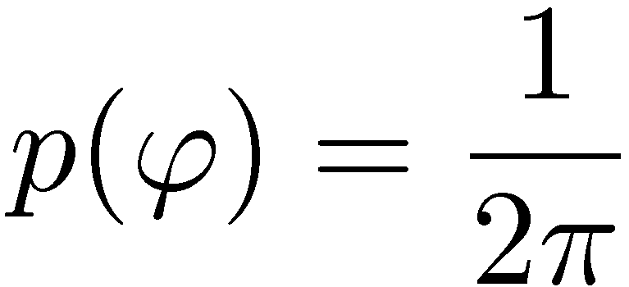
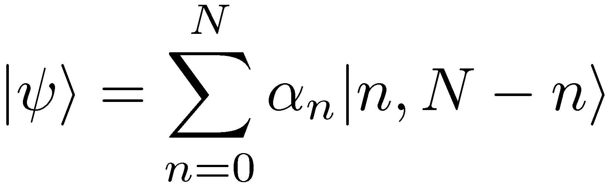
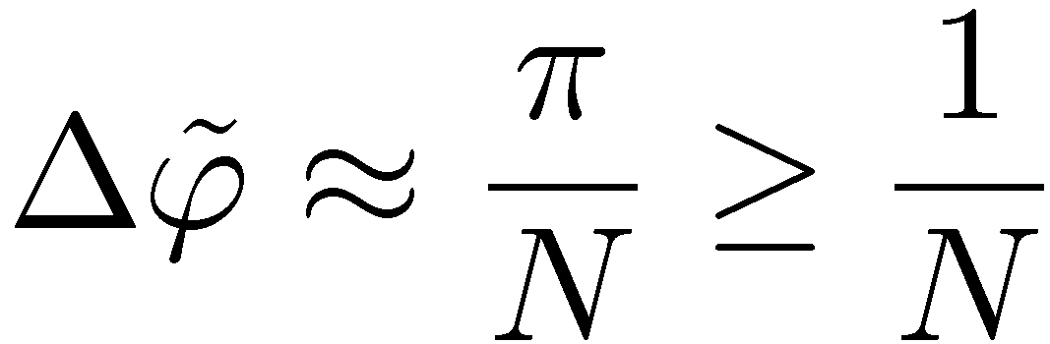
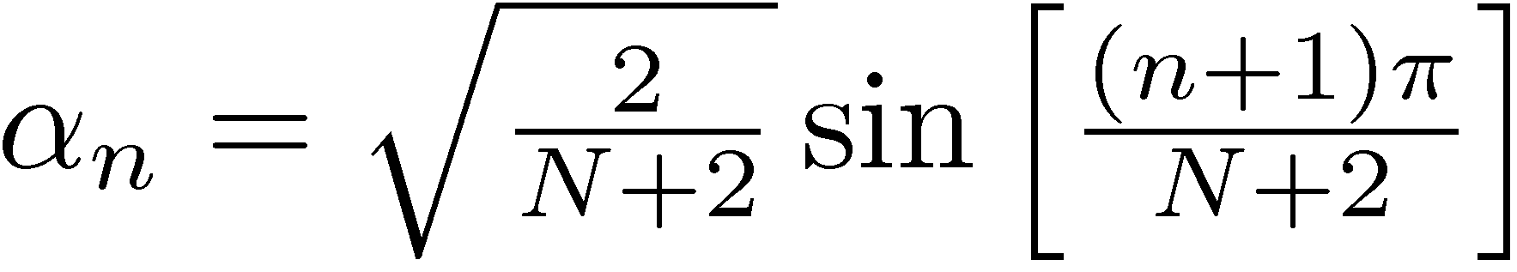
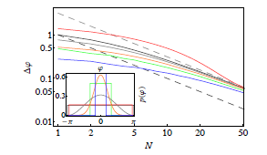
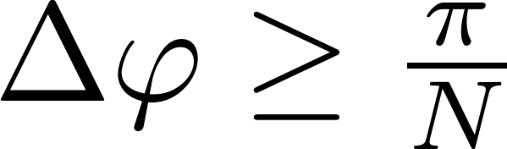
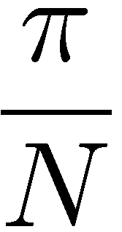

The true Heisenberg limit
For decoherence free phase estimaion, flat prior
D. W. Berry and H. M. Wiseman, Phys. Rev. Lett. 85, 5098 (2000).
The π factor is present any regular prior,
Valid also for indefninte photon numer states
M. Jarzyna, RDD, New J. Phys. 17, 013010 (2015)

Slide 5
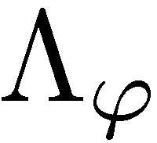
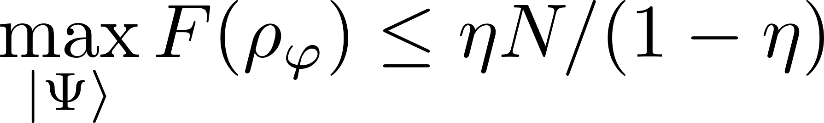
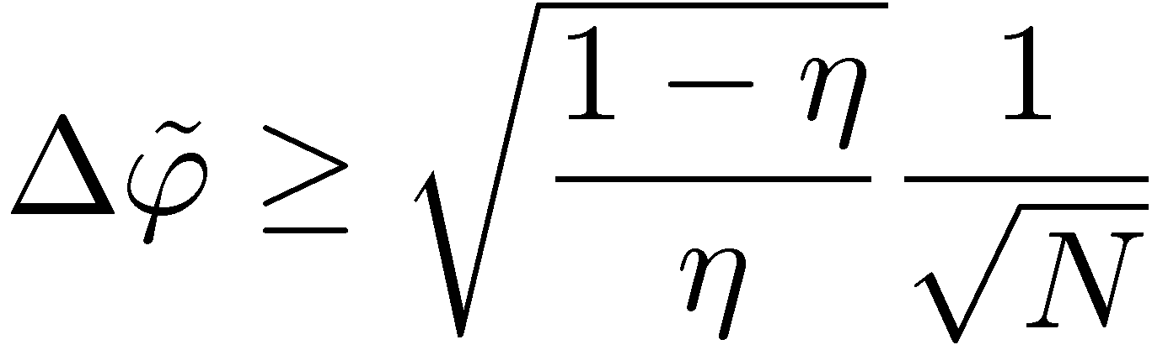
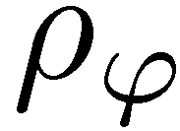
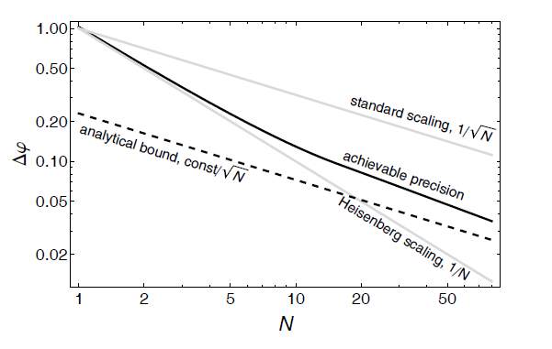


Quantum metrology in presence of losses
Quantum gain
Heisenberg scaling lost
Lossy interferometer
J. Kolodyński, R. Demkowicz-Dobrzański, PRA 82,053804 (2010)
B. M. Escher, R. L. de Matos Filho, L. Davidovich Nature Phys. 7, 406–411 (2011)
RDD, J. Kolodynski, M. Guta, Nature Communications 3, 1063 (2012)
S. I Knysh, E. H. Chen, and G. A. Durkin arXiv:1402.0495 (2014)

Slide 6
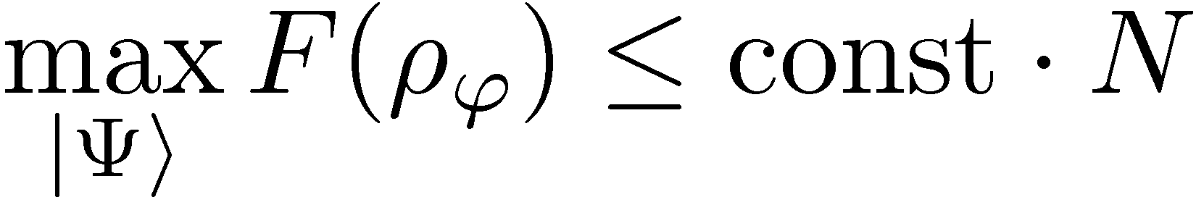
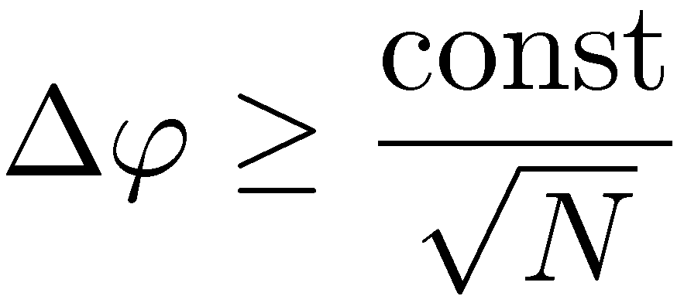
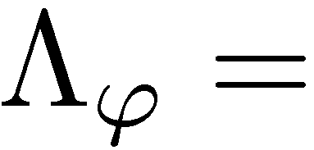
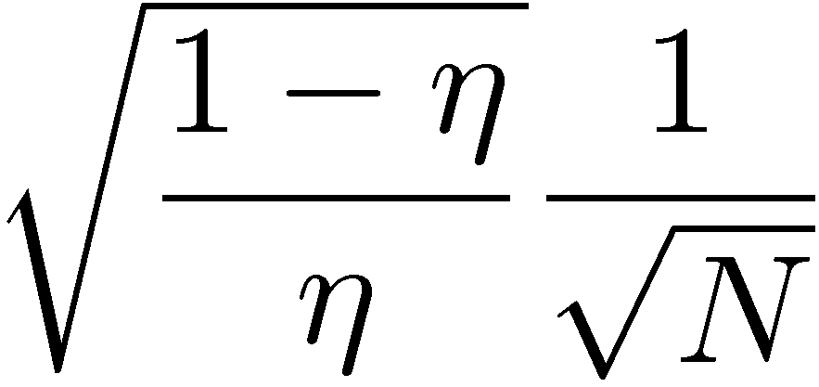
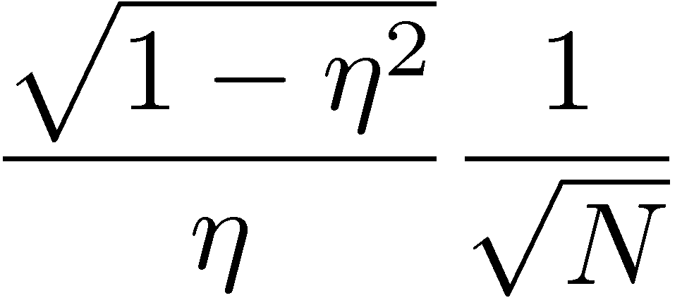
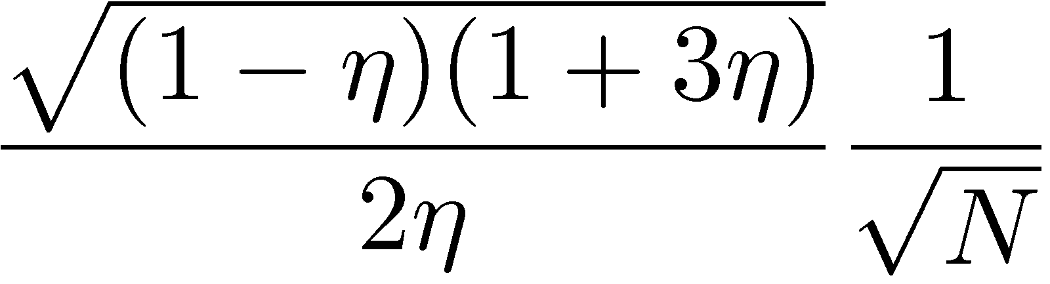
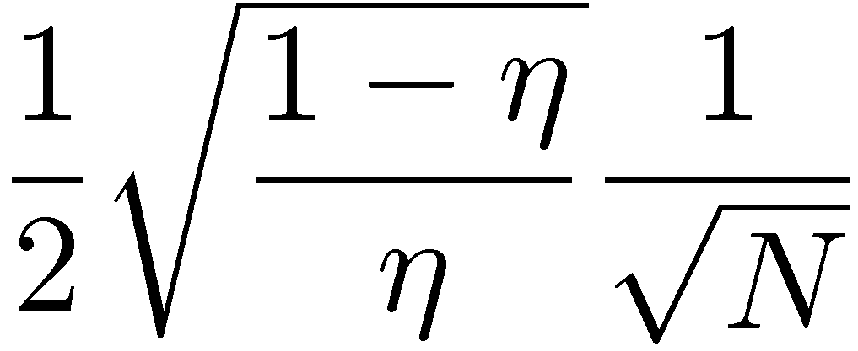
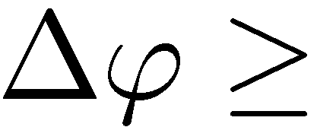
Generic impact of decoherence…
Heisenberg scaling generically lost
B. M. Escher, R. L. de Matos Filho, L. Davidovich Nature Phys. 7, 406–411 (2011)
RDD, J. Kolodynski, M. Guta, Nature Communications 3, 1063 (2012)
S. I Knysh, E. H. Chen, and G. A. Durkin arXiv:1402.0495 (2014)
Lossy interferometer | Dephasing | Depolarization | Spontaneous emission

Slide 7
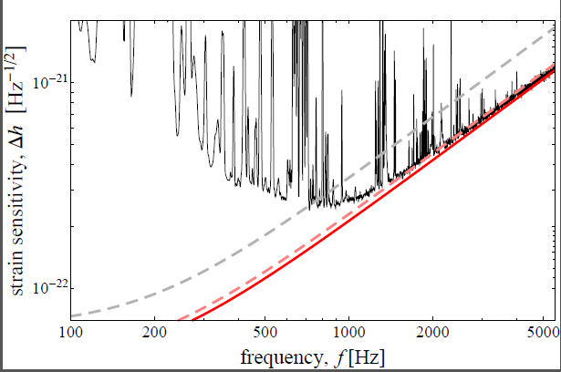
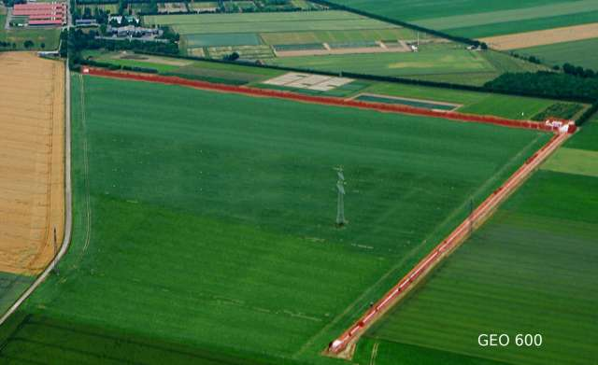
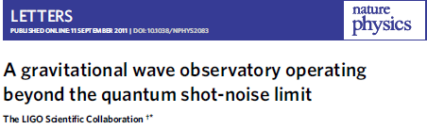
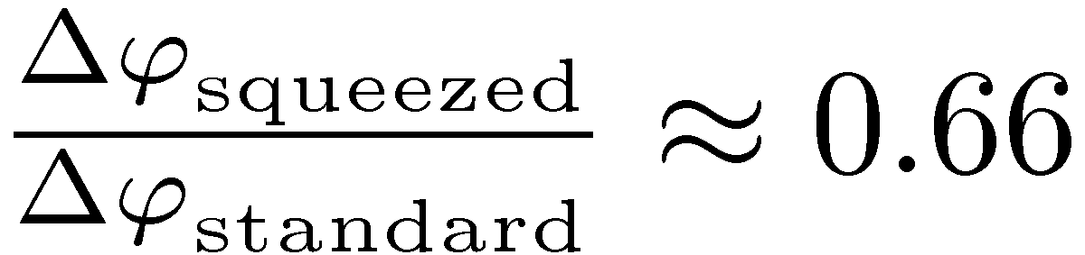
GEO600 interferometer at the fundamental quantum bound
coherent light
+10dB squeezed
fundamental bound
The most general quantum strategies could additionally improve the precision by at most 8%
RDD, K. Banaszek, R. Schnabel, Phys. Rev. A, 041802(R) (2013)

Slide 8
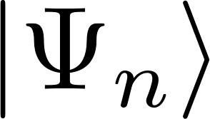








Matrix product states and metrology

Slide 9


Matrix product states and metrology
No need to entangle large number of probes
Matrix product state with bond dimension D
D=1
D=2
Low bond dimension matrix product states are sufficient.
D=3
M.Jarzyna, R. Demkowicz-Dobrzanski, Phys. Rev. Lett. 110, 240405 (2013)

Slide 10





Basic scheme of atomic clock operation
microwave generator
feedback correction
crystal oscillator
microwave atomic clock
optical atomic clock

Slide 11

















Ramsey interrogation
Exactly the same as in the Mach-Zehnder
Cs atomic fountain clock (NIST)
Frequency difference estimation precision
clock transition

Slide 12
Why atomic clocks are not just optical interferometers divided by „T”
Freedom in choosing time of evolution makes „local sensing” regime not well defined apriori – e.g. when we can use quantum Fisher information?
In atomic clocks we are interested in stabilizing fluctuating frequency and not measuring unknown fixed frequency!

Slide 13




Allan variance

Slide 14



Looking for the fundamental stability bound
adaptiveness allowed!!!
Given: LO noise, atomic decoherence, number of atoms
Find: optimal states, interrogation times, measurements, feedbacks to minimize the Allan variance!
The quantum Allan variance

Slide 15

First step towards fundamental bounds
single step corrected frequency fluctuations
Assuming no correlations between corrected frequnecy fluctuations at subsequent steps
If the optimal interrogation time determined by atomic decoherence and the resulting interrogation time longer than LO correlation time then OK
We are looking for a completely general method…
E. Kessler, P. Komar, M. Bishof, L. Jiang, A.S.Sorensen, J.Ye, M.D.Lukin, Phys. Rev. Lett. 112, 190403 (2014)

Slide 16







Calculating the Quantum Allan Variance
unitary frequency sensing
atomic decoherence
stochastic proces describing
LO frequency fluctuations
Assume the input state is given:
Notes:
atomic decoherence

Slide 17






Optimal Quantum Bayesian parameter estimation for variance cost function
prior distribution
family of states
measurement
estimator
average cost:
Notes:
atomic decoherence

Slide 18




Optimal Quantum Bayesian parameter estimation for variance cost function
prior distribution
family of states
measurement
estimator
average cost:
solution:
Helstrom, Quantum Detection and Estimation Theory, (1976)
K. Macieszczak, M. Fraas, RDD, New J. Phys. 16, 113002 (2014)
Notes:
atomic decoherence

Slide 19

Minimizing the Allan Variance
Bayesian variance minimization:
Allowing for collective measurements, and arbitrary correction function we can solve the problem!!!
Notes:
Complexity grows with the number

Slide 20



The Quantum Allan Variance
uncorrected LO Allan variance
K. Chabuda, I. Leroux, RDD, New J. Phys. 18, 083035 (2016)

Slide 21



Using Matrix Product Operators to improve numerical efficiency
Noise correlations are only local. Possibility of a more efficient description?

Slide 22






Issues with implementation
Approximate with a MPO:
correlation matrix dependent on LO noise
How big reduced matrices need to consider (length of correlations)
Take translationally invariant correlations? Impose translational invariance?
Impose positive semidefinitness?
Write as an MPO:
diagonal (K x K) matrices
dependent on LO noise
Find L as a MPO
- What bond dimension of C matrices will be sufficient?
Notes:
Pryblizanie, zapisa L

Slide 23
Summary and outlook
Tell me your LO noise spectrum and the number of atoms and I will tell you your stability limits
if you help me with numerics….
K. Macieszczak, M. Fraas, RDD, New J. Phys. 16, 113002 (2014)
K. Chabuda, I. Leroux, RDD, New J. Phys. 18, 083035 (2016)

