Slide 1
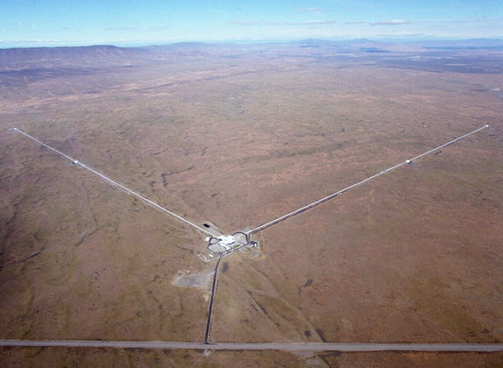
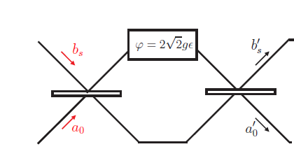
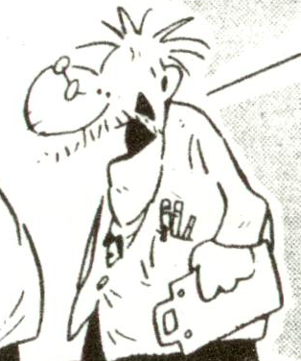







Quantum limits in optical interferometry
R. Demkowicz-Dobrzański¹, K. Banaszek¹, J. Kołodyński¹, M. Jarzyna¹,
M. Guta², K. Macieszczak^{1,2}, R. Schnabel³, M. Fraas⁴
¹Faculty of Physics, University of Warsaw, Poland
² School of Mathematical Sciences, University of Nottingham, United Kingdom
³ Max-Planck-Institut fur Gravitationsphysik, Hannover, Germany
⁴ Theoretische Physik, ETH Zurich, 8093 Zurich, Switzerland

Slide 2
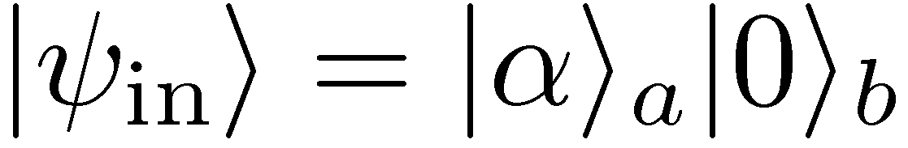
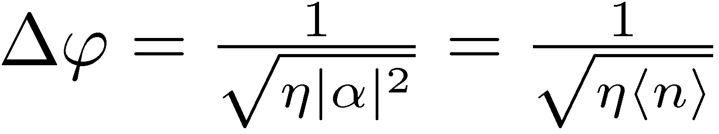
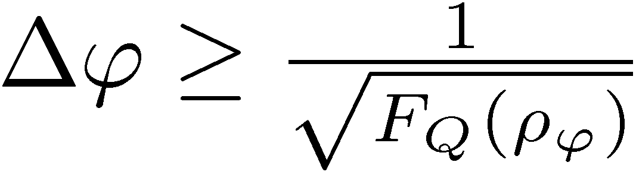
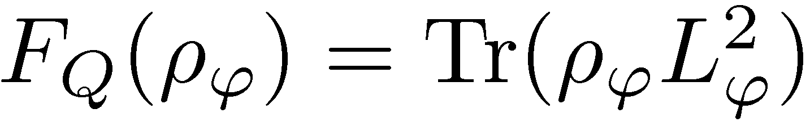
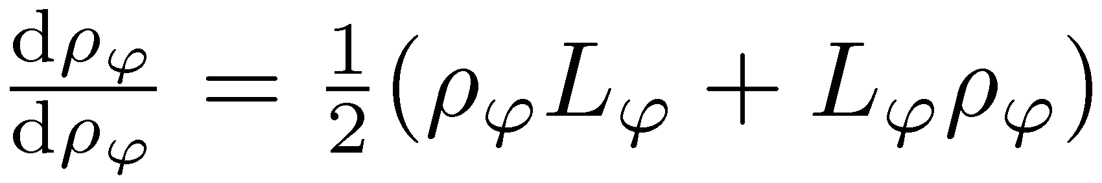
Quantum enhncement in an imperfect
Mach-Zehnder interferometer
imperfect visibility
loss
for classical light:
shot noise
What is the maximal quantum enhanced precision we can get using non-classical states of light with fixed total energy at the input?
Quantum Cramer-Rao bound
Quantum Fisher Information
Symmetric logarithmic derrivative
Maximize F_{Q} over input states

Slide 3
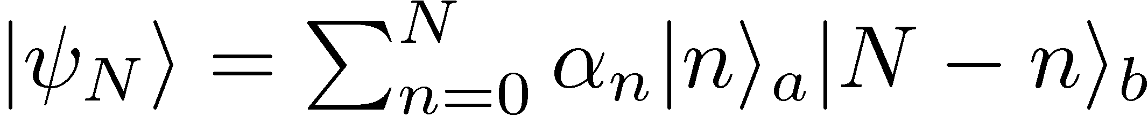
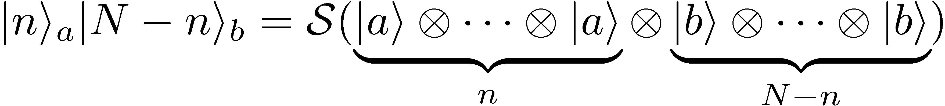
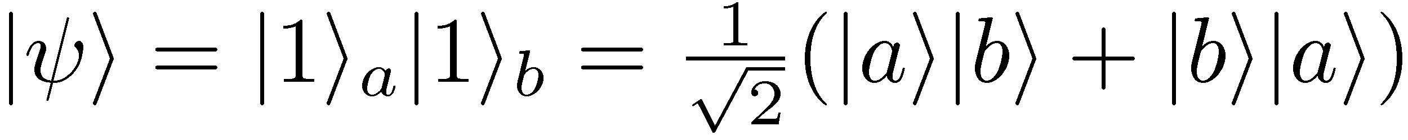
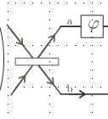
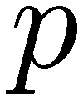
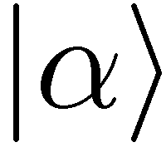
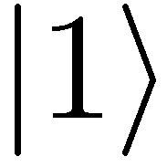

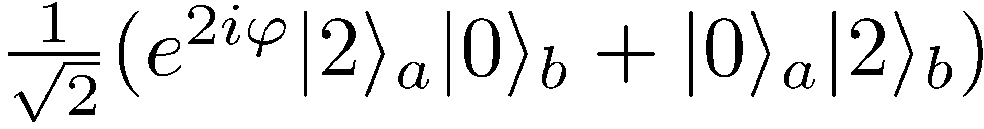
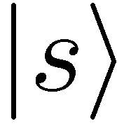
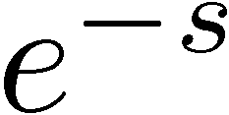
Mode vs particle description of light
A general N photon two mode state:
a
b
Written in the language of N formally distinguishable particles:
symetrization
Mode vs particle entanglement
enhanced sensitivity
when projected on a fixed photon number sector yields a particle entangled states
Hong-Ou-Mandel interference
It is the particle entanglement that is the fundamental source for quantum precision enhancement

Slide 4
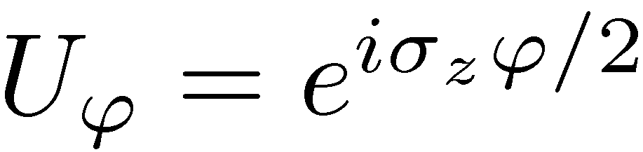
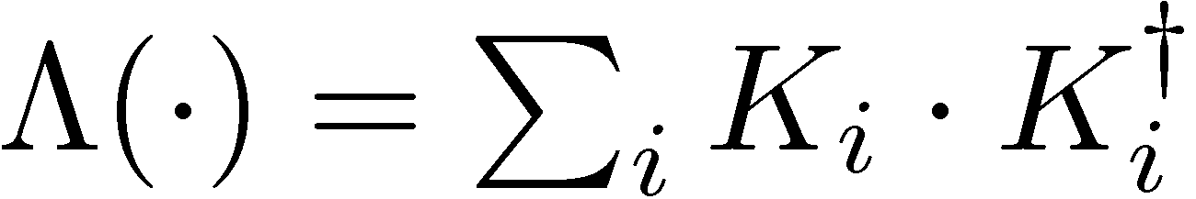
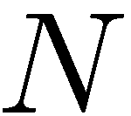
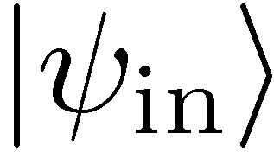
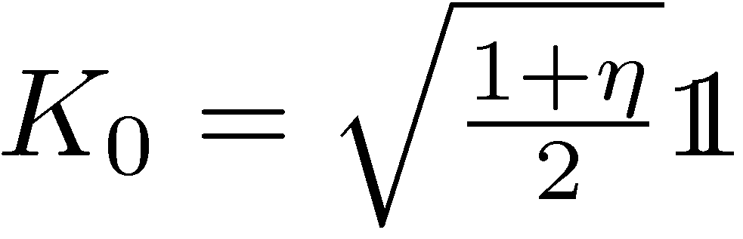
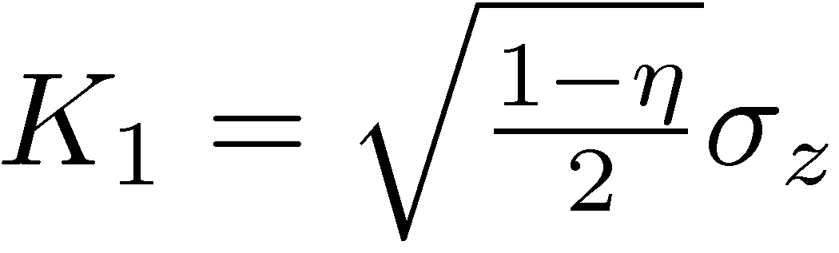
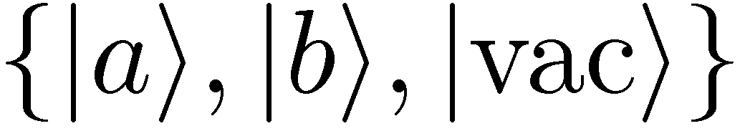
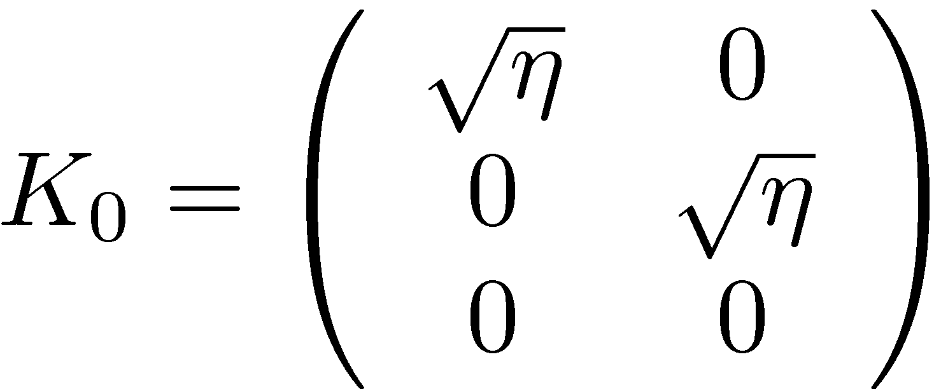
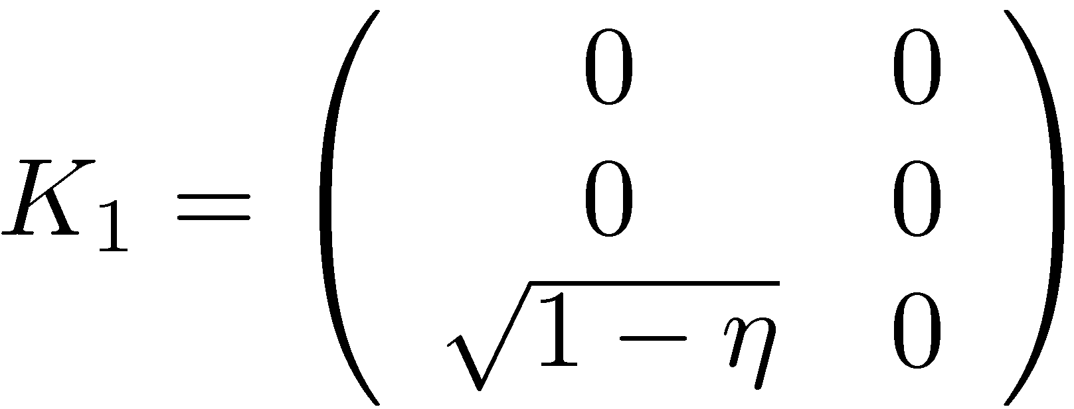
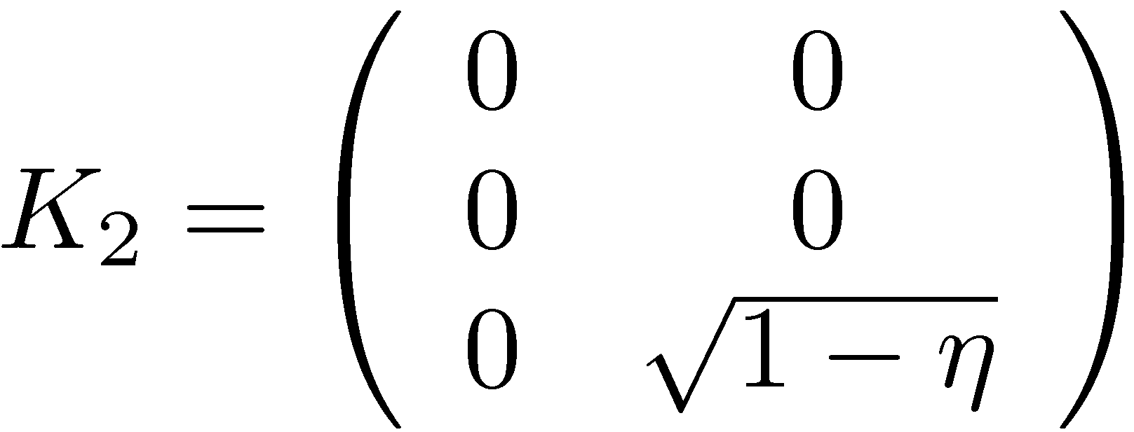
Quantum enhanced interferometry using the particle description
phase encoding
decoherence
imperfect viisbility – loss of coherence between the modes (local qubit dephasing)
loss – we use three dimensional output space
uncorrelated noise models
commute with the phase encoding
Find the bounds on the quantum Fisher information as a function of N
photon survives
lost in mode a
lost in mode b

Slide 5
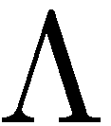
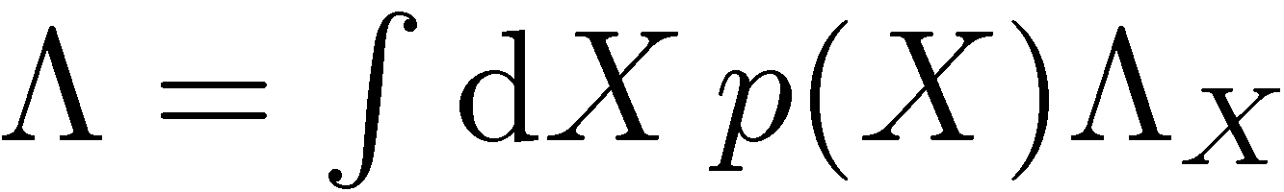
Classical simulation of a quantum channel
Convex set of quantum channels
Notes:
For qubit dephasing exact result, for interfereomter unfortunately not possible. Other methods also quite simple but not that geometric

Slide 6
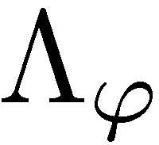
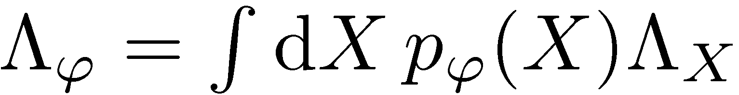
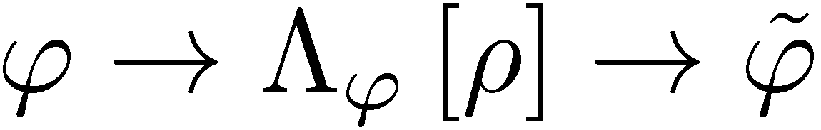
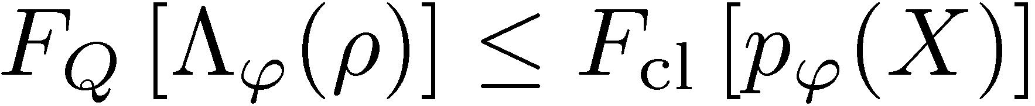
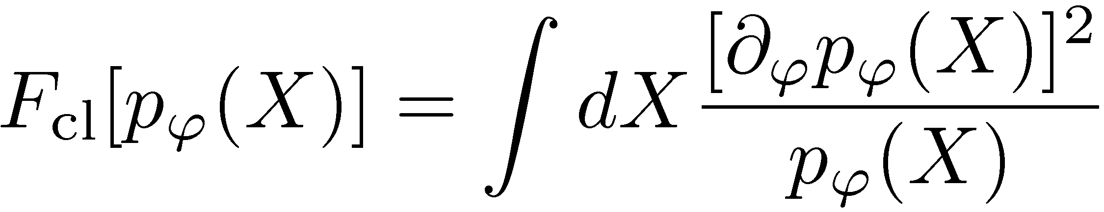
Classical simulation of a quantum channel
Convex set of quantum channels
Parameter dependence moved to mixing probabilities
Before:
After:
By Markov property….
K. Matsumoto, arXiv:1006.0300 (2010)
Notes:
For qubit dephasing exact result, for interfereomter unfortunately not possible. Other methods also quite simple but not that geometric

Slide 7
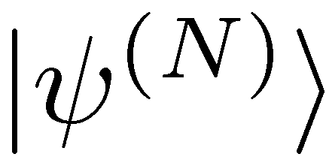
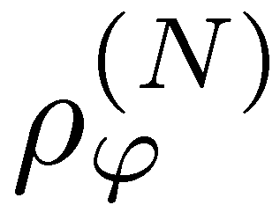
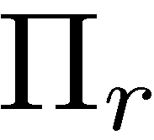
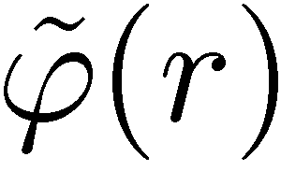
Classical simulation of N channels used in parallel
Notes:
For qubit dephasing exact result, for interfereomter unfortunately not possible. Other methods also quite simple but not that geometric

Slide 8
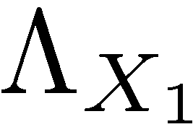
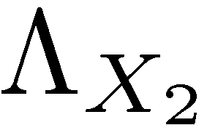
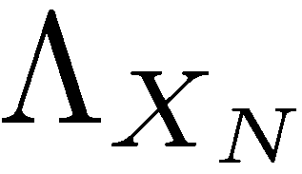
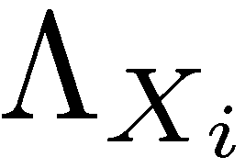
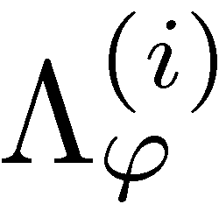
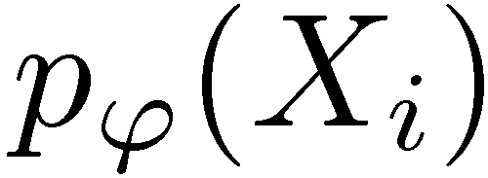
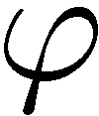
Classical simulation of N channels used in parallel
=
Notes:
For qubit dephasing exact result, for interfereomter unfortunately not possible. Other methods also quite simple but not that geometric

Slide 9
Classical simulation of N channels used in parallel
=
Notes:
For qubit dephasing exact result, for interfereomter unfortunately not possible. Other methods also quite simple but not that geometric

Slide 10
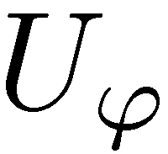
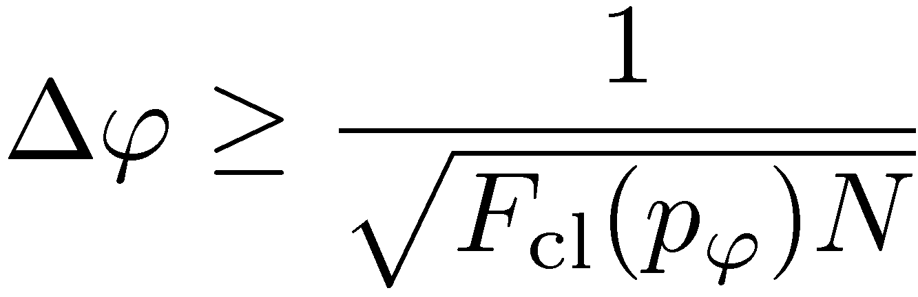
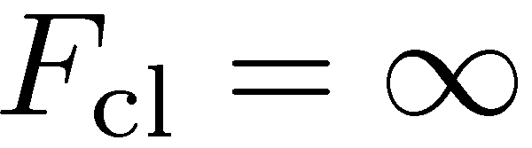
Precision bounds thanks to classical simulation
For unitary channels
Heisenberg scaling possible
Generic decoherence model will manifest shot noise scaling
To get the tighest bound we need to find the classical simulation with lowest F_{cl}

Slide 11
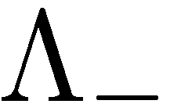







Precision bounds thanks to classical simulation
For unitary channels
Heisenberg scaling possible
Generic decoherence model will manifest shot noise scaling
To get the tighest bound we need to find the classical simulation with lowest F_{cl}
RDD, J. Kolodynski, M. Guta, Nature Communications 3, 1063 (2012)

Slide 12









Example: dephasing
dephasing
For „classical strategies”
Maximal quantum enhancment
RDD, J. Kolodynski, M. Guta, Nature Communications 3, 1063 (2012)

Slide 13





Example: loss
Lossy interferometer
photon transmitted
photon lost from
the upper arm
Bound useless
photon lost from
the lower arm
Need to generalize the idea of classical simmulation

Slide 14




Quantum simulation
Classical simulation
=
=

Slide 15

Quantum simulation
Quantum simulation
=
arbitrary state
arbitrary map

Slide 16



Quantum simulation
Fisher information cannot increase under parameter independent CP map
We should look for the ,,worst’’ quantum simulation to get the tightest bounds

Slide 17







Search for the,,worst’’ Quantum simulation
A semi-definite programm
dephasing
Lossy interferometer
the same as from classical simulation
lossy interferometer -> dephasing
Heisenberg 1/N scaling lost!
RDD, J. Kolodynski, M. Guta, Nature Communications 3, 1063 (2012)
J. Kolodynski, RDD, New J. Phys. 15, 073043 (2013)

Slide 18
Search for the,,worst’’ Quantum simulation
A semi-definite programm
dephasing
Lossy interferometer
dephasing = losses + sending back decohered photons
RDD, J. Kolodynski, M. Guta, Nature Communications 3, 1063 (2012)
J. Kolodynski, RDD, New J. Phys. 15, 073043 (2013)

Slide 19











Explicit example of a quantum simulation
lossy interferometr:
a
we will prove this bound for
b
photon lost with probability 1/2
quantum simulation:

Slide 20




Saturating the fundamental bounds is simple!
Fundamental bound
For strong beams:
Simple estimator based
on n₁- n₂ measurement
C. Caves, Phys. Rev D 23, 1693 (1981)
Weak squezing + simple measurement + simple estimator = optimal strategy!
The same is true for dephasing (also atomic dephasing – spin squeezed states are optimal)
S. Huelga, et al. Phys. Rev. Lett 79, 3865 (1997), B. M. Escher, R. L. de Matos Filho, L. Davidovich Nature Phys. 7, 406–411 (2011), D. Ulam-Orgikh and M. Kitagawa, Phys. Rev. A 64, 052106 (2001).

Slide 21






GEO600 interferometer at the fundamental quantum bound
coherent light
+10dB squeezed
fundamental bound
The most general quantum strategies could improve the precision by at most 8%
RDD, K. Banaszek, R. Schnabel, Phys. Rev. A, 041802(R) (2013)

Slide 22

Definite vs. indefinite photon number
bound derrived for N photon states
Typically we use states with indefinite photon number (coherent, squeezed)

Slide 23





Definite vs. indefinite photon number
bound derrived for N photon states
Typically we use states with indefinite photon number (coherent, squeezed)
If no other phase reference beam is used:
no coherence between different total photon number sectors
Thanks to convexity of Fisher information

Slide 24


Take home…
Precision bounds in quantum metrology with uncorrelated noise
can be derrived using classical/quantum simulations ideas
RDD, J. Kolodynski, M. Guta, , Nature Communications 3, 1063 (2012)
Bounds are also valid for indefinite photon number states, and can be applied to real setups (GEO600):
RDD, K. Banaszek, R. Schnabel, Phys. Rev. A, 041802(R) (2013)
Error correction: adding ancillas and peforming adaptive measurements does not affect the bounds.
papers with error correction in metrology, use transversal noise: arxiv:1310.3750, arXiv:1310.3260
Bounds are not guaranteed to be tight, but are in case of loss and dephasing
see e.g. S. Knysh, E. Chen, G. Durkin, arXiv:1402.0495
Review paper is comming:
RDD, M. Jarzyna, J. Kolodynski, Quantum limits in optical interferometry, Progress in Optics, ???
Frequency estimation, Bayesian approach
K. Macieszczak, RDD, M. Fraas, arXiv:1311.5576

