Slide 1
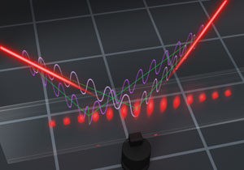
Role of entanglement in extracting information on quantum processes
R. Demkowicz-Dobrzański, Faculty of Physics, University of Warsaw, Poland

Slide 2
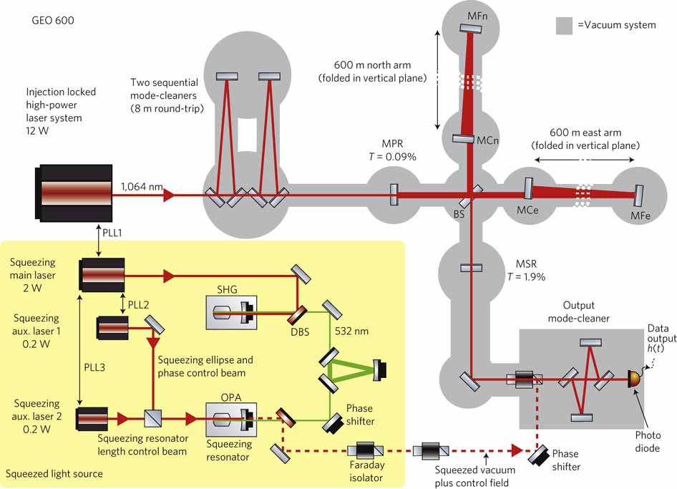
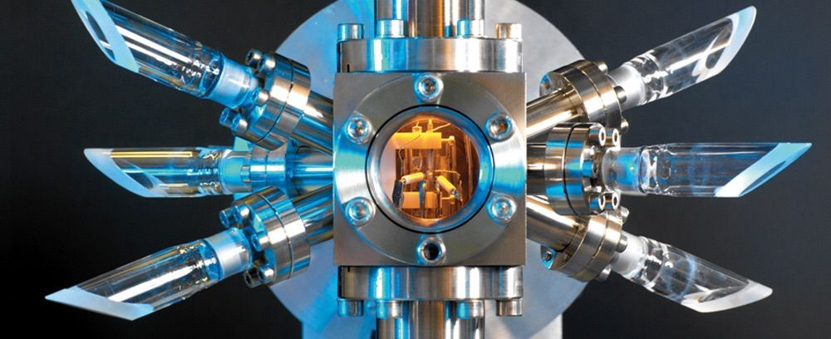
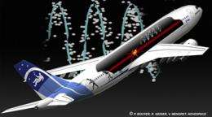
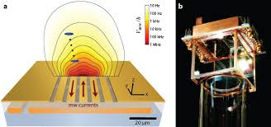
Quantum Metrology
Gravitational wave detectors utilizing squeezed light
Atomic clocks
Acelerometers, gravitometers based on atomic interferometry
Magnetometry utilizing BEC
spin squeezed states

Slide 3
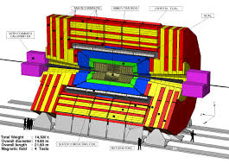

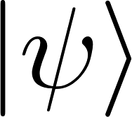
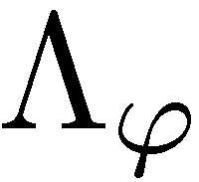
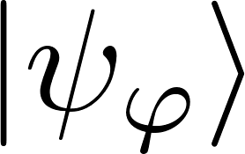
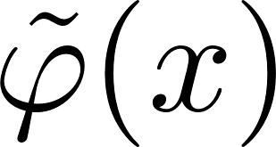

Particle physics experiment as a quantum channel estimation problem
What are the optimal input states?
What are the optimal measurements?
Does entanglement of the input particles help?

Slide 4

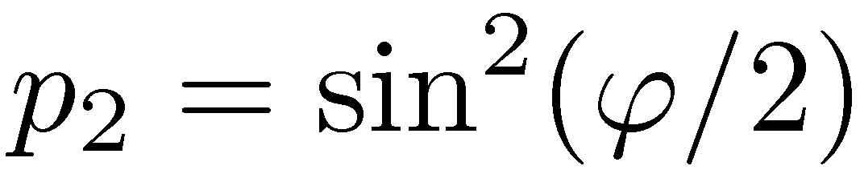

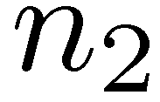
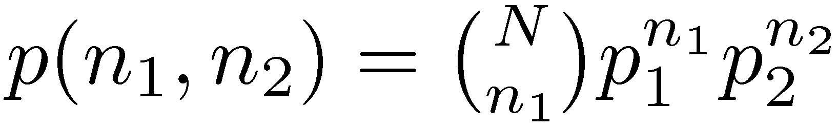
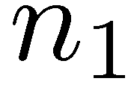
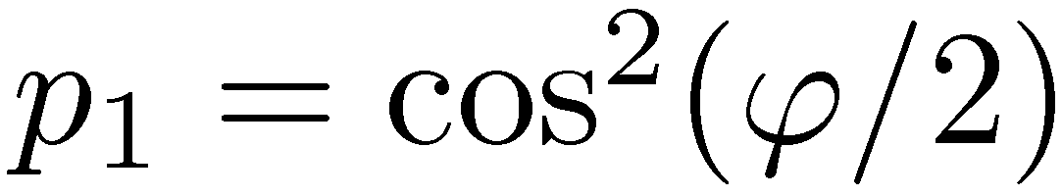
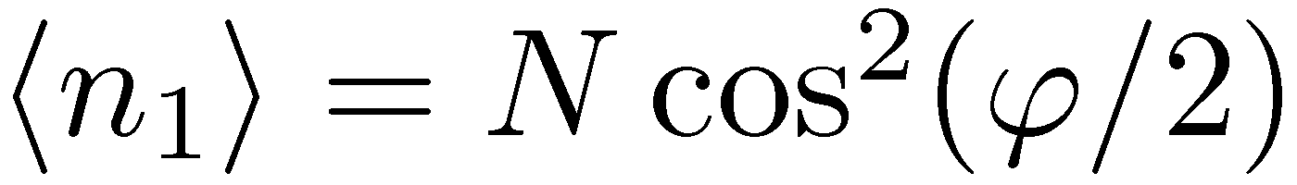
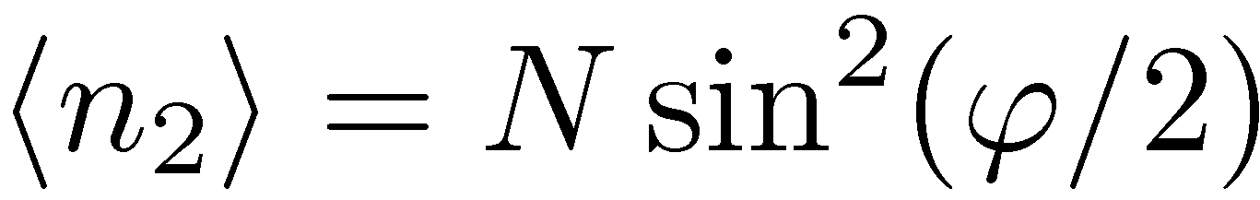
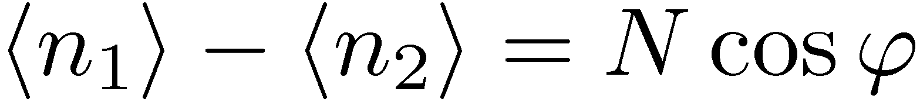
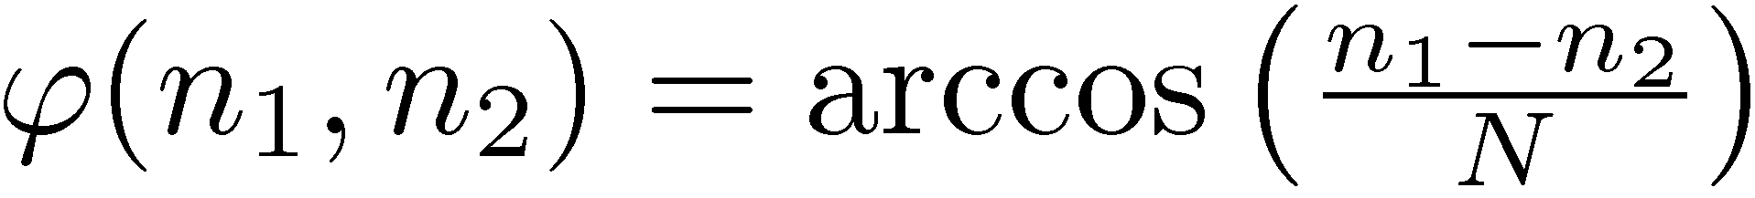
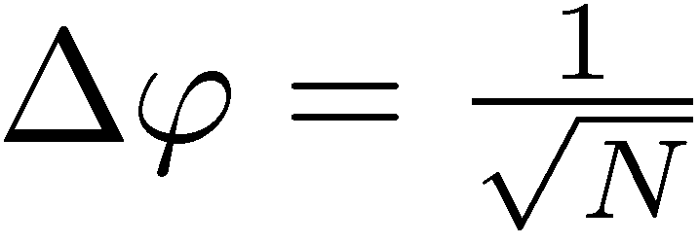
„Classical” interferometry
example of an estimator:
Estimator uncertainty:
Standard Limit (Shot noise)

Slide 5


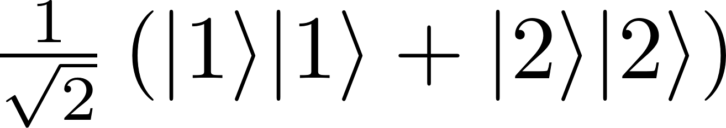
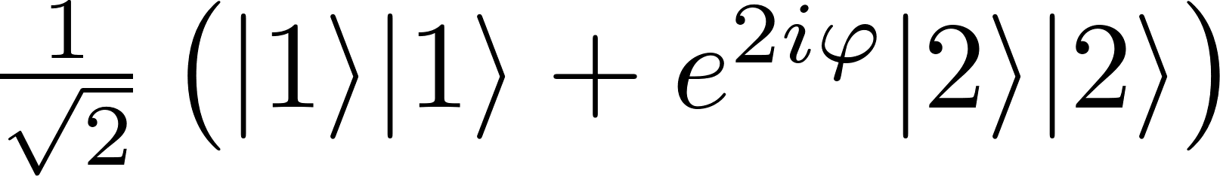

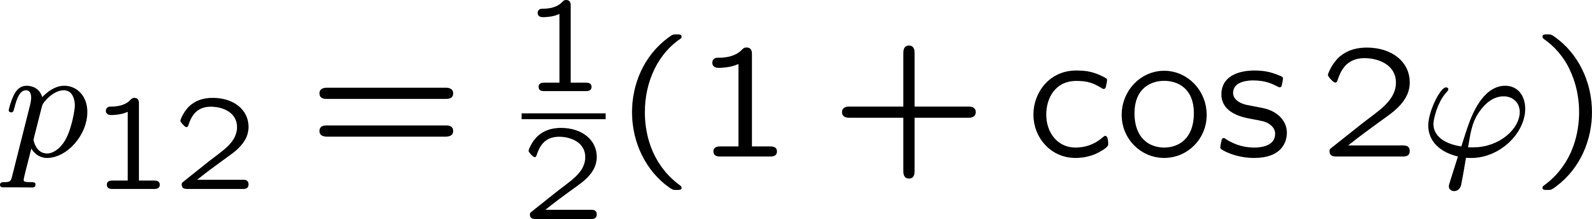
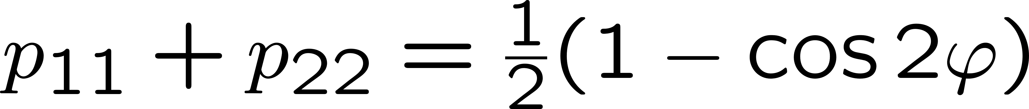
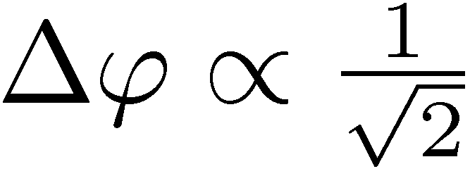
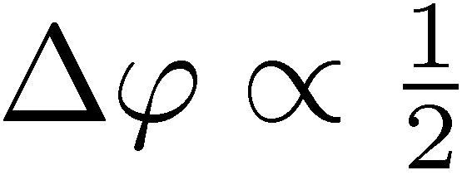
Entanglement enhanced precision
Hong-Ou-Mandel interference
&

Slide 6
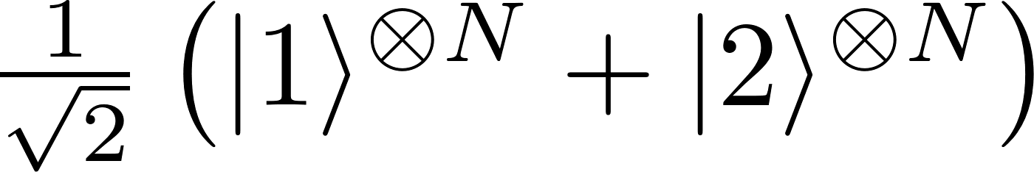
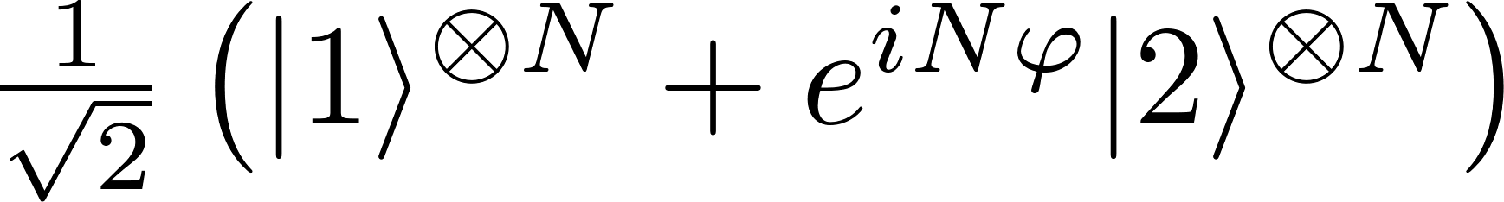

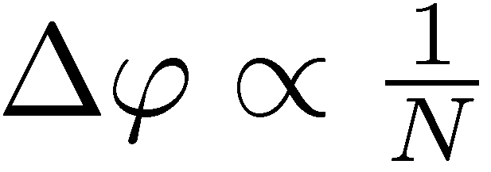
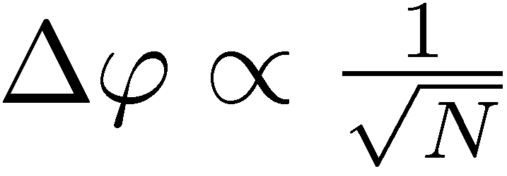
Entanglement enhanced precision
GHZ states
State
preparation
Estimator
Measuremnt
Heisenberg limit
Standard Quantum Limit

Slide 7
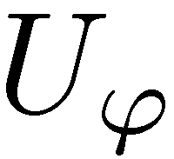
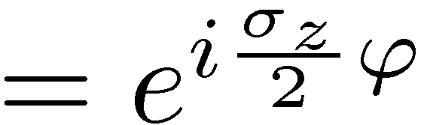
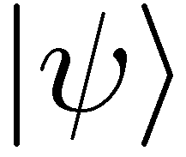
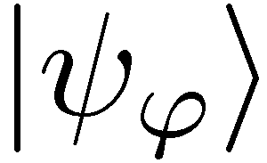
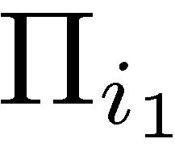

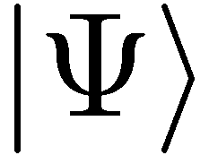
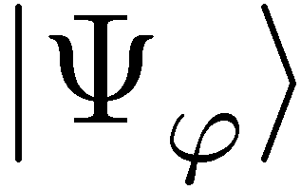
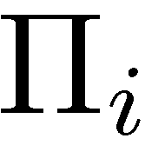
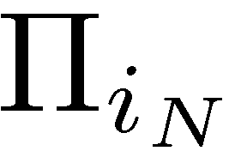
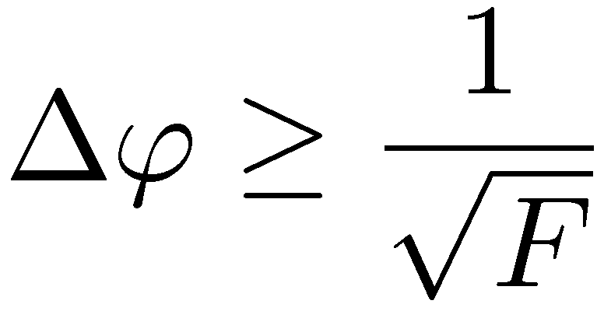
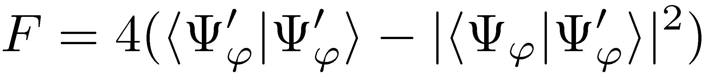
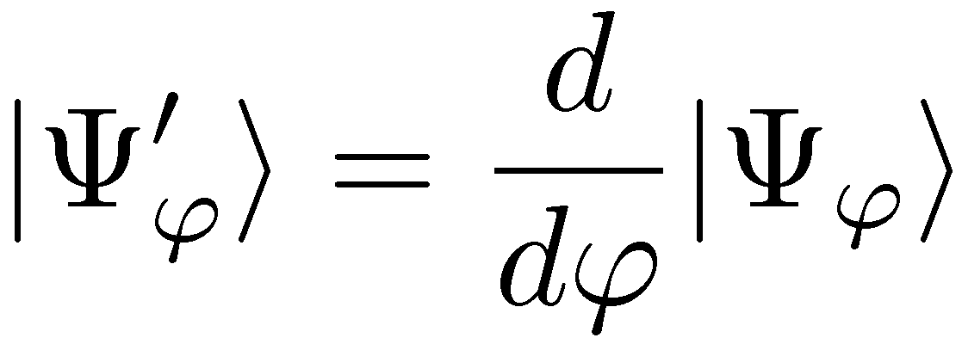
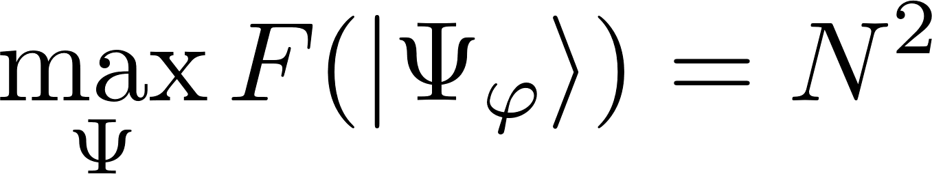
Quantum interferometry as a quantum channel estimation problem
=
,,Classical’’ scheme
Entanglement-enhanced scheme
Quantum Cramer-Rao bound:
GHZ states maximize the quantum Fisher information

Slide 8
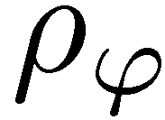
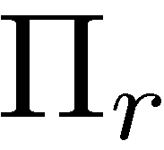
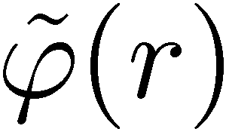
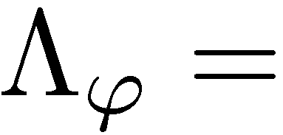

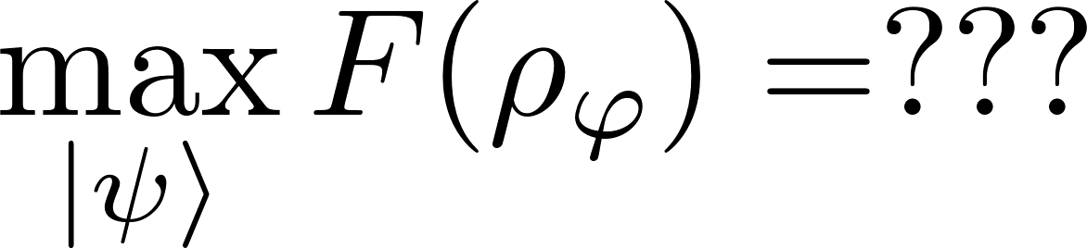
Optimal interferometry in presence of losses?
Problem: Analizing and optimizing Quantum Fisher Information for mixed states dificult in the limit of large numer of photons

Slide 9

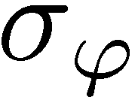
Channel simulation idea
If we find a simulation of the channel…
=

Slide 10
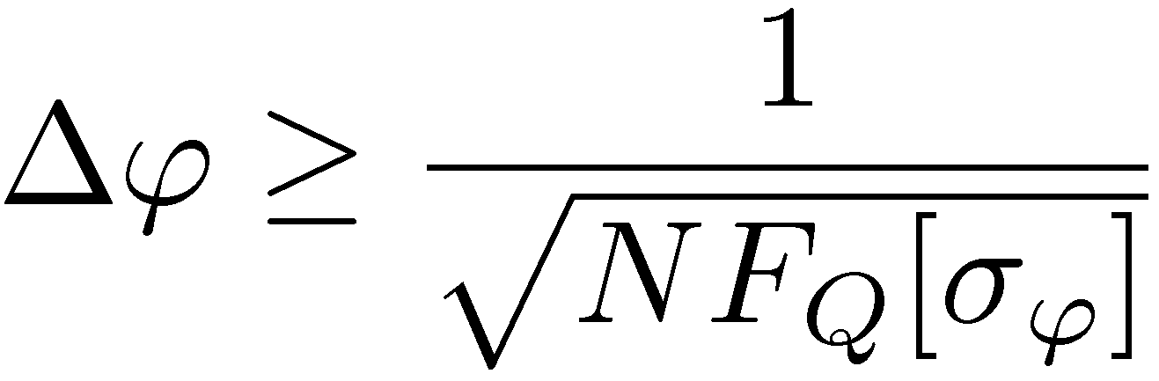

Channel simulation idea
Quantum Fisher information is nonincreasing under parameter independent channels!
We call the simulation classical:

Slide 11












Geometric construction of (local) channel simulation

Slide 12


Geometric construction of (local) channel simulation
Heisenberg scaling is generically lost! Entanglement provides constant factor precision enhancement
RDD, J. Kolodynski, M. Guta, Nature Communications 3, 1063 (2012)
RDD, L. Maccone Phys. Rev. Lett. 113, 250801 (2014)

Slide 13




Good news: fundamental limit can be saturated in practice!!!
Fundamental bound
coherent state +
squeezed vacuum
In the strong intensity regime:
C. Caves, Phys. Rev D 23, 1693 (1981)
Weak squezing + simple measurement + simple estimator = optimal strategy!

Slide 14




GEO600 interferometer at the fundamental quantum bound
coherent light
+10dB squeezed
fundamental bound
The most general quantum strategies could additionally improve the precision by at most 8%
RDD, K. Banaszek, R. Schnabel, Phys. Rev. A, 041802(R) (2013)

Slide 15



Squeezed states in LIGO?
Squeezed light to be used in LIGO in 2018
Transmission expected to be on the level of
Expected reduction in noise on the level of 3dB (50%) above 100Hz
Observable distance increased by a factor of 2, number of sources by a factor of 8, thanks to entanglement of photons!!!

Slide 16





Gravitational wave detectors sensitivity limits
Atomic-clocks stability limits
RDD, K. Banaszek, R. Schnabel Phys. Rev. A 88, 041802(R) (2013)
RDD, J. Kolodynski, M. Jarzyna, Progress in Optics 60, 345 (2015)
K. Macieszczak, M. Fraas, RDD, New J. Phys. 16, 113002 (2014)
K. Chabuda, I. Leroux, RDD, New J. Phys. 18, 083035 (2016)
Quantum metrological precision bounds
RDD, J. Kolodynski, M. Guta, Nature Communications 3, 1063 (2012)
RDD, L. Maccone, Phys. Rev. Lett. 113, 250801 (2014)
Entanglement enhanced sensing in high energy Physics???
Quantum computing speed-up limits
RDD, M. Markiewicz, Phys. Rev. A 91, 062322 (2015)

