Slide 1
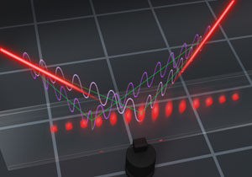
Adaptive Quantum Metrology under general Markovian noise (arxiv:1704.06280)
R. Demkowicz-Dobrzański¹, J. Czajkowski¹, P. Sekatski² J. Kołodyński¹, K. Banaszek¹, M. Guta³, R. Schnabel^{4,}, L. Maccone ⁵
¹Faculty of Physics, University of Warsaw, Poland
²Institut fur Theoretische Physik, Universitat Innsbruck, Austria
³School of Mathematical Sciences, University of Nottingham, United Kingdom
⁴Max-Planck-Institut fur Gravitationsphysik, Hannover, Germany
⁵ Universit`a di Pavia, Italy.

Slide 2
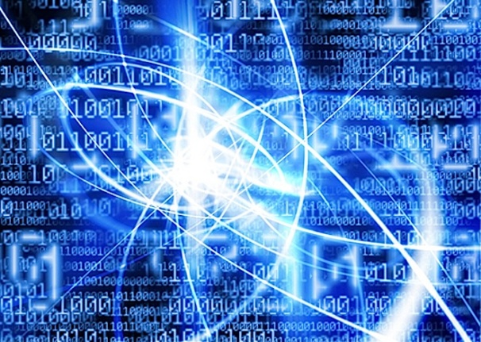
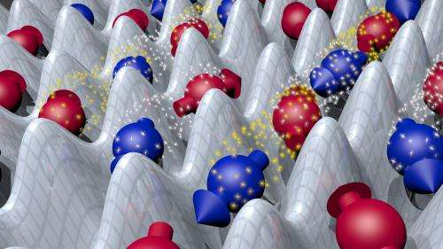
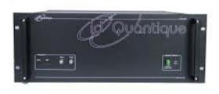
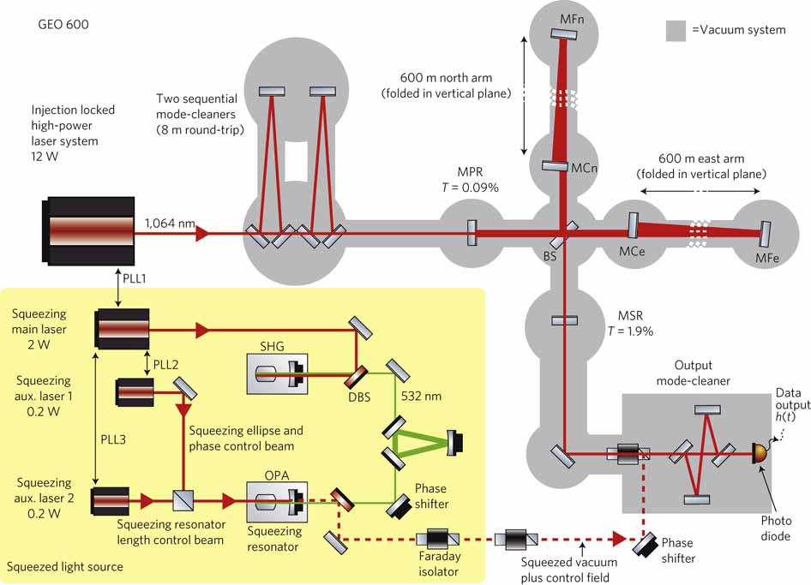
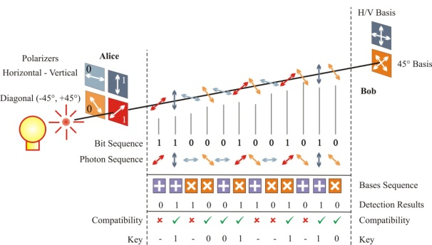
Making the most of the quantum world
Quantum computing
Quantum simmulators
Quantum communication
Quantum metrology

Slide 3
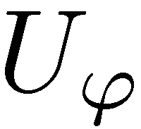
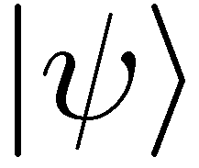
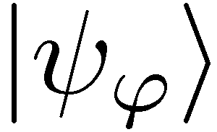
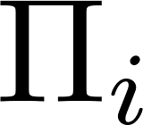
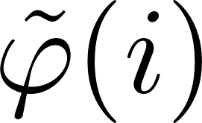
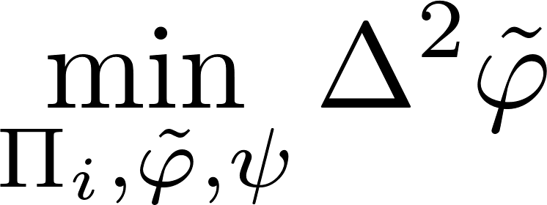
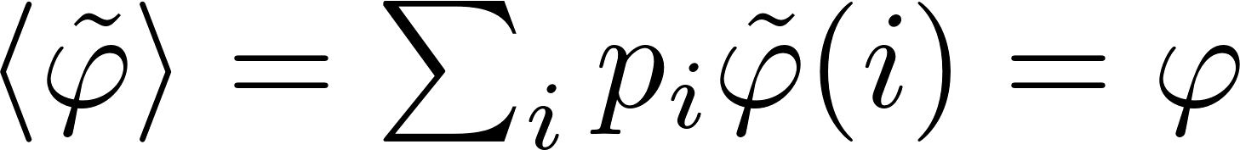
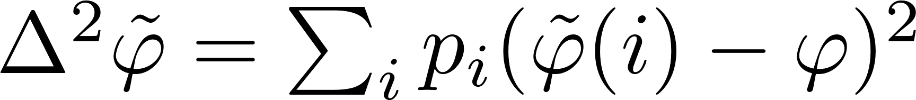
Quantum metrology as a quantum channel estimation problem
unbiasedness condition
estimator variance

Slide 4
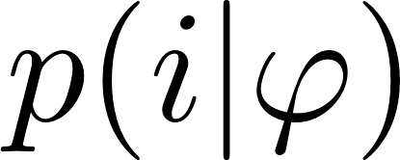
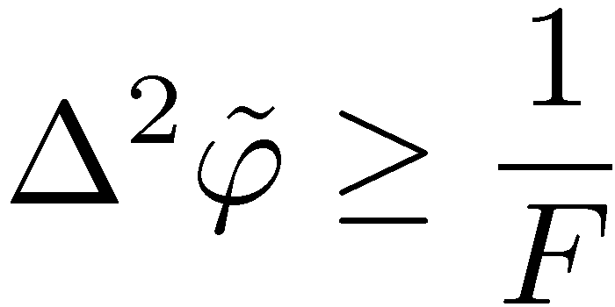
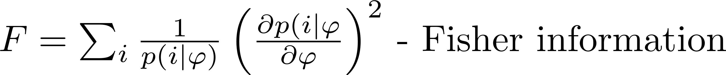
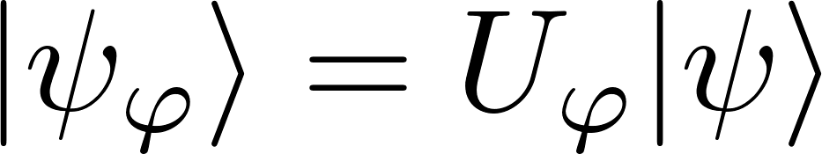
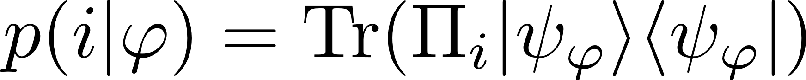
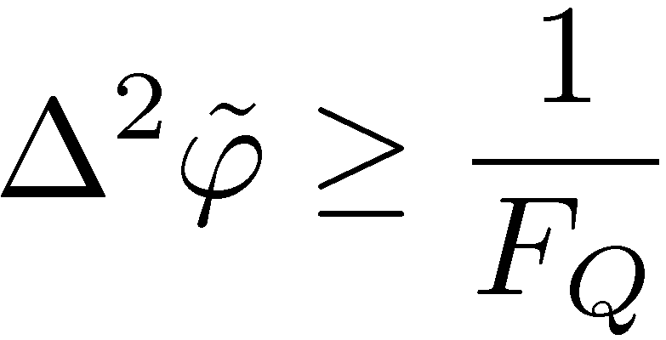
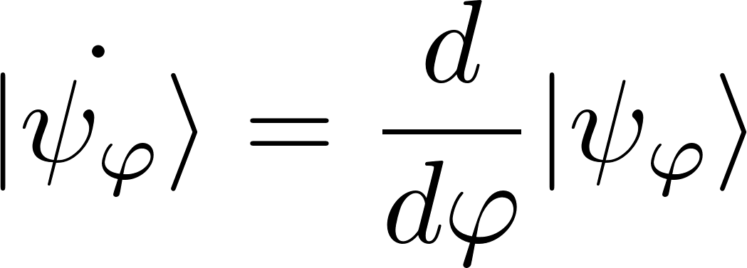
Quantum Cramer-Rao bound
Classical Cramer-Rao inequality
Quantum Cramer-Rao inequality
Quantum Fisher information
No need to optimize over measurements nor estimators!

Slide 5

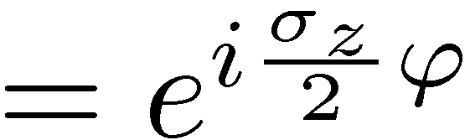
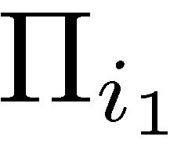


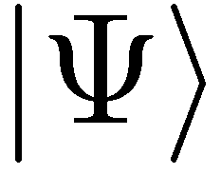
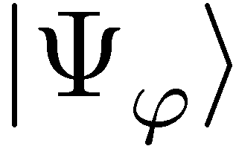
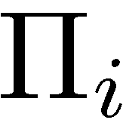
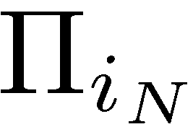
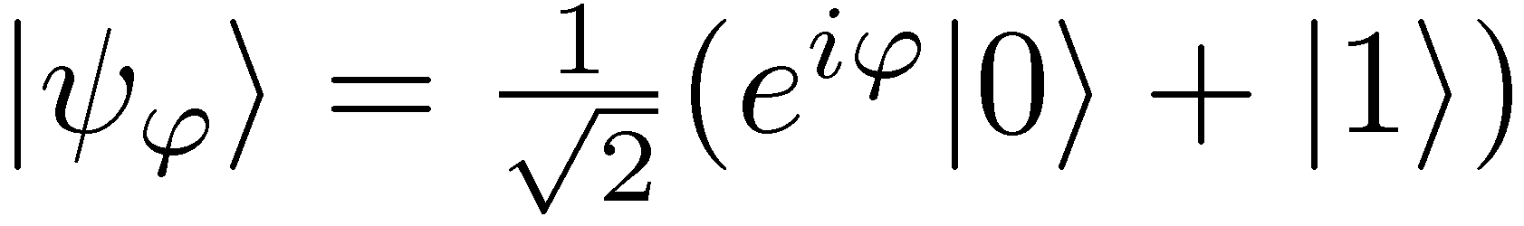
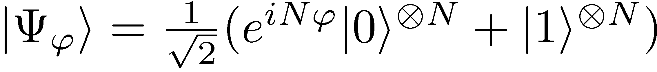
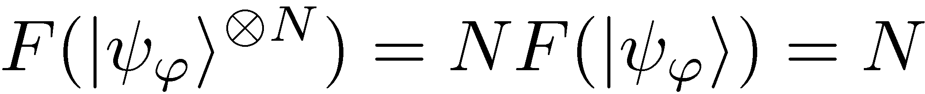
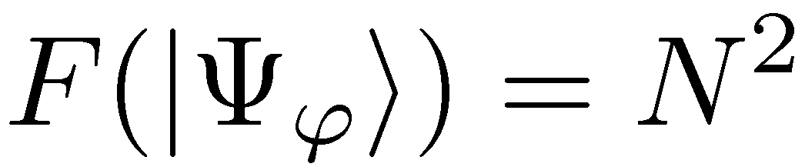
N photon interferometry
=
,,Classical’’ scheme
Entanglement-enhanced scheme
Maximize Quantum Fisher Information over input states

Slide 6
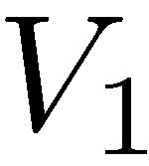

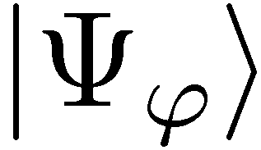
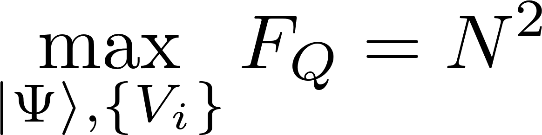
The most general adaptive scheme
No improvement thanks to adaptiveness!
V. Giovannetti, S. Lloyd, and L. Maccone, Phys. Rev. Lett. 96, 010401 (2006).

Slide 7
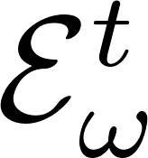
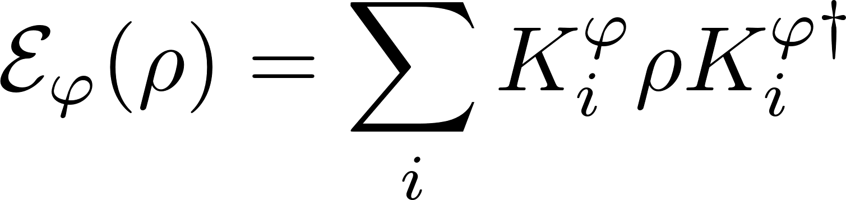

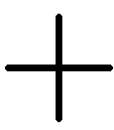
Impact of decoherence…
loss
dephasing

Slide 8
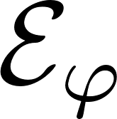
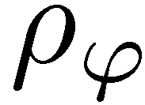
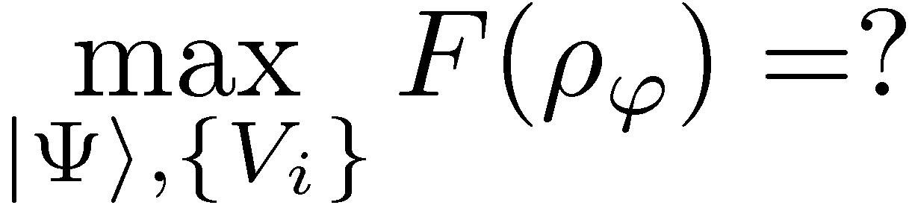
Impact of decoherence…

Slide 9
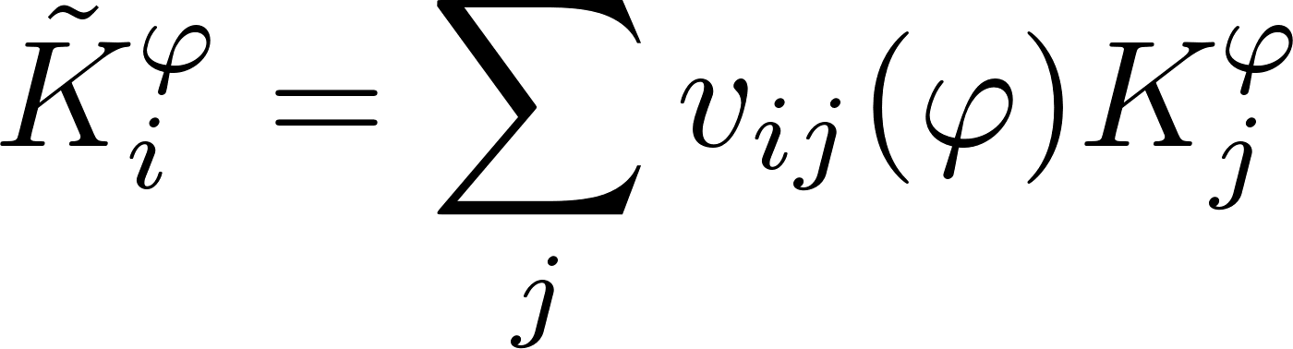
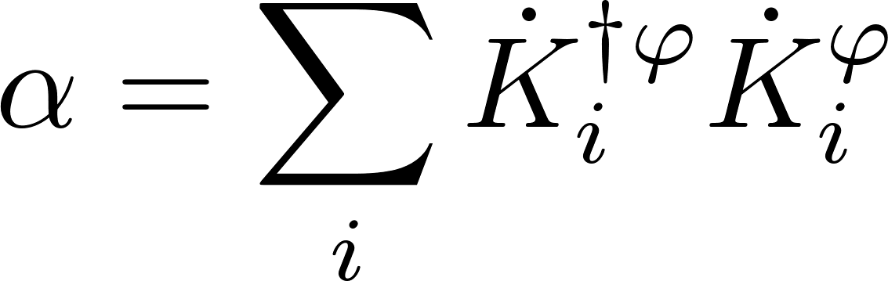
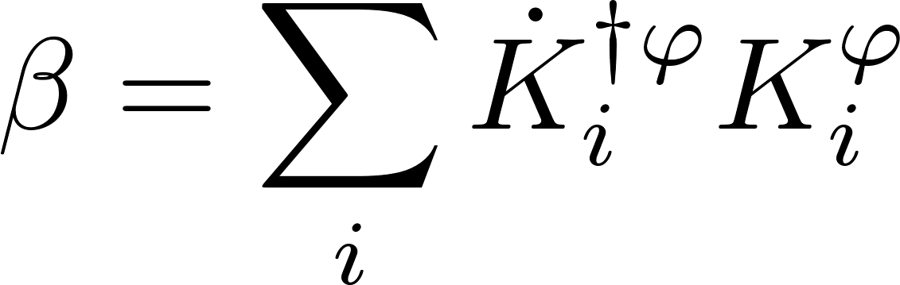
Precision bounds via minimization over equivalent Kraus representations
single channel optimization!
A. Fujiwara, H. Imai, J. Phys. A 41, 255304 (2008)
B. M. Escher, R. L. de Matos Filho, L. Davidovich Nature Phys. 7, 406–411 (2011)
RDD, J. Kolodynski, M. Guta, Nat. Commun. 3, 1063 (2012)
RDD, L. Maccone Phys. Rev. Lett. 113, 250801 (2014) [Adaptive schemes included]

Slide 10
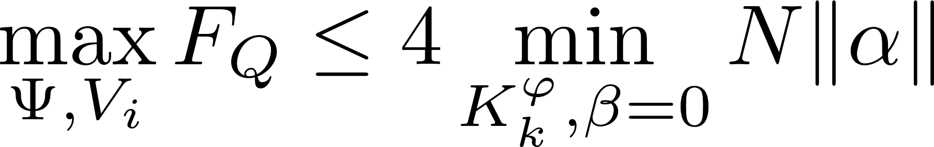
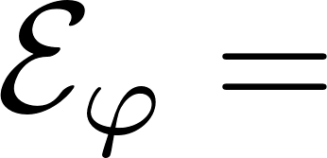
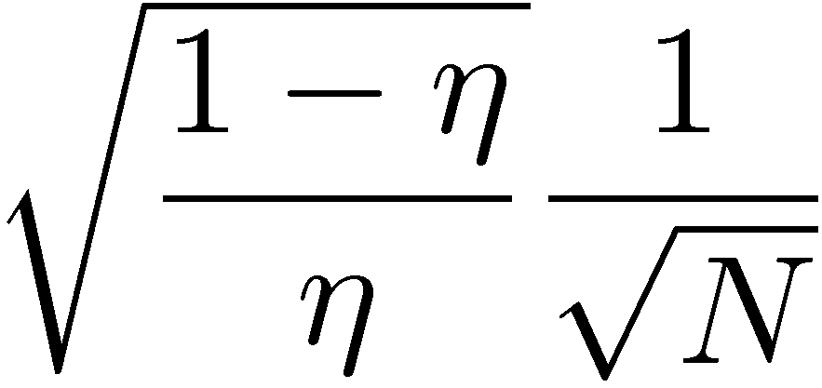
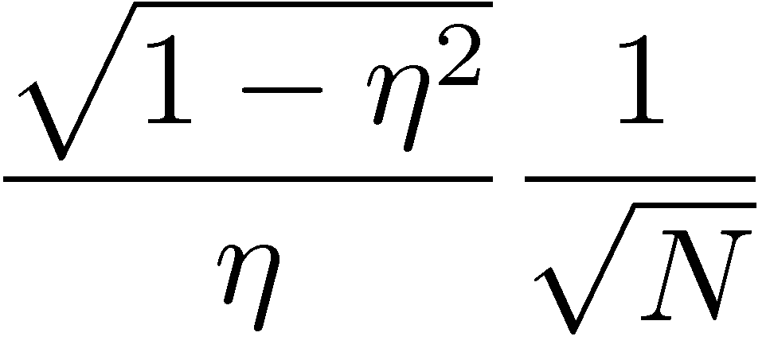
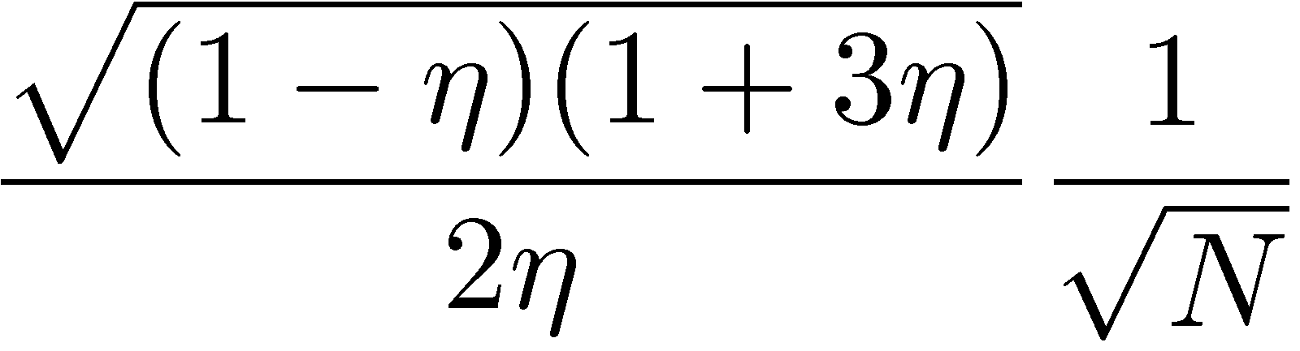
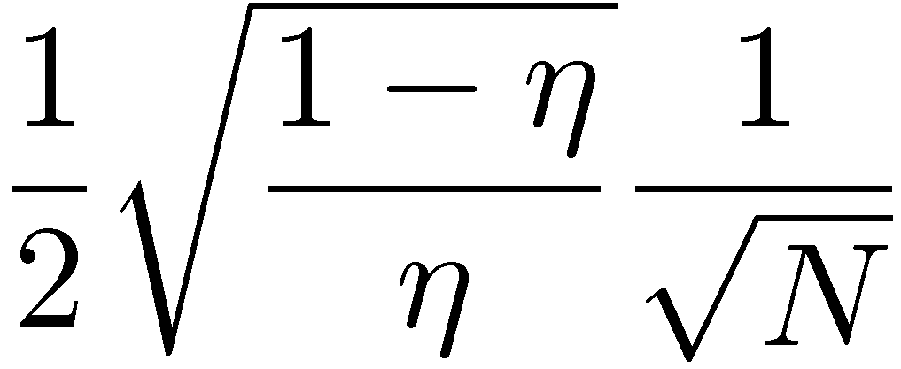
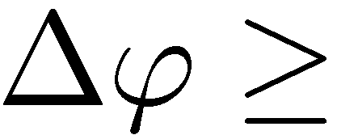
Generic loss of Heisenberg scaling
β can be made zero for all full-rank channels bound can be effectively determined via semi-definite programming
Lossy interferometer | Dephasing | Depolarization | Spontaneous emission

Slide 11




GEO600 interferometer at the fundamental quantum bound
coherent light
+10dB squeezed
fundamental bound
The most general quantum strategies could additionally improve the precision by at most 8%
RDD, K. Banaszek, R. Schnabel, Phys. Rev. A, 041802(R) (2013)

Slide 12






Frequency estimation
Maximize Quantum Fisher Information under fixed total interrogation time T
?
Previous methods required knowledge of Kraus operators (integrating dynamics)

Slide 13

Frequency estimation bounds directly from quantum Master equation
Without loss of generality we may always consider limit t->0…..
Expand β and α in t…

Slide 14


Frequency estimation bounds directly from quantum Master equation
Quantitative bound:
Can be solved by semi-definite programming:
RDD, J. Czajkowski, P. Sekatski, arXiv:1704.06280

Slide 15





Examples
a) Dephasing:
a) Perpendicular dephasing:
It is possible to find an adaptive protocol that yields
E. Kessler et.al Phys. Rev. Lett. 112, 150802 (2014)
W. Dür, et al., Phys. Rev. Lett. 112, 080801 (2014)
P. Sekatski, M. Skotiniotis, J. Kolodynski, W. Dur, arXiv:1603.08944

Slide 16


Quantum error-correction protocol for perpendicular dephasing

Slide 17

Take home message
RDD, J. Czajkowski, P. Sekatski, arXiv:1704.06280 (Accepted in PRX)

Slide 18

Take home message
RDD, J. Czajkowski, P. Sekatski, arXiv:1704.06280 (Accepted in PRX)
S. Zhou, M. Zhang, J. Preskill, and L. Jiang, arxiv:1706.02445

Slide 19





Application to quantum merology with many-body interractions
k-body Hamiltonian
l-body decoherence
RDD, J. Czajkowski, P. Sekatski, arXiv:1704.06280

