Slide 1
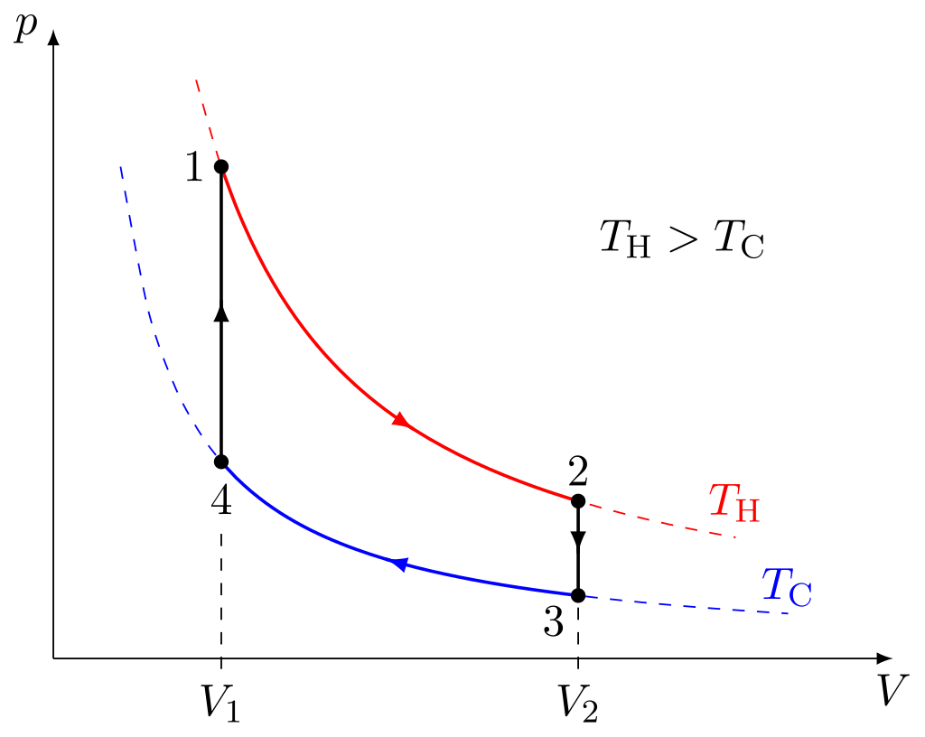
Silnik Stirlinga
1-2 izotermiczne rozprężanie (T grzejnika = TH)
2-3 izochoryczne chłodzenie
3-4 izotermiczne sprężanie (T chłodnicy = TC)
4-1 izochoryczne ogrzewanie
Wikipedia: Stirling engine

Slide 2
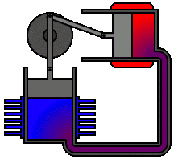
1. Płyn roboczy (np. powietrze) pozostaje zamknięty – nie ma wydechu
2. Silnik wytwarza mało hałasu
3. W niektórych modelach używany jest tzw. regenerator – czyli zbiornik ciepła
Alpha-type Stirling engine. There are two cylinders. The expansion cylinder (red) is maintained at a high temperature while the compression cylinder (blue) is cooled.
The passage between the two cylinders contains the regenerator
Wikipedia: Stirling engine

Slide 3

Beta-type Stirling engine, with only one cylinder, hot at one end and cold at the other. A loose-fitting displacer shunts the air between the hot and cold ends of the cylinder.
A power piston at the open end of the cylinder drives the flywheel
Wikipedia: Stirling engine

Slide 4
The idealised Stirling cycle consists of four thermodynamic processes acting on the working fluid:
Isothermal expansion. The expansion-space and associated heat exchanger are maintained at a constant high temperature, and the gas undergoes near-isothermal expansion absorbing heat from the hot source.
Constant-volume (known as isovolumetric or isochoric) heat-removal. The gas is passed through the regenerator, where it cools, transferring heat to the regenerator for use in the next cycle.
Isothermal compression. The compression space and associated heat exchanger are maintained at a constant low temperature so the gas undergoes near-isothermal compression rejecting heat to the cold sink
Constant-volume (known as isovolumetric or isochoric) heat-addition. The gas passes back through the regenerator where it recovers much of the heat transferred in process 2, heating up on its way to the expansion space.
The engine is designed so the working gas is generally compressed in the colder portion of the engine and expanded in the hotter portion resulting in a net conversion of heat into work.^{[2]} An internal regenerative heat exchanger increases the Stirling engine's thermal efficiency compared to simpler hot air engines lacking this feature.
Wikipedia: Stirling engine

