Slide 1
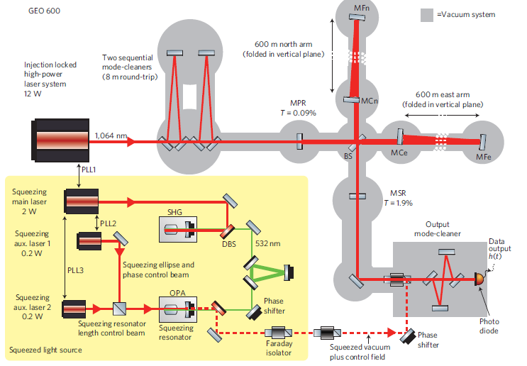
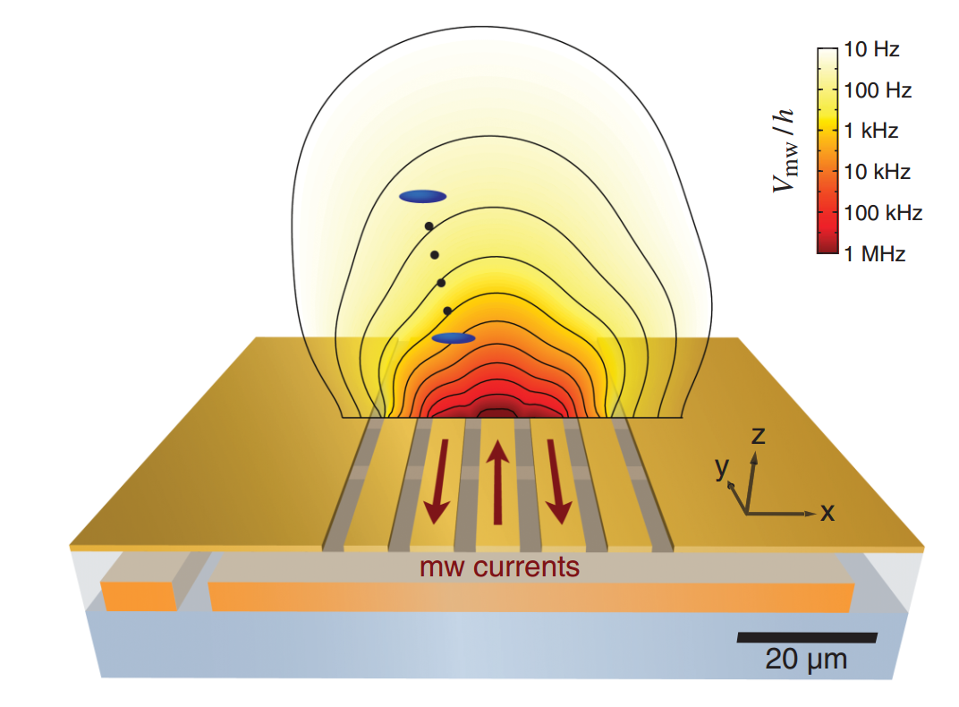
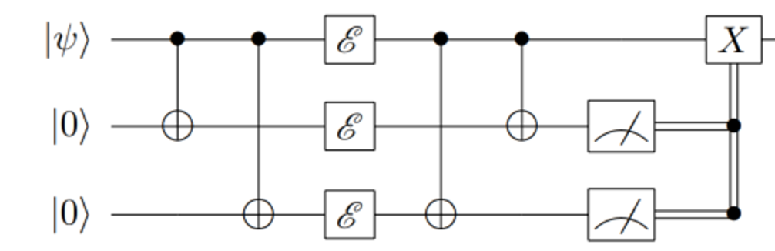
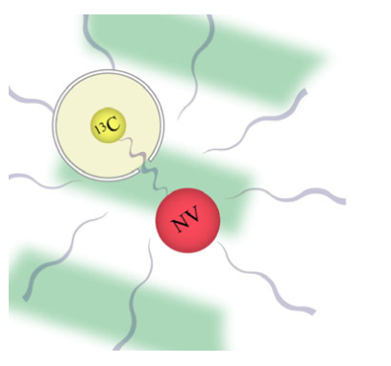
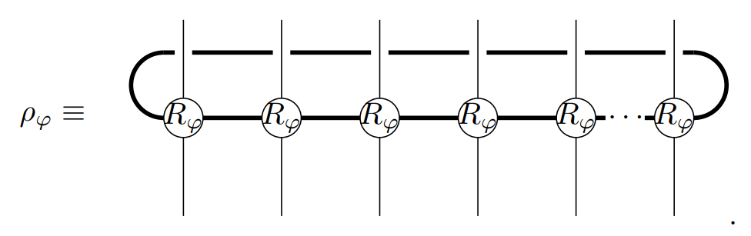
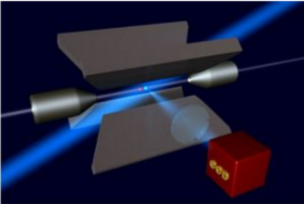
Quantum Metrology in the Era of Quantum Information
Quantum metrology
Methods of quantum information
?
Interferometers using
non-classical light
Cold atom magnetometers
Quantum error correction
Tensor networks
Atomic clocks
NV sensors
Rafal Demkowicz-Dobrzański
Faculty of Physics, University of Warsaw, Poland

Slide 2
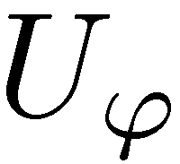
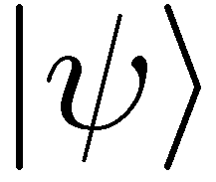
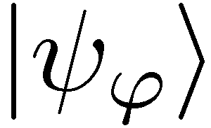
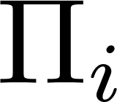
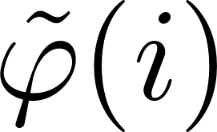
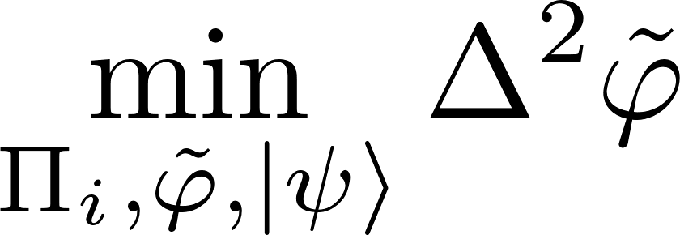
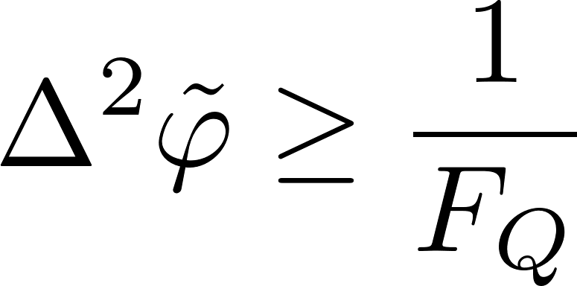
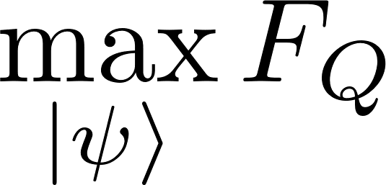
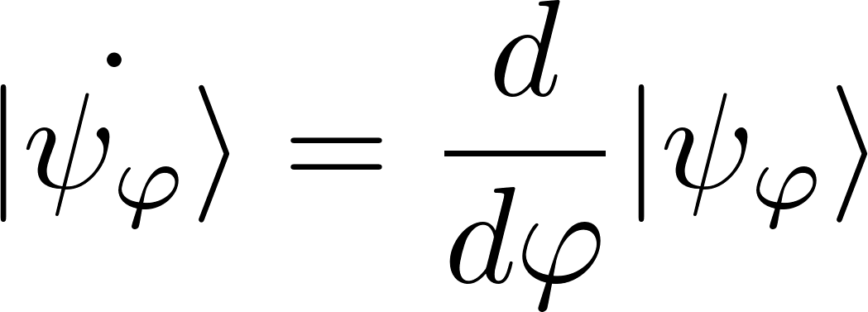
Quantum metrology as a quantum channel estimation problem
Quantum Cramer-Rao bound

Slide 3

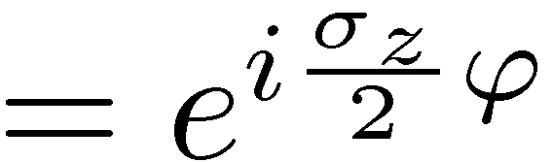

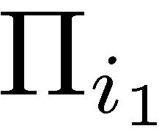

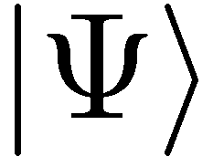
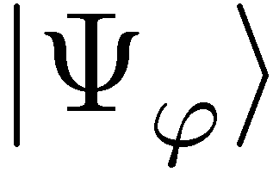
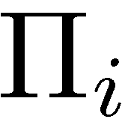
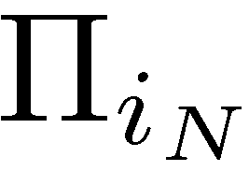
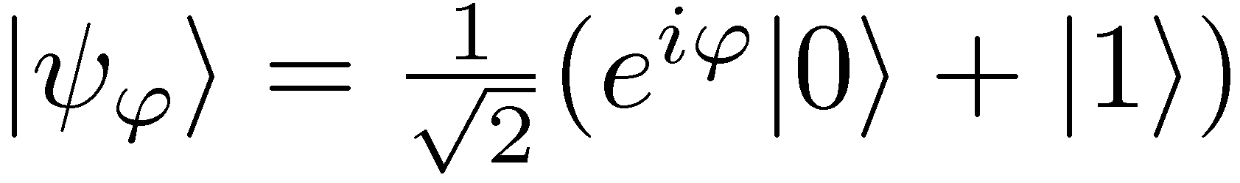
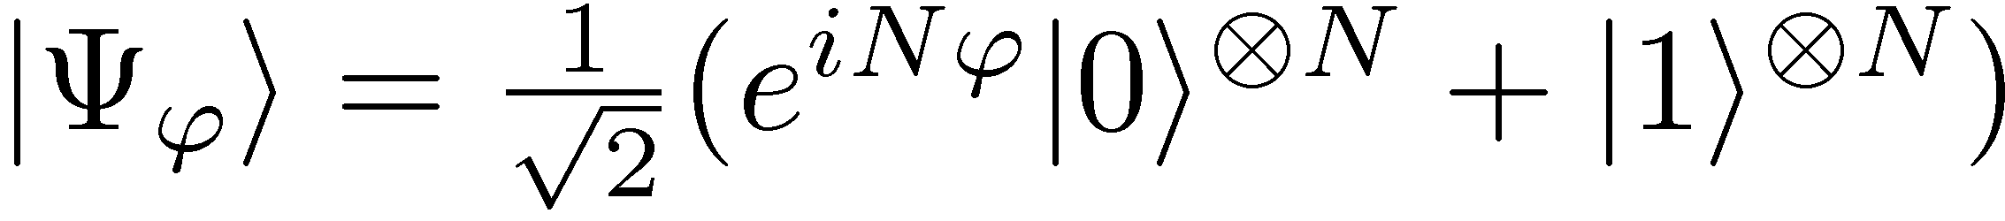
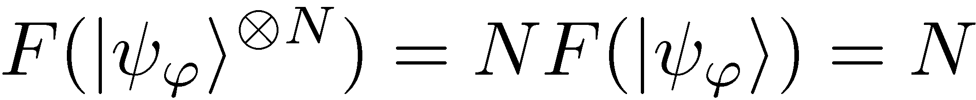
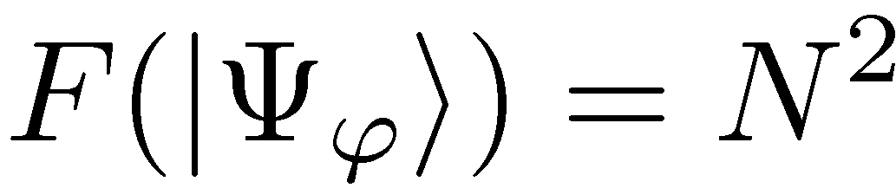
Phase estimation with N uses of a channel
Uncorrelated scheme
Entanglement-enhanced scheme
Maximize Quantum Fisher Information over input states
standard scaling
Heisenberg scaling

Slide 4
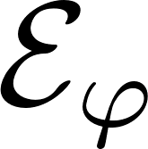
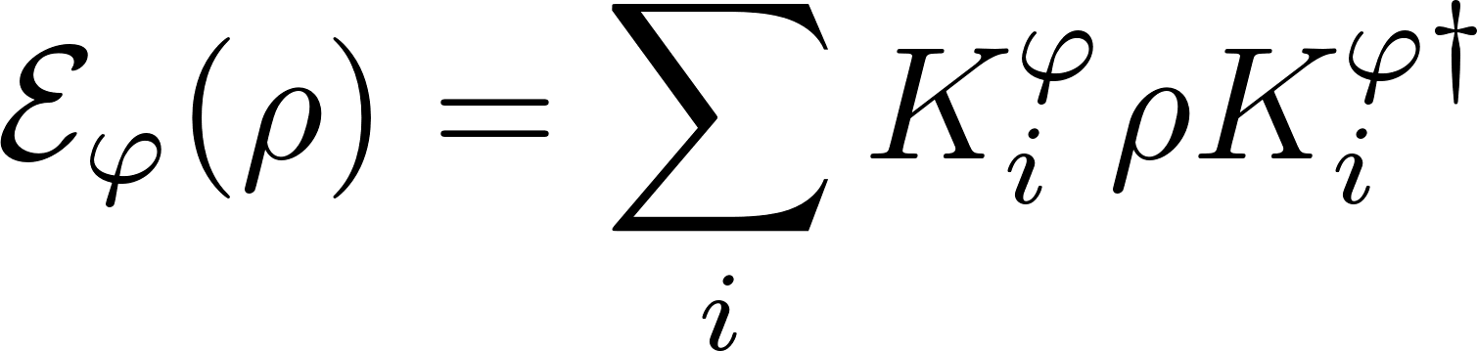
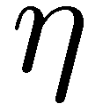
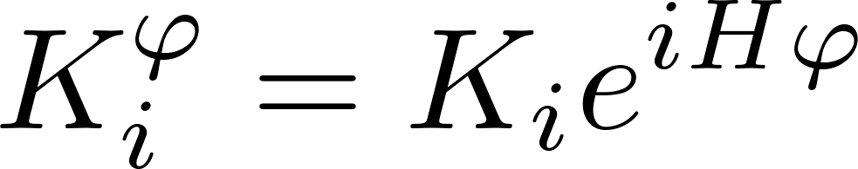
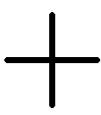
Impact of decoherence…
loss
dephasing

Slide 5
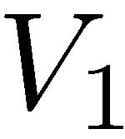
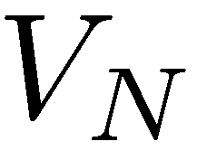
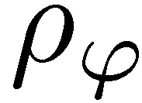
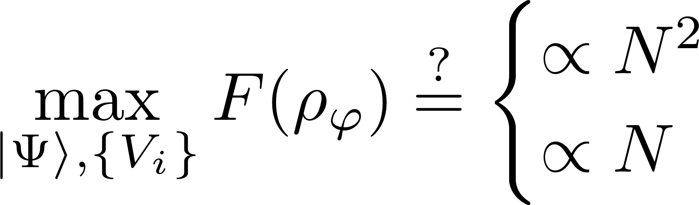
The most general adaptive scheme
Heisenberg scaling
standard scaling

Slide 6
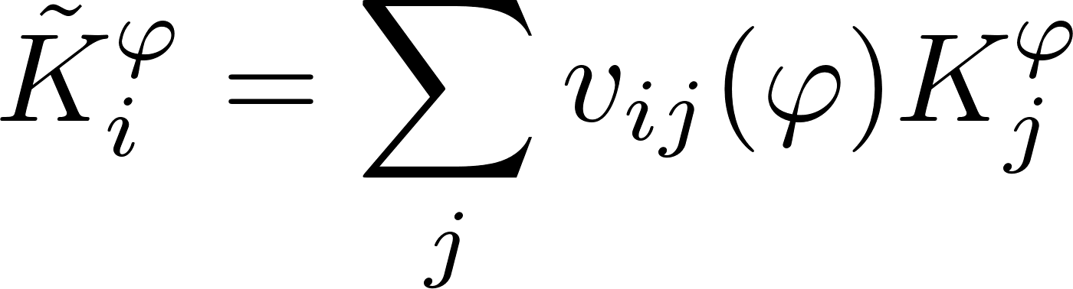
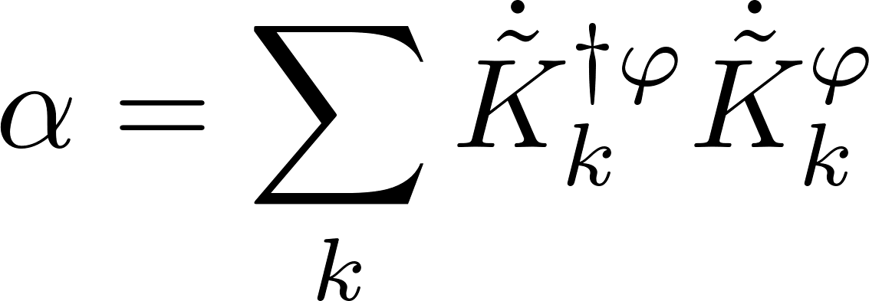
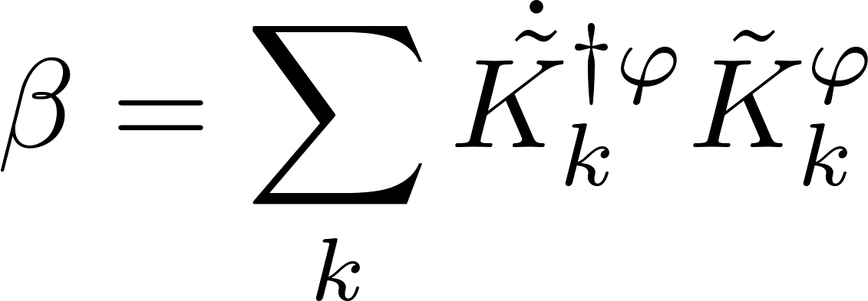
Precision bounds via minimization over equivalent Kraus representations
single channel optimization!
A. Fujiwara, H. Imai, J. Phys. A 41, 255304 (2008)
B. M. Escher, R. L. de Matos Filho, L. Davidovich Nature Phys. 7, 406–411 (2011)
RDD, J. Kolodynski, M. Guta, Nat. Commun. 3, 1063 (2012)
RDD, L. Maccone, Phys. Rev. Lett. 113, 250801 (2014) [Adaptive schemes included]

Slide 7
Heisenberg vs. No-Heisenberg scaling

Slide 8
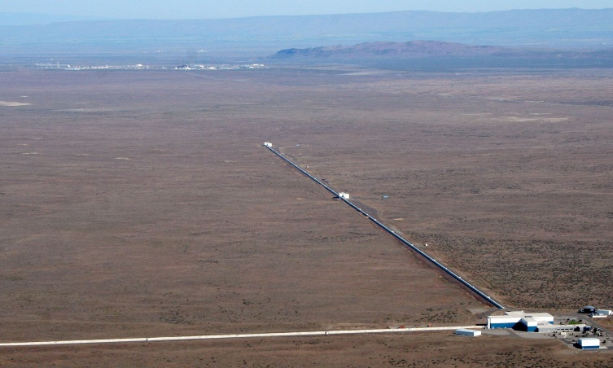
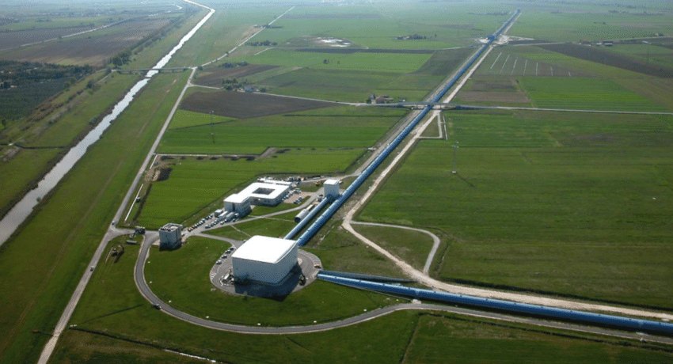
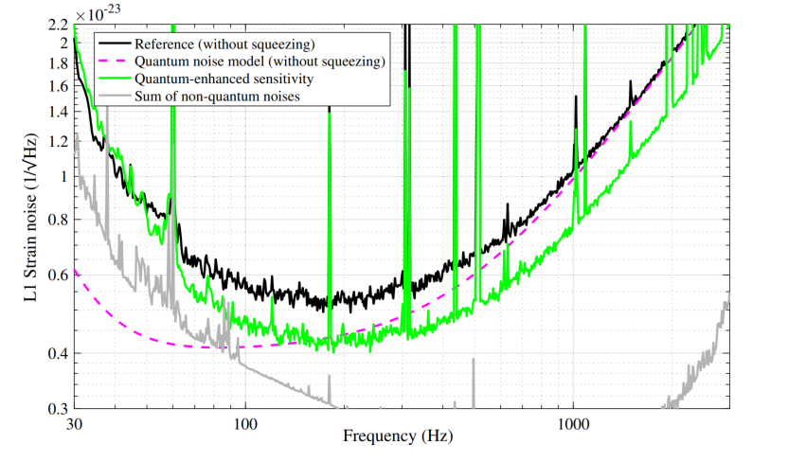
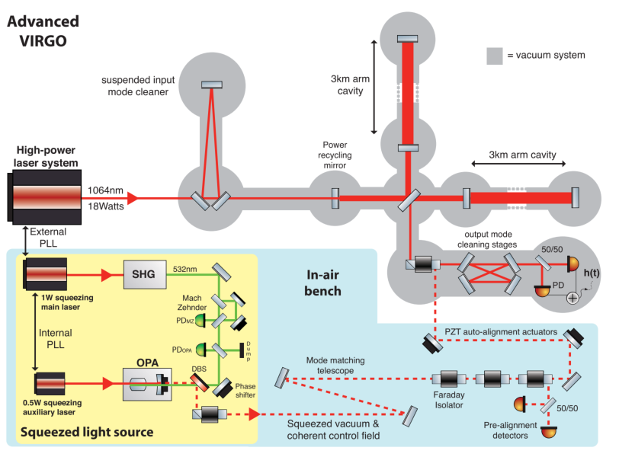
Squeezed light enhanced gravitational wave detectors
LIGO
VIRGO
Fundamental bounds can be asymptotically reached with simple schemes involving weakly squeezed states!
RDD, K. Banaszek, R. Schnabel, Phys. Rev. A, 041802(R) (2013)
Phys. Rev. Lett. 123, 231107 (2019)
Phys. Rev. Lett. 123, 231108 (2019)
35% reduction of noise thanks to squeezing
– equivalent of increasing the power by 85%!
~100 `quantum’ photons contribute the same improvement as 10^{20 `}classical’ photons

Slide 9
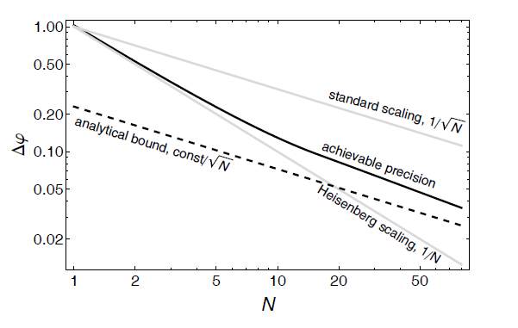
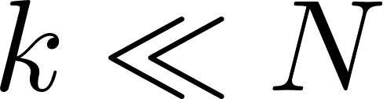
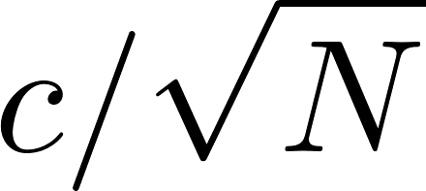

Typical behaviour in the limit of large number of probes….
No need to entangle large number of probes
Maybe matrix product states will effectively describe the optimal states
M.Jarzyna, RDD. Phys. Rev. Lett. 110, 240405 (2013)

Slide 10
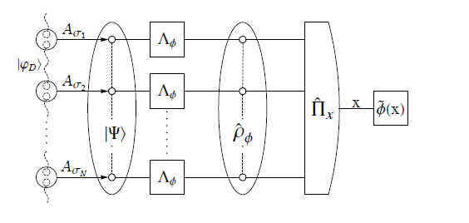

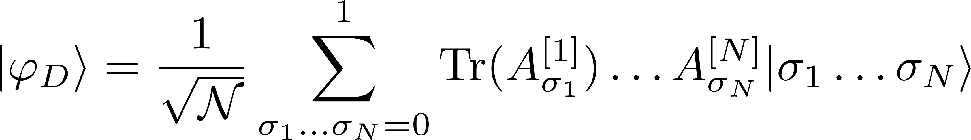
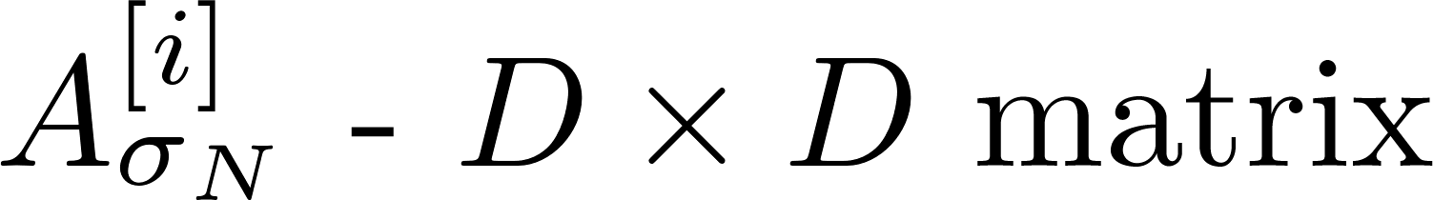
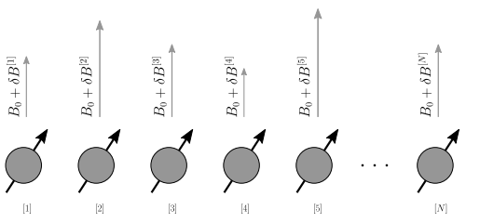
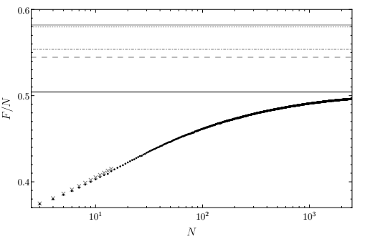
Optimal metrological protocols in the large particle limit via tensor networks
Perform an iterative optimization to find the optimal input state within a matrix product states of a given bond dimension
Calculate Quantum Fisher Information for a Matrix Product Operator (MPO) representing a mixed quantum state
matrix product state
Use infinite matrix product operators (iMPO) to obtain asymtpotic precision behaviour
Take into account models with locally correlated noise
(D – bond dimension)
Example: magnetic field estimation (with correlated fluctuations)
asymptotic QFI for uncorrealted fluctuation model
bounds adapting state-of-the art. methods
asymptotic QFI (via iMPO)
QFI per particle
QFI (via MPO)
brute force
K.Chabuda, J. Dziarmaga, T. Osborne, RDD, Nat. Commun 11, 250 (2020)
open-source numerical package in Python will be available soon

Slide 11
Can quantum error-correction be useful in quantum metrology?

Slide 12






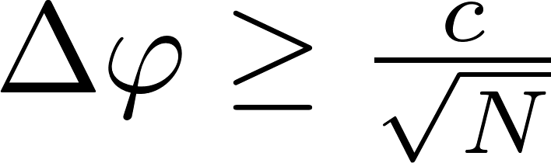



Heisenberg scaling via
Quantum Error-Correction
Idea: we can correct all the noise while still some part of the unitary parameter encoding remains intact
G. Arad et al Phys. Rev. Lett 112, 150801 (2014)
E. Kessler et.al Phys. Rev. Lett. 112, 150802 (2014)
W. Dür, et al., Phys. Rev. Lett. 112, 080801 (2014)
P. Sekatski, M. Skotiniotis, J. Kolodynski, W. Dur, Quantum 1, 27 (2017)
RDD, J. Czajkowski, P. Sekatski,, Phys. Rev. X 7, 041009 (2017)
S. Zhou, M. Zhang, J. Preskill, and L. Jiang, Nat. Commun. 9, 78 (2018)
Useful to reach the optimal bounds, even when Heisenberg scaling is not possible
S. Zhou, L. Jiang, arXiv: 2003.10559 (2020)
S. Zhou, L. Jing, Phys. Rev. Research 2, 013235 (2020)

Slide 13
What can quantum metrological bounds tell about quantum error-correcting codes?
maybe something interesting in case of noise models
where Heisenberg limit cannot be achieved…

Slide 14


Fault tollerance and transversality
When encoding logical qubits into physical ones it is desirable that logical unitaries are product of physical unitaries (transversality)
Transversal gates do not propagate errors
Bad News (Knill-Eastin Theorem, 2009):
„For any non-trivial local error-detecting quantum code, the set of transversal logical unitaries is not universal”
B. Eastin and E. Knill, Phys. Rev. Lett. 102 (2009),

Slide 15





Approximate Eastin-Knill theorem
How the imperfection of error-correcting codes admiting universal and transversal set of gates scales with increasing resources?
(resources = physical systems used for encoding)
P. Faist, S. Nezami, V. V. Albert, G.Salton, F. Pastawski, P. Hayden, and J.Preskill arXiv:1902.07714 (2019)
Mischa P. Woods and Alvaro M. Alhambra, Quantum 4, 245 (2020)
Idea of a metrological perspective proof: error correcting codes cannot be too good, as otherwise they would lead to violation of fundamental metrological bounds
Covariant Error Correcting Codes
A.Kubica, RDD arxiv:2004.11893
see also: S. Zhou, Z.-W. Liu, L.Jiang, arxiv:2005.11918

Slide 16
Approximate Eastin-Knill theorem
How the imperfection of error-correcting codes admiting universal and transversal set of gates scales with increasing resources?
(resources = physical systems used for encoding)
P. Faist, S. Nezami, V. V. Albert, G.Salton, F. Pastawski, P. Hayden, and J.Preskill arXiv:1902.07714 (2019)
Mischa P. Woods and Alvaro M. Alhambra, Quantum 4, 245 (2020)
Idea of a metrological perspective proof: error correcting codes cannot be too good, as otherwise they would lead to violation of fundamental metrological bounds
Covariant Error Correcting Codes
A.Kubica, RDD arxiv:2004.11893
see also: S. Zhou, Z.-W. Liu, L.Jiang, arxiv:2005.11918

Slide 17



Approximate Eastin-Knill theorem
How the imperfection of error-correcting codes admiting universal and transversal set of gates scales with increasing resources?
(resources = physical systems used for encoding)
P. Faist, S. Nezami, V. V. Albert, G.Salton, F. Pastawski, P. Hayden, and J.Preskill arXiv:1902.07714 (2019)
Mischa P. Woods and Alvaro M. Alhambra, Quantum 4, 245 (2020)
Idea of a metrological perspective proof: error correcting codes cannot be too good, as otherwise they would lead to violation of fundamental metrological bounds
Covariant Error Correcting Codes
A.Kubica, RDD arxiv:2004.11893
see also: S. Zhou, Z.-W. Liu, L.Jiang, arxiv:2005.11918

Slide 18


Take home messages
Phys. Rev. Lett. 113, 250801 (2014), Phys. Rev. X 7, 041009 (2017), Nat. Commun. 9, 78 (2018), Nat. Commun 11, 250 (2020)
arxiv:2004.11893, arxiv:2005.11918
Nat. Commun. 9, 78 (2018), Quantum 4, 288 (2020) [multiparameter case]

