Slide 1
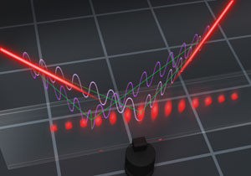
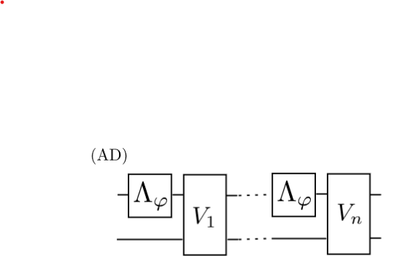
Quantum Metrological Theoretical Toolbox all you need to know to find the optimal protocols!
Rafal Demkowicz-Dobrzański
Faculty of Physics, University of Warsaw, Poland

Slide 2
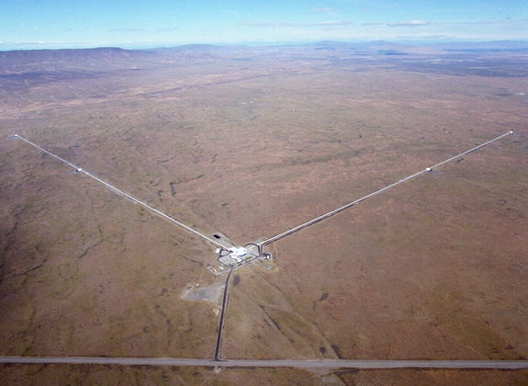
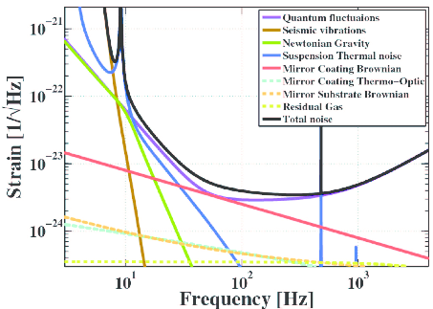
Interferometry at its limits
LIGO - gravitational wave detector
Michelson interferometer
How fundamental are these limits?

Slide 3
Interferometry at its limits
LIGO - gravitational wave detector
Michelson interferometer
How fundamental are these limits?

Slide 4
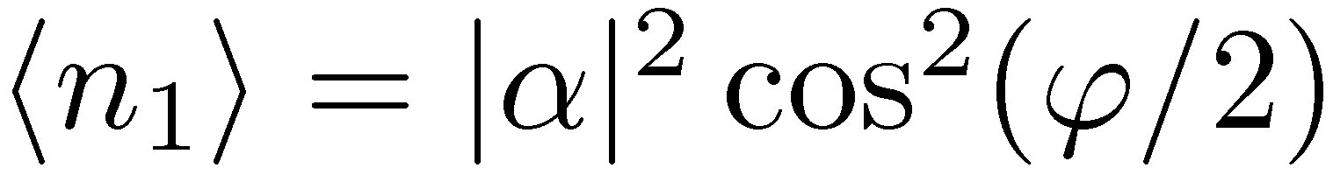
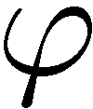
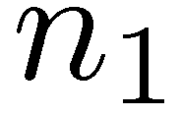
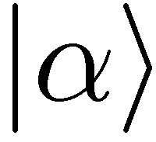
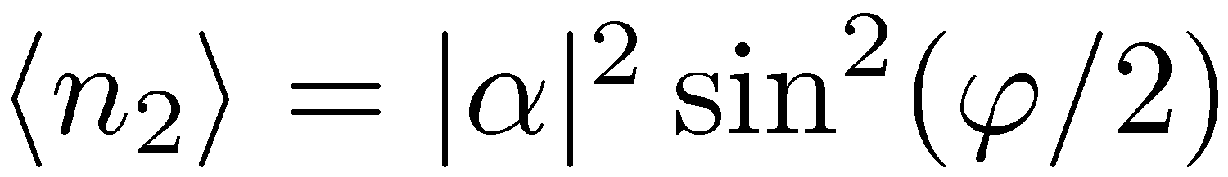
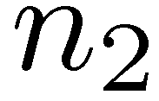
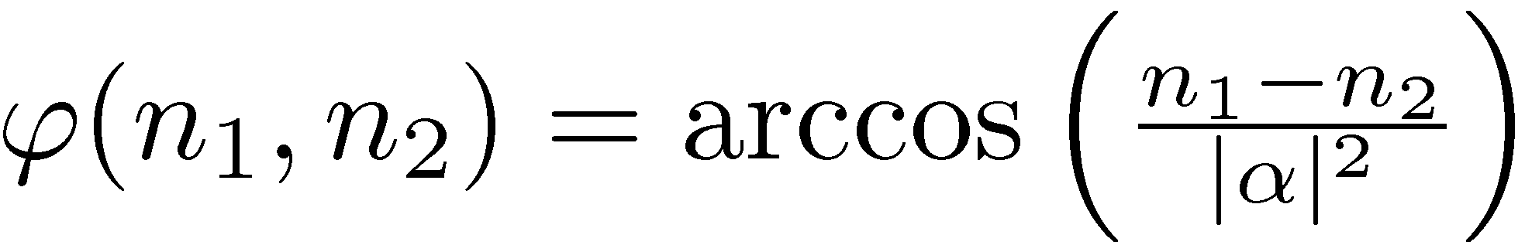
,,Classical’’ interferometry
reasonable estimator

Slide 5
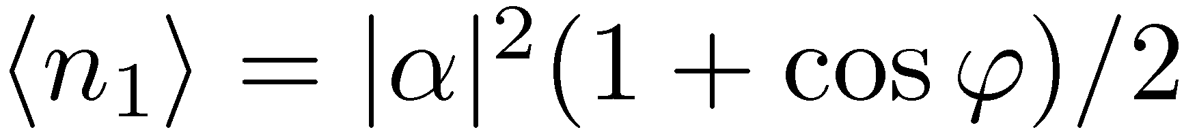
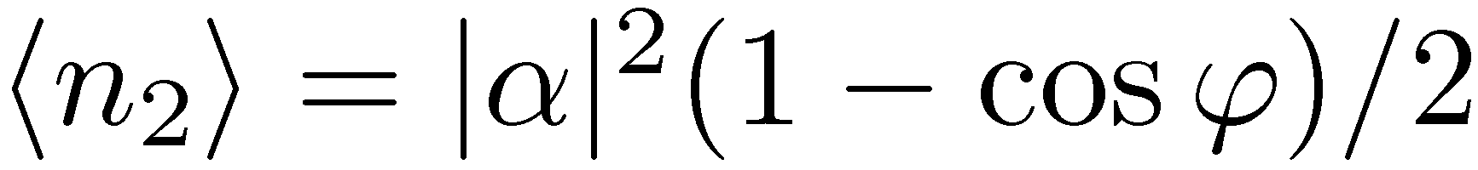
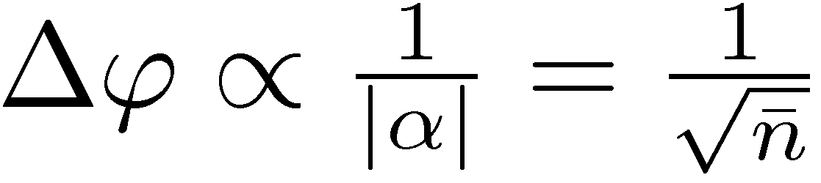
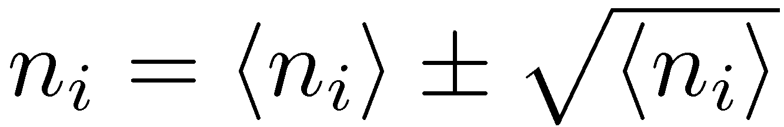
„Classical” interferometry
reasonable estimator
Poissonian statistics
Standard limit (Shot noise)

Slide 6
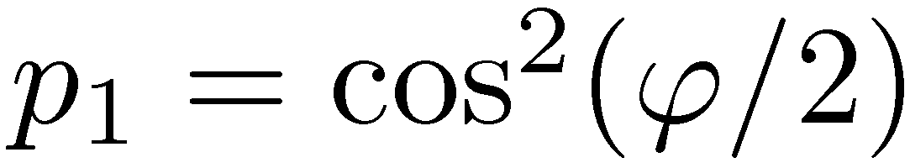
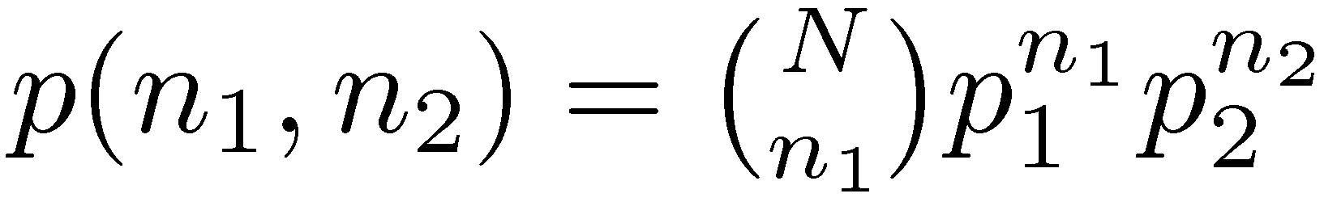
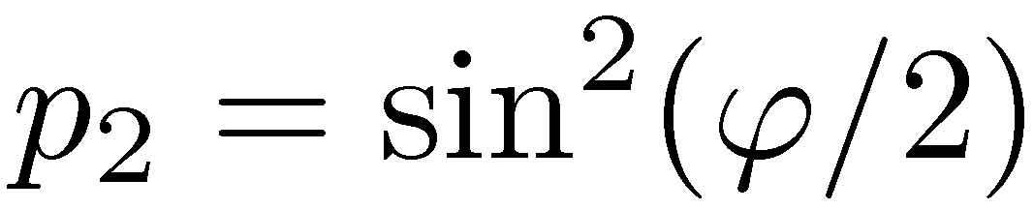
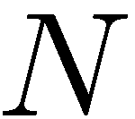
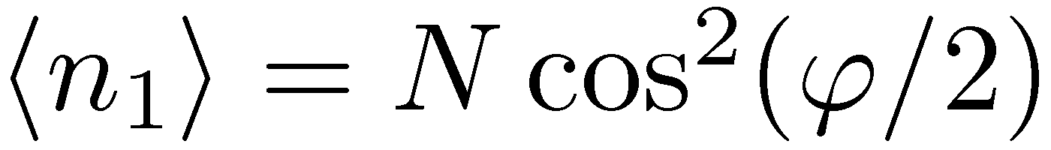
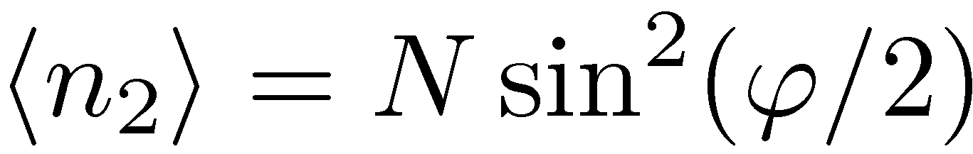
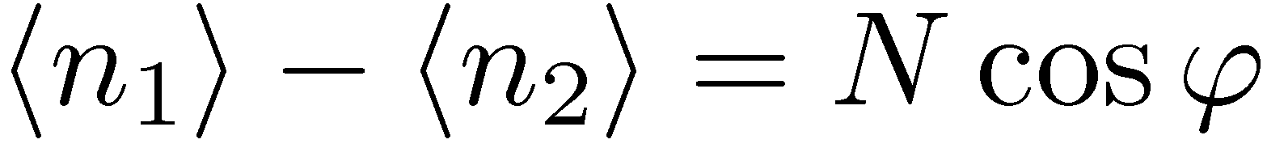
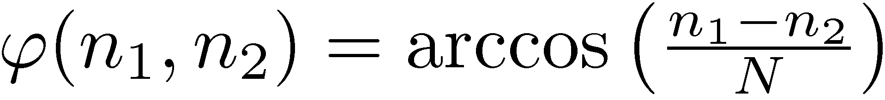
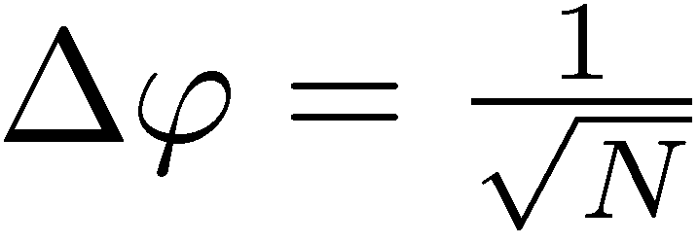
N independent photons
optimal estimator:
Again shot noise limited

Slide 7
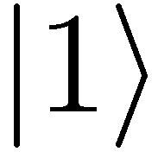
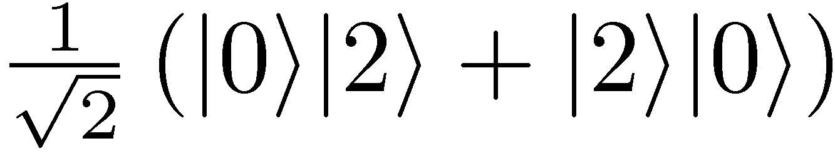
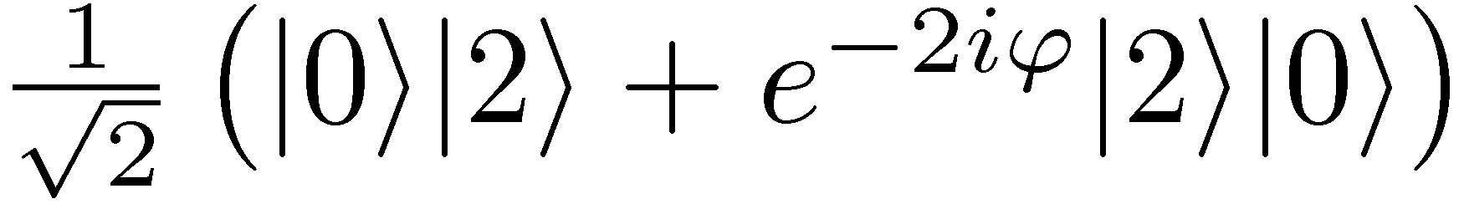
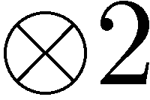
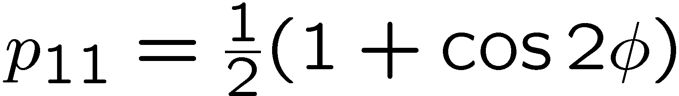
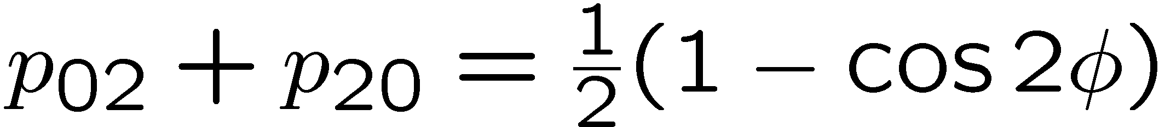
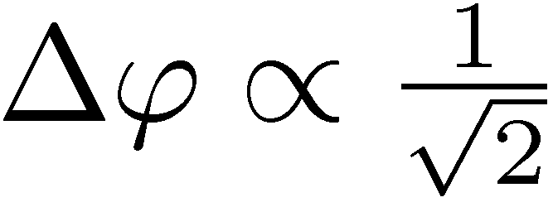
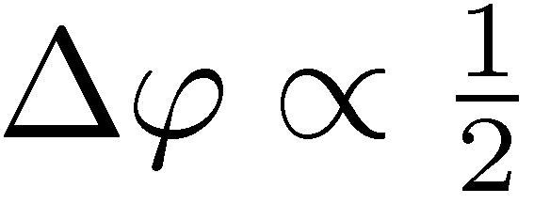
Entanglement enhanced precision
Hong-Ou-Mandel interference
&

Slide 8
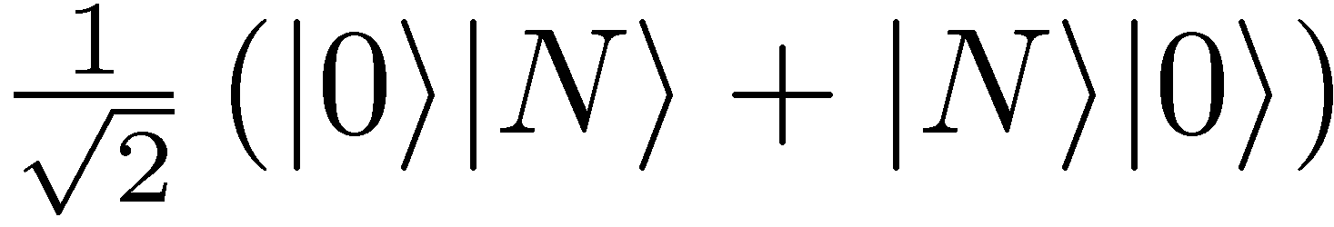
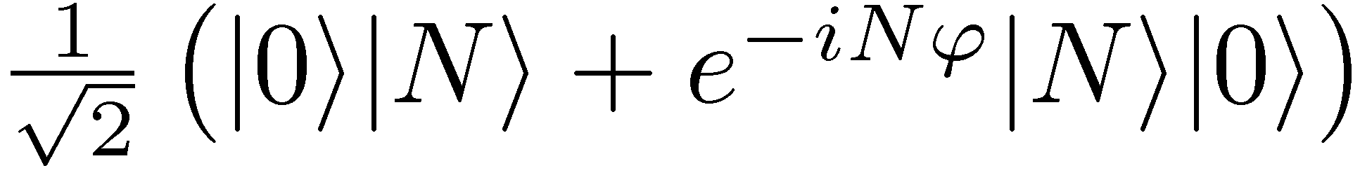
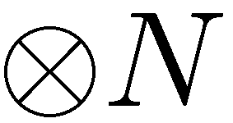
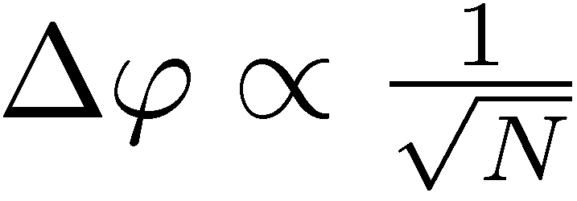
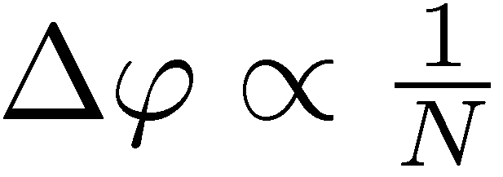
Entanglement enhanced precision
NOON states
State
preparation
Estimator
Measuremnt
Standard Quantum Limit
Heisenberg limit

Slide 9
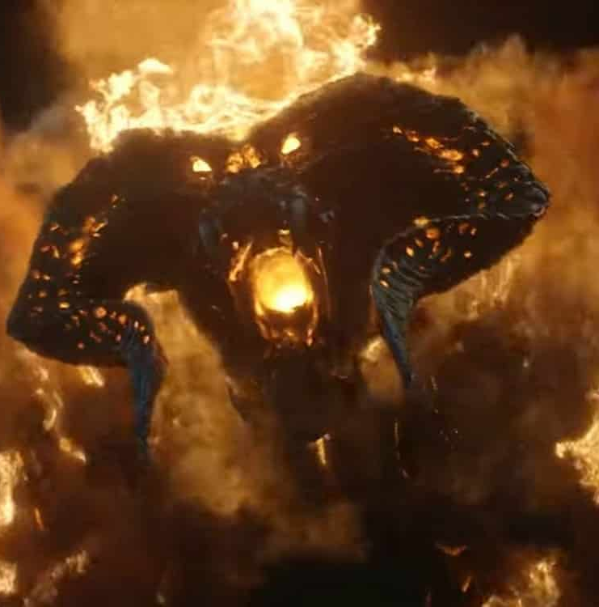
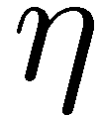
Is quantum enhancement achievable in practice?
loss of photons
decoherence!
loss of a single photon
no phase information!
Can we observe quantum advantage in presence of decoherence?

Slide 10
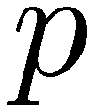
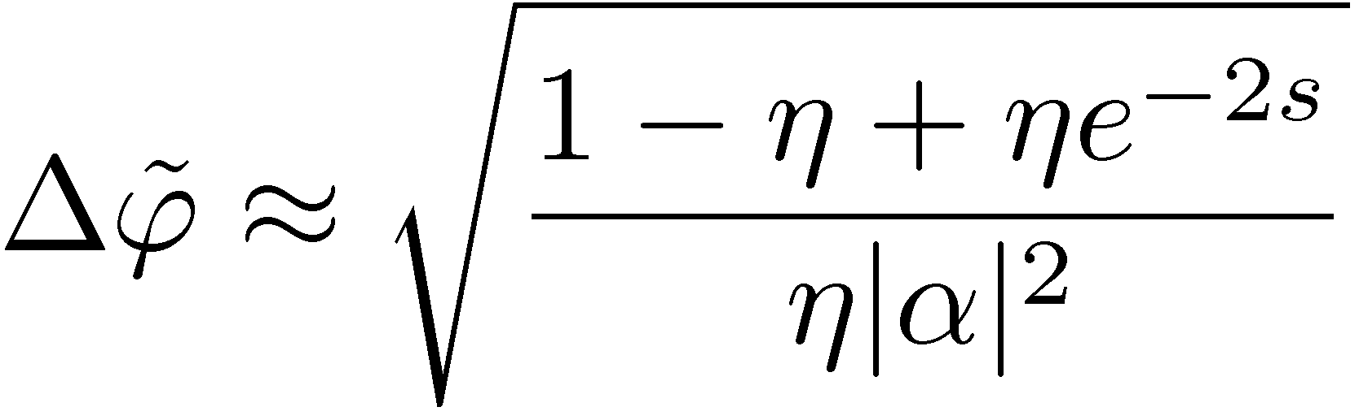

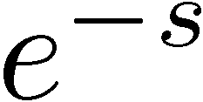
Squeezed states interferometry
- effective transmission
coherent state
Shot noise
vacuum
Better sensitivity thanks to
sub-Poissonian fluctuations of n₁- n₂!
squeezed vacuum
C. Caves, Phys. Rev D 23, 1693 (1981)

Slide 11
What are the fundamental limits for optical interferometry in presence of loss?
(or any quantum metrological protocol in presence of decoherence)
Can we do better?
N photon state
Measurement
Take a Quantum Information perspective!

Slide 12
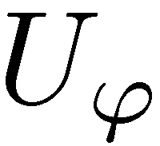
Singe photon = a qubit
Evolution of each photon through an interferometer
=
Superposition of a photon travelling in upper and lower arms
=
Unitary rotation of a qubit (spin 1/2)

Slide 13

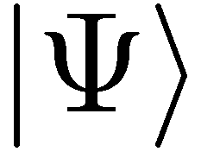
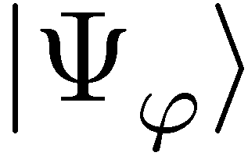
N photon interferometry ->
N qubit phase estimation
N photon state
Measurement
N qubit state*
Measurement
Optical interferometry as a quantum channel estimation problem!
*we formally treat photons as distinguishable (may only improve estimation!)

Slide 14
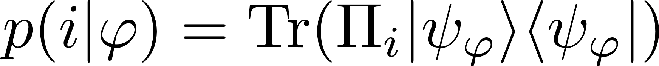
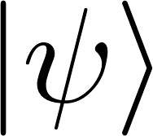
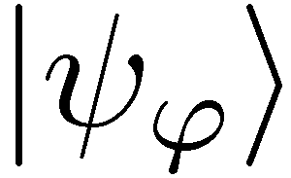
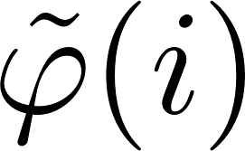
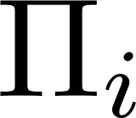

Unitary channel estimation problem

Slide 15



Unitary channel estimation problem
Quantum Cramer-Rao inequality
Quantum Fisher information (QFI)

Slide 16


Unitary channel estimation problem
Quantum Cramer-Rao inequality
Quantum Fisher information (QFI)
Time-Energy uncertainty relation

Slide 17


Unitary channel estimation problem
Quantum Channel Cramer-Rao inequality
Channel Quantum Fisher Information

Slide 18








Estimation using N channels
(i)
(ii)
each atom/photon interfers with itself
(shot noise scheme)
entanglement-enhanced scheme
(iii)
The most general adaptive scheme

Slide 19


Maximal Quantum Fisher Information for noiseless models
Heisenberg limit
V. Giovannetti, S. Lloyd, and L. Maccone, Phys. Rev. Lett. 96, 010401 (2006).

Slide 20






Take into account decoherence
Let things decohere!
to model loss – we use three dimensional output space
photon survives
lost in mode a
lost in mode b

Slide 21
N photon interferometry ->
N qubit phase estimation
N photon state
Measurement
N qubit state*
Measurement
What is the ultimate estimation precision we can achieve in presence of losses?

Slide 22


Allow for adaptive schemes as well!

Slide 23


QFI for noisy channels
Channel QFI:
difficult to compute for noisy channels!

Slide 24


Idea of minimization over purifications (MOP)
S
S
E
A. Fujiwara, H. Imai, J. Phys. A 41, 255304 (2008)

Slide 25





Channel QFI via MOP
S
S
E
computing the channel QFI:
A. Fujiwara, H. Imai, J. Phys. A 41, 255304 (2008)

Slide 26
Channel QFI via MOP
S
S
E
computing the channel QFI:
A. Fujiwara, H. Imai, J. Phys. A 41, 255304 (2008)

Slide 27
Channel QFI via MOP
S
S
E
computing the channel QFI:
equivalent Kraus representations
K x K Hermitian matrix
A. Fujiwara, H. Imai, J. Phys. A 41, 255304 (2008)

Slide 28

Channel QFI via MOP
S
S
E
computing the channel QFI:
K x K Hermitian matrix
A simple SDP programme!
RDD, J. Kolodynski, M. Guta, Nat. Commun. 3, 1063 (2012)

Slide 29
More channels! What are advantages of different levels of quantumness?
(C)
(E)
coherence
entanglement (passive way)
+ sequentiality
(AD)
entanglement + adaptiveness (active quantum feedback)

Slide 30
Optimal entanglement based strategies (E)
Works if N is small enough…
(for qubit channels N ≤ 5)
Minimization over purifications (MOP)
Iterative See-Saw (ISS)

Slide 31
What to do for many channel protocols N>1
Parallel protocols
Adaptive protocols
Straightforward generalization
Optimization over quantum combs

Slide 32
What to do for many channel protocols N>1
Parallel protocols
Adaptive protocols
Applicabiilty resticted to small N !
Straightforward generalization
Optimization over quantum combs
Generalization of MOP method to combs -> SDP program
Altherr, Y. Yang, Phys. Rev. Lett 127, 060501 (2021)
Q. Liu, Z. Hu, H. Yuan, Y. Yang, Phys. Rev. Lett. 130, 070803 (2023)

Slide 33

What to do when N is very large?
no-go way
constructive way
Use MOP idea to derive bounds
Apply iterative see-saw (ISS) optimization and tensor network methods to find optimal protocols withing some restricted class
Ideally!
See poster by Staszek Kurdziałek
S.Kurdzialek, P. Dulian, J. Majsak, S. Chakrabotry, RDD, New J. Phys. 27 013019 (2025)
Q. Liu, Y. Yang, Quantum 8, 1571 (2024)

Slide 34

Precision bounds via minimization over equivalent Kraus representations
single channel optimization! (SDP)
A. Fujiwara, H. Imai, J. Phys. A 41, 255304 (2008)
B. M. Escher, et al. Nature Phys. 7, 406–411 (2011)
RDD, J. Kolodynski, M. Guta, Nat. Commun. 3, 1063 (2012)
RDD, L. Maccone, Phys. Rev. Lett. 113, 250801 (2014)
RDD, J. Czajkowski, P. Sekatski, Phys. Rev. X 7, 041009 (2017)
S. Zhou et al., Nat. Commun. 9, 78 (2018)
S. Zhou, L. Jiang, PRX Quantum 2, 010343 (2021)
S. Kurdzialek, W. Gorecki, F. Albarelli, RDD, PRL 131, 090801 (2023)

Slide 35
Precision bounds via minimization over equivalent Kraus representations
single channel optimization! (SDP)
true for generic noisy channels
Heisenberg scaling is asymptotically lost!

Slide 36

Fundamental bound for lossy interferometry
N photon state
Measurement
Valid also for adaptive protocols.
Quantum Error Correction will not help!

Slide 37

Good News: Saturating the fundamental bounds is simple!
fundamental bound
for lossy interferometer
For strong beams:
Simple estimator based
on n₁- n₂ measurement
C. Caves, Phys. Rev D 23, 1693 (1981)
Weak squezing + simple measurement + simple estimator = optimal strategy!
Analogous behaviour in Ramsey interferometry – spin squeezed states saturate asymptotically the fundamental bound
S. Huelga et al. Phys.Rev.Lett. 79, 3865 (1997)
D. Ulam-Orgikh , M. Kitagawa Phys. Rev. A 64 052106 (2001)
B. M. Escher, R. L. de Matos Filho, L. Davidovich Nature Phys. 7, 406–411 (2011)

Slide 38




Squeezed states in gravitational wave detectors
LIGO
VIRGO
Phys. Rev. Lett. 123, 231107 (2019)
Phys. Rev. Lett. 123, 231108 (2019)
35% reduction in noise thanks to squeezing
equivalent to an increase of laser power by 85%!
~100 `quantum’ photons provides the same imprivement as 10²⁰ `classical’ photons

Slide 39











When Heisenberg scaling is possible….
Idea: we can correct all the noise while still some part of the unitary parameter encoding remains intact – Quantum Error Correction inspired protocols!
W. Dür, M. Skotiniotis, F. Fröwis, and B. Kraus Phys. Rev. Lett. 112, 080801 (2014)
G.Arrad Y. Vinkler, D. Aharonov, and A. Retzker Phys. Rev. Lett. 112, 150801 (2014)
E. Kessler et al. Phys. Rev. Lett. 112, 150802 (2014)
P. Sekatski, M. Skotiniotis, J. Kolodynski, W. Dur, Quantum 1, 27 (2017)
RDD, J. Czajkowski, P. Sekatski,, Phys. Rev. X 7, 041009 (2017)
S. Zhou, M. Zhang, J. Preskill, and L. Jiang, Nat. Commun. 9, 78 (2018)
S. Zhou, L. Jiang, PRX Quantum 2, 010343 (2021)

Slide 40

Fundamental bounds latest developments
The best way to bound the increase of QFI when one channel is added
Efficient SDP
No asymptotic gain thanks to adaptiveness for all models with uncorrelated noise!
S. Kurdzialek, W. Gorecki, F. Albarelli, RDD, PRL 131, 090801 (2023)

Slide 41

Fundamental bounds very latest developments, correlated noise models
How to derive a computable asymptotic bound that takes into account correlations?
S. Kurdzialek, F. Albarelli, RDD, arxiv:2410.01881 (2024)

Slide 42
Fundamental bounds very latest developments, correlated noise models
Bound the increase of QFI when a general Quantum Comb acts on m added (correlated!) channels
Bound the increase of QFI when a general Quantum Comb acts on m added (correlated!) channels
S. Kurdzialek, F. Albarelli, RDD, arxiv:2410.01881 (2024)

Slide 43
Which methods we can use when we go multiparameter?

Slide 44


Multiparameter issues!
?
Input probe incompatibility
Measurement incompatibility
Correlated estimators
S. Ragy, M, Jarzyna, RDD, Phys. Rev. A 94, 052108 (2016)

Slide 45
Multiparameter issues!
?
Input probe incompatibility
may affect scaling of precision with the numer of parameters involved!
Measurement incompatibility
asymptotically at most twice overhead in resources for noisy models
Correlated estimators
problem removed if proper parametrization chosen
S. Ragy, M, Jarzyna, RDD, Phys. Rev. A 94, 052108 (2016)

Slide 46














Heisenberg limit in multi-parameter noisy metrology?
estimators covariance matrix
Multiparameter quadratic cost:
Can we have the Heisenberg scaling with N uses of the channel ?
Kraus span:
Heisenberg scaling is possible if and only if
„Hamiltonian” of p parameter
are linearly independent
W. Gorecki, S. Zhou, L. Jiang, RDD, Quantum 4, 288 (2020)

Slide 47

Relaxing the tightness of the bounds…
Multiparameter quadratic cost:
We choose a parametrization where C = diag(c₁, …, c_{p})
By analyzing the (weighted) trace of QFI we can still get insight into probe incompatibility issue (i)

Slide 48

Optimizing the trace of the matrix (MOP)
QFI matrix for a mixed state is again the minimum over its purifications! (in the sense of matrix ordering)
And this implies the same equality for the trace
Sum under the operator norm! We get insight into probe incompatibility!
The formula for trace of the channel QFI matrix:
F. Albarelli, R. Demkowicz-Dobrzanski, PRX 12, 011039 (2022)

Slide 49
Multi-parameter bounds via MOP
Bound on the increase of trace of QFI matrix after a single step
If for all parameters we can have h_{i} such that
Allows to study asymptotic effects of probe incompatibility in presence of noise
F. Albarelli, R. Demkowicz-Dobrzanski, PRX 12, 011039 (2022)+ unpublished

Slide 50






Summary
Qualitative conditions for Heisenberg scaling
no
yes
Heisenberg scaling not possible.
Heisenberg scaling possible
Quantitative optimization methods for the QFI (or trace of the QFI matrix)
Minimization over purifications (MOP)
can be used to derive bounds for large N
Iterative See-Saw (ISS)
can be combined with tensor-network approach
to optimize QFI for large N
W. Gorecki, S. Zhou, L. Jiang, RDD, Quantum 4, 288 (2020)
F. Albarelli, RDD, PRX 12, 011039 (2022)
S. Kurdzialek, W. Gorecki, F. Albarelli, RDD, PRL 131, 090801 (2023)
S. Kurdzialek, F. Albarelli, RDD, arxiv:2410.01881 (2024)
K.Chabuda, J. Dziarmaga, T. Osborne, RDD,
Nat. Commun 11, 250 (2020)
S.Kurdzialek, P. Dulian, J. Majsak, S. Chakrabotry, RDD,
New J. Phys. 27 013019 (2025)

