Slide 1

Quantum Error Correction in multi-parameter quantum metrology
Mo Parameters Mo Problems
Featuring: Rafal Demkowicz-Dobrzański
Faculty of Physics, University of Warsaw
Design: Boulat Bash

Slide 2
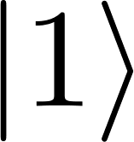
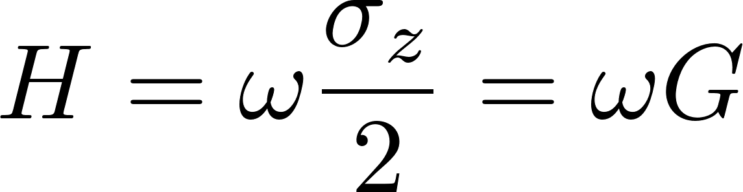

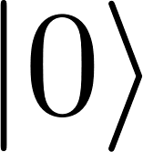
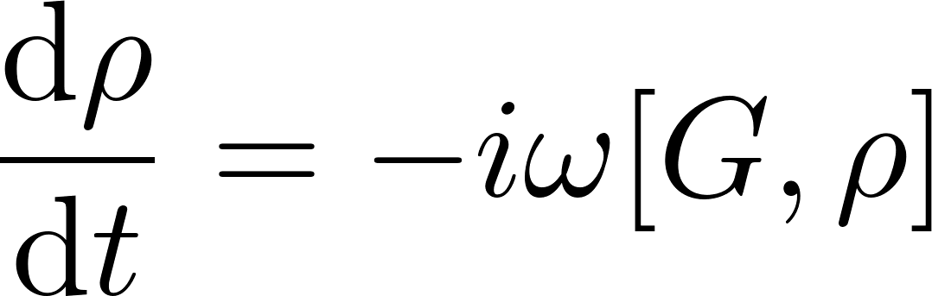
Frequency estimation problem
How precise we can estimate ω given total interrogation time T ?

Slide 3
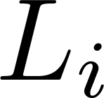
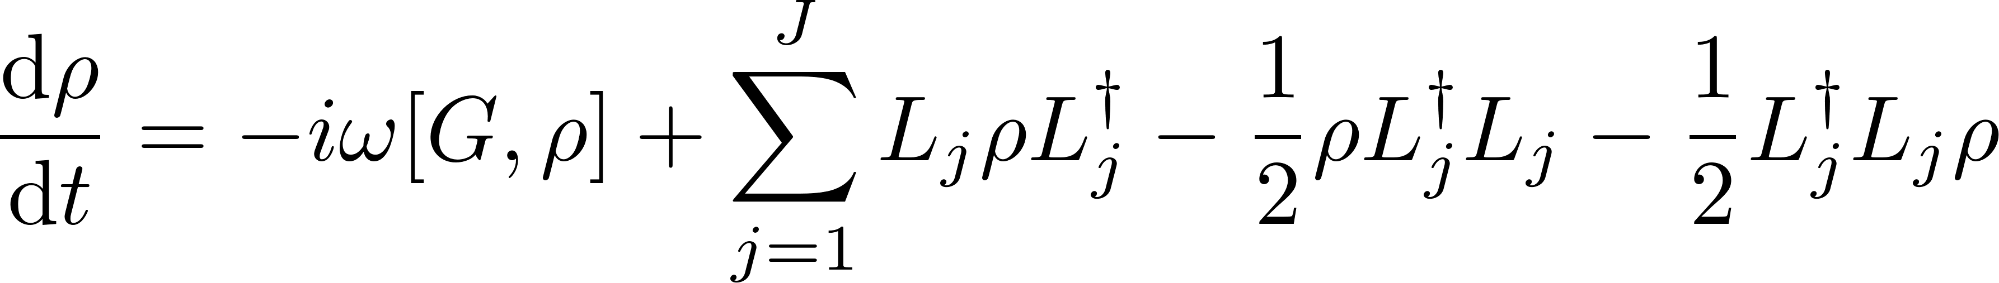
Frequency estimation problem in presence of general Markovian noise
How precise we can estimate ω given total interrogation time T ?

Slide 4

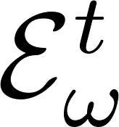
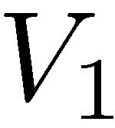
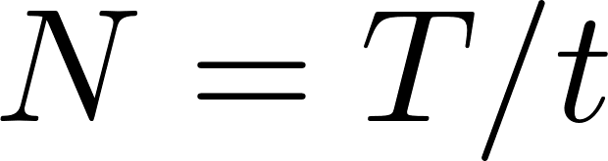
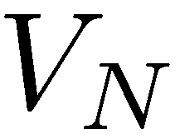
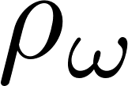
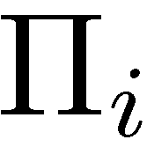
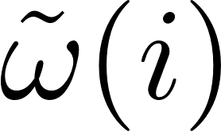
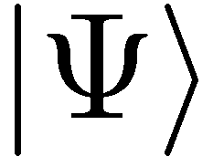
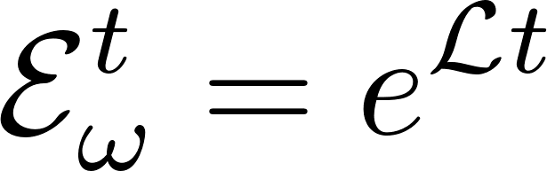
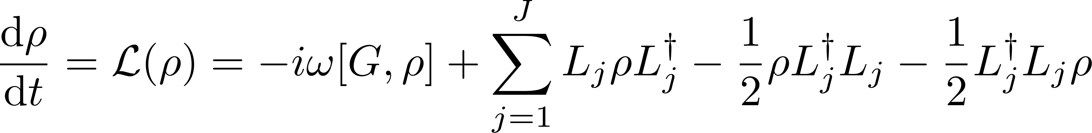
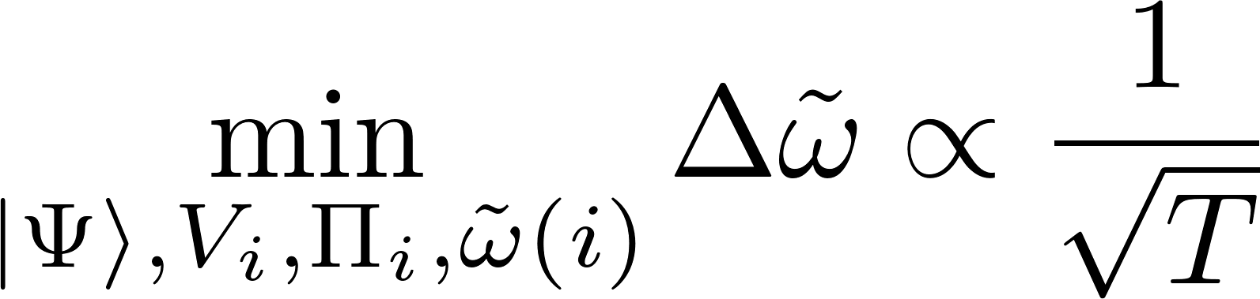
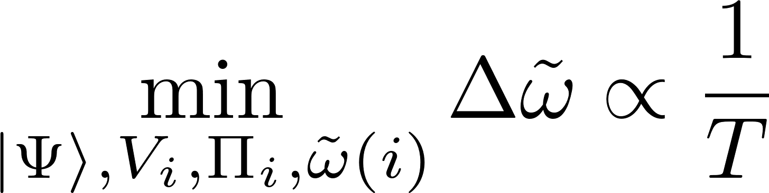
General adaptive frequency estimation scheme
Minimize uncertainty of estimating the frequency parameter under fixed total time T
?
Standard scaling
Heisenberg scaling

Slide 5
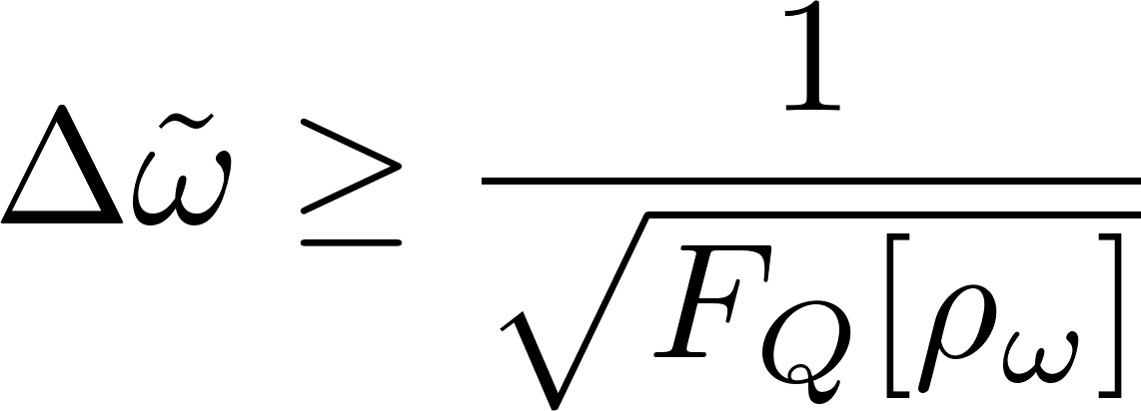
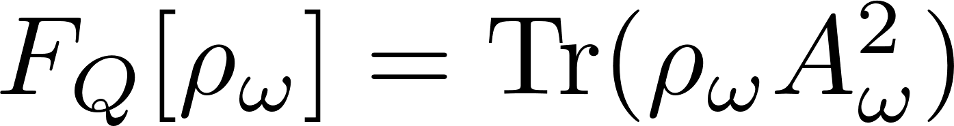
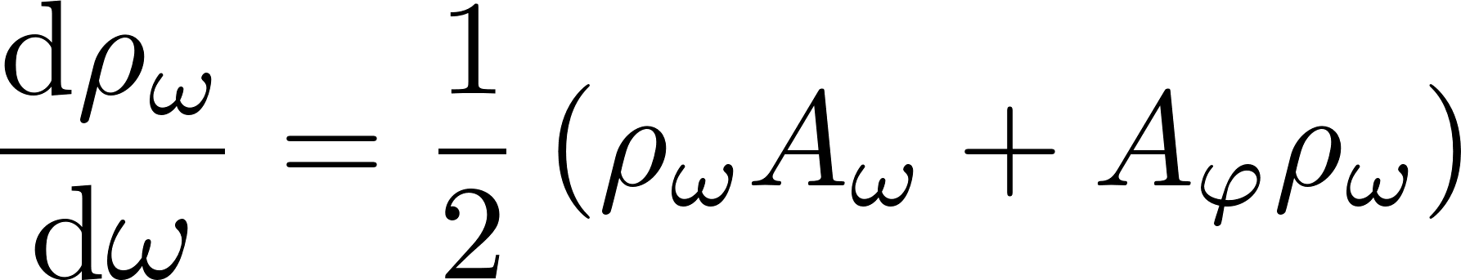
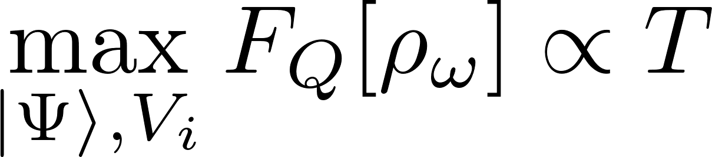
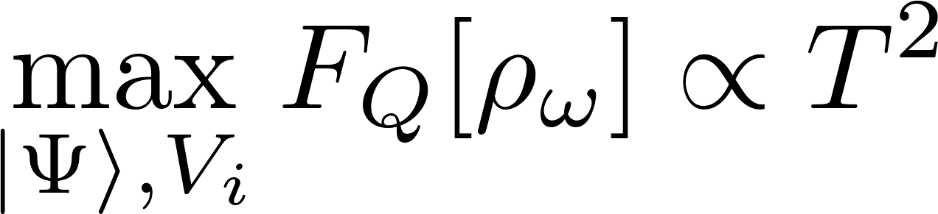
Use Quantum Fisher information as a figure of merit….
Quantum Cramer-Rao bound
?
Standard scaling
Heisenberg scaling

Slide 6
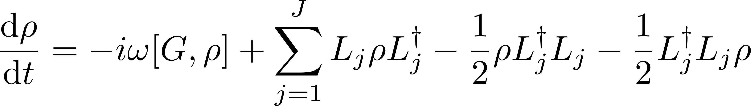
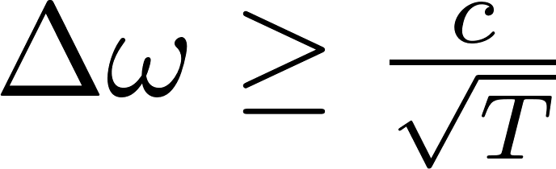
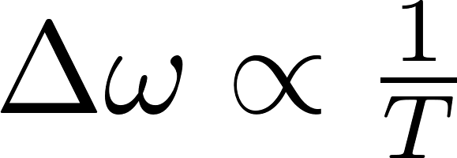
Long way to a simple result…
at most a constant factor improvement
over ,,classical’’ strategies
Heisenberg scaling can be recovered
(via application of quantum error correction)
A. Fujiwara, H. Imai, J. Phys. A 41, 255304 (2008)
B. M. Escher, R. L. de Matos Filho, L. Davidovich Nature Phys. 7, 406–411 (2011)
RDD, J. Kolodynski, M. Guta, Nat. Commun. 3, 1063 (2012)
RDD, L. Maccone Phys. Rev. Lett. 113, 250801 (2014)
P. Sekatski, M. Skotiniotis, J. Kolodynski, W. Dur, Quantum 1, 27 (2017)
RDD, J. Czajkowski, P. Sekatski,, Phys. Rev. X 7, 041009 (2017)
S. Zhou, M. Zhang, J. Preskill, and L. Jiang, Nat. Commun. 9, 78 (2018)

Slide 7
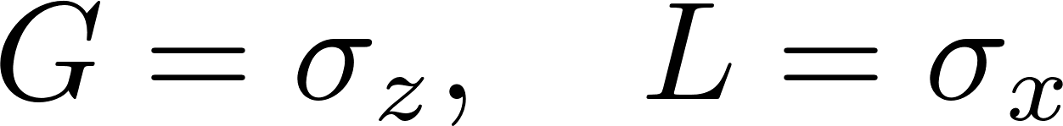
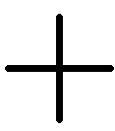
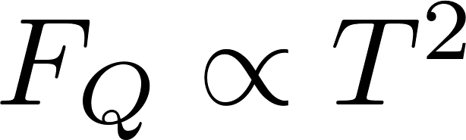
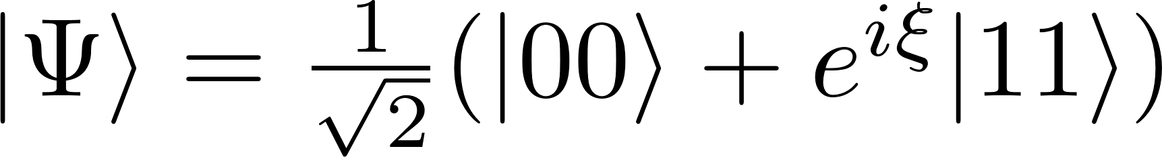
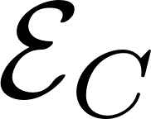
Recovering the Heisenberg scaling via Quantum Error Correction - Example
Perpendicular dephasing:
Simple quantum error correction scheme leads to
G. Arad et al Phys. Rev. Lett 112, 150801 (2014)
E. Kessler et.al Phys. Rev. Lett. 112, 150802 (2014)
W. Dür, et al., Phys. Rev. Lett. 112, 080801 (2014)
P. Sekatski, M. Skotiniotis, J. Kolodynski, W. Dur, Quantum 1, 27 (2017)

Slide 8
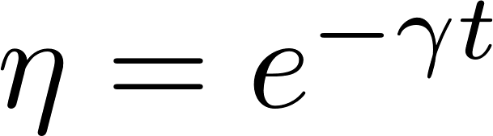
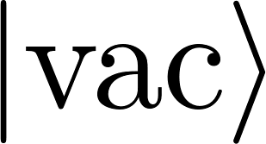
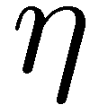
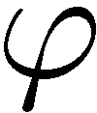
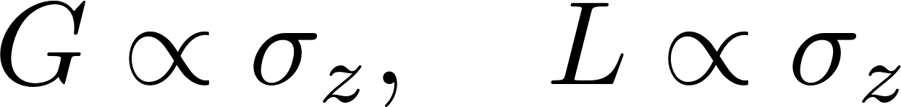


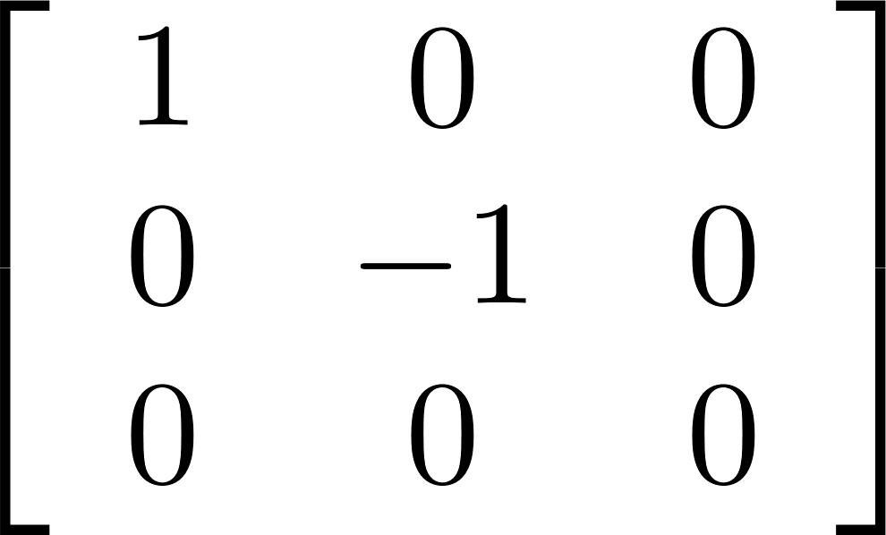
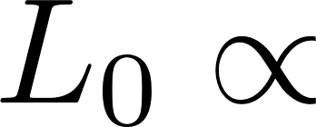
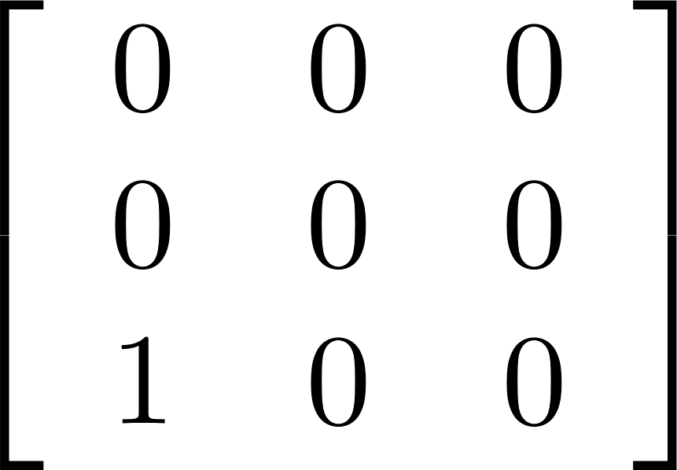
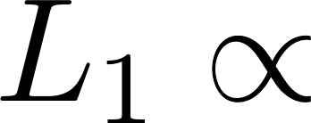
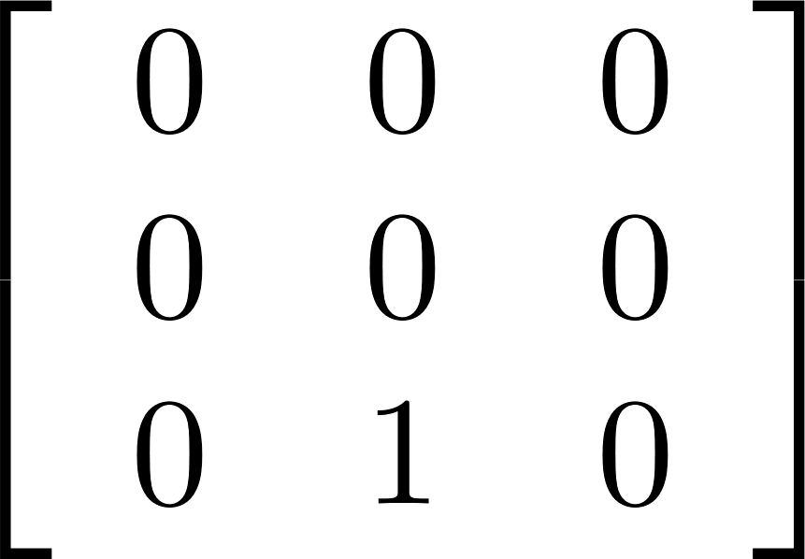
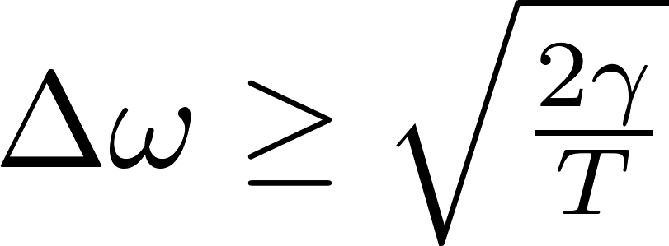
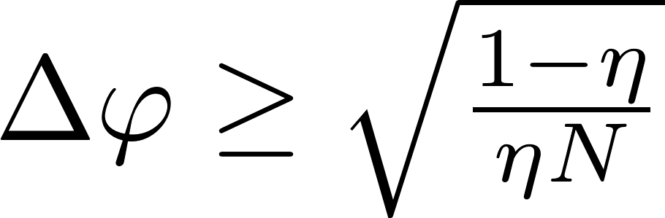
…but for the most common noise models Heisenberg scaling is lost
Standard dephasing:
Lossy interferometry
Single photon modeled as a three level system:
Fundamental bound can be asymptotically reached with simple schemes involving weakly squeezed states!

Slide 9
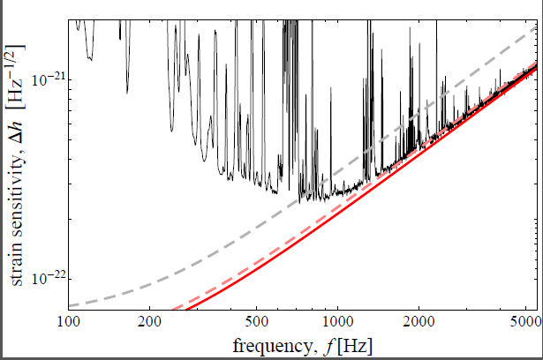
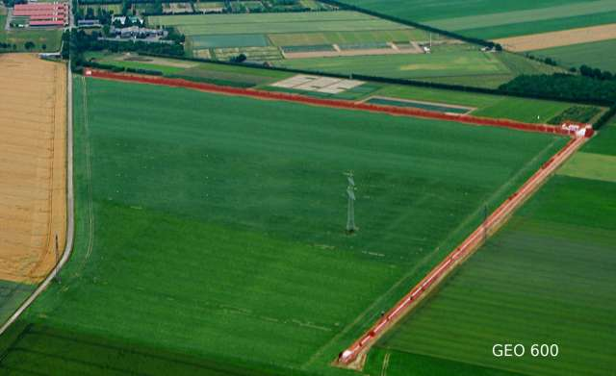
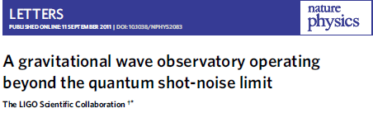
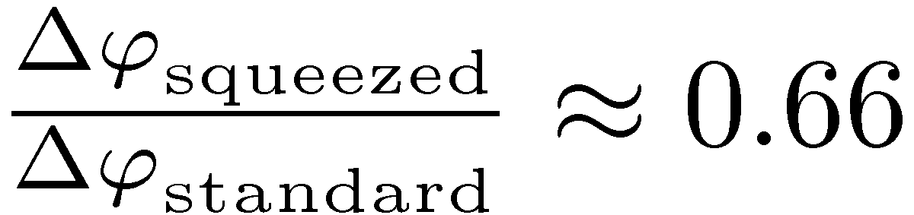
GEO600 interferometer at the fundamental quantum bound
coherent light
+10dB squeezed
fundamental bound
RDD, K. Banaszek, R. Schnabel, Phys. Rev. A, 041802(R) (2013)

Slide 10
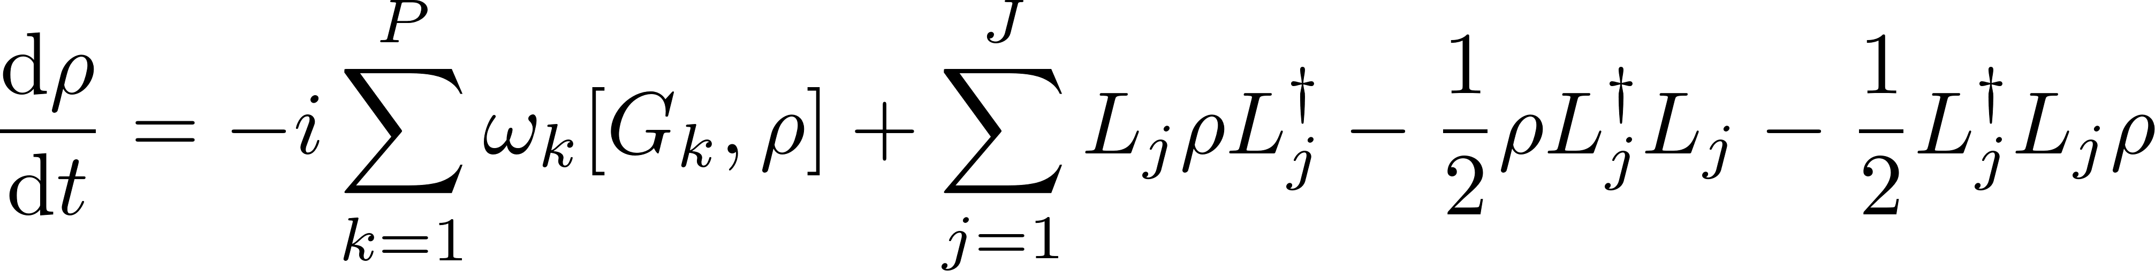
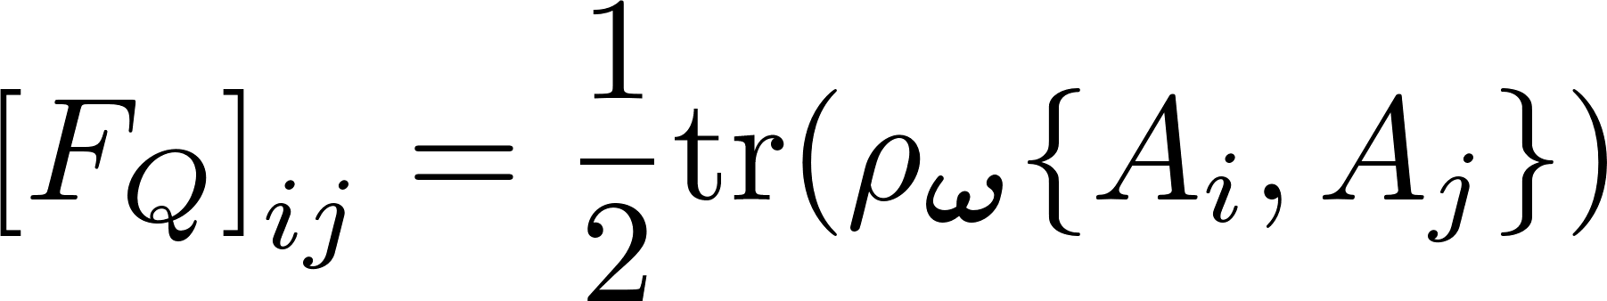
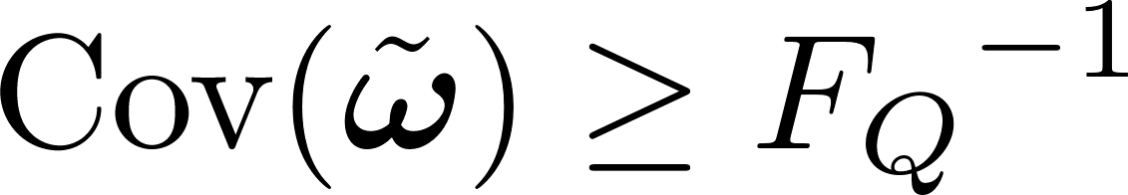



Mo parameters, mo problems…
Different parameters lead to incompatible optimal protocols!
Multi-parameter Quantum Cramer-Rao bound:
QFI matrix
- cost matrix
potential incompatibility of optimal measurements ignored!
S. Ragy, M. Jarzyna, RDD, Physical Review A 94, 052108 (2016)
M. Szczykulska, T. Baumgratz, A. Datta, Advances in Physics: X (2016)

Slide 11



Achievability of the Heisenberg scaling in multiparameter estimation
if and only if
are linearly independent
W. Górecki, S. Zhou, L. Jiang, RDD, arXiv:1901.00896 (2019)

Slide 12


Quantitatively it is much more challenging…
Equivalent formula for the multi-parameter QFI based cost:
Holevo Cramer-Rao bound
takes into account potential incompatibility of optimal measurements
Quadratic semi-definte optimization algorithm developed yielding the optimal error-correction strategy minimizing the cost
W. Górecki, S. Zhou, L. Jiang, RDD, arXiv:1901.00896 (2019)

Slide 13




Example: Two qubits sensing all the components of magnetic field with anti-correlated Z component fluctuations
Heisenberg achievability condition satisfied
When each parameter is estimated optimally using 1/3 of available resources:
For the optimal quantum error-correction sensing protocol (requires a 4 dim ancilla)
Notes:
In noisless case we would have 5.19

Slide 14


Take home message
are linearly
independent
iff
minimal c can be identified via a quadratic semi-definite algorithm
W. Górecki, S. Zhou, L. Jiang, RDD, arXiv:1901.00896 (2019)

Slide 15










More quantum metrology…
Pi-Corrected Heisenberg limit
Quantum metrology with many body interactions
W. Gorecki, D. Berry, H. Wiseman, RDD, in prep.
Atomic clocks - the Quantum Allan Variance
RDD, J. Czajkowski, P. Sekatski,, Phys. Rev. X 7, 041009 (2017)
J.Czajkowski, K. Pawłowski, RDD, New. J. Phys, (2019)
Matrix Product Operator Formalism
K. Macieszczak, M. Fraas, RDD, New J. Phys. 16, 113002 (2014)
K. Chabuda, I. Leroux, RDD, New J. Phys. 18, 083035 (2016)
M. Jarzyna, RDD, Phys. Rev. Lett. 110, 240405 (2013)
K.Chabuda, J. Dziarmaga, T. Osborne, RDD, in prep.

