Slide 1
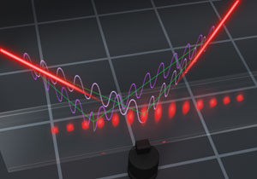
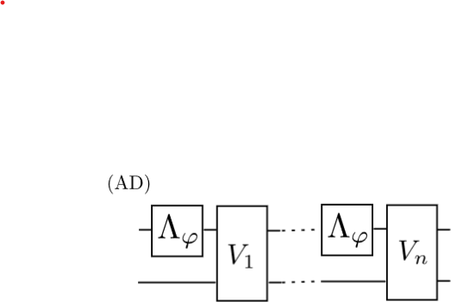
Quantum Metrological Theoretical Toolbox all you need to know to find the optimal protocols!
Rafal Demkowicz-Dobrzański
Faculty of Physics, University of Warsaw, Poland

Slide 2
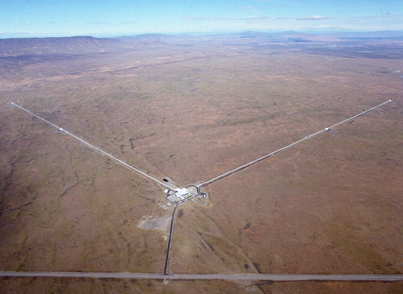
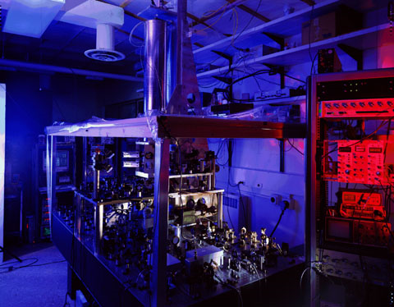
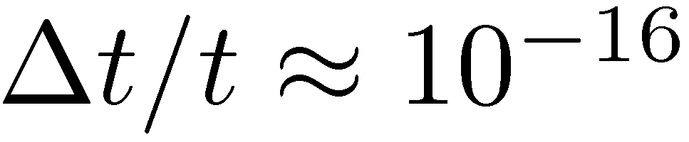
Interferometry at its limits
LIGO - gravitational wave detector
NIST - Cs fountain atomic clock
Michelson interferometer
Ramsey interferometry
How foundamental are these limits?

Slide 3
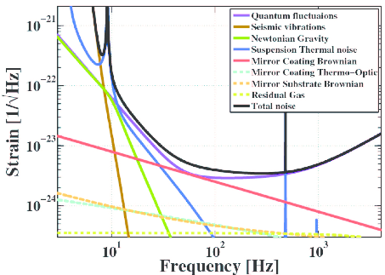
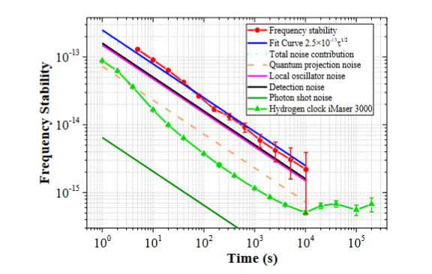
Experimentalist approach

Slide 4

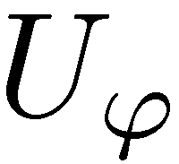
A very naive theorist approach
=
=
=
each photon evolves through an ideal Mach-Zehnder interferometer
each atom treated as a two level system (qubit) is rotated in the Bloch sphere picture by an angle ϕ

Slide 5



A slighlty less naive theorist approach
=
=
=
Take into account optical losses, detector inefficiencies,…
Take into account atomic dephasing,
LO fluctuations…

Slide 6

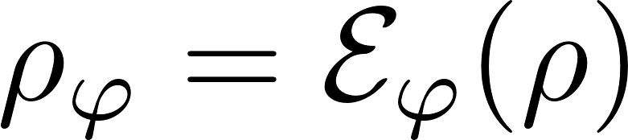

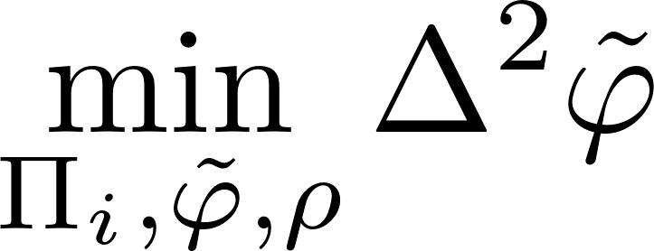
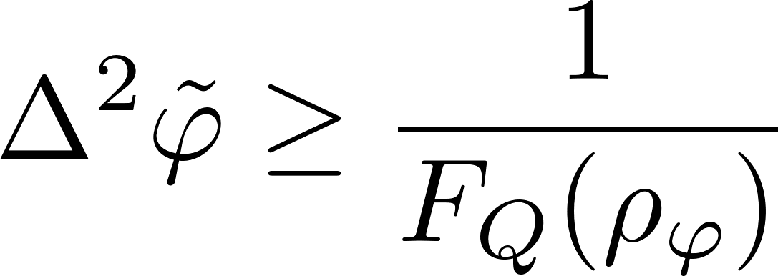
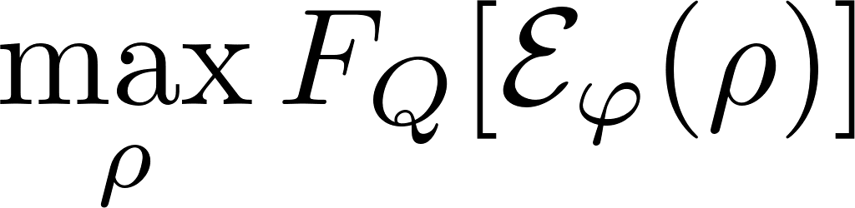
Quantum metrology as a quantum channel estimation problem…
Quantum Cramer-Rao bound

Slide 7
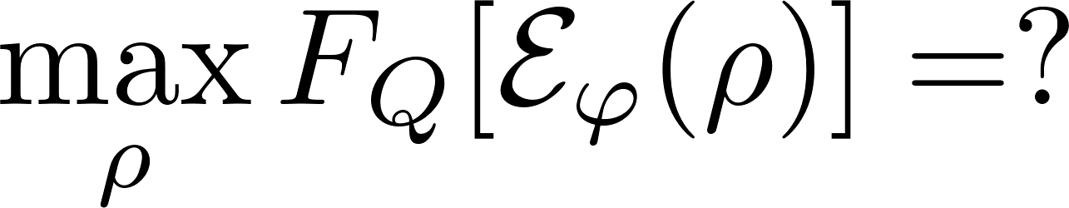
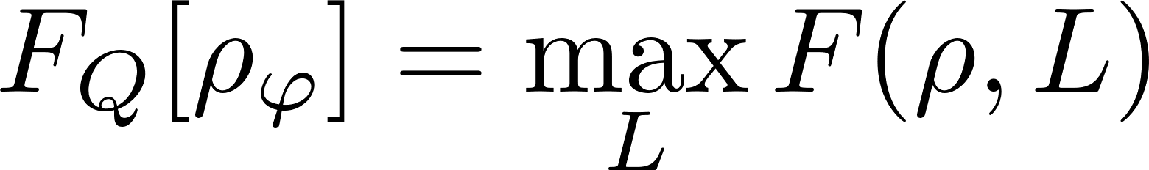
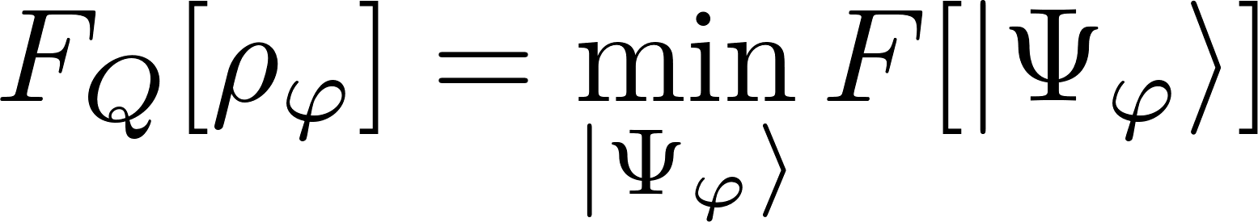
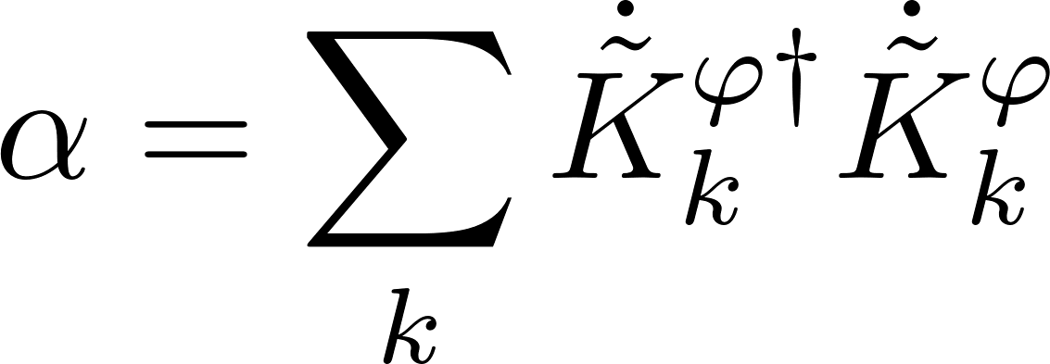
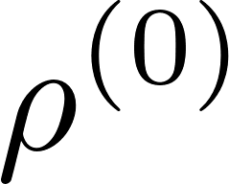
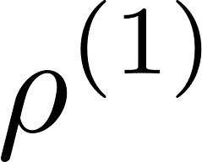
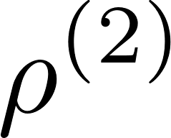
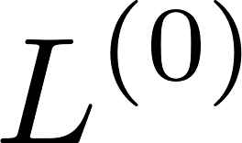
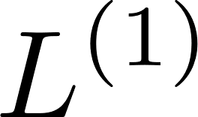
Quantum metrology as a quantum channel estimation problem…
Minimization over purifications (MOP)
Iterative See-Saw (ISS)
Each step is a simple linear or an eigenvalue problem!
A simple SDP programme!
Fujiwara, H. Imai, J. Phys. A 41, 255304 (2008)
K. Macieszczak, arxiv:1312.1356 (2013)
RDD, J. Kolodynski, M. Guta, Nat. Commun. 3, 1063 (2012)

Slide 8
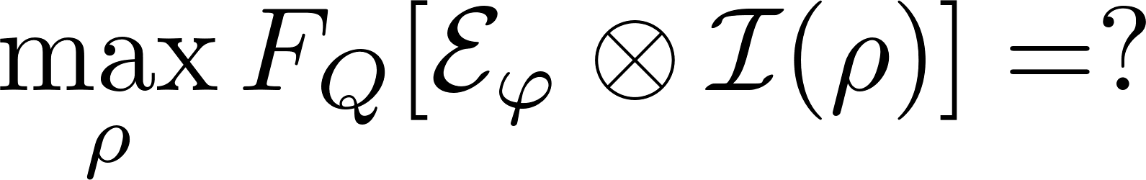
Quantum metrology as a quantum channel estimation problem…
Ancilla insensitive!
Ancilla sensitive!
Minimization over purifications (MOP)
Iterative See-Saw (ISS)
Each step is a simple linear or an eigenvalue problem!
A simple SDP programme!
Fujiwara, H. Imai, J. Phys. A 41, 255304 (2008)
RDD, J. Kolodynski, M. Guta, Nat. Commun. 3, 1063 (2012)
Works in Bayesian approach as well!
RDD, Phys. Rev. A 83, 061802(R) (2011)
K. Macieszczak, arxiv:1312.1356 (2013)
K. Macieszczak, M. Fraas, RDD, New J. Phys. 16, 113002 (2014)

Slide 9
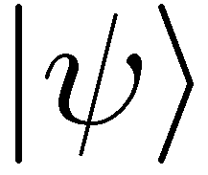
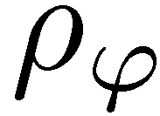
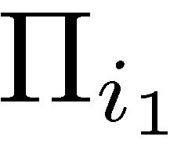


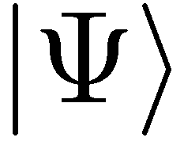
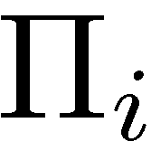
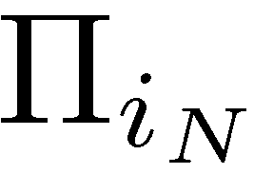

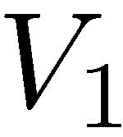

More channels! What are advantages of different levels of quantumness?
(C)
(E)
coherence
entanglement (passive way)
+ sequentiality
(AD)
entanglement + adaptiveness (active quantum feedback)

Slide 10
Optimal entanglement based strategies (E)
If N is small enough… (for qubit channels N ≤ 5)
Minimization over purifications (MOP)
Iterative See-Saw (ISS)

Slide 11
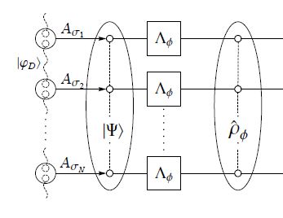
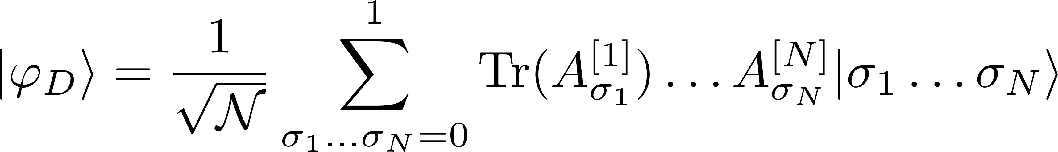
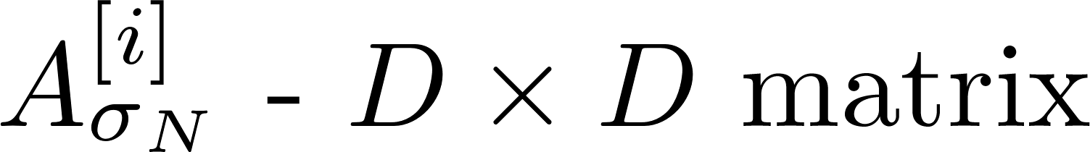
Optimal entanglement based strategies (E)
If N is large we can combine ISS and tensor networks formalism
Minimization over purifications (MOP)
Iterative See-Saw (ISS)
Typically, optimal
matrix product state
Low bond dimensions are usually enough to find the optimal states!
(D – bond dimension)
TNQMetro Package, K.Chabuda, J. Dziarmaga, T. Osborne, RDD, Nat. Commun 11, 250 (2020)

Slide 12
Optimal adaptive protocols (AD)
Looking for optimal adaptive strategies = optimization over quantum combs (SDP)
≡
Minimization over purifications (MOP)
Iterative See-Saw (ISS)
Altherr, Y. Yang, Phys. Rev. Lett 127, 060501 (2021)
Q. Liu, Z. Hu, H. Yuan, Y. Yang, Phys. Rev. Lett. 130, 070803 (2023)
Control over size of ancilla
Can be combined with the tensor-network framework and work for large N !!!!
Exact optimal solution!
No control over size of ancilla
Not efficient for large N
S.Kurdzialek, P. Dulian, J. Majsak, S. Chakrabotry, RDD, arxiv:2403.04854
Q. Liu, Y. Yang, arXiv:2403.09519

Slide 13
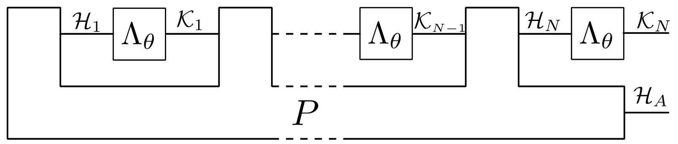
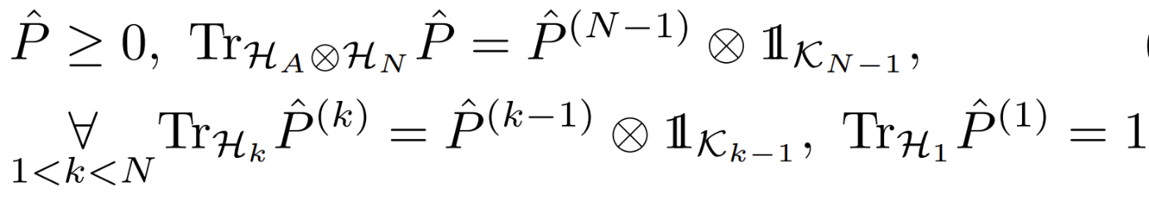
Adaptive startegy as a Quantum comb
Choi-Jamiołkowski operator of the comb

Slide 14
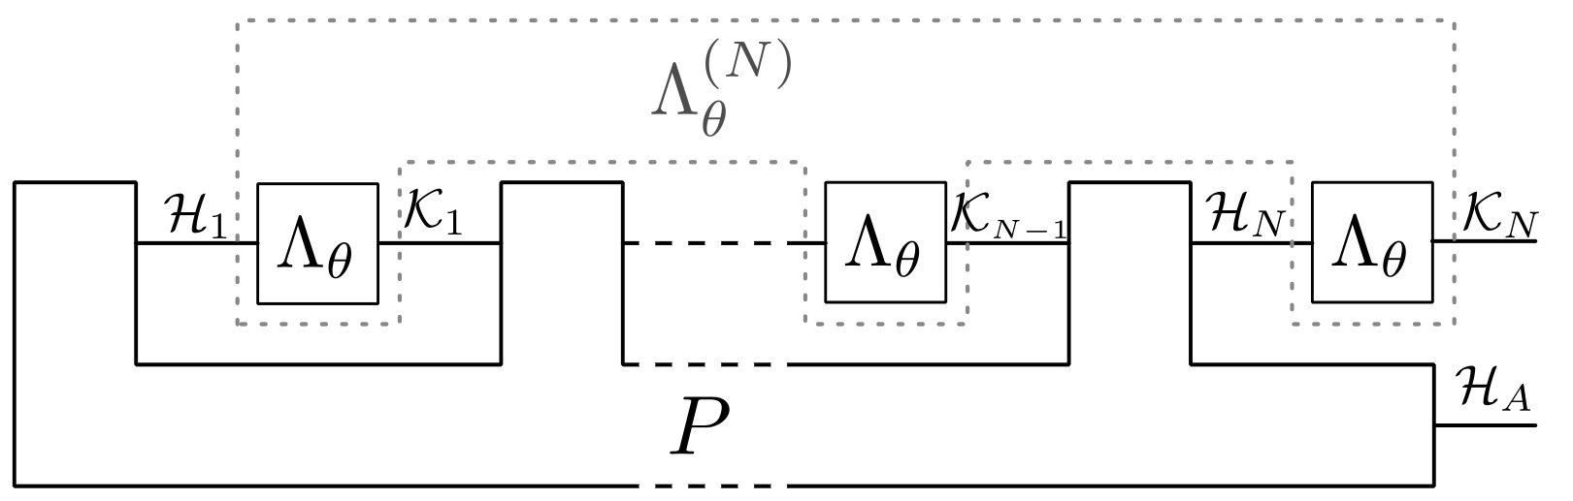
Adaptive startegy as a Quantum comb
We can also take into account corelations in the sensing process
Choi-Jamiołkowski operator of the comb

Slide 15

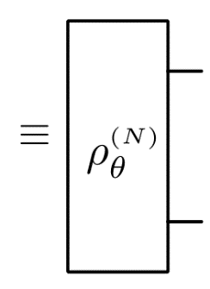

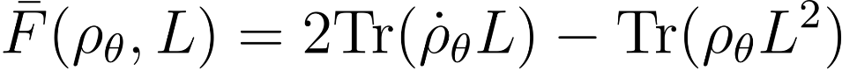
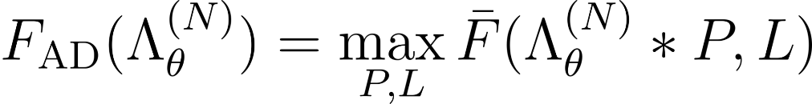


Iterative optimization for combs
Maximizing Quantum Fisher Information:
Link product concatination of maps, on the level of Choi operators
(linear in both arguments)
SDP: Linear in P linear + positivity constraints
SDP: Quadratic in L
We control the size of ancilla
Comb P grows exponentially with N

Slide 16
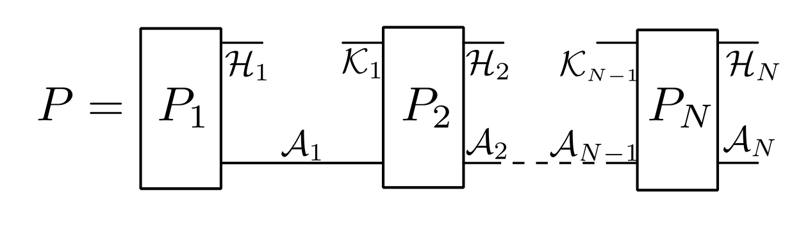
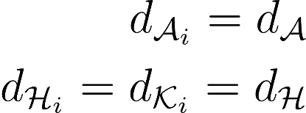
Break a Comb into Teeth!
Efficient method if the (almost) optimal protocols can be found with a small-size ancilla!

Slide 17
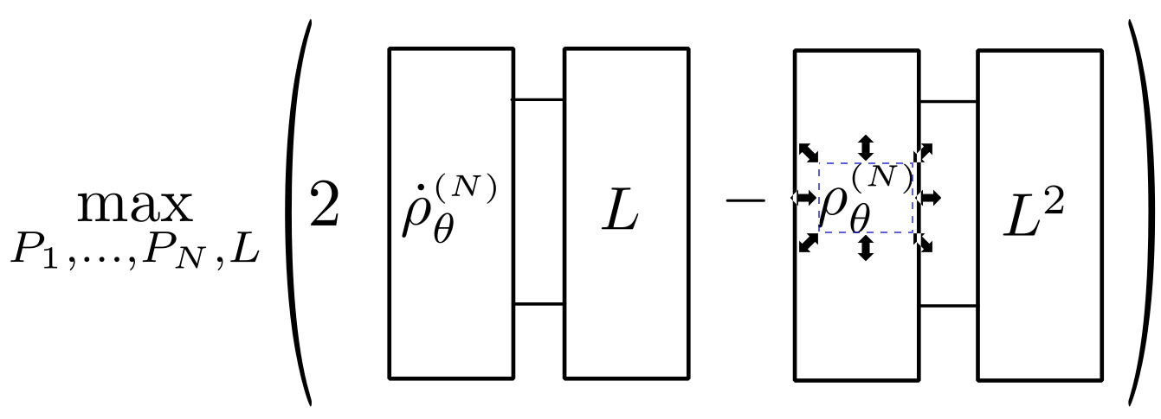
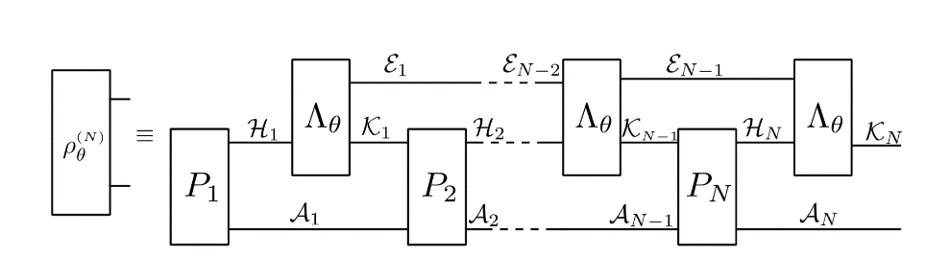

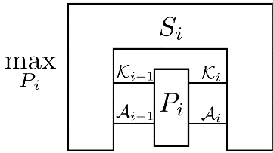
Optimize QFI using tensor networks
Optimization over L
contract all the indices in
the solve the standard SDP to find L
Optimization over P_{i}
contract all the indices apart
from the P_{i} indices and solve:

Slide 18

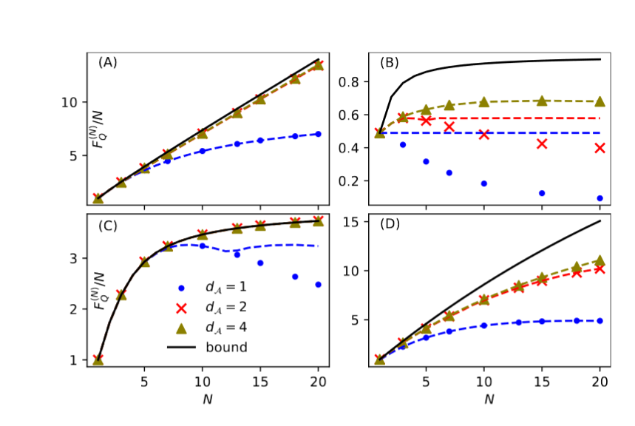
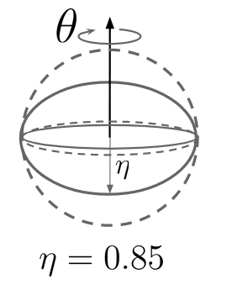
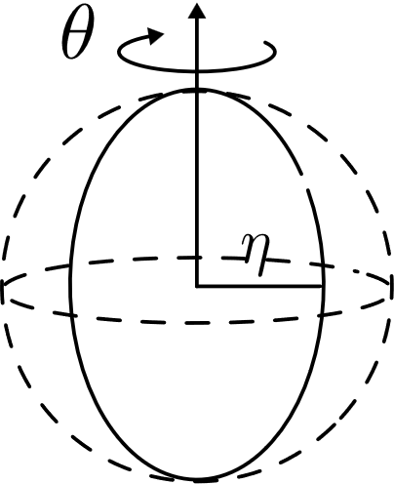

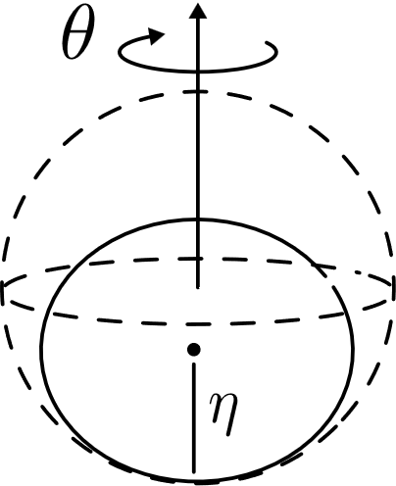
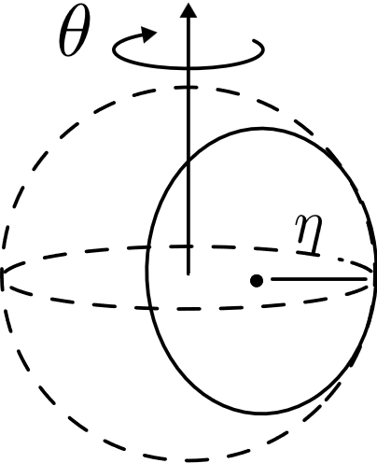
Examples
Perpendicular dephasing
Parallel dephasing
Perpendicular amplitude damping
Parallel amplitude damping

Slide 19
Examples
Perpendicular dephasing
Parallel dephasing
Perpendicular amplitude damping
Parallel amplitude damping

Slide 20
Examples
Perpendicular dephasing
Parallel dephasing
Perpendicular amplitude damping
Parallel amplitude damping

Slide 21
Examples
Perpendicular dephasing
Parallel dephasing
Perpendicular amplitude damping
Parallel amplitude damping
Small ancilla size enough in models where noise of significantly different character than the signal. Otherwise better use paralel schemes + Matrix Product States

Slide 22
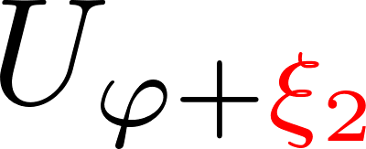
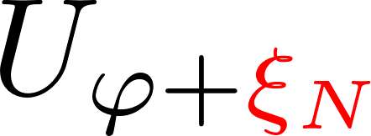


Correlated dephasing noise example
Binary phase shifts correlated via a Markov process
C – correlation parameter
S.Kurdzialek, P. Dulian, J. Majsak, S. Chakrabotry, RDD, arxiv:2403.04854

Slide 23
Complementary approach: derive fundamental bounds!
no-go way
constructive way
Derive analytical/semianalytical upper bounds
Find numerically/guess the best metrological protocols
Ideally!
The best method via minimizations over purifications of the noisy quantum channel
A. Fujiwara, H. Imai, J. Phys. A 41, 255304 (2008)
B. M. Escher, et al. Nature Phys. 7, 406–411 (2011)
RDD, J. Kolodynski, M. Guta, Nat. Commun. 3, 1063 (2012)
RDD, L. Maccone, Phys. Rev. Lett. 113, 250801 (2014) RDD, J. Czajkowski, P. Sekatski, Phys. Rev. X 7, 041009 (2017)
S. Zhou et al., Nat. Commun. 9, 78 (2018)
S. Zhou, L. Jiang, PRX Quantum 2, 010343 (2021) S. Kurdzialek, W. Gorecki, F. Albarelli, RDD, PRL 131, 090801 (2023)
Das, W. Górecki, RDD, arXiv:2404.03954 (2024)
S. Kurdzialek, F. Albarelli, RDD, arxiv:2410.01881 (2024)

Slide 24


Fundamental bounds state-of-the art results (<2023)
Entangled based (E)
Adaptive (AD)
Efficient single channel optimization! (SDP)
A. Fujiwara, H. Imai, J. Phys. A 41, 255304 (2008)
B. M. Escher, et al. Nature Phys. 7, 406–411 (2011)
RDD, J. Kolodynski, M. Guta, Nat. Commun. 3, 1063 (2012)
S. Zhou, L. Jiang, PRX Quantum 2, 010343 (2021) [Asymptotically saturable]
RDD, L. Maccone, Phys. Rev. Lett. 113, 250801 (2014)
P. Sekatski, M. Skotiniotis, J. Kolodynski, W. Dur, Quantum 1, 27 (2017)
true for generic noisy channels
Heisenberg scaling is asymptotically lost!

Slide 25



Fundamental bounds in most common scenarios
N-atom interferometry under dephasing
N-photon lossy interferometry
Constant factor gains over non-entangled strategies
Good news: Bounds are saturable asymptotically with strategies utilizing weakly squeezed states

Slide 26




Squeezed states in gravitational wave detectors
LIGO
VIRGO
Phys. Rev. Lett. 123, 231107 (2019)
Phys. Rev. Lett. 123, 231108 (2019)
35% reduction in noise thanks to squeezing
equivalent to an increase of laser power by 85%!
~100 `quantum’ photons provides the same imprivement as 10²⁰ `classical’ photons

Slide 27

Fundamental bounds latest developments
The best way to bound the increase of QFI when one channel is added
Efficient SDP
No asymptotic gain thanks to adaptiveness for all models with uncorrelated noise!
S. Kurdzialek, W. Gorecki, F. Albarelli, RDD, PRL 131, 090801 (2023)

Slide 28

Fundamental bounds very latest developments, correlated noise models
How to derive a computable asymptotic bound that takes into account correlations?
S. Kurdzialek, F. Albarelli, RDD, arxiv:2410.01881 (2024)

Slide 29
Fundamental bounds very latest developments, correlated noise models
Bound the increase of QFI when a general Quantum Comb acts on m added (correlated!) channels
Bound the increase of QFI when a general Quantum Comb acts on m added (correlated!) channels
S. Kurdzialek, F. Albarelli, RDD, arxiv:2410.01881 (2024)

Slide 30

Fundamental bounds very latest developments, correlated noise models
Bound the increase of QFI when a general Quantum Comb acts on m added (correlated!) channels
Single SDP optimization. Larger m leads to a tighter bound.
Every m-channels we allow for an access to environment.
S. Kurdzialek, F. Albarelli, RDD, arxiv:2410.01881 (2024)

Slide 31


Fundamental bounds correlated (paralel) dephasing model
bounds
Binary phase shifts correlated via a Markov process
C – correlation parameter
N
S. Kurdzialek, F. Albarelli, RDD, arxiv:2410.01881 (2024)

Slide 32



Fundamental bounds latest developments, continuous time models
Assuming optimal quantum control, what is the character of the short and asymtpotic time scaling of the QFI?
A. Das, W. Górecki, RDD, arxiv: arXiv:2404.03954 (2024)

Slide 33


Fundamental bounds latest developments, continuous time models
Taking the continuous limit of the discrete bound:
We get
Where
It is enough to determine the minimal achievable values of operator norms of a(h) and b(h) to determine initial and asymptotic scaling…
A. Das, W. Górecki, RDD, arxiv: arXiv:2404.03954 (2024)

Slide 34

Fundamental bounds latest developments, continuous time models
A simple SDP programme
A. Das, W. Górecki, RDD, arxiv: arXiv:2404.03954 (2024)

Slide 35









Summary
no
yes
Heisenberg scaling not possible. Small-ancilla size adaptive protocols or low-bond dimension MPS paralell protocols optimal
Heisenberg scaling possible.
Small ancilla-size adaptive protocols optimal
S. Kurdzialek, W. Gorecki, F. Albarelli, RDD, PRL 131, 090801 (2023)
S. Kurdzialek, P. Dulian, J. Majsak, S. Chakrabotry, RDD, arxiv: arxiv:2403.04854 (2024)
Das, W. Górecki, RDD, arxiv: arXiv:2404.03954 (2024) S. Kurdzialek, F. Albarelli, RDD, arxiv:2410.01881 (2024)

Slide 36
Summary
We can also deal with correlated noise models…
no
yes
Heisenberg scaling not possible. Small-ancilla size adaptive protocols or low-bond dimension MPS paralell protocols optimal
Heisenberg scaling possible.
Small ancilla-size adaptive protocols optimal
Thank you!
S. Kurdzialek, W. Gorecki, F. Albarelli, RDD, PRL 131, 090801 (2023)
S. Kurdzialek, P. Dulian, J. Majsak, S. Chakrabotry, RDD, arxiv: arxiv:2403.04854 (2024)
A.Das, W. Górecki, RDD, arxiv: arXiv:2404.03954 (2024) S. Kurdzialek, F. Albarelli, RDD, arxiv:2410.01881 (2024)

Slide 37

Big picture overview
S.Kurdzialek, P. Dulian, J. Majsak, S. Chakrabotry, RDD, arxiv:2403.04854
TNQMetro Package, K.Chabuda, J. Dziarmaga, T. Osborne, RDD, Nat. Commun 11, 250 (2020)

