Slide 1
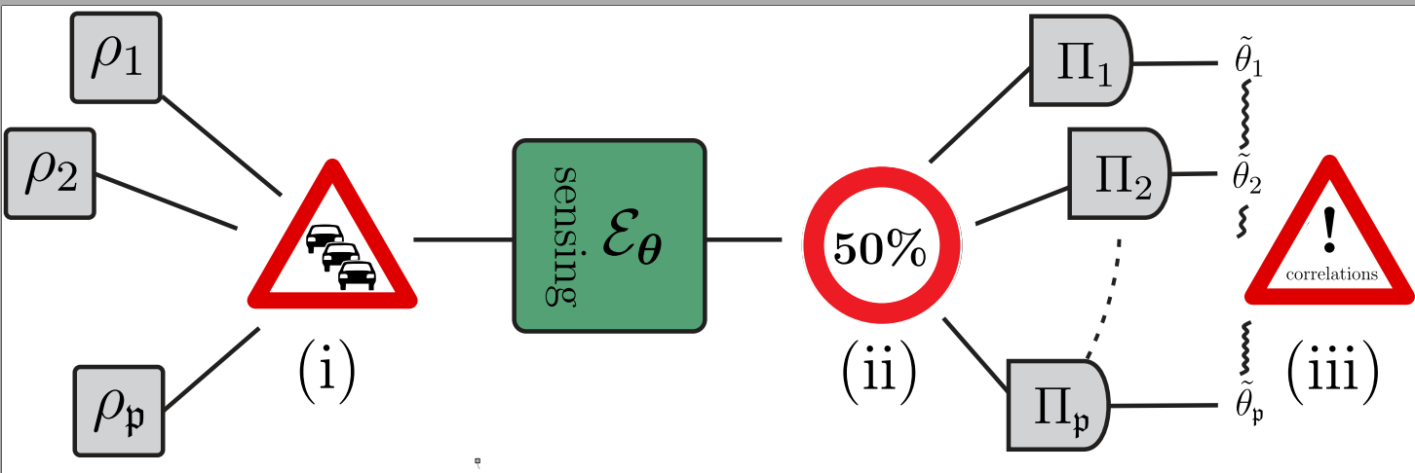

Fundamental Limits in Mutiparameter Quantum Metrology
F. Albarelli, RDD, PRX 12, 011039 (2022) W. Górecki, RDD, PRL 128, 040504 (2022)
R. Demkowicz-Dobrzański, F. Albarelli, W Górecki
Faculty of Physics, University of Warsaw, Poland

Slide 2

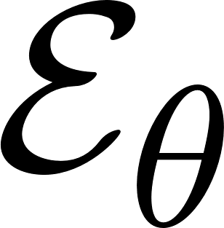

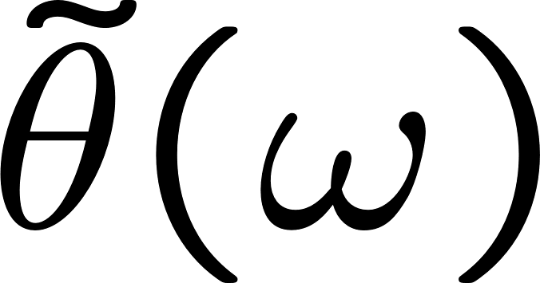
A basic quantum metrology problem
input state
measurement
estimator
input state
a quantum channel
with unknown parameter

Slide 3


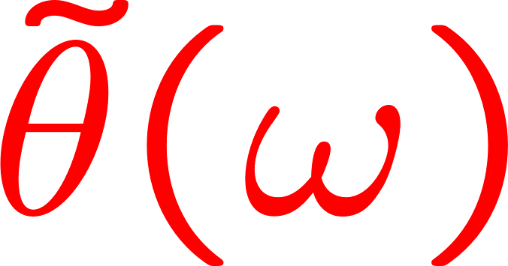
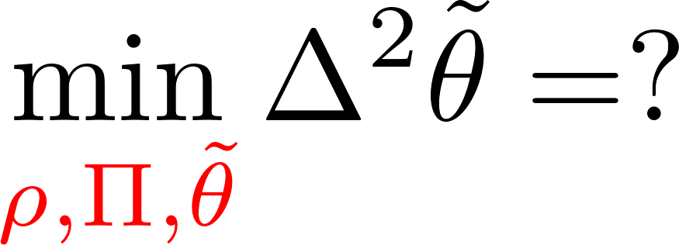
A basic quantum metrology problem
input state
measurement
estimator
input state
a quantum channel
with unknown parameter

Slide 4
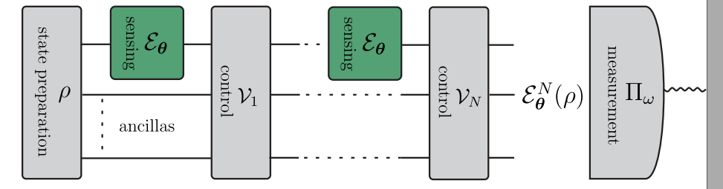
Optimal adaptive protocol involving N uses of a channel

Slide 5
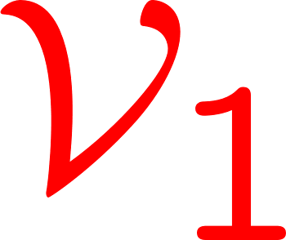
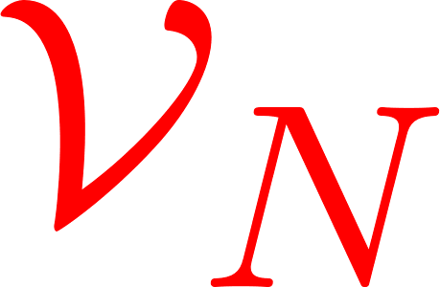
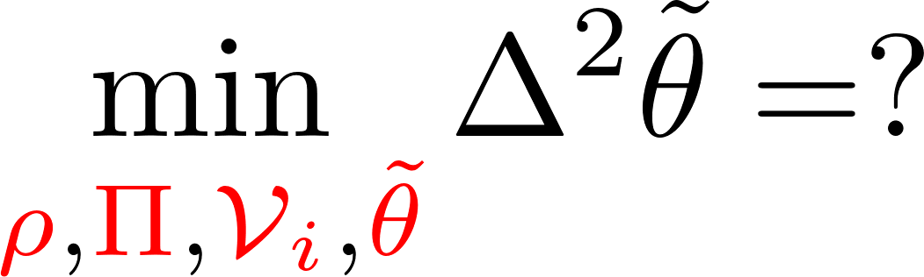
Optimal adaptive protocol involving N uses of a channel

Slide 6
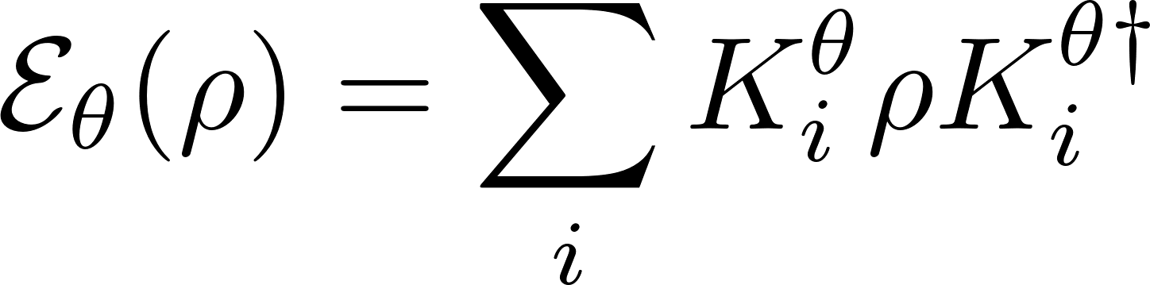
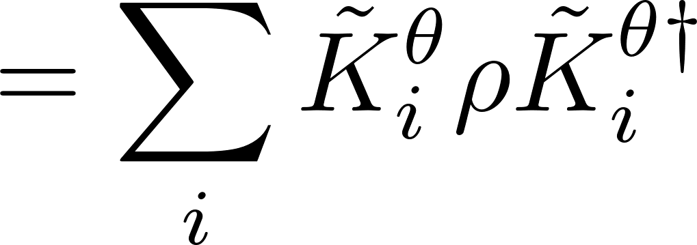
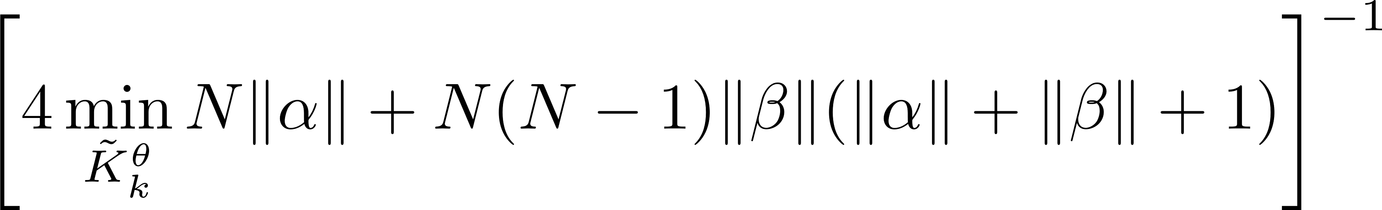
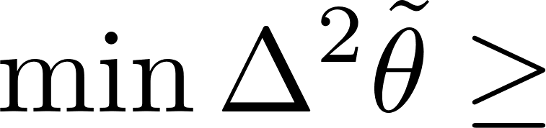
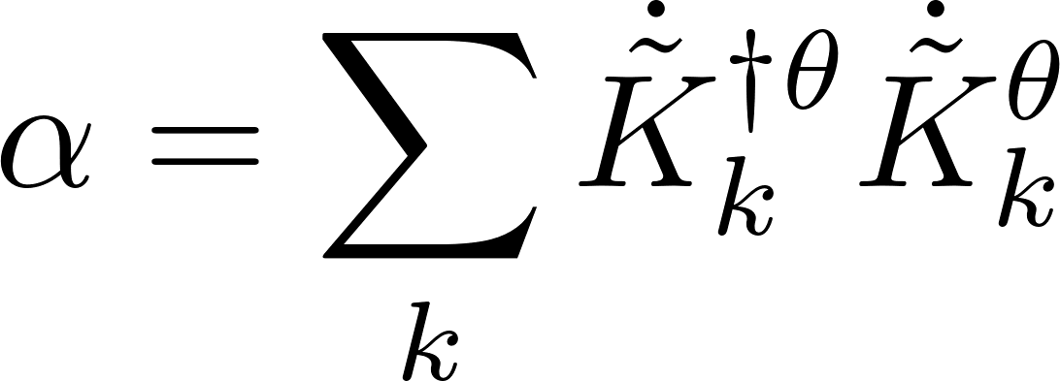
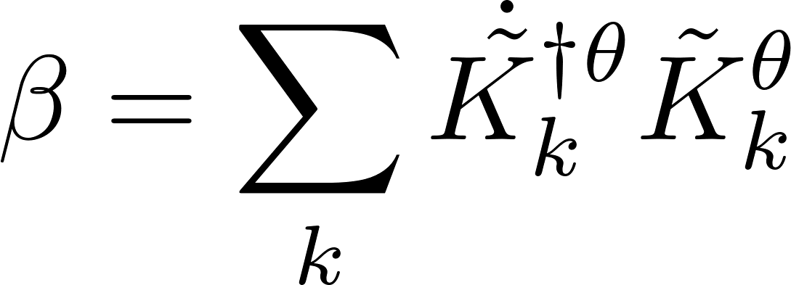
Single parameter noisy case saturable bounds using quantum Fisher information approach
single channel optimization! an efficient SDP programme
true for generic noisy channels
A. Fujiwara, H. Imai, J. Phys. A 41, 255304 (2008)
B. M. Escher, R. L. de Matos Filho, L. Davidovich Nature Phys. 7, 406–411 (2011)
RDD, J. Kolodynski, M. Guta, Nat. Commun. 3, 1063 (2012)
RDD, L. Maccone, Phys. Rev. Lett. 113, 250801 (2014) [Adaptive schemes included]
RDD, J. Czajkowski, P. Sekatski, Phys. Rev. X 7, 041009 (2017)
S. Zhou, M. Zhang, J. Preskill, and L. Jiang, Nat. Commun. 9, 78 (2018)
S. Zhou, L. Jiang, PRX Quantum 2, 010343 (2021) [Saturability proven using q. error correction ideas]

Slide 7
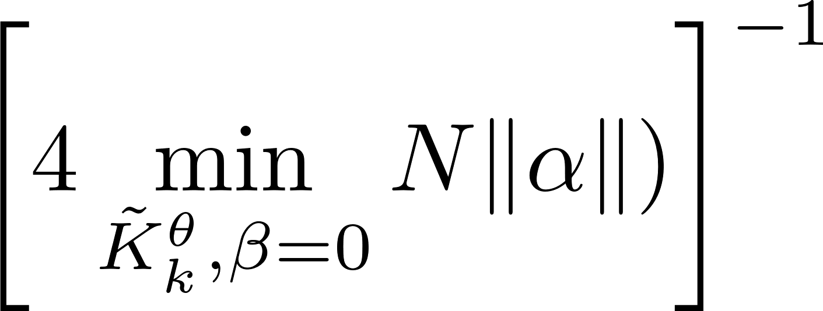
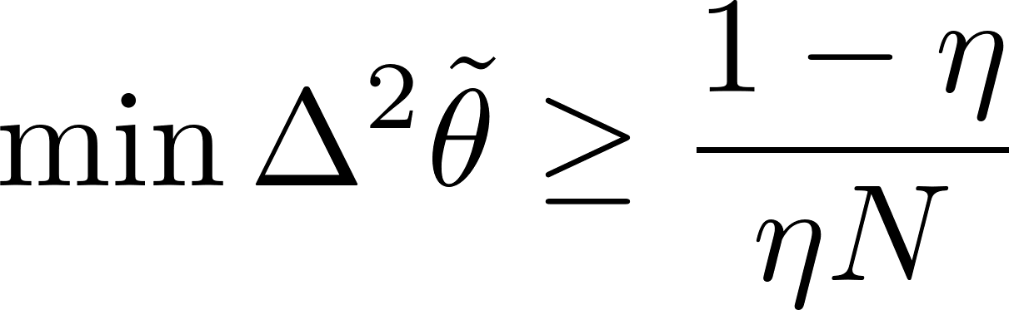
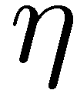

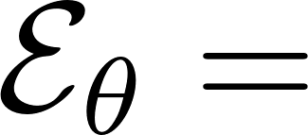
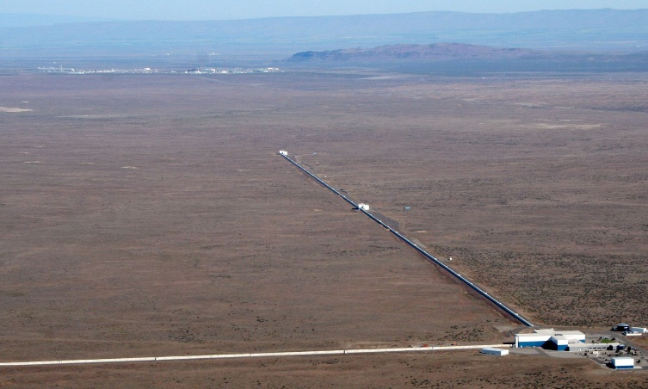
Asymptotic constant factor quantum improvement – Heisenberg scaling lost
Lossy interferometry
quantum enhancement factor
Fundamental bound saturable with squeezed vacuum + coherent state interferometry!
Almost optimal gain observed in LIGO/VIRGO!
C.Caves, Phys. Rev. D 23, 1693 (1981)
RDD, K. Banaszek, R. Schnabel, Phys. Rev. A 88, 041802(R) (2013)

Slide 8
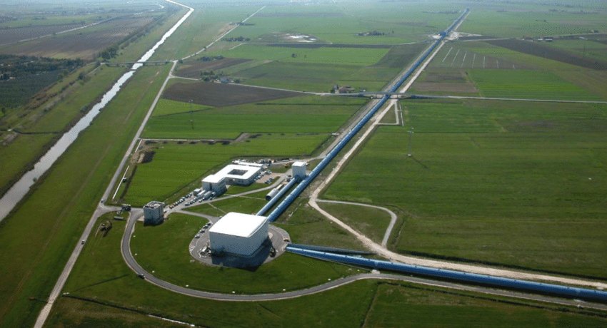
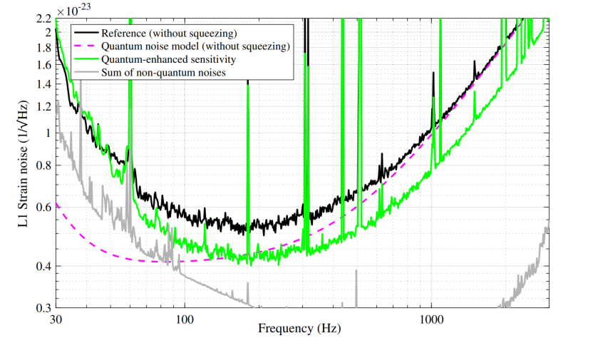
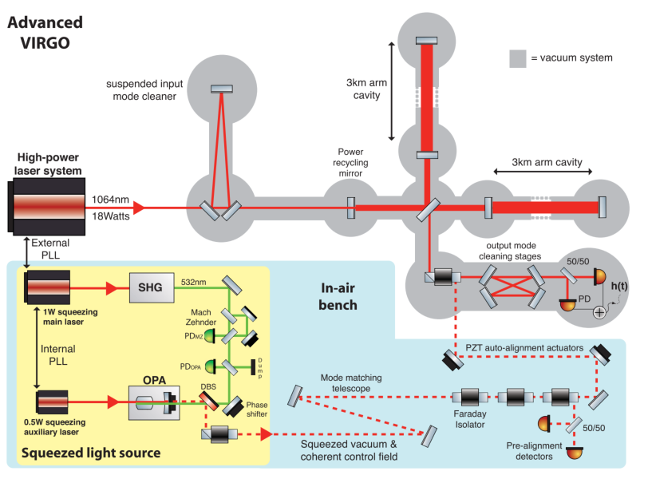
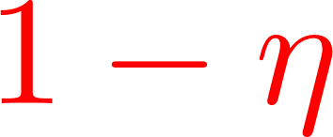
Squeezed light enhanced gravitational wave detectors
LIGO
VIRGO
Phys. Rev. Lett. 123, 231107 (2019)
Phys. Rev. Lett. 123, 231108 (2019)
35% reduction of noise thanks to squeezing
– equivalent of increasing the power by 85%!
~100 `quantum’ photons contribute the same improvement as 10^{20 `}classical’ photons

Slide 9
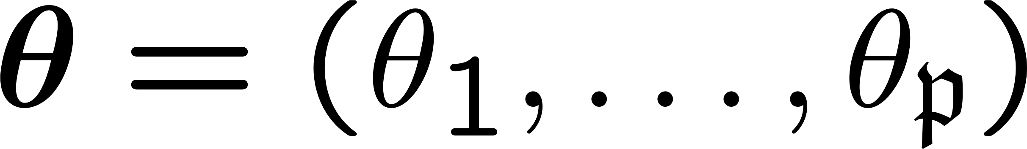
Multiparameter issues!
Input probe incompatibility
Measurement incompatibility
Correlated estimators
S. Ragy, M, Jarzyna, RDD, Phys. Rev. A 94, 052108 (2016)

Slide 10
Multiparameter issues!
Input probe incompatibility may affect scaling of precision with the numer of parameters involved!
Measurement incompatibility asymptotically at most twice overhead in resources for noisy models
Correlated estimators problem removed if proper parametrization chosen
S. Ragy, M, Jarzyna, RDD, Phys. Rev. A 94, 052108 (2016)

Slide 11
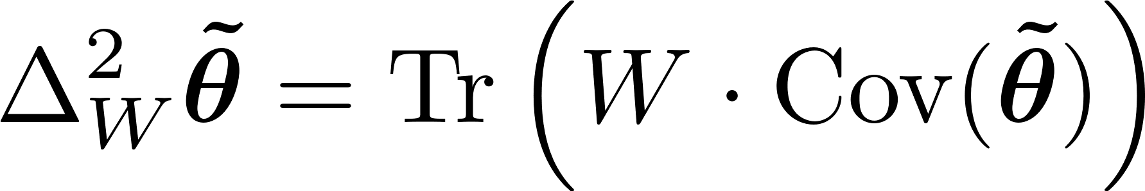
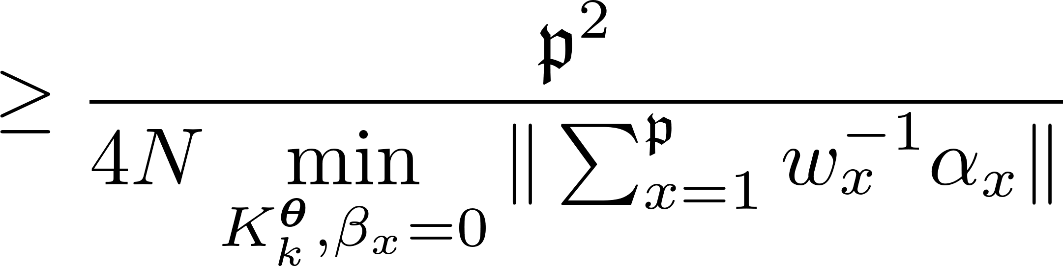
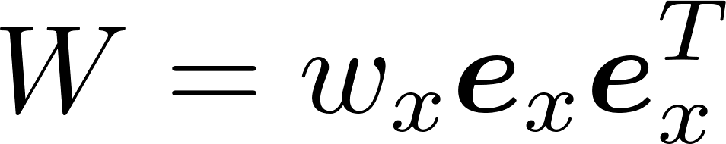
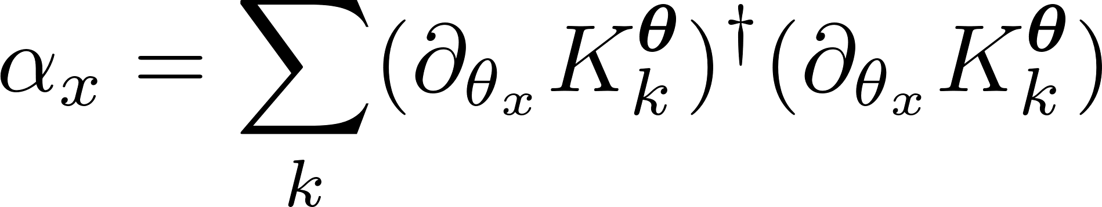
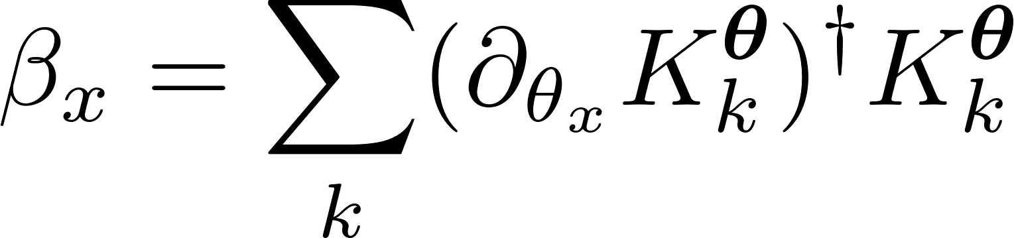
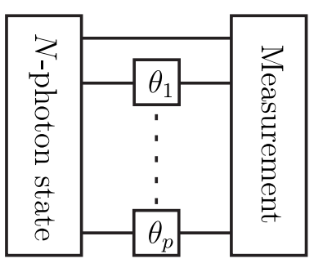

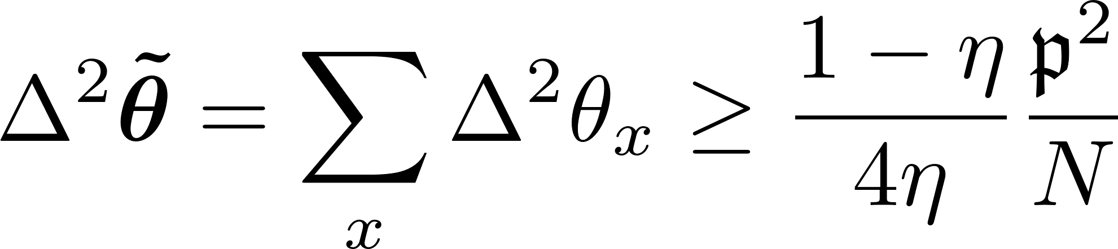
Fundamental multiparameter bound in generic noisy metrology
estimator covariance matrix
cost matrix
cost matrix eigendecompositions
(natural parametrization)
Multiple-phase lossy interferometry (including adaptive schemes)
F. Albarelli, RDD, PRX 12, 011039 (2022)

Slide 12
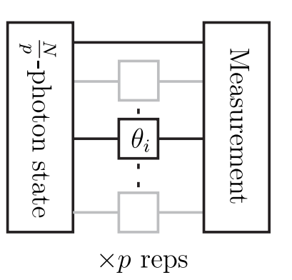
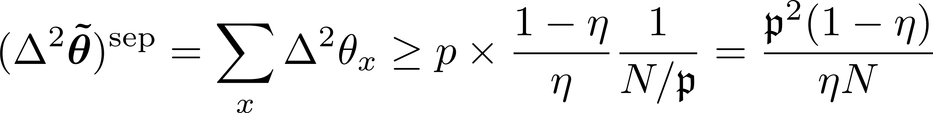
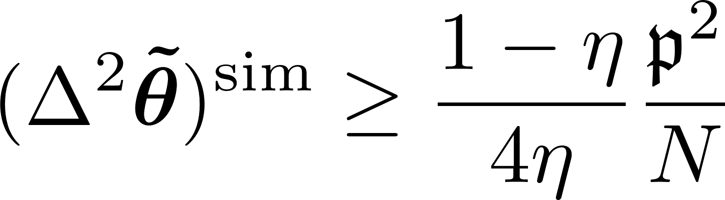
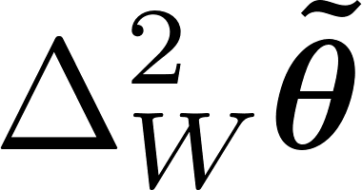
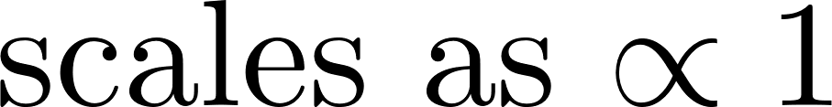
Simultanous vs. Separate estimation
If we perform separate estimation we need to split resources
Simultaenous estimation has an advantage but at most o factor of 4
No scaling advantage in numer of parameters due to probe incompatibility!
F. Albarelli, RDD, PRX 12, 011039 (2022) )

Slide 13
Noiseless metrology The true Heisenberg limit

Slide 14
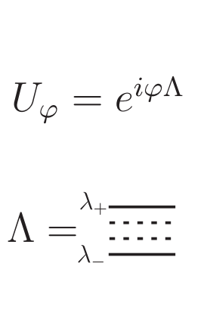
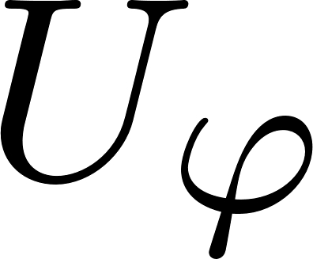
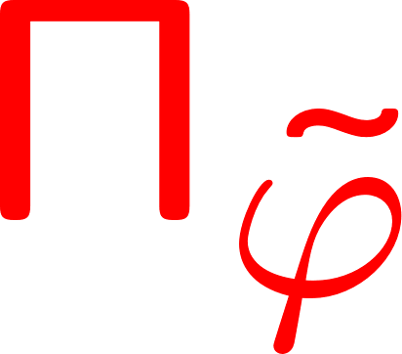
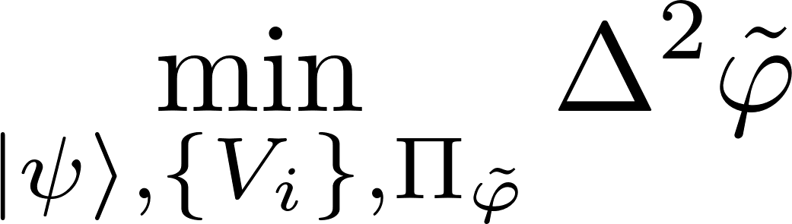
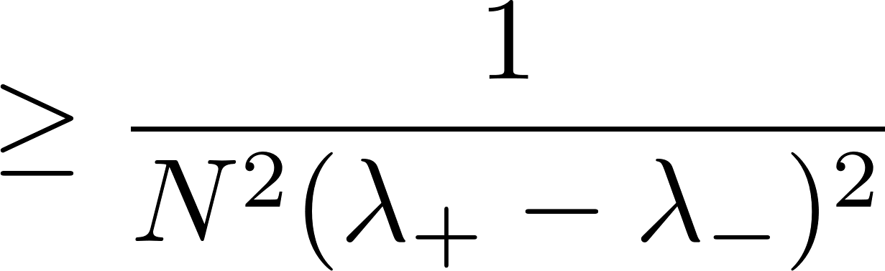
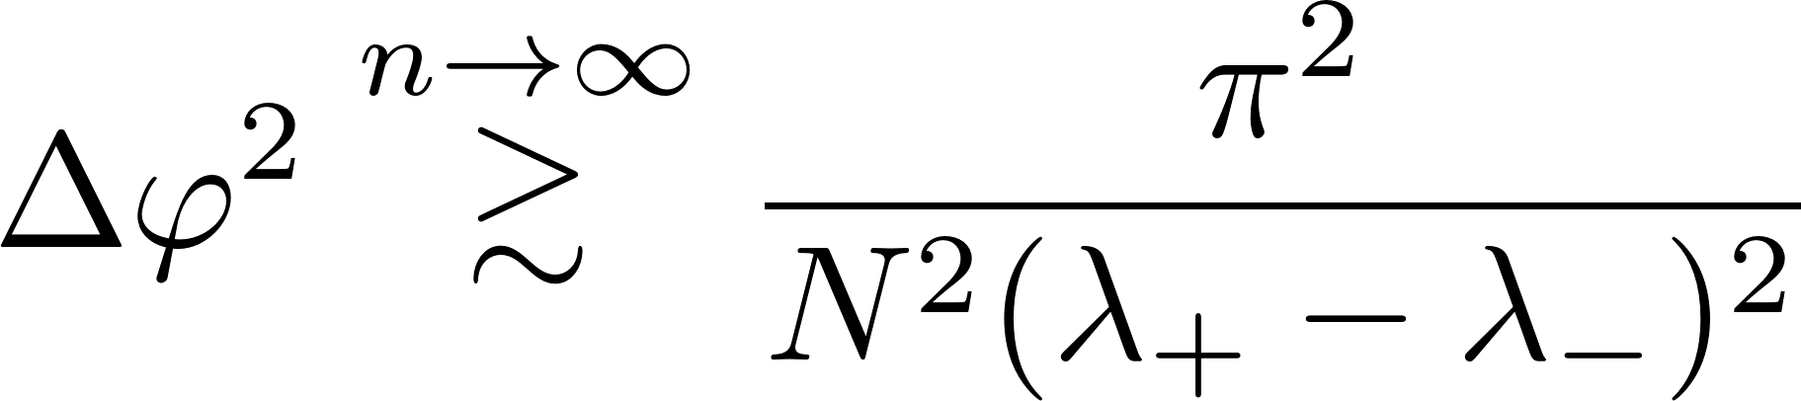
Single parameter noiseless case
Using Fisher information approach, one can derive:
Not operationally saturable!
V. Giovannetti, S. Lloyd, and L. Maccone, Phys. Rev. Lett. 96, 010401 (2006).
Using Bayesian approach. We get an asymptotically saturable bound:
Pi-corrected Heisenberg limit!
W. Gorecki, RDD, H. M. Wiseman, D. W. Berry, Phys. Rev. Lett 124, 030401 (2020)

Slide 15
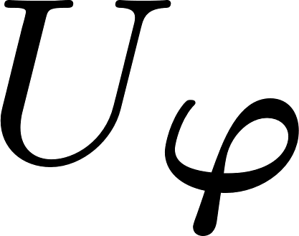
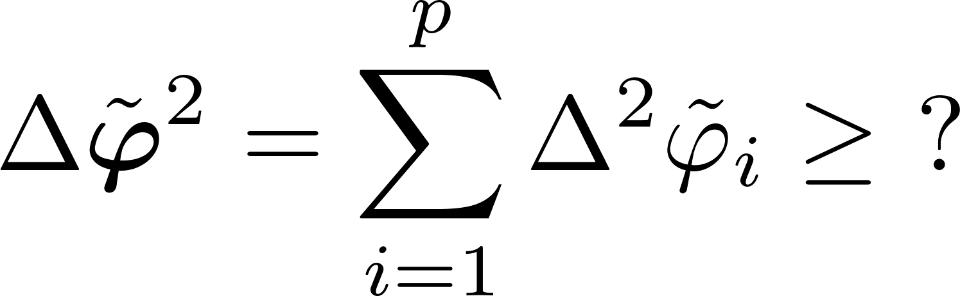
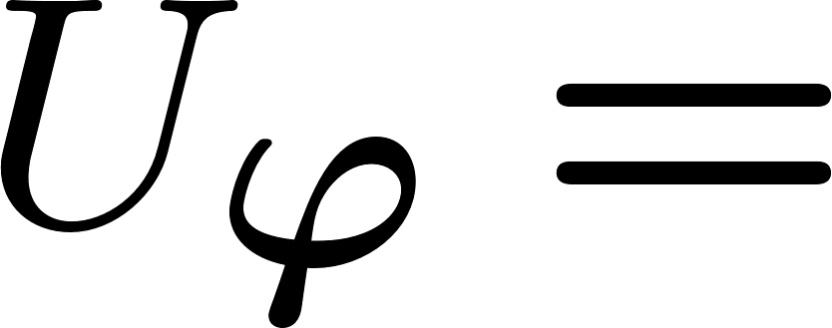
Multiple phases noiseless interferometry

Slide 16
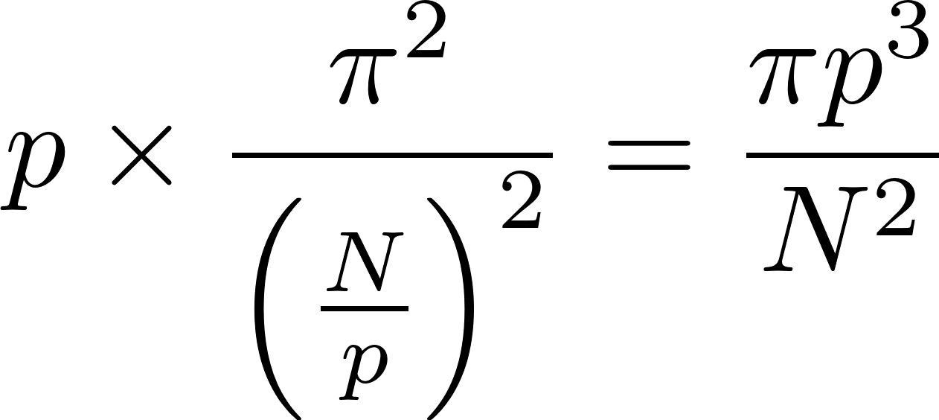
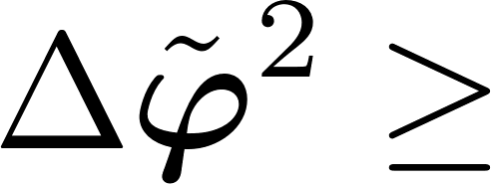
Multiple phases noiseless interferometry
Adaptiveness is not relevant
Separate strategy

Slide 17
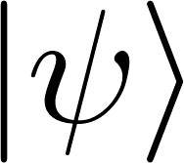
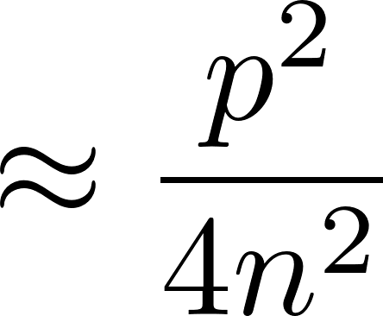




Multiple phases noiseless interferometry simultaneous vs separate strategies
Quantum Fisher information based analysis
P. C. Humphreys, M. Barbieri, A. Datta, and I. A. Walmsley, Phys. Rev. Lett. 111, 070403 (2013)
A better scaling of precision in terms of numer of estimated parameters…
Quantum Fisher Information matrix
Not achievable, unless many-repetition scenario considered!!!
Bayesian approach
Only a constant factor gain over separate strategies!
W. Górecki, RDD, PRL 128, 040504 (2022)

Slide 18
Summary
Probe incompatibility, the most relevant feature of multiparameter metrology
Nontrivial bounds in noisy multiple-parameter metrology derrived
Results may be applied to discrimination tasks -> bounds on noisy Grover algorithm
In noisless cases the Bayesian approach provides proper operationally saturable bounds in terms of the total resources used.
Thank you!
F. Albarelli, RDD, PRX 12, 011039 (2022) W. Górecki, RDD, PRL 128, 040504 (2022)

