Slide 1
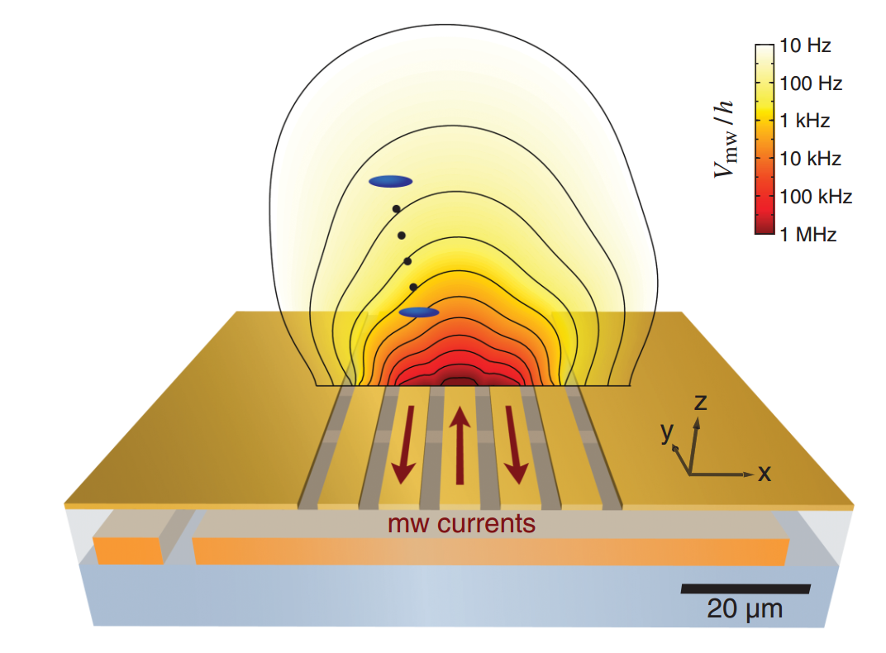
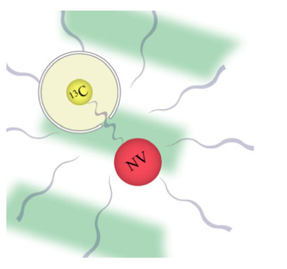
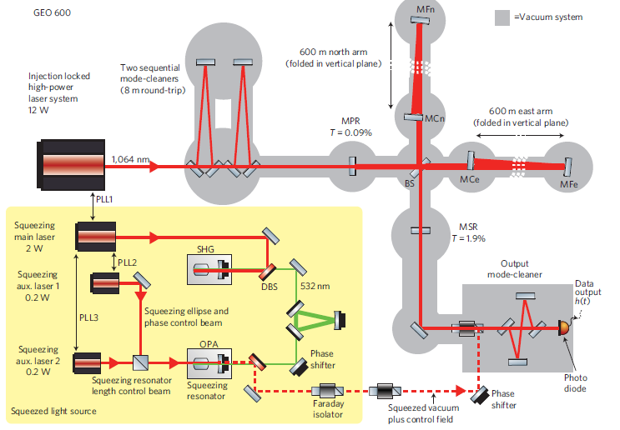

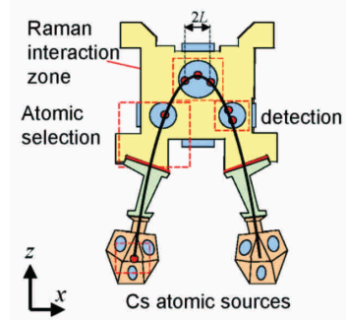
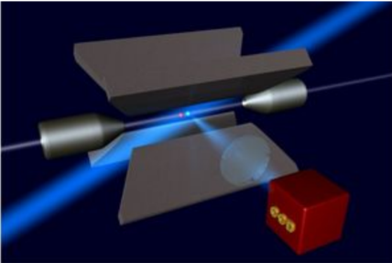
The Grand Unified Theory of Quantum Metrology
Cold atom magnetometers
GUT
Optical interferometers using
non-classical light
NV sensors
Atomic inertial sensors
Atomic clocks
Rafal Demkowicz-Dobrzański
Faculty of Physics, University of Warsaw, Poland

Slide 2
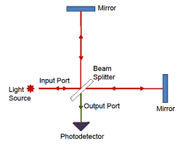
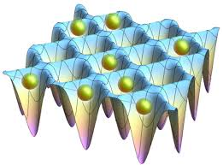

Quantum Metrology
under relevant physical constraints make the most of quantum coherence (and entanglement) to boost measurement precision
 | Optical interferometry | Atomic clocks | NV center magnetometers
Coherence | „classical” light | uncorrelated/single atoms | electron spin only
Entanglement | squeezed light | entangled atoms | electron spin entangled with nuclear spins
Decoherence | photon loss | LO fluctuations, atom dephasing, loss | spin dephasing
Notes:
1.

Slide 3
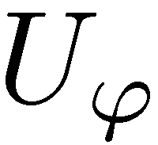
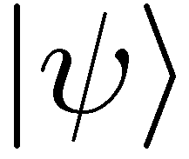
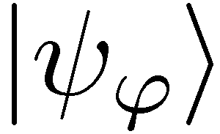
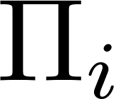
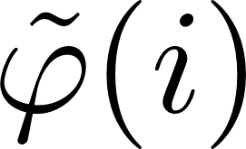
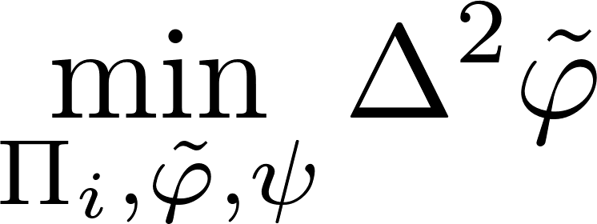
Quantum metrology as a quantum channel estimation problem

Slide 4
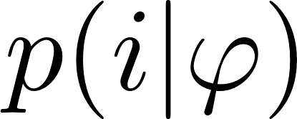
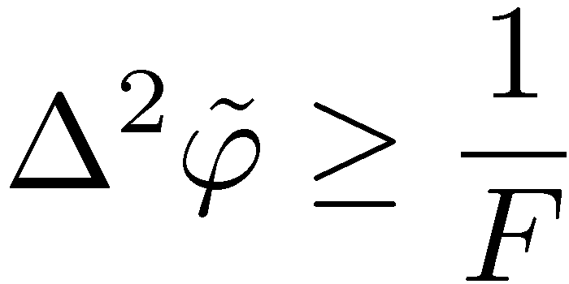
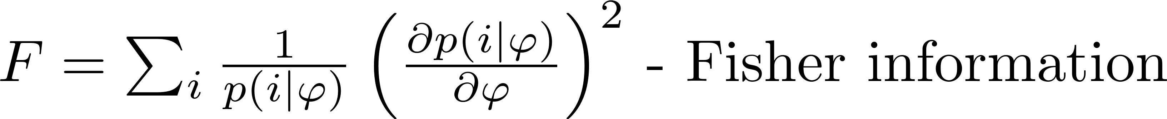
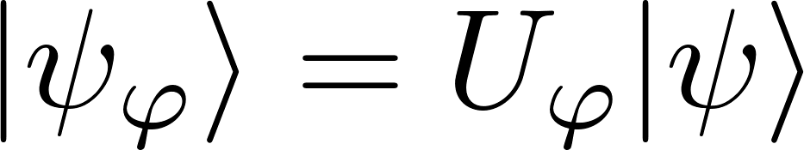
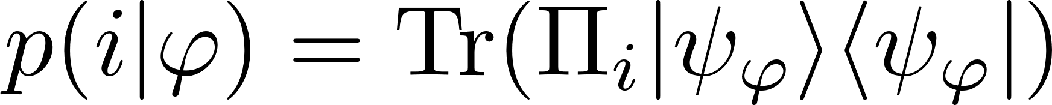
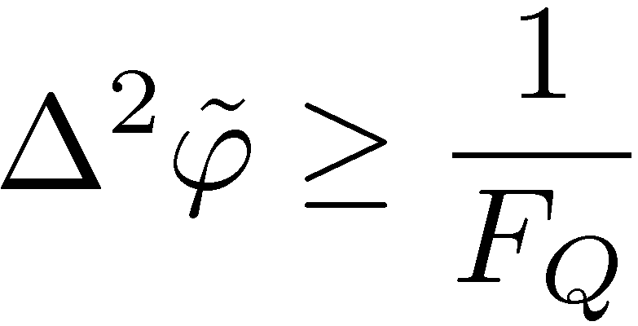
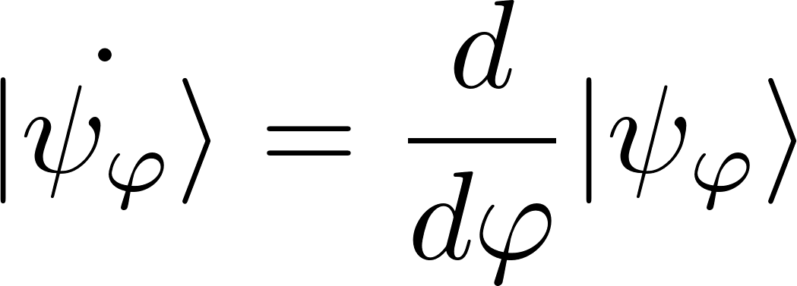
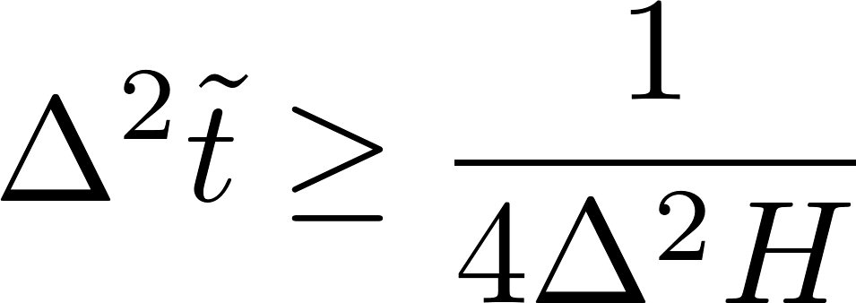
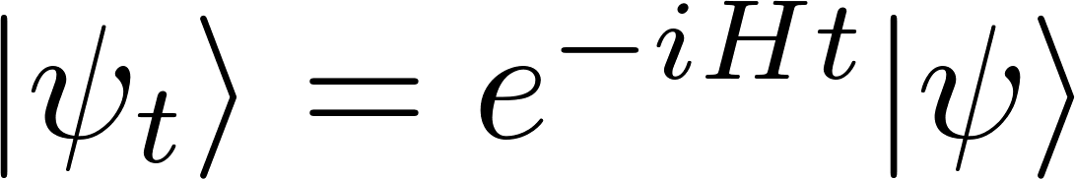
Quantum Cramer-Rao bound
Classical Cramer-Rao inequality
Quantum Cramer-Rao inequality
Quantum Fisher information
Time-Energy uncertainty relation

Slide 5

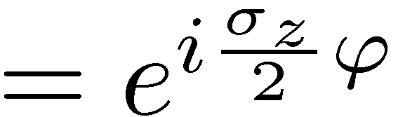
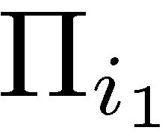


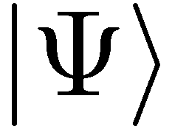
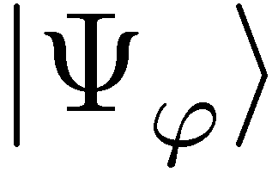
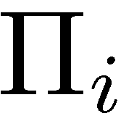
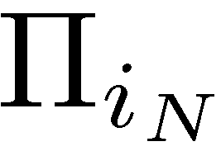
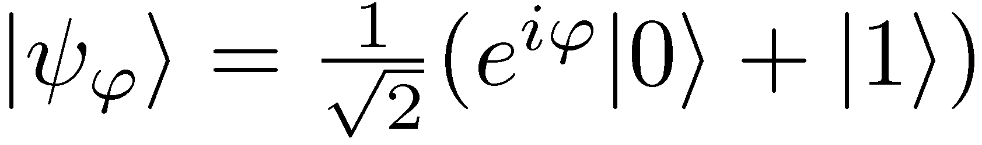
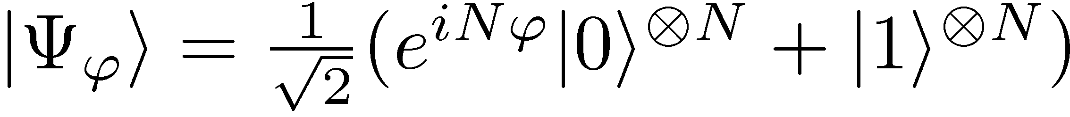
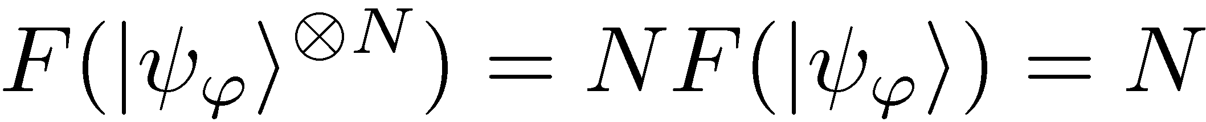
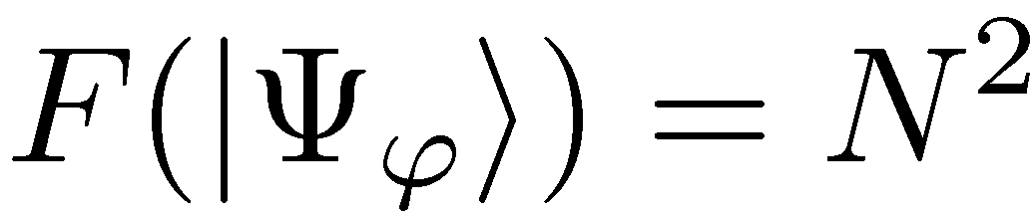
Phase estimation with N uses of a channel
Uncorrelated scheme
Entanglement-enhanced scheme
Maximize Quantum Fisher Information over input states

Slide 6
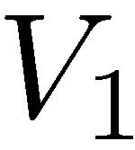
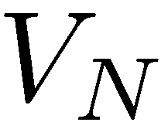
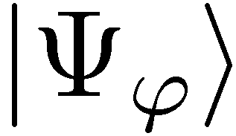
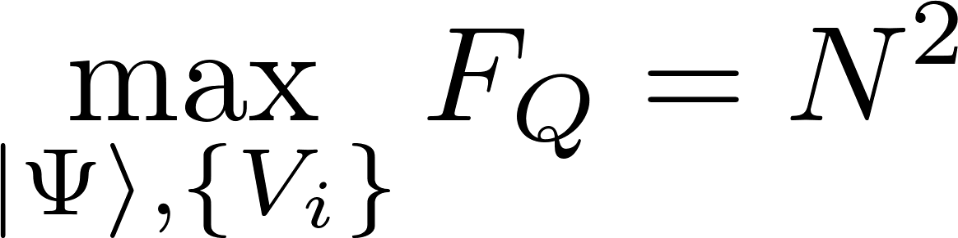
The most general adaptive scheme
No improvement thanks to adaptiveness!
V. Giovannetti, S. Lloyd, and L. Maccone, Phys. Rev. Lett. 96, 010401 (2006).

Slide 7
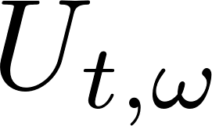
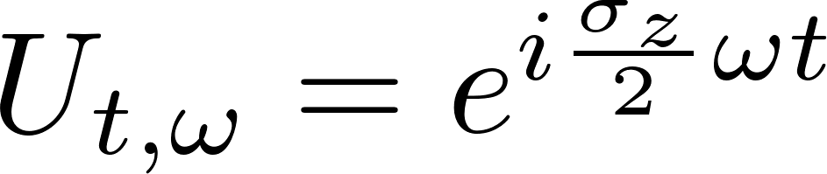
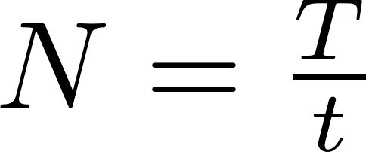
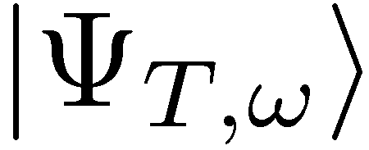
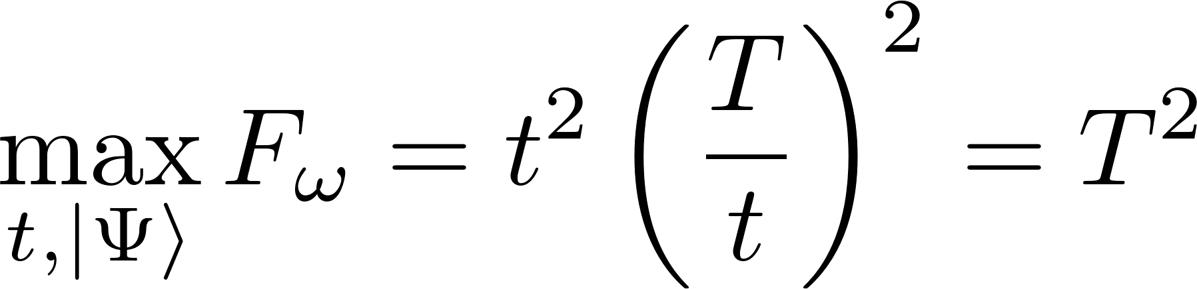
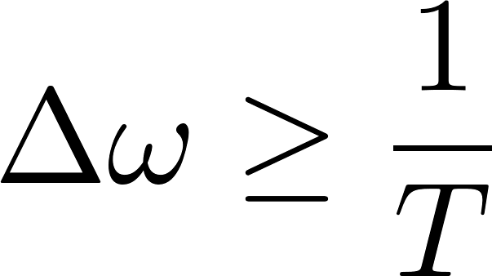
Noiseless frequency estimation
Estimate frequency, for total interrogation time T

Slide 8
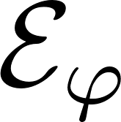
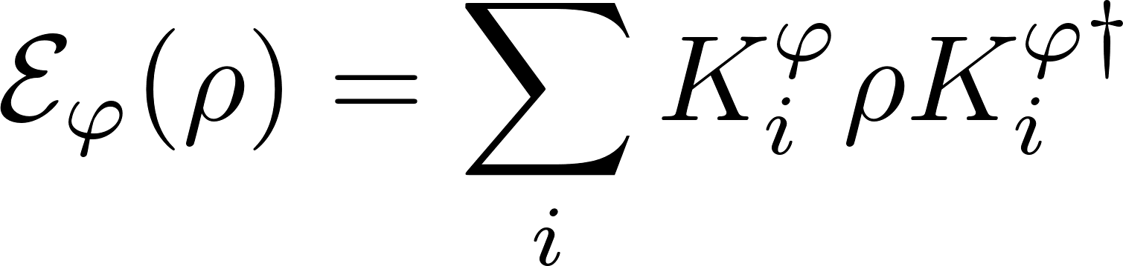
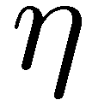
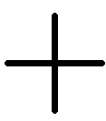
Impact of decoherence…
loss
dephasing

Slide 9
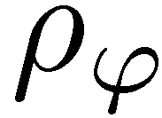
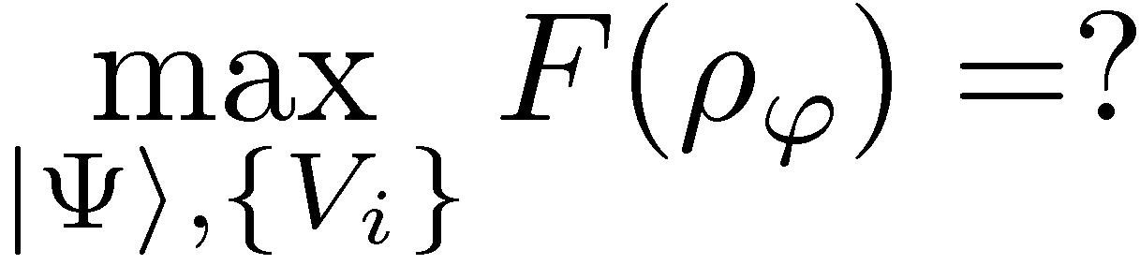
Impact of decoherence…

Slide 10

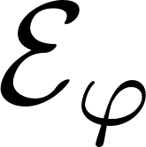
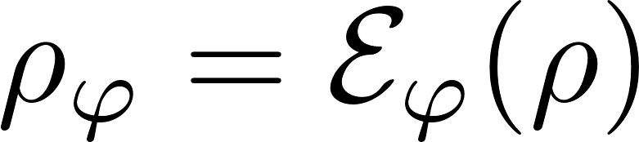




Quantum Fisher Information for mixed states
difficult to analyze….
may sometimes be helpful in deriving bounds…

Slide 11



Precision bounds via minimization over equivalent Kraus representations
single channel optimization!
A. Fujiwara, H. Imai, J. Phys. A 41, 255304 (2008)
B. M. Escher, R. L. de Matos Filho, L. Davidovich Nature Phys. 7, 406–411 (2011)
RDD, J. Kolodynski, M. Guta, Nat. Commun. 3, 1063 (2012)
RDD, L. Maccone Phys. Rev. Lett. 113, 250801 (2014) [Adaptive schemes included]

Slide 12








Adaptive frequency estimation
Maximize Quantum Fisher Information under fixed total interrogation time T
?

Slide 13


General frequency estimation problem under Markovian noise
Maximize Quantum Fisher Information under fixed total interrogation time T
?

Slide 14

Frequency estimation bounds directly from the quantum Master equation
Without loss of generality we may always consider limit t->0…..
Expand β and α in t…

Slide 15


Frequency estimation bounds directly from the quantum Master equation
Quantitative bound:
Can be solved by semi-definite programming:
RDD, J. Czajkowski, P. Sekatski,, Phys. Rev. X 7, 041009 (2017)

Slide 16















Heisenberg scaling is typically lost
Single photon modeled as a three level system:
Fundamental bound can be asymptotically reached with simple schemes involving weakly squeezed states!

Slide 17




GEO600 interferometer at the fundamental quantum bound
The most general quantum strategies could additionally improve the precision by at most 8%
coherent light
+10dB squeezed
fundamental bound
RDD, K. Banaszek, R. Schnabel, Phys. Rev. A, 041802(R) (2013)

Slide 18




Recovering the Heisenberg scaling via Quantum Error Correction - Example
Perpendicular dephasing:
Simple quantum error correction scheme leads to
G. Arad et al Phys. Rev. Lett 112, 150801 (2014)
E. Kessler et.al Phys. Rev. Lett. 112, 150802 (2014)
W. Dür, et al., Phys. Rev. Lett. 112, 080801 (2014)
P. Sekatski, M. Skotiniotis, J. Kolodynski, W. Dur, Quantum 1, 27 (2017)

Slide 19



Recovering the Heisenberg scaling via Quantum Error Correction - General
can be improved with semi-definite programming algorithm
S. Zhou, M. Zhang, J. Preskill, and L. Jiang, Nat. Commun. 9, 78 (2018)

Slide 20




Application to quantum merology with many-body interractions
k-body Hamiltonian
l-body decoherence

Slide 21



Application to quantum merology with many-body interractions
RDD, J. Czajkowski, P. Sekatski,, Phys. Rev. X 7, 041009 (2017)

Slide 22

Beyond uncorrelated noise models
Temporarily correlated noise
Atomic clocks – the Quantum Allan Variance
K. Macieszczak, M. Fraas, RDD, New J. Phys. 16, 113002 (2014)
K. Chabuda, I. Leroux, RDD, New J. Phys. 18, 083035 (2016)
Locally corrleated input states
+
Locally correlated noise models
=
Matrix Product Operator Formalism
Spatiall correlated noise
M. Jarzyna, RDD, Phys. Rev. Lett. 110, 240405 (2013)
K.Chabuda, J. Dziarmaga, T. Osborne, RDD, in preparation

Slide 23
Take home message
RDD, J. Czajkowski, P. Sekatski,, Phys. Rev. X 7, 041009 (2017)
S. Zhou, M. Zhang, J. Preskill, and L. Jiang, Nat. Commun. 9, 78 (2018)

Slide 24







Rotation vs Adiabatic scenarios
Rotation | Adiabatic
ground state
adiabatic change
dimensionality
critical exponent
time to equilibrate?
energy gap scaling exponent
M. Rams, P. Sierant, O. Dutta, P. Horodecki, J. ZakrzewskiPhys. Rev. X 8, 021022 (2018)

