Slide 1
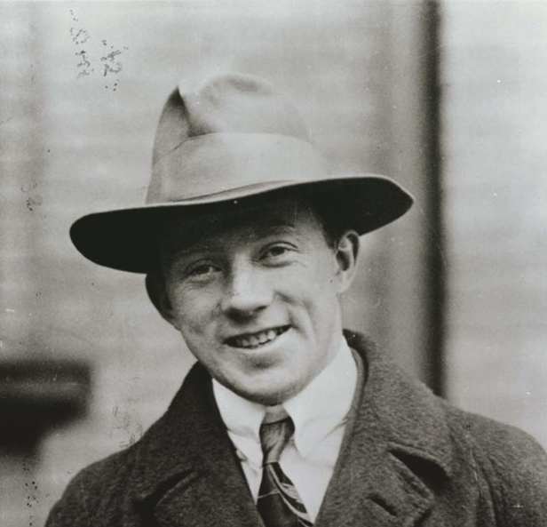
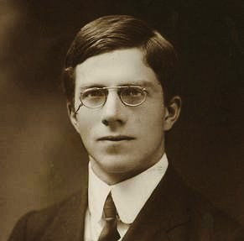
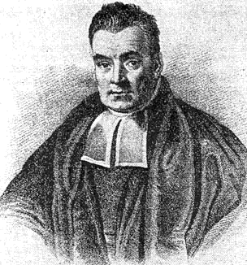
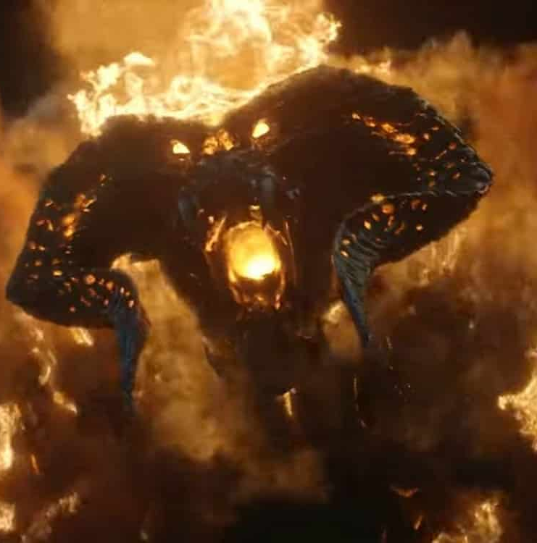
Optimal metrological protocols in presence of noise can single parameter methods be generalized to multiparameter scenarios?
Bye Bayes, this is my day!
Ohhh!!!
dramatis personae:
Heisenberg
Noise
Fisher
Bayes
Rafal Demkowicz-Dobrzański
Faculty of Physics, University of Warsaw, Poland

Slide 2
Review of QFI based methods for single parameter quantum metrology

Slide 3
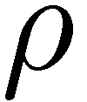
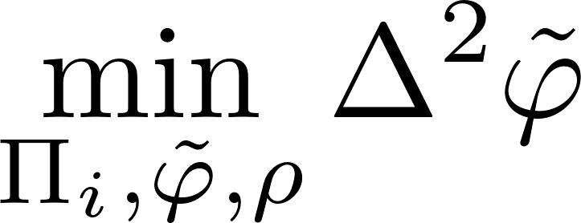
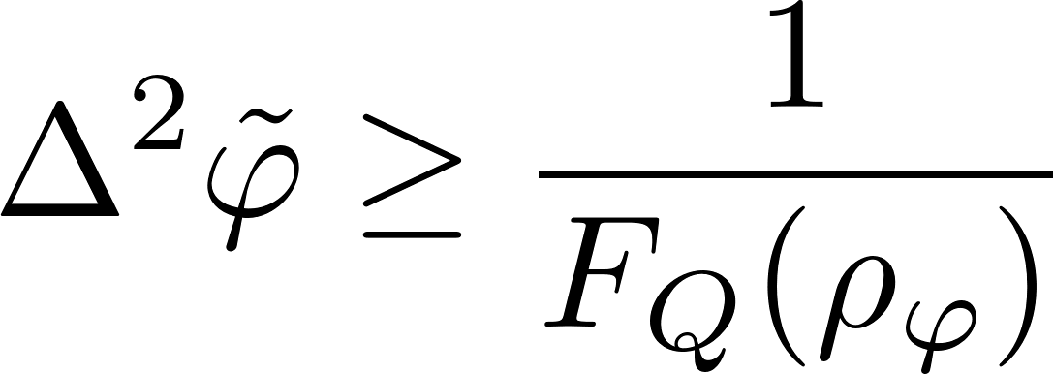
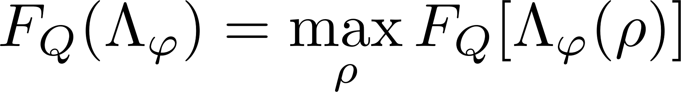
Quantum metrology as a quantum channel estimation problem…
Quantum Cramer-Rao bound
Channel QFI

Slide 4

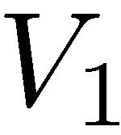
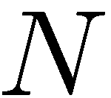
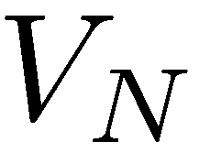
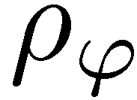
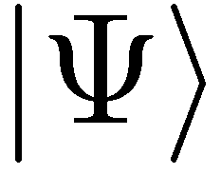
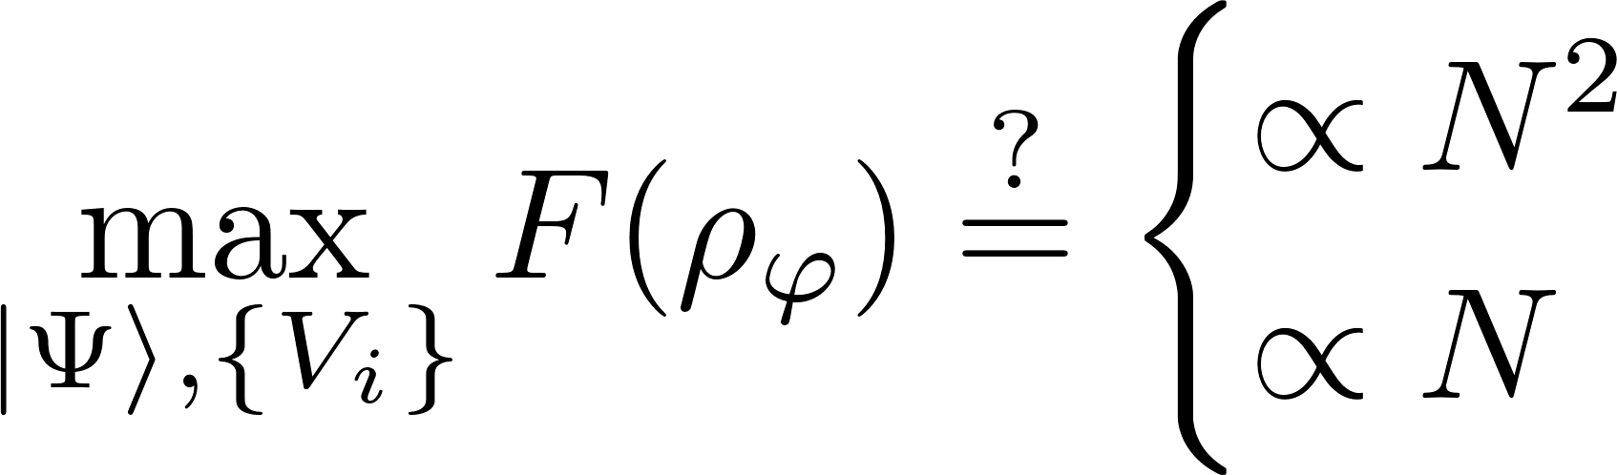
The potential of the most general adaptive metrological scheme
Heisenberg scaling
standard scaling

Slide 5
The „no-go” and the „constructive” way
no-go way
constructive way
Derive analytical/semianalytical upper bounds
Find numerically/guess good metrological protocols
Ideally!
S.Kurdzialek, P. Dulian, J. Majsak, S. Chakrabotry, RDD, New J. Phys. 27 013019 (2025)
Q. Liu, Y. Yang, Quantum 8, 1571 (2024)

Slide 6
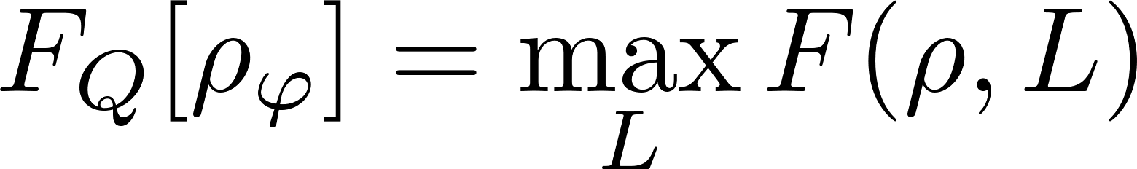
Optimization of QFI for mixed states is tricky…
difficult to analyze and optimize directly….
Alternative formulation for Quantum Fisher information

Slide 7
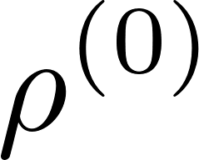
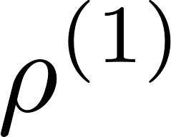
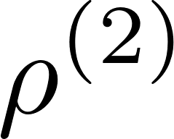
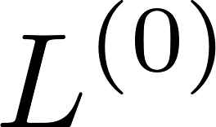
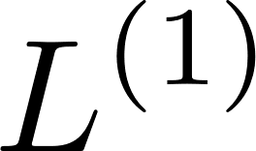
Iterative see-saw optimization (ISS)
Allows to formulate the problem as a double maximization problem
Each step is a simple linear or an eigenvalue problem!
Very efficient, provided Hilbert space dimension is reasonably small
K. Macieszczak, arxiv:1312.1356 (2013)
K. Macieszczak, M. Fraas, RDD, New J. Phys. 16, 113002 (2014)

Slide 8
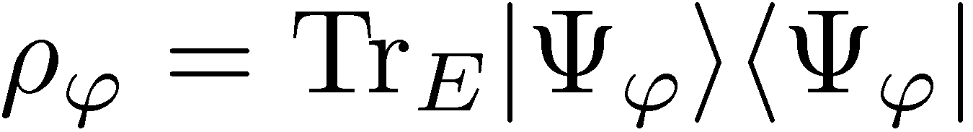
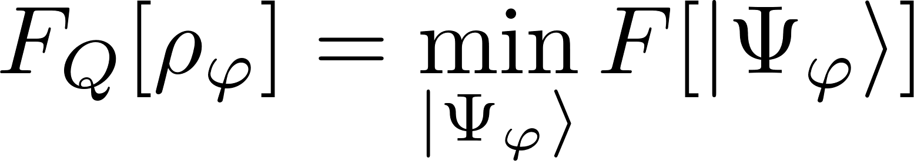
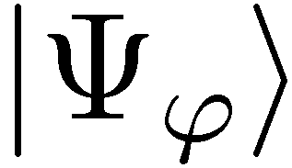
Minimization over purifications (MOP)
QFI for a mixed state as the minimum over its purifications
S
S
E
A. Fujiwara, H. Imai, J. Phys. A 41, 255304 (2008)

Slide 9
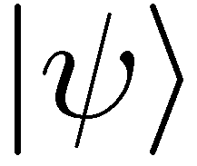
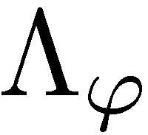
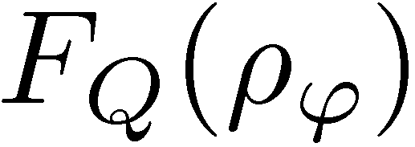
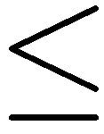
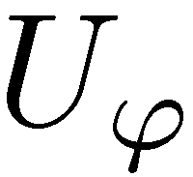
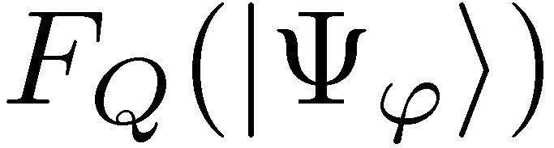
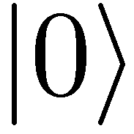
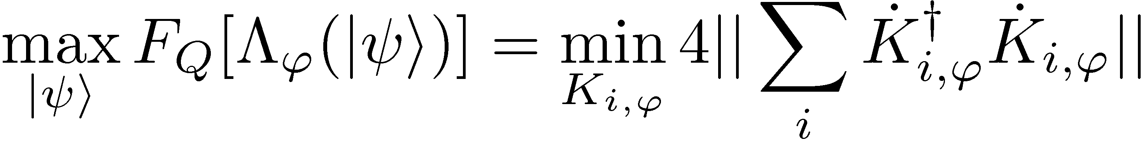
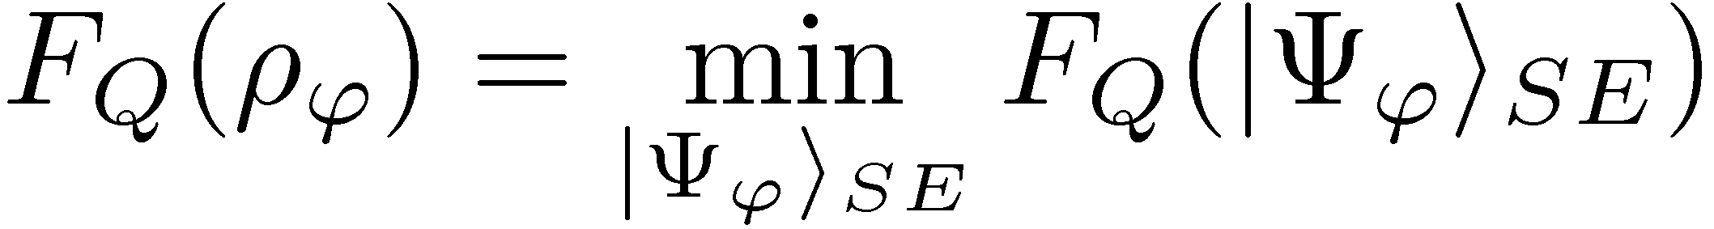
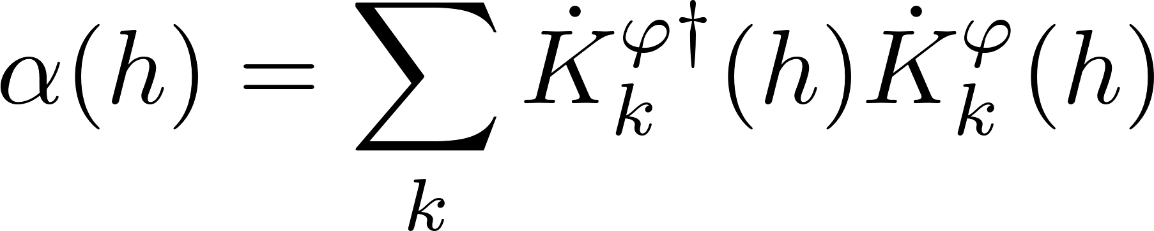
Minimization over purifications (MOP)
S
S
E
computing the channel QFI:
K x K Hermitian matrix
A simple SDP programme!
A. Fujiwara, H. Imai, J. Phys. A 41, 255304 (2008)
RDD, J. Kolodynski, M. Guta, Nat. Commun. 3, 1063 (2012)

Slide 10
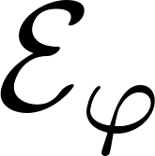
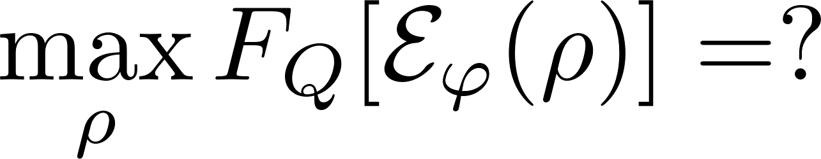
Methods to find channel QFI
Minimization over purifications (MOP)
Iterative See-Saw (ISS)

Slide 11
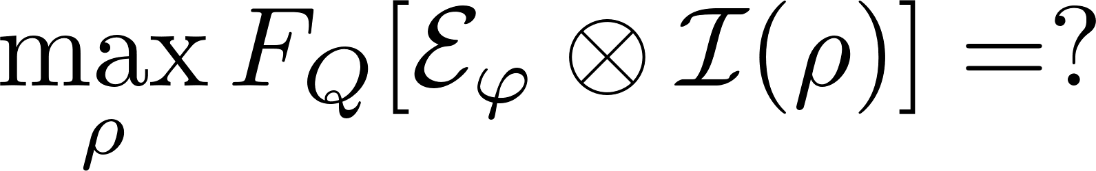
Methods to find channel QFI
Ancilla insensitive!
Ancilla sensitive!
Minimization over purifications (MOP)
Iterative See-Saw (ISS)

Slide 12
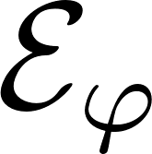
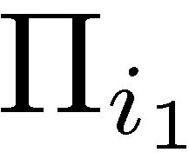
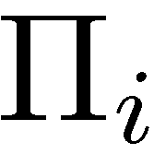
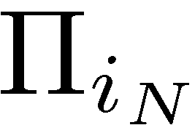

Strategies involving multiple channel uses
(C)
(E)
coherence
entanglement (passive way)
+ sequentiality
(AD)
entanglement + adaptiveness (active quantum feedback)

Slide 13
Optimal entanglement based strategies (E)
If N is small enough…
(for qubit channels N ≤ 5)
ancilla assisted
Minimization over purifications (MOP)
Iterative See-Saw (ISS)
In fact MOP always implicitly assumes availability of ancilla!

Slide 14
Optimal adaptive protocols (AD)
Looking for optimal adaptive strategies = optimization over quantum combs (SDP)
≡
Minimization over purifications (MOP)
Iterative See-Saw (ISS)
Altherr, Y. Yang, Phys. Rev. Lett 127, 060501 (2021)
Q. Liu, Z. Hu, H. Yuan, Y. Yang, Phys. Rev. Lett. 130, 070803 (2023)
Direct generalization of ISS, since comb constraints are compatible with SDP
Exact optimal solution!
S.Kurdzialek, P. Dulian, J. Majsak, S. Chakrabotry, RDD, New J. Phys. 27 013019 (2025)
Q. Liu, Y. Yang, Quantum 8, 1571 (2024)

Slide 15
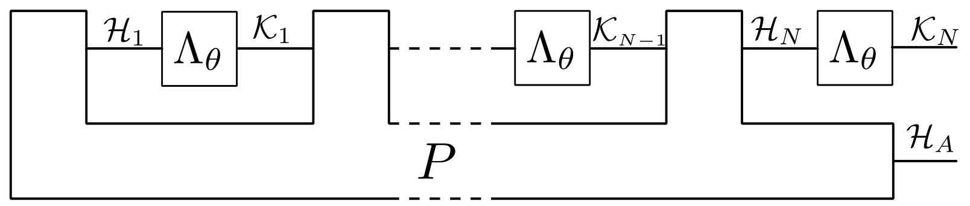
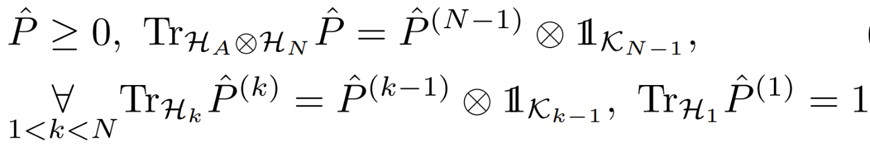
Adaptive startegy as a Quantum comb
Choi-Jamiołkowski operator of the comb

Slide 16
What to do when N is large?
Adaptive
Parallel
Minimization over purifications (MOP)
Iterative See-Saw (ISS)
Combine ISS optimization with tensor networks methods
Parallel schemes:
Matrix product states (MPS) + Matrix product operators (MPO)
K.Chabuda, J. Dziarmaga, T. Osborne, RDD,
Nat. Commun 11, 250 (2020)
Adaptive schemes:
break comb into `teeth’ and optimize sequentially
S.Kurdzialek, P. Dulian, J. Majsak, S. Chakrabotry, RDD,
New J. Phys. 27 013019 (2025)
Use the idea of purifications to derive effectively computable bounds
(No go way!)
A. Fujiwara, H. Imai, J. Phys. A 41, 255304 (2008)
B. M. Escher, et al. Nature Phys. 7, 406–411 (2011)
RDD, J. Kolodynski, M. Guta, Nat. Commun. 3, 1063 (2012)
RDD, L. Maccone, Phys. Rev. Lett. 113, 250801 (2014)
RDD, J. Czajkowski, P. Sekatski, Phys. Rev. X 7, 041009 (2017)
S. Zhou et al., Nat. Commun. 9, 78 (2018)
S. Zhou, L. Jiang, PRX Quantum 2, 010343 (2021)
S. Kurdzialek, W. Gorecki, F. Albarelli, RDD, PRL 131, 090801 (2023)

Slide 17
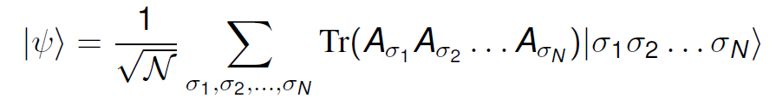
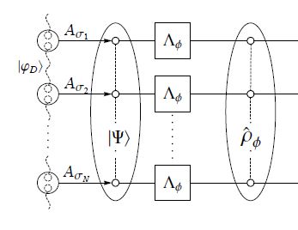
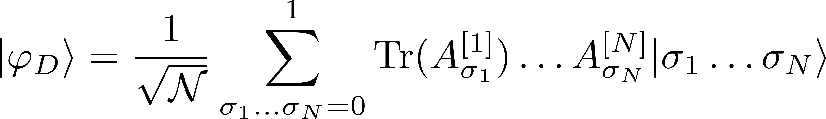
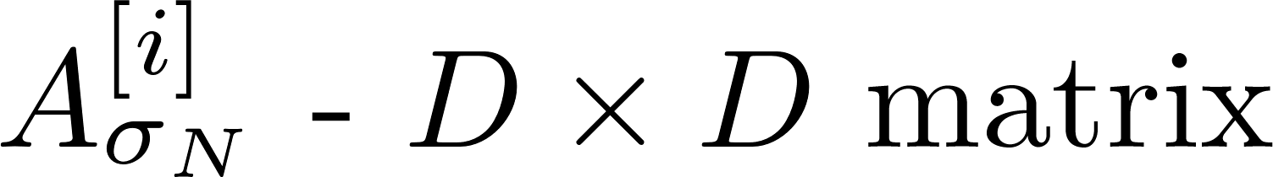
Optimal paralel protocols (ISS) via matrix product states
If N is large we can combine ISS and tensor networks formalism
Matrix product state
Iterative See-Saw (ISS)
D x D matrices
Typically, optimal
D – bond dimension
Number of parameters:
matrix product state
Low bond dimension D are usually enough to find the optimal states(MPS) and optimal SLD operators (MPO)
(D – bond dimension)
K.Chabuda, J. Dziarmaga, T. Osborne, RDD, Nat. Commun 11, 250 (2020)

Slide 18
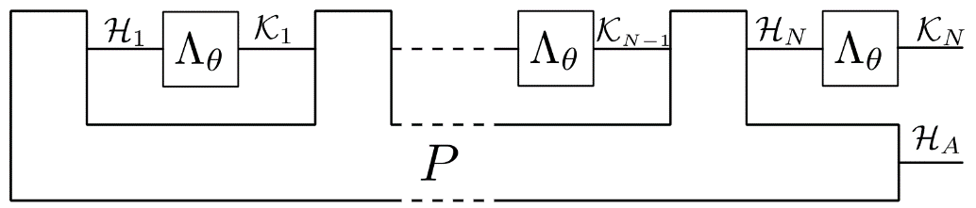
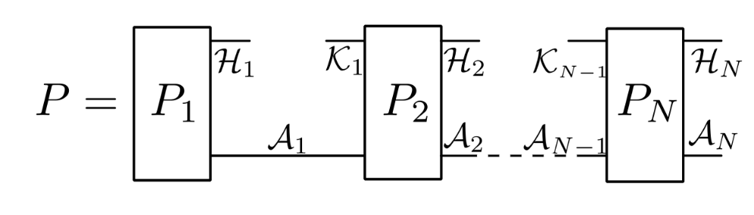
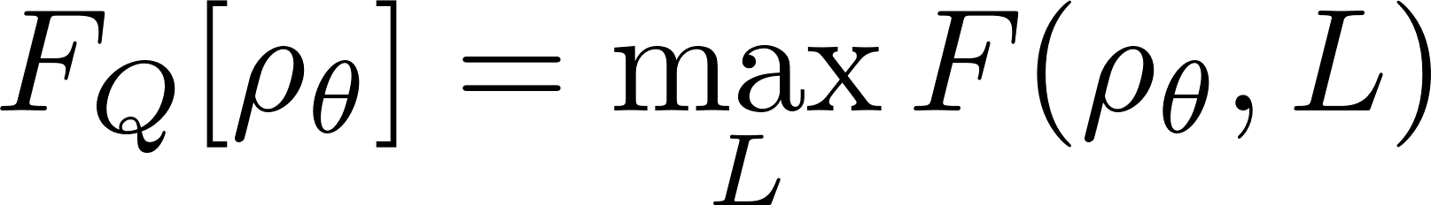
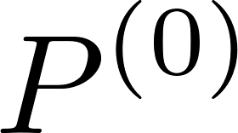


Optimal adaptive protocols (ISS)
Looking for optimal adaptive strategies = optimization over quantum combs (SDP)
P – a quantum comb
For large N, break comb into teeth and use tensor network methods!
Iterative See-Saw (ISS)
Efficient method if the (almost) optimal protocols can be found with a small-size ancilla!
Each step is a simple linear or an eigenvalue problem!
S.Kurdzialek, P. Dulian, J. Majsak, S. Chakrabotry, RDD, New J. Phys. 27 013019 (2025)

Slide 19


Break a Comb into Teeth!
Efficient method if the (almost) optimal protocols can be found with a small-size ancilla!

Slide 20





Examples
Perpendicular dephasing
Parallel dephasing
Perpendicular amplitude damping
Parallel amplitude damping
Small ancilla size enough in models where noise of significantly different character than the signal. Otherwise better use paralel schemes + Matrix Product States

Slide 21
Fundamental bounds via MOP!
no-go way
constructive way
Derive analytical/semianalytical upper bounds
Find numerically/guess the best metrological protocols
MPO or ISS
Ideally!
The best method via minimizations over purifications
(MOP) of the noisy quantum channel
A. Fujiwara, H. Imai, J. Phys. A 41, 255304 (2008)
B. M. Escher, et al. Nature Phys. 7, 406–411 (2011)
RDD, J. Kolodynski, M. Guta, Nat. Commun. 3, 1063 (2012)
RDD, L. Maccone, Phys. Rev. Lett. 113, 250801 (2014)
RDD, J. Czajkowski, P. Sekatski, Phys. Rev. X 7, 041009 (2017)
S. Zhou et al., Nat. Commun. 9, 78 (2018)
S. Zhou, L. Jiang, PRX Quantum 2, 010343 (2021)
S. Kurdzialek, W. Gorecki, F. Albarelli, RDD, PRL 131, 090801 (2023)
Das, W. Górecki, RDD, arXiv:2404.03954 (2024)
S. Kurdzialek, F. Albarelli, RDD, arxiv:2410.01881 (2024)

Slide 22


Fundamental bounds via MOP state-of-the art results (<2023)
Entangled based (E)
Adaptive (AD)
Efficient single channel optimization! (SDP)
A. Fujiwara, H. Imai, J. Phys. A 41, 255304 (2008)
B. M. Escher, et al. Nature Phys. 7, 406–411 (2011)
RDD, J. Kolodynski, M. Guta, Nat. Commun. 3, 1063 (2012)
S. Zhou, L. Jiang, PRX Quantum 2, 010343 (2021) [Asymptotically saturable]
RDD, L. Maccone, Phys. Rev. Lett. 113, 250801 (2014)
P. Sekatski, M. Skotiniotis, J. Kolodynski, W. Dur, Quantum 1, 27 (2017)
true for generic noisy channels
Heisenberg scaling is asymptotically lost!

Slide 23


Fundamental bounds latest developments
The best way to bound the increase of QFI when one channel is added
Efficient SDP
No asymptotic gain thanks to adaptiveness for all models with uncorrelated noise!
S. Kurdzialek, W. Gorecki, F. Albarelli, RDD, PRL 131, 090801 (2023)

Slide 24

Fundamental bounds very latest developments, correlated noise models
How to derive a computable asymptotic bound that takes into account correlations?
S. Kurdzialek, F. Albarelli, RDD, arxiv:2410.01881 (2024)

Slide 25
Fundamental bounds very latest developments, correlated noise models
Bound the increase of QFI when a general Quantum Comb acts on m added (correlated!) channels
Bound the increase of QFI when a general Quantum Comb acts on m added (correlated!) channels
S. Kurdzialek, F. Albarelli, RDD, arxiv:2410.01881 (2024)

Slide 26

Fundamental bounds very latest developments, correlated noise models
Bound the increase of QFI when a general Quantum Comb acts on m added (correlated!) channels
Single SDP optimization. Larger m leads to a tighter bound.
Every m-channels we allow for an access to environment.
S. Kurdzialek, F. Albarelli, RDD, arxiv:2410.01881 (2024)

Slide 27
Which methods we can use when we go multiparameter?

Slide 28


Multiparameter issues!
?
Input probe incompatibility
Measurement incompatibility
Correlated estimators
S. Ragy, M, Jarzyna, RDD, Phys. Rev. A 94, 052108 (2016)

Slide 29
Multiparameter issues!
?
Input probe incompatibility
may affect scaling of precision with the numer of parameters involved!
Measurement incompatibility
asymptotically at most twice overhead in resources for noisy models
Correlated estimators
problem removed if proper parametrization chosen
S. Ragy, M, Jarzyna, RDD, Phys. Rev. A 94, 052108 (2016)

Slide 30














Heisenberg limit in multi-parameter noisy metrology?
estimators covariance matrix
Multiparameter quadratic cost:
Can we have the Heisenberg scaling with N uses of the channel ?
Kraus span:
Heisenberg scaling is possible if and only if
„Hamiltonian” of p parameter
are linearly independent
W. Gorecki, S. Zhou, L. Jiang, RDD, Quantum 4, 288 (2020)

Slide 31

Relaxing the tightness of the bounds…
Multiparameter quadratic cost:
We choose a parametrization where C = diag(c₁, …, c_{p})
By analyzing the (weighted) trace of QFI we can still get insight into probe incompatibility issue (i)

Slide 32



Optimizing the trace of the QFI matrix (ISS)
We can optimize all L_{i} are independentently
Each step is again a simple linear or an eigenvalue problem!
We can generalize optimization over combs, and use tensor networks as well

Slide 33

Optimizing the trace of the matrix (MOP)
QFI matrix for a mixed state is again the minimum over its purifications! (in the sense of matrix ordering)
And this implies the same equality for the trace
Sum under the operator norm! We get insight into probe incompatibility!
The formula for trace of the channel QFI matrix:
F. Albarelli, R. Demkowicz-Dobrzanski, PRX 12, 011039 (2022)

Slide 34
Multi-parameter bounds via MOP
Bound on the increase of trace of QFI matrix after a single step
If for all parameters we can have h_{i} such that
Allows to study asymptotic effects of probe incompatibility in presence of noise
F. Albarelli, R. Demkowicz-Dobrzanski, PRX 12, 011039 (2022)+ unpublished

Slide 35






Summary
Qualitative multiparameter conditions for Heisenberg scaling
no
yes
Heisenberg scaling not possible.
Heisenberg scaling possible
Quantitative optimization methods for the trace of the channel QFI matrix
Minimization over purifications (MOP)
can also be used to derive bounds
Iterative See-Saw (ISS)
can be combined with tensor-network approach
Single parameter references:
Multi-parameter references:
S. Kurdzialek, W. Gorecki, F. Albarelli, RDD, PRL 131, 090801 (2023)
S. Kurdzialek, F. Albarelli, RDD, arxiv:2410.01881 (2024)
S.Kurdzialek, P. Dulian, J. Majsak, S. Chakrabotry, RDD,
New J. Phys. 27 013019 (2025)
W. Gorecki, S. Zhou, L. Jiang, RDD, Quantum 4, 288 (2020)
F. Albarelli, R. Demkowicz-Dobrzanski,
PRX 12, 011039 (2022)

