Slide 1
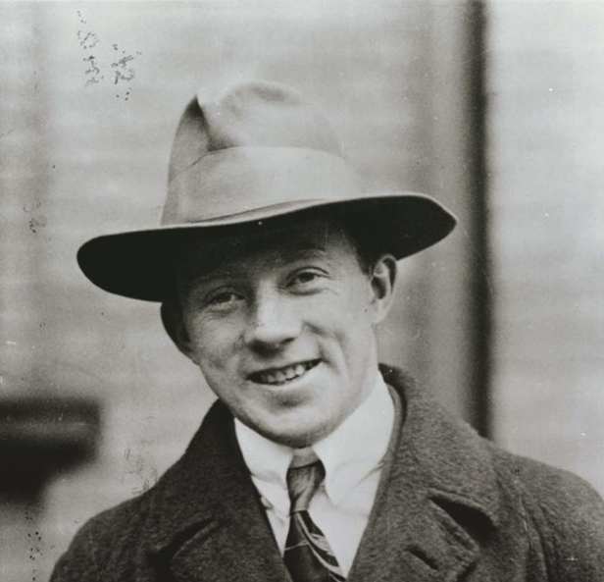
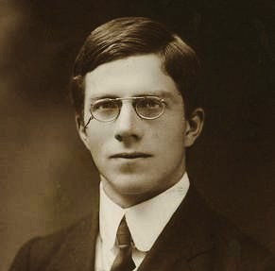
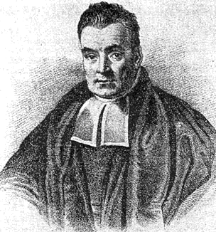
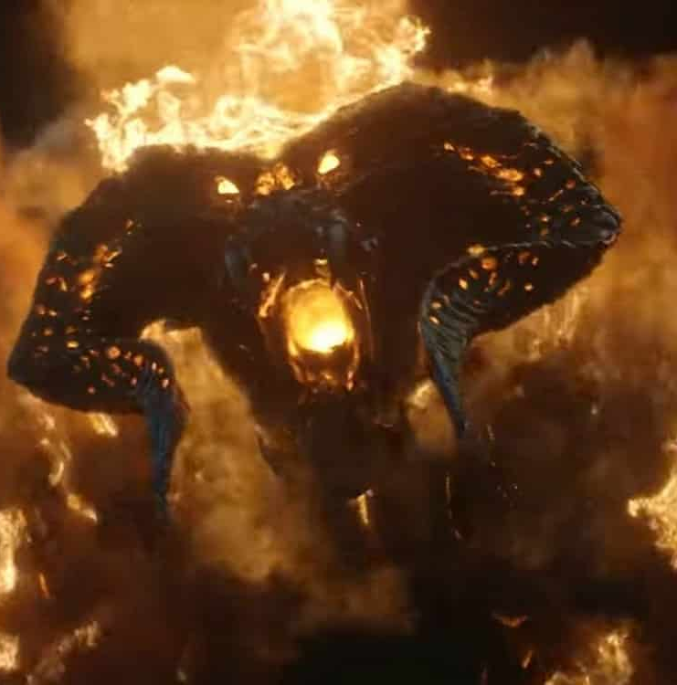
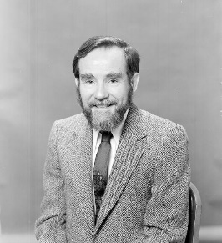
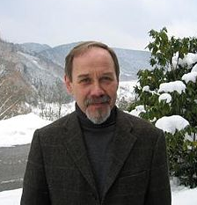
Multiparameter quantum metrology
dramatis personae:
Heisenberg
Noise
Fisher
Bayes
(Helstrom, Holevo)
Rafal Demkowicz-Dobrzański
Faculty of Physics, University of Warsaw, Poland

Slide 2
Welcome to the House of the Single Parameter!
Come on guys! I want to tell you why the Heisenberg limit is called the Heisenberg limit
Oh great, I am talking about the Heisenberg limit for 20 years and never though why.

Slide 3
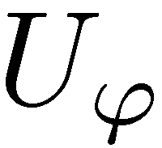
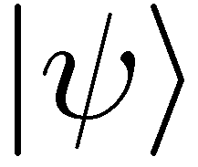
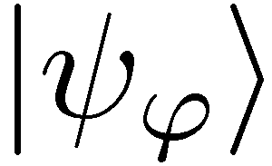
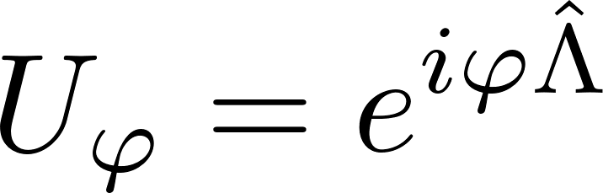
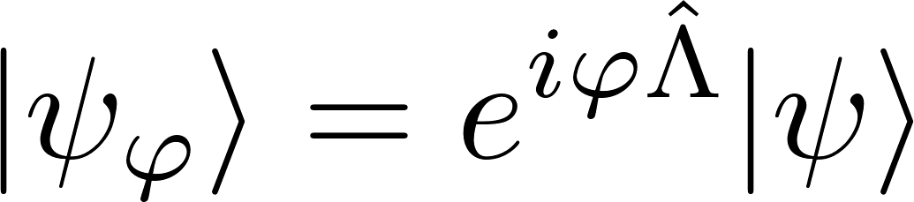
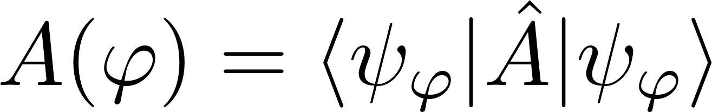

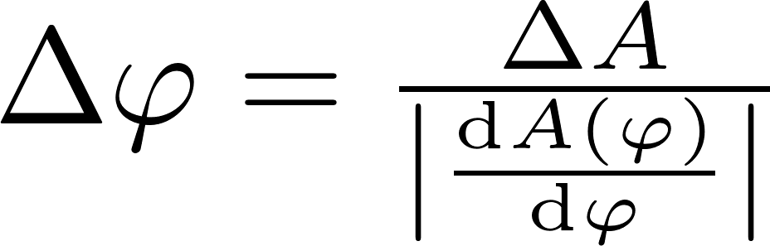
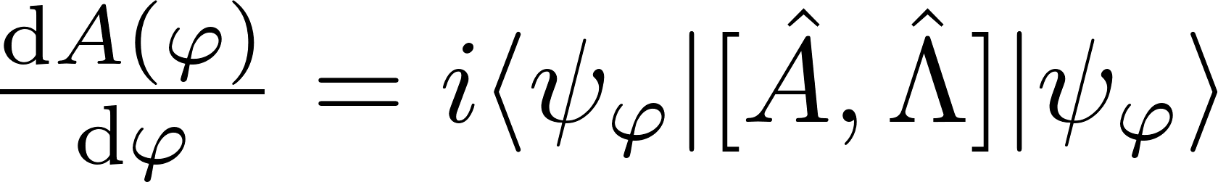
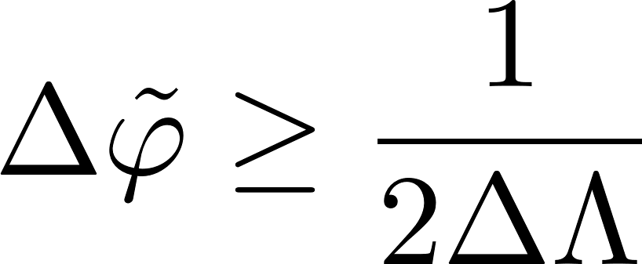
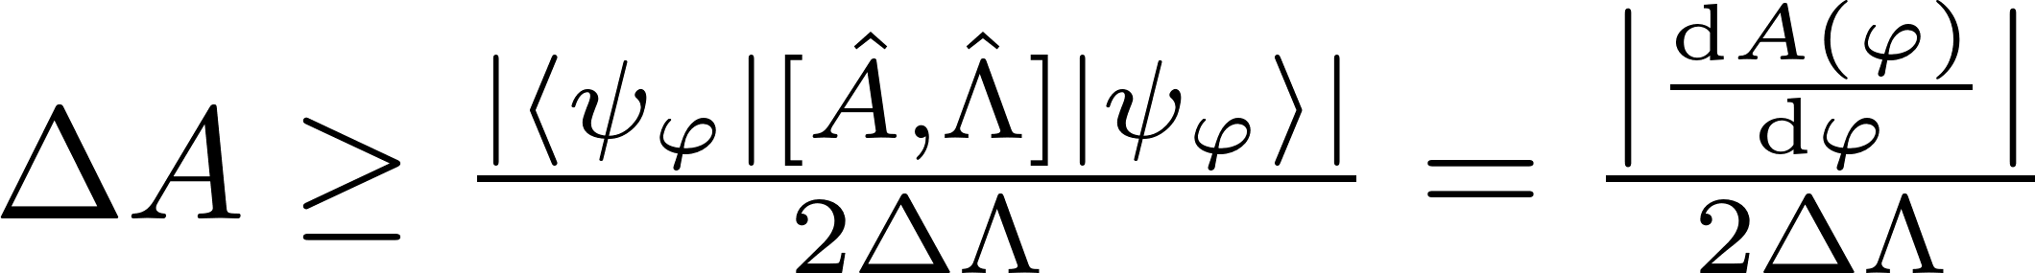
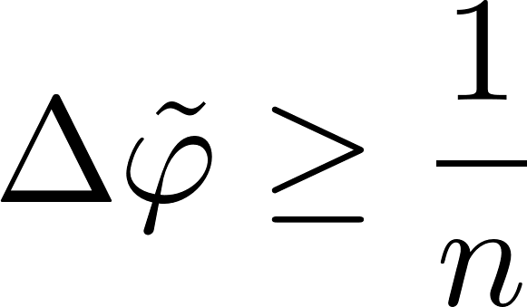
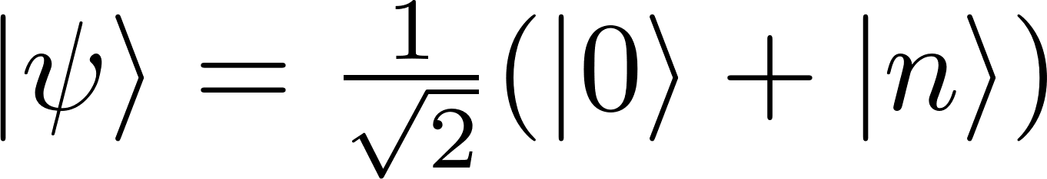
Heisenberg limit explained
Very simple!
Try to estimate a unitary shift ϕ generated by Λ
We extract information by measuring some observable A
Linear error propagation formula for estimating
Linear error propagation formula for estimating
Apply the Heisenberg uncertainty relation:
Estimation uncertainty
(not an RMSD of some operator)
RMSD of the generator
If the generator eigenvalues in [0, n]
(interferometry with up to n photons)
The „optimal” state…

Slide 4
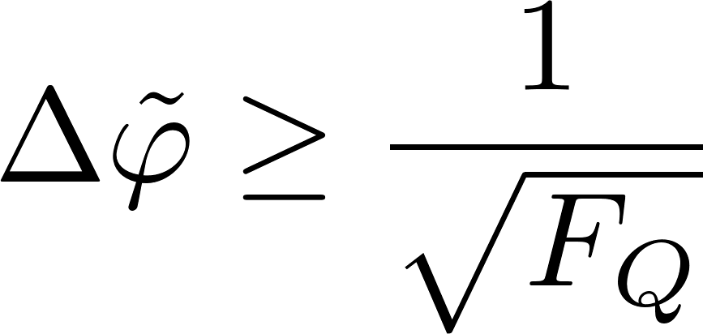
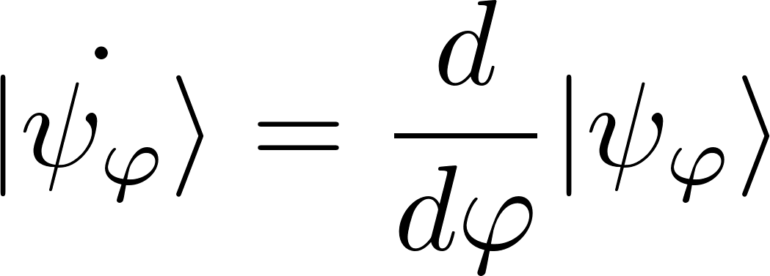

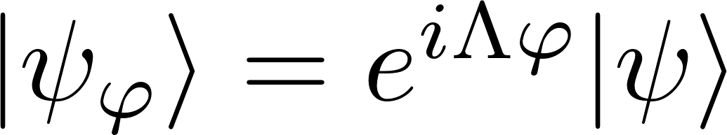
Ok, but this is very heuristic and not really geenral
Fisher says…
Quantum Cramer-Rao inequality
valid for any locally unbiased estimator
and arbitrary measurements
Quantum Fisher Information
General unitary parameter encoding

Slide 5
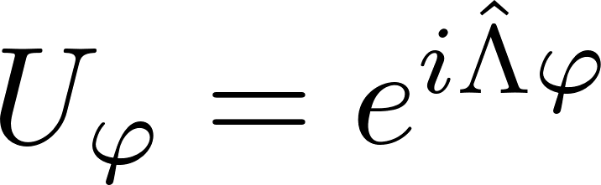
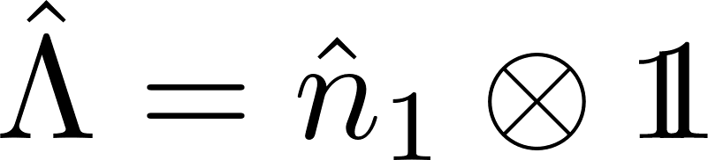
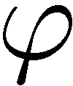
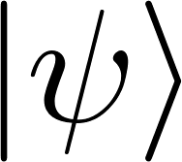
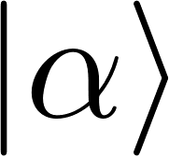
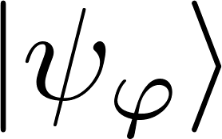
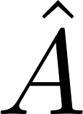
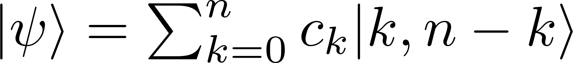
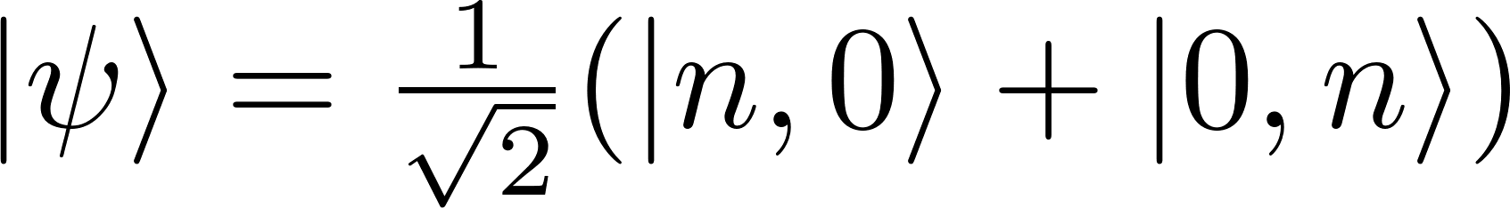
In case of interferometry
Evolution
Evolution generator
(numer of photons in the upper arm)
Measurement of observable A
arbitrary n-photon input state
I think it should be renamed to Fisher (Helstrom) limit….
The Heisenberg limit:

Slide 6
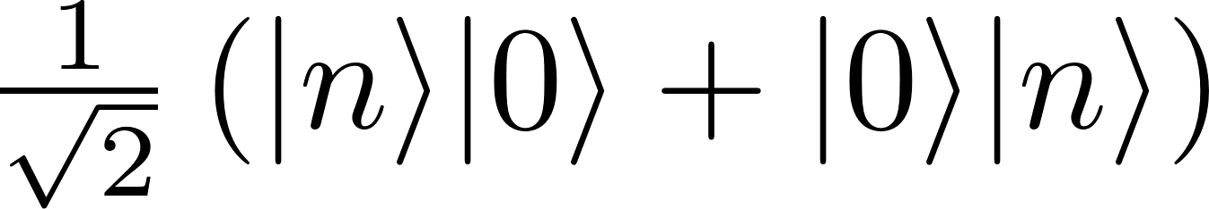
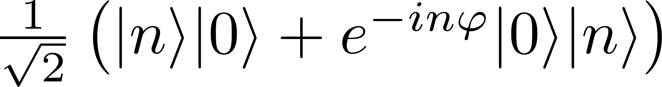
Bayes not satisfied…
Can we really reach this limit when n->∞
State
preparation
Estimator
Measuremnt
So you see we are using NOON states and we get Heisenberg

Slide 7
Bayes not satisfied…
We need to be in the Heisenberg limit to reach the Heisenberg limit! Stupid!
State
preparation
Estimator
Measuremnt
Do not listen to this old fart!

Slide 8
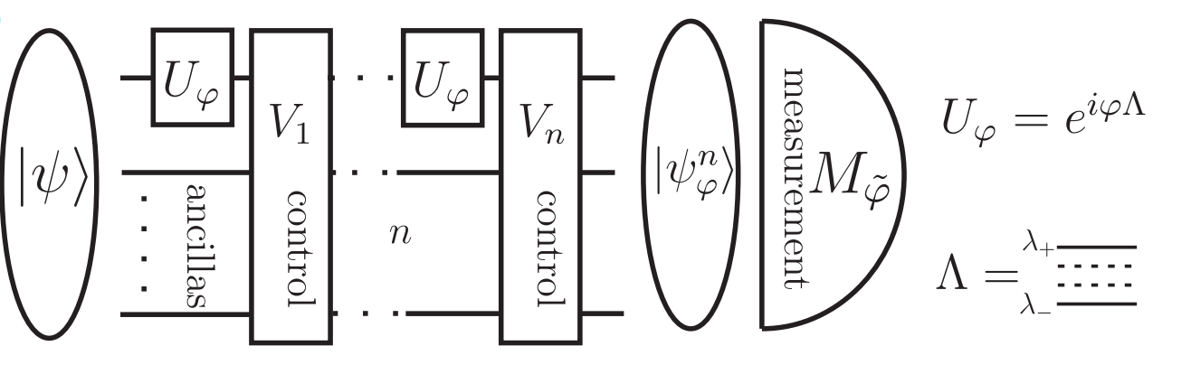
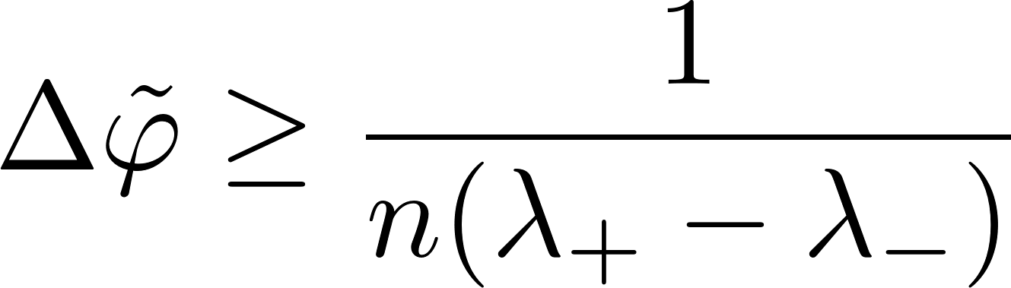
The most general form of the Heisenberg limit
Look Heisenberg, such a beautiful generalization!
OMG…
V. Giovannetti, S. Lloyd, and L. Maccone, Phys. Rev. Lett. 96, 010401 (2006).

Slide 9
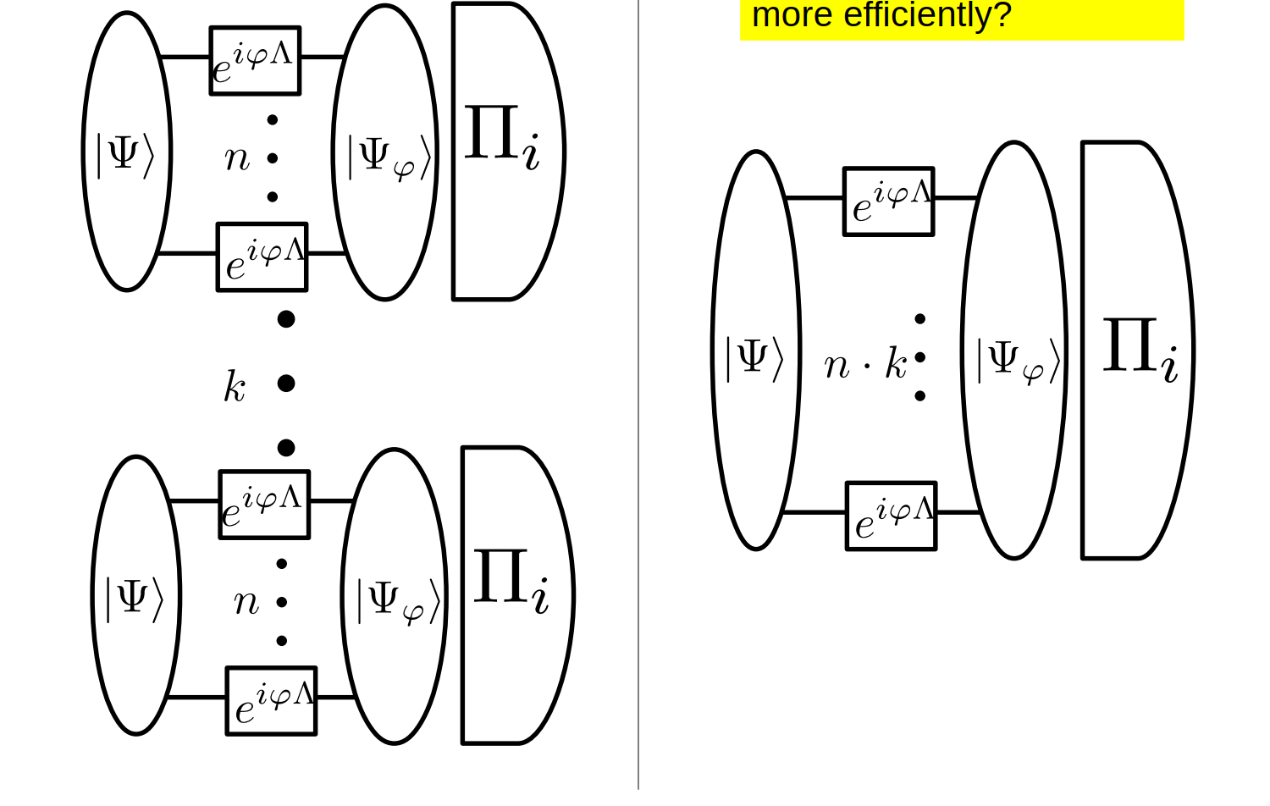
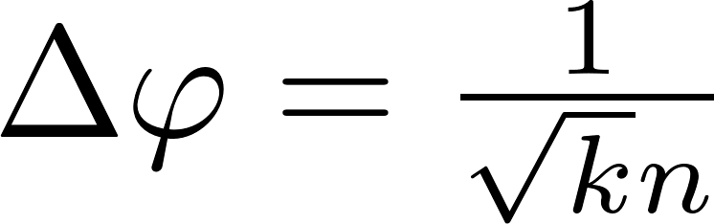
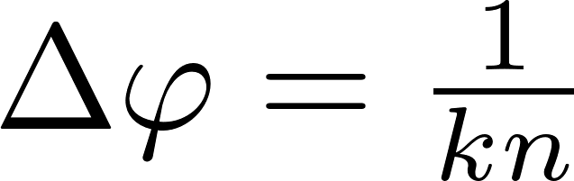
Many repetition scenario guarantees asymptotic saturability of the CR bound
It is OK, if you do it like this
Poor man’s Heisenberg limit
Heisenberg limit in terms of
all the resources consumed

Slide 10
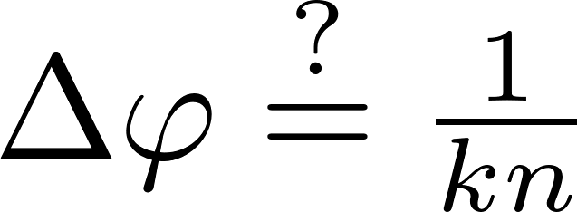
Many repetition scenario guarantees asymptotic saturability of the CR bound
But it doesn’t make sense in the single shot approach
Bla, bla, bla…
Poor man’s Heisenberg limit
Heisenberg limit in terms of
all the resources consumed

Slide 11
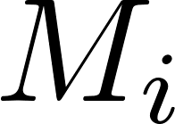
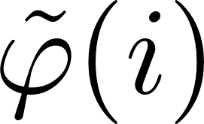
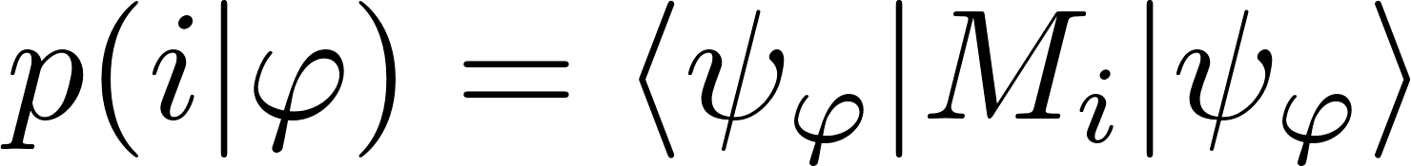
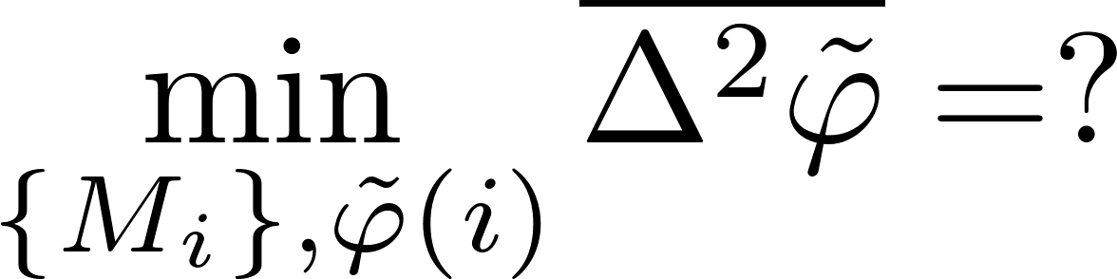
The True Heisenberg limit
The Bayesian approach
The Bayesian variance
prior
no unbiasedness assumption
Now, look how it should be done!

Slide 12
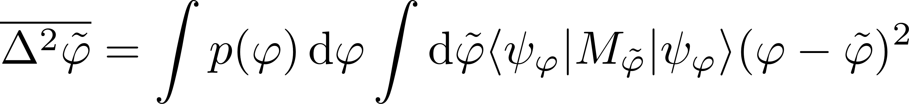
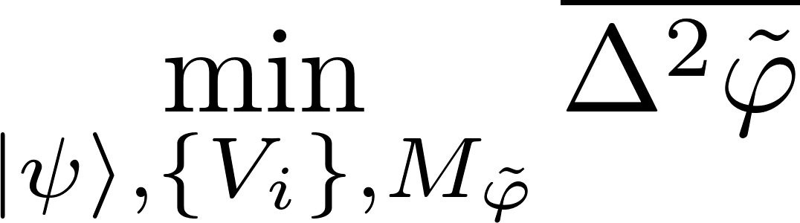
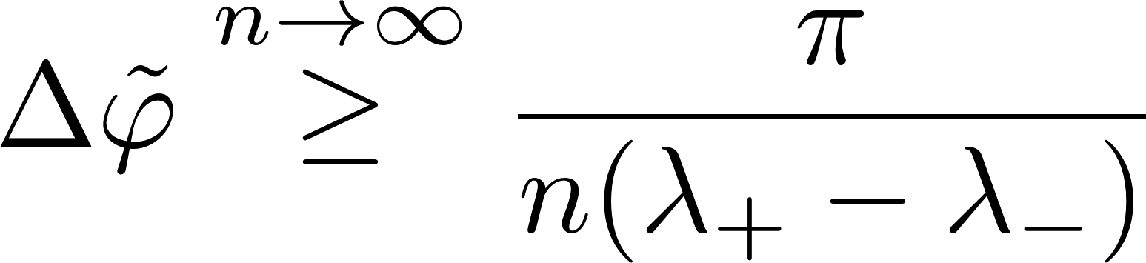
The True Heisenberg limit
You get a Pi factor – what can be more elegant!
For any prior regular enough we get
W. Gorecki, R. Demkowicz-Dobrzanski, H. M. Wiseman, D. W. Berry, Phys. Rev. Lett 124, 030401 (2020)

Slide 13


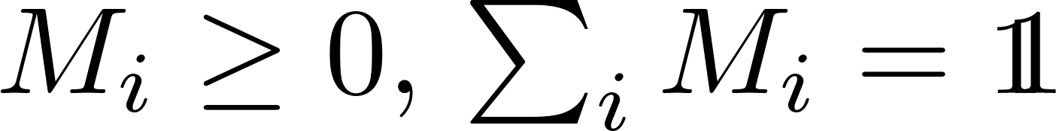
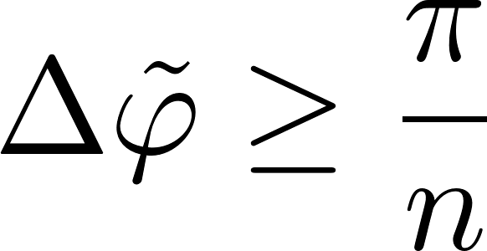
The true Heisenberg limit
In case of interferometry it would look like this
arbitrary n-photon state
arbitrary measurement
The asymptotically saturable Heisenberg limit:
W. Gorecki, R. Demkowicz-Dobrzanski, H. M. Wiseman, D. W. Berry, Phys. Rev. Lett 124, 030401 (2020)

Slide 14
Welcome to the House of the Single Parameter!
I better hide somewhere!
Oh, look the noise comes….

Slide 15
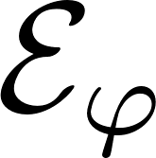
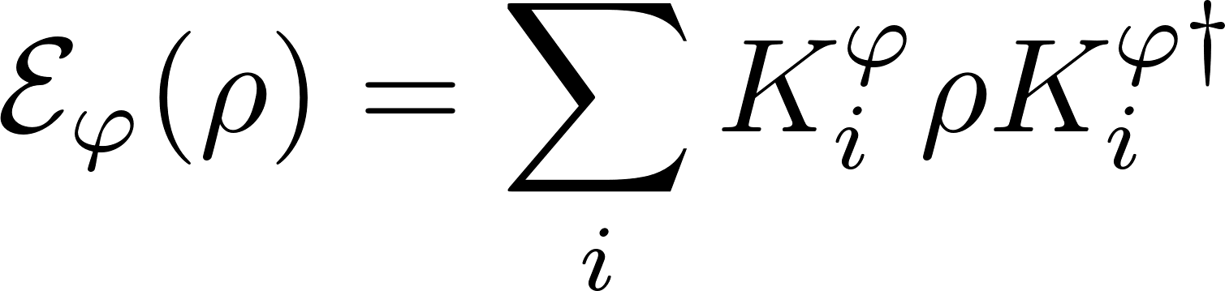
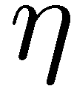


Impact of noise…
Let things decohere!
loss
dephasing

Slide 16












General adaptive bound in presence of noise
Fisher information is powerful!
single channel optimization! an efficient SDP programme
A. Fujiwara, H. Imai, J. Phys. A 41, 255304 (2008)
B. M. Escher, R. L. de Matos Filho, L. Davidovich Nature Phys. 7, 406–411 (2011)
RDD, J. Kolodynski, M. Guta, Nat. Commun. 3, 1063 (2012)
RDD, L. Maccone, Phys. Rev. Lett. 113, 250801 (2014) [Adaptive schemes included]
RDD, J. Czajkowski, P. Sekatski, Phys. Rev. X 7, 041009 (2017)
S. Zhou, M. Zhang, J. Preskill, and L. Jiang, Nat. Commun. 9, 78 (2018)
S. Zhou, L. Jiang, PRX Quantum 2, 010343 (2021) [Saturability proven using q. error correction ideas]

Slide 17
General adaptive bound in presence of noise
Heisenberg, where are you?
single channel optimization! an efficient SDP programme
true for generic noisy channels
A. Fujiwara, H. Imai, J. Phys. A 41, 255304 (2008)
B. M. Escher, R. L. de Matos Filho, L. Davidovich Nature Phys. 7, 406–411 (2011)
RDD, J. Kolodynski, M. Guta, Nat. Commun. 3, 1063 (2012)
RDD, L. Maccone, Phys. Rev. Lett. 113, 250801 (2014) [Adaptive schemes included]
RDD, J. Czajkowski, P. Sekatski, Phys. Rev. X 7, 041009 (2017)
S. Zhou, M. Zhang, J. Preskill, and L. Jiang, Nat. Commun. 9, 78 (2018)
S. Zhou, L. Jiang, PRX Quantum 2, 010343 (2021) [Saturability proven using q. error correction ideas]

Slide 18







Recovering Heisenberg scaling via Quantum Error-Correction
Nope, sorry
Idea: we can correct all the noise and still keep some part of the unitary parameter encoding intact
Can you check, this algebraic property? I could then join you…
P. Sekatski, M. Skotiniotis, J. Kolodynski, W. Dur, Quantum 1, 27 (2017)
RDD, J. Czajkowski, P. Sekatski,, Phys. Rev. X 7, 041009 (2017)
S. Zhou, M. Zhang, J. Preskill, and L. Jiang, Nat. Commun. 9, 78 (2018)
S. Zhou, L. Jiang, PRX Quantum 2, 010343 (2021)

Slide 19


Recovering Heisenberg scaling via Quantum Error-Correction
Oh great you can come!
Idea: we can correct all the noise while still some part of the unitary parameter encoding remains intact
Maybe some other noise model, please….
P. Sekatski, M. Skotiniotis, J. Kolodynski, W. Dur, Quantum 1, 27 (2017)
RDD, J. Czajkowski, P. Sekatski,, Phys. Rev. X 7, 041009 (2017)
S. Zhou, M. Zhang, J. Preskill, and L. Jiang, Nat. Commun. 9, 78 (2018)
S. Zhou, L. Jiang, PRX Quantum 2, 010343 (2021)

Slide 20





Generic behaviour in quantum metrology
Oh, but this is equivalent to a many repetition scenario, so we will get the same asymptotic results!
Heisenberg does not tolerate generic nosie, but we can still have some gains
No need to entangle large number of probes

Slide 21





Lossy interferometry and optimality of using squeezed vacuum
Lossy interferometry
quantum enhancement factor
Fundamental bound saturable with squeezed vacuum + coherent state interferometry!
C.Caves, Phys. Rev. D 23, 1693 (1981)
RDD, K. Banaszek, R. Schnabel, Phys. Rev. A 88, 041802(R) (2013)

Slide 22
Welcome to the Multiparameter House
Sorry, I slept a bit, I am slightly bored with single parameters… what about an afterparty…

Slide 23






Fisher approach to the multiparameter problem…
Oh, it is all the same, you just replace a scalar with a matrix..
QFI matrix
But what about the optimal measurements? What if they are incompatible…

Slide 24




Holevo’s help
Sure, we can make your bound tighter! here you go…
They are so picky about this measurement incompatibility. Maybe you can help?
cost matrix

Slide 25

Holevo Cramer-Rao bound
Wow! But how to compute efficiently? And how much tighter it can be?
What? I never thought about it…
Excuse, me professors. I think it can be computed as an SDP, and is at most two times tighter than the CR bound
Tight bound for pure state models
For mixed states, asymptotically tight for multiple copies
F. Albarelli, J. Friel, A. Datta, PRL 123, 200503 (2019)
M. Tsang, F. Albarelli, A Datta, PRX 10, 031023 (2020)
A. Carollo, et.al J. Stat. Mech. 094010 (2019)

Slide 26
Bayes still not satisfied…
So we can use (Holevo)CR bound and everything is great!
Ok, but if we really want to reach the Heisenberg scaling in a single shot, we will have the same problems as in the single parameter case…

Slide 27

Multiple-arm interferometry

Slide 28


Estimating each phase separately
If we divide resources we get

Slide 29


Optimal joint-phase estimation
If we do it jointly we get a better prefactor, but not a better scaling in terms of the number of parameters!
W. Gorecki, R. Demkowicz-Dobrzanski, Phys. Rev. Lett. 128, 040504 (2022)

Slide 30




Quantum Fisher information based analysis
I thought the scaling was better…
Multiparameter quantum Cramer-Rao bound
Quantum Fisher Information matrix
A better scaling of precision in terms of numer of estimated parameters…
Not achievable, unless many-repetition scenario considered!!!
P. C. Humphreys, M. Barbieri, A. Datta, and I. A. Walmsley, Phys. Rev. Lett. 111, 070403 (2013)

Slide 31
Welcome to the Multiparameter House
Everybody run… the Noise is comming again!

Slide 32





Multiparameter estimation cost scaling in the presence of noise
If Heisenberg is to join our afterparty…
if and only if
are linearly independent
we can implement QEC protocols and recover Heisenberg scaling
He will probably not join…
W. Gorecki, S. Zhou, L. Jiang, R. Demkowicz-Dobrzanski, Quantum 4, 288 (2020)

Slide 33





Bounds for noisy metrology if Heisenberg scaling not possible
estimator covariance matrix
cost matrix
cost matrix eigendecompositions
(natural parametrization)
This bounds may not be tight, but I did my best, to capture the probe incompatibility aspect of the problem
F. Albarelli, R. Demkowicz-Dobrzanski, PRX 12, 011039 (2022)

Slide 34


Incompatibilities in multiparameter metrology
Input probe incompatibility
Measurement incompatibility
Correlated estimators
S. Ragy, M, Jarzyna, RDD, Phys. Rev. A 94, 052108 (2016)

Slide 35
Incompatibilities in multiparameter metrology
Input probe incompatibility
Measurement incompatibility
Correlated estimators
S. Ragy, M, Jarzyna, RDD, Phys. Rev. A 94, 052108 (2016)

Slide 36



Summary
no
yes
Heisenberg scaling not possible.
Fisher (+Holevo) yields achievable asymptotics
Heisenberg scaling possible Bayesian approach yields achievable asymptotics

Slide 37


Summary
no
yes
Heisenberg scaling not possible.
Fisher (+Holevo) yields achievable asymptotics
Heisenberg scaling possible Bayesian approach yields achievable asymptotics
Thank You!
Slava Ukraini!
(post-doc positions available, deadline 13th of November)

