Slide 1
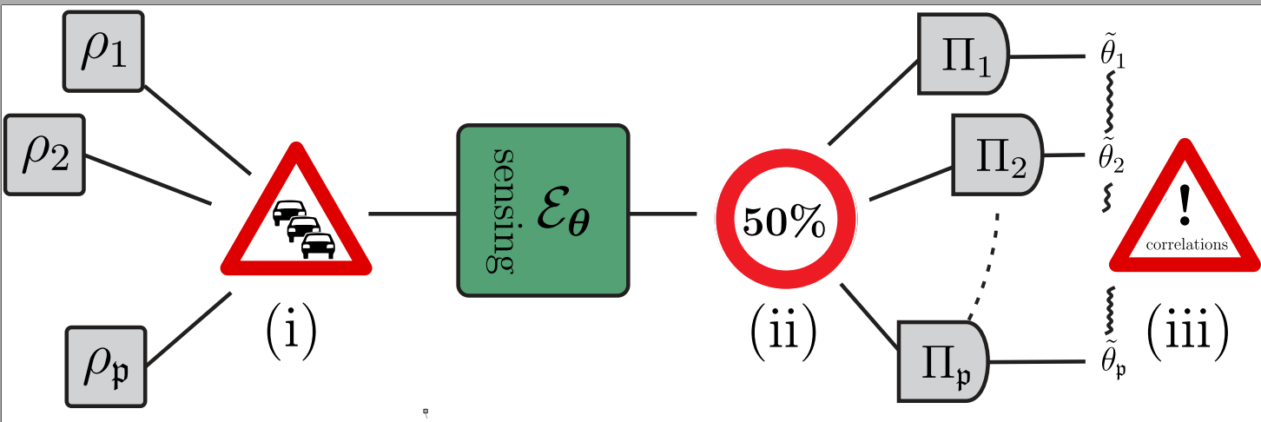

Fundamental Limits in Mutiparameter
Quantum Metrology
F. Albarelli, RDD, PRX 12, 011039 (2022)
W. Górecki, RDD, PRL 128, 040504 (2022)
R. Demkowicz-Dobrzański, F. Albarelli, W Górecki
Faculty of Physics, University of Warsaw, Poland

Slide 2

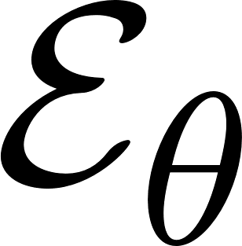
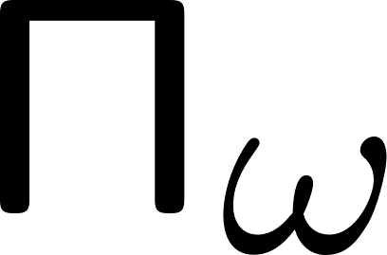
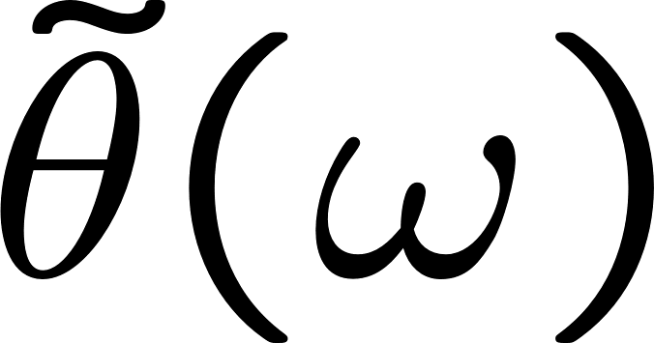
A basic quantum metrology problem
input state
measurement
estimator
input state
a quantum channel
with unknown parameter

Slide 3


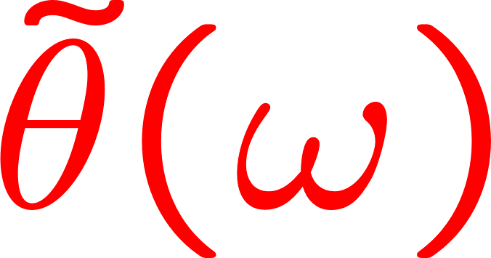
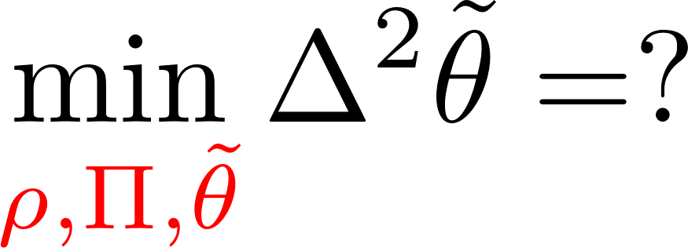
A basic quantum metrology problem
input state
measurement
estimator
input state
a quantum channel
with unknown parameter

Slide 4
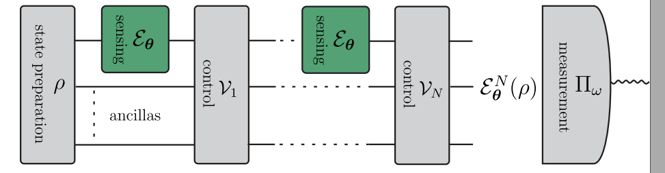
Optimal adaptive protocol involving N uses of a channel

Slide 5
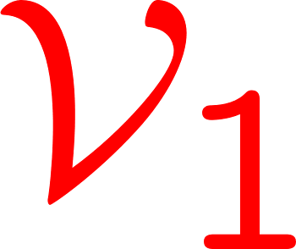
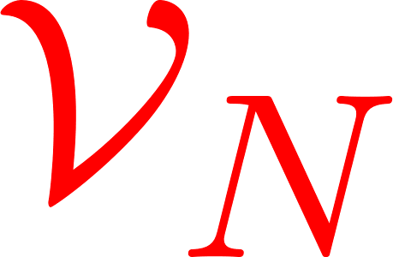
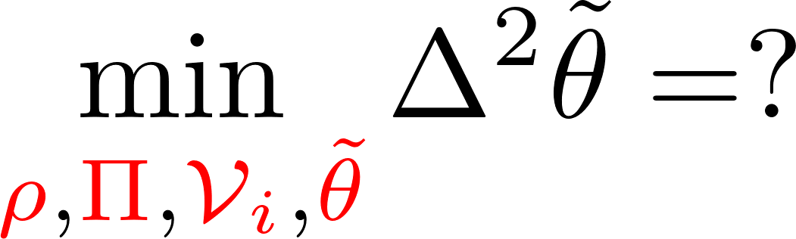
Optimal adaptive protocol involving N uses of a channel

Slide 6
Noisy metrology
The elusive Heisenberg limit

Slide 7
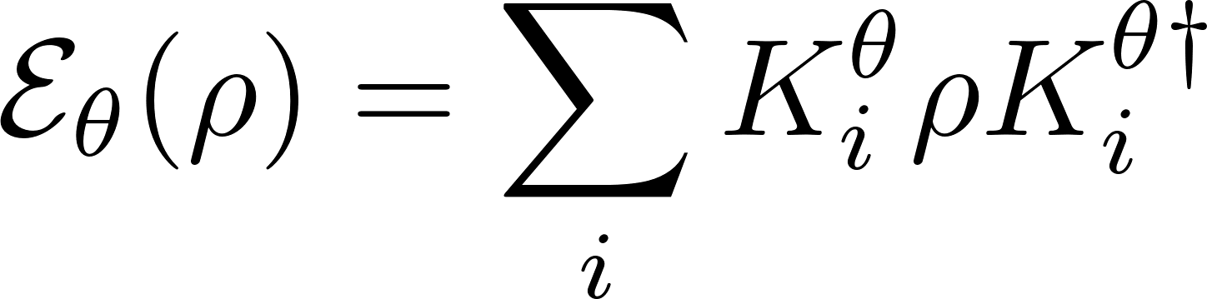
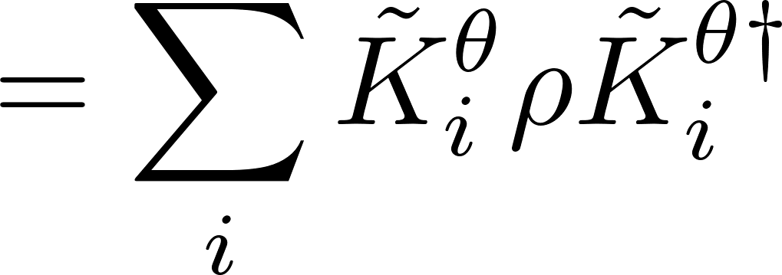
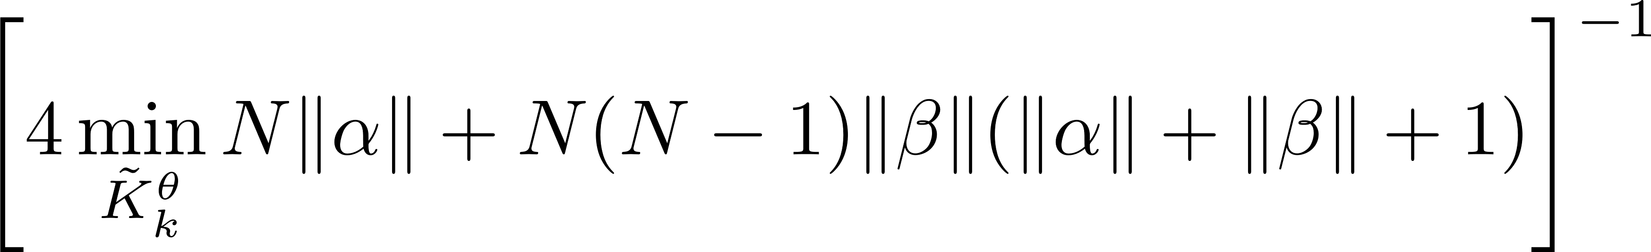
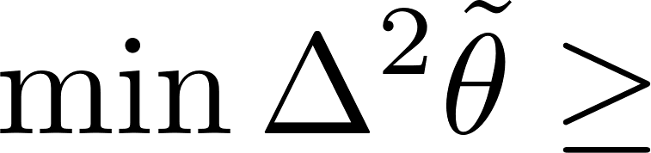
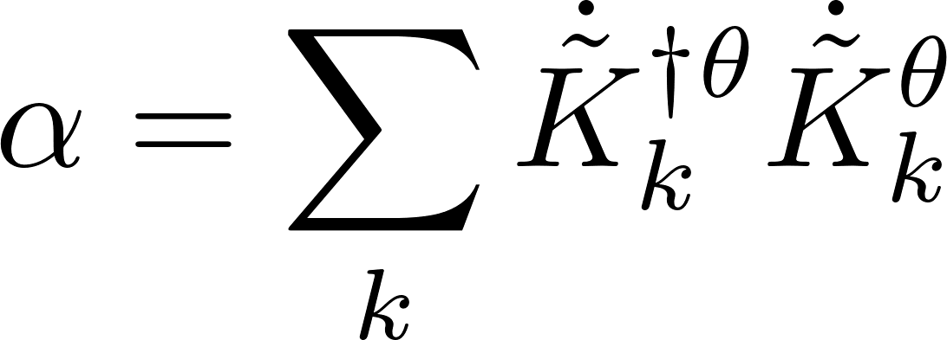
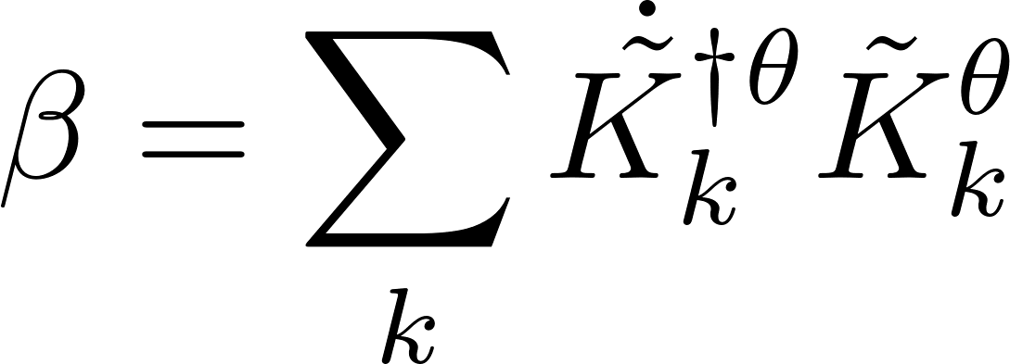
Single parameter noisy case saturable bounds using quantum Fisher information approach
single channel optimization! an efficient SDP programme
true for generic noisy channels
A. Fujiwara, H. Imai, J. Phys. A 41, 255304 (2008)
B. M. Escher, R. L. de Matos Filho, L. Davidovich Nature Phys. 7, 406–411 (2011)
RDD, J. Kolodynski, M. Guta, Nat. Commun. 3, 1063 (2012)
RDD, L. Maccone, Phys. Rev. Lett. 113, 250801 (2014) [Adaptive schemes included]
RDD, J. Czajkowski, P. Sekatski, Phys. Rev. X 7, 041009 (2017)
S. Zhou, M. Zhang, J. Preskill, and L. Jiang, Nat. Commun. 9, 78 (2018)
S. Zhou, L. Jiang, PRX Quantum 2, 010343 (2021) [Saturability proven using q. error correction ideas]

Slide 8
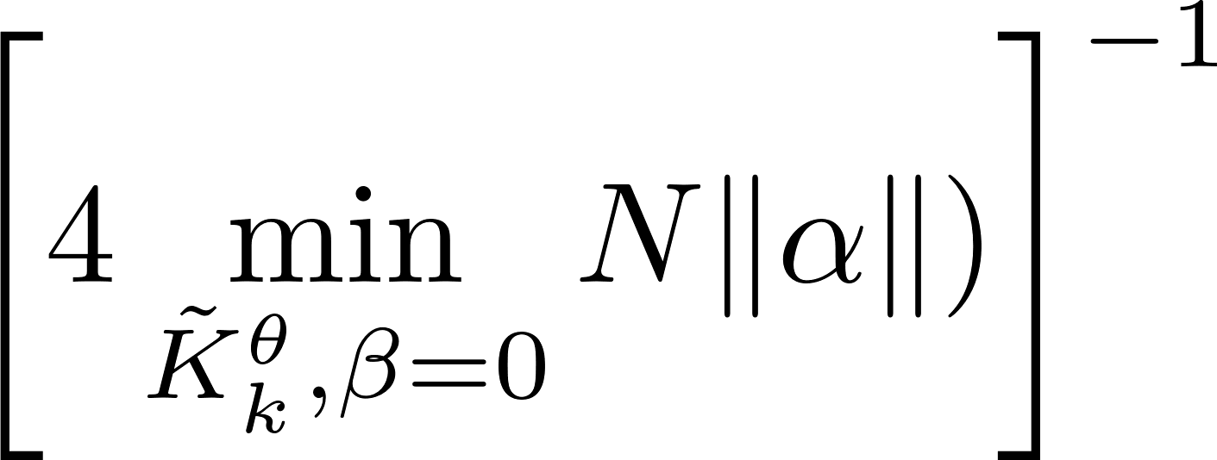
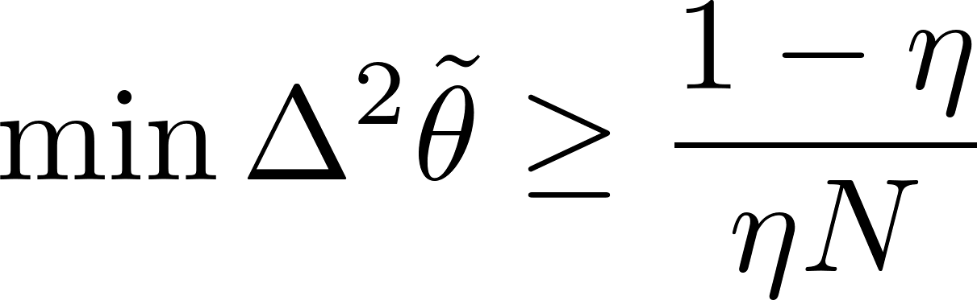
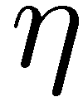

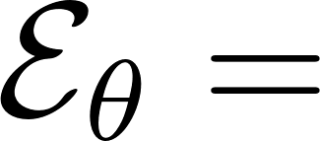
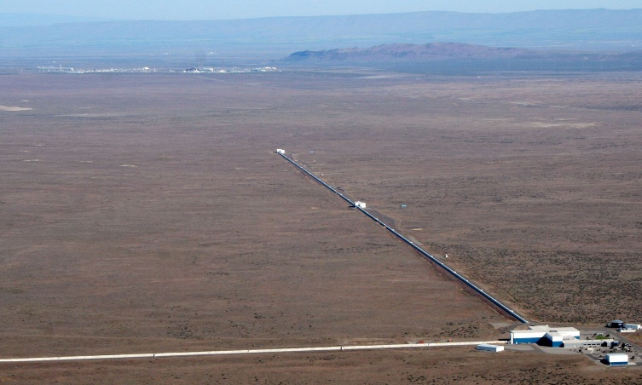
Asymptotic constant factor quantum improvement – Heisenberg scaling lost
Lossy interferometry
quantum enhancement factor
Fundamental bound saturable with squeezed vacuum + coherent state interferometry!
Almost optimal gain observed in LIGO/VIRGO!
Phys. Rev. Lett. 123, 231107 (2019)
Phys. Rev. Lett. 123, 231108 (2019
C.Caves, Phys. Rev. D 23, 1693 (1981)
RDD, K. Banaszek, R. Schnabel, Phys. Rev. A 88, 041802(R) (2013)

Slide 9
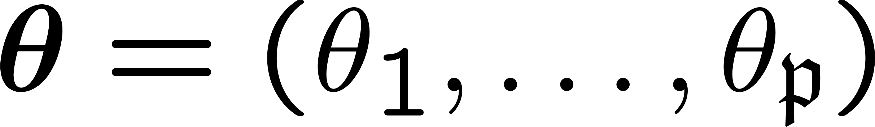
Multiparameter issues!
Input probe incompatibility
Measurement incompatibility
Correlated estimators
S. Ragy, M, Jarzyna, RDD, Phys. Rev. A 94, 052108 (2016)

Slide 10
Multiparameter issues!
Input probe incompatibility
may affect scaling of precision with the numer of parameters involved!
Measurement incompatibility
asymptotically at most twice overhead in resources for noisy models
Correlated estimators
problem removed if proper parametrization chosen
S. Ragy, M, Jarzyna, RDD, Phys. Rev. A 94, 052108 (2016)

Slide 11
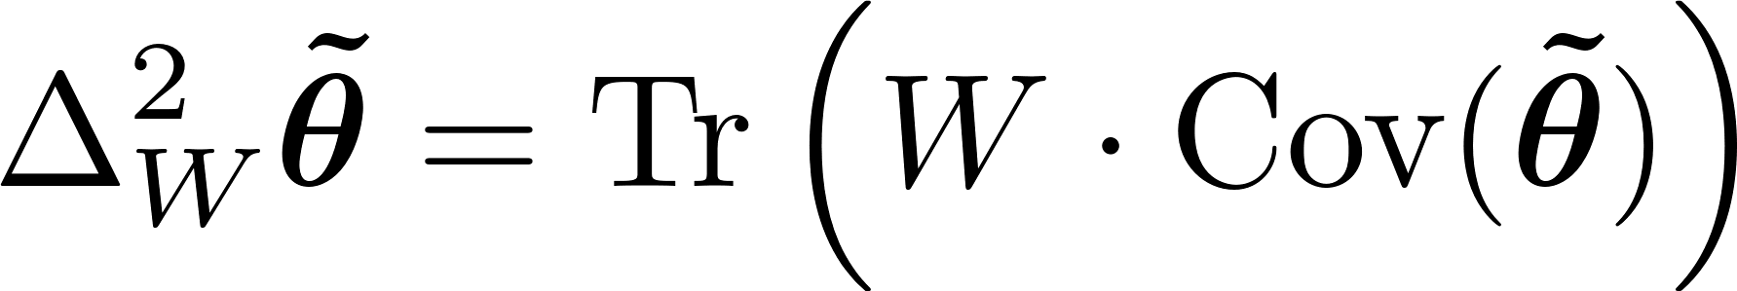
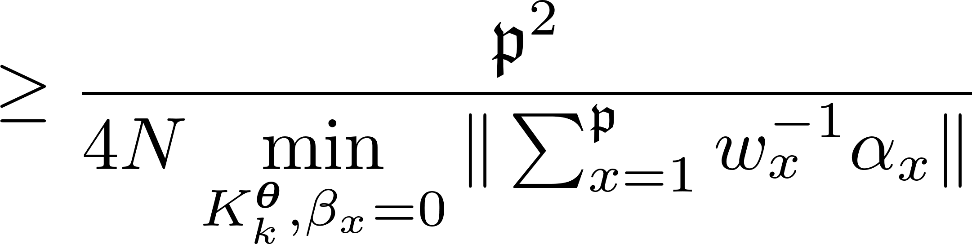
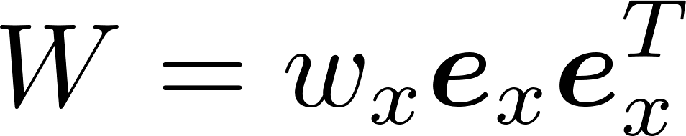
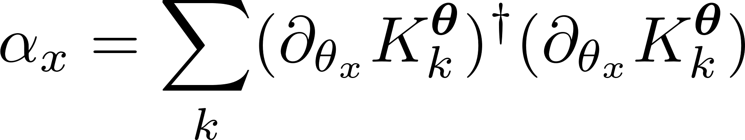
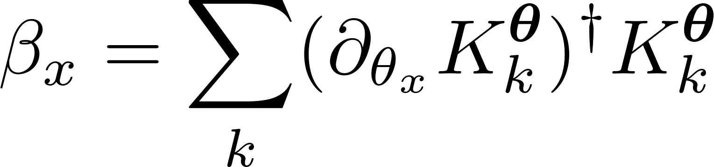
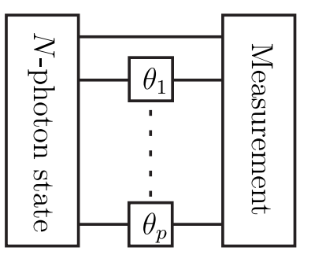

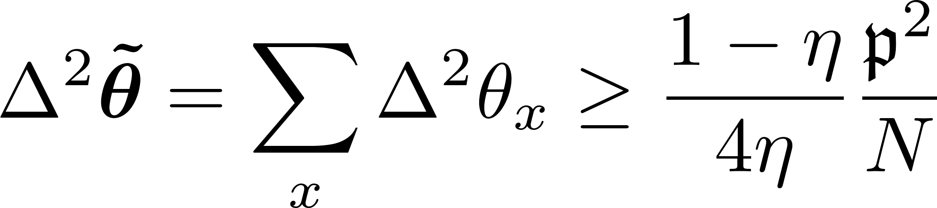
Fundamental multiparameter bound in generic noisy metrology
estimator covariance matrix
cost matrix
cost matrix eigendecompositions
(natural parametrization)
Multiple-phase lossy interferometry
(including adaptive schemes)
F. Albarelli, RDD, PRX 12, 011039 (2022)

Slide 12
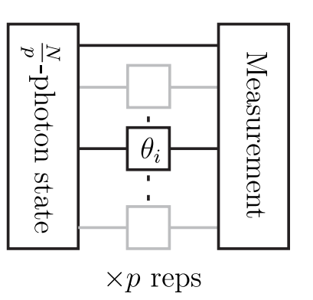
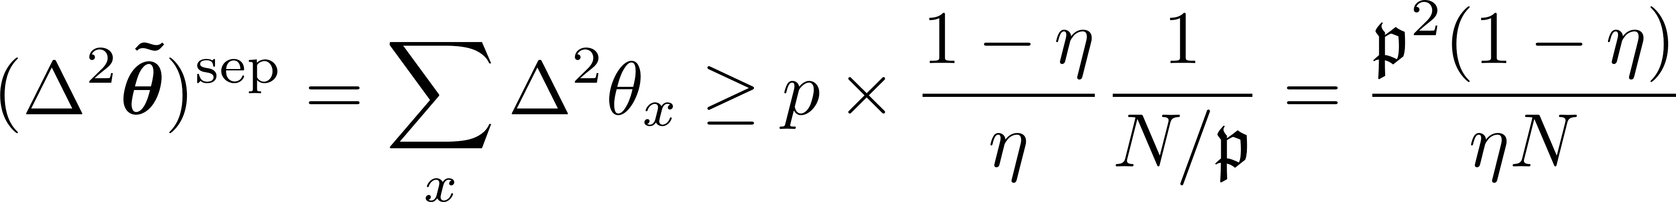
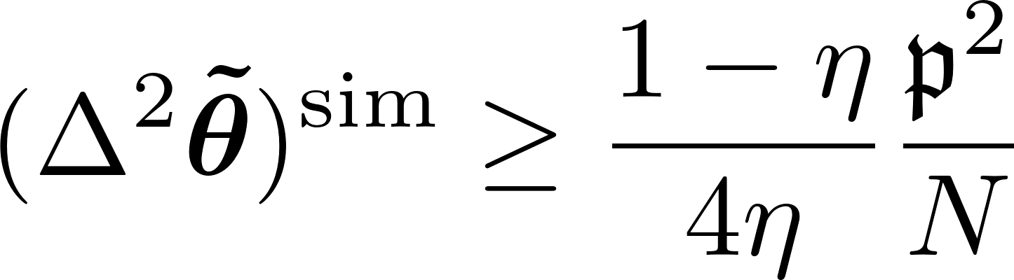
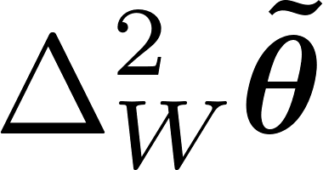
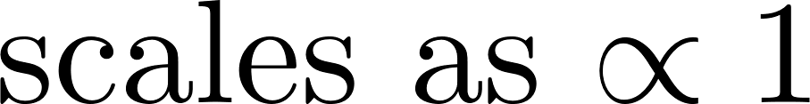
Simultanous vs. Separate estimation
If we perform separate estimation we need to split resources
Simultaenous estimation has an advantage but at most o factor of 4
No scaling advantage in numer of parameters due to probe incompatibility!
F. Albarelli, RDD, PRX 12, 011039 (2022)
)

Slide 13
Noiseless metrology
The true Heisenberg limit

Slide 14
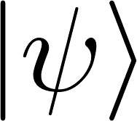
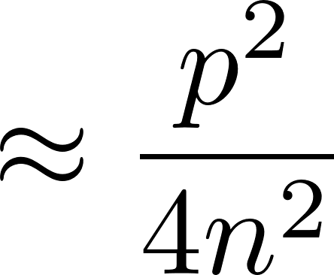
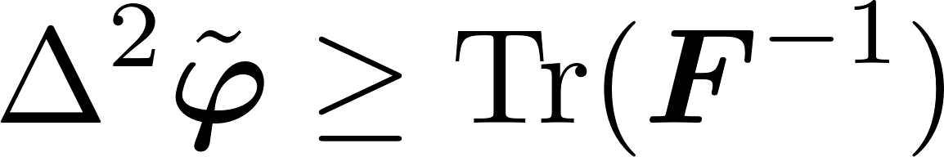
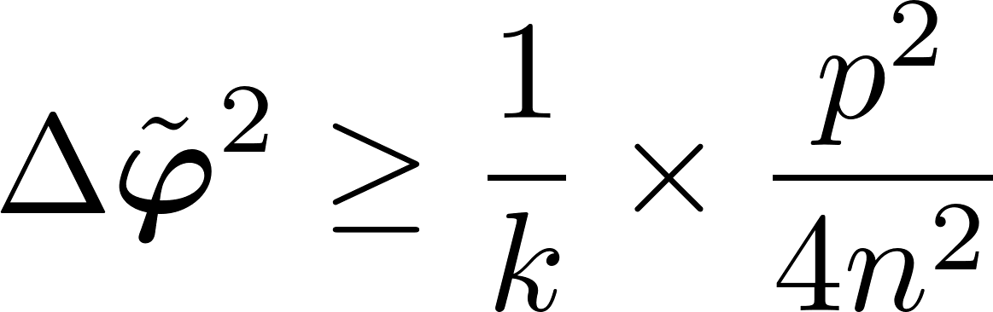
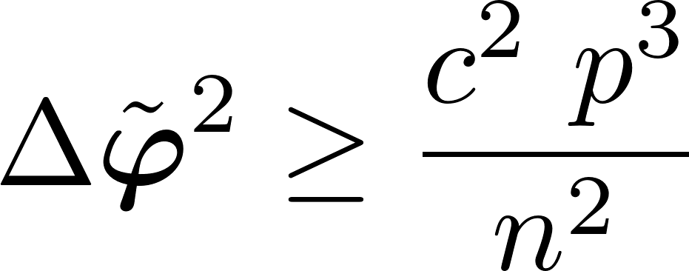
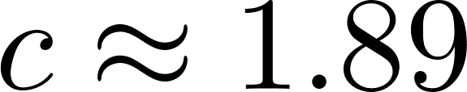
Multiple phases noiseless interferometry simultaneous vs separate strategies
Quantum Fisher information based analysis
P. C. Humphreys, M. Barbieri, A. Datta, and I. A. Walmsley, Phys. Rev. Lett. 111, 070403 (2013)
A better scaling of precision in terms of numer of estimated parameters…
Quantum Fisher Information matrix
Not achievable, unless many-repetition scenario considered!!!
Bayesian approach
Only a constant factor gain over separate strategies!
W. Górecki, RDD, PRL 128, 040504 (2022)

Slide 15
Summary
Probe incompatibility, the most relevant feature of multiparameter metrology
Nontrivial bounds in noisy multiple-parameter metrology derrived
Results may be applied to discrimination tasks -> bounds on noisy Grover algorithm
In noisless cases the Bayesian approach provides proper operationally saturable bounds in terms of the total resources used.
Thank you!
F. Albarelli, RDD, PRX 12, 011039 (2022)
W. Górecki, RDD, PRL 128, 040504 (2022)

Slide 16
