Slide 1
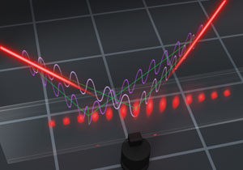
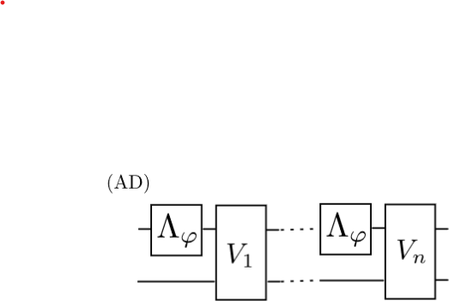

Quantum Metrological Toolbox a biased theorist perspective
Rafal Demkowicz-Dobrzański
Faculty of Physics, University of Warsaw, Poland

Slide 2
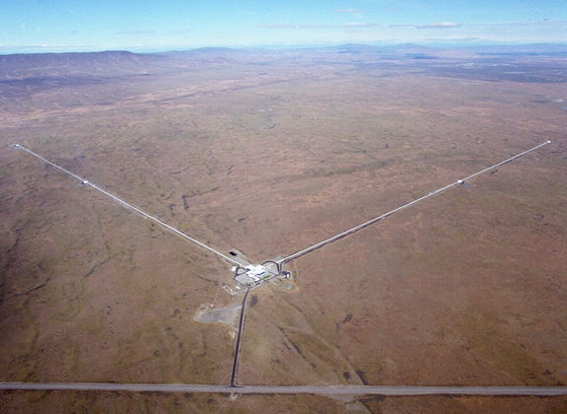
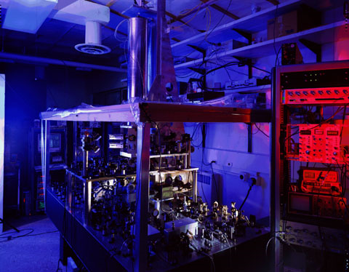
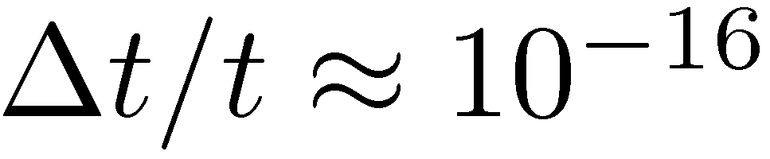
Interferometry at its limits
LIGO - gravitational wave detector
NIST - Cs fountain atomic clock
Michelson interferometer
Ramsey interferometry
How foundamental are these limits?

Slide 3
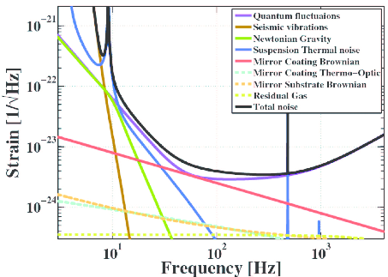
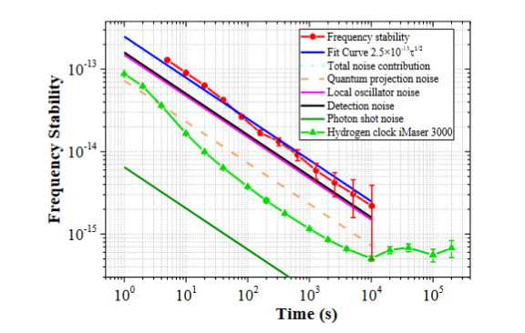
Experimentalist approach

Slide 4

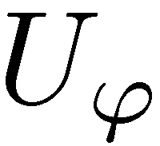
A very naive theorist approach
=
=
=
each photon evolves through an ideal Mach-Zehnder interferometer
each atom treated as a two level system (qubit) is rotated in the Bloch sphere picture by an angle ϕ

Slide 5
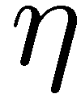
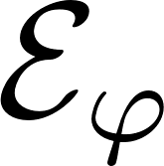
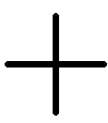
A slighlty less naive theorist approach
=
=
=
Take into account optical losses,
detector inefficiencies,…
Take into account atomic dephasing,
LO fluctuations…

Slide 6
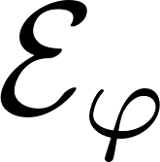
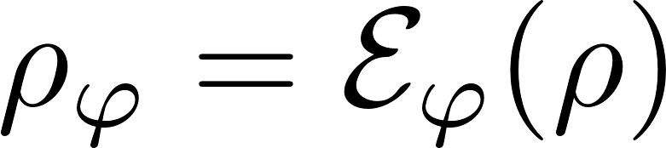

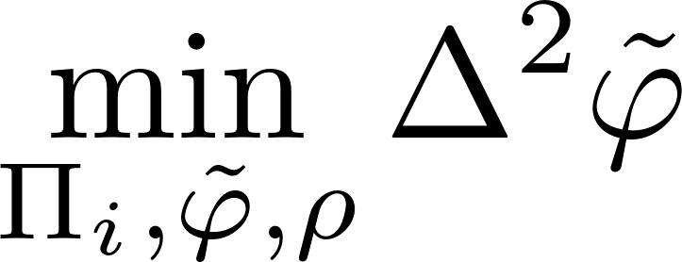
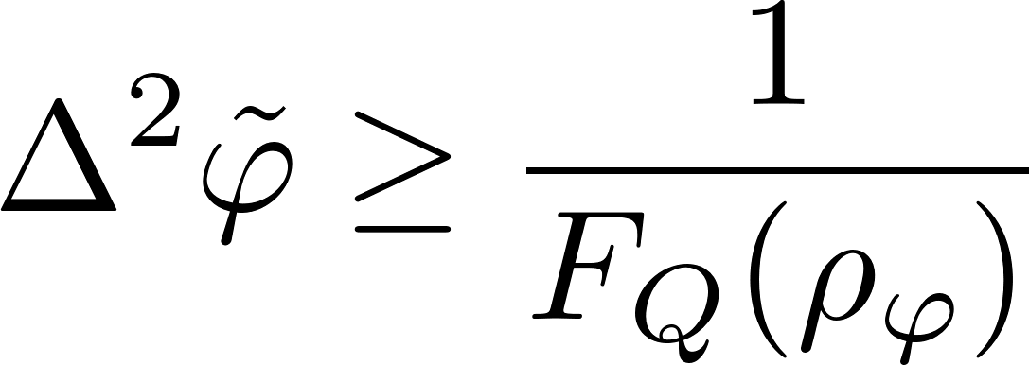
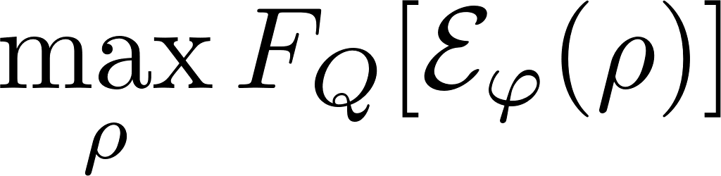
From interferometry to a quantum channel estimation problem…
Quantum Cramer-Rao bound

Slide 7
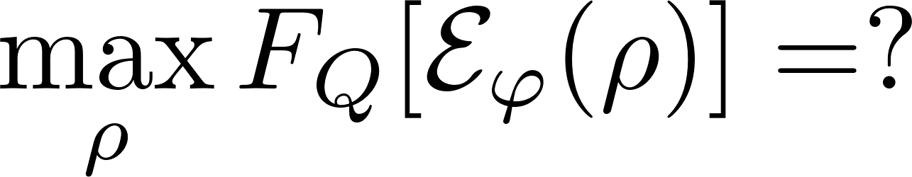
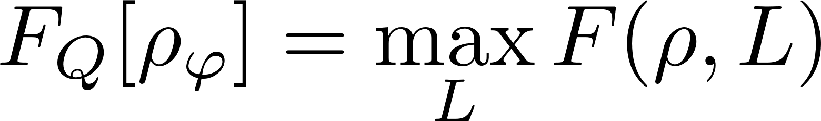
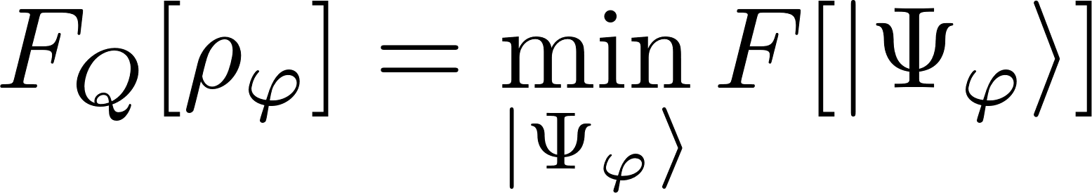
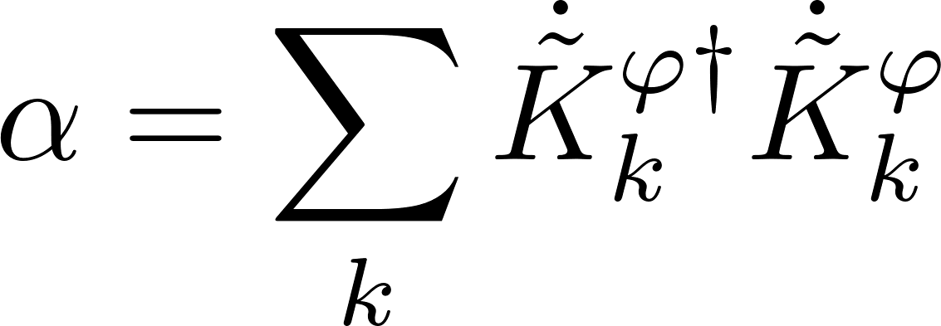
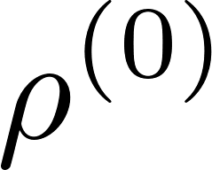
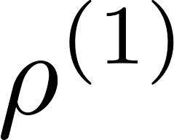
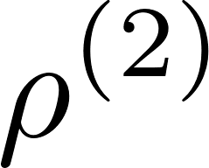
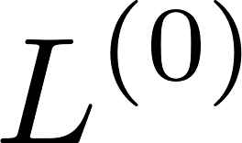
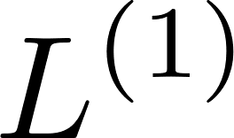
From interferometry to a quantum channel estimation problem…
Minimization over purifications (MOP)
Iterative See-Saw (ISS)
Each step is a simple linear or an eigenvalue problem!
A simple SDP programme!
Fujiwara, H. Imai, J. Phys. A 41, 255304 (2008)
K. Macieszczak, arxiv:1312.1356 (2013)
RDD, J. Kolodynski, M. Guta, Nat. Commun. 3, 1063 (2012)

Slide 8
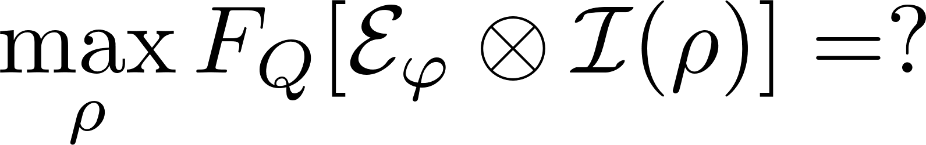
From interferometry to a quantum channel estimation problem…
Ancilla insensitive!
Ancilla sensitive!
Minimization over purifications (MOP)
Iterative See-Saw (ISS)
Each step is a simple linear or an eigenvalue problem!
A simple SDP programme!
Fujiwara, H. Imai, J. Phys. A 41, 255304 (2008)
RDD, J. Kolodynski, M. Guta, Nat. Commun. 3, 1063 (2012)
Works in Bayesian approach as well!
K. Macieszczak, arxiv:1312.1356 (2013)
K. Macieszczak, M. Fraas, RDD, New J. Phys. 16, 113002 (2014)

Slide 9
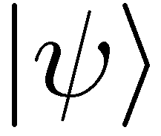
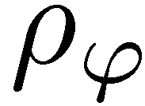
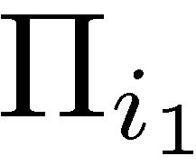


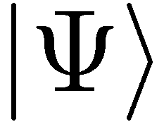
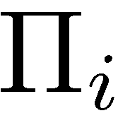
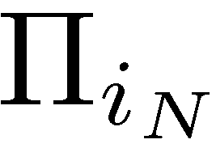

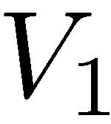
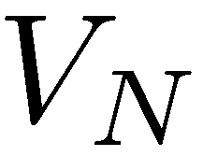
More channels! What are advantages of different levels of quantumness?
(C)
(E)
coherence
entanglement (passive way)
+ sequentiality
(AD)
entanglement + adaptiveness (active quantum feedback)

Slide 10
Optimal entanglement based strategies (E)
If N is small enough…
(for qubit channels N ≤ 5)
Minimization over purifications (MOP)
Iterative See-Saw (ISS)

Slide 11
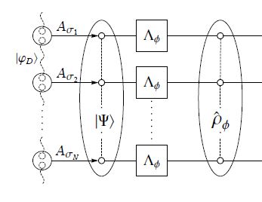
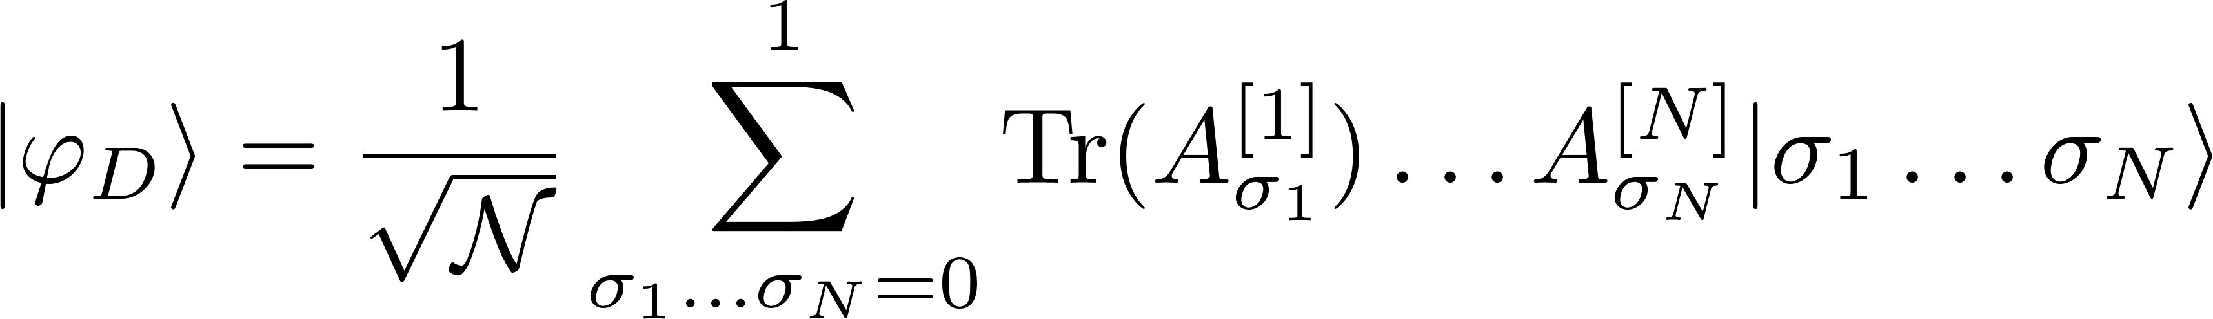
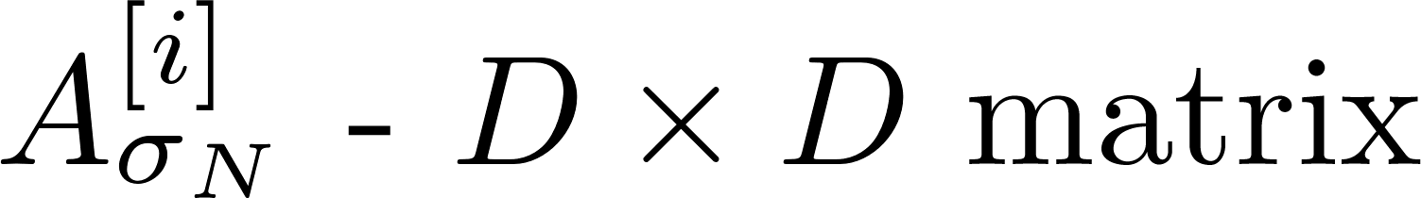
Optimal entanglement based strategies (E)
If N is large we can combine ISS and tensor networks formalism
Minimization over purifications (MOP)
Iterative See-Saw (ISS)
Typically, optimal
Low bond dimensions are usually enough to find optimal states!
matrix product state
(D – bond dimension)
TNQMetro Package, K.Chabuda, J. Dziarmaga, T. Osborne, RDD, Nat. Commun 11, 250 (2020)

Slide 12
Optimal adaptive protocols (AD)
Looking for optimal adaptive strategies = optimization over quantum combs (SDP)
≡
Minimization over purifications (MOP)
Iterative See-Saw (ISS)
Altherr, Y. Yang, Phys. Rev. Lett 127, 060501 (2021)
Q. Liu, Z. Hu, H. Yuan, Y. Yang, Phys. Rev. Lett. 130, 070803 (2023)
Control over size of ancilla
Can be combined with the tensor-network framework and work for large N !!!!
No control over size of ancilla
Not efficient for large N
see Staszek Kurdziałek
talk in a few minutes…

Slide 13
Alternative way! Derive useful bounds
no-go way
constructive way
Derive analytical/semianalytical upper bounds
Find numerically/guess the best metrological protocols
Ideally!
The best method: minimization of QFI over purifications of the noisy quantum channel
A. Fujiwara, H. Imai, J. Phys. A 41, 255304 (2008)
B. M. Escher, et al. Nature Phys. 7, 406–411 (2011)
RDD, J. Kolodynski, M. Guta, Nat. Commun. 3, 1063 (2012)
RDD, L. Maccone, Phys. Rev. Lett. 113, 250801 (2014)
RDD, J. Czajkowski, P. Sekatski, Phys. Rev. X 7, 041009 (2017)
S. Zhou et al., Nat. Commun. 9, 78 (2018)
S. Zhou, L. Jiang, PRX Quantum 2, 010343 (2021)
S. Kurdzialek, W. Gorecki, F. Albarelli, RDD, PRL 131, 090801 (2023)

Slide 14
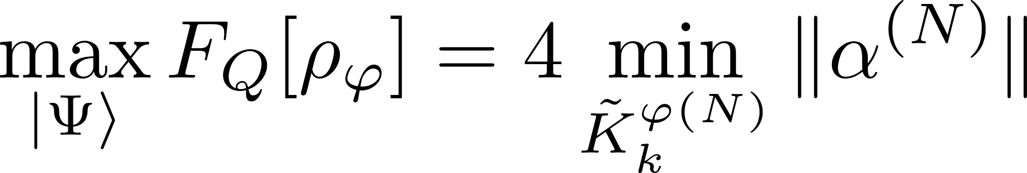
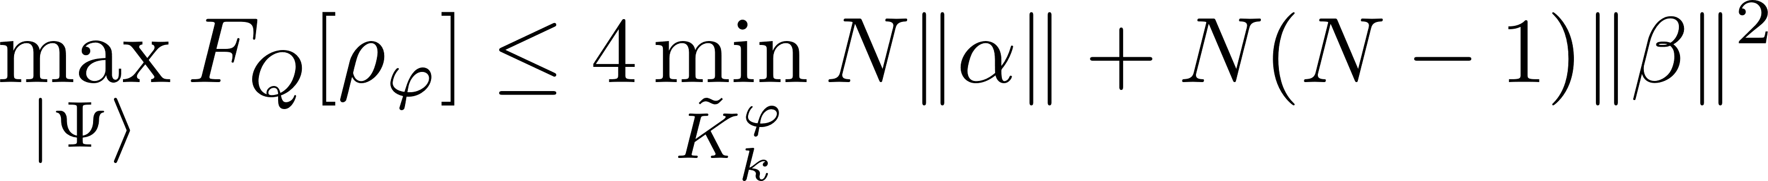
Fundamental bounds state-of-the art results (<2023)
Entangled based (E)
Adaptive (AD)
Efficient single channel optimization! (SDP)
A. Fujiwara, H. Imai, J. Phys. A 41, 255304 (2008)
B. M. Escher, et al. Nature Phys. 7, 406–411 (2011)
RDD, J. Kolodynski, M. Guta, Nat. Commun. 3, 1063 (2012)
S. Zhou, L. Jiang, PRX Quantum 2, 010343 (2021) [Asymptotically saturable]
RDD, L. Maccone, Phys. Rev. Lett. 113, 250801 (2014)
P. Sekatski, M. Skotiniotis, J. Kolodynski, W. Dur, Quantum 1, 27 (2017)
true for generic noisy channels
Heisenberg scaling is asymptotically lost!

Slide 15
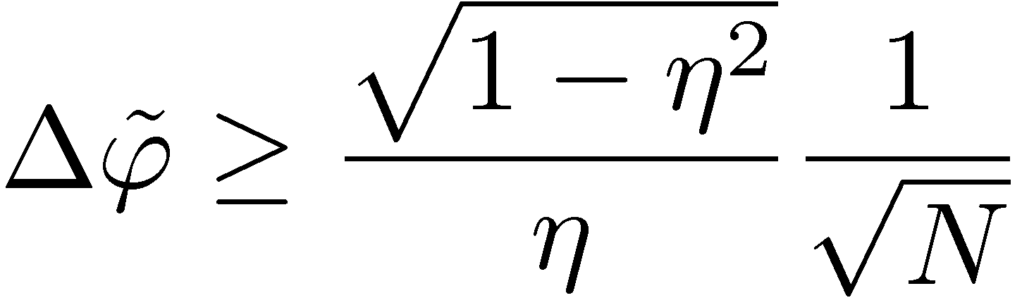
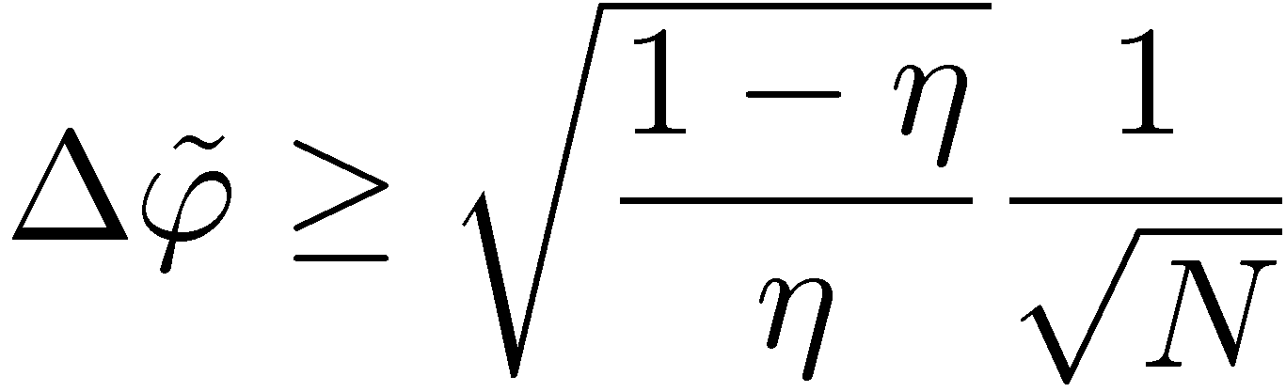


Fundamental bounds in most common scenarios
dephasing
Lossy interferometer
Constant factor gains over non-entangled strategies
Good news: Bounds are saturable asymptotically with strategies utilizing weakly squeezed states

Slide 16
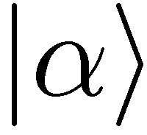
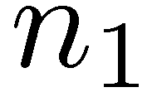
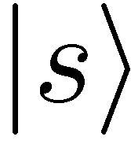
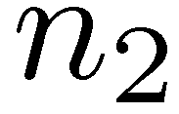
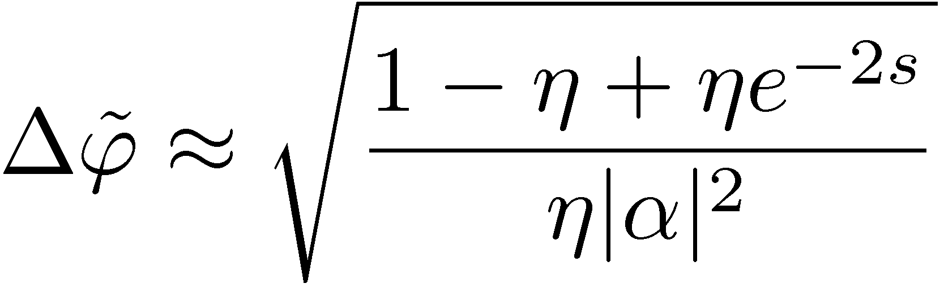
Good News: Saturating fundamental bounds asymptotically is simple!
fundamental bound
for lossy interferometer
For strong beams:
Cannot be achieved by sequential strategy.
Entanglement really helps!!!
Simple estimator based
on n₁- n₂ measurement
C. Caves, Phys. Rev D 23, 1693 (1981)
Weak squezing + simple measurement + simple estimator = optimal strategy!
Analogous behaviour in Ramsey interferometry – spin squeezed states saturate asymptotically the fundamental bound
S. Huelga et al. Phys.Rev.Lett. 79, 3865 (1997)
D. Ulam-Orgikh , M. Kitagawa Phys. Rev. A 64 052106 (2001)
B. M. Escher, R. L. de Matos Filho, L. Davidovich Nature Phys. 7, 406–411 (2011)
S. Zhou, L. Jiang, PRX Quantum 2, 010343 (2021)

Slide 17
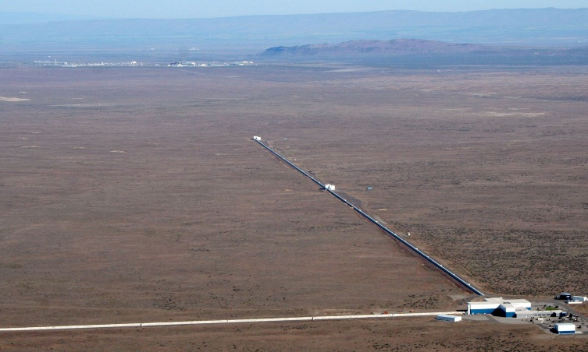
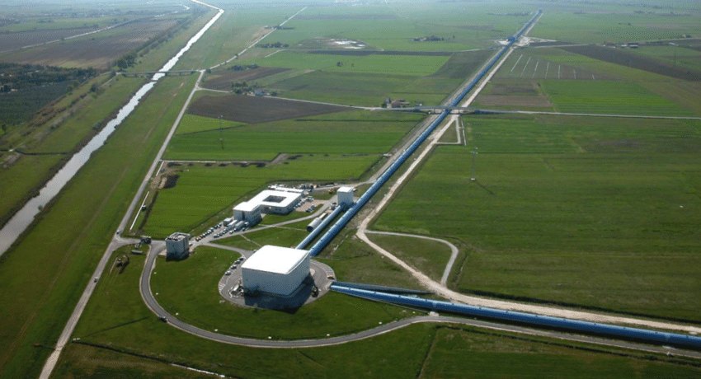
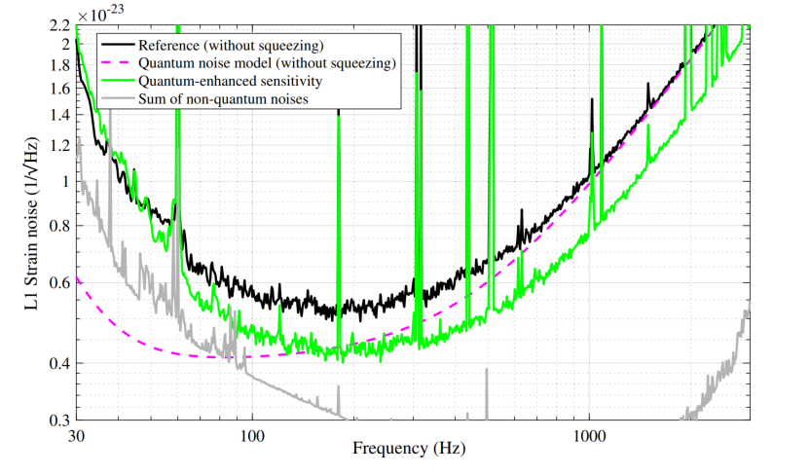
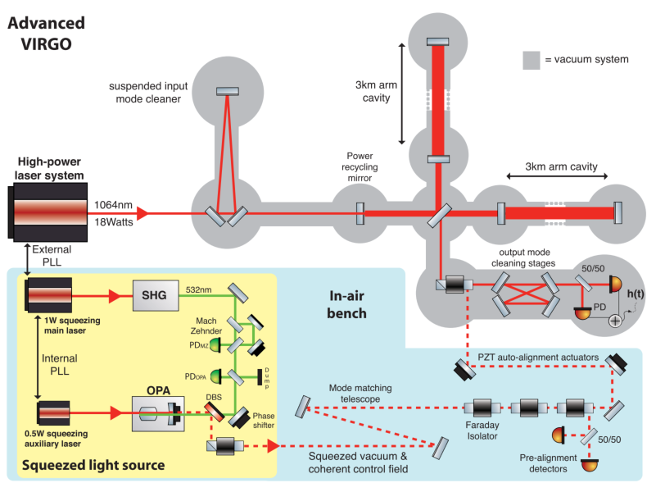
Squeezed states in gravitational wave detectors
LIGO
VIRGO
Phys. Rev. Lett. 123, 231107 (2019)
Phys. Rev. Lett. 123, 231108 (2019)
35% reduction in noise thanks to squeezing
equivalent to an increase of laser power by 85%!
~100 `quantum’ photons provides the same imprivement as 10²⁰ `classical’ photons

Slide 18










When Heisenberg scaling is possible….
Idea: we can correct all the noise while still some part of the unitary parameter encoding remains intact – Quantum Error Correction inspired protocols!
W. Dür, M. Skotiniotis, F. Fröwis, and B. K aus Phys. Rev. Lett. 112, 080801 (2014)
G.Arrad Y. Vinkler, D. Aharonov, and A. Retzker Phys. Rev. Lett. 112, 150801 (2014)
E. Kessler et al. Phys. Rev. Lett. 112, 150802 (2014)
P. Sekatski, M. Skotiniotis, J. Kolodynski, W. Dur, Quantum 1, 27 (2017)
RDD, J. Czajkowski, P. Sekatski,, Phys. Rev. X 7, 041009 (2017)
S. Zhou, M. Zhang, J. Preskill, and L. Jiang, Nat. Commun. 9, 78 (2018)
S. Zhou, L. Jiang, PRX Quantum 2, 010343 (2021)

Slide 19

Idea of minimization over different Kraus representations pushed to its limits
We optimize Kraus representation at every step
Efficient SDP
New simple universaly valid closed formula:
The best old formula:
S. Kurdzialek, W. Gorecki, F. Albarelli, RDD, PRL 131, 090801 (2023)

Slide 20






Do we have asymptotic gain thanks to adaptiveness?
vs.
asymptotically saturable
S. Zhou, L. Jiang, PRX Quantum 2, 010343 (2021)
seems to allow for a gain thanks to adaptiveness if Heisenberg scaling possible
valid also for causal superposition strategies
asymptotically tighter bound
S. Kurdzialek, W. Gorecki, F. Albarelli, RDD, PRL 131, 090801 (2023)
No asymptotic gain thanks to adaptiveness for all models with uncorrelated noise!

Slide 21









Summary
Generalize methods to correlated noise models!
no
yes
Heisenberg scaling not possible.
Small-scale entangelment protocols optimal
Heisenberg scaling possible.
Quantum error-correction inspired protocols optimal
Thank you!
Efficient numerical methods to find bounds and identify optimal protocols (SDP+tensor networks)
In single parameter estimation adaptiveness not useful asymptotically (QFI approach)
S. Kurdzialek, W. Gorecki, F. Albarelli, RDD, PRL 131, 090801 (2023)
S. Kurdzialek, P. Dulian, J. Majsak, S. Chakrabotry, RDD, coming soon…

