Slide 1
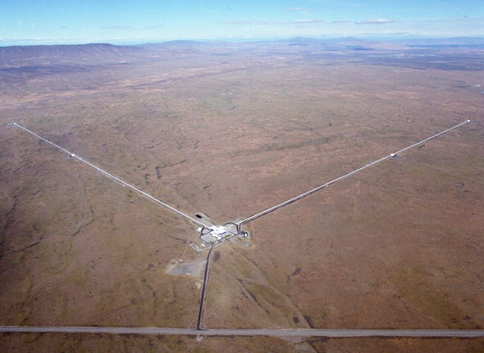
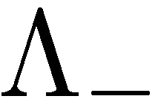

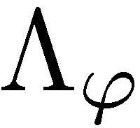
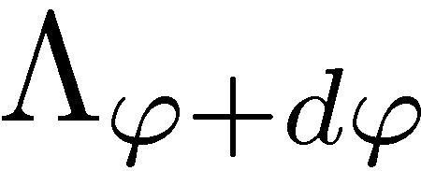
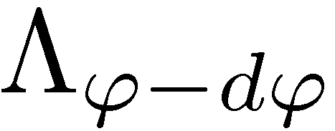
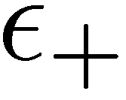
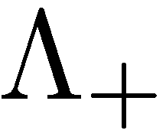






From Gravitational Wave Detectors to Completely Positive Maps and Back
R. Demkowicz-Dobrzański¹, K. Banaszek¹, J. Kołodyński¹, M. Jarzyna¹,
M. Guta², K. Macieszczak^{1,2}, R. Schnabel³, M. Fraas⁴
¹Faculty of Physics, University of Warsaw, Poland
² School of Mathematical Sciences, University of Nottingham, United Kingdom
³ Max-Planck-Institut fur Gravitationsphysik, Hannover, Germany
⁴ Theoretische Physik, ETH Zurich, 8093 Zurich, Switzerland
Notes:
abstract mathematics allows to tell something about real physical phenomena

Slide 2
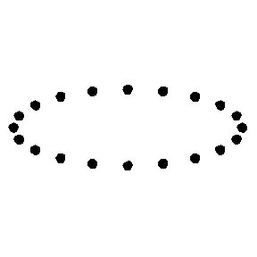
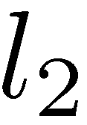
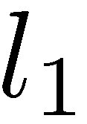
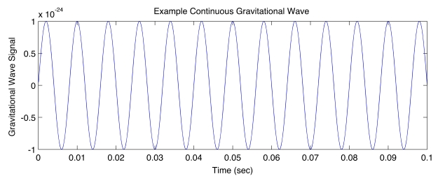

Gravitational waves detectors
LIGO – Laser Interferometer Gravitational Wave Observatory
Noise

Slide 3
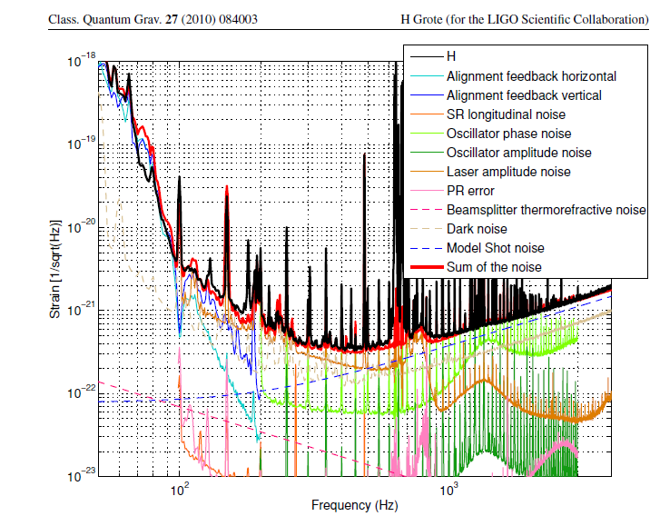
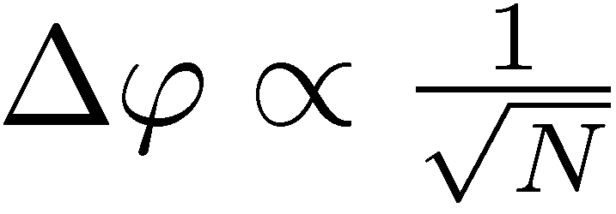
Shot Noise
each photon interfers only with itself

Slide 4
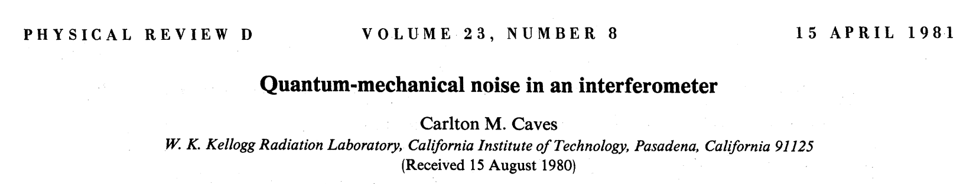
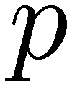
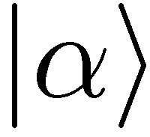

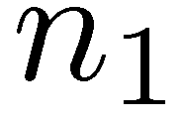

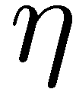
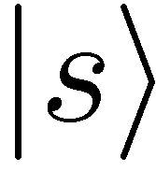
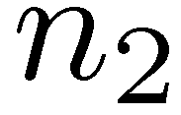
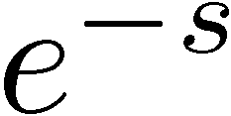
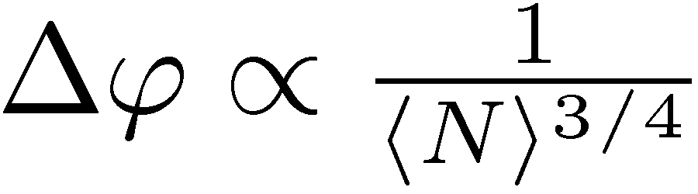
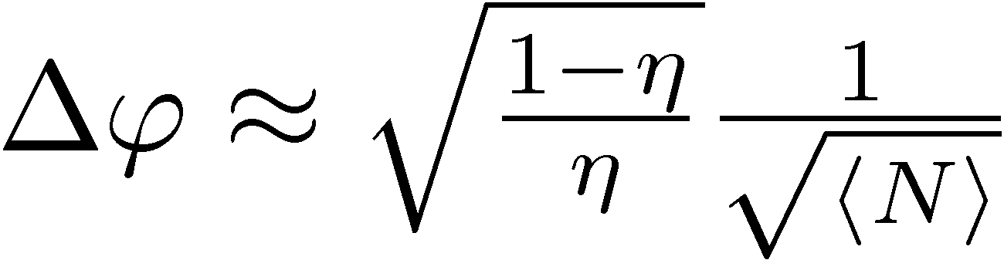
Beating the Shot Noise
Coherent state
Precision enhancement thanks to subpoissonian fluctuations of n₁- n₂!
Squeezed vacuum
ideal case
lossy case

Slide 5
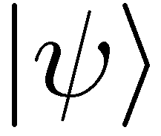
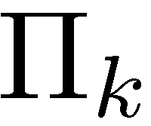
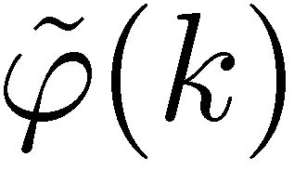
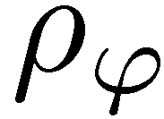
Looking for the ultimate limits
estimator
General two-mode
N photon state
general quantum measurement
single parameter quantum channel estimation

Slide 6
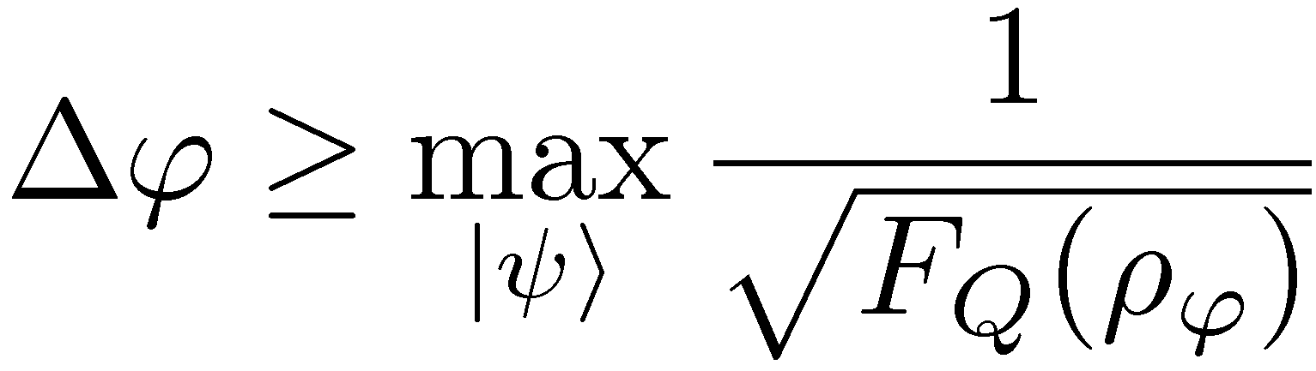
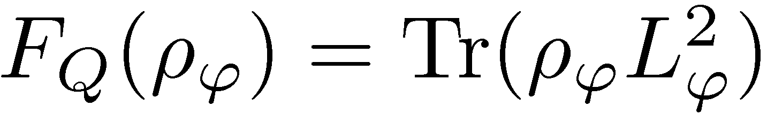
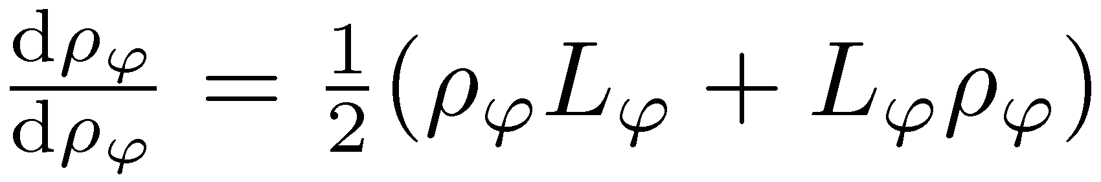
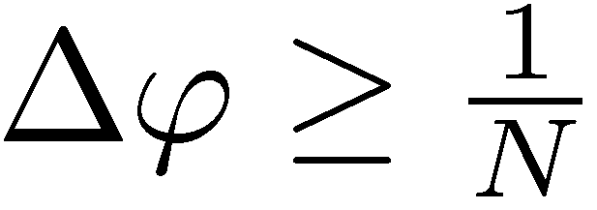
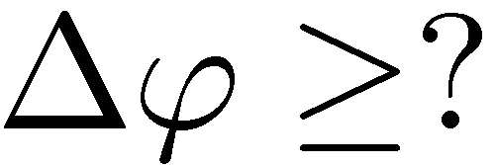
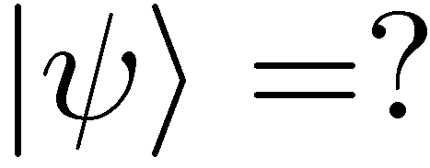
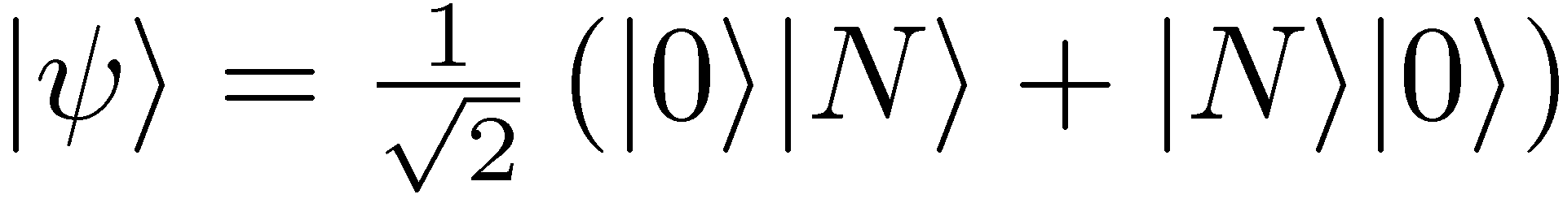
The blessing of the
Quantum Fisher Information
Limit on the optimal N photon strategy:
Ideal case (Heisenberg limit)
lossy case
no analytical bound until 2010!
J. Kolodyński, RDD, PRA 82,053804 (2010)
S. Knysh, V. Smelyanskiy, G. Durkin , PRA 83, (2011)
B. M. Escher, R. L. de Matos Filho, L. Davidovich Nature Phys. 7, 406–411 (2011)
RDD, J. Kolodynski, M. Guta, Nature Communications 3, 1063 (2012)

Slide 7
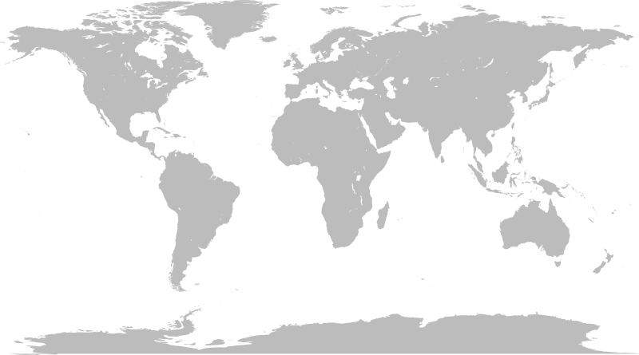
Wind from the East….
Classical/Quantum simulation of a quantum channel
K. Matsumoto, arXiv:1006.0300 (2010)
Nottingham
Warsaw
Tokyo,Osaka
Rio
Purification of a quantum channel
Fujiwara, A., and H. Imai, J. Phys. A: Math. Theor. 41, 255304 (2008)
Notes:
Mapka swiata -> wiatr z Japoniii do Europy i Rio

Slide 8
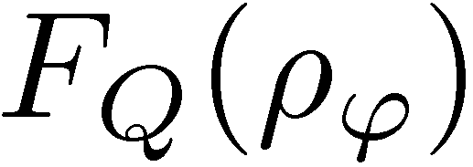
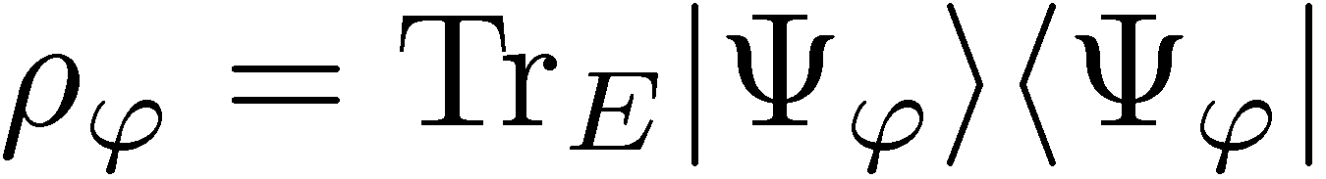
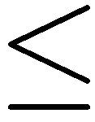
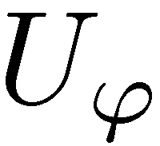
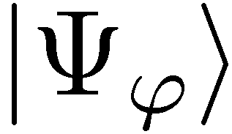
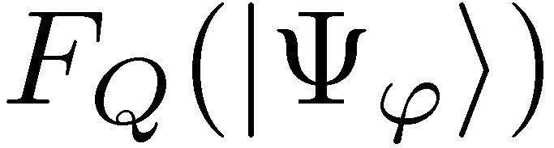
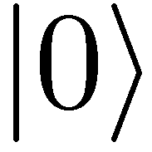
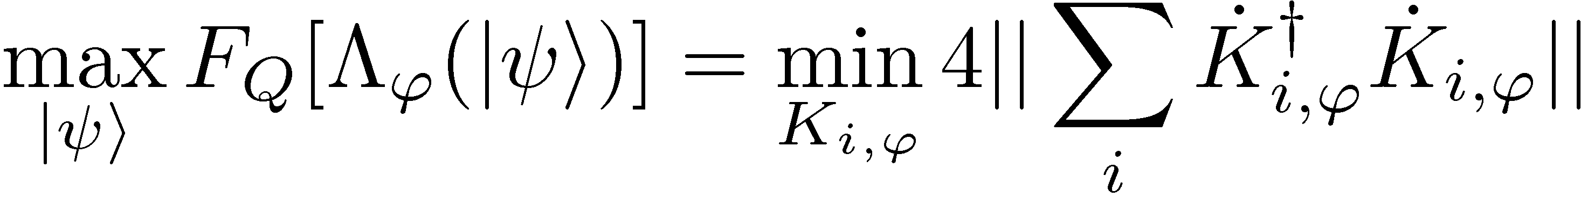
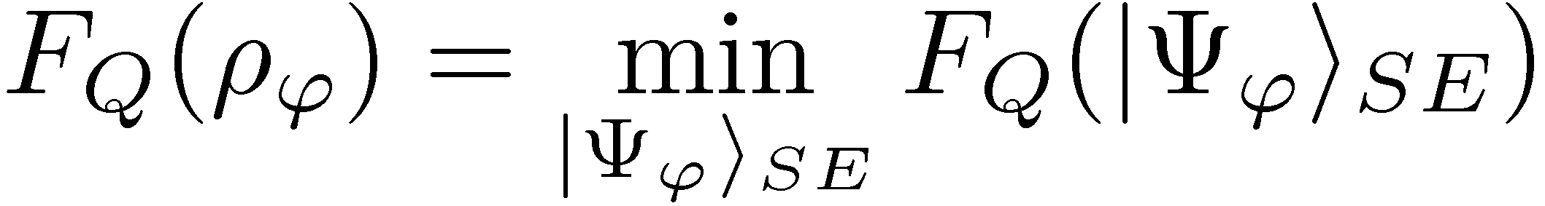
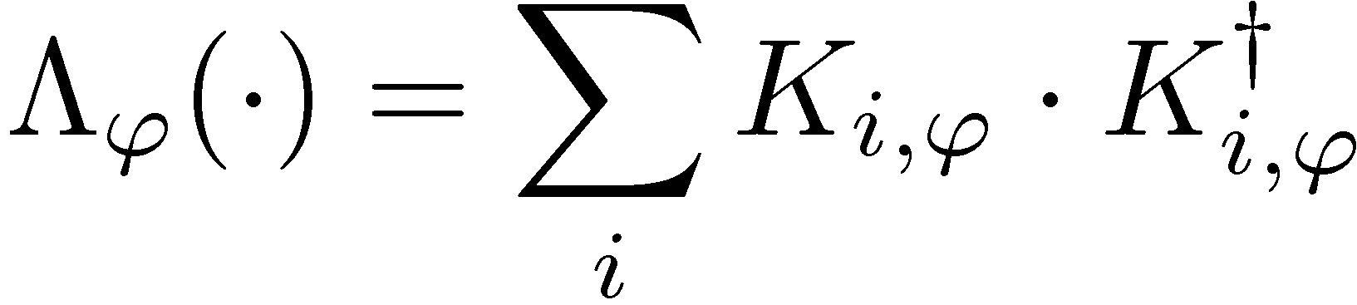
Purification idea
S
S
E
educated guess needed, but any representation gives an upper bound
Fujiwara, A., and H. Imai, J. Phys. A: Math. Theor. 41, 255304 (2008)
B. M. Escher, R. L. de Matos Filho, L. Davidovich Nature Phys. 7, 406–411 (2011)
Notes:
Mapka swiata -> wiatr z Japoniii do Europy i Rio

Slide 9
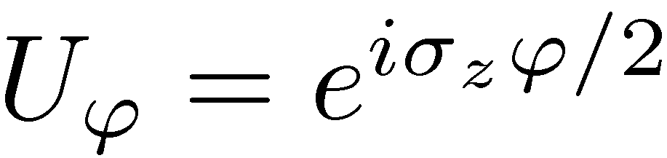
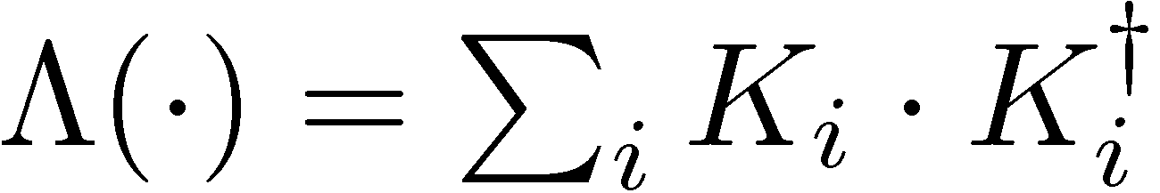
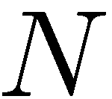
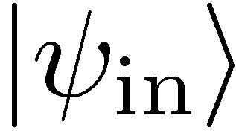
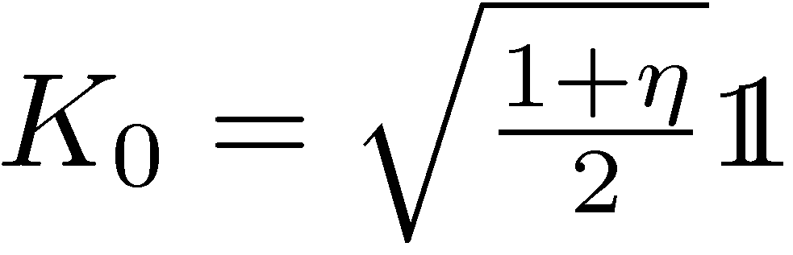







Distinguishable particles and uncorrelated noise
phase encoding
decoherence
atomic local dephasing
sngle photon loss map– output space:
a
b
photon survives
lost in mode a
lost in mode b

Slide 10


Purification idea applied to uncorrelated noise
)
Restrict to optimization over Kraus representation of a single channel
No need for an educated guess, can be cast as a semidefinite program
Fujiwara, A., and H. Imai, J. Phys. A: Math. Theor. 41, 255304 (2008)
B. M. Escher, R. L. de Matos Filho, L. Davidovich Nature Phys. 7, 406–411 (2011)
R. Demkowicz-Dobrzański, J. Kolodyński, M. Guta, Nat. Commun. 3, 1063 (2012

Slide 11





Purification idea applied to uncorrelated noise
Lossy interferometer | Dephasing | Depolarization | Spontaneous emission
-> No Heisenberg scaling

Slide 12



Classical/Quantum simulation idea
If we find a simulation of the channel…
=

Slide 13


Classical/Quantum simulation idea
Quantum Fisher information is nonincreasing under parameter independent CP maps!
We call the simulation classical:

Slide 14


Geometric classical simulation bound
Quantum enhancement = constant factor improvement!
RDD, J. Kolodynski, M. Guta, Nature Communications 3, 1063 (2012)

Slide 15


Saturating the fundamental bound for lossy interferometry is simple!
Fundamental bound
For strong beams:
Simple estimator based
on n₁- n₂ measurement
C. Caves, Phys. Rev D 23, 1693 (1981)
Weak squezing + simple measurement + simple estimator = optimal strategy!
The same is true for dephasing (also atomic dephasing – spin squeezed states are optimal)
S. Huelga, et al. Phys. Rev. Lett 79, 3865 (1997), B. M. Escher, R. L. de Matos Filho, L. Davidovich Nature Phys. 7, 406–411 (2011), D. Ulam-Orgikh and M. Kitagawa, Phys. Rev. A 64, 052106 (2001).

Slide 16






GEO600 interferometer at the fundamental quantum bound
coherent light
+10dB squeezed
fundamental bound
The most general quantum strategies could improve the precision additionally by at most 8%
RDD, K. Banaszek, R. Schnabel, Phys. Rev. A, 041802(R) (2013)

Slide 17




Adaptive schemes, error correction…???
loss, dephasing
The same bound is valid for the most general adaptive strategies:
RDD, L. Maccone, arxiv:1407.2934 (2014) (to appear in Phys. Rev. Lett.)
Better than shot-noise scaling? Effective turning off of decoherence at short nterrgoation times (e.g. perpendicular or non-Markovian dephasing)
A. Chin et al Phys. Rev. Lett. 109, 233601 (2012)
R. Chaves et al.Phys. Rev. Lett. 111, 120401 (2013)
E. Kessler et.al Phys. Rev. Lett. 112, 150802 (2014)

Slide 18

Classical/Quantum simulation bound for the adaptive schemes
Open problem: characterize cases when adaptive schemes offer metrological advantage
RDD, L. Maccone arxiv: 1407.2934 (2014) (to appear in Phys. Rev. Lett.)

Slide 19








Beyond Quantum Cramer-Rao bound the Bayesian approach
Cramer-Rao bound approach well justified for „local sensing” (narrow priors)
No gurantee of saturability in a single-shot scenario
May lead to overoptimistic claims of existence of sub-Heisenberg precision protocols implementaiton of which require impractical prior knowledge
Bayesian approach:
prior distribution
cost function
Bayesian Cramer-Rao bound:
For unitary models, and
Is there a Bayesian strategy saturating the C-R bound?

Slide 20








Decoherence-free phase estimation the Bayesian approach
For decoherence free phase estimaion, flat prior and a simple cost function
D. W. Berry and H. M. Wiseman, Phys. Rev. Lett. 85, 5098 (2000).
The π factor is present any regular prior, (rigorous proof for gaussian priors)
M. Jarzyna, R. Demkowicz-Dobrzanski, arxiv:1407.4805 (2014) (to appear in New J. Phys)

Slide 21








Bayes = Cramer-Rao approach in presence of uncorrelated decoherence
Due to decoherence Quantum Fisher information scales at most linearly:
almost optimal performance by entanlging only finite number of particles
(e.g matrix product states)
asymptotic bound
Bayes
CR
M. Jarzyna, RDD, Phys. Rev. Lett. 110, 240405 (2013)
M. Jarzyna, R.DD, arxiv:1407.4805 (2014) (to appear in New J. Phys)

Slide 22



Atomic clocks
Stationary condition:
We look for optimal atomic states, interrogation times, measurements and estimators so that the stationary variance is minimal (Bayesian approach)
Assumption of lack of correlation of frequnecy fluctuations in subsequent interrogation cycles
No rigorous proof of optimality of the presented strategy
In fact we should analyze fundamental limits on Allan variance….
K. Macieszczak, M. Fraas , RDD New J. Phys. 16, 113002 (2014)
Notes:
Comment on phase ambiguity…

Slide 23



Quantum computation and
quantum metrology
Quantum metrology
Quantum Grover-like algorithms
Quadratic quantum enhancement in absence of decoherence
Generic loss of quadratic gain due to decoherence???
!
?
RDD, M. Markiewicz, in preparation (2014)

Slide 24

Summary
GW detectors sensitivity limits
Atomic-clocks stability limits
Quantum metrological bounds
Quantum computing speed-up limits
Review paper: RDD, M.Jarzyna, J. Kolodynski, arxiv: arXiv:1405.7703

