Slide 1
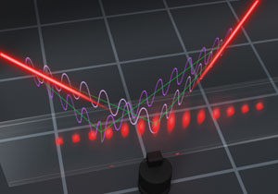
Using entanglement against noise in quantum metrology
R. Demkowicz-Dobrzański¹, J. Kołodyński¹, M. Jarzyna¹, K. Banaszek¹
M. Markiewicz¹, K. Chabuda¹, M. Guta² , K. Macieszczak^{1,2}, R. Schnabel^{3,},
M Fraas⁴ , L. Maccone ⁵
¹Faculty of Physics, University of Warsaw, Poland
² School of Mathematical Sciences, University of Nottingham, United Kingdom
³Max-Planck-Institut fur Gravitationsphysik, Hannover, Germany
⁴ Theoretische Physik, ETH Zurich, 8093 Zurich, Switzerland
⁵ Universit`a di Pavia, Italy.

Slide 2

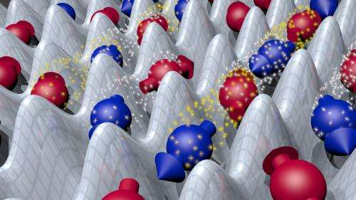
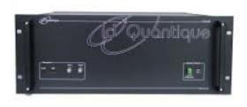
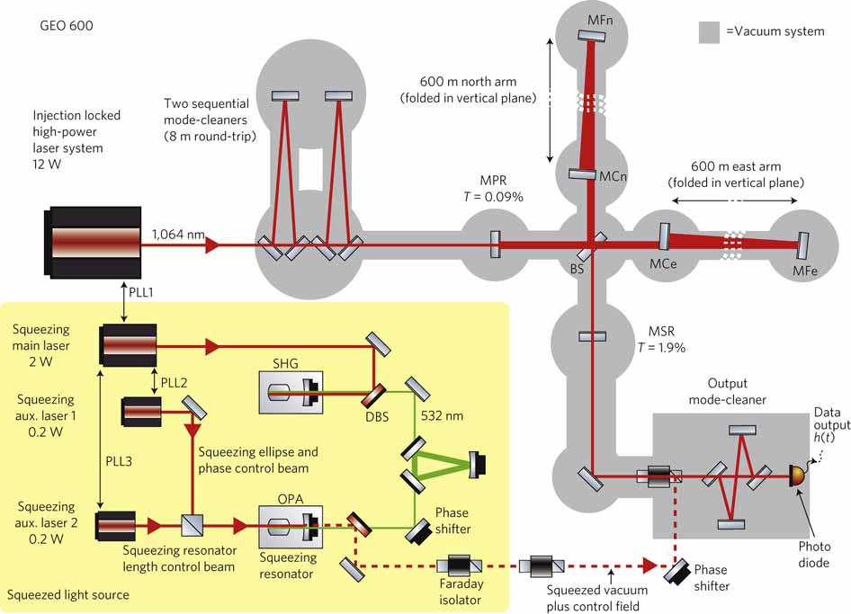
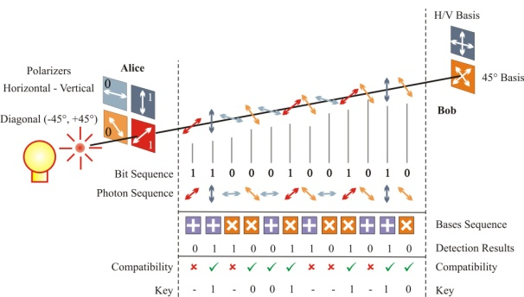
Making the most of the quantum world
Quantum computing
Quantum simmulators
Quantum communication
Quantum metrology

Slide 3
Quantum Metrology ≈
Quantum Interferometry

Slide 4
Quantum Metrology ≈
Quantum Interferometry >
Classical Interferometry

Slide 5
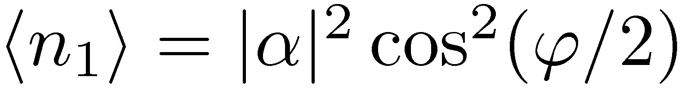

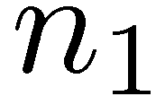
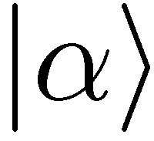
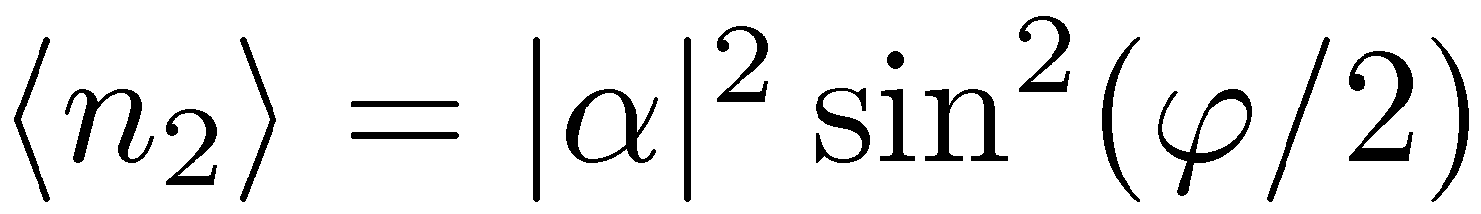
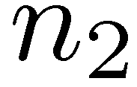
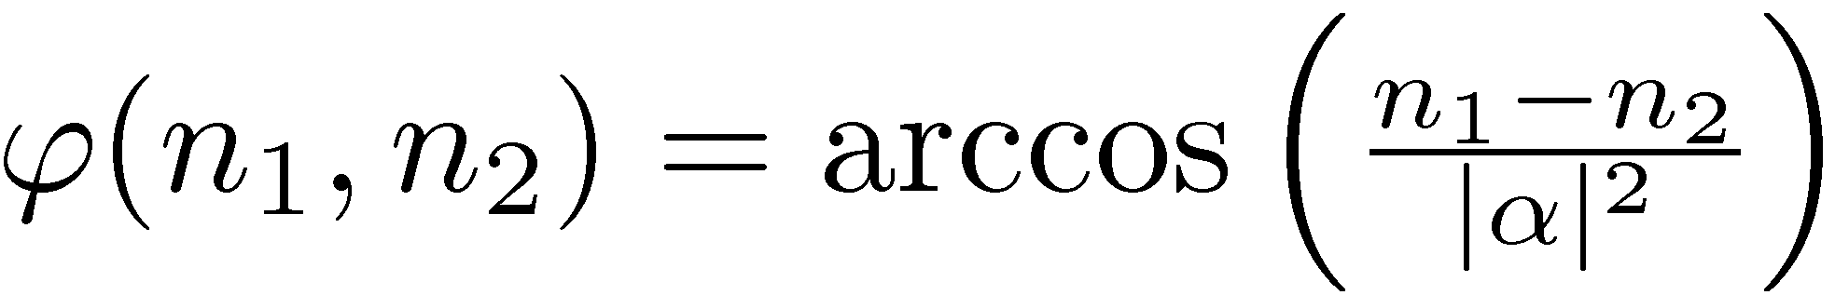
,,Classical’’ interferometry
reasonable estimator

Slide 6
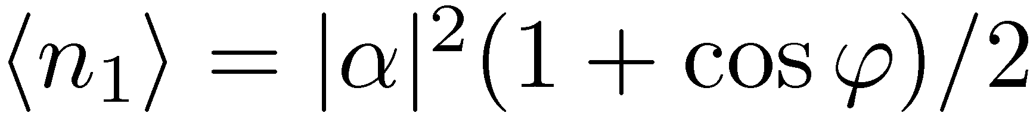
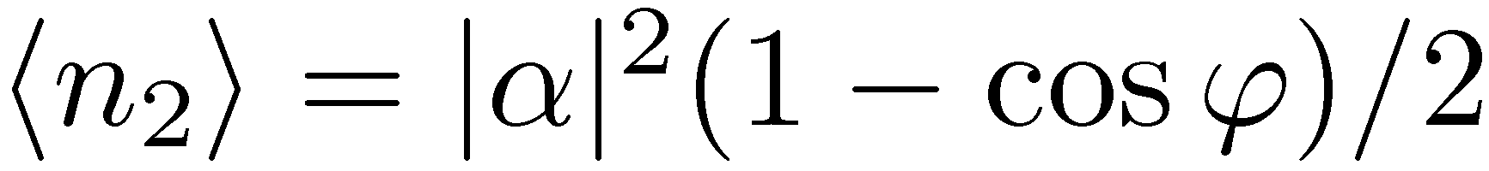
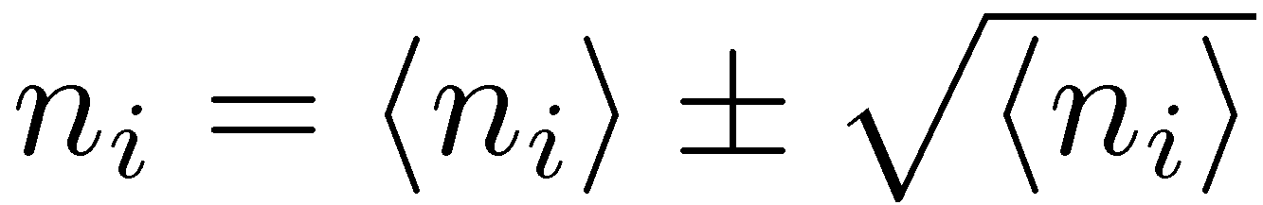
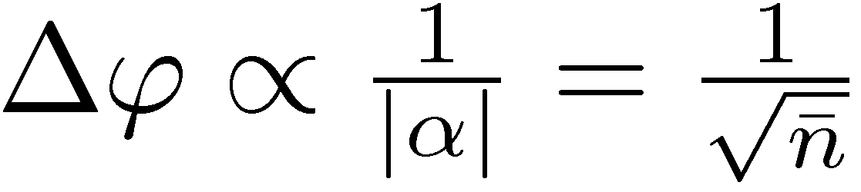
„Classical” interferometry
reasonable estimator
Poissonian statistics
Standard limit (Shot noise)

Slide 7
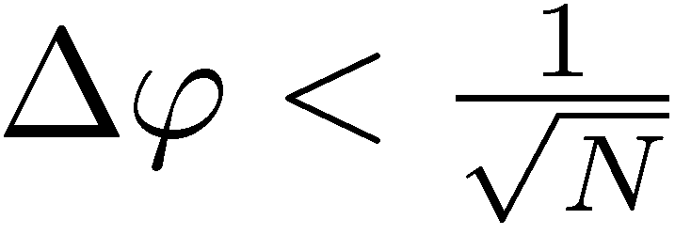
Quantum Interferometry
beating the shot noise using non-classical states of light

Slide 8
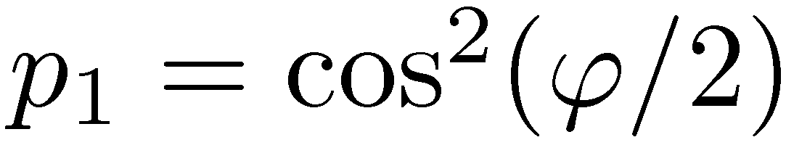
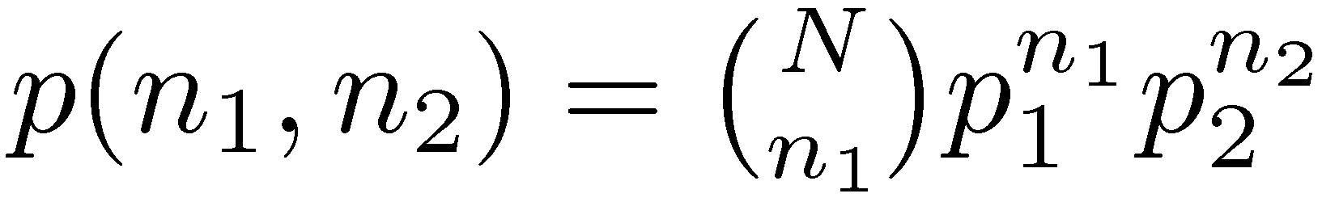
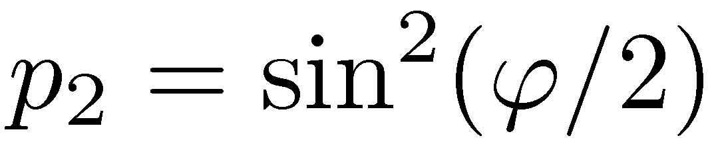

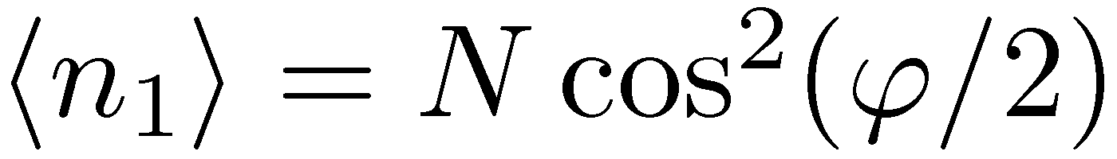
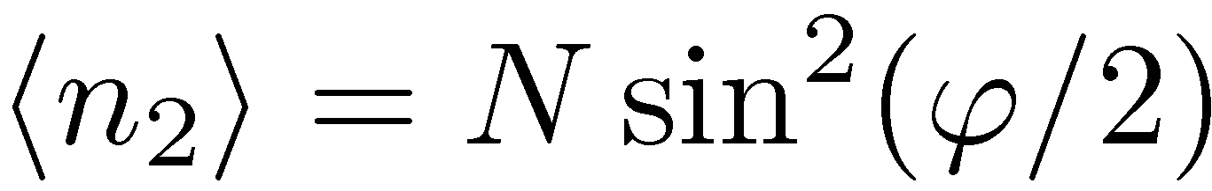
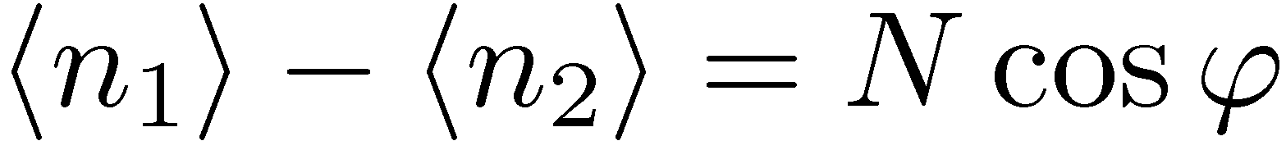
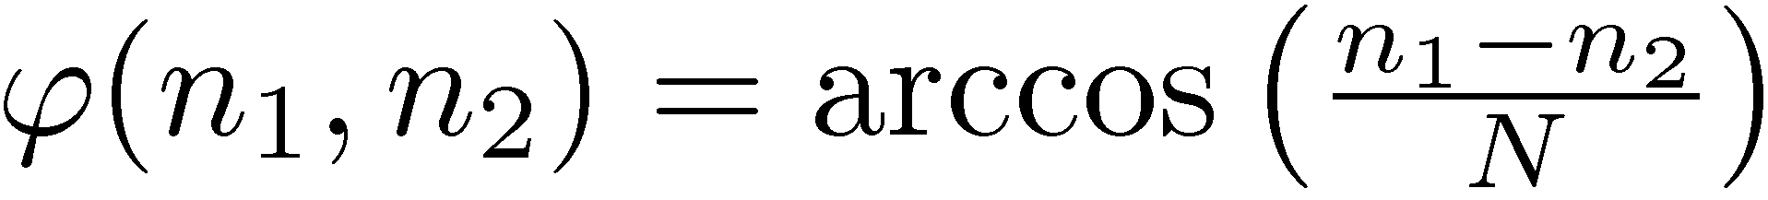
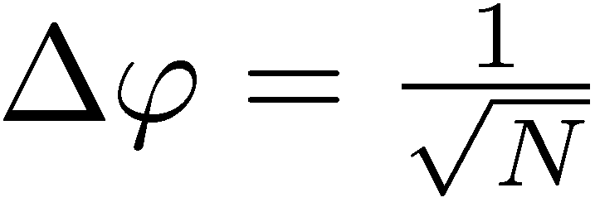
N independent photons
example of an estimator:
Estimator uncertainty:
Standard Limit (Shot noise)

Slide 9
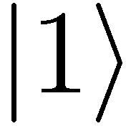
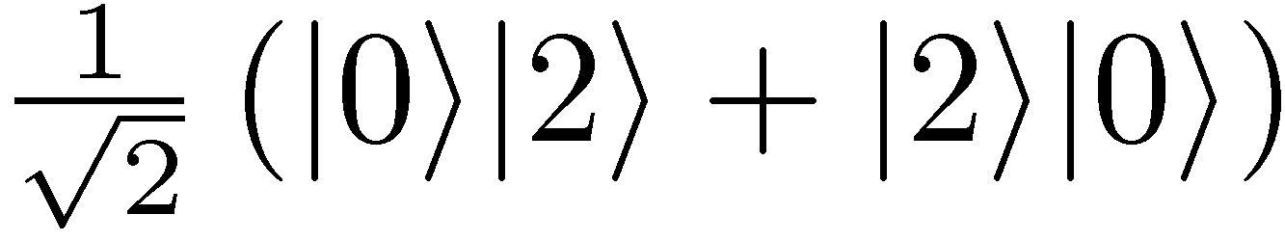
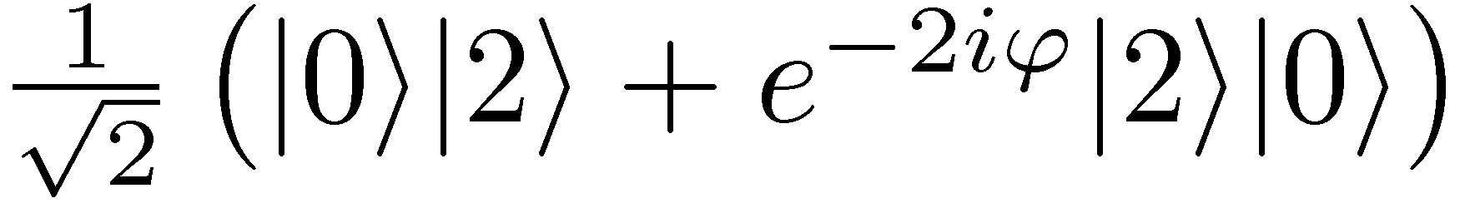

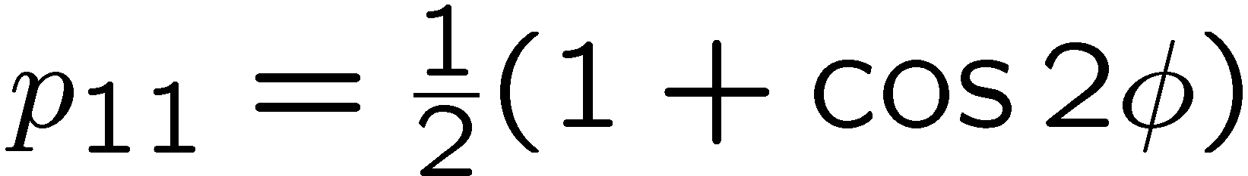
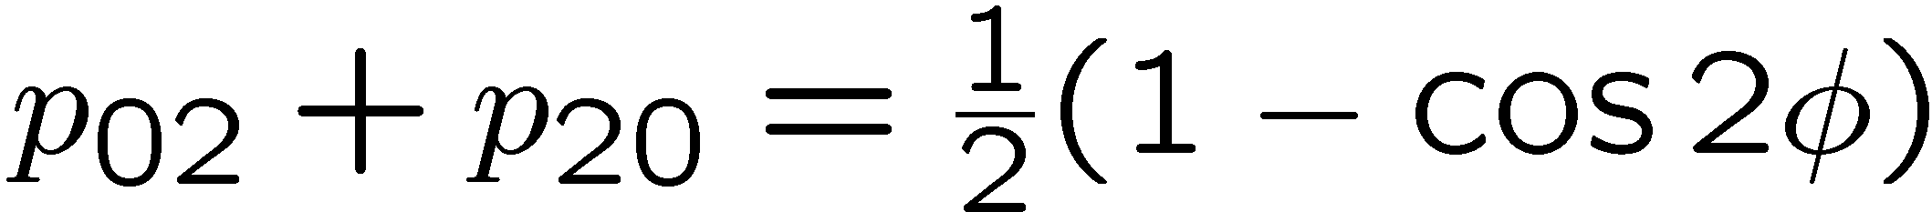
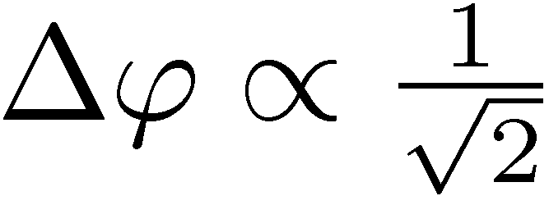
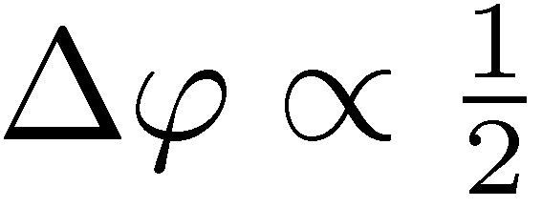
Entanglement enhanced precision
Hong-Ou-Mandel interference
&

Slide 10
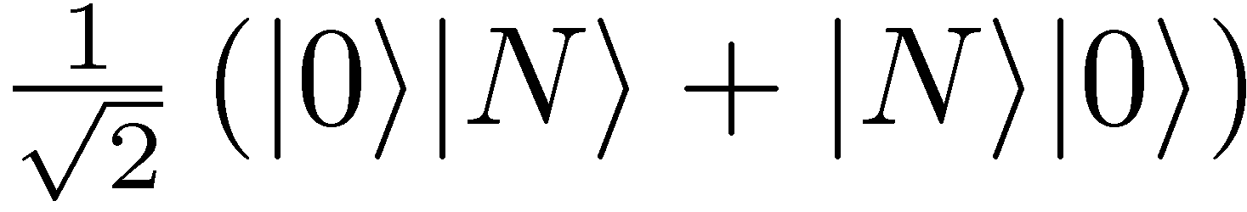
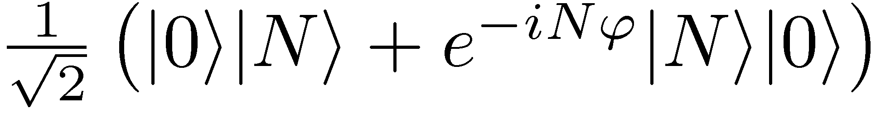
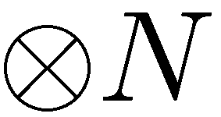
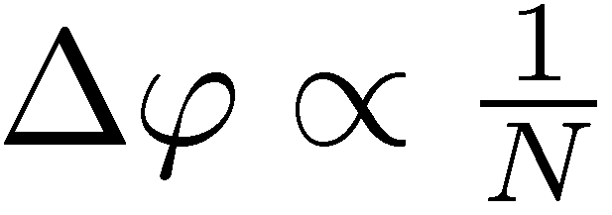
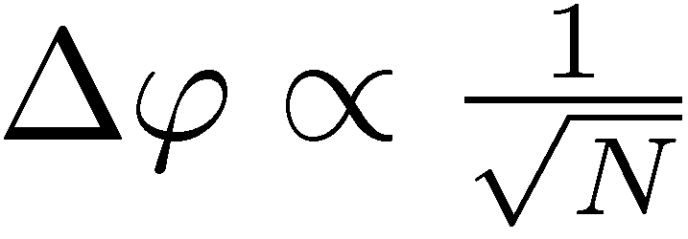
Entanglement enhanced precision
NOON states
State
preparation
Estimator
Measuremnt
Heisenberg limit
Standard Quantum Limit

Slide 11
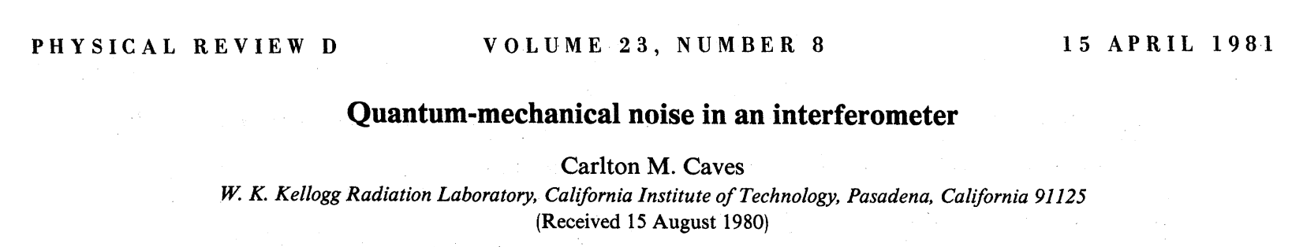


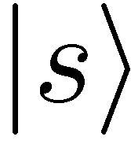
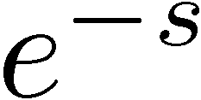
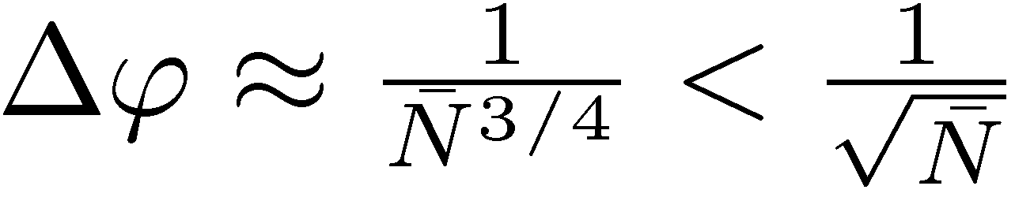
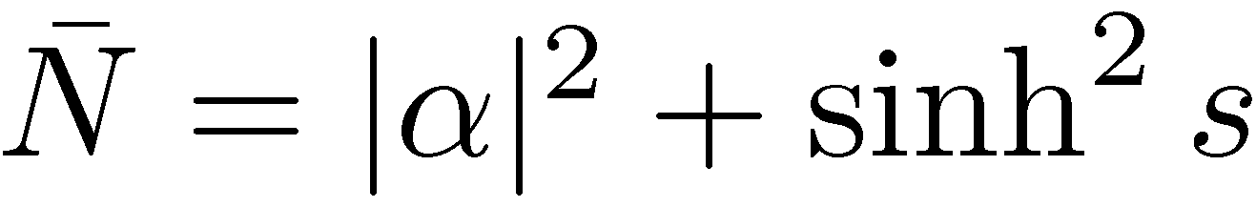
What about squeezing?
coherent state
sub-shot noise fluctuations of n₁- n₂!
squeezed vaccum

Slide 12
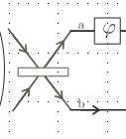
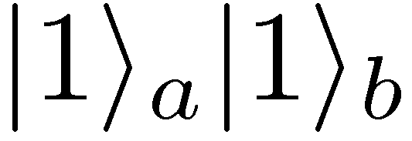
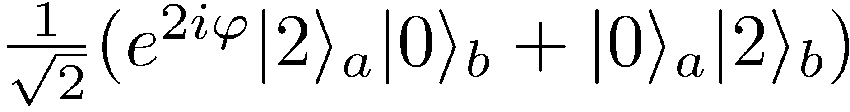
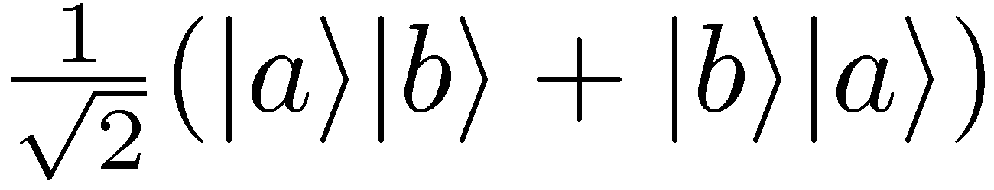
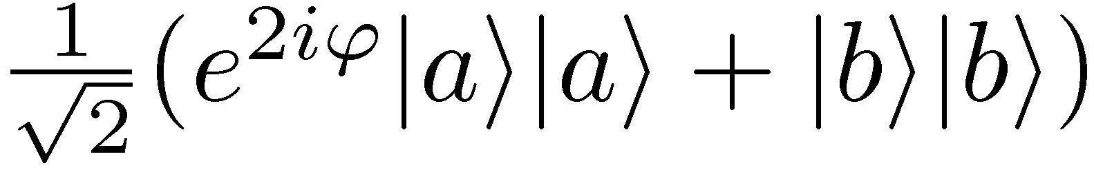
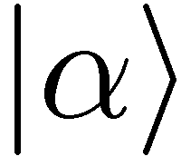
Squeezing and Particle Entanglement
=
=
=
1 photon sector
2 photon sector
Particle entanglement is a necessary condition for breaking the shot noise limit!
Pezzé, L., and A. Smerzi, Phys. Rev. Lett. 102, 100401 (2009)
Notes:
It is useful to treat particles as distinguishable.

Slide 13
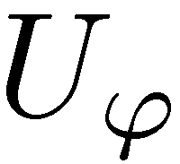
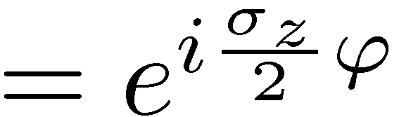
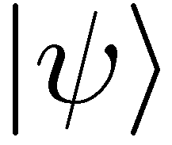














Quantum metrology as a quantum channel estimation problem
=
,,Classical’’ scheme
Entanglement-enhanced scheme
Quantum Cramer-Rao bound:

Slide 14


Given N uses of a channel… coherence will also do
N
Sequential strategy is as good as the entanglement-enhanced one
(if time is not an issue…)
B. L. Higgins, D. W. Berry, S. D. Bartlett, H. M. Wiseman, G. J. Pryde, Nature (2007)

Slide 15

Sensing a quantumm channel using entanglement
N
entanglement
enhanced
sequential
strategy
entanglement-
enhanced
ancilla-assisted
most general
adaptive scheme
All schemes are equivalent in decoherence-free metrology!
V. Giovannetti, S. Lloyd, and L. Maccone, Phys. Rev. Lett. 96, 010401 (2006)

Slide 16



Impact of decoherence…
loss
dephasing

Slide 17





Dephasing
sequential strategy
optimal probe state:
entanglement enhanced strategy
upper bound via channel simulation method….
RDD, J. Kolodynski, M. Guta, Nature Communications 3, 1063 (2012)

Slide 18



Channel simulation idea
If we find a simulation of the channel…
=

Slide 19


Channel simulation idea
Quantum Fisher information is nonincreasing under parameter independent CP maps!
We call the simulation classical:

Slide 20












Geometric construction of (local) channel simulation

Slide 21



Geometric construction of (local) channel simulation
dephasing
loss

Slide 22

Geometric construction of (local) channel simulation
dephasing
Bounds are saturable! (spin-squeezed states /MPS)
S. Huelga et al. Phys.Rev.Lett. 79, 3865 (1997)
D. Ulam-Orgikh and M. Kitagawa, Phys. Rev. A 64, 052106 (2001)
M. Jarzyna, RDD, Phys. Rev. Lett. 110, 240405 (2013)

Slide 23




Entanglement is useful!
thanks to decoherence :-0
e
e = 2.71 – entanglement enhancement in quantum metrology

Slide 24




Adaptive schemes, error correction…???
E. Kessler et.al Phys. Rev. Lett. 112, 150802 (2014)
W. Dür, et al., Phys. Rev. Lett. 112, 080801 (2014)
The same bounds apply!
RDD, L. Maccone Phys. Rev. Lett. 113, 250801 (2014)

Slide 25



Channel simulation idea
Quantum Fisher information is nonincreasing under parameter-independent CP maps!

Slide 26
Entanglement enhancement in quantum metrology
RDD, L. Maccone Phys. Rev. Lett. 113, 250801 (2014)

Slide 27
Practical applications….

Slide 28


Going back to the Caves idea…
fundamental bound
for lossy interferometer
For strong beams:
Simple estimator based
on n₁- n₂ measurement
C. Caves, Phys. Rev D 23, 1693 (1981)
M. Jarzyna, RDD, Phys. Rev. A 85, 011801(R) (2012)
Weak squezing + simple measurement + simple estimator = optimal strategy!

Slide 29


Optimality of the squeezed vacuum+coherent state strategy

Slide 30




GEO600 interferometer at the fundamental quantum bound
coherent light
+10dB squeezed
fundamental bound
The most general quantum strategies could additionally improve the precision by at most 8%
RDD, K. Banaszek, R. Schnabel, Phys. Rev. A, 041802(R) (2013)

Slide 31



Atomic clocks
We look for optimal atomic states, interrogation times, measurements and estimators to minimize the Allan variance – requires Bayesian approach
go back in time to yesterday’s talk by M. Jarzyna or
M.Jarzyna, RDD, New J. Phys. 17, 013010 (2015)

Slide 32


















Atomic clocks – preeliminary results
interrogation time t
Allan variance for averaging time:
For single atom interrogation strategy…
expected behavior
Exemplary LO noise spectrum
[Nat. Photonics 5 158–61 (2011) NIST, Yb clock]
K. Chabuda, RDD, in preparation
K. Macieszczak, M. Fraas, RDD, New J. Phys. 16, 113002 (2014)

Slide 33




Quantum computation and
quantum metrology
Quantum metrology
Quantum Grover-like algorithms
Generic loss of quadratic gain due to decoherence
go back in time to yesterday’s talk by M. Markiewicz or
RDD, M. Markiewicz, Phys. Rev. A 91, 062322 (2015)

Slide 34




Summary
GW detectors sensitivity limits
Atomic-clocks stability limits
Quantum metrological bounds
E is for
Entanglement Enhancement
but only when decoherence is present…
Quantum computing speed-up limits
Review paper: Quantum limits in optical interferometry ,
RDD, M.Jarzyna, J. Kolodynski, Progress in Optics 60, 345 (2015) arXiv:1405.7703

