Slide 1
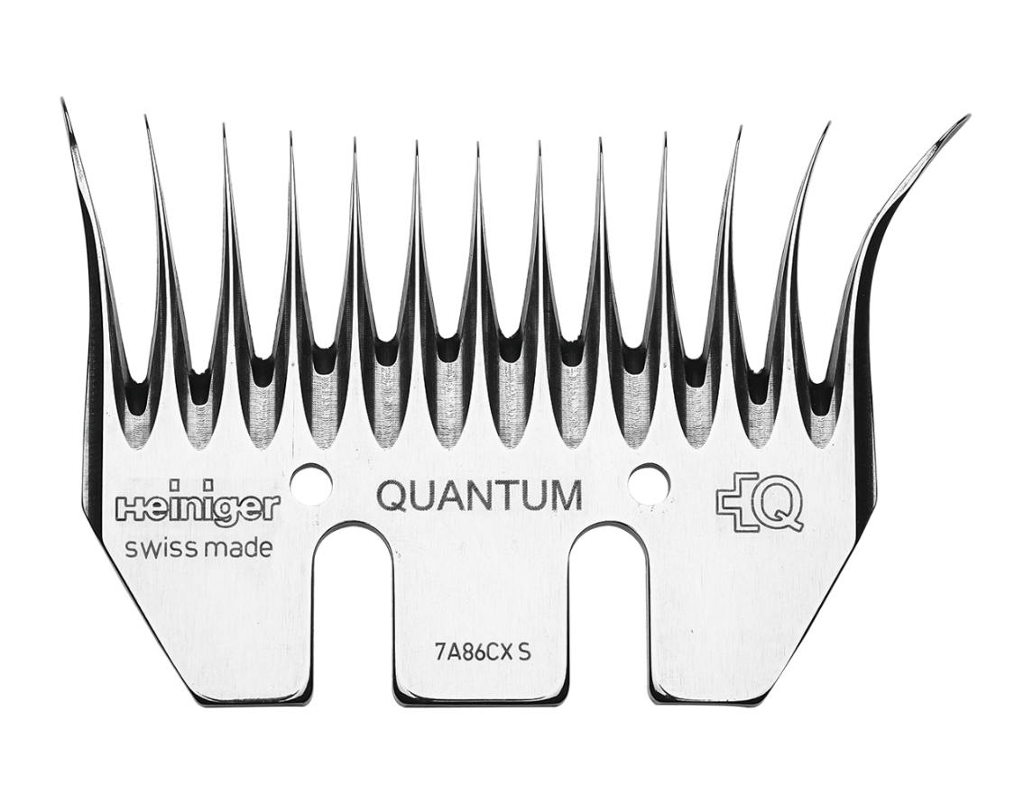
Quantum metrology using quantum combs and tensor network formalism
Rafal Demkowicz-Dobrzański
Faculty of Physics, University of Warsaw, Poland

Slide 2

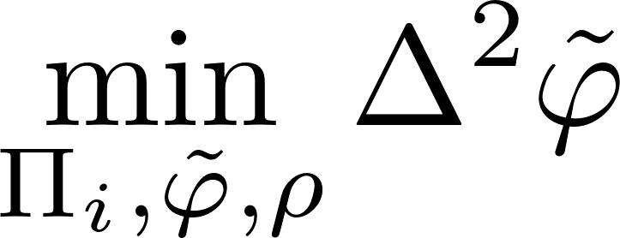
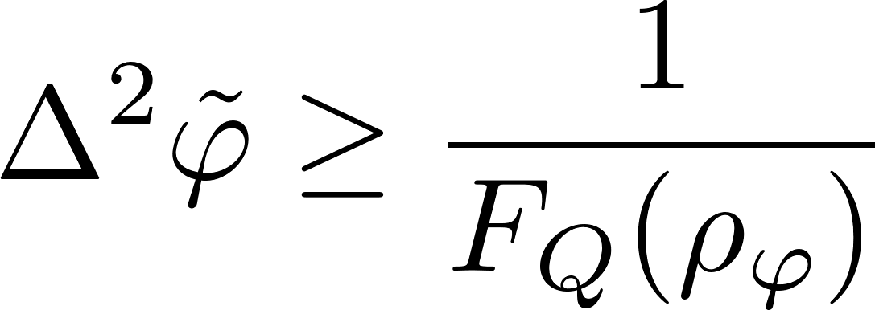
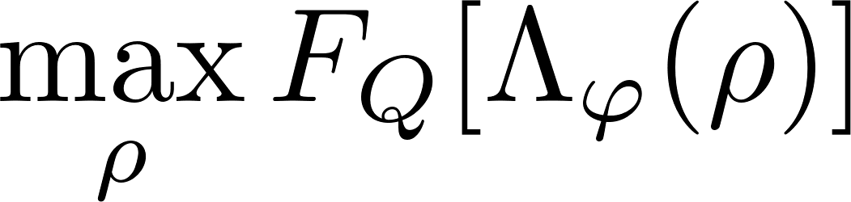
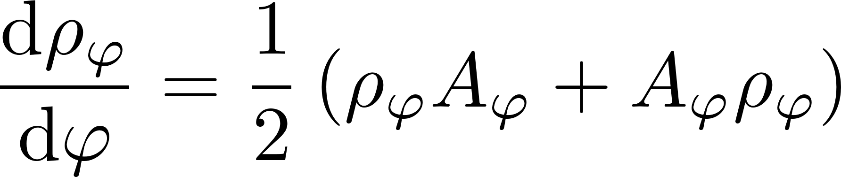
Quantum metrology as a quantum channel estimation problem…
Quantum Cramer-Rao bound

Slide 3
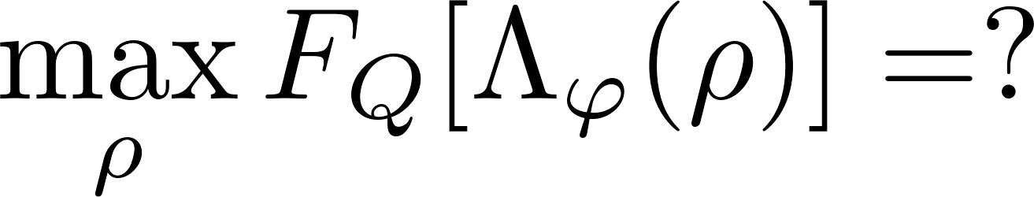
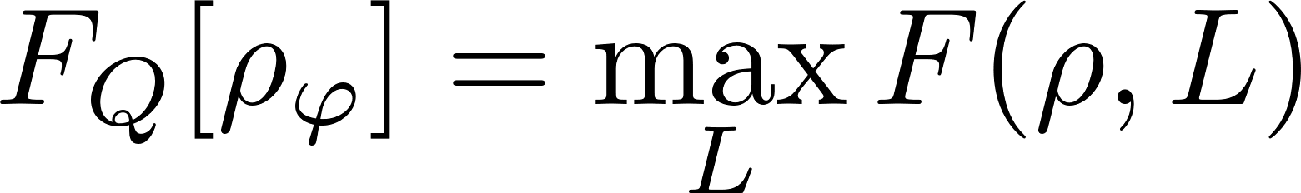
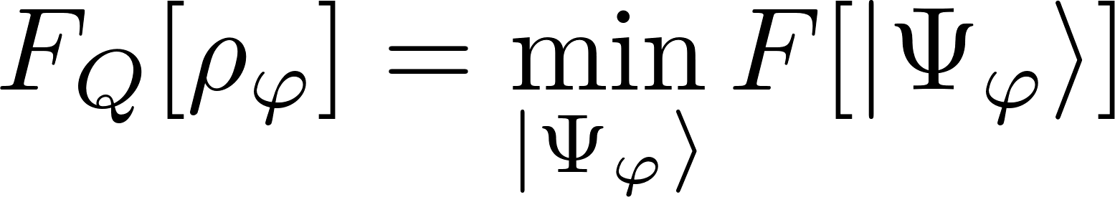
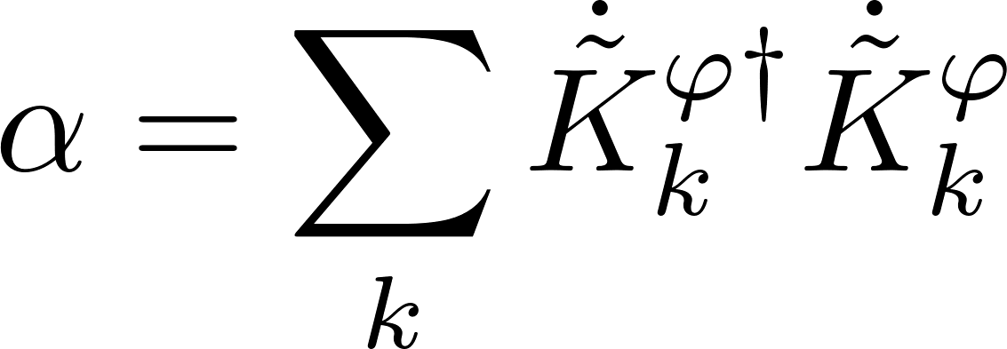
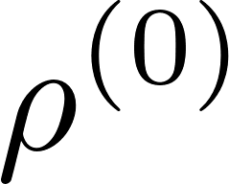
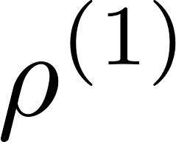
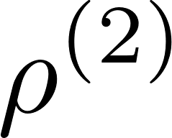
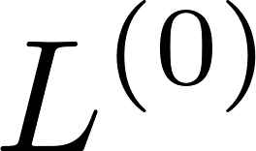
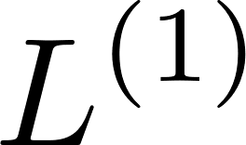
How to find the optimal input state?
Minimization over purifications (MOP)
Iterative See-Saw (ISS)
Each step is a simple linear or eigenvalue problem!
A simple SDP programme!
Fujiwara, H. Imai, J. Phys. A 41, 255304 (2008)
K. Macieszczak, arxiv:1312.1356 (2013)
RDD, J. Kolodynski, M. Guta, Nat. Commun. 3, 1063 (2012)

Slide 4
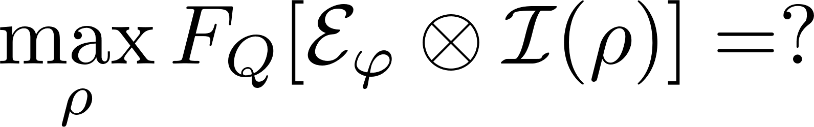
How to find the optimal input state?
Ancilla insensitive!
Ancilla sensitive!
Minimization over purifications (MOP)
Iterative See-Saw (ISS)
Each step is a simple linear or an eigenvalue problem!
A simple SDP programme!
Fujiwara, H. Imai, J. Phys. A 41, 255304 (2008)
RDD, J. Kolodynski, M. Guta, Nat. Commun. 3, 1063 (2012)
Works in Bayesian approach as well!
K. Macieszczak, arxiv:1312.1356 (2013)
K. Macieszczak, M. Fraas, RDD, New J. Phys. 16, 113002 (2014)

Slide 5
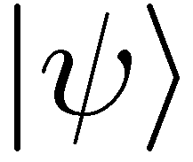
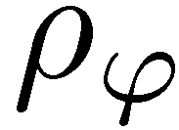
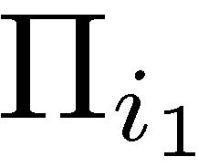


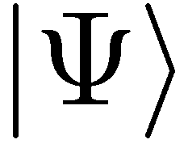
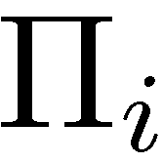
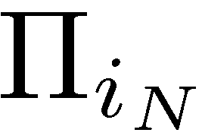

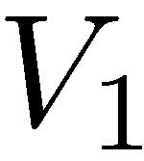
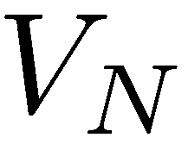
More channels! What are advantages of different levels of quantumness?
(C)
(E)
coherence
entanglement (passive way)
+ sequentiality
(AD)
entanglement + adaptiveness (active quantum feedback)

Slide 6
Optimal entanglement based strategies (E)
If N is small enough… (for qubit channels N ≤ 5)
Minimization over purifications (MOP)
Iterative See-Saw (ISS)

Slide 7
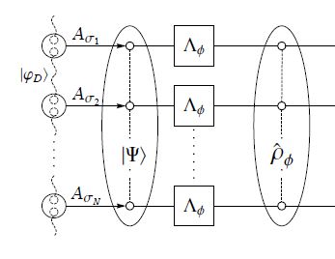
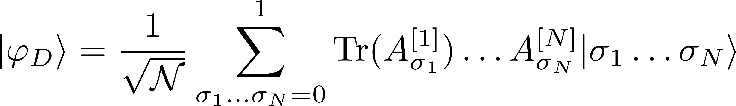
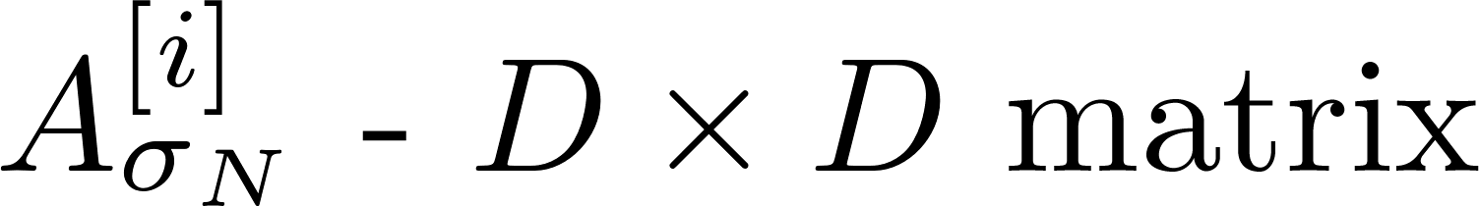
Optimal entanglement based strategies (E)
If N is large we can combine ISS and tensor networks formalism
Minimization over purifications (MOP)
Iterative See-Saw (ISS)
Typically, optimal
Low bond dimensions are usually enough to find the optimal states!
matrix product state
(D – bond dimension)
TNQMetro Package, K.Chabuda, J. Dziarmaga, T. Osborne, RDD, Nat. Commun 11, 250 (2020)

Slide 8
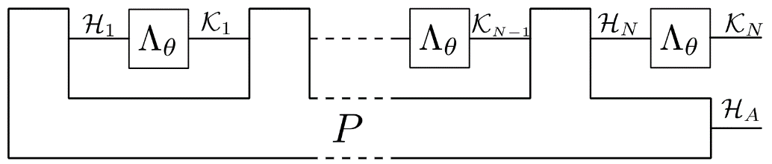
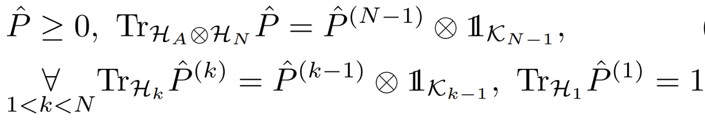
Optimal adaptive protocols (AD)
Looking for optimal adaptive strategies = optimization over quantum combs (SDP)
P – a quantum comb
Choi-Jamiołkowski operator of a comb
Needs to satisfy the `CP supermap’ constraints

Slide 9
Optimal adaptive protocols (AD)
Looking for optimal adaptive strategies = optimization over quantum combs (SDP)
P – a quantum comb
Minimization over purifications (MOP)
Iterative See-Saw (ISS)
Altherr, Y. Yang, Phys. Rev. Lett 127, 060501 (2021)
Q. Liu, Z. Hu, H. Yuan, Y. Yang, Phys. Rev. Lett. 130, 070803 (2023)
Control over size of ancilla
Can be combined with the tensor-network framework and work for large N !!!!
No control over size of ancilla
Not efficient for large N
S.Kurdzialek, P. Dulian, J. Majsak, S. Chakrabotry, RDD, arxiv:2403.04854

Slide 10
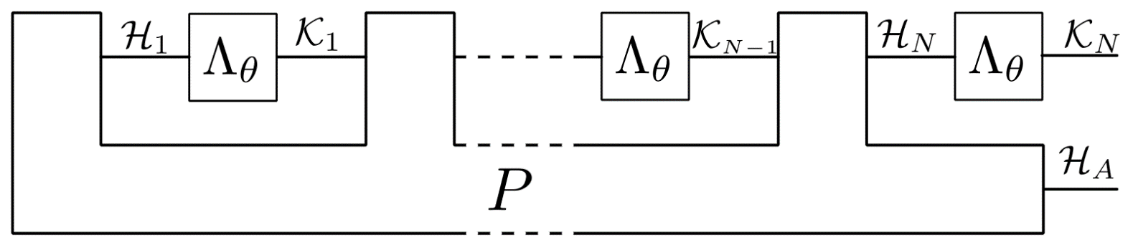
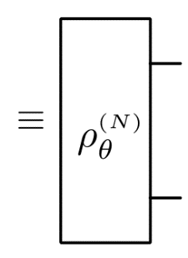

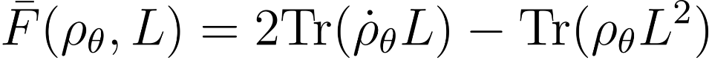
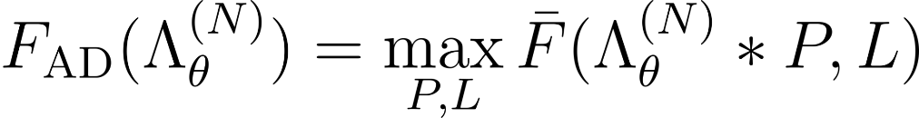


Iterative optimization for combs
Maximizing Quantum Fisher Information:
Link product concatination of maps, on the level of Choi operators
(linear in both arguments)
SDP: Linear in P linear + positivity constraints
SDP: Quadratic in L
We control the size of ancilla
Comb P grows exponentially with N

Slide 11
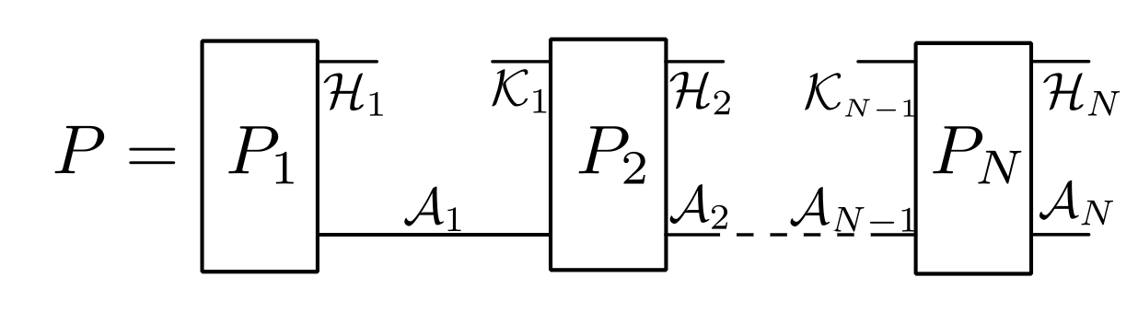
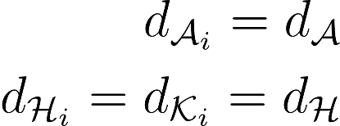
Break a Comb into Teeth!
Efficient method if small-size ancilla is enough!

Slide 12
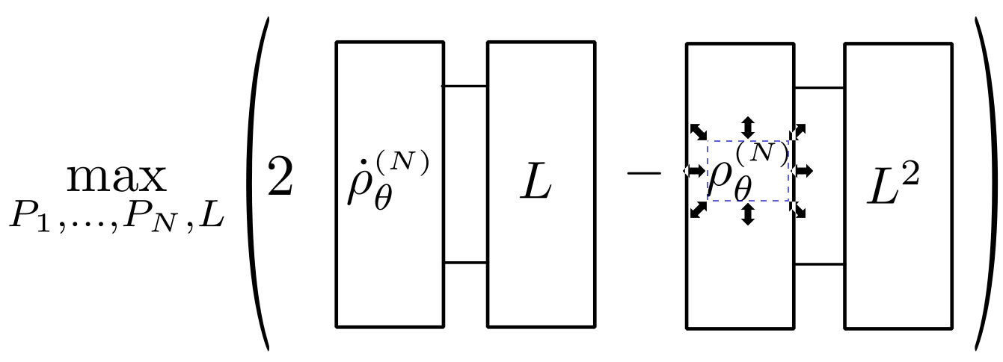
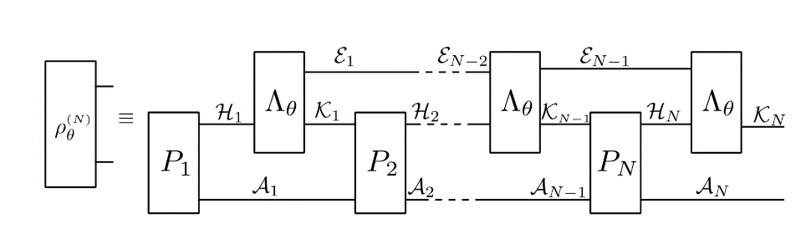

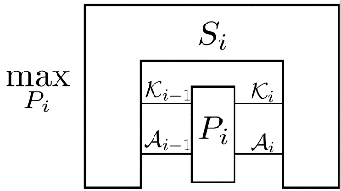
Optimize QFI using tensor networks
Optimization over L
contract all the indices in
the solve the standard SDP to find L
Optimization over P_{i}
contract all the indices apart
from the P_{i} indices and solve:
More details: see the poster by Piotr Dulian

Slide 13

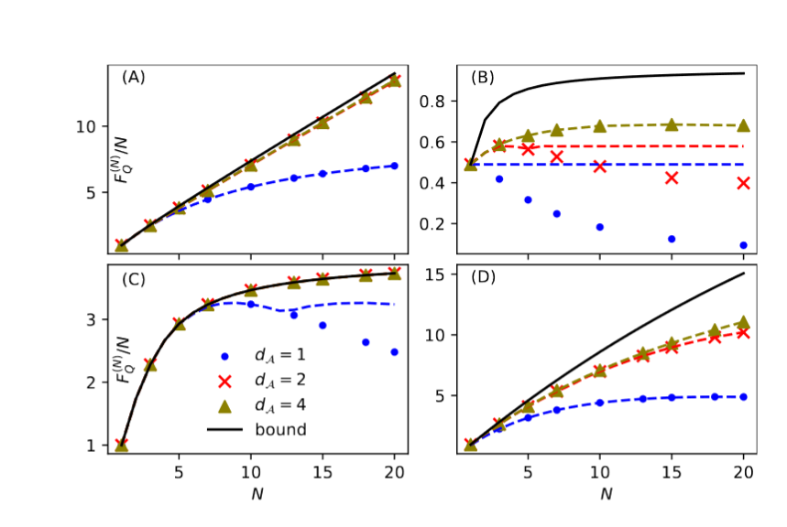
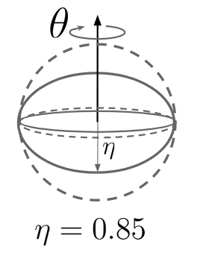
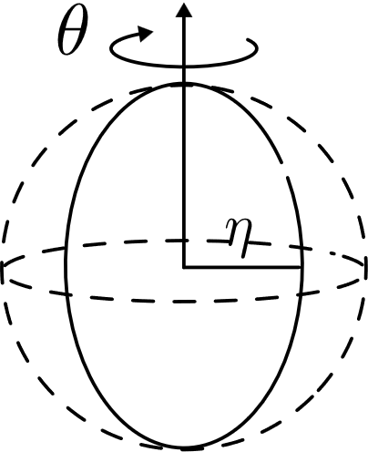
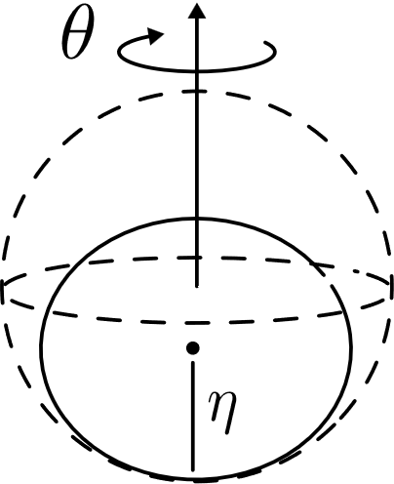
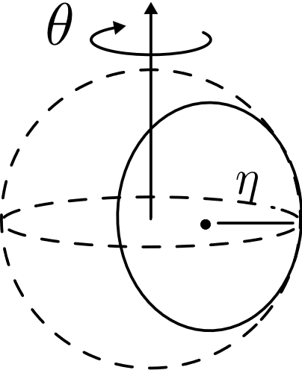
Examples
Perpendicular dephasing
Parallel dephasing
Perpendicular amplitude damping
Parallel amplitude damping
Small ancilla size enough in models where the noise is significantly different in character than the signal.
Otherwise better use paralel schemes + Matrix Product States

Slide 14
Complementary approach: derive fundamental bounds!
no-go way
constructive way
Derive analytical/semianalytical upper bounds
Find numerically/guess the best metrological protocols
Ideally!
Latest development in tigheninng the adaptive bounds – see the poster by Staszek Kurdziałek
The best method: minimization of QFI over purifications of the noisy quantum channel
A. Fujiwara, H. Imai, J. Phys. A 41, 255304 (2008)
B. M. Escher, et al. Nature Phys. 7, 406–411 (2011)
RDD, J. Kolodynski, M. Guta, Nat. Commun. 3, 1063 (2012)
RDD, L. Maccone, Phys. Rev. Lett. 113, 250801 (2014) RDD, J. Czajkowski, P. Sekatski, Phys. Rev. X 7, 041009 (2017)
S. Zhou et al., Nat. Commun. 9, 78 (2018)
S. Zhou, L. Jiang, PRX Quantum 2, 010343 (2021) S. Kurdzialek, W. Gorecki, F. Albarelli, RDD, PRL 131, 090801 (2023)
A. Das, W. Górecki, RDD, arXiv:2404.03954 (2024)
Latest development in deriving fundamental bounds for continuous Markovian models – see the poster by Arpan Das

Slide 15
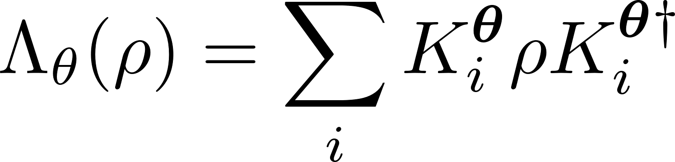
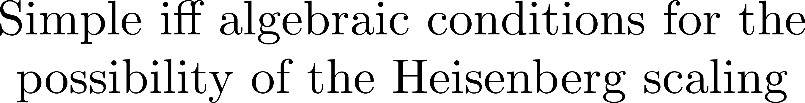
Summary
correlated noise models results coming soon…
no-go way
constructive way
Thank you!
S. Kurdzialek, W. Gorecki, F. Albarelli, RDD, PRL 131, 090801 (2023) [Adaptive channel estimation bounds]
K.Chabuda, J. Dziarmaga, T. Osborne, RDD, Nat. Commun 11, 250 (2020) [Parallel schemes]
A.Das, W. Górecki, RDD, arXiv:2404.03954 (2024)
[Time continuous bounds for Markovian models]
S. Kurdzialek, P. Dulian, J. Majsak, S. Chakrabotry, RDD arxiv:2403.04854 [Adaptive schemes]

