Slide 1
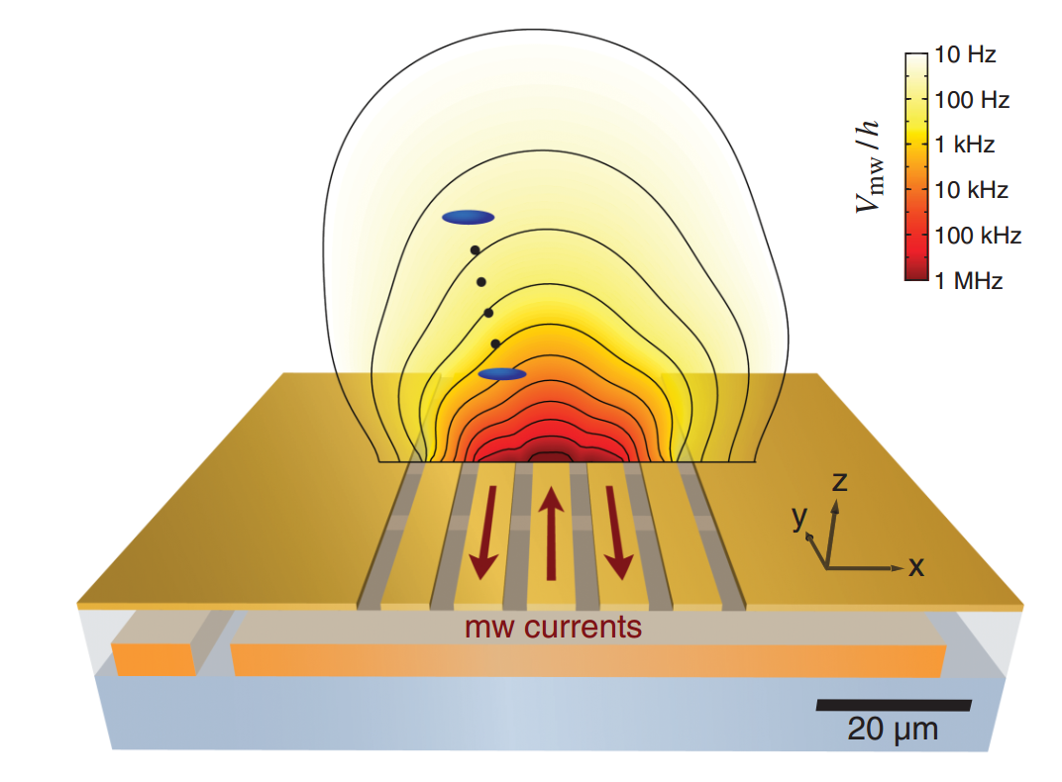
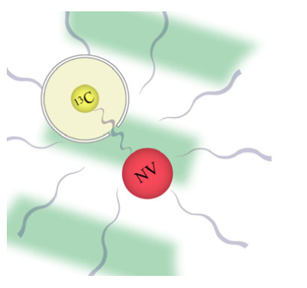
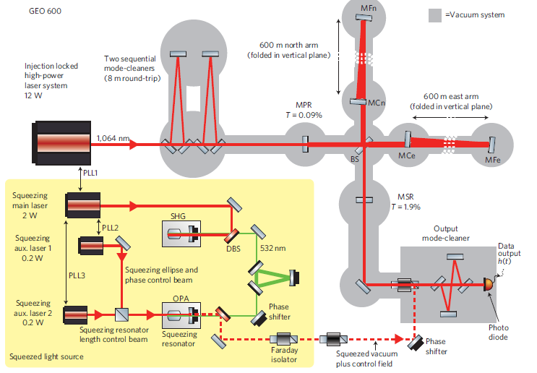

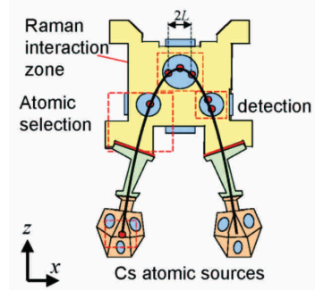
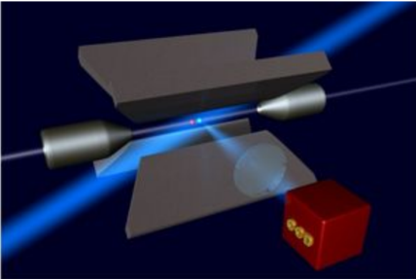
The Grand Unified Theory of Quantum Metrology
Cold atom magnetometers
GUT
Optical interferometers using
non-classical light
NV sensors
Atomic inertial sensors
Atomic clocks
R. Demkowicz-Dobrzański¹, J. Czajkowski¹, P. Sekatski²
¹Faculty of Physics, University of Warsaw, Poland
²Institut fur Theoretische Physik, Universitat Innsbruck, Austria

Slide 2
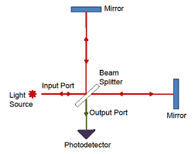
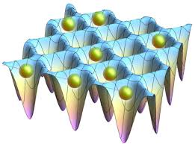

Quantum Metrology
under relevant physical constraints make the most of quantum coherence (and entanglement) to boost measurement precision
 | Optical interferometry | Atomic clocks | NV center magnetometers
Coherence | „classical” light | uncorrelated/single atoms | electron spin only
Entanglement | squeezed light | entangled atoms | electron spin entangled with nuclear spins
Decoherence | photon loss | LO fluctuations, atom dephasing, loss | spin dephasing
Notes:
1.

Slide 3

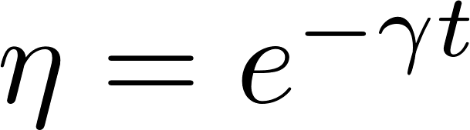




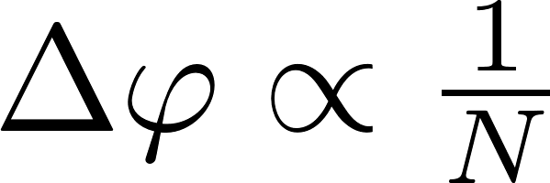
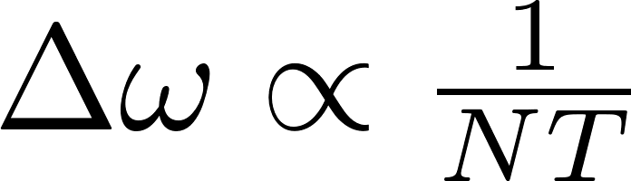
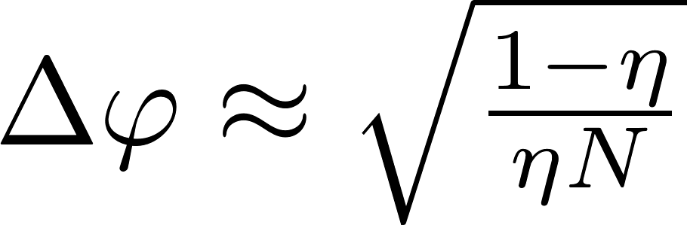
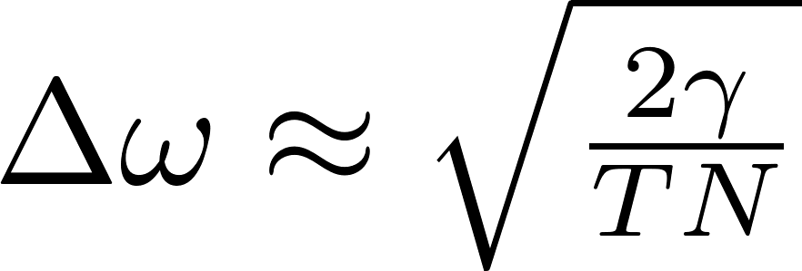
Important case studies
 | Optical phase estimation in presence of losses C. Caves, Phys. Rev D 23, 1693 (1981) | Frequency estimation in presence of atomic dephasing S. Huelga et al. Phys.Rev.Lett. 79, 3865 (1997)
without decoherence
with decoherence
N – number of photons used,
squeezed light, NOON states
H. Lee, P. Kok, J. P. Dowling J. Mod. Opt. 49, 2325 (2002).
N – number of atoms,
T – total interrogation time
spin-squeezed states or GHZ state
weakly squeezed light
weakly spin-squeezed states

Slide 4

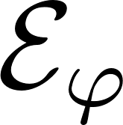
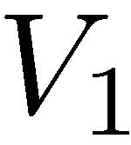

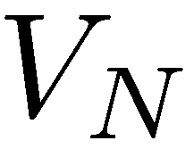
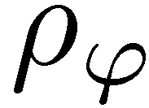
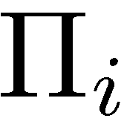
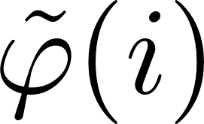
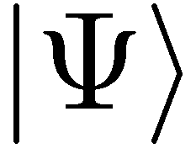
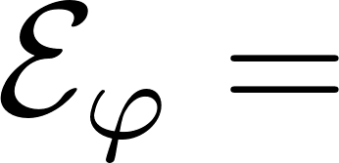
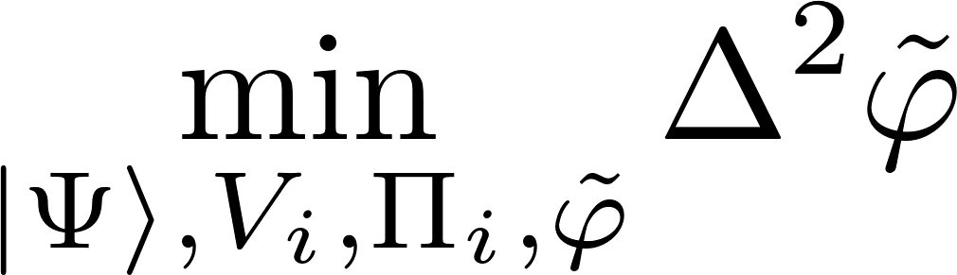
Most general adaptive interferometry scheme utilizing N photons
Optimal scheme:

Slide 5

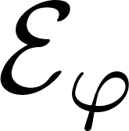
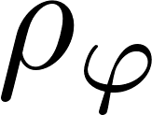
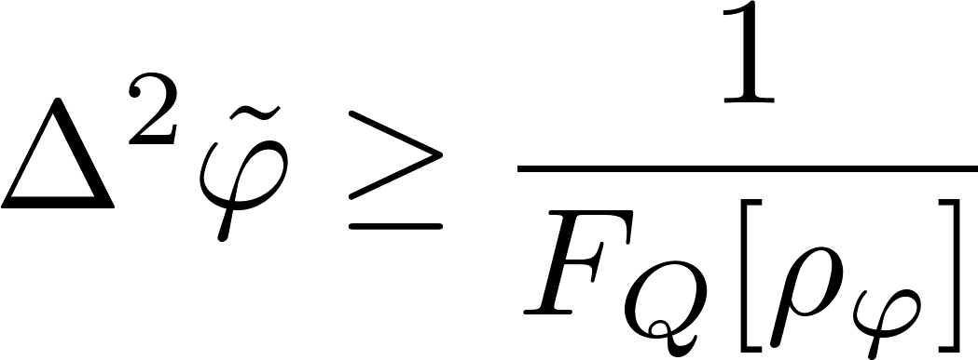
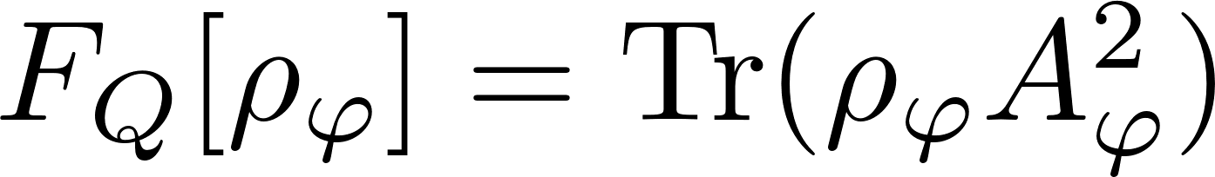
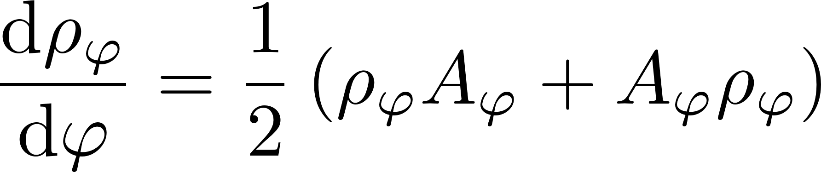
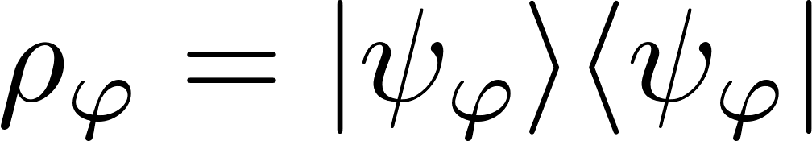
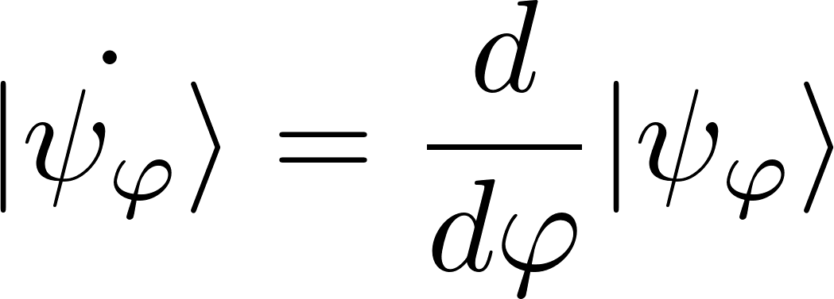
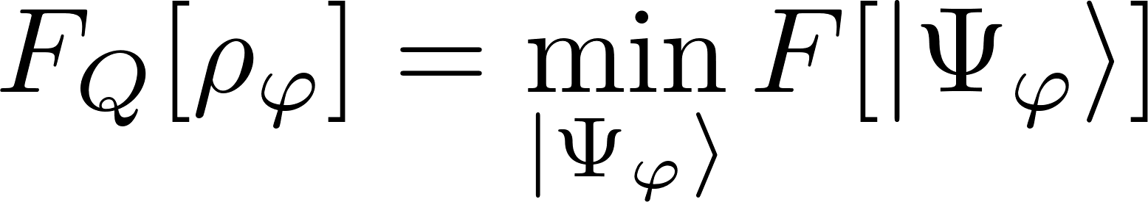
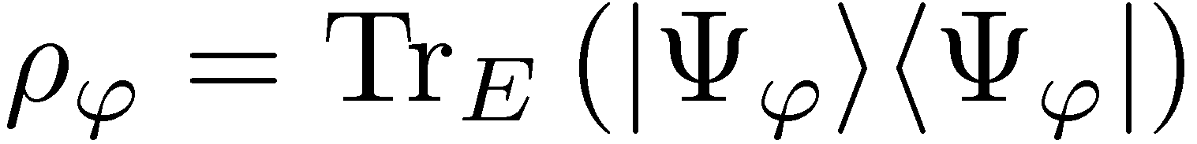
Quantum Fisher Information
Quantum Cramer-Rao inequality:
For pure states:
Mixed state quantum Fisher via minimization over purifications:

Slide 6
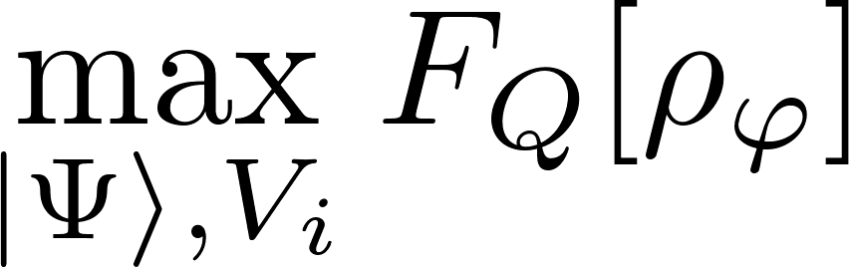
Most general adaptive interferometry scheme utilizing N photons
Optimal scheme:
V. Giovannetti, S. Lloyd, and L. Maccone, Phys. Rev. Lett. 96, 010401 (2006).

Slide 7
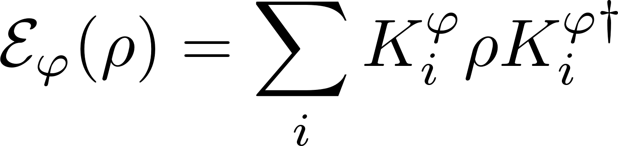
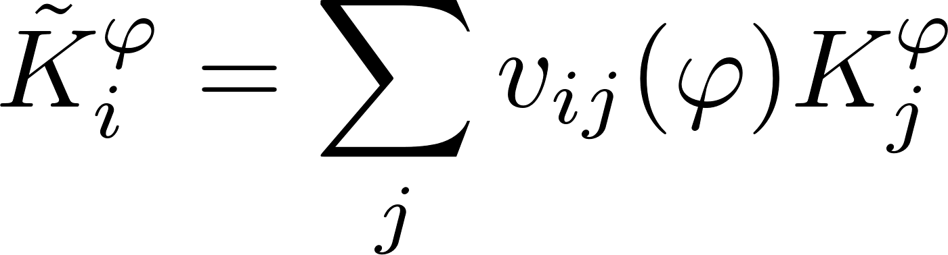
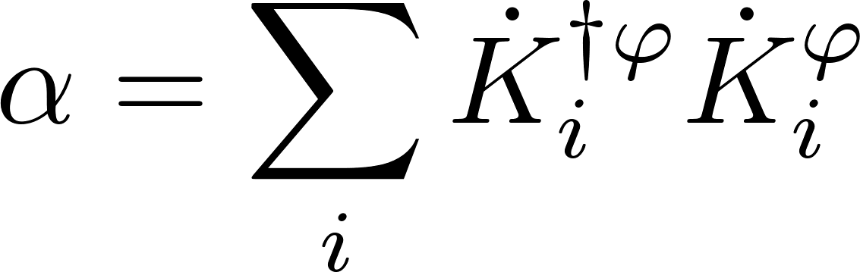
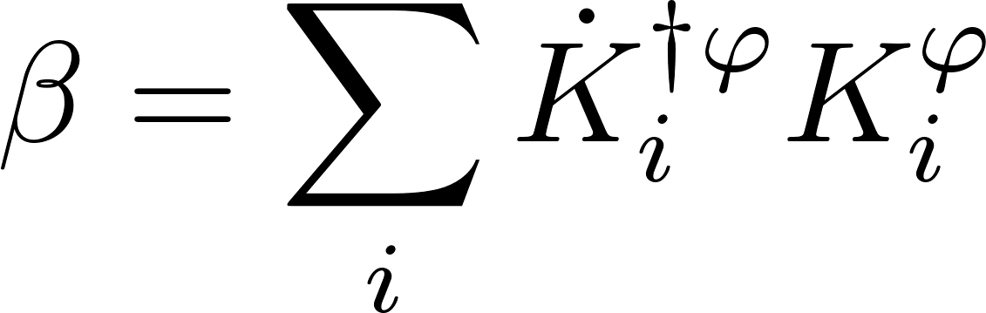
Precision bounds via minimization over equivalent Kraus representations
single channel optimization!
A. Fujiwara, H. Imai, J. Phys. A 41, 255304 (2008)
B. M. Escher, R. L. de Matos Filho, L. Davidovich Nature Phys. 7, 406–411 (2011)
RDD, J. Kolodynski, M. Guta, Nat. Commun. 3, 1063 (2012)
RDD, L. Maccone Phys. Rev. Lett. 113, 250801 (2014) [Adaptive schemes included]

Slide 8
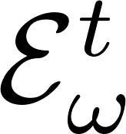
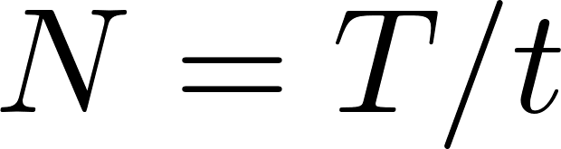
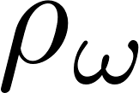

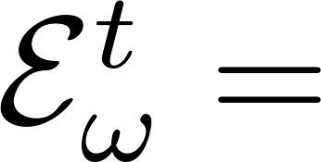
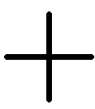
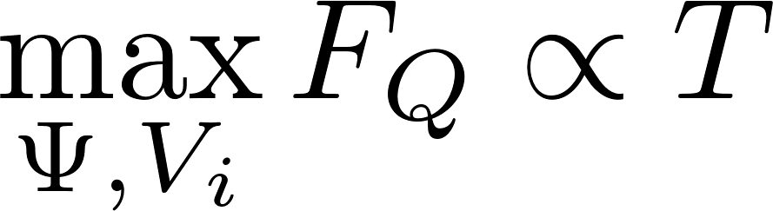
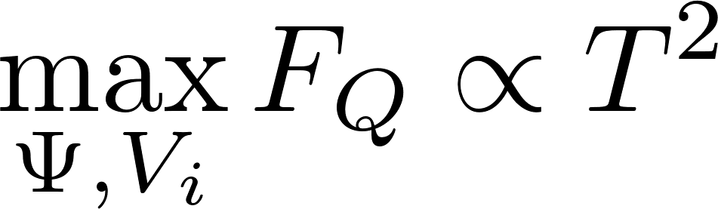
Adaptive frequency estimation
Maximize Quantum Fisher Information under fixed total interrogation time T
?

Slide 9
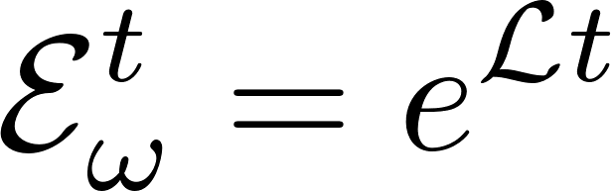
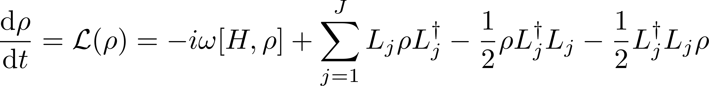
General frequency estimation problem under Markovian noise
Maximize Quantum Fisher Information under fixed total interrogation time T
?

Slide 10
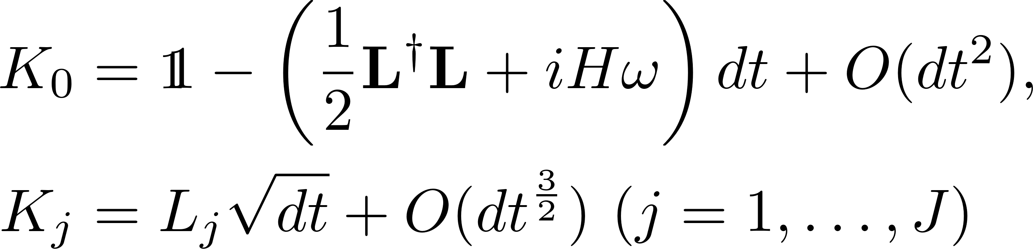
Frequency estimation bounds directly from the quantum Master equation
Without loss of generality we may always consider limit t->0…..
Expand β and α in t…

Slide 11
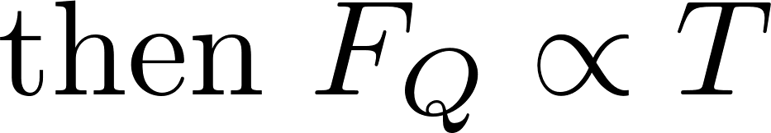
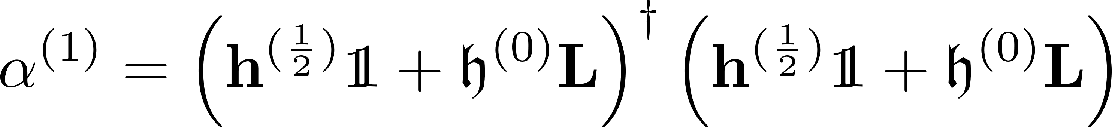
Frequency estimation bounds directly from the quantum Master equation
Quantitative bound:
Can be solved by semi-definite programming:
RDD, J. Czajkowski, P. Sekatski,, Phys. Rev. X 7, 041009 (2017)

Slide 12
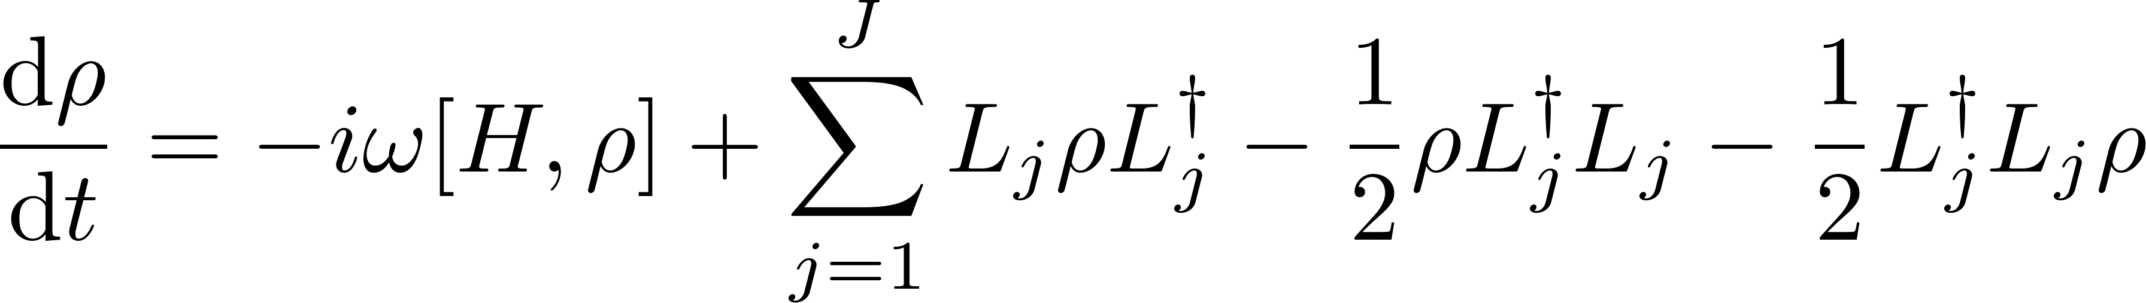
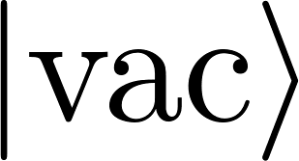
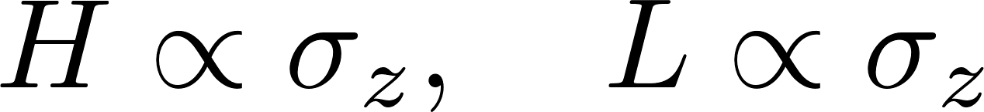









Heisenberg scaling is typically lost
Single photon modeled as a three level system:
Fundamental bound can be asymptotically reached with simple schemes involving weakly squeezed states!

Slide 13




GEO600 interferometer at the fundamental quantum bound
The most general quantum strategies could additionally improve the precision by at most 8%
coherent light
+10dB squeezed
fundamental bound
RDD, K. Banaszek, R. Schnabel, Phys. Rev. A, 041802(R) (2013)

Slide 14




Recovering the Heisenberg scaling via Quantum Error Correction - Example
Perpendicular dephasing:
Simple quantum error correction scheme leads to
G. Arad et al Phys. Rev. Lett 112, 150801 (2014)
E. Kessler et.al Phys. Rev. Lett. 112, 150802 (2014)
W. Dür, et al., Phys. Rev. Lett. 112, 080801 (2014)
P. Sekatski, M. Skotiniotis, J. Kolodynski, W. Dur, Quantum 1, 27 (2017)

Slide 15



Recovering the Heisenberg scaling via Quantum Error Correction - General
can be improved with semi-definite programming algorithm
S. Zhou, M. Zhang, J. Preskill, and L. Jiang, Nat. Commun. 9, 78 (2018)

Slide 16
Take home message
RDD, J. Czajkowski, P. Sekatski,, Phys. Rev. X 7, 041009 (2017)
S. Zhou, M. Zhang, J. Preskill, and L. Jiang, Nat. Commun. 9, 78 (2018)

Slide 17




Application to quantum merology with many-body interractions
k-body Hamiltonian
l-body decoherence

Slide 18



Application to quantum merology with many-body interractions

Slide 19


Application to quantum merology with many-body interractions
RDD, J. Czajkowski, P. Sekatski, arXiv:1704.06280

Slide 20

Example: nonlinear dephasing models

