Slide 1
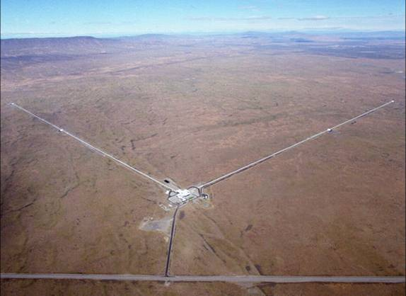
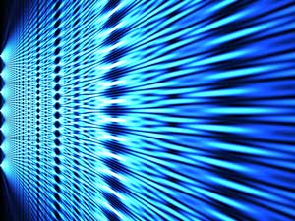





from
Quantum metrological precision bounds
to
Quantum computation speed-up limits
R. Demkowicz-Dobrzański, M. Markiewicz
Faculty of Physics, University of Warsaw, Poland
Notes:
Quantum computer = big interferometer

Slide 2
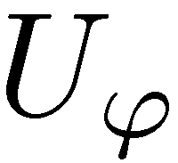
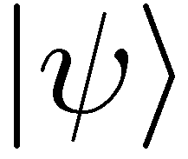
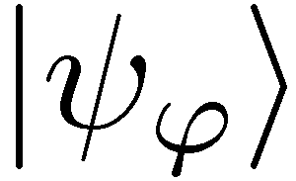
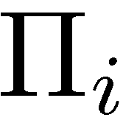
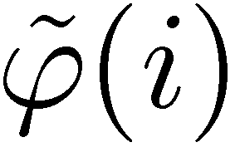
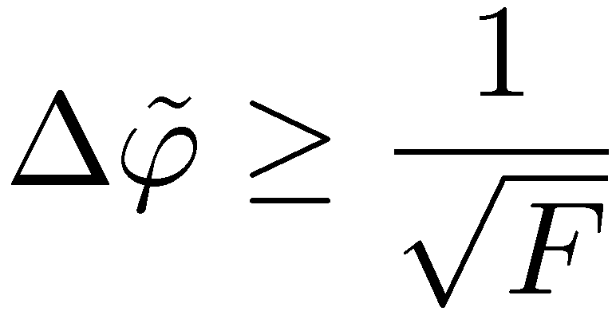
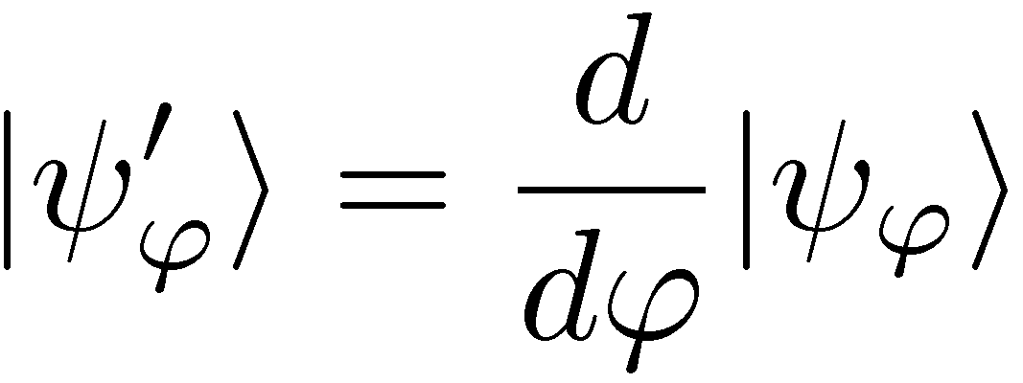
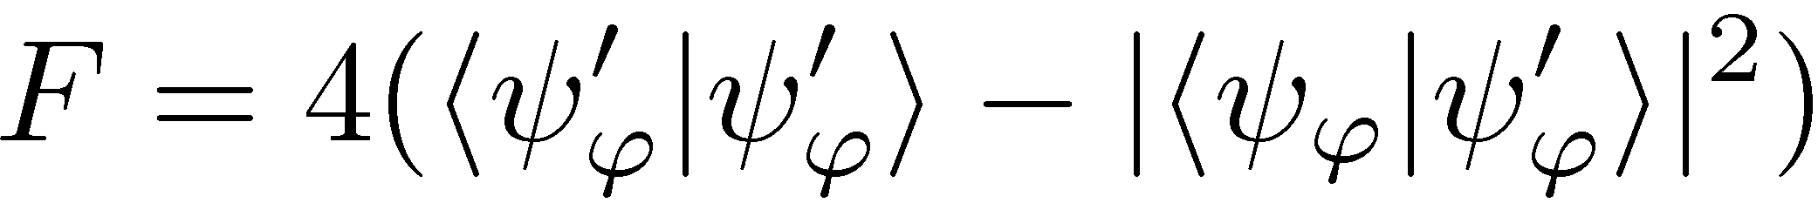
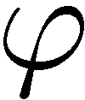
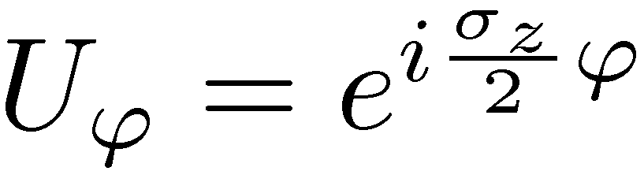
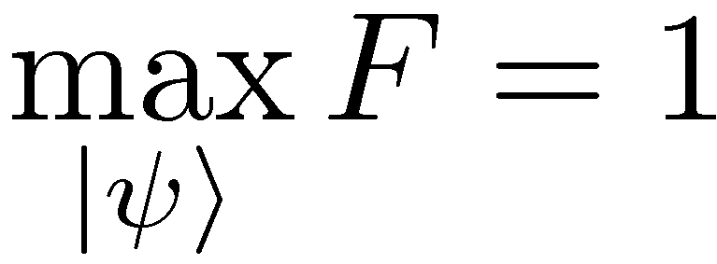
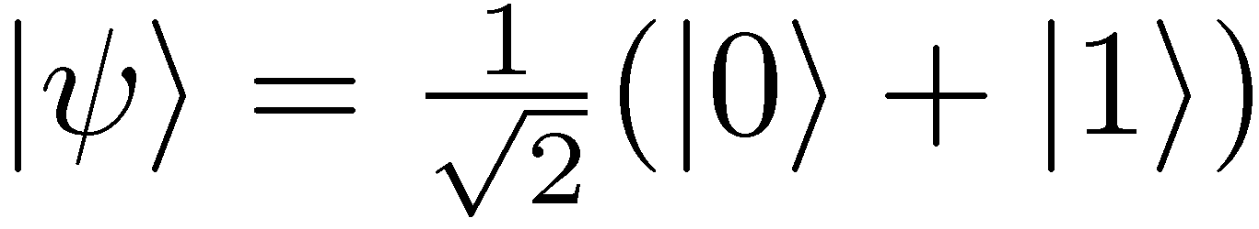
Quantum metrology
Quantum Fisher Information

Slide 3
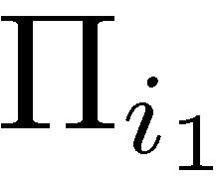
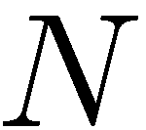
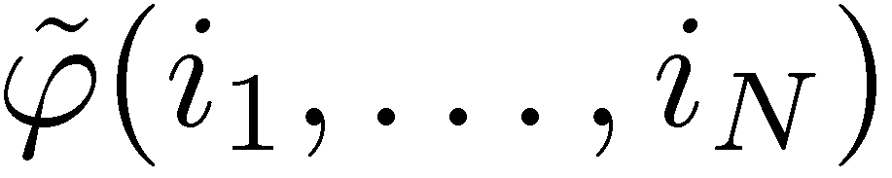
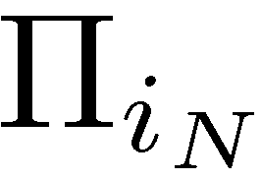
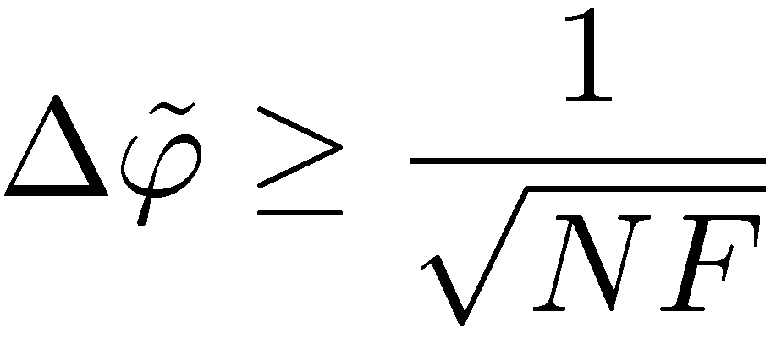
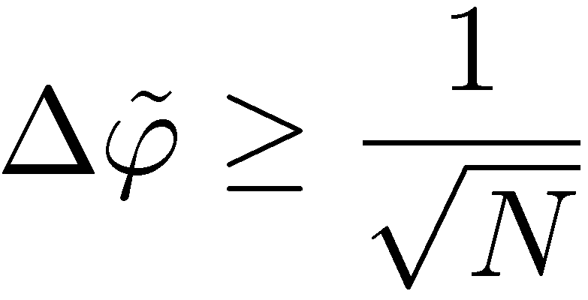
Standard quantum metrology
standard scaling

Slide 4

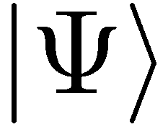
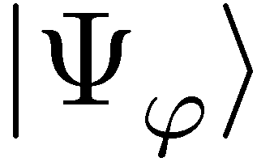
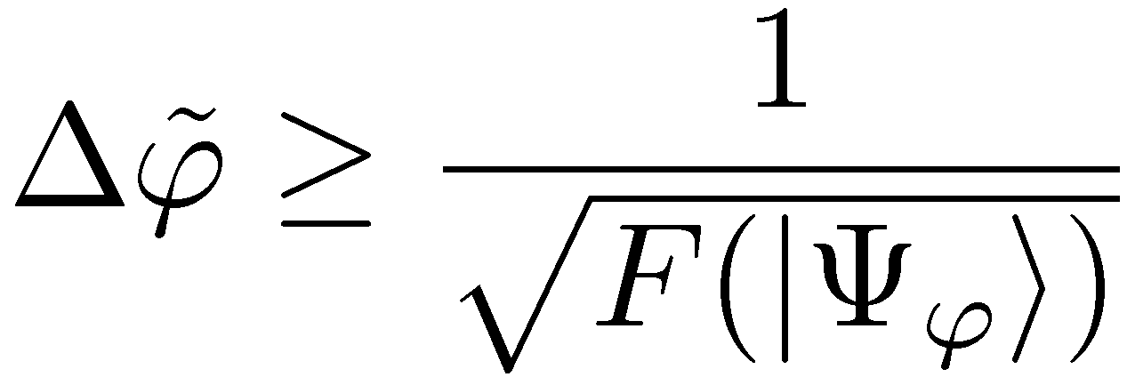
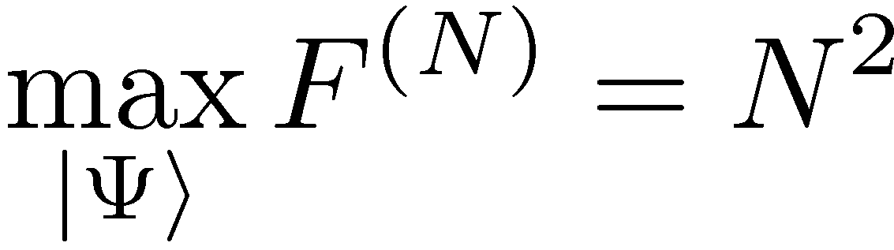
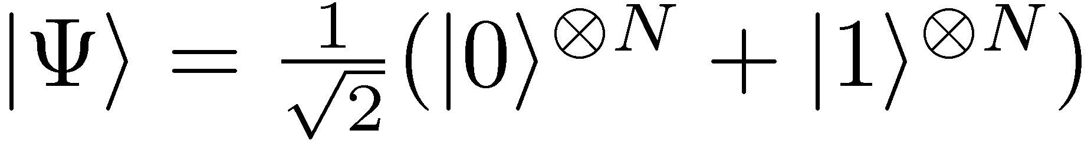
Entanglement-enhanced metrology
quadratic precision enhancement

Slide 5
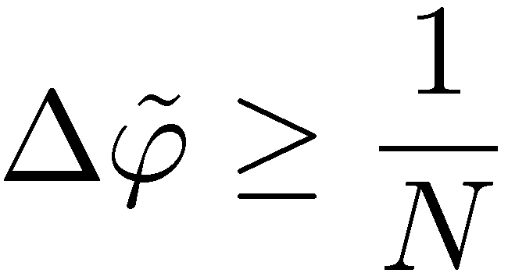
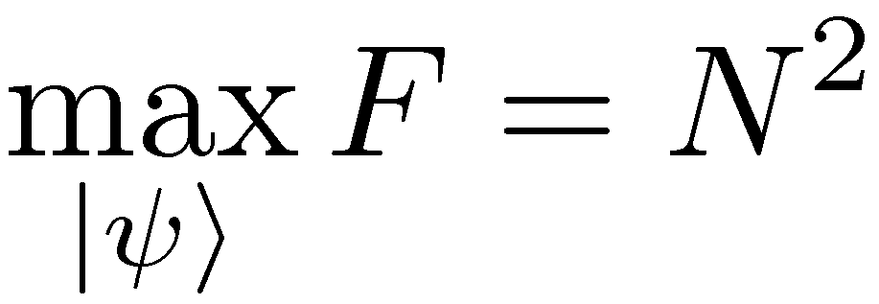
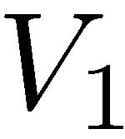
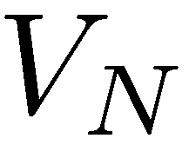
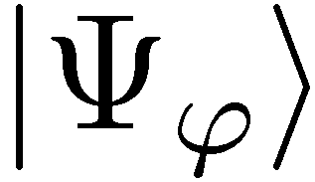
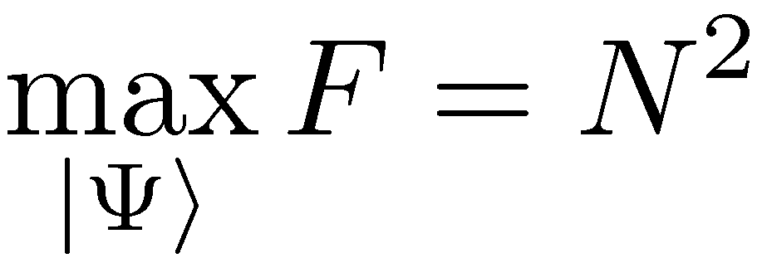
Coherence will also do…
The most general scheme (adaptive, ancilla assisted)…
If the number of channel uses is a resource, entanglement is useless
V. Giovannetti, S. Lloyd, and L. Maccone, Phys. Rev. Lett. 96, 010401 (2006).

Slide 6
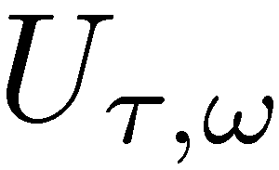
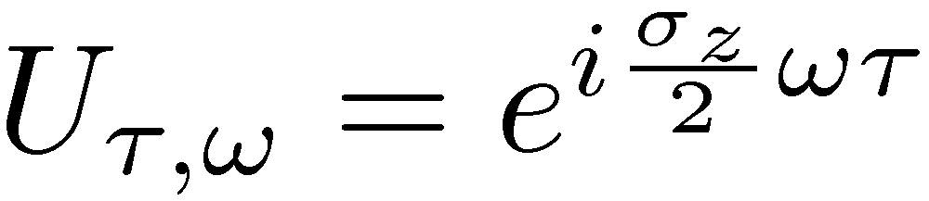
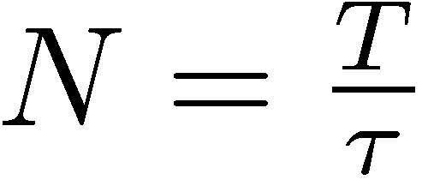
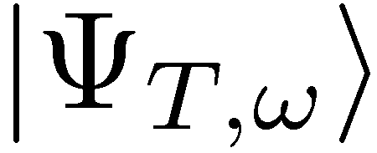
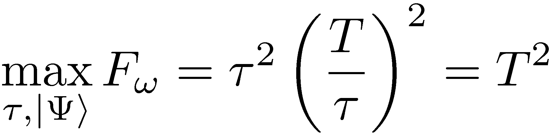
Frequency vs phase estimation
Estimate frequnecy, for total interrogation time T
Quadratic quantum gain thanks to a coherent evolution

Slide 7
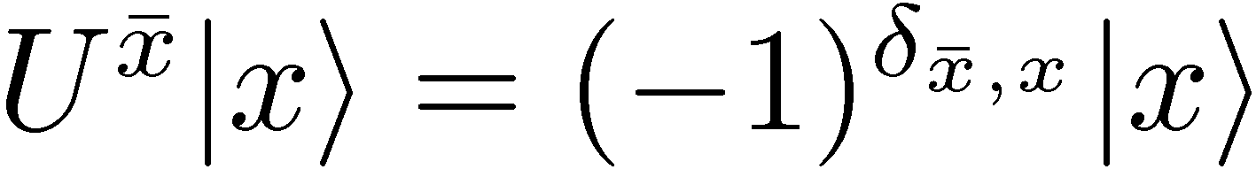
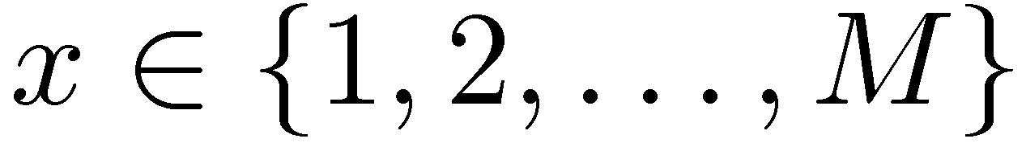
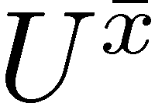
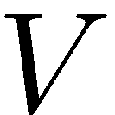
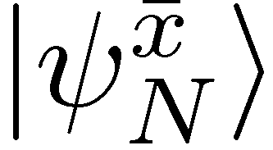
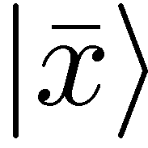
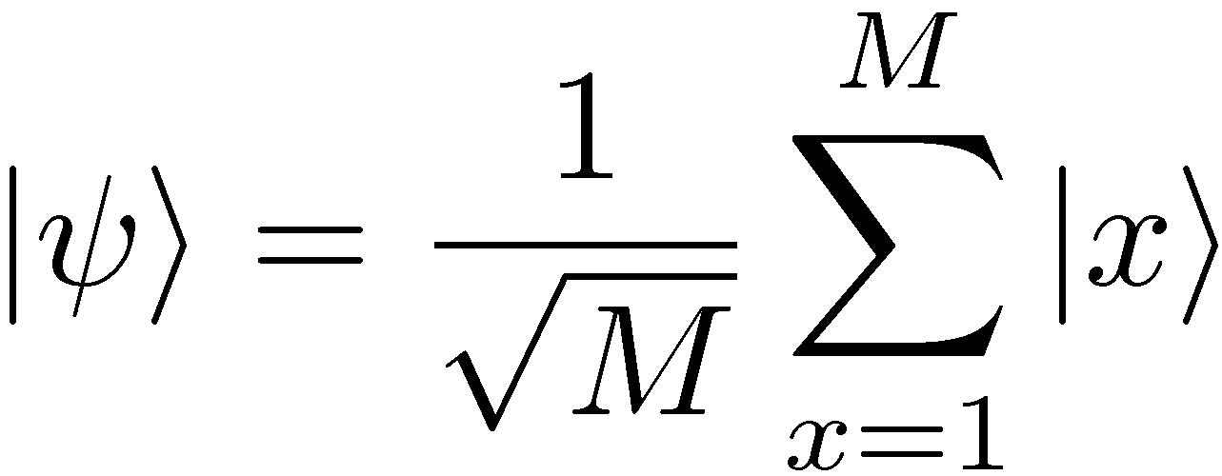
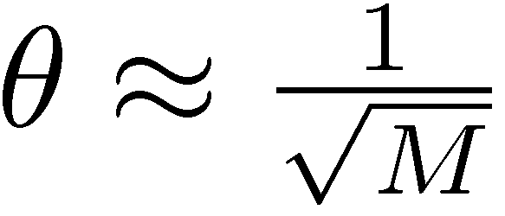
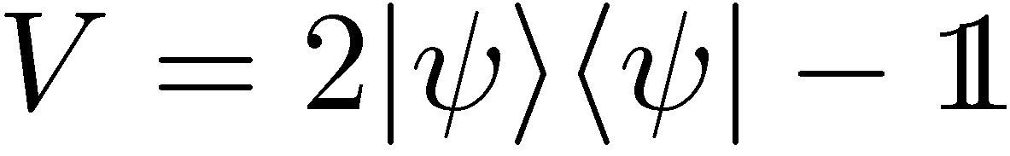

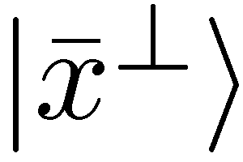
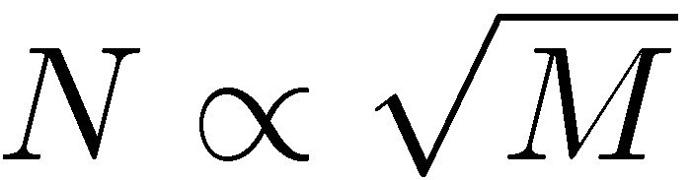
Just as in the Grover algorithm
Number of oracle calls to find the distinguished state:
Quadratic enhancement just as in metrology

Slide 8
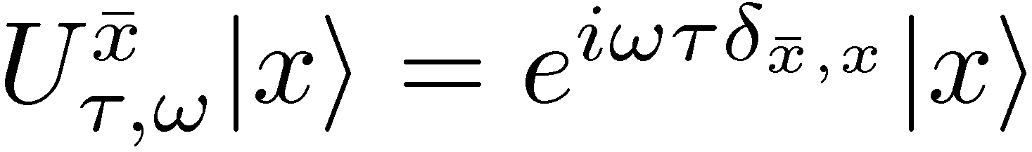
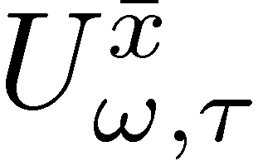
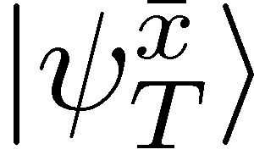


Continuous version of the Grover algorithm
Total interrogation time required
Interrogation time required reduced as in metrology

Slide 9



Grover and Metrology two sides of the same coin
Under total interrogation time T fixed
Notes:
We want the output state to evolve as far as possible from initial state

Slide 10







Limit on how fast probe states can become distinguishable?
Fix oracle index x
reference state
Bures angular distance:
By triangle inequality:

Slide 11










What Grover needs…
Final states should be distinguishable
We know that
too week
Probe needs to be sensitive to all oracles simultaneously !!!
Grover is optimal

Slide 12
Impact of decoherence

Slide 13












Frequency estimation under dephasing noise
Fundamental bound on Quantum Fisher Information
B. M. Escher, R. L. de Matos Filho, L. Davidovich Nature Phys. 7, 406–411 (2011)
RDD, J. Kolodynski, M. Guta, Nature Communications 3, 1063 (2012)
RDD, L. Maccone Phys. Rev. Lett. 113, 250801 (2014)
(Valid also for most general adaptive strategy!)

Slide 14











Proof of the bound
If we can simmulate evolution of the channel (locally) by changing mixing porbabilities…
Then by Quantum Fisher Information of nonincreasing under CP maps we have:
=

Slide 15






Proof of the bound
Remark: without entanglement we could get:
S. Huelga et al. Phys.Rev.Lett. 79, 3865 (1997)

Slide 16






Grover with imperfect oracles
dephasing in M dimensional space – all off-diagonal elements multiplied by
conjecture
Grover quadratic speed-up lost
RDD, M. Markiewicz, Phys. Rev. A 91, 062322 (2015)
Notes:
We want the output state to evolve as far as possible from initial state

Slide 17


Summary
Quantum metrological bounds
frequency estimation variance
RDD, L. Maccone Phys. Rev. Lett. 113, 250801 (2014)
RDD, J. Kolodynski, M. Guta, Nature Communications 3, 1063 (2012)
B. M. Escher, R. L. de Matos Filho, L. Davidovich Nature Phys. 7, 406–411 (2011)
Quantum computing speed-up limits
search time of a database with M elements
RDD, M. Markiewicz, Phys. Rev. A 91, 062322 (2015)

