Slide 1
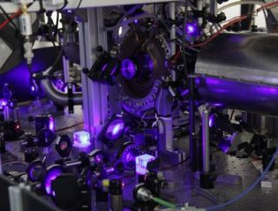
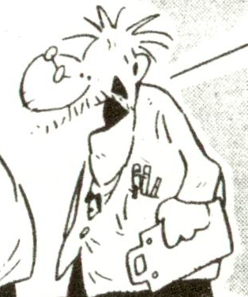







The Quantum Allan Variance
R. Demkowicz-Dobrzański¹, K .Chabuda¹, K. Macieszczak^{1,2}, M. Fraas³, Ian Leroux⁴
¹Faculty of Physics, University of Warsaw, Poland
² School of Mathematical Sciences, University of Nottingham, United Kingdom
³ Theoretische Physik, ETH Zurich, Switzerland
⁴ QUEST Institut, Physikalisch-Technische Bundesanstalt, Braunschweig, Germany

Slide 2
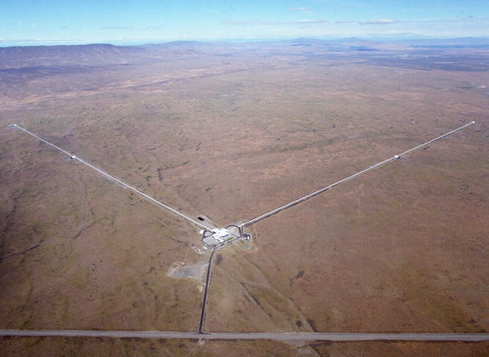
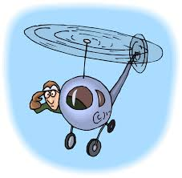
Helicopter view of fundamental quantum precision limits in optical interferometry
R. Demkowicz-Dobrzański¹, K. Banaszek¹, J. Kołodyński¹, M. Jarzyna¹,
M. Guta², R. Schnabel³
¹Faculty of Physics, University of Warsaw, Poland
² School of Mathematical Sciences, University of Nottingham, United Kingdom
³ Max-Planck-Institut fur Gravitationsphysik, Hannover, Germany
⁴ Theoretische Physik, ETH Zurich, 8093 Zurich, Switzerland

Slide 3
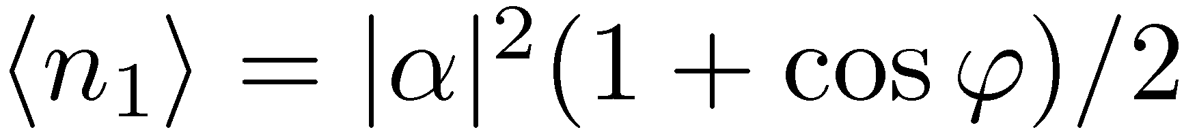
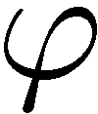
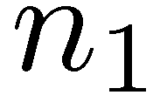
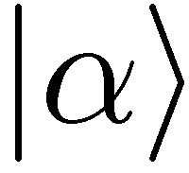
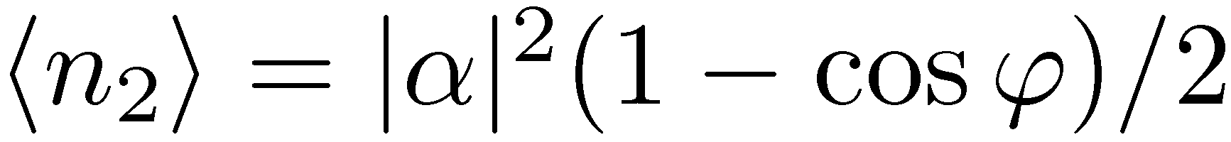
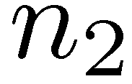
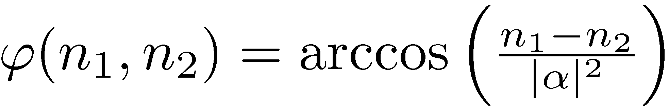
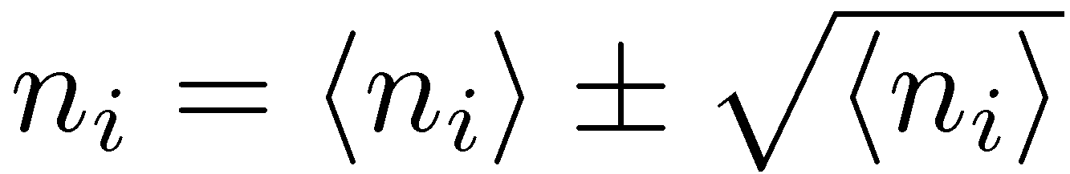
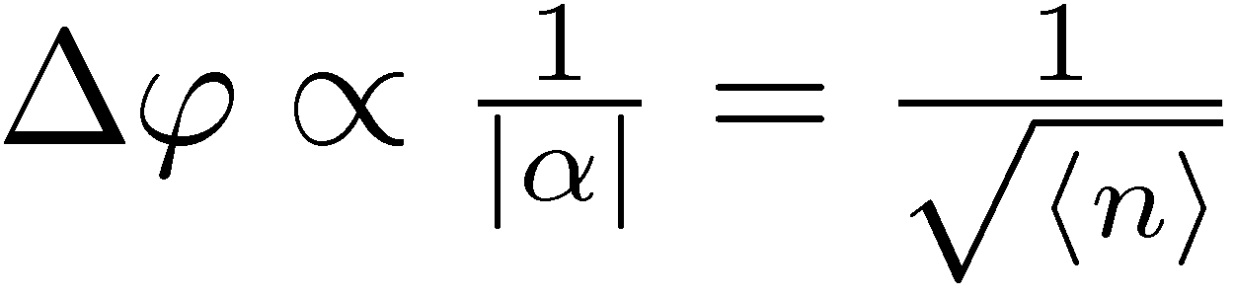
„Classical” interferometry
Each photon interferes only with itself!
the best estimator
Poisson statistics
classical (standard) scaling

Slide 4
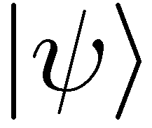
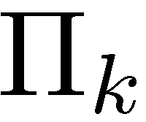
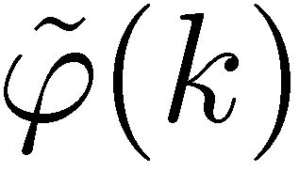
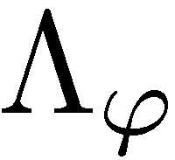
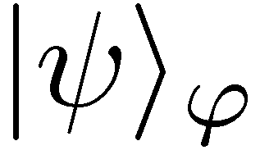
Optimal strategy?
estimator
General two-mode
N photon state
general quantum measurement
single parameter quantum channel estimation
Notes:
Special case of channel tomography

Slide 5
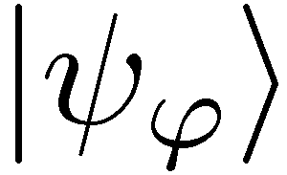
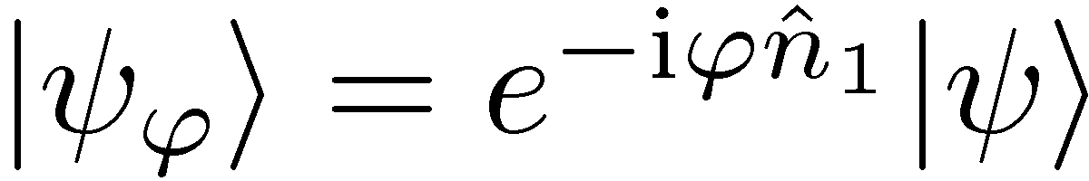
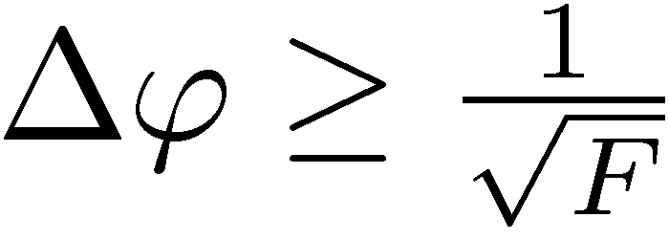
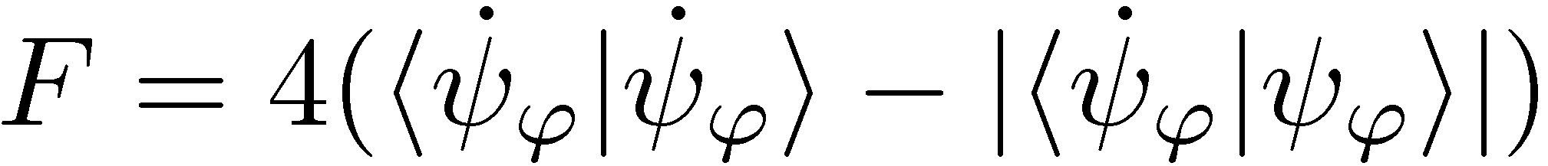
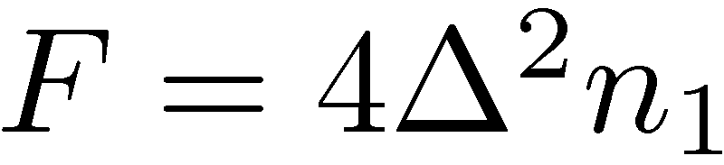
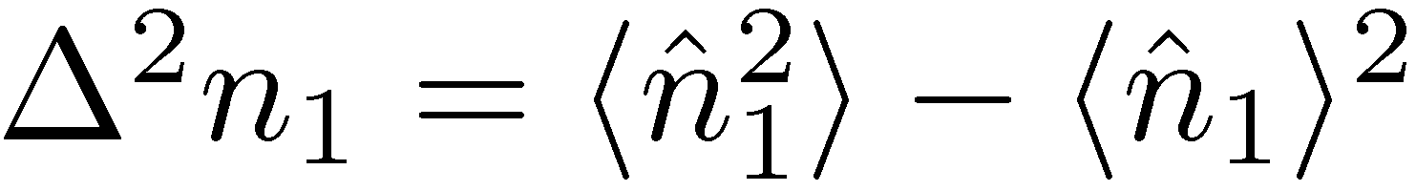
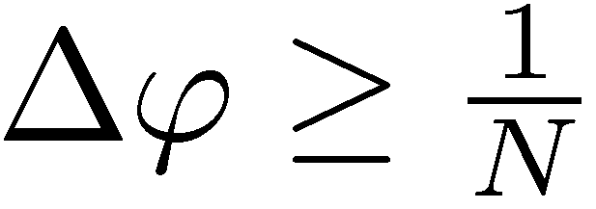
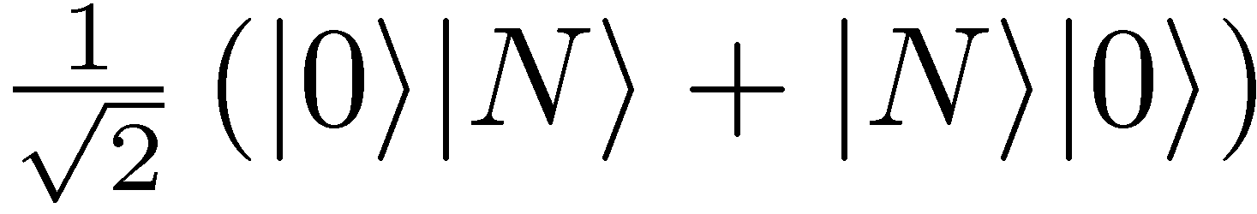
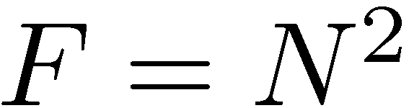
Quantum Cramer-Rao bound and the optimal N photon state
1
2
estimator
Good estimation possible only for states with high Δn₁
NOON states
Heisenberg limit

Slide 6
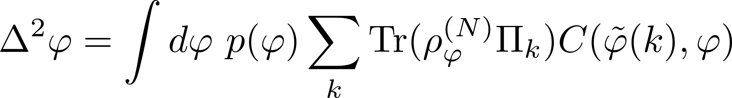
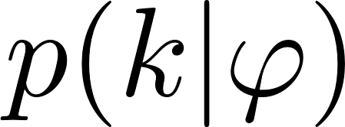
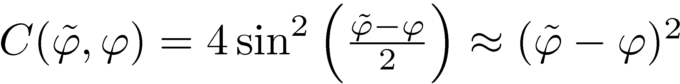
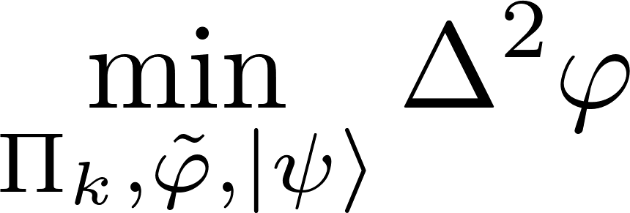
Is it really a saturable limit? the Bayesian approach
Cramer-Rao bound approach well justified for „local sensing” (narrow priors)
No gurantee of saturability in a single-shot scenario
May lead to overoptimistic claims
Bayesian approach:
prior distribution
cost function
Is there a Bayesian strategy yielding the Heisenberg limit?

Slide 7
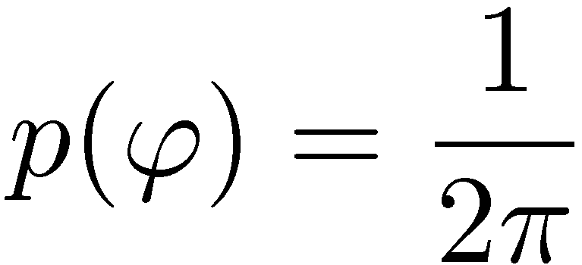
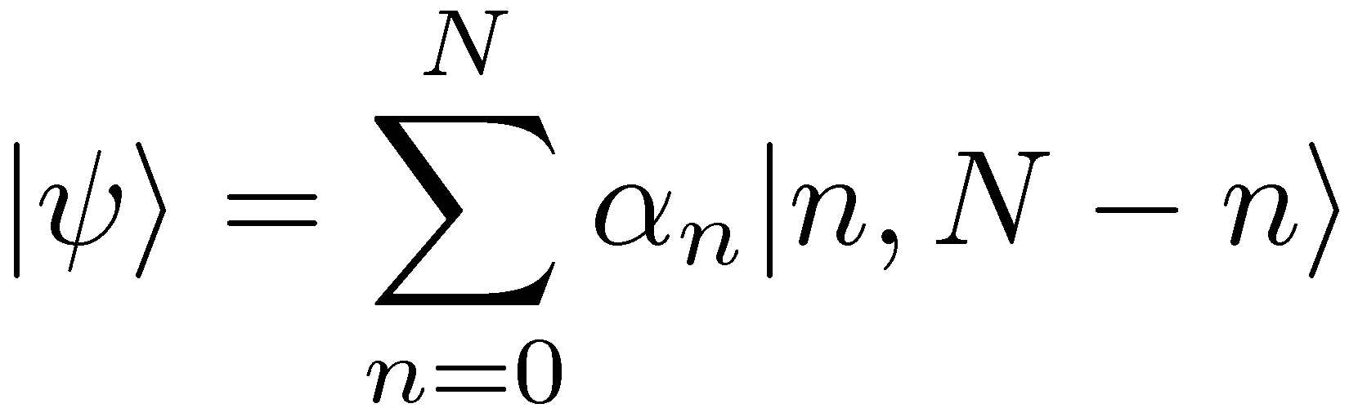
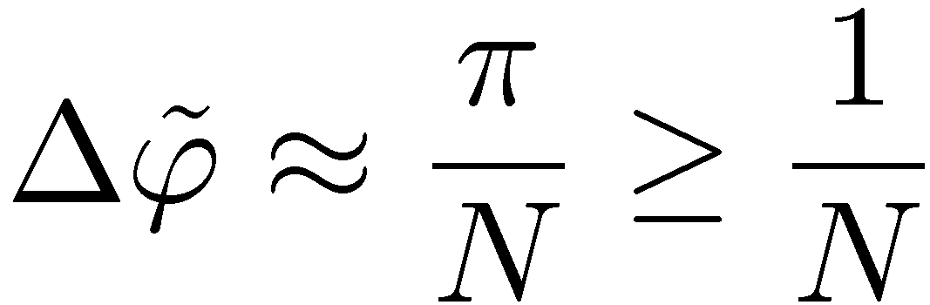
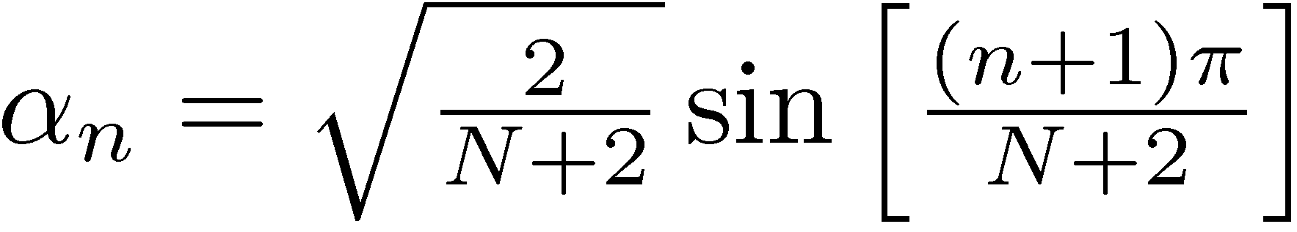
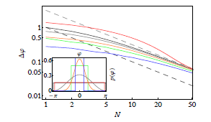
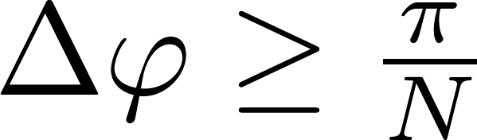
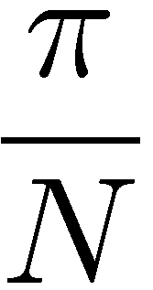

The true Heisenberg limit
For decoherence free phase estimaion, flat prior
D. W. Berry and H. M. Wiseman, Phys. Rev. Lett. 85, 5098 (2000).
The π factor is present any regular prior,
Valid also for indefninte photon numer states
M. Jarzyna, RDD, New J. Phys. 17, 013010 (2015)

Slide 8
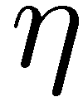
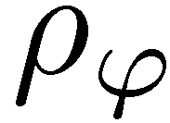
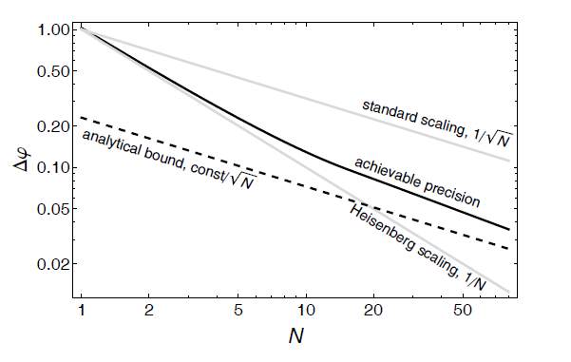
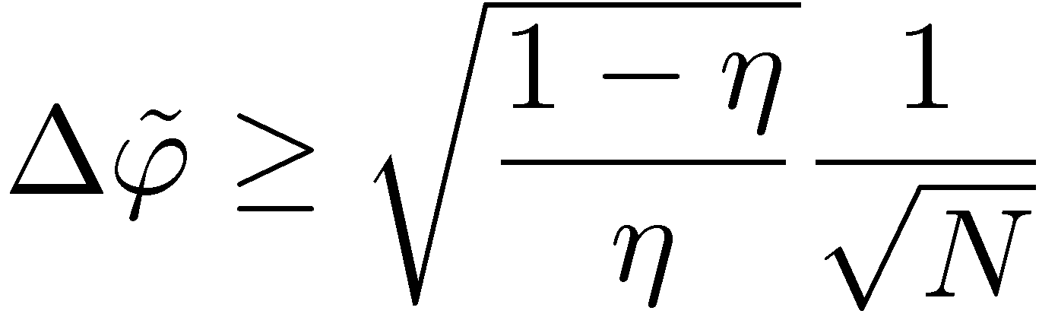
Quantum interferometry in the presence of loss
estimator
Quantum gain
Heisenberg scaling is lost!
also valid if N replaced with ⟨N⟩
J. Kolodyński, R. Demkowicz-Dobrzański, PRA 82,053804 (2010) – Bayesian approach
S. Knysh, V. Smelyanskiy, G. Durkin , PRA 83, (2011) – Fisher information approach
B. M. Escher, R. L. de Matos Filho, L. Davidovich, Nat. Phys. 7, 406 (2011)
R. Demkowicz-Dobrzański, J. Kolodyński, M. Guta, Nat. Commun. 3, 1063 (2012)

Slide 9

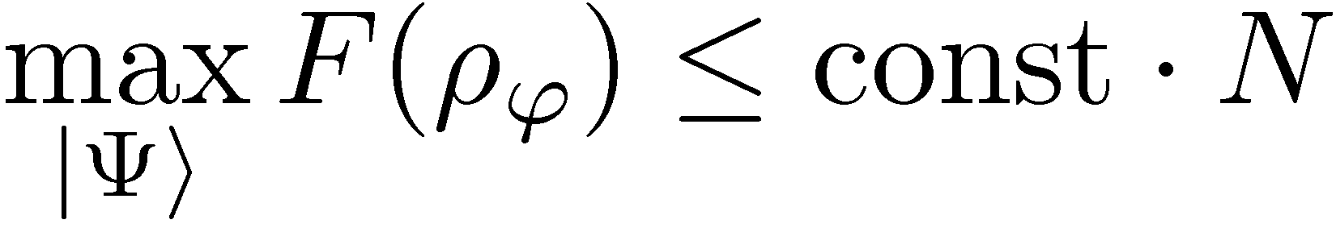
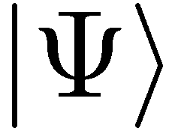
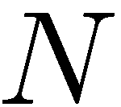
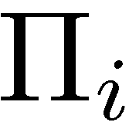
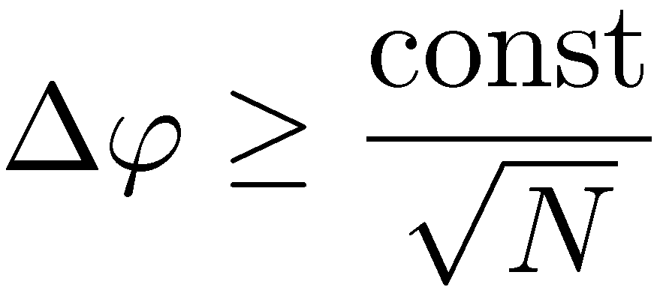
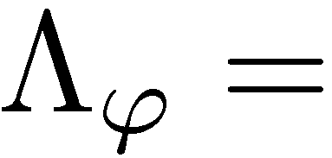
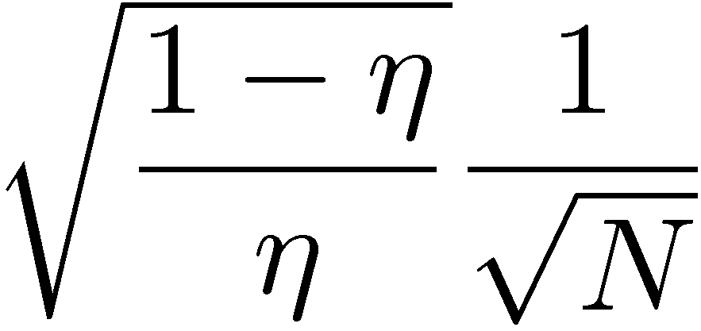
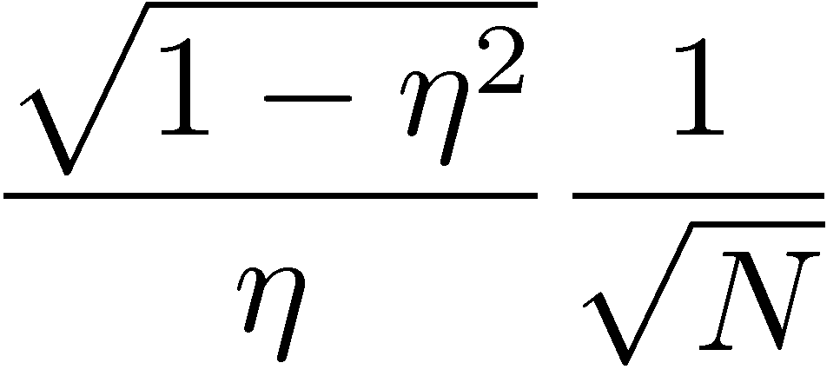



Generic impact of decoherence…
In the parallel setting
Heisenberg scaling generically lost
B. M. Escher, R. L. de Matos Filho, L. Davidovich Nature Phys. 7, 406–411 (2011)
RDD, J. Kolodynski, M. Guta, Nature Communications 3, 1063 (2012)
S. I Knysh, E. H. Chen, and G. A. Durkin arXiv:1402.0495 (2014)
Lossy interferometer | Dephasing | Depolarization | Spontaneous emission

Slide 10




GEO600 interferometer at the fundamental quantum bound
coherent light
+10dB squeezed
fundamental bound
The most general quantum strategies could additionally improve the precision by at most 8%
RDD, K. Banaszek, R. Schnabel, Phys. Rev. A, 041802(R) (2013)

Slide 11

Summary of the Helicopter view…
Quantum interferometry precision limit
in absence of decoherence:
Quantum interferometry precision limit
in presence of decoherence
In presence of decoherence, fundamental limits can be saturated asymptotically by strategies involving squeezed states. Bayesian and Fisher information approaches equivalent.
RDD, M.Jarzyna, J. Kolodynski, Progress in Optics 60, 345 (2015) (theory)
R. Schnabel, arXiv:1611.03986 (experiment)

Slide 12
The Quantum Allan Variance
R. Demkowicz-Dobrzański¹, K .Chabuda¹, K. Macieszczak^{1,2}, M. Fraas³, Ian Leroux⁴
¹Faculty of Physics, University of Warsaw, Poland
² School of Mathematical Sciences, University of Nottingham, United Kingdom
³ Theoretische Physik, ETH Zurich, Switzerland
⁴ QUEST Institut, Physikalisch-Technische Bundesanstalt, Braunschweig, Germany

Slide 13





Basic scheme of atomic clock operation
microwave generator
feedback correction
crystal oscillator
microwave atomic clock
optical atomic clock

Slide 14

















Ramsey interrogation
Exactly the same as in the Mach-Zehnder
Cs atomic fountain clock (NIST)
Frequency difference estimation precision
clock transition
quantum projection noise

Slide 15
Why atomic clocks are not just optical interferometers divided by „T”
Freedom in choosing time of evolution makes „local sensing” regime not well defined apriori – e.g. when we can use quantum Fisher information?
In atomic clocks we are interested in stabilizing fluctuating frequency and not measuring unknown fixed frequency!

Slide 16




Allan variance

Slide 17




Looking for the fundamental stability bound
adaptiveness allowed!!!
Given: LO noise, atomic decoherence, number of atoms
Find: optimal states, interrogation times, measurements, feedbacks to minimize the Allan variance!
The quantum Allan variance

Slide 18

First step towards fundamental bounds
single step corrected frequency fluctuations
Assuming no correlations between corrected frequnecy fluctuations at subsequent steps
If the optimal interrogation time determined by atomic decoherence and the resulting interrogation time longer than LO correlation time then OK
We are looking for a completely general method…
E. Kessler, P. Komar, M. Bishof, L. Jiang, A.S.Sorensen, J.Ye, M.D.Lukin, Phys. Rev. Lett. 112, 190403 (2014)

Slide 19







Calculating the Quantum Allan Variance
unitary frequency sensing
atomic decoherence
stochastic proces describing
LO frequency fluctuations
Assume the input state is given:
Notes:
atomic decoherence

Slide 20






Optimal Quantum Bayesian parameter estimation for variance cost function
prior distribution
family of states
measurement
estimator
average cost:
Notes:
atomic decoherence

Slide 21




Optimal Quantum Bayesian parameter estimation for variance cost function
prior distribution
family of states
measurement
estimator
average cost:
solution:
Helstrom, Quantum Detection and Estimation Theory, (1976)
K. Macieszczak, M. Fraas, RDD, New J. Phys. 16, 113002 (2014)
Notes:
atomic decoherence

Slide 22

Minimizing the Allan Variance
Bayesian variance minimization:
Allowing for collective measurements, and arbitrary correction function we can solve the problem!!!
Notes:
Complexity grows with the number

Slide 23



The Quantum Allan Variance
Bayesian variance minimization:
uncorrected LO Allan variance
To find the optimal probe state apply iterative procedure:
given input state find optimal measurement/feedback strategy
given measurement/feedback strategy find optimal input state
repeat

Slide 24

Exemplary LO noise
approximated by white + lorenzian spectrum
autocorrelation function:
Nat. Photonics 5 158–61 (2011) NIST, Yb clock

Slide 25




Results (single atom)
entangling atoms at different
interrogation steps
simulations
simplified model
neglecting LO noise correlations

Slide 26



Using Matrix Product Operators to improve numerical efficiency
Noise correlations are only local. Possibility of a more efficient description?
Numerical stability and efficient implementation still a challange….

Slide 27
Summary and outlook
Tell me your LO noise spectrum and the number of atoms and I will tell you your stability limits
if you help me with numerics….
K. Macieszczak, M. Fraas, RDD, New J. Phys. 16, 113002 (2014)
K. Chabuda, I. Leroux, RDD, New J. Phys. 18, 083035 (2016)
See the poster of Krzysztof Chabuda

