Slide 1
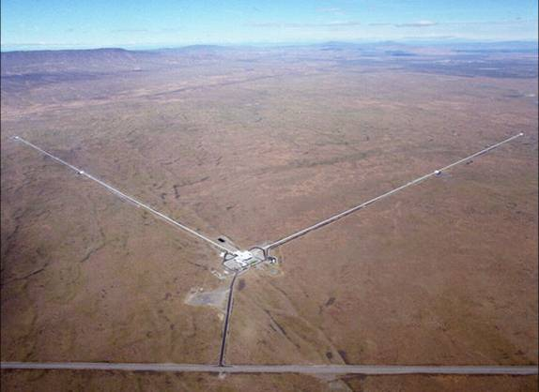
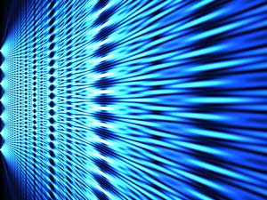
from
Quantum metrological precision bounds
to
Quantum computation speed-up limits
R. Demkowicz-Dobrzański¹, J. Kołodyński¹, M. Jarzyna¹, K. Banaszek¹
M. Markiewicz¹, K. Chabuda¹, M. Guta² , K. Macieszczak^{1,2}, R. Schnabel^{3,}, M Fraas⁴ , L. Maccone ⁵
¹Faculty of Physics, University of Warsaw, Poland
² School of Mathematical Sciences, University of Nottingham, United Kingdom
³Max-Planck-Institut fur Gravitationsphysik, Hannover, Germany
⁴ Theoretische Physik, ETH Zurich, 8093 Zurich, Switzerland
⁵ Universit`a di Pavia, Italy.
Notes:
Quantum computer = big interferometer

Slide 2
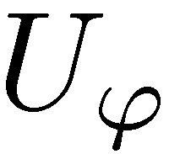
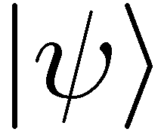
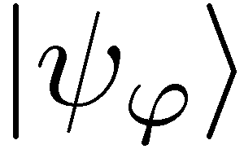
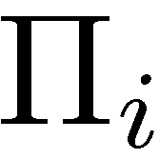
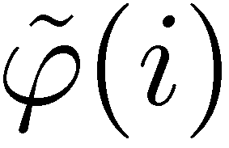
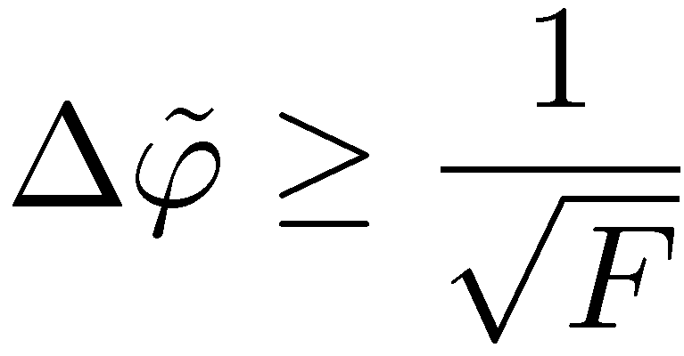
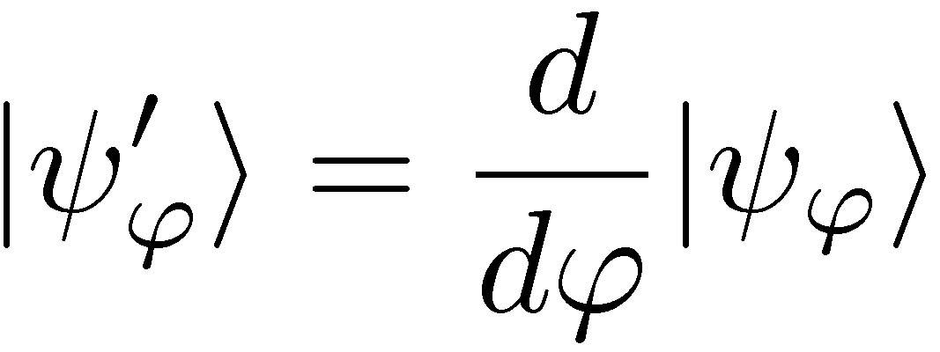
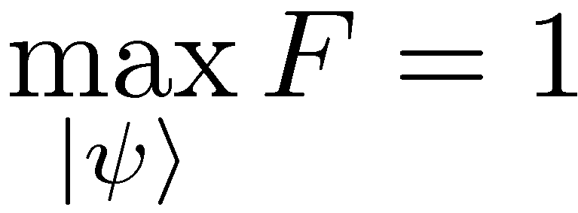
Quantum metrology
=
Quantum Fisher Information

Slide 3
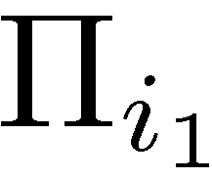
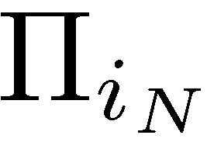
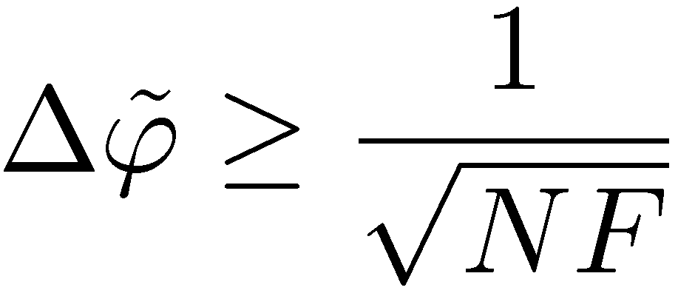
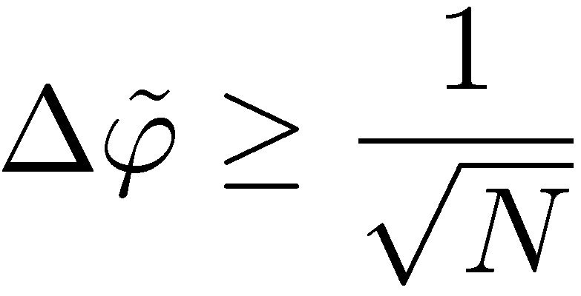
Standard quantum metrology
standard scaling

Slide 4
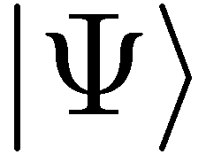
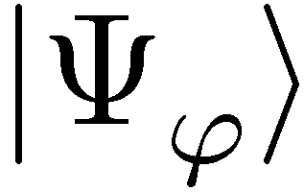
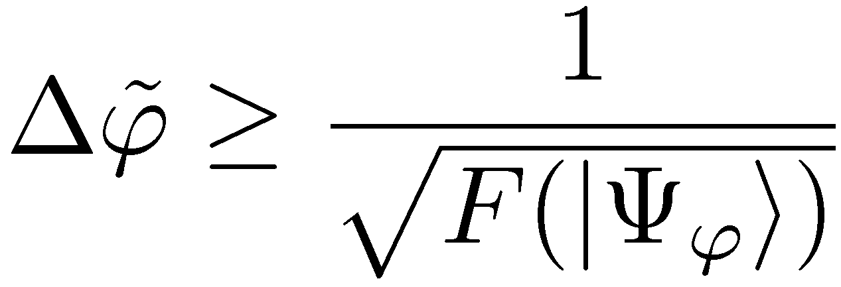
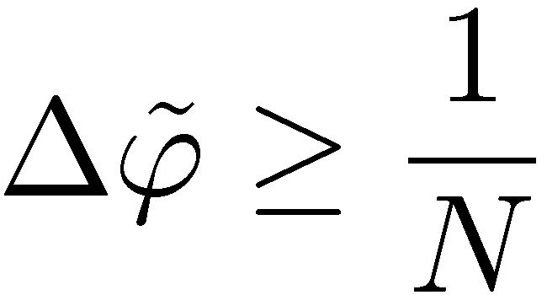
Entanglement-enhanced metrology
quadratic precision enhancement

Slide 5
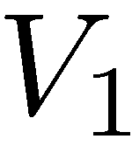
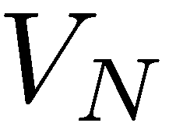
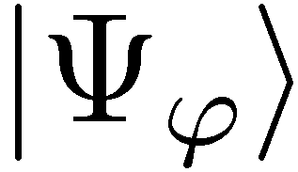
The most general scheme
(adaptive, ancilla assisted)…
V. Giovannetti, S. Lloyd, and L. Maccone, Phys. Rev. Lett. 96, 010401 (2006)

Slide 6
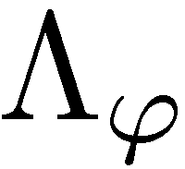
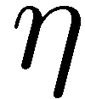
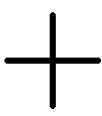
Impact of decoherence…
loss
dephasing
What are the fundamental precision bounds?

Slide 7
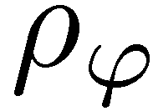
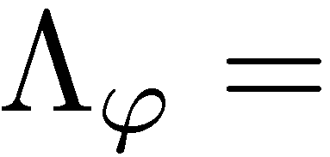
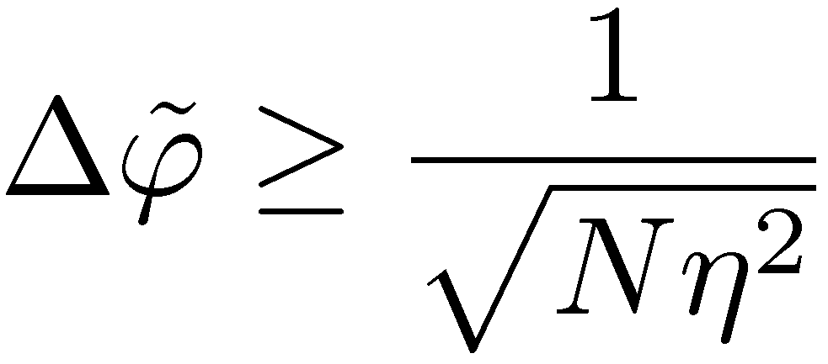
Standard scheme in presence of dephasing

Slide 8
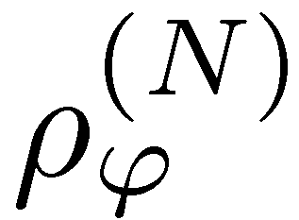
Entanglement-enhanced scheme in presence of dephasing
What is the behaviour for large N?
B. M. Escher, R. L. de Matos Filho, L. Davidovich Nature Phys. 7, 406–411 (2011)
RDD, J. Kolodynski, M. Guta, Nature Communications 3, 1063 (2012)
S. Knysh, E. Chen, G. Durkin, arXiv:1402.0495 (2014)

Slide 9
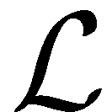
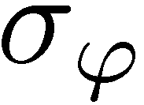
Channel simulation idea
If we find a simulation of the channel…
=

Slide 10
Channel simulation idea
Quantum Fisher information is nonincreasing under parameter independent CP maps!
We call the simulation classical:

Slide 11
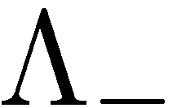
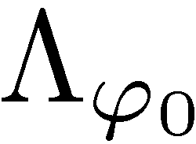
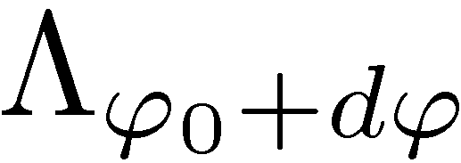
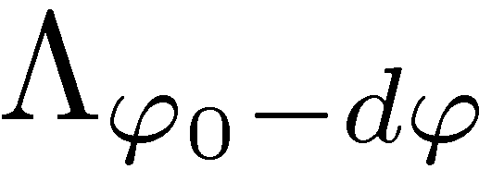
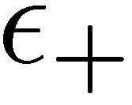
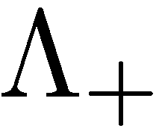
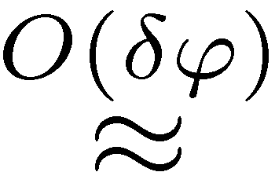
Geometric construction of (local) channel simulation

Slide 12
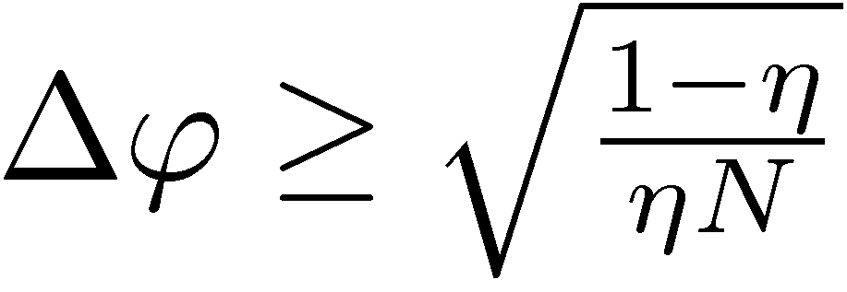
Heisenberg scaling lost
dephasing
loss
Bounds are easy to saturate ! (squeezed, spin-squeezed states)

Slide 13
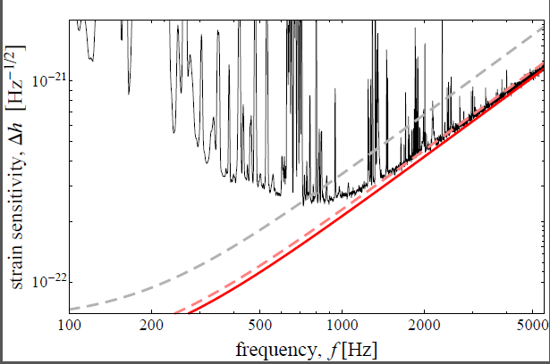
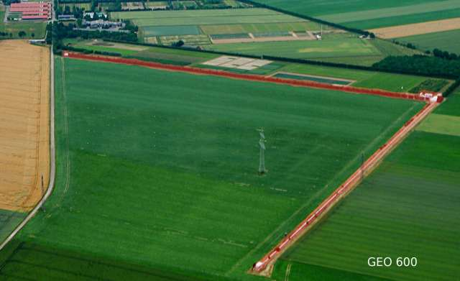
GEO600 interferometer at the fundamental quantum bound
coherent light
+10dB squeezed
fundamental bound
The most general quantum strategies could additionally improve the precision by at most 8%
RDD, K. Banaszek, R. Schnabel, Phys. Rev. A, 041802(R) (2013)

Slide 14
Adaptive schemes, error correction…???
E. Kessler et.al Phys. Rev. Lett. 112, 150802 (2014)
W. Dür, et al., Phys. Rev. Lett. 112, 080801 (2014)
The same bounds apply!
RDD, L. Maccone Phys. Rev. Lett. 113, 250801 (2014)

Slide 15
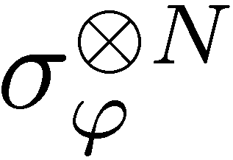
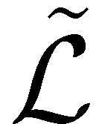
Channel simulation works as well

Slide 16
Quantum Metrology: quadratic gain in precision in ideal scenario reduced to constant factor improvement in presence of decoherence
Quantum Search algorithm: quadratic gain in precision in ideal scenario
??????? in presence of decoherence

Slide 17
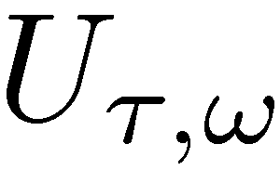
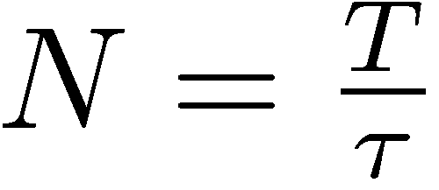
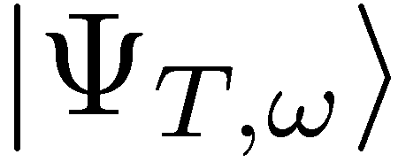
Frequency vs phase estimation
Estimate frequnecy, under total interrogation time T

Slide 18
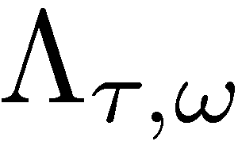
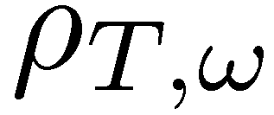
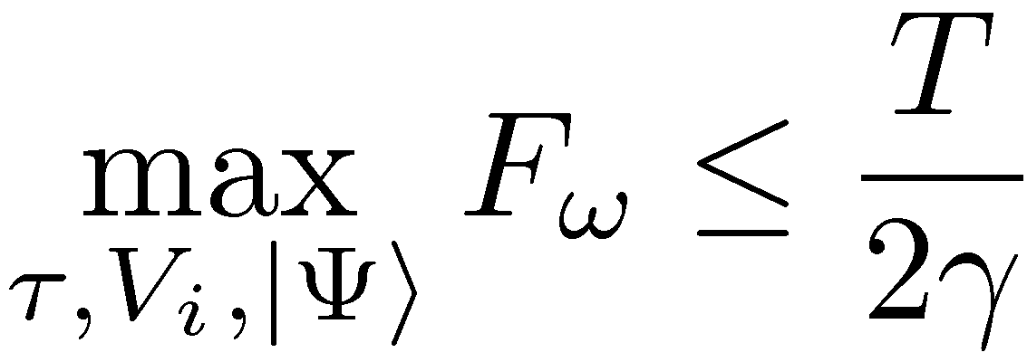
Frequency estimation in presence of dephasing

Slide 19
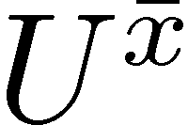
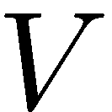
The Grover algorithm
Number of oracle calls to find the distinguished state:
Quadratic enhancement just as in metrology

Slide 20
Continuous version of the Grover algorithm
Total interrogation time required
Interrogation time required reduced as in metrology

Slide 21
Grover and Metrology two sides of the same coin
Under total interrogation time T fixed
Notes:
We want the output state to evolve as far as possible from initial state

Slide 22
Limit on how fast probe states can become distinguishable?
Fix oracle index x
reference state
Bures angular distance:
By triangle inequality:

Slide 23
What Grover needs…
Final states should be distinguishable
We know that
Probe needs to be sensitive to all oracles simultaneously !!!
Grover is optimal

Slide 24
Grover with imperfect oracles
dephasing in M dimensional space – all off-diagonal elements multiplied by
conjecture
Grover quadratic speed-up lost
RDD, M. Markiewicz, Phys. Rev. A 91, 062322 (2015)
Notes:
We want the output state to evolve as far as possible from initial state

Slide 25
Summary
GW detectors sensitivity limits
Atomic-clocks stability limits
Quantum metrological bounds
Quantum computing speed-up limits

