Slide 1
Theoretical tools for
Quantum-enhanced metrology
the illusion of the Heisenberg scaling
R. Demkowicz-Dobrzański¹, J. Kołodyński¹, K. Banaszek¹, M. Jarzyna¹,
M. Guta²
¹Faculty of Physics, Warsaw University, Poland
² School of Mathematical Sciences, University of Nottingham, United Kingdom

Slide 2
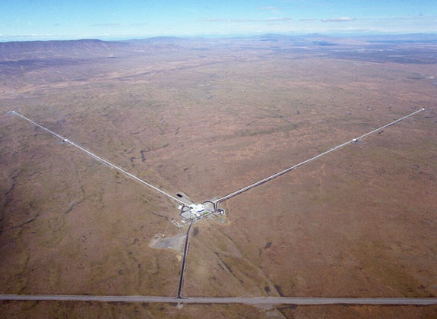
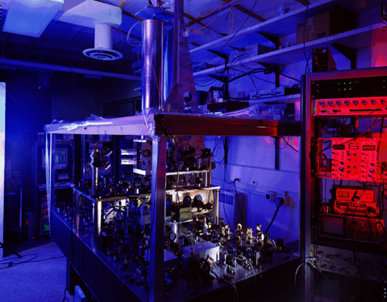
Interferometry at its (classical) limits
LIGO - gravitational wave detector
NIST - Cs fountain atomic clock
Michelson interferometer
Ramsey interferometry
Precision limited by:

Slide 3
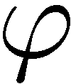
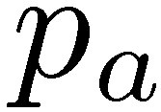
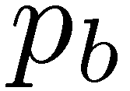
1 photon in an interferometer

Slide 4
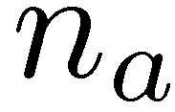
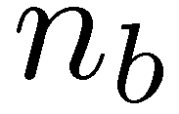
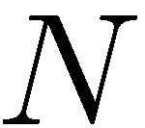
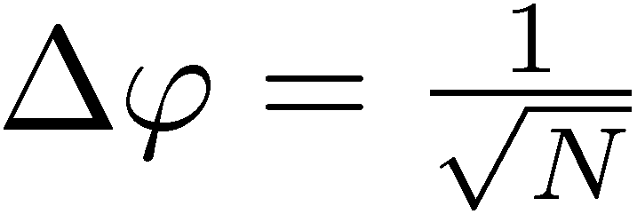
N independent photons
the best estimator:
Estimator uncertainty:
Standard Quantum Limit (Shot noise limit)
The same (or worse) result for classical states of light

Slide 5
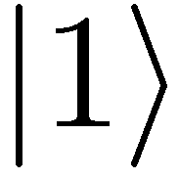
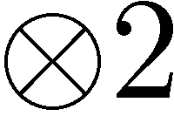
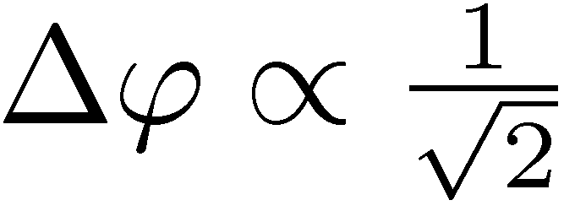
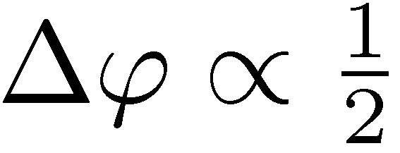
Entanglement enhanced precision
Hong-Ou-Mandel interference
&

Slide 6
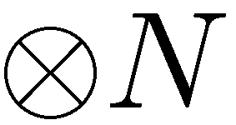
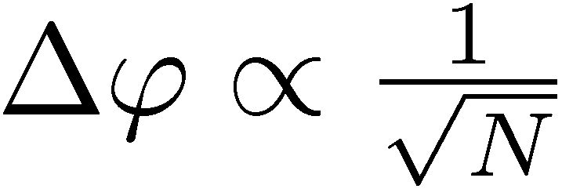
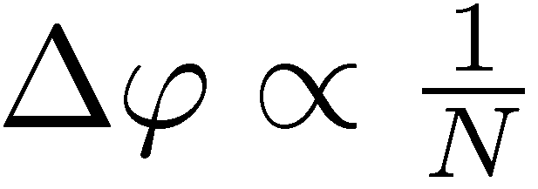
Entanglement enhanced precision
NOON states
State
preparation
Estimator
Measuremnt
Standard Quantum Limit
Heisenberg limit

Slide 7
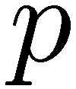
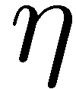
In practice: squeezed states
coherent states
Photon loss = decoherence
squeezed vaccum
One quadrature fluctuations below vaccum fluctuations

Slide 8
What are the fundamental bounds
in presence of decoherence?

Slide 9
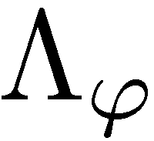
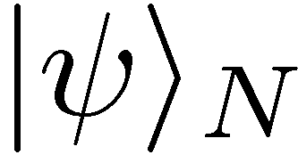
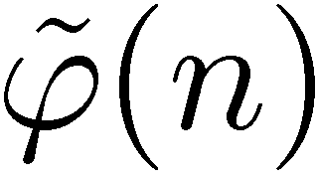
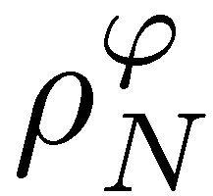
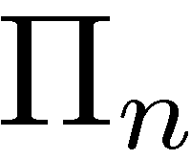
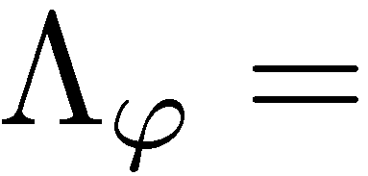
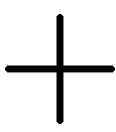
General scheme in q. metrology
Input state of N particles
phase shift + decoherence
measurement
estimation
Interferometer with losses
(gravitational wave detectors)
Qubit rotation + dephasing
(atomic clock frequency callibrations)

Slide 10
General scheme in q. metrology
Input state of N particles
phase shift + decoherence
measurement
estimation
a priori knowledge
Very hard problem!

Slide 11
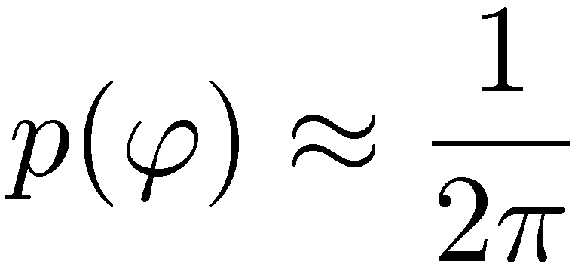
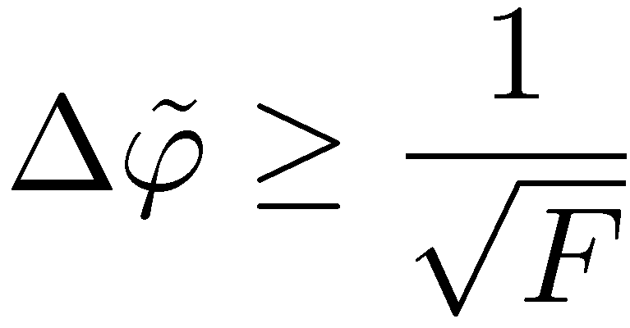
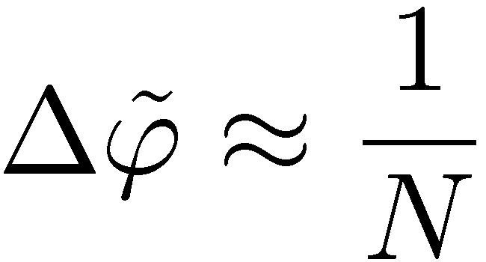
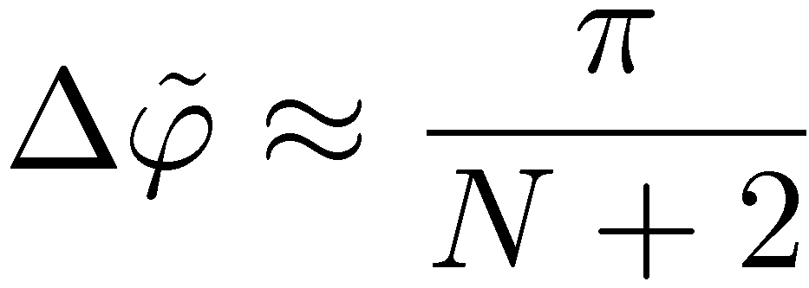
Local approach
Global approach
we want to sense small fluctuations around a known phase
no a priori knowledge about the phase
Tool: Fisher Information, Cramer-Rao bound
Tool: Symmetry implies a simple structure of the optimal measurement
Optimal state:
The optimal N photon state for interferometry:
J. J. . Bollinger, W. M. Itano, D. J. Wineland, and
D. J. Heinzen, Phys. Rev. A 54, R4649 (1996).
D. W. Berry and H. M. Wiseman, Phys. Rev. Lett. 85, 5098 (2000).
Heisenberg scaling

Slide 12
Impact of decoherence?
Local approach
Global approach
Tool: Fisher Information, Cramer-Rao bound
Tool: Symmetry implies a simple structure of the optimal measurement
Fisher Information, more difficult to calculate
Optimal states do not have simple structure
Heisenberg scaling lost!
No analytical formulas for the optimal precision and states
nontrivial eigenvalue problem
RDD, et al. PRA 80, 013825 (2009)
U. Dorner, et al., PRL. 102, 040403 (2009)
Analytical lower bound:
Analytical lower bound:
S. Knysh, V. Smelyanskiy, G. Durkin PRA 83, (2011)
J. Kolodynski, RDD, PRA 82,053804 (2010)
Notes:
Derivation of the bounds required quite a bit of computational effort and ingenuity…., can you do it simpler and in more general way…

Slide 13
Fundamental bound on quantum enhancement of precision

Slide 14
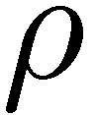
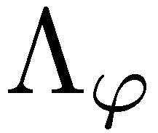
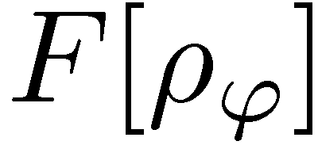
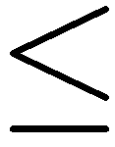
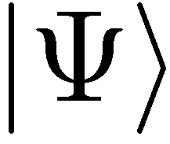
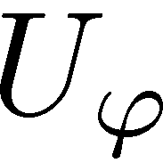
General method for other decoherence models?
Fisher information via purifications
System
+
Environment
B. M. Escher, R. L. de Matos Filho, and L. Davidovich, Nature Physics, 7, 406 (2011)
A. Fujiwara and H. Imai, J. Phys. A: Math. Theor., 41, 255304 (2008).

Slide 15
General method for other decoherence models?
Fisher information via purifications
Kraus representation
Equivalent Kraus set
Minmization over different Kraus representation non-trivial
dephasing
B. M. Escher, R. L. de Matos Filho, and L. Davidovich, Nature Physics, 7, 406 (2011)

Slide 16
Can you do it simpler, more general, more intutive?
Yes!!!

Slide 17
Classical simulation of a quantum channel
Convex set of quantum channels
Notes:
For qubit dephasing exact result, for interfereomter unfortunately not possible. Other methods also quite simple but not that geometric

Slide 18
Classical simulation of a quantum channel
Convex set of quantum channels
Parameter dependence moved to mixing probabilities
Before:
After:
By Markov property….
K. Matsumoto, arXiv:1006.0300 (2010)
Notes:
For qubit dephasing exact result, for interfereomter unfortunately not possible. Other methods also quite simple but not that geometric

Slide 19
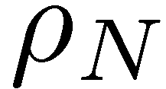
Classical simulation of N channels used in parallel
Notes:
For qubit dephasing exact result, for interfereomter unfortunately not possible. Other methods also quite simple but not that geometric

Slide 20
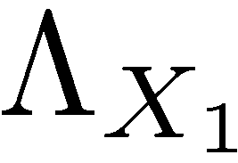
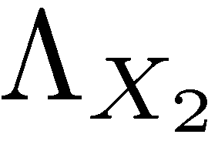
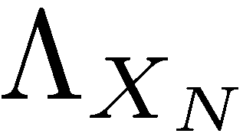
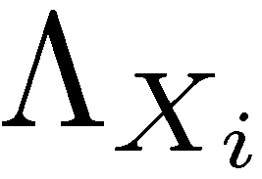
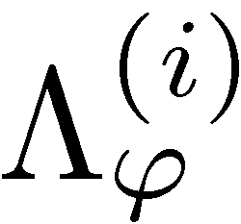
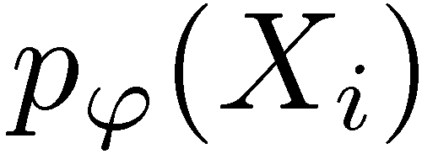
Classical simulation of N channels used in parallel
=
Notes:
For qubit dephasing exact result, for interfereomter unfortunately not possible. Other methods also quite simple but not that geometric

Slide 21
Classical simulation of N channels used in parallel
=
Notes:
For qubit dephasing exact result, for interfereomter unfortunately not possible. Other methods also quite simple but not that geometric

Slide 22
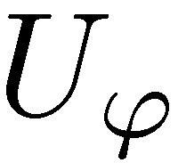
Precision bounds thanks to classical simulation
For unitary channels
Heisenberg scaling possible
Generlic decoherence model will manifest shot noise scaling
To get the tighest bound we need to find the „worst” classical simulation

Slide 23
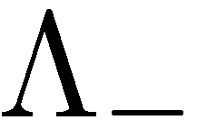
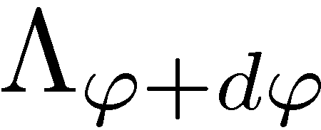
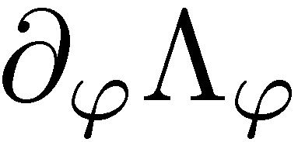
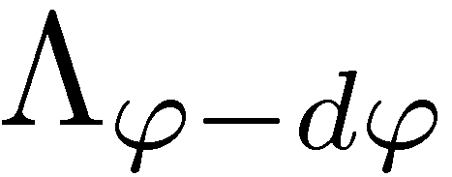
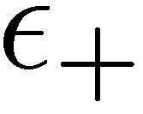
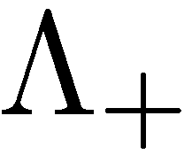
The „Worst” classical simulation
Quantum Fisher Information at a given depends only on
It is enough to analize,,local classical simulation’’:
The „worst” classical simulation:
Works for non-extremal channels
RDD, M. Guta, J. Kolodynski, arXiv:1201.3940 (2012)
Notes:
For qubit dephasing exact result, for interfereomter unfortunately not possible. Other methods also quite simple but not that geometric

Slide 24
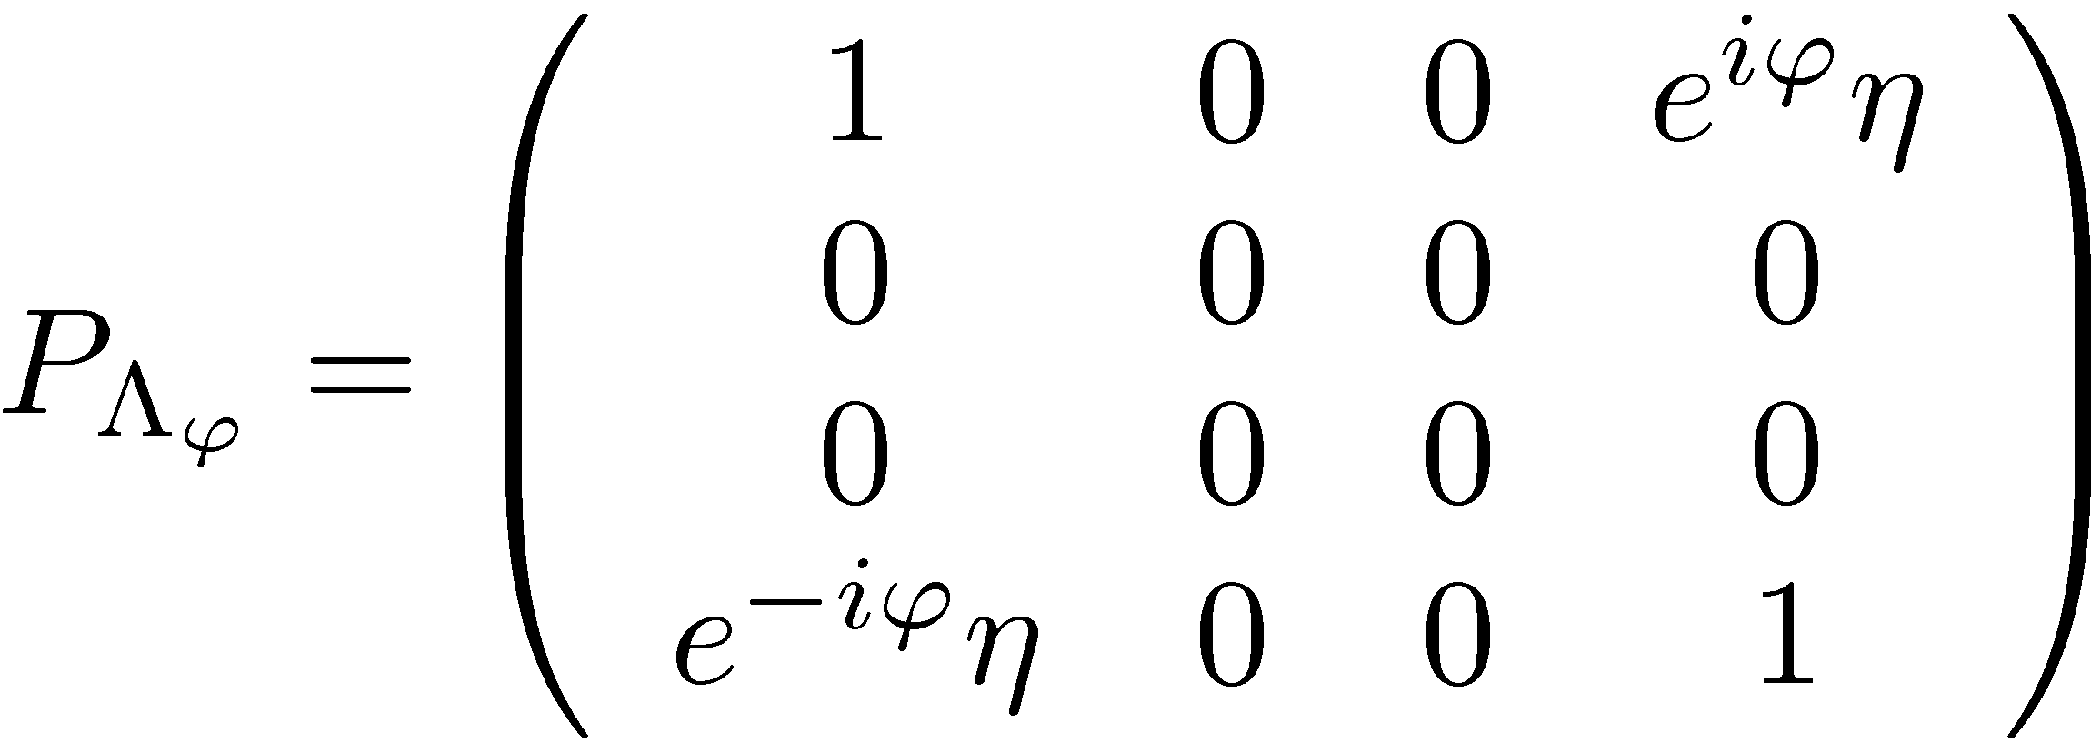
Dephasing: derivation of the bound in 60 seconds!
dephasing
Choi-Jamiolłowski-isomorphism (positivie operators correspond to physical maps)
RDD, M. Guta, J. Kolodynski, arXiv:1201.3940 (2012)

Slide 25
Dephasing: derivation of the bound in 60 seconds!
dephasing
Choi-Jamiolłowski-isomorphism (positivie operators correspond to physical maps)
RDD, M. Guta, J. Kolodynski, arXiv:1201.3940 (2012)

Slide 26
Summary
Heisenberg scaling is lost for a generic decoherence channel even for infinitesimal noise
Simple bounds on precision can be derived using classical simulation idea
Channels for which classical simulation does not work
( extremal channels) have less Kraus operators, other methods easier to apply
RDD, M. Guta, J. Kolodynski, arXiv:1201.3940 (2012)

