Slide 1
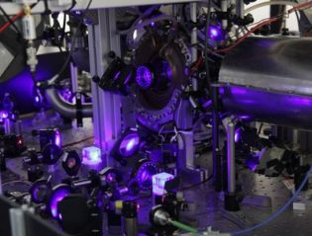
Fundamental bounds on stability of atomic clocks
R. Demkowicz-Dobrzański¹, K .Chabuda¹, K. Macieszczak^{1,2}, M. Fraas³, Ian Leroux⁴
¹Faculty of Physics, University of Warsaw, Poland
² School of Mathematical Sciences, University of Nottingham, United Kingdom ³ Theoretische Physik, ETH Zurich, Switzerland
⁴ QUEST Institut, Physikalisch-Technische Bundesanstalt, Braunschweig, Germany

Slide 2
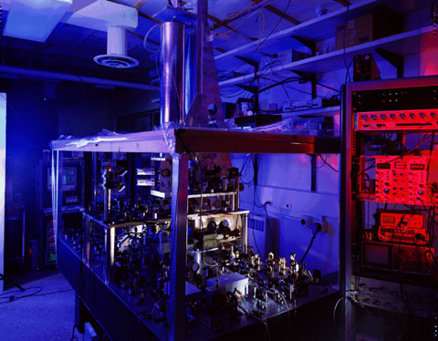
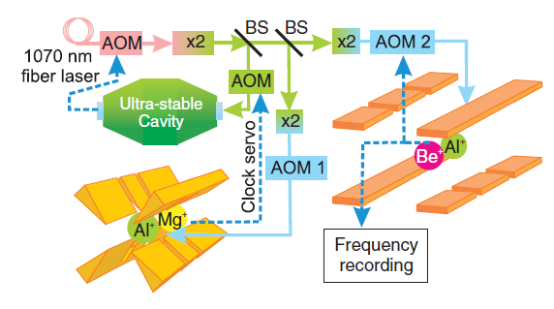
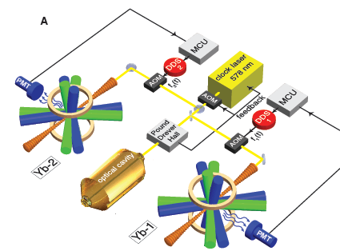
Best atomic clocks
Cs atomic fountain clock (NIST)
Al⁺ ion atomic clock (NIST)
Measuring the age of the universe with 1s precision!
Sensing elevation changes due to gravitational redshift with 1cm precision! (relativistic geodesy)
Optical lattice clocks (NIST, SYRTE, Tokyo), approaching:
Given a realistic noise model, what are the fundamental bounds on stability imposed solely by quantum mechanics?

Slide 3
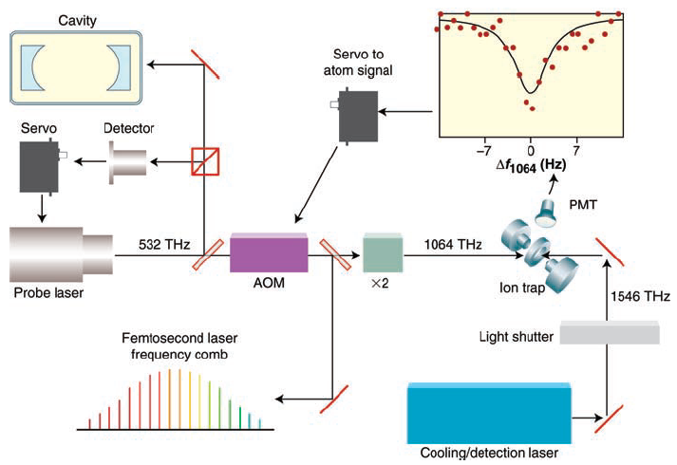
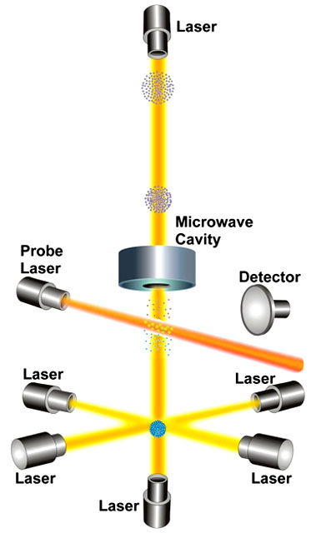
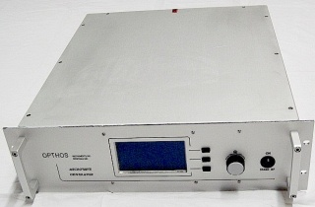
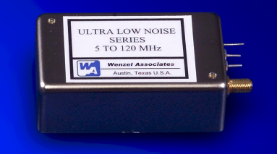
Basic scheme of atomic clock operation
microwave generator
feedback correction
crystal oscillator
microwave atomic clock
optical atomic clock

Slide 4
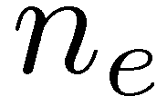
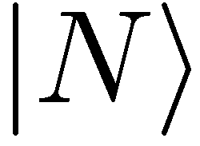
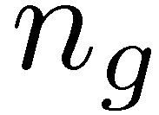
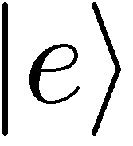
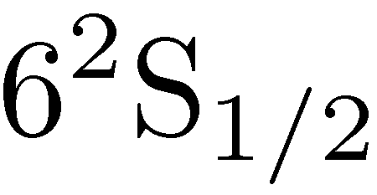
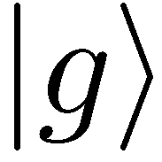
Ramsey interrogation
Exactly the same as in the Mach-Zehnder
Cs atomic fountain clock (NIST)
Frequency difference estimation precision
clock transition
quantum projection noise

Slide 5
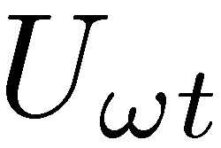
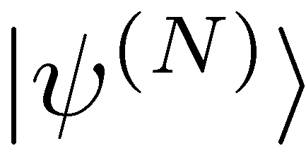
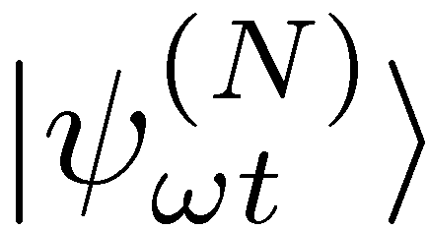
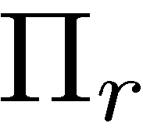
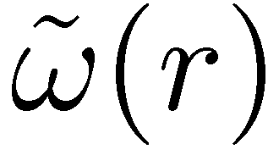
General quantum metrological scheme for frequency estimation
general N
atom (probe) state
general measurement
general estimator

Slide 6
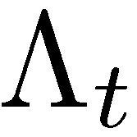
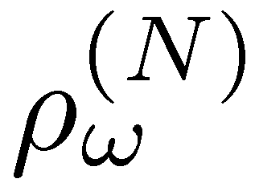
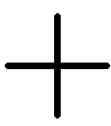
General quantum metrological scheme for frequency estimation
general N
atom (probe) state
general measurement
general estimator

Slide 7
General quantum metrological scheme for frequency estimation
general N
atom (probe) state
general measurement
general estimator
Quantum Fisher Information approach:

Slide 8
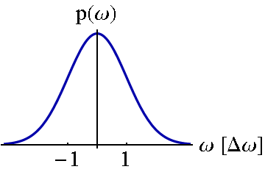
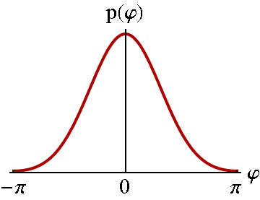
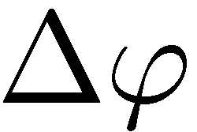
Frequency vs Phase estimation
frequency prior distribution
phase priori distribution
Larger t = Better precision?

Slide 9
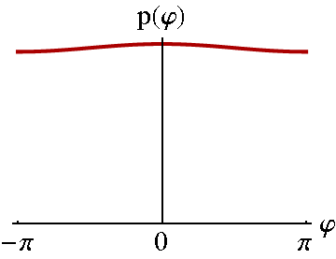
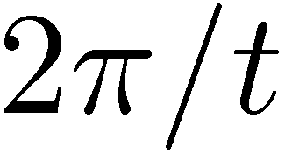
Frequency vs Phase estimation
frequency prior distribution
phase priori distribution
?
Too long t makes frequency estimation ambiguous

Slide 10
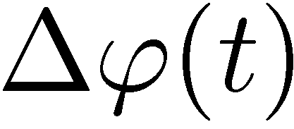
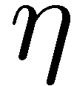
Frequency vs Phase estimation
frequency prior distribution
phase priori distribution
?
Too long t makes frequency estimation ambiguous
Too long t increses decoherence effects

Slide 11
Why Quantum Fisher Information approach is not enough?
Quantum Fisher Information approach well justified for „local sensing”
Freedom in choosing time of evolution makes „local sensing” regime not well defined apriori
Saturation of Cramer-Rao bound not always guranteed in a single shot
In atomic clocks we are interested in stabilizing fluctuating frequnecy and not measuring unknown fixed frequency!
Bayesian approach more justified

Slide 12
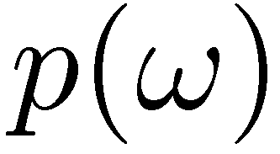
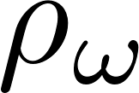
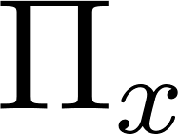
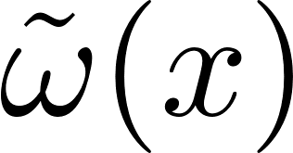
Optimal Quantum Bayesian frequency estimation
prior distribution
family of states
measurement
estimator
average cost:
Notes:
atomic decoherence

Slide 13
Optimal Quantum Bayesian parameter estimation for variance cost function
prior distribution
family of states
measurement
estimator
average cost:
solution:
Helstrom, Quantum Detection and Estimation Theory, (1976)
K. Macieszczak, M. Fraas, RDD, New J. Phys. 16, 113002 (2014)
Notes:
atomic decoherence

Slide 14
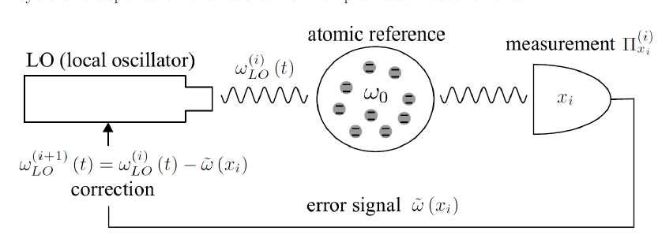
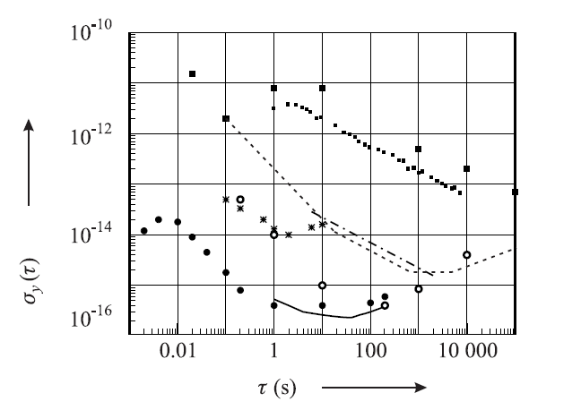
Allan variance

Slide 15
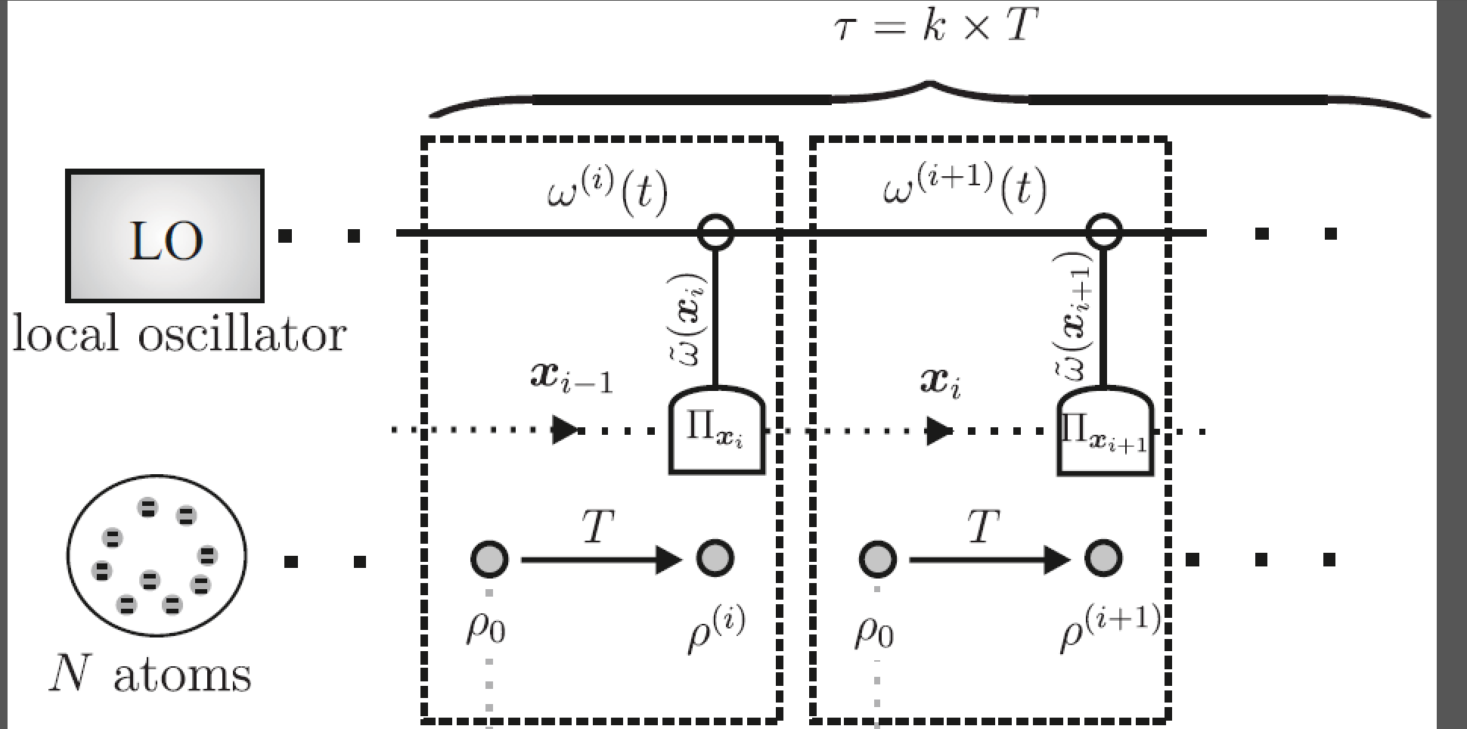
Looking for the fundamental stability bound
adaptiveness allowed!!!
Given: LO noise, atomic decoherence, number of atoms
Find: optimal states, interrogation times, measurements, feedbacks to minimize the Allan variance!
The quantum Allan variance

Slide 16
Calculating the Quantum Allan Variance
unitary frequency sensing
atomic decoherence
stochastic proces describing
LO frequency fluctuations
Assume the input state is given:
Notes:
atomic decoherence

Slide 17
Minimizing the Allan Variance
Bayesian variance minimization:
Allowing for collective measurements, and arbitrary correction function we can solve the problem!!!
Notes:
Complexity grows with the number

Slide 18
The Quantum Allan Variance
Bayesian variance minimization:
uncorrected LO Allan variance
To find the optimal probe state apply iterative procedure:
given input state find optimal measurement/feedback strategy
given measurement/feedback strategy find optimal input state
repeat

Slide 19
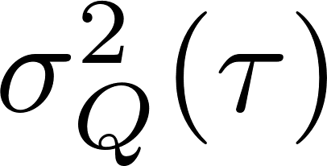
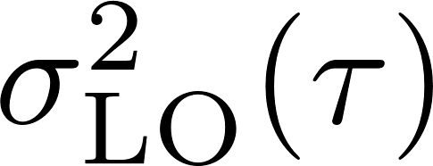
Results (single atom)
entangling atoms at different interrogation steps
simulations
simplified model neglecting LO noise correlations
Realistic noise model taken from Nat. Photonics 5 158–61 (2011) NIST, Yb clock

Slide 20
Summary and outlook
Tell me your LO noise spectrum and the number of atoms and I will tell you your stability limits
K. Macieszczak, M. Fraas, RDD, New J. Phys. 16, 113002 (2014)
K. Chabuda, I. Leroux, RDD, arXiv:1601.01685 (2016)

