Slide 1






Almost all decoherence models lead to shot noise scaling in quantum enhanced metrology
the illusion of the Heisenberg scaling
R. Demkowicz-Dobrzański¹, J. Kołodyński¹, M. Guta²
¹Faculty of Physics, Warsaw University, Poland
² School of Mathematical Sciences, University of Nottingham, United Kingdom

Slide 2
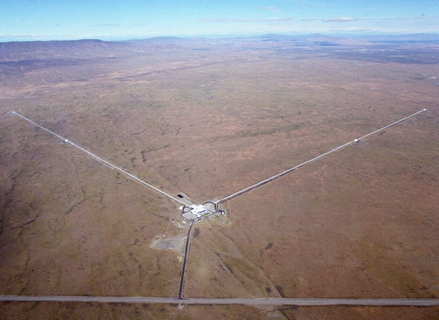
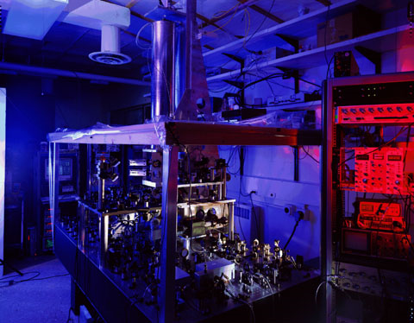
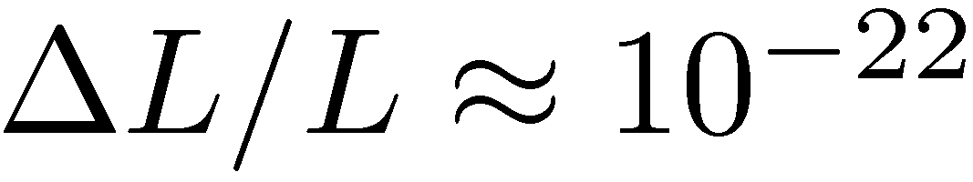
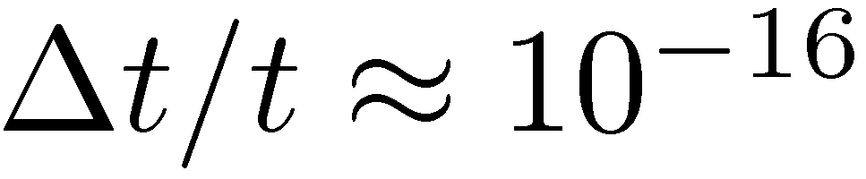
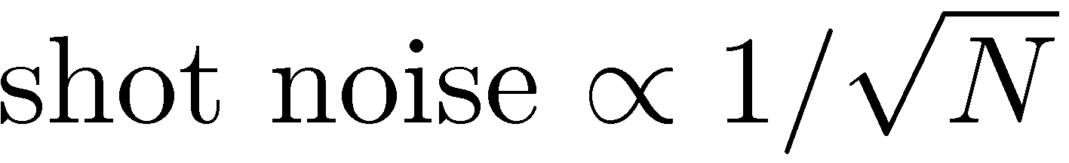
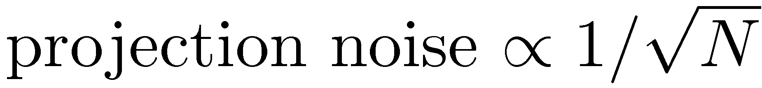
Interferometry at its (classical) limits
LIGO - gravitational wave detector
NIST - Cs fountain atomic clock
Michelson interferometer
Ramsey interferometry
Precision limited by:

Slide 3
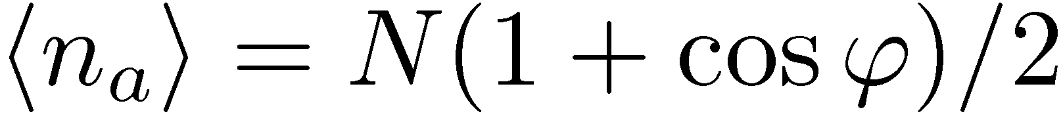
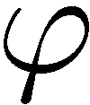
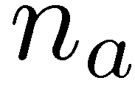
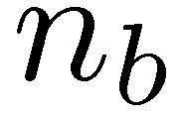
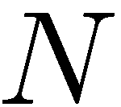
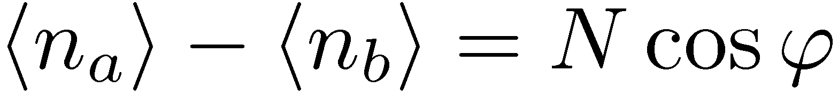
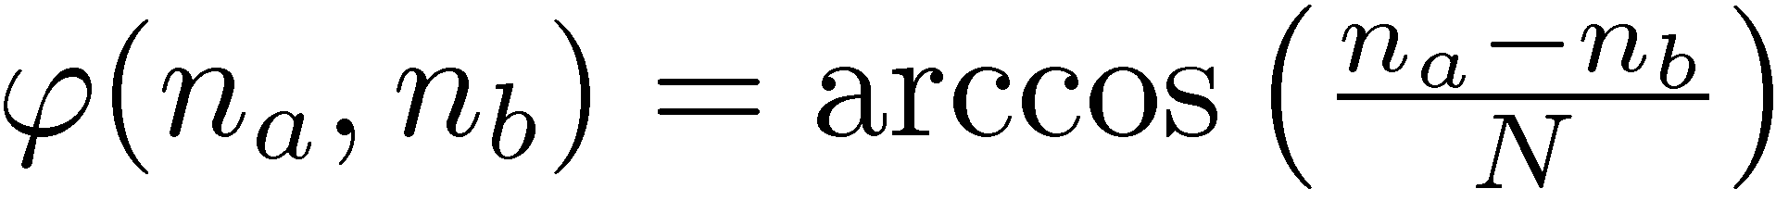
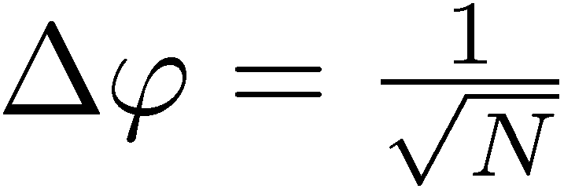
N independent photons
the best estimator:
Estimator uncertainty:
Standard Quantum Limit (Shot noise limit)

Slide 4
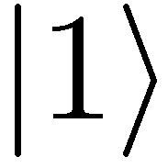
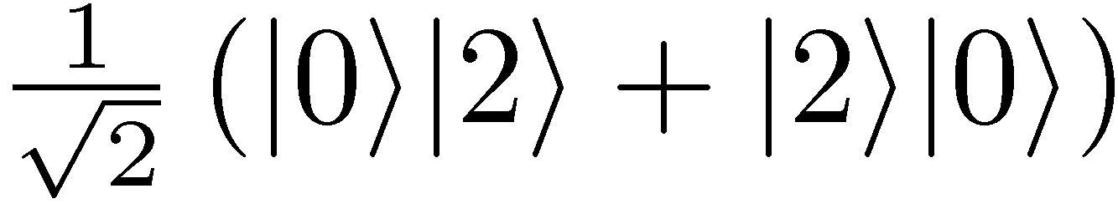
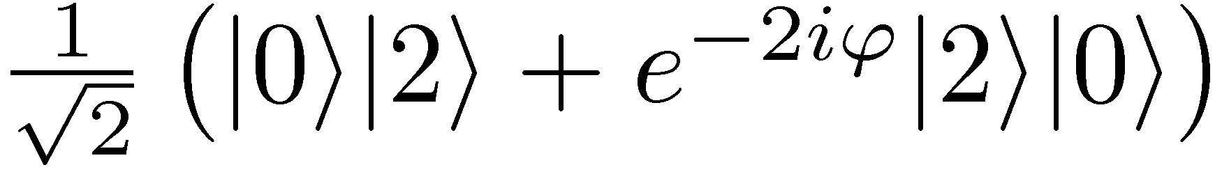
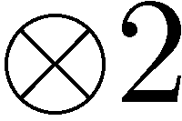
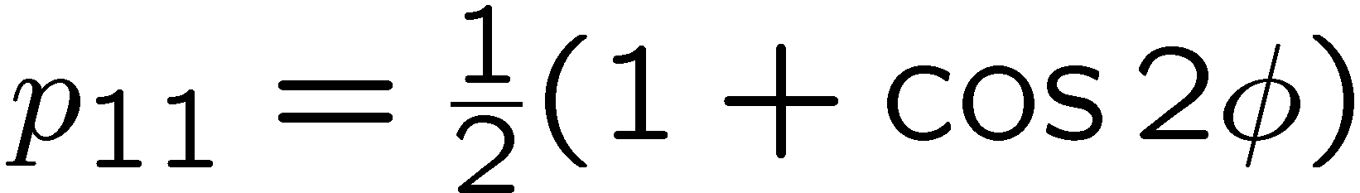
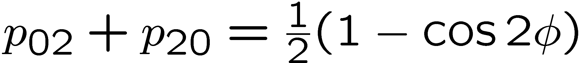
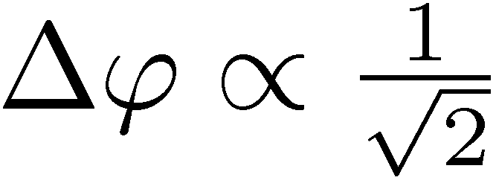
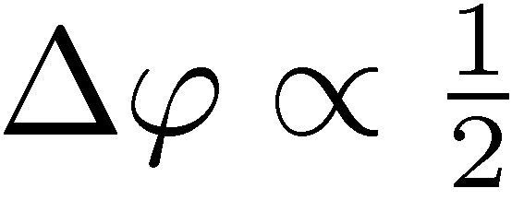
Entanglement enhanced precision
Hong-Ou-Mandel interference
&

Slide 5
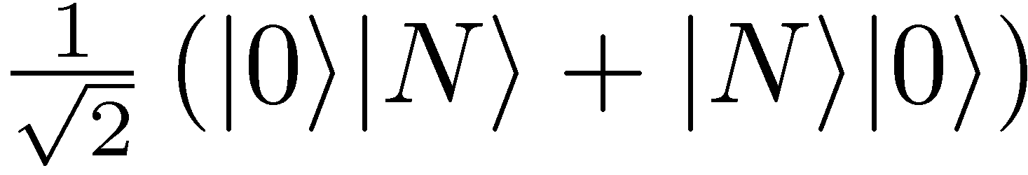
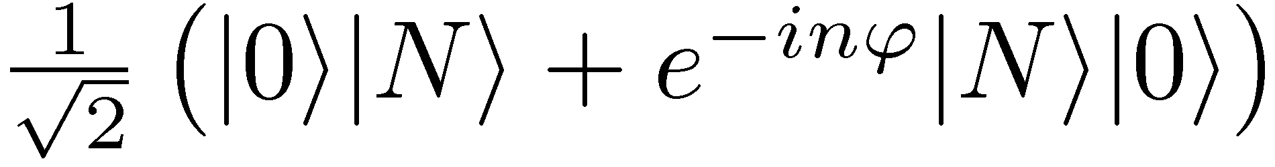
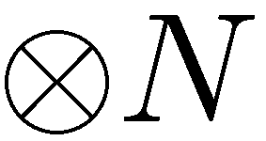
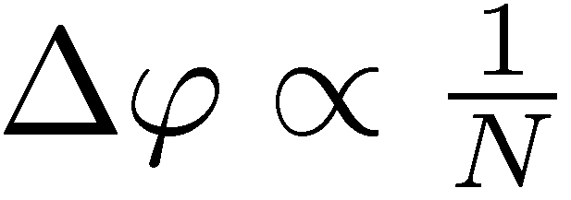
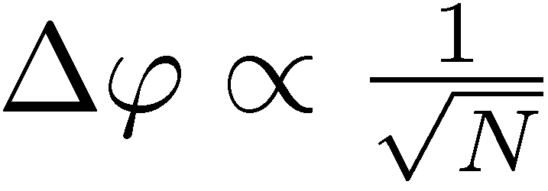
Entanglement enhanced precision
NOON states
State
preparation
Estimator
Measuremnt
Heisenberg limit
Standard Quantum Limit

Slide 6
What are the fundamental bounds
in presence of decoherence?

Slide 7
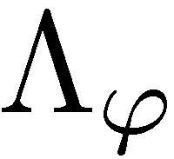
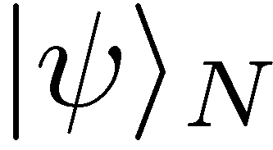
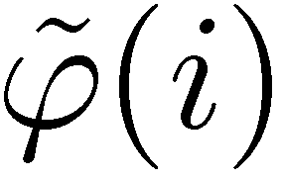
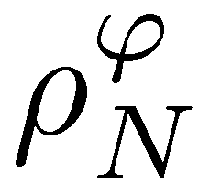
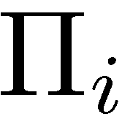
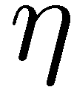
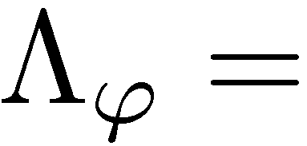
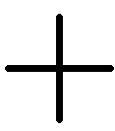
General scheme in q. metrology
Input state of N particles
phase shift + decoherence
measurement
estimation
Interferometer with losses
(gravitational wave detectors)
Qubit rotation + dephasing
(atomic clock frequency callibrations)

Slide 8
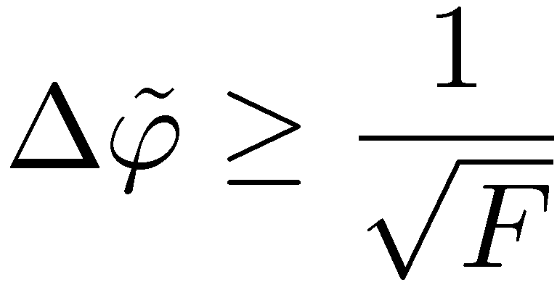
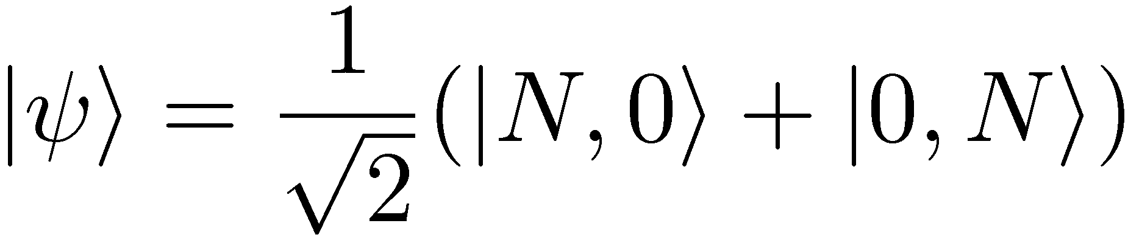
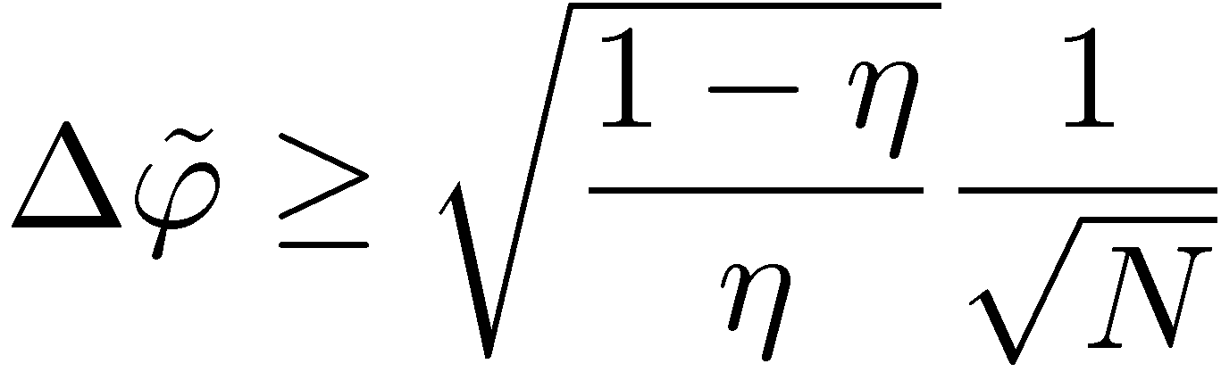
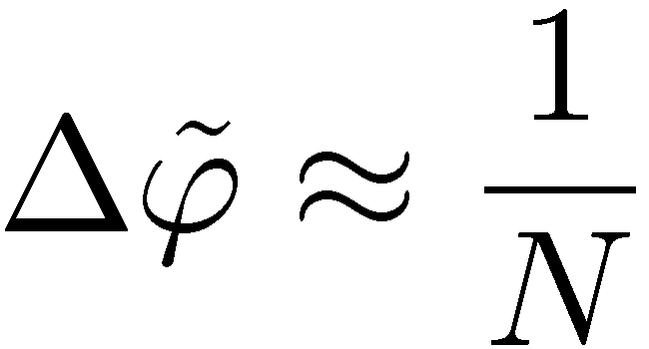
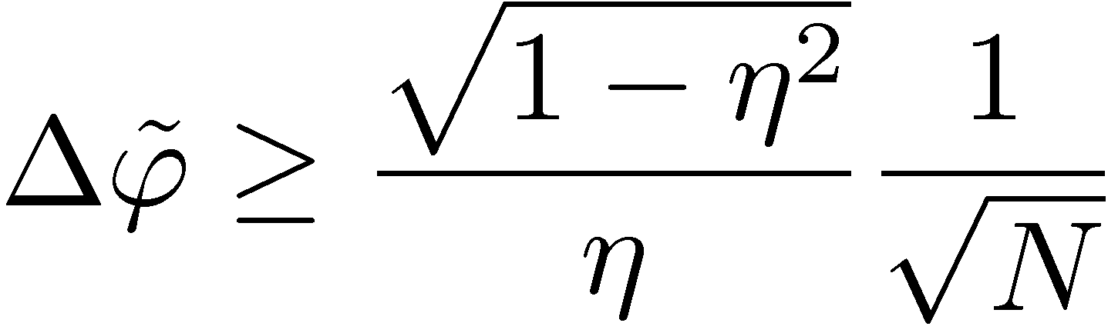
Local approach using Fisher information
Cramer-Rao bound:
F – Fisher information
(depends only on the input state)
No decoherence
With decoherence
- The output state is mixed
- Fisher Information, difficult to calculate
Optimal states do not have simple structure
Heisenberg scaling is lost even for infinitesimal decoherence!!!
- Optimal N photon state (maximal F=N²):
RDD, et al. PRA 80, 013825 (2009),
U. Dorner, et al., PRL. 102, 040403 (2009)
- Asymptotic analytical lower bound:
J. Kolodynski, RDD, PRA 82,053804 (2010),
S. Knysh, V. Smelyanskiy, G. Durkin PRA 83, (2011)
Heisenberg scaling
B. M. Escher, et al. Nature Physics, 7, 406 (2011)
(minimization over different Kraus representations)
J. J. . Bollinger, W. M. Itano, D. J. Wineland, and D. J. Heinzen, Phys. Rev. A 54, R4649 (1996).

Slide 9
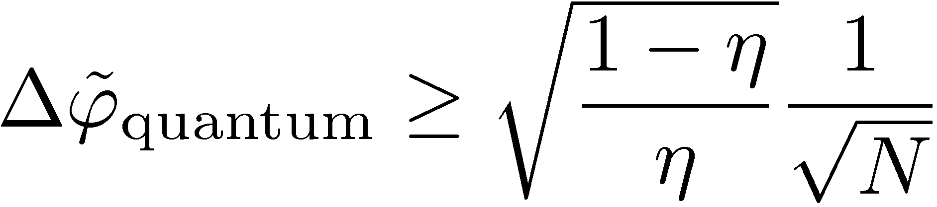
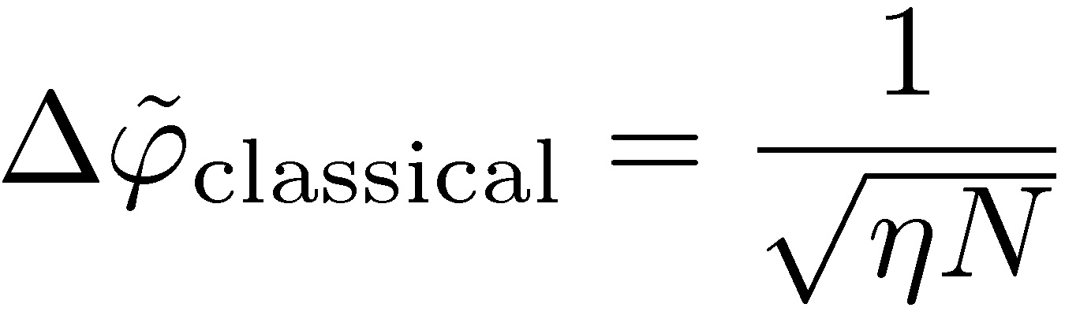
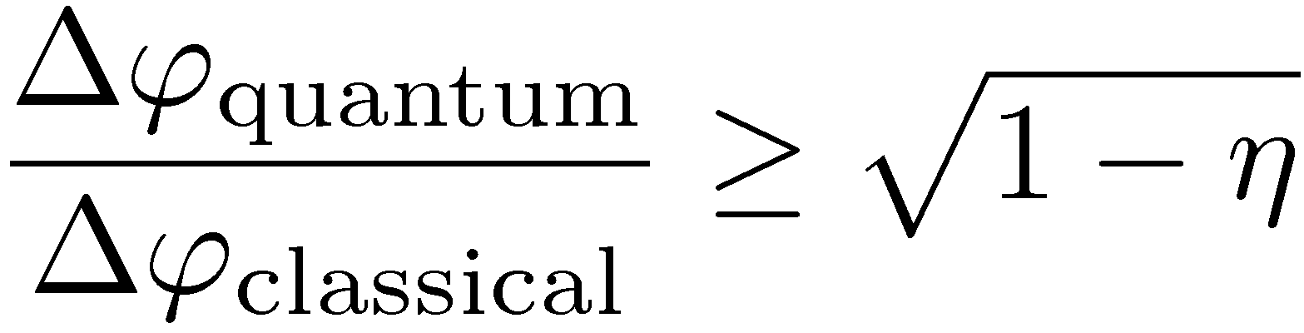
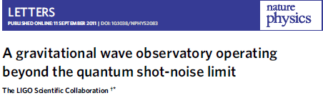
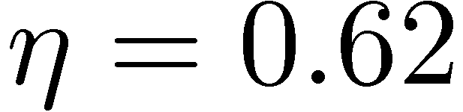
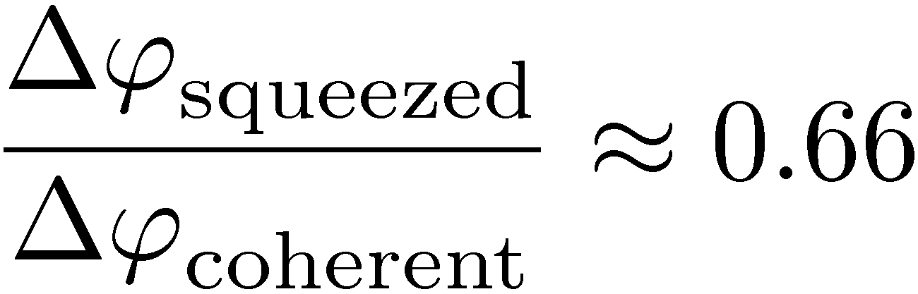
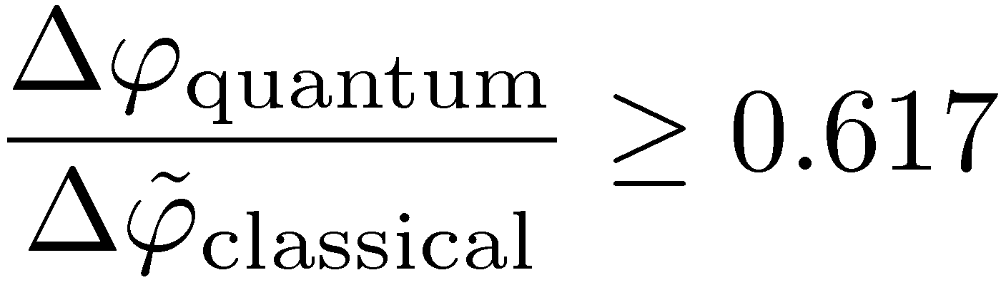
Maximal quantum enhancement

Slide 10
Heisenberg scaling is lost even for infinitesimal decoherence!!!
Can you prove
simpler, more general and more intutive?
Yes!!!

Slide 11
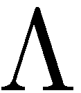
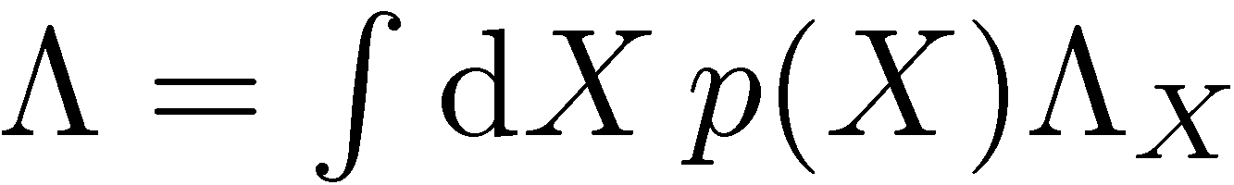
Classical simulation of a quantum channel
Convex set of quantum channels
Notes:
For qubit dephasing exact result, for interfereomter unfortunately not possible. Other methods also quite simple but not that geometric

Slide 12
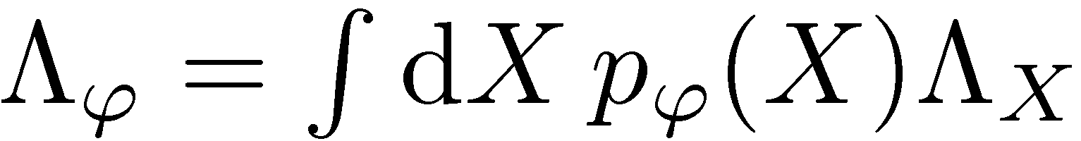



Classical simulation of a quantum channel
Convex set of quantum channels
Parameter dependence moved to mixing probabilities
Before:
After:
By Markov property….
K. Matsumoto, arXiv:1006.0300 (2010)
Notes:
For qubit dephasing exact result, for interfereomter unfortunately not possible. Other methods also quite simple but not that geometric

Slide 13



Classical simulation of N channels used in parallel
Notes:
For qubit dephasing exact result, for interfereomter unfortunately not possible. Other methods also quite simple but not that geometric

Slide 14






Classical simulation of N channels used in parallel
=
Notes:
For qubit dephasing exact result, for interfereomter unfortunately not possible. Other methods also quite simple but not that geometric

Slide 15
Classical simulation of N channels used in parallel
=
Notes:
For qubit dephasing exact result, for interfereomter unfortunately not possible. Other methods also quite simple but not that geometric

Slide 16



Precision bounds thanks to classical simulation
For unitary channels
Heisenberg scaling possible
Generlic decoherence model will manifest shot noise scaling
To get the tighest bound we need to find the classical simulation with lowest F_{cl}

Slide 17









The „Worst” classical simulation
Quantum Fisher Information at a given depends only on
It is enough to analize,,local classical simulation’’:
The „worst” classical simulation:
Works for non-extremal channels
RDD, M. Guta, J. Kolodynski, arXiv:1201.3940 (2012)
Notes:
For qubit dephasing exact result, for interfereomter unfortunately not possible. Other methods also quite simple but not that geometric

Slide 18







Dephasing: derivation of the bound in 60 seconds!
dephasing
Choi-Jamiołkowski isomorphism (positivie operators correspond to physical maps)
RDD, M. Guta, J. Kolodynski, arXiv:1201.3940 (2012)

Slide 19




Dephasing: derivation of the bound in 60 seconds!
dephasing
Choi-Jamiołkowski isomorphism (positivie operators correspond to physical maps)
RDD, M. Guta, J. Kolodynski, arXiv:1201.3940 (2012)

Slide 20
Summary
Heisenberg scaling is lost for a generic decoherence channel even for infinitesimal noise
Simple bounds on precision can be derived using the classical simulation idea
Channels for which classical simulation does not work
( extremal channels) have less Kraus operators, other methods easier to apply
RDD, J. Kolodynski, M. Guta, arXiv:1201.3940 (2012)

