Slide 1
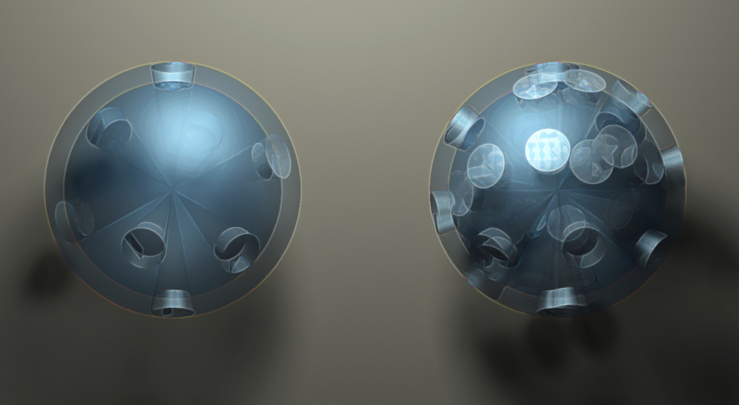
Cold Atom Physics
Marek Trippenbach
Jan Chwedeńczuk
Paweł Ziń
Tomasz Wasak
Piotr Szańkowski
Warszawa, 19.04.2012

Slide 2
Plan
Introduction
Trends in ultra-cold physics
Recent „technological” breakthroughs
Condensates collisions
Towards entanglement

Slide 3
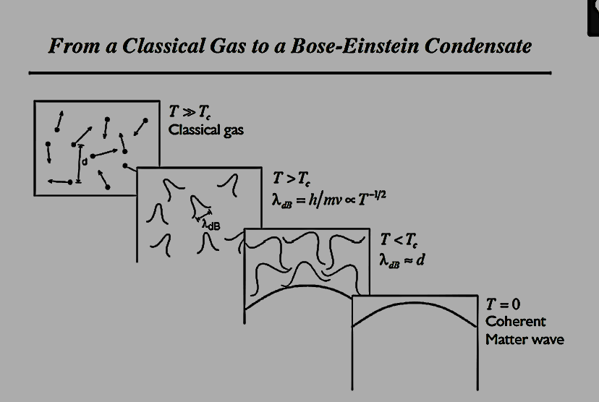
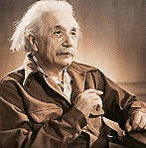
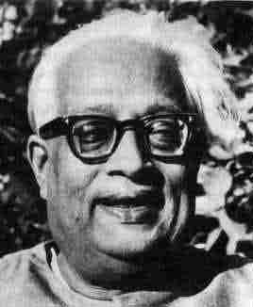
Cold atoms

Slide 4
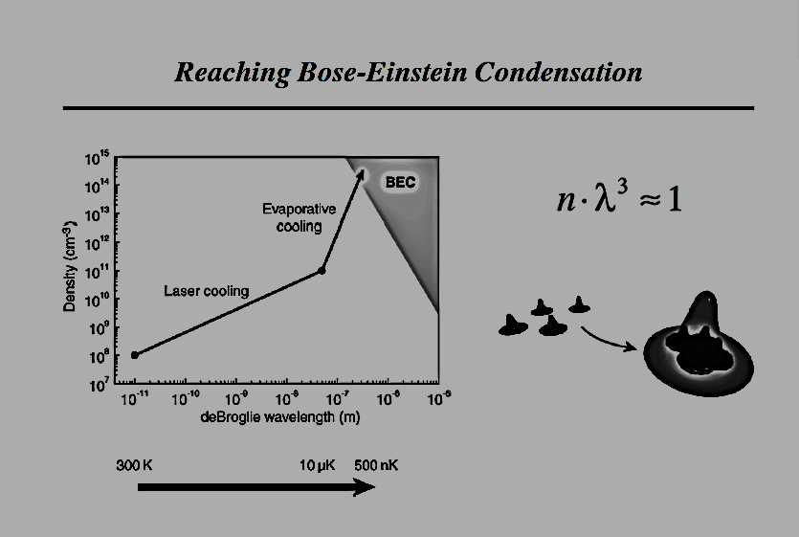

Bose-Einstein statistics
T>T_{c}
T<T_{c}
N₀/N
1-(T/T_{c})³
1
T_{c}
T
$$n_{0}^{1/3}Λ_{dB}\left(T_{c}\right)=1.377…$$
Condition for BEC:

Slide 5
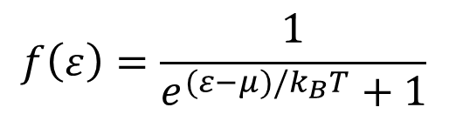
Fermions in a Harmonic Trap
Fermi-Dirac distribution
$$f\left(ε\right)=\frac{1}{e^{(ε−μ)/k_{B}T}+1}$$
T>T_{F}
T<T_{F}
f(ε)
T=0
T~T_{F}
1
Fermi temperature
T>T_{F}
ε_{F}
ε

Slide 6
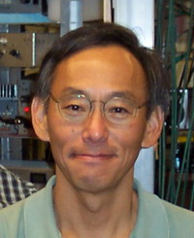
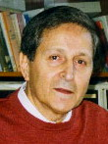
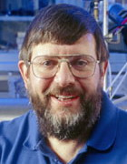
How we cool atoms. Doppler cooling
Cooling
and trapping of atoms
with light –
Nobel 1997
S.Chu
,
C.Cohe
n
-
Tannoudji
,
W.Phillips
→ two counter propagating beams
( ω_{L} < ω₀)
ω₀
ω_{L}

Slide 7
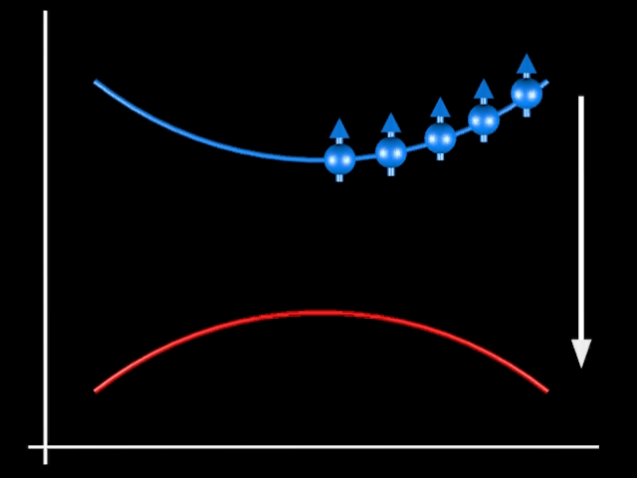
Evaporative cooling

Slide 8
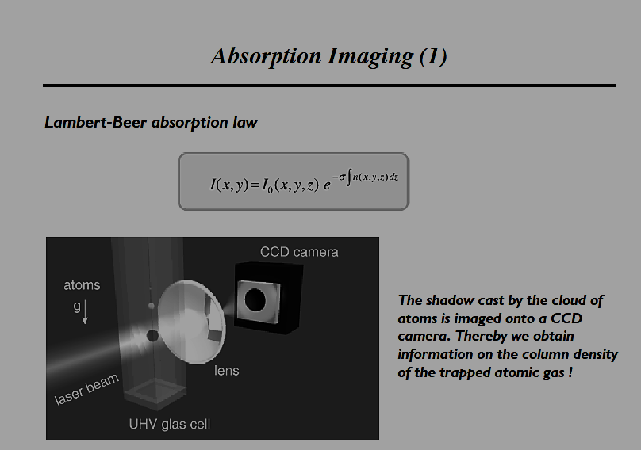
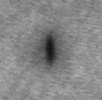
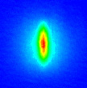
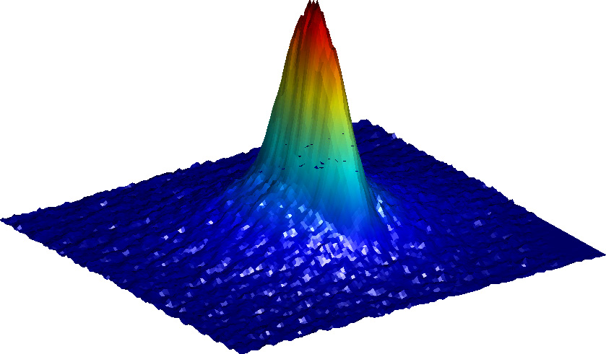
Detection

Slide 9
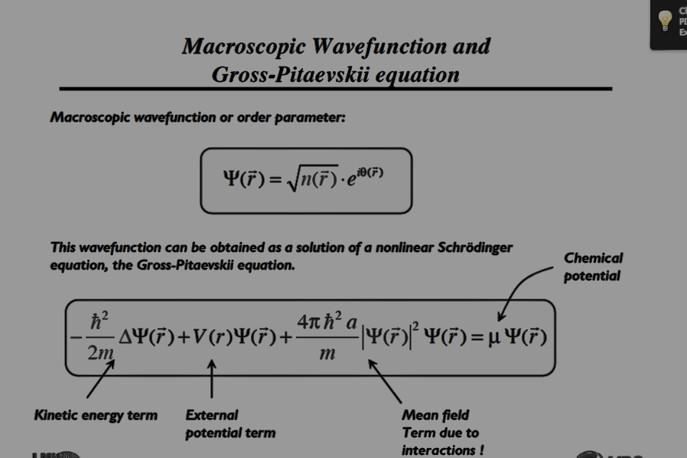

Slide 10
Trends in Ultracold Research
Cold Molecule
Many-body Physics
Cold Plasma &
Rydberg Gas
From Physics
to Chemistry
From atomic to
condensed-matter
physics
Cold Atom
From ground to
highly-excited states
From fundamental
to application
From isotropic to
anisotropic interaction
Quantum Correlations
Dipolar Gas

Slide 11
Recent "technological" break through
Atom chips
Feshbach resonance
Optical lattice
New detection schemes

Slide 12
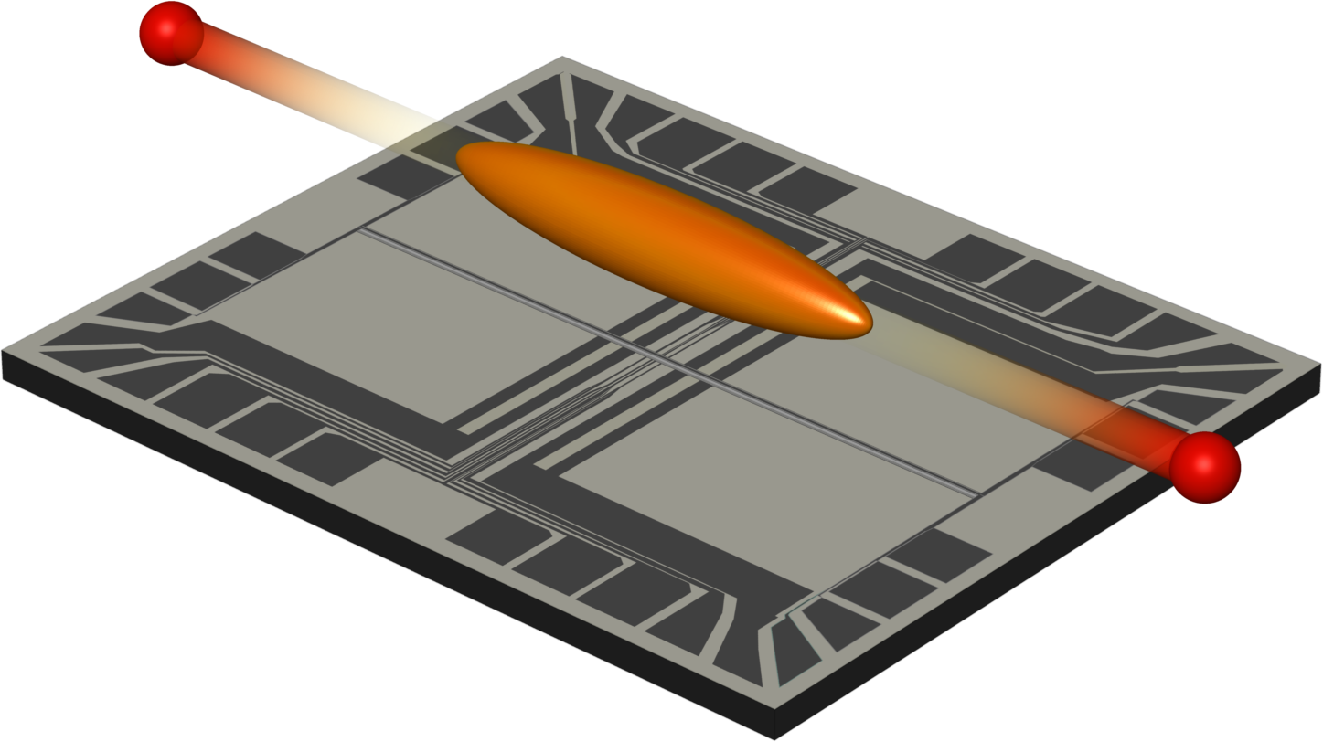
Atom chip

Slide 13
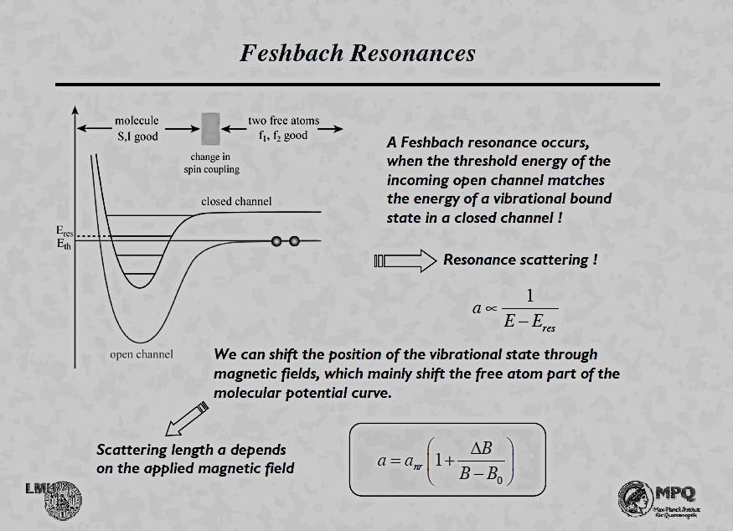
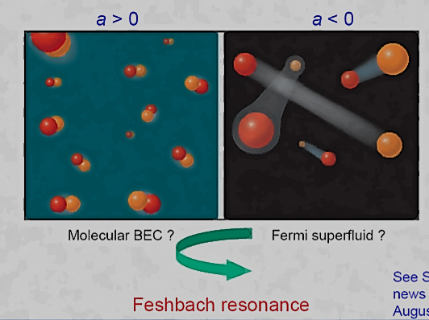
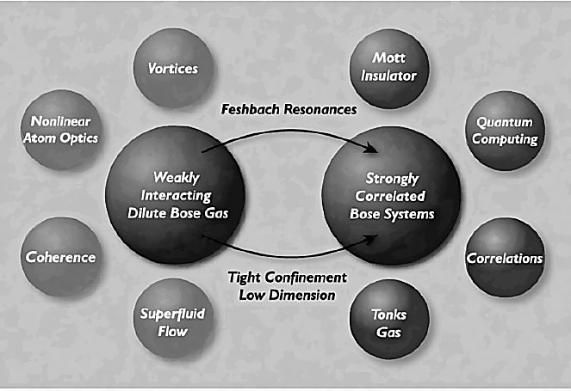

Slide 14
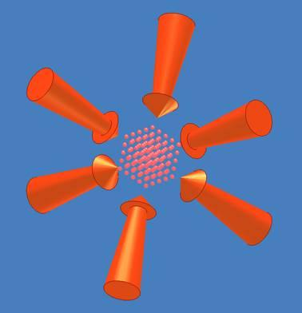
Optical Lattices
1D:
I,ω
I,ω
2D:
3D:

Slide 15
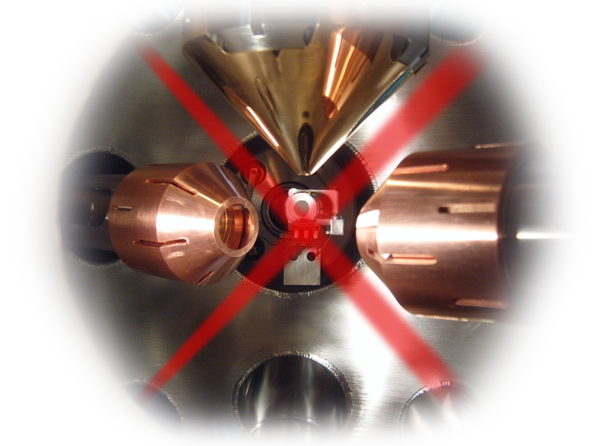

BEC in a one-dimensional optical lattice
Creating a structured gas target
λ = 850 nm, P = 30 mW, w₀ = 120 µm
k_{eff}
k_{eff}
k
k

Slide 16
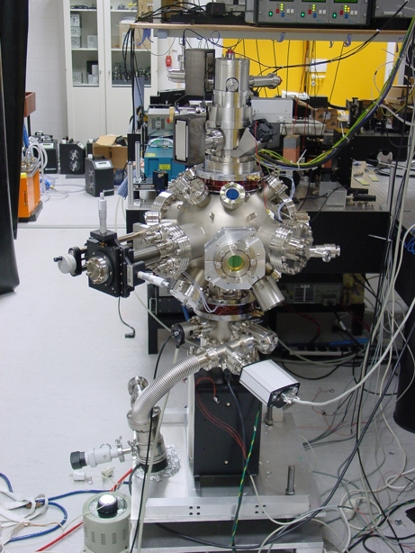
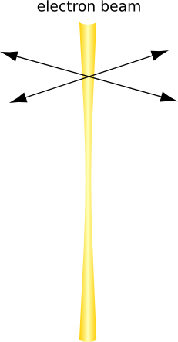
Electron-atom interaction
electron column
ion detector
vacuum chamber
ion getter pump
Elastic scattering
Inelastic scattering
Impact ionization
~ 5%
~ 55%
~40%

Slide 17
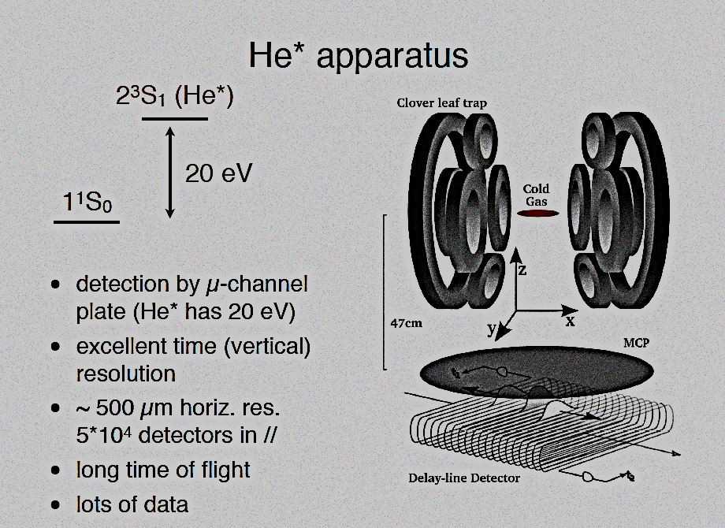
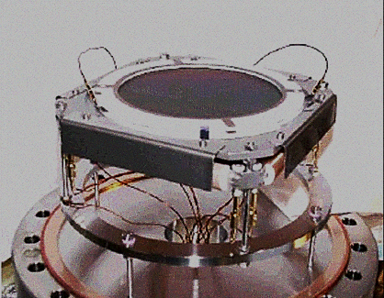
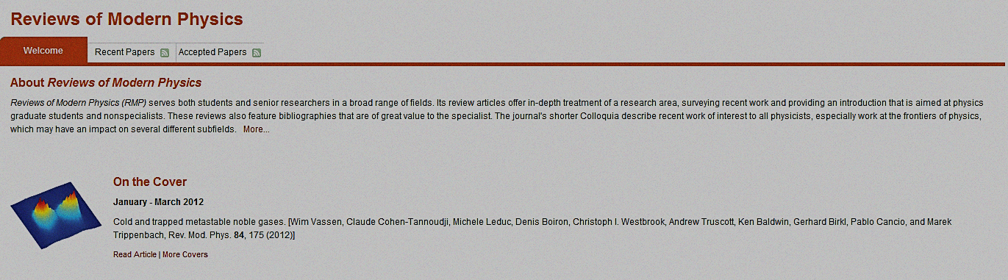
Metastable atoms

Slide 18
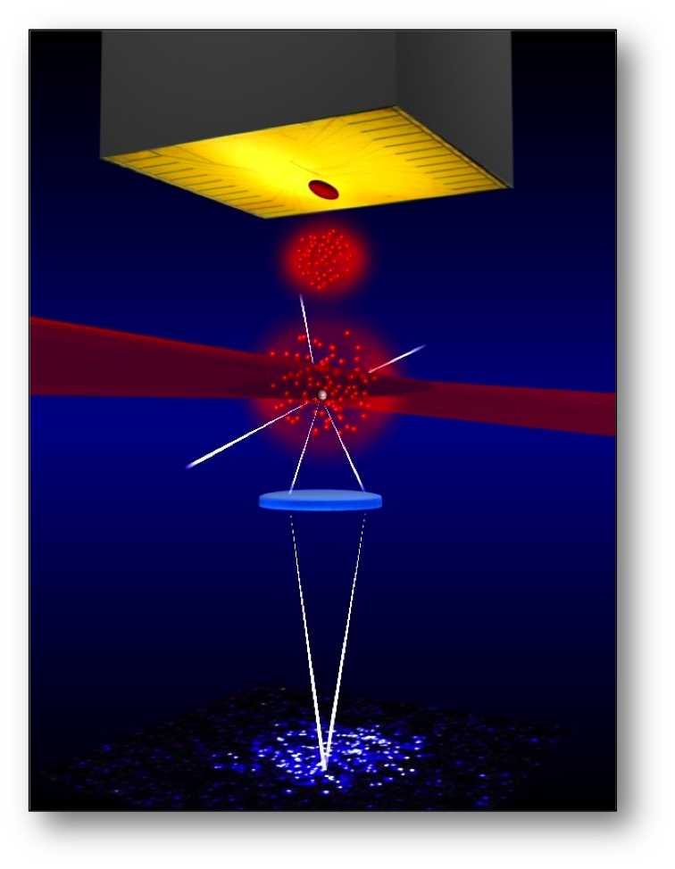
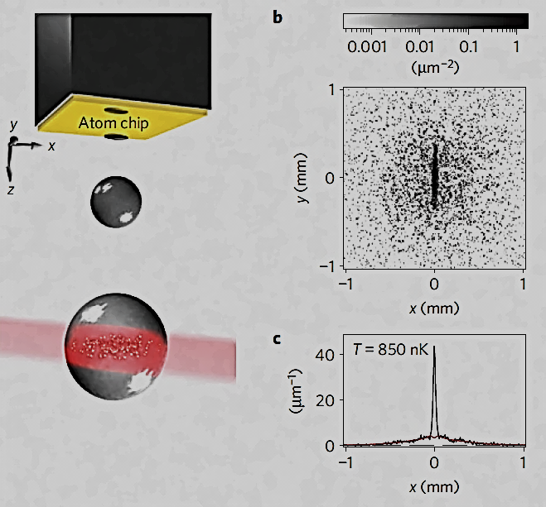
Fluorescence imaging

Slide 19
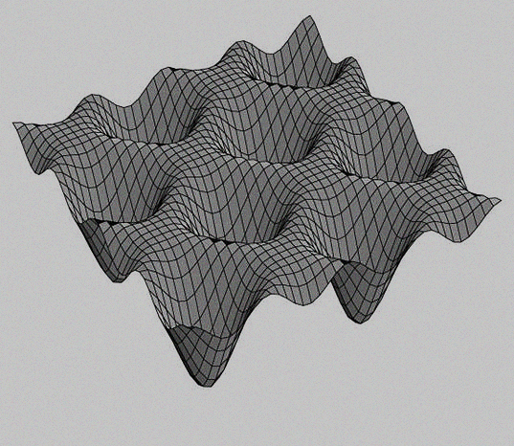
Correlation Physics
Solid-state Physics
Cold Atoms
in lattice
Quantum
Correlations
&
Entanglement
Quantum Computing
Quantum simulations

Slide 20
“Half collision”

Slide 21
Nonlinear optics of atoms
Light propagation
Condensate evolution

Slide 22
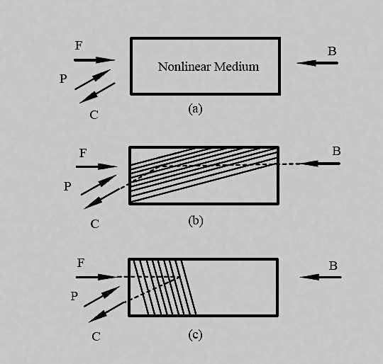
4 wave mixing

Slide 23
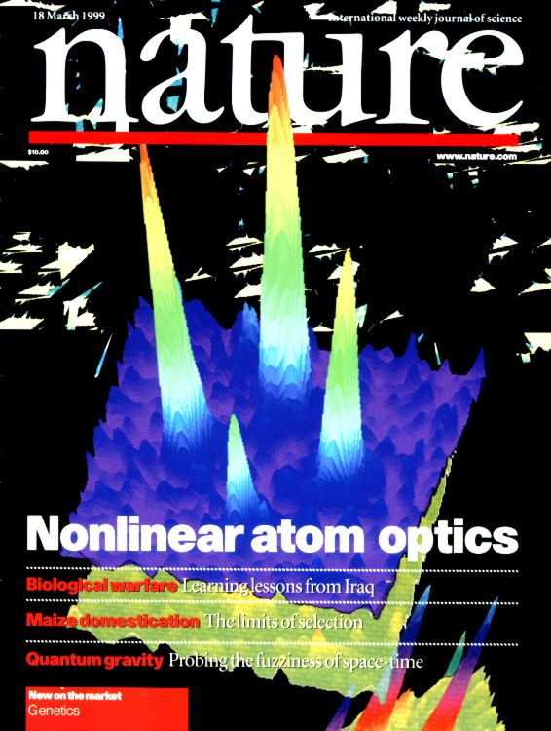
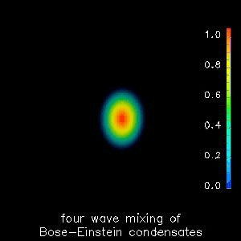
Atomic 4 wave mixing

Slide 24

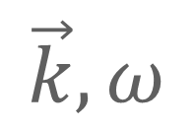
“Half collision”
$$−\vec{k}, ω$$
$$\vec{k}, ω$$

Slide 25
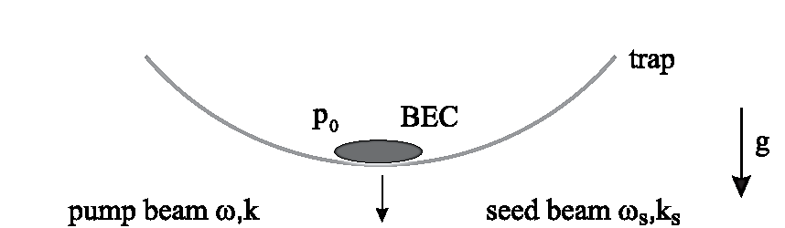
Bragg scattering

Slide 26

Scattered atoms

Slide 27
Elastic collisions

Slide 28
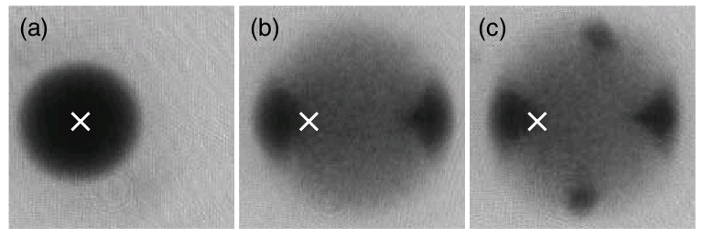
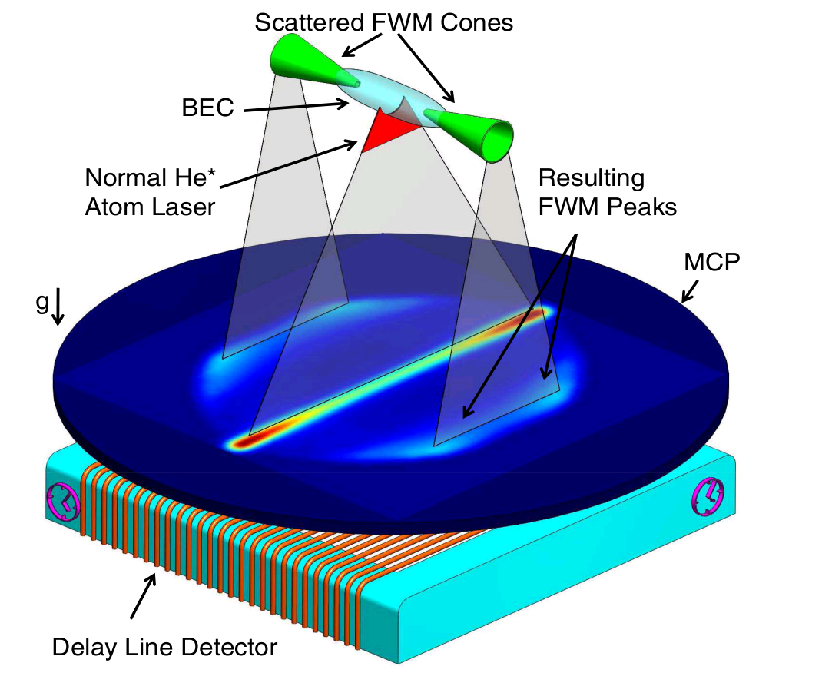
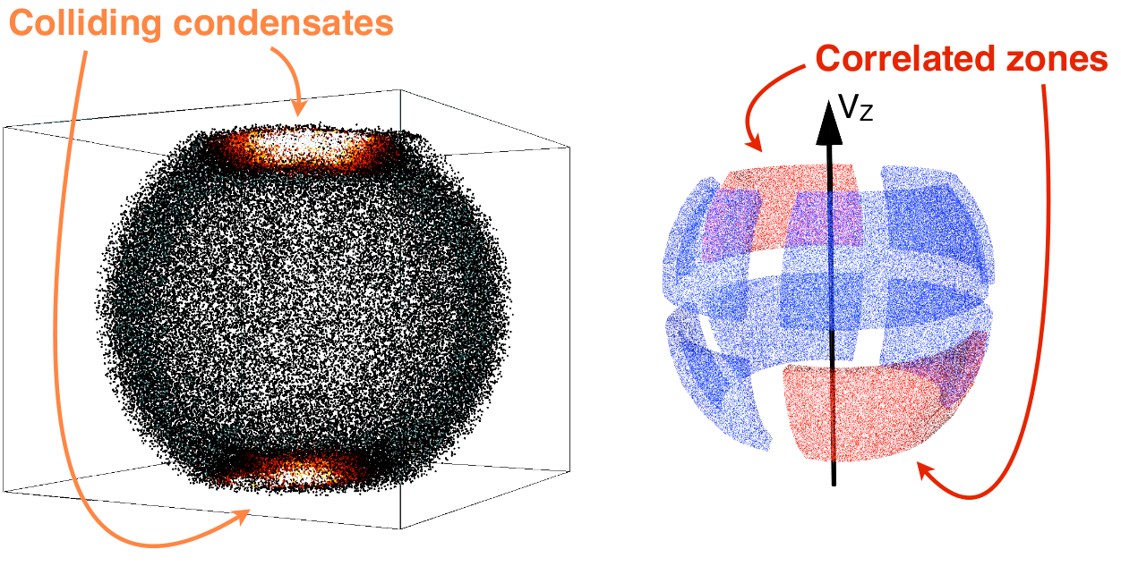
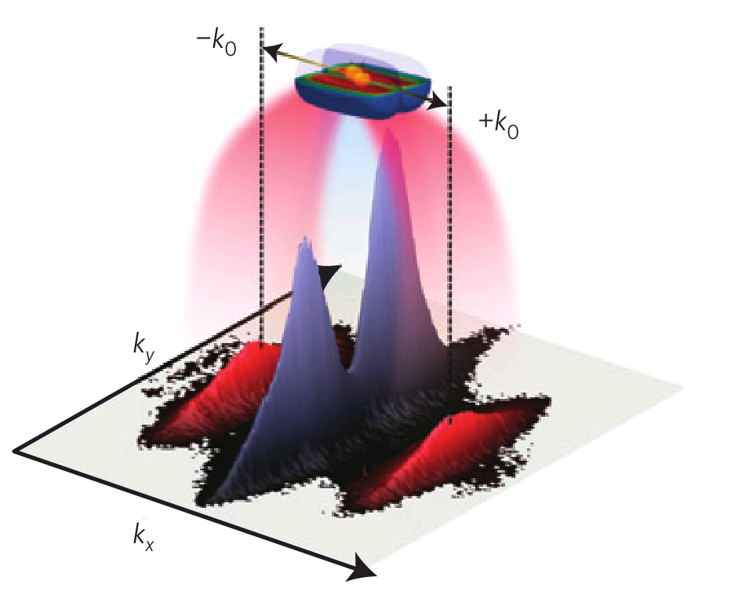
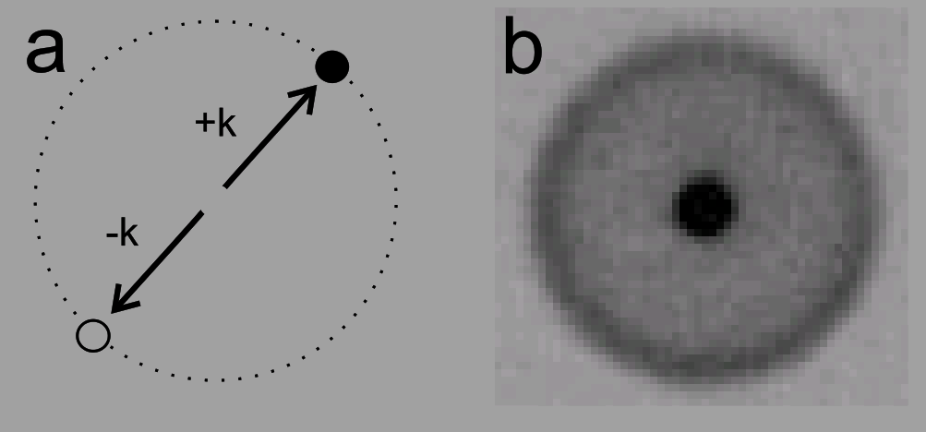
Detecting correlated atoms
Vogels, Xu, Ketterle, PRL 89, 020401 (2002)
RuGway, Hodgman, Dall, Johnsson, Truscott, PRL 107, 075301 (2011)
Jaskula, Bonneau,…, Aspect,
Boiron,Westbrook, PRL 105, 190402 (2010)
Pair emission from a 1D gas
Dissociation of molecular BEC
Bucker, Grond, Manz, Berrada, Betz, Koller, Hohenster, Schumm, Perrin, Schmiedmayer, Nature Phys. 7, 608 (2011)
Greiner et al.,n, PRL 94, 110401 (2005)

Slide 29
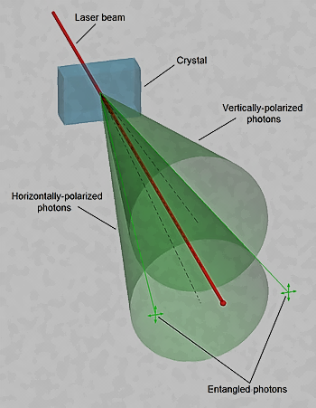
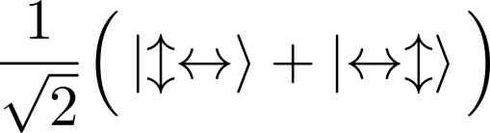
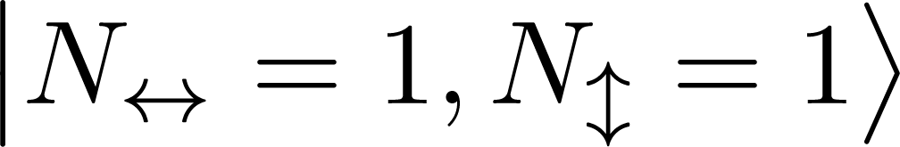

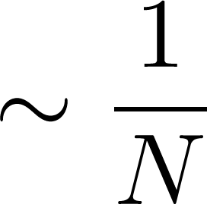

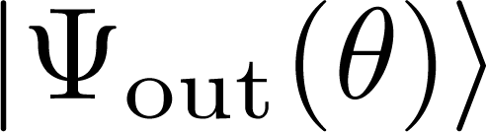

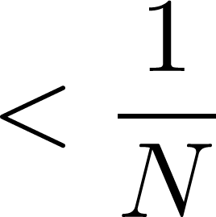

Number squeezing and entanglement
# of photons in horizontal and vertical modes
Photons are entangled
Photons are indistinguishable
Photons are distinguishable
No entanglement
Shot noise limit
Testing for quantum correlations
Classical states
$$θ$$
„Quantum” states

Slide 30
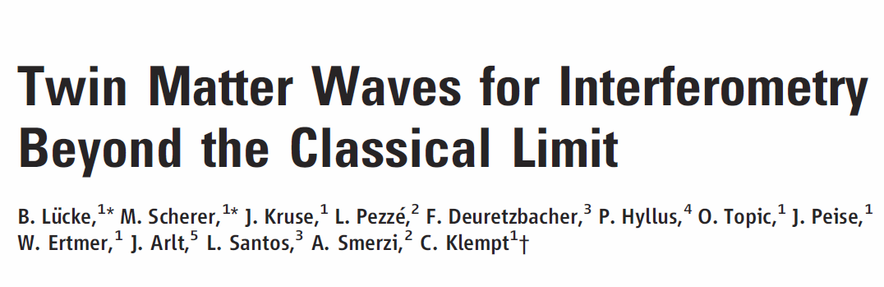
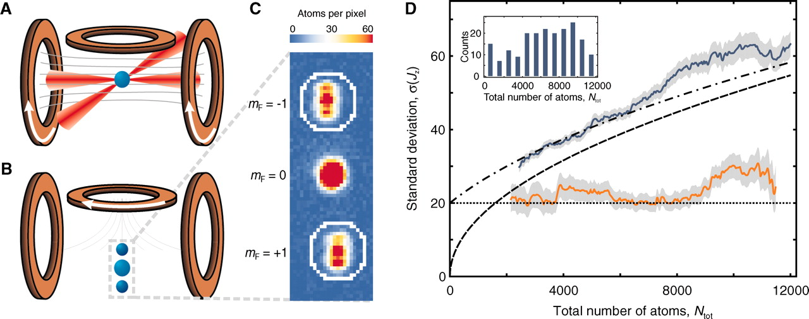
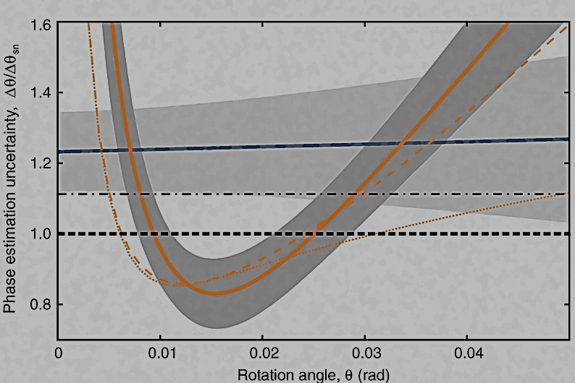
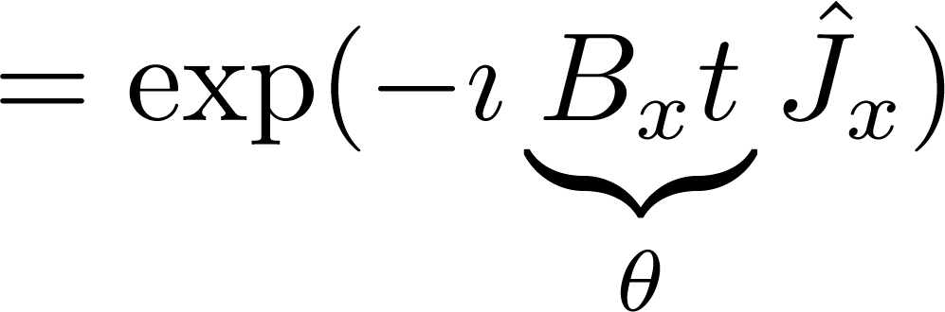

$$θ$$

Slide 31



Collisions of metastable atoms
Experiment:
Chris Westbrook
Denis Boiron
Jean-Christophe Jaskula
Valentina Krachmalnicoff
Marie Bonneau
Vanessa Leung
Guthrie Partridge
Alain Aspect
Theory:
Marek Trippenbach (Warsaw)
Jan Chwedeńczuk
Tomasz Wasak
Paweł Ziń
Piotr Deuar (Warsaw)
Karen Kheruntsyan
(Queensland)
t=0.3 s expansion
⁴He in metastable state
momentum distribution
Single atom detection efficiency η ~ 12%

Slide 32



Experimental Results

Slide 33



Pairing and density correlations
BB (back-to-back)
HBT (Hanbury Brown-Twiss)
Perrin, Chang, Krachmalnicoff, Schellekens, Boiron, Aspect, Westbrook, PRL 99, 150405 (2007)
HBT
BB
Jaskula, Bonneau, Partridge, Krachmalnicoff, PD, Kheruntsyan, Aspect, Boiron,Westbrook, PRL 105, 190402 (2010)

Slide 34







2nd generation experiment
BB
0.02k₀
0.17k₀
J-C. Jaskula, PhD Thesis (2010)
BB
HBT
Squeezing of relative particle number
BB
Jaskula et al, PRL 105, 190402 (2010)

Slide 35




Quantum description at T=0
g > 0 repulsive
contact interactions
Boson field
Initial state:
Bragg pulse at t=0
splits into components
with momentum
GP ground state in the t<=0 trap

Slide 36

The trouble with incoherent scattering
Can't use Gross-Pitaevskii equation
    because field is initially zero in the interesting region
Can't use truncated Wigner method
    because N=100 000, while we need 10 000 000 lattice sites to describe the physics
    (so would have 5 000 000 virtual noise particles (>> N) )

Slide 37





First try: positive-P representation
Complete representation
of the full quantum dynamics
Probability distribution of
bra & ket coherent fields
PD, Drummond, PRL, 98, 120402 (2007)
Observables:
Dynamics:
However:
intractable
after an
inconvenient
time
Gaussian real white noise

Slide 38

Bad news: instability
The positive-P treatment of the full field becomes intractable after a certain time
Reason: nonlinear amplification of the noise
too many trajectories needed
Typical example:
“Quantum
triangulation”
method
PD, PRL 103, 130402 (2009)
Collision ends
Positive-P dies

Slide 39



Second try: Positive-P Bogoliubov
PD, Chwedenczuk, Trippenbach, Zin, PRA 83, 063625 (2011)
(symmetry breaking version)
condensate
Bogoliubov fluctuation field – MUST BE “small”
Treat only using positive-P representation
(Mean field)
Now equations are linear - no blow-up of noise
Can use plane wave basis - no diagonalizing of 10⁶ x 10⁶ matrices
Signal-to-noise far superior to an earlier Wigner-Bogoliubov treatment
Sinatra, Castin, Lobo, J. Mod. Opt. 47, 2629 (2000)

Slide 40


Slide 41



Slide 42



Slide 43


Slide 44


Slide 45







Zbyszek Idziaszek Jan Chwedeńczuk
Michał Krych Paweł Ziń
Krzysztof Jachymski Tomasz Wasak
Piotr Szańkowski
ESF: Cigma
EUROQUAM
Special THANKS to my young collabolators

Slide 46
Special THANKS to my young collabolators
Zbyszek Idziaszek Jan Chwedeńczuk
Michał Krych Paweł Ziń
Krzysztof Jachymski Tomasz Wasak
Piotr Szańkowski

