Slide 1


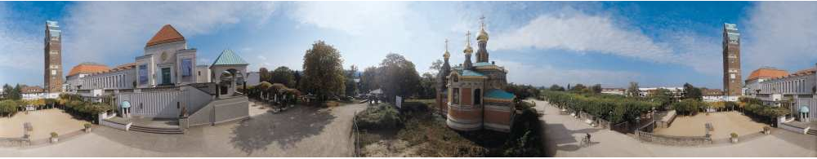
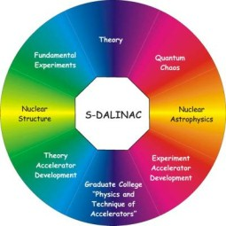






Three-body forces: From exotic nuclei to neutron stars
Achim Schwenk
Zdzisław Szymański Prize
University of Warsaw, Nov. 7, 2013

Slide 2

Notes:
2
I would like to very much thank the selection committee for this great honor!
It is a very exciting time for nuclear physics and in my opinion there are many young scientists who would have deserved this prize.
Upon preparing my talk I read the biography articles of Zdzisław Szymański. I was really struck by his personality and scientific accomplishments.
Reading about his youth, I learned that he was taken into forced labor for the German Third Reich. Given the cruelties that were committed then, it is very privileged to be living in Europe today and to be part of an international scientific family, where we pursue physics independent of our backgrounds. In this sense, I also feel very honored that you have opened this prize to the international community.
I was also struck by the description of Zdzisław Szymański starting his great adventure into nuclear physics. I did not know him, but knowing his offsprings in physics, I can sense the fascination and enthusiasm for physics that he bestowed upon them. He can be very proud of his achievements, because without the Polish nuclear theory community, nuclear physics would certainly not be where it is today.
Receiving the Zdzisław Szymański prize from you today is a great honor for me and I would like to thank you very much!

Slide 3
Three-body forces: From exotic nuclei to neutron stars
Achim Schwenk
Zdzisław Szymański Prize
University of Warsaw, Nov. 7, 2013

Slide 4
Outline
Understanding three-nucleon (3N) forces
3N forces and neutron-rich nuclei
3N forces and neutron matter/stars
Dark matter response of nuclei
Notes:
4

Slide 5
Why are there three-body forces?
tidal effects lead to 3-body forces
in earth-sun-moon system

Slide 6
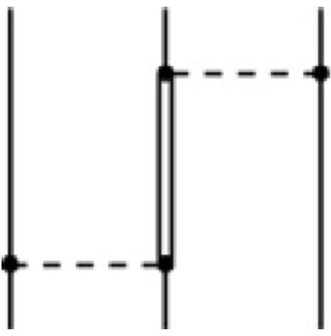
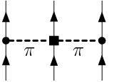
Why are there 3N forces?
Nucleons are finite-mass composite particles,
can be excited to resonances
dominant contribution from Δ(1232 MeV)
+ many shorter-range parts
chiral effective field theory (EFT)
Delta-less (Δ is treated as heavy): + shorter-range parts
EFT provides a systematic and powerful approach for 3N forces
tidal effects lead to 3-body forces
in earth-sun-moon system

Slide 7


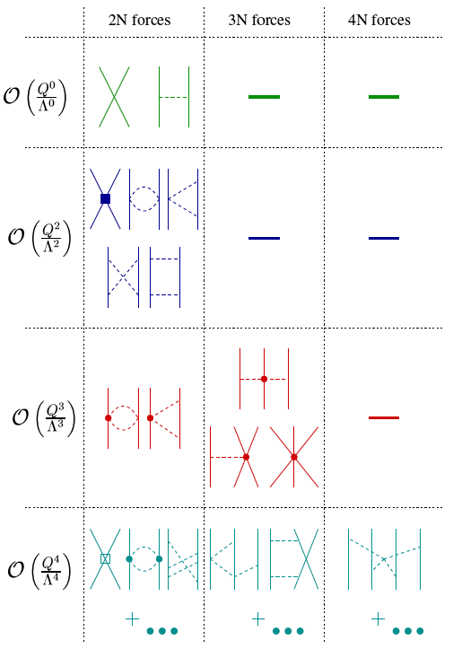
Chiral effective field theory for nuclear forces
Separation of scales: low momenta breakdown scale ~500 MeV
NN 3N 4N
limited resolution at low energies,
can expand in powers (Q/Λ_{b})^{n}
LO, n=0 - leading order,
NLO, n=2 - next-to-leading order,…
expansion parameter ~ 1/3
(compare to multipole expansion
for a charge distribution)
Weinberg, van Kolck, Kaplan, Savage, Wise, Bernard, Epelbaum, Kaiser, Machleidt, Meissner,…

Slide 8
Chiral effective field theory for nuclear forces
Separation of scales: low momenta breakdown scale ~500 MeV
NN 3N 4N
include long-range pion physics
few short-range couplings,
fit to experiment once
systematic: can work to desired
accuracy and obtain error estimates
consistent electroweak interactions
and matching to lattice QCD
Weinberg, van Kolck, Kaplan, Savage, Wise, Bernard, Epelbaum, Kaiser, Machleidt, Meissner,…

Slide 9
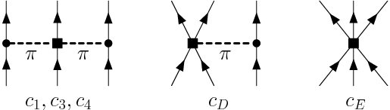


Chiral effective field theory and many-body forces
Separation of scales: low momenta breakdown scale ~500 MeV
NN 3N 4N
consistent NN-3N-4N interactions
3N,4N: 2 new couplings to N³LO
c_{i} from πN and NN Meissner et al. (2007)
single-Δ: c₁=0, c₃=-c₄/2=-3 GeV⁻¹
c_{D}, c_{E} fit to ³H, ⁴He properties only
Weinberg, van Kolck, Kaplan, Savage, Wise, Bernard, Epelbaum, Kaiser, Machleidt, Meissner,…

Slide 10
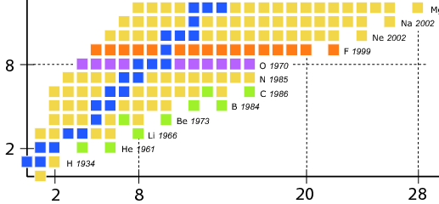
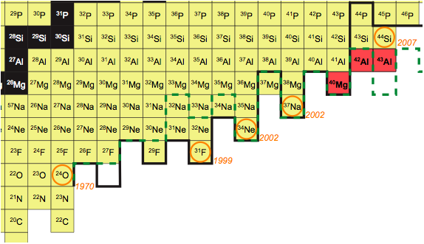
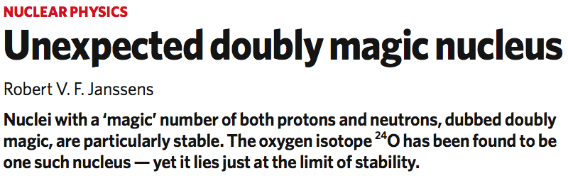
The oxygen anomaly
F
O
Notes:
10
10

Slide 11
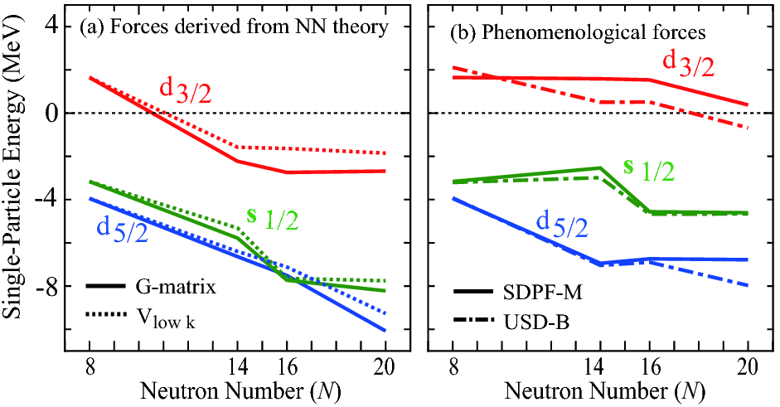
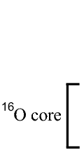
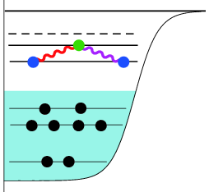
The oxygen anomaly - not reproduced without 3N forces
F
O
without 3N forces, NN interactions too attractive
¹⁶O
²⁴O
²⁸O
fit to experiment
many-body theory based
on two-nucleon forces:
drip-line incorrect at ²⁸O
Notes:
11
11

Slide 12
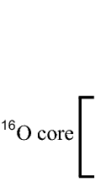
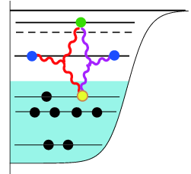
The shell model - impact of 3N forces
include ‘normal-ordered’ 2-body part of 3N forces (enhanced by core A)
leads to repulsive interactions between valence neutrons
contributions from residual three valence-nucleon
interactions suppressed by E_{ex}/E_{F} ~ N_{valence}/N_{core}
Friman, AS (2011)
Notes:
12
12

Slide 13

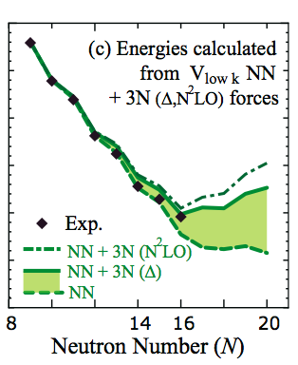

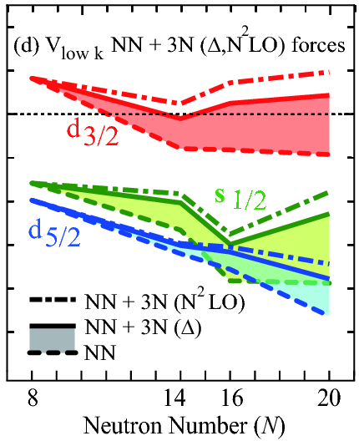
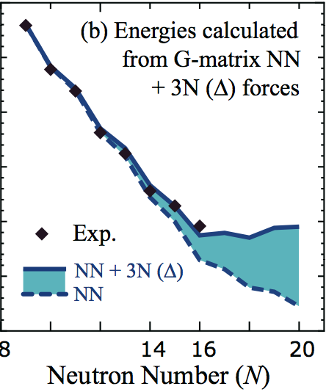
Oxygen isotopes - impact of 3N forces
include ‘normal-ordered’ 2-body part of 3N forces (enhanced by core A)
leads to repulsive interactions between valence neutrons
contributions from residual three valence-nucleon
interactions suppressed by E_{ex}/E_{F} ~ N_{valence}/N_{core}
Friman, AS (2011)
d_{3/2} orbital remains unbound from ¹⁶O to ²⁸O
microscopic explanation of the oxygen anomaly Otsuka et al. (2010)
Notes:
13
13

Slide 14
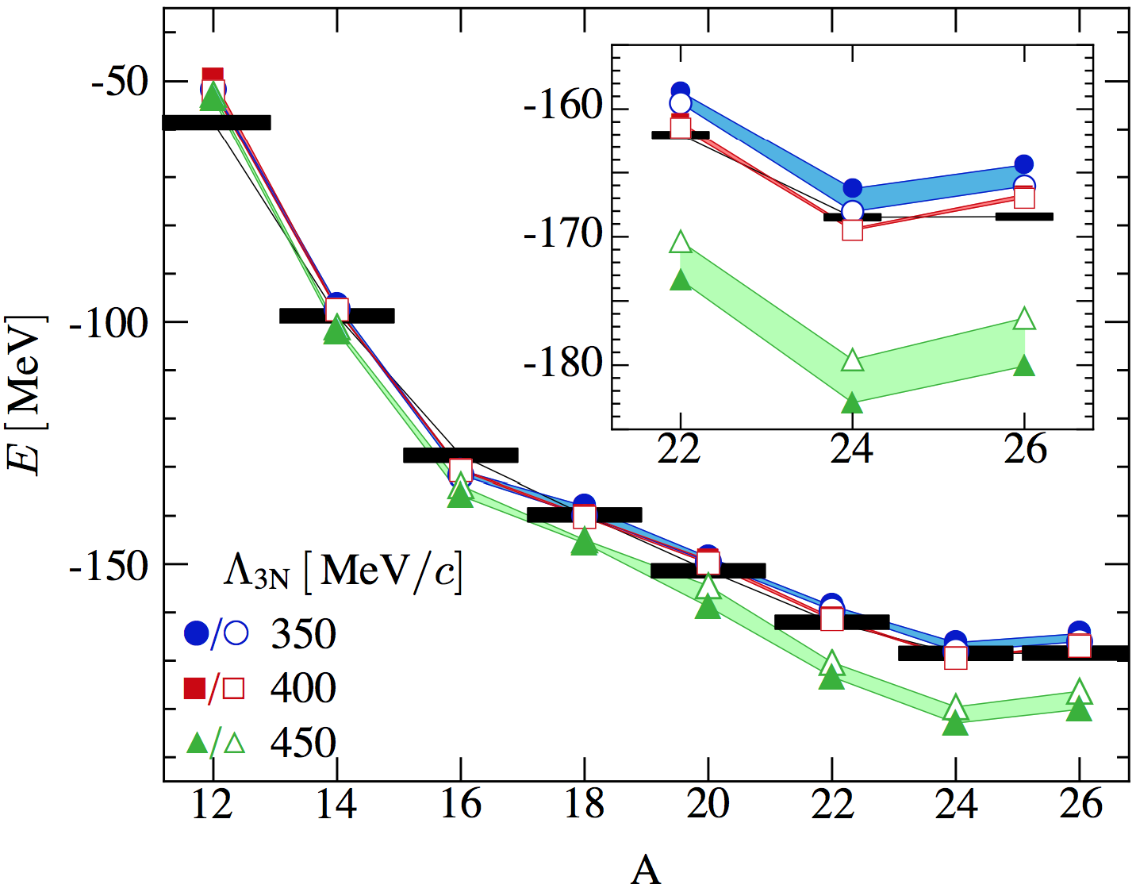
New ab-initio methods extend reach
impact of 3N forces confirmed in large-space calculations:
Coupled Cluster theory with phenomenological 3N forces Hagen et al. (2012)
In-Medium Similarity RG based on chiral NN+3N Hergert et al. (2013)
Green’s function methods based on chiral NN+3N Cipollone et al. (2013)
Notes:
14
14

Slide 15
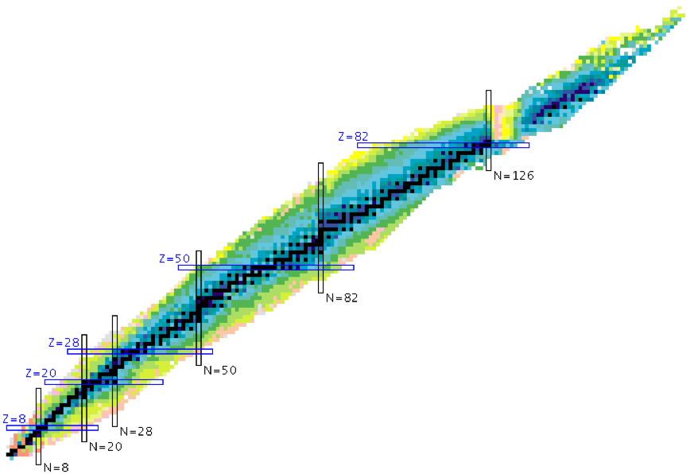
Three-body forces and magic numbers
no N=28 magic number from microscopic NN forces
Zuker, Poves,…
Notes:
15

Slide 16
Three-body forces and magic numbers
Hagen et al. (2012)
Holt et al. (2012, 2013)
no N=28 magic number from microscopic NN forces
Zuker, Poves,…
Notes:
16

Slide 17

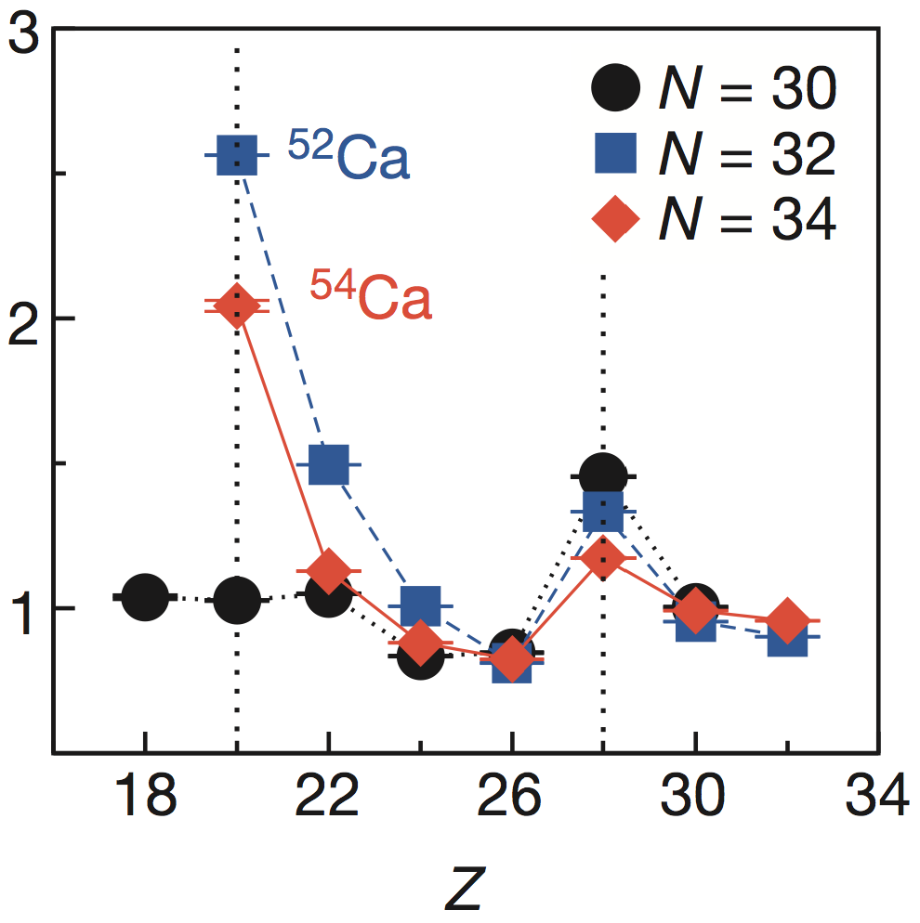
Three-body forces and magic numbers
Hagen et al. (2012)
Holt et al. (2012, 2013)
2⁺ energy measured at RIBF
suggests magic number N=34
Steppenbeck et al. (2013)
Notes:
17

Slide 18
Evolution to neutron-rich calcium isotopes
repulsive 3N contributions also key for calcium ground-state energies
Holt, Otsuka, AS, Suzuki (2012)
mass measured to ⁵²Ca
shown to exist to ⁵⁸Ca
gs energy flat with N,
continuum important
for dripline location!
fit to experiment
pf shell
Notes:
18
18

Slide 19
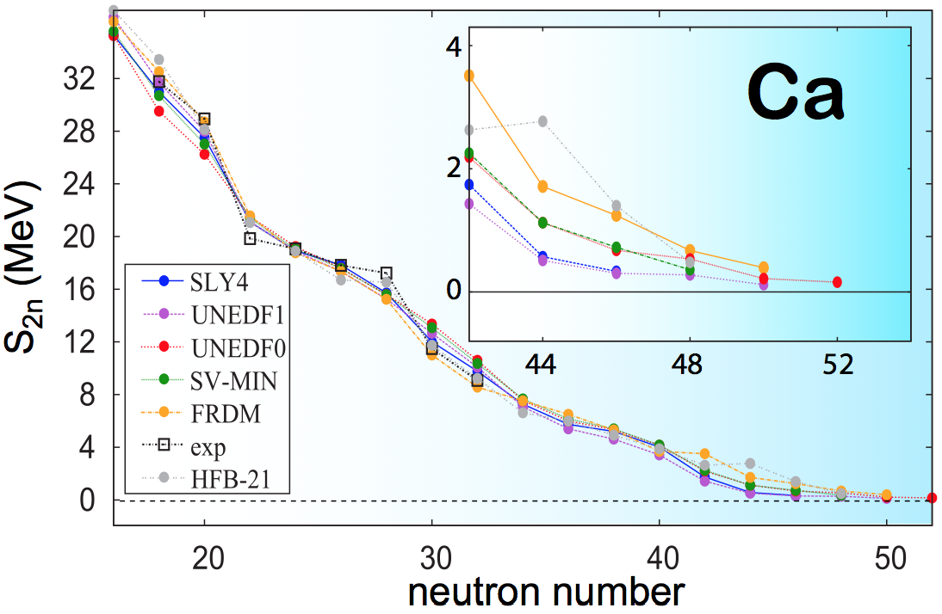
Evolution to neutron-rich calcium isotopes
repulsive 3N contributions also key for calcium ground-state energies
Holt, Otsuka, AS, Suzuki (2012)
mass measured to ⁵²Ca
shown to exist to ⁵⁸Ca
gs energy flat with N,
continuum important
for dripline location!
see Forssen et al. (2013)
fit to experiment
pf shell
Notes:
19
19

Slide 20
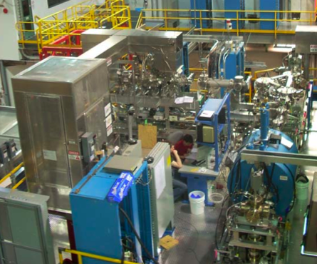
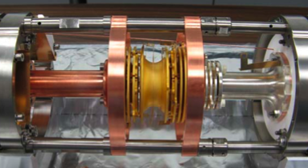
new ^{51,52}Ca TITAN measurements
⁵²Ca is 1.75 MeV more bound
compared to atomic mass evaluation
Gallant et al. (2012)
behavior of 2n separation energy S_{2n}
agrees with NN+3N predictions
Notes:
20
20

Slide 21
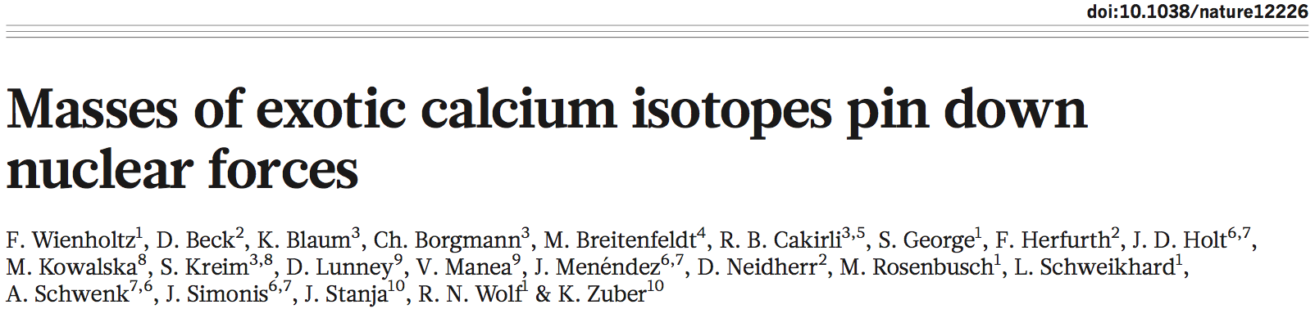
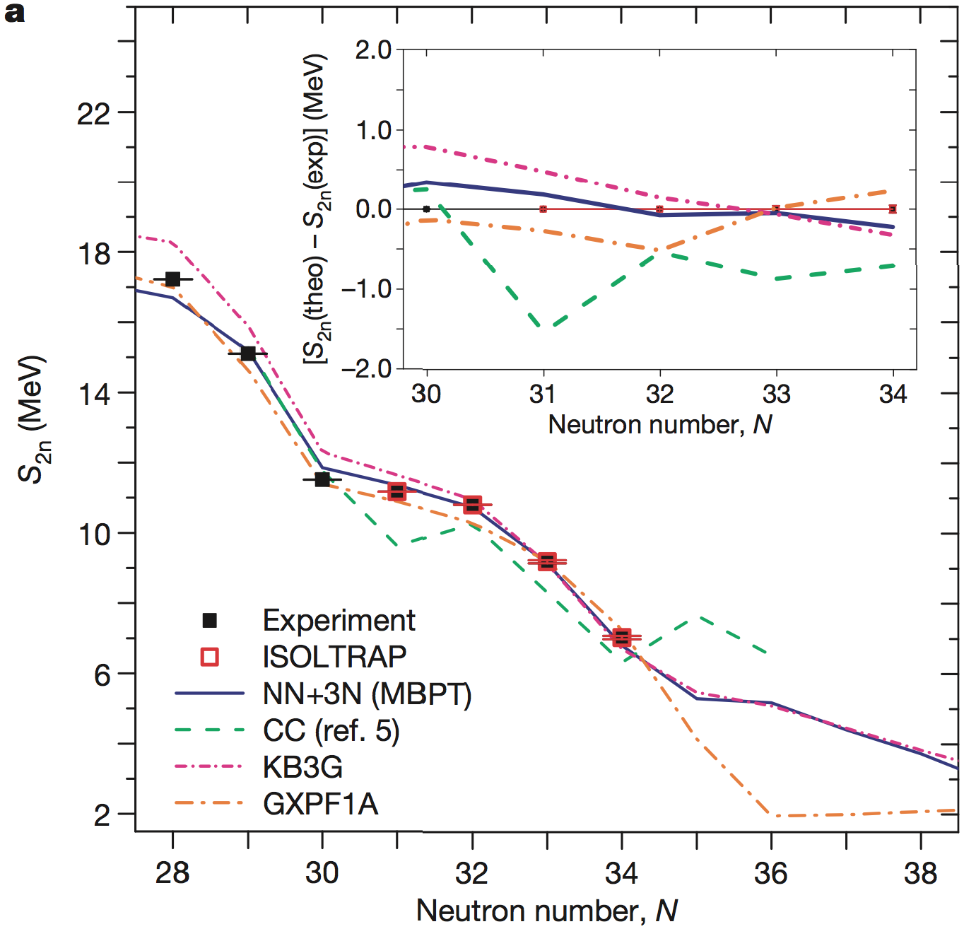
^{53,54}Ca masses measured
at ISOLTRAP using new
MR-TOF mass spectrometer
establish prominent N=32
shell closure in calcium
excellent agreement with
theoretical predictions
Notes:
21
21

Slide 22
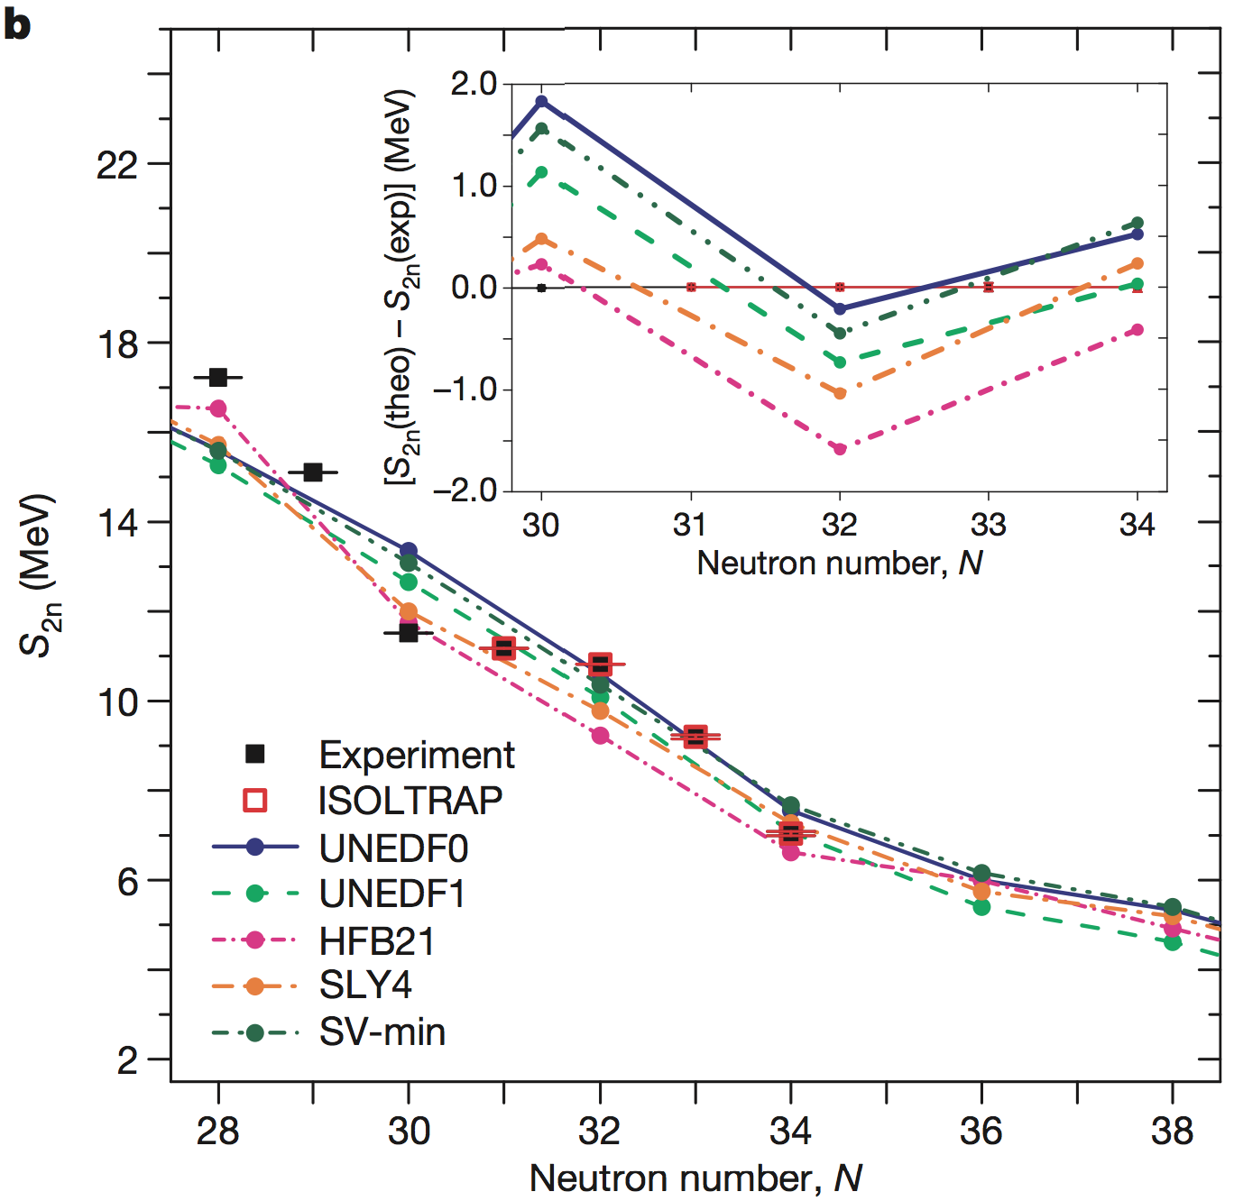
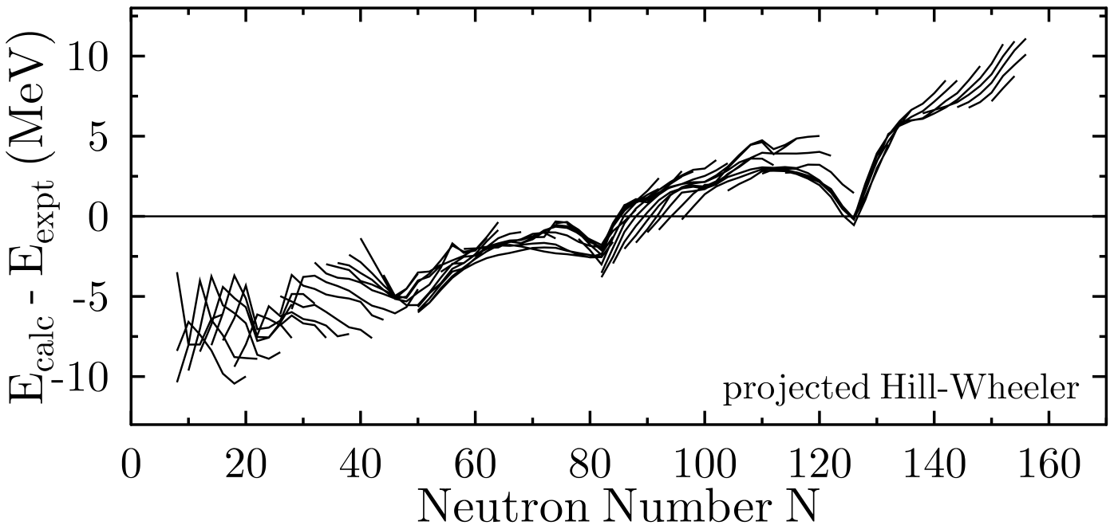
overall good agreement with
density functional predictions
challenge to reproduce
shell closures
cf. N=50, 82, 126 “arches”
Bender et al. (2005)
Notes:
22
22

Slide 23
3N forces and proton-rich nuclei Holt, Menendez, AS (2013)
first results with 3N forces for ground and excited states of N=8, 20
3N forces
prediction for ²⁰Mg agrees with new state observed at GSI Mukha, private comm.
Notes:
23
23

Slide 24
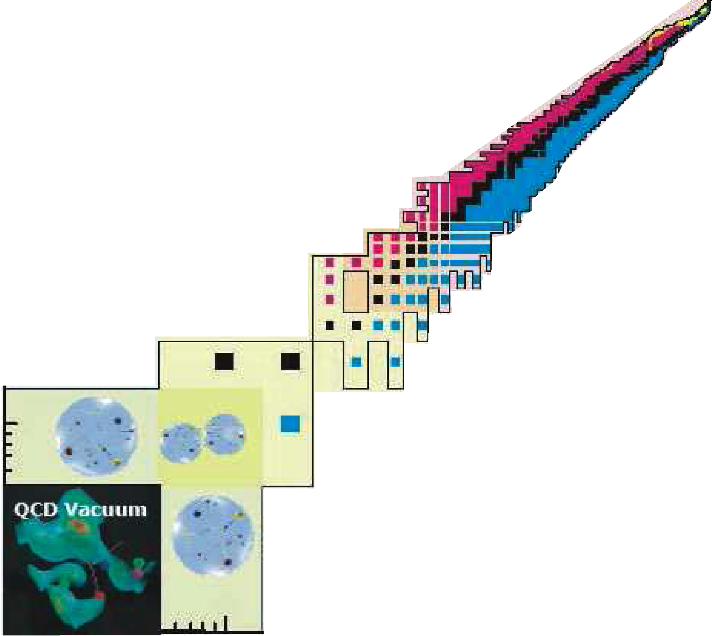
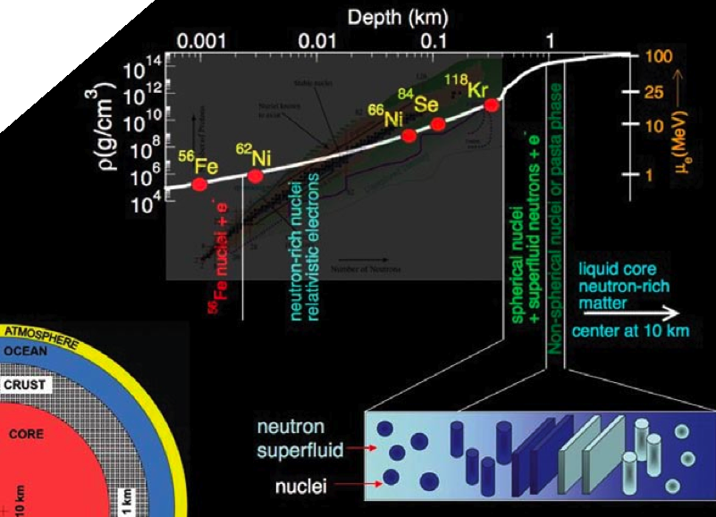
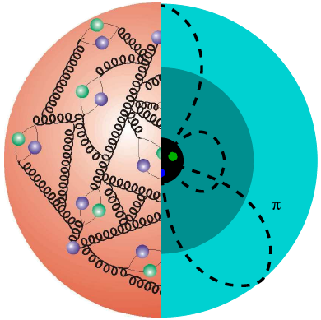
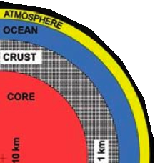
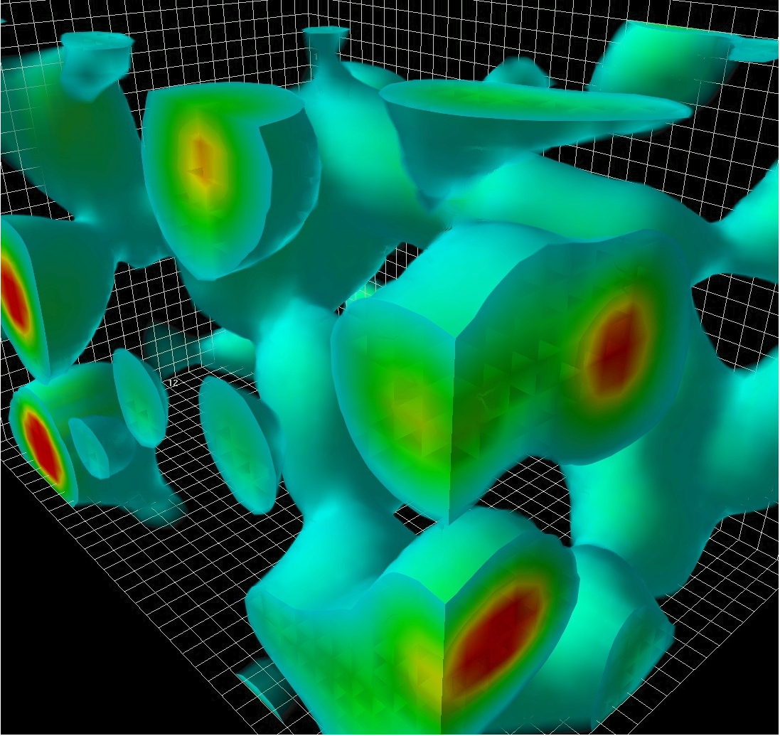
Neutron matter and neutron stars

Slide 25
Chiral effective field theory for nuclear forces
Separation of scales: low momenta breakdown scale ~500 MeV
NN 3N 4N
c_{D}, c_{E} don’t contribute for neutrons
because of Pauli principle and
pion coupling to spin, also for c₄
Hebeler, AS (2010)
all 3- and 4-neutron forces are
predicted to N³LO!
study 3N and 4N in neutron matter
Tews, Krüger, Hebeler, AS (2013)
Weinberg, van Kolck, Kaplan, Savage, Wise, Bernard, Epelbaum, Kaiser, Machleidt, Meissner,…

Slide 26
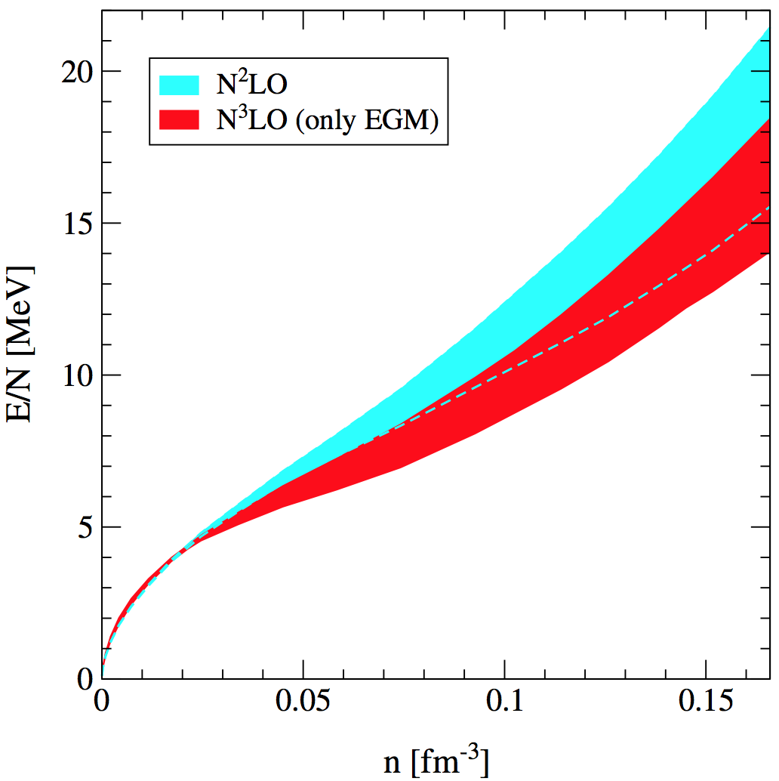
Complete N³LO calculation of neutron matter
first complete N³LO result Tews, Krüger, Hebeler, AS (2013)
includes uncertainties from NN, 3N (dominates), 4N

Slide 27
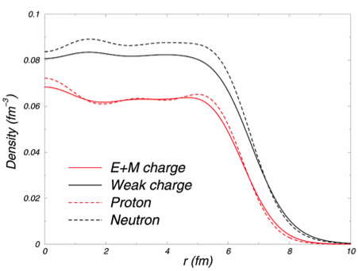
Neutron skin of ²⁰⁸Pb
probes neutron matter energy/pressure,
neutron matter band predicts
neutron skin of ²⁰⁸Pb: 0.17±0.03 fm (±18% !)
Hebeler et al. (2010)

Slide 28
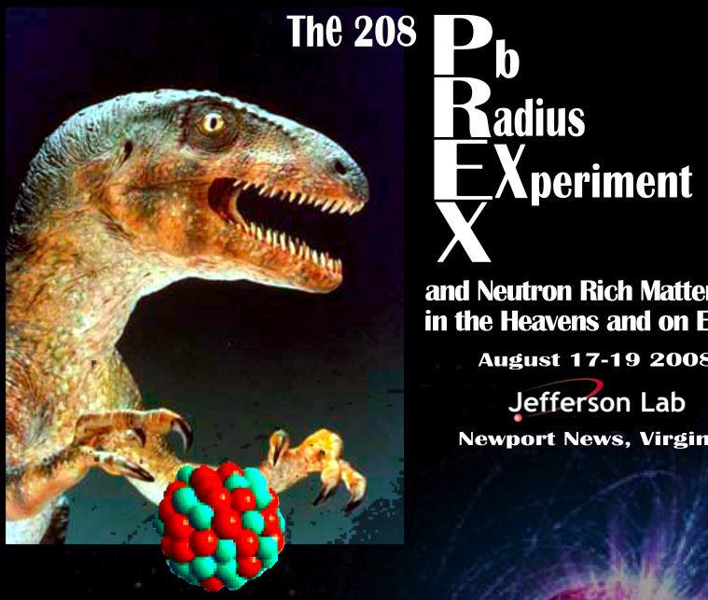
Neutron skin of ²⁰⁸Pb
probes neutron matter energy/pressure,
neutron matter band predicts
neutron skin of ²⁰⁸Pb: 0.17±0.03 fm (±18% !)
Hebeler et al. (2010)
in excellent agreement with extraction from complete E1 response
0.156+0.025-0.021 fm
PREX: neutron skin from parity-violating electron-scattering at JLAB
electron exchanges Z-boson, couples preferentially to neutrons
goal II: ±0.06 fm

Slide 29
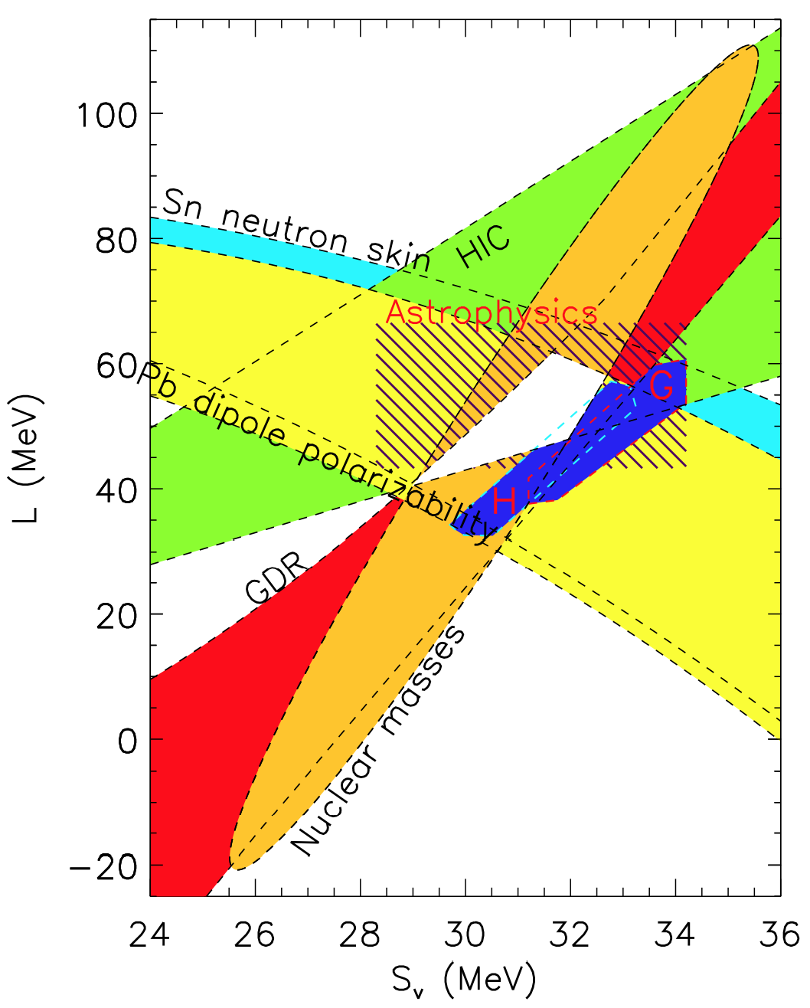
Symmetry energy and pressure of neutron matter
neutron matter band predicts
symmetry energy S_{v} and
its density derivative L
comparison to experimental
and observational constraints
Lattimer, Lim (2013)
neutron matter constraints
H: Hebeler et al. (2010, 2013)
G: Gandolfi et al. (2011)
microscopic calculations
provide tight constraints!

Slide 30
Ab-initio calculations of asymmetric matter Drischler, Soma, AS (2013)
E_{sym} comparison with extraction from isobaric analogue states (IAS)

Slide 31
Complete N³LO calculation of neutron matter
first complete N³LO result Tews, Krüger, Hebeler, AS (2013)
includes uncertainties from NN, 3N (dominates), 4N

Slide 32
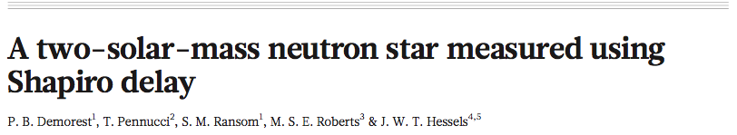
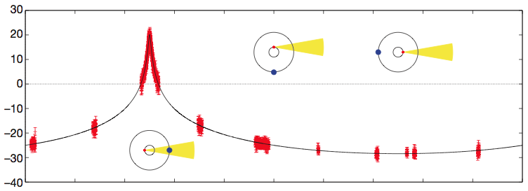
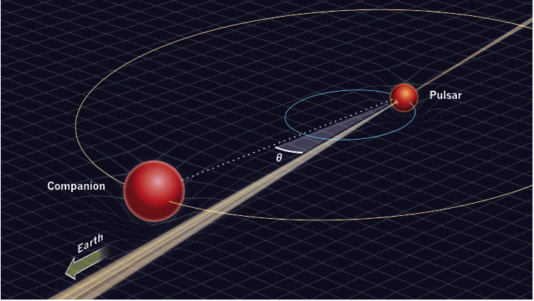
Discovery of the heaviest neutron star
Nature (2010)
direct measurement of
neutron star mass from
increase in signal travel time near companion
J1614-2230
most edge-on binary
pulsar known (89.17°)
+ massive white dwarf
companion (0.5 M_{sun})
heaviest neutron star
with 1.97±0.04 M_{sun}
Notes:
32

Slide 33
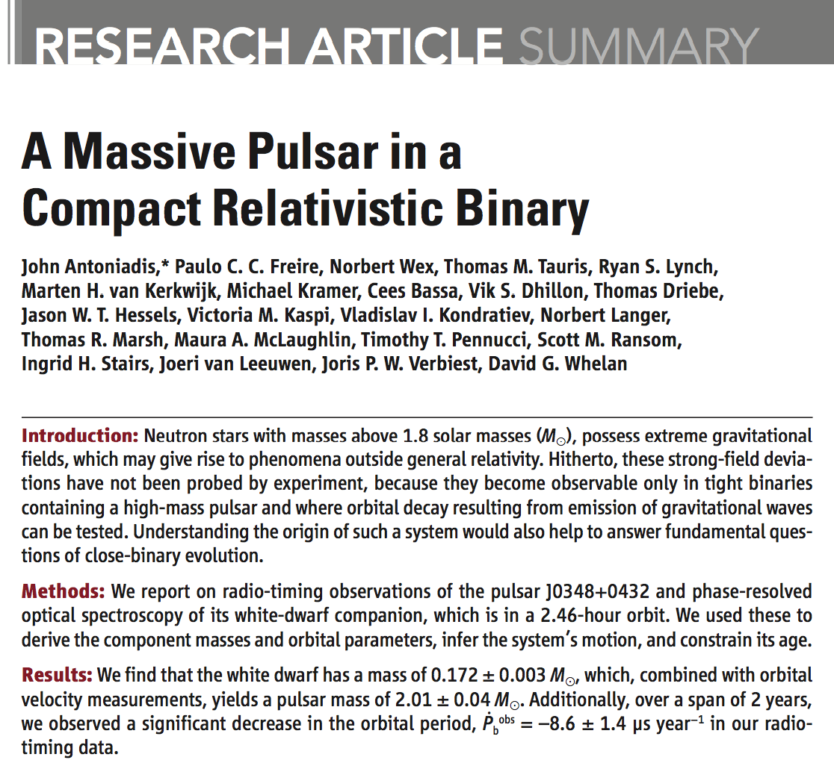
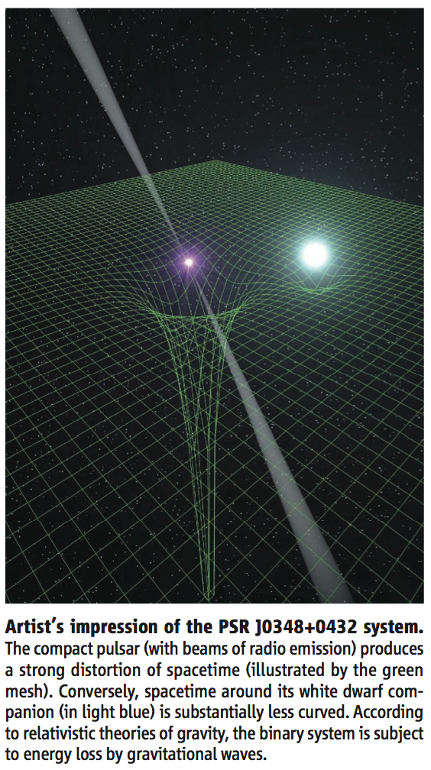
Discovery of the heaviest neutron star (2013)
Notes:
33

Slide 34
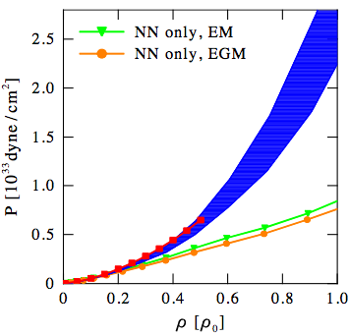
Impact on neutron stars Hebeler et al. (2010, 2013)
Equation of state/pressure for neutron-star matter (includes small Y_{e,p})
pressure below nuclear densities agrees with standard crust equation of state only after 3N forces are included

Slide 35
Impact on neutron stars Hebeler et al. (2010, 2013)
Equation of state/pressure for neutron-star matter (includes small Y_{e,p})
pressure below nuclear densities agrees with standard crust equation of state only after 3N forces are included
extend uncertainty band to higher densities using piecewise polytropes
allow for soft regions

Slide 36
Impact on neutron stars Hebeler et al. (2010, 2013)
constrain high-density EOS by causality, require to support 1.97 M_{sun} star
low-density pressure sets scale, chiral EFT interactions provide strong constraints, ruling out many model equations of state
causality
1.97 M_{sun}
Notes:
36

Slide 37
Impact on neutron stars Hebeler et al. (2010, 2013)
constrain high-density EOS by causality, require to support 1.97 M_{sun} star
low-density pressure sets scale, chiral EFT interactions provide strong constraints, ruling out many model equations of state
predicts neutron star radius: 9.7-13.9 km for M=1.4 M_{sun} (±18% !)
causality
1.97 M_{sun}
Notes:
37

Slide 38
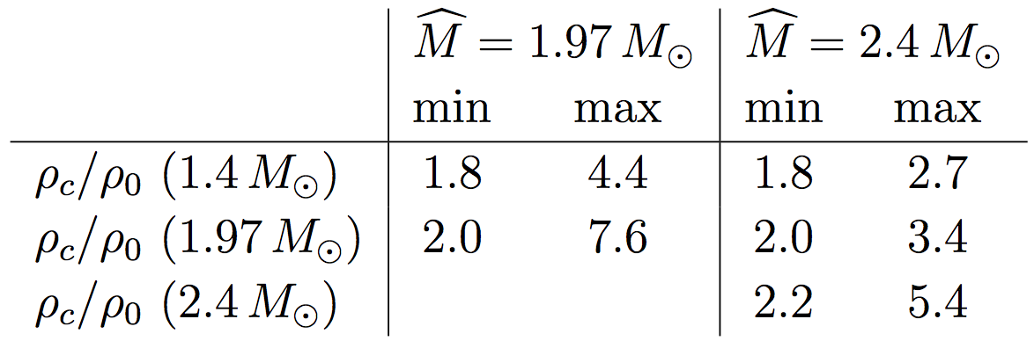
Impact on neutron stars Hebeler et al. (2010, 2013)
constrain high-density EOS by causality, require to support 1.97 M_{sun} star
low-density pressure sets scale, chiral EFT interactions provide strong constraints, ruling out many model equations of state
central densities for 1.4 M_{sun} star: 1.8-4.4 ρ₀
causality
1.97 M_{sun}
Notes:
38

Slide 39
Neutron star mergers and gravitational waves
Notes:
39

Slide 40
Neutron-star mergers and gravitational waves
explore sensitivity to neutron-rich matter
in neutron-star merger and gw signal
Bauswein, Janka (2012), Bauswein, Janka, Hebeler, AS (2012).
Notes:
40

Slide 41
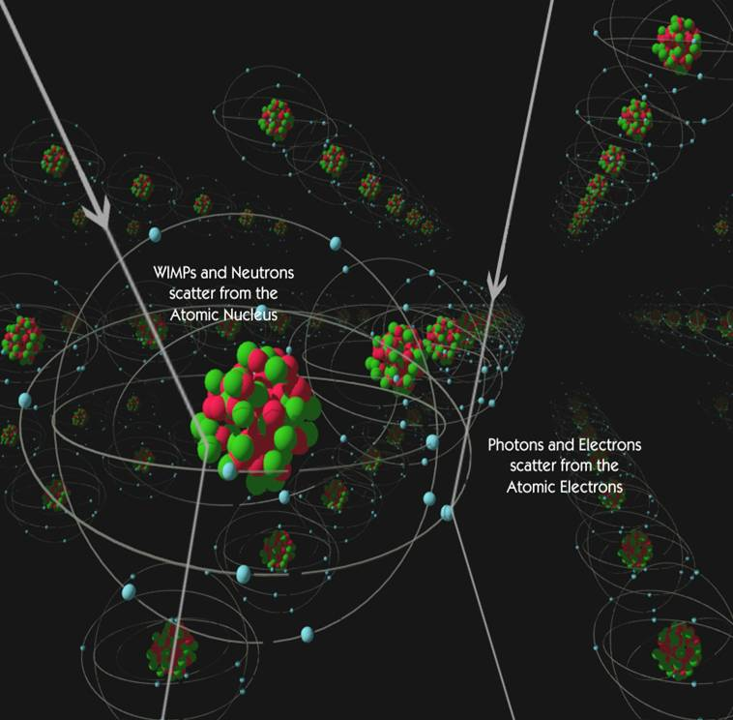
Direct dark matter detection
WIMP scattering off nuclei needs nuclear structure factors as input
particularly sensitive to nuclear physics for spin-dependent couplings
relevant momentum transfers ~ m_{π}
calculate systematically
with chiral effective field theory
Menendez, Gazit, AS (2012),
Klos, Menendez, Gazit, AS (2013)
from CDMS collaboration

Slide 42
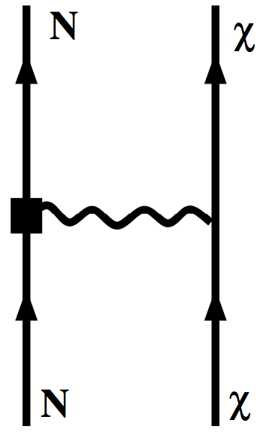
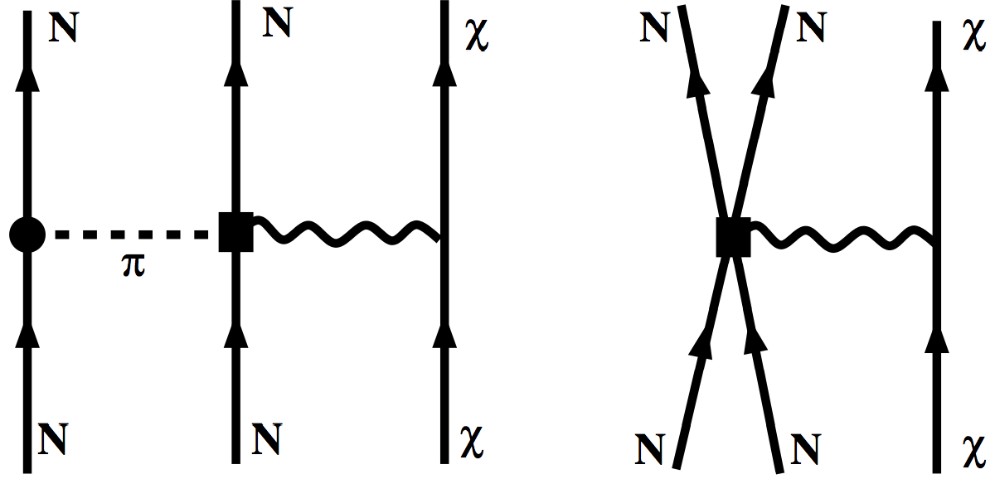
Chiral EFT for WIMP currents in nuclei
NN 3N 4N
one-body currents at Q⁰ and Q²
+ two-body currents at Q³
same couplings in forces and currents!

Slide 43
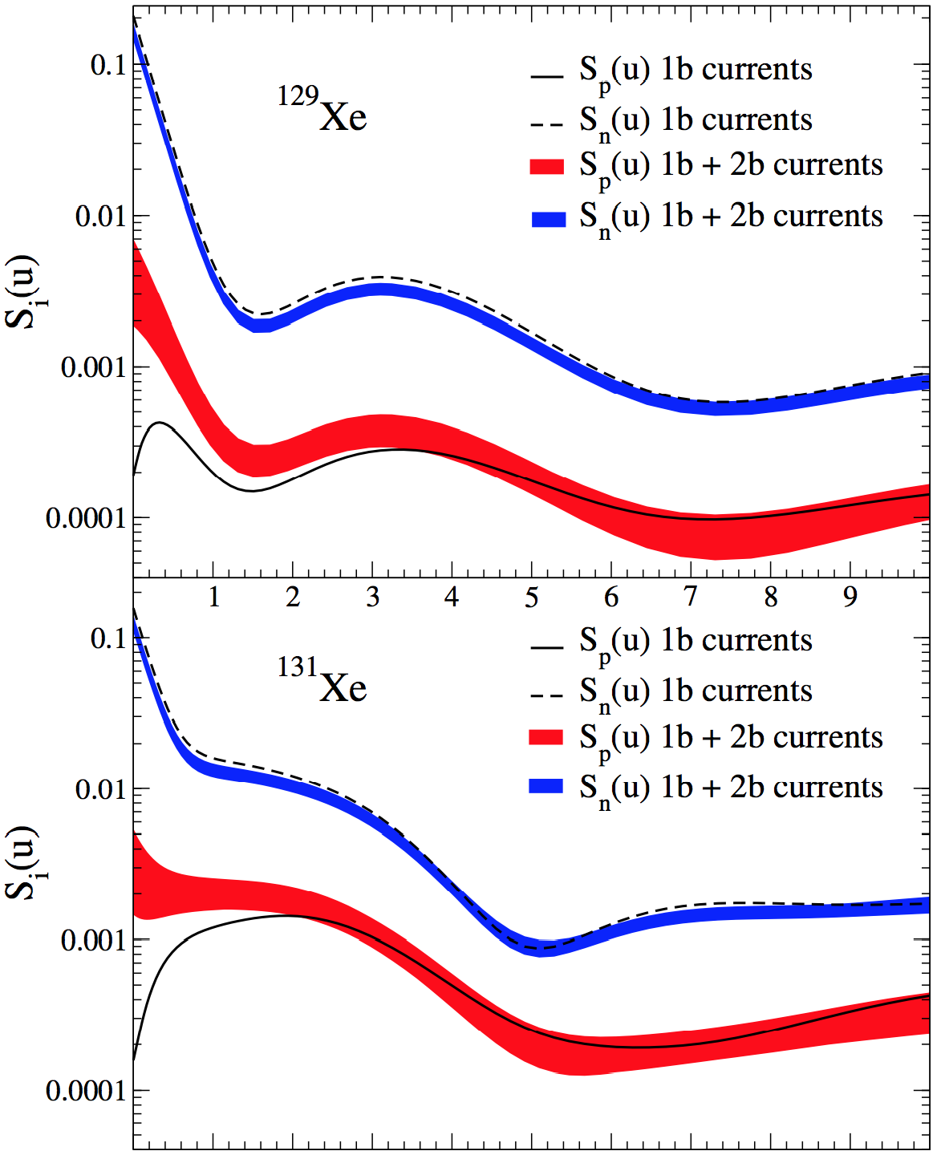
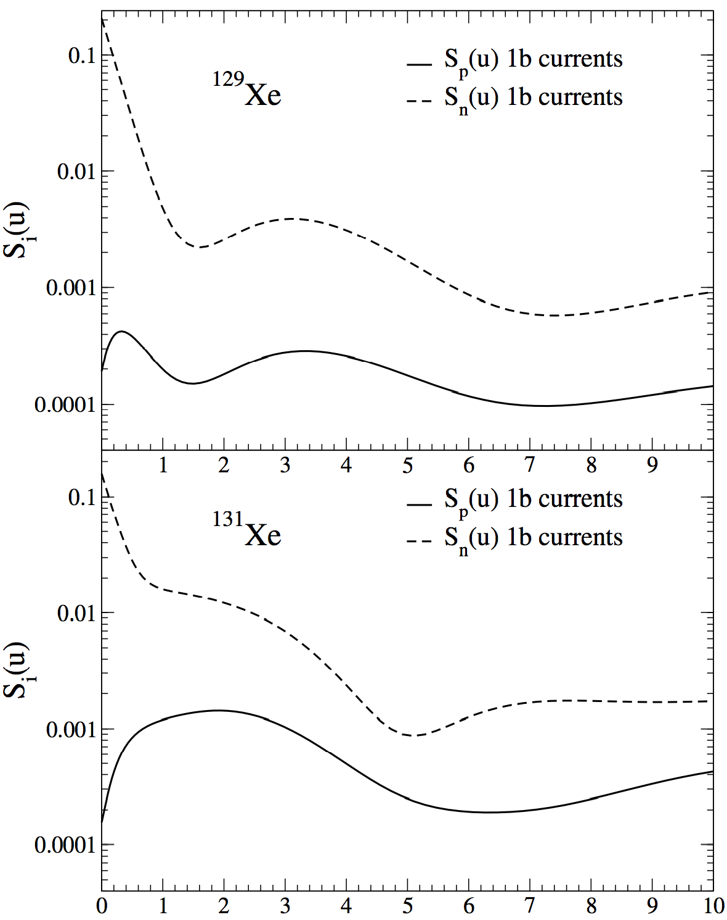
Xenon response with 1+2-body currents
two-body currents due to strong interactions among nucleons
WIMPs couple to neutrons and protons at the same time
enhances coupling to even species in all cases
first calculations with chiral EFT
currents and state-of-the-art
nuclear interactions
u=(pb)²/2

Slide 44
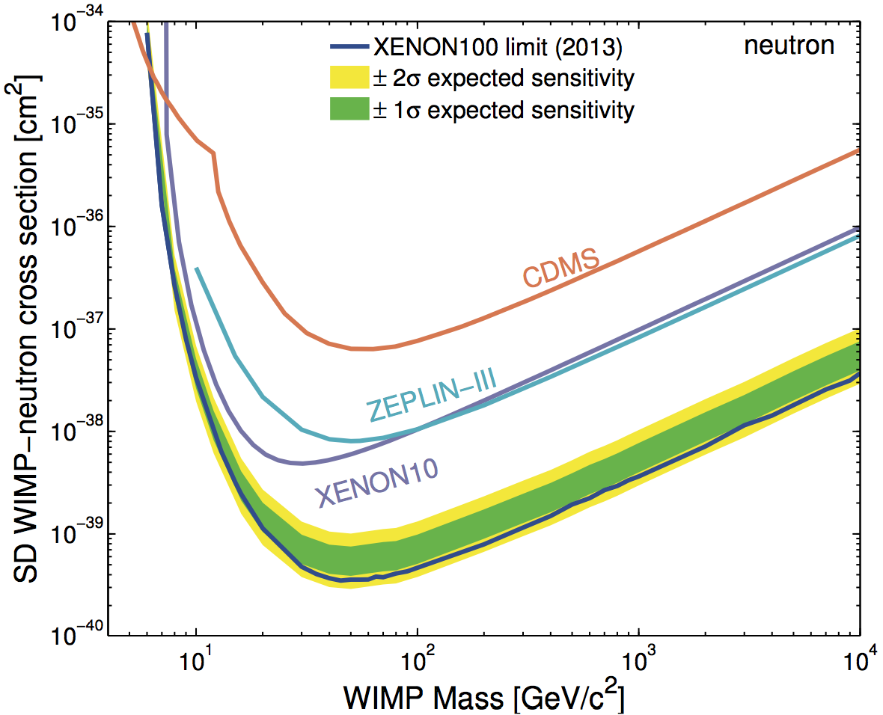
Limits on SD WIMP-neutron interactions
best limits from XENON100 Aprile et al. (2013)
used our calculations with uncertainty bands for WIMP currents in nuclei

Slide 45
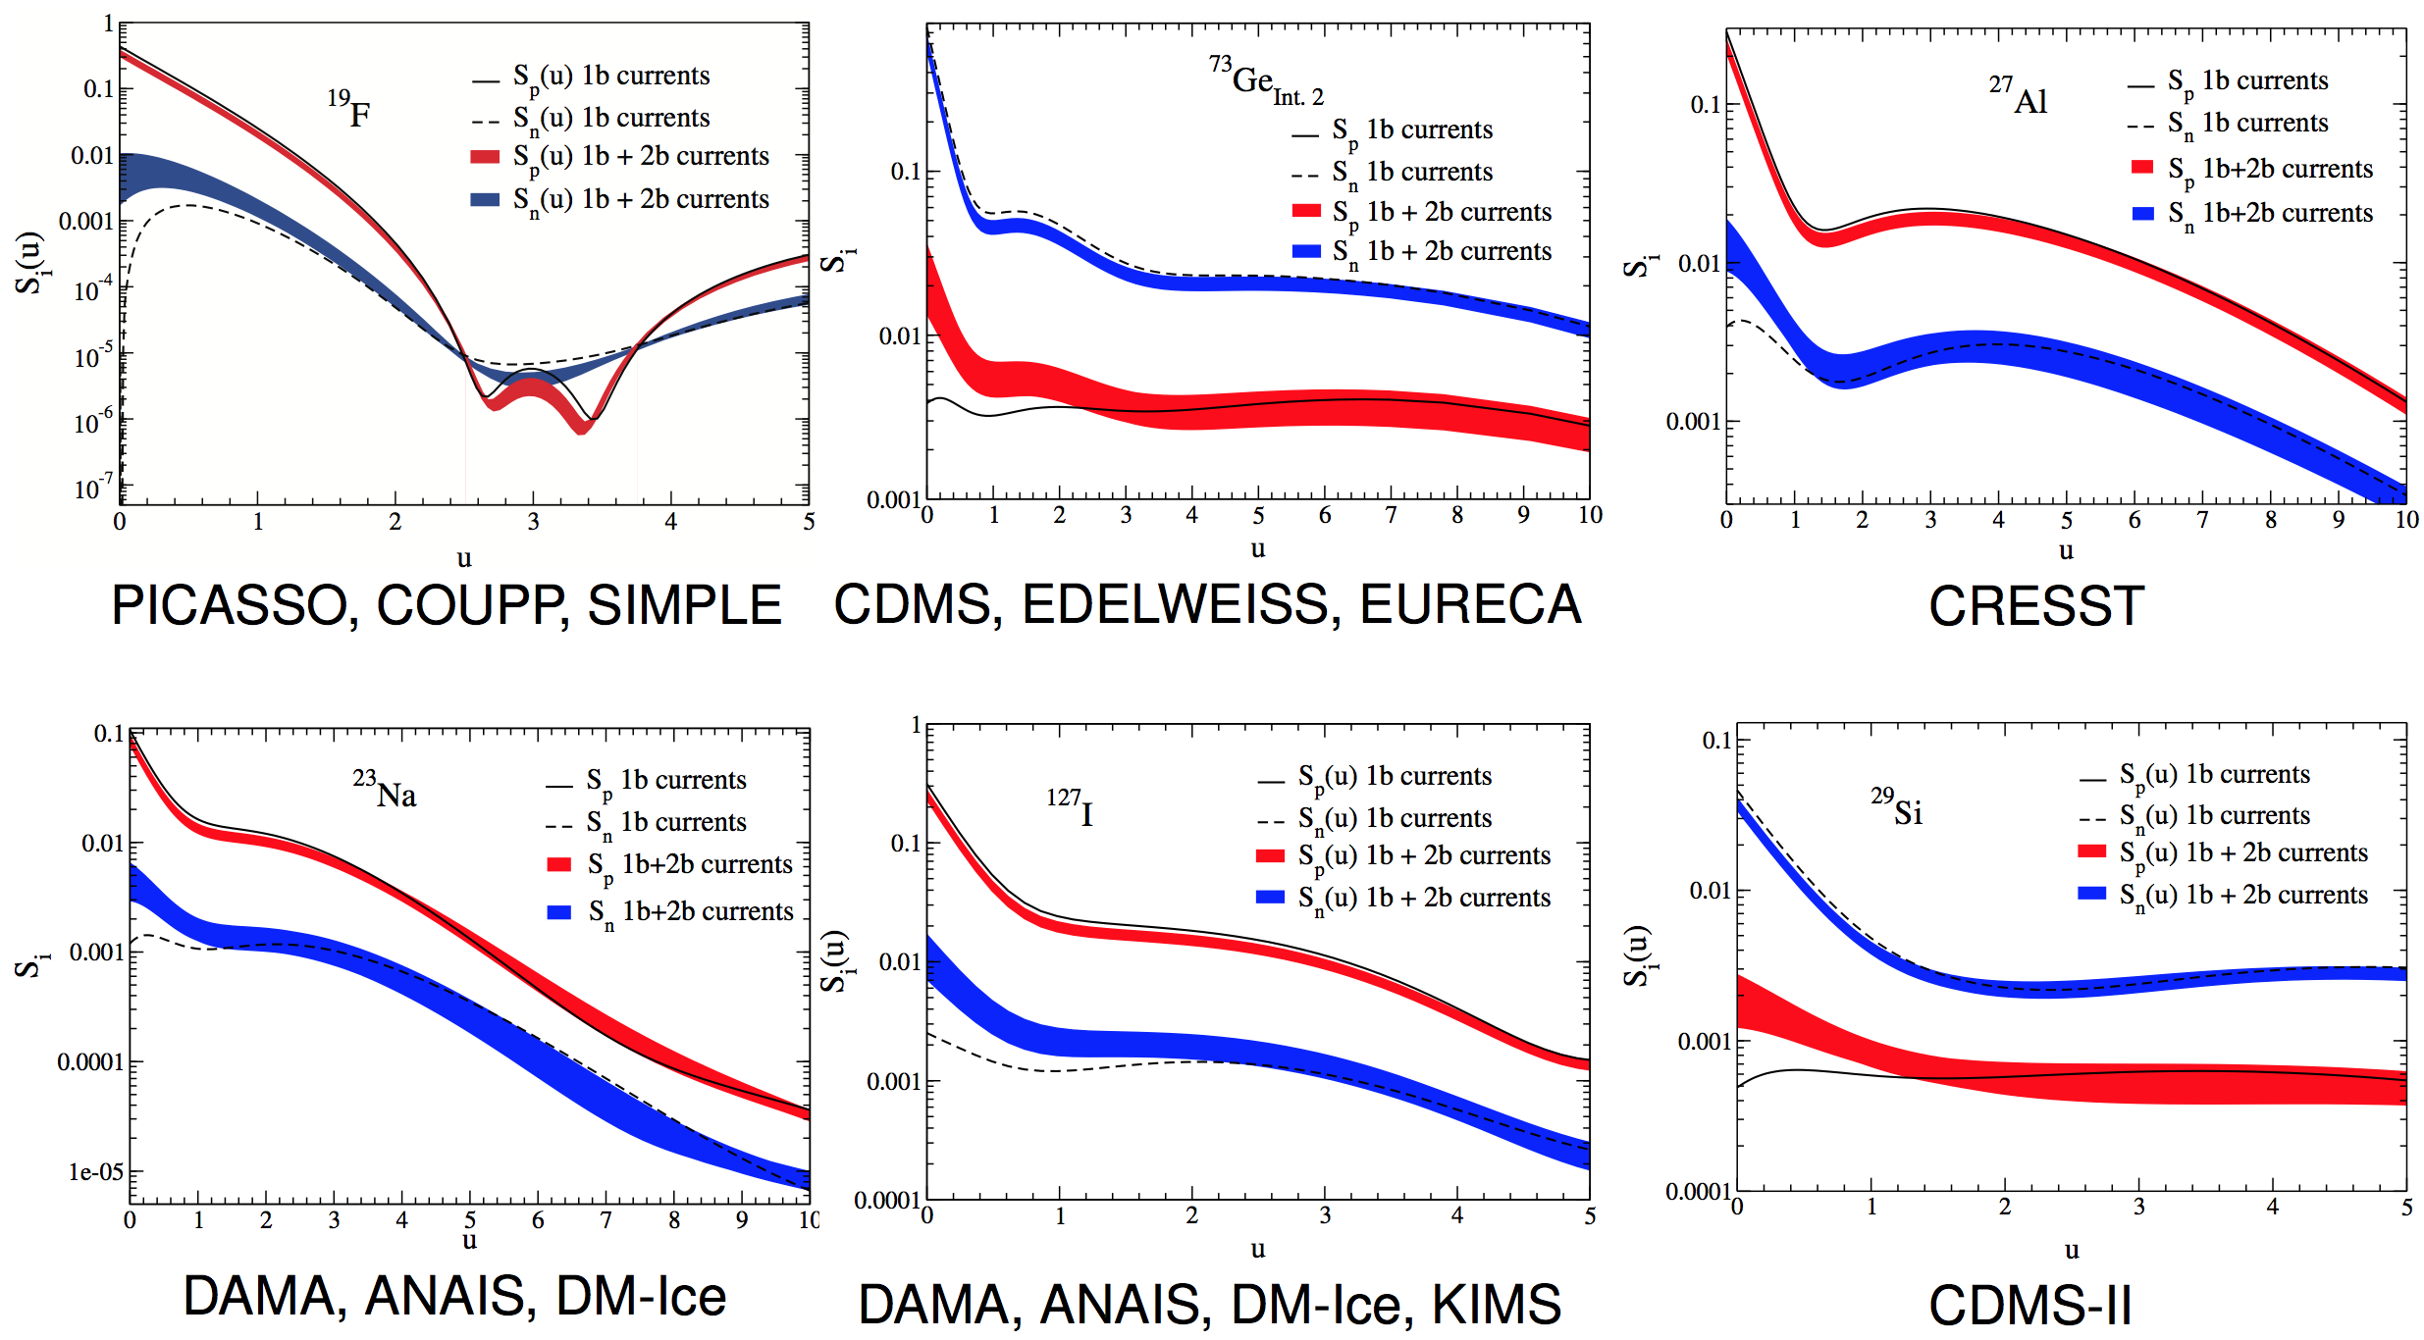
Spin-dependent WIMP-nucleus response for
¹⁹F, ²³Na, ²⁷Al, ²⁹Si, ⁷³Ge, ¹²⁷I
Klos, Menendez, Gazit, AS (2013)

Slide 46

Nuclear structure for direct detection
valence-shell Hamiltonian calculated from NN interactions + corrections to compensate for not including 3N forces (will improve in the future)
valence spaces and interactions have been tested successfully in nuclear structure calculations, largest spaces used
very good agreement for spectra; ordering and grouping well reproduced
Menendez, Gazit, AS (201)
connects WIMP direct detection with double-beta decay

Slide 47
Inelastic WIMP scattering to 40 and 80 keV excited states
Baudis, Kessler, Klos, Lang, Menendez, Reichard, AS, arXiv:1309.0825
inelastic channel comparable/dominates elastic channel for
p ~ 150 MeV

Slide 48
Signatures for inelastic WIMP scattering
elastic recoil + promt γ from de-excitation
combined information from elastic and inelastic channel will allow to determine dominant interaction channel in one experiment

Slide 49

Signatures for inelastic WIMP scattering
elastic recoil + promt γ from de-excitation
combined information from elastic and inelastic channel will allow to determine dominant interaction channel in one experiment
inelastic excitation sensitive to WIMP mass

Slide 50
Summary
3N forces are a frontier
in chiral EFT, for neutron-rich nuclei, matter, and neutron stars
key for neutron-rich nuclei: O, Ca isotopes, N=28 and shell evolution
J.D. Holt, J. Menéndez, T. Otsuka, J. Simonis, T. Suzuki
dominant uncertainty of neutron (rich) matter below nuclear densities
predicts neutron skin with theoretical uncertainty comparable to exp.
constrains neutron star radii and equation of state for astrophysics
C. Drischler, K. Hebeler, T. Krüger, V. Soma, I. Tews, J.M. Lattimer, C.J. Pethick
dark matter response of nuclei and two-body currents
J. Menéndez, P. Klos, D. Gazit
Thank you very much!

Slide 52

shell gap of 4 MeV
evolution to Z=20
similar for N=28 and 32
Notes:
52
52

Slide 53
Neutron matter from chiral EFT interactions
direct calculations without RG/SRG evolution, 3N to N²LO only

Slide 54
N³LO 3N and 4N interactions in neutron matter
evaluated at Hartree-Fock level

Slide 55

Comparisons to equations of state in astrophysics
many equations of state used in supernova simulations not consistent with neutron matter results

Slide 56


Symmetry energy and density derivative L
extract using empirical parametrization Hebeler, Lattimer, Pethick, AS (2013)
expansion in Fermi momentum (γ=4/3),
kinetic energy + quadratic asymmetry
α, η fit to empirical saturation point
α_{L}, η_{L} fit to neutron matter calculations

Slide 57

Ab-initio calculations of asymmetric matter
based on N³LO NN + N²LO 3N interactions Drischler, Soma, AS (2013)
uncertainty band dominated by 3N

Slide 58


Ab-initio calculations of asymmetric matter
compares well with quadratic expansion even for n-rich conditions

Slide 59

Ab-initio calculations of asymmetric matter
benchmark empirical parametrization: ΔE = diff. to neutron matter
good agreement with ab-initio calculations, very useful for astrophysics

Slide 60
Chiral EFT currents and electroweak interactions
predicts consistent 1- and 2-body currents
GFMC calculations of magnetic moments in light nuclei Pastore et al. (2012)
2-body currents (meson-exchange currents) are key!

Slide 61

Electroweak interactions and 3N forces
weak axial currents couple to spin, similar to pions
two-body currents predicted by NN, 3N couplings to N³LO
Park et al., Phillips,…
two-body analogue of Goldberger-Treiman relation
explored in light nuclei, but not for larger systems
dominant contribution to Gamow-Teller transitions,
important in nuclei (Q~100 MeV)
3N couplings predict quenching of g_{A} (dominated by long-range part)
and predict momentum dependence (weaker quenching for larger p)
Menendez, Gazit, AS (2011)

Slide 62
AFDMC results for neutron matter
order-by-order convergence up to saturation density
bands similar to
phase shift bands
NLO ~ N²LO
due to large c_{i}

Slide 63

Comparison to perturbative calculations at N²LO
Hartree-Fock +2nd order +3rd order (pp+hh), same as for N³LO calcs.
band at each order from free to HF spectrum
low cutoffs (400 MeV)
3rd order corr. small,
excellent agreement with AFDMC

