Slide 1
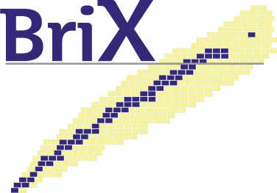

Numerical accuracy of mean-field calculations
The case of the 3-dimensional mesh scheme
The Lagrange implementation
P. Bonche, J. Dobaczewski, H. Flocard
M. Bender, W. Ryssens

Slide 2
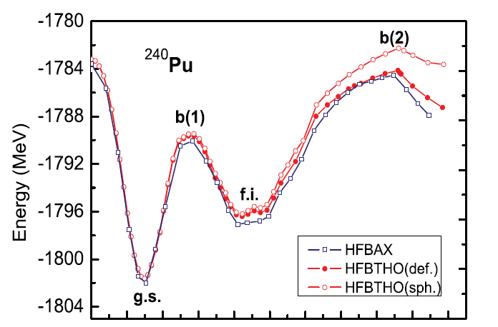
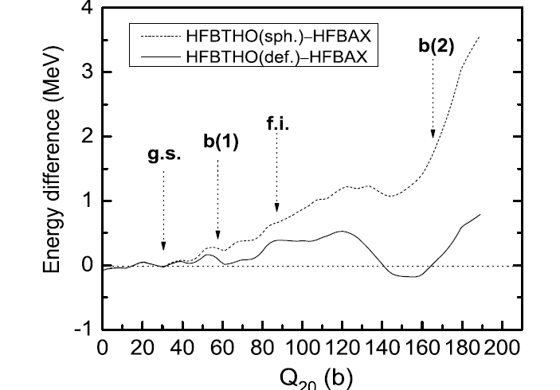
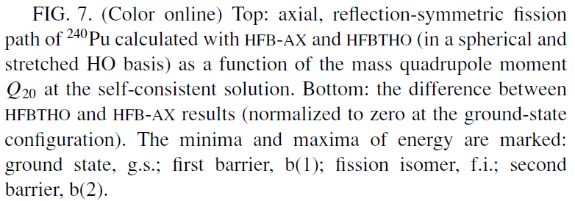
Pei et al.

Slide 3
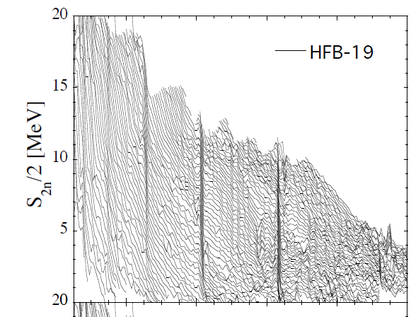
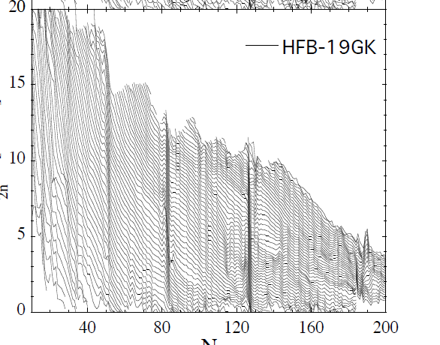
Goriely et al. Journal of the Korean Physical Society, Vol. 59, 2100 2105
S2n/2 surfaces for HFB19 mass table before (left panel) and after (right panel) smoothing the masses with the GK smoothing procedure as described in the text.

Slide 4
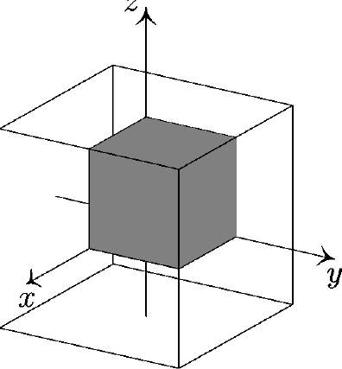
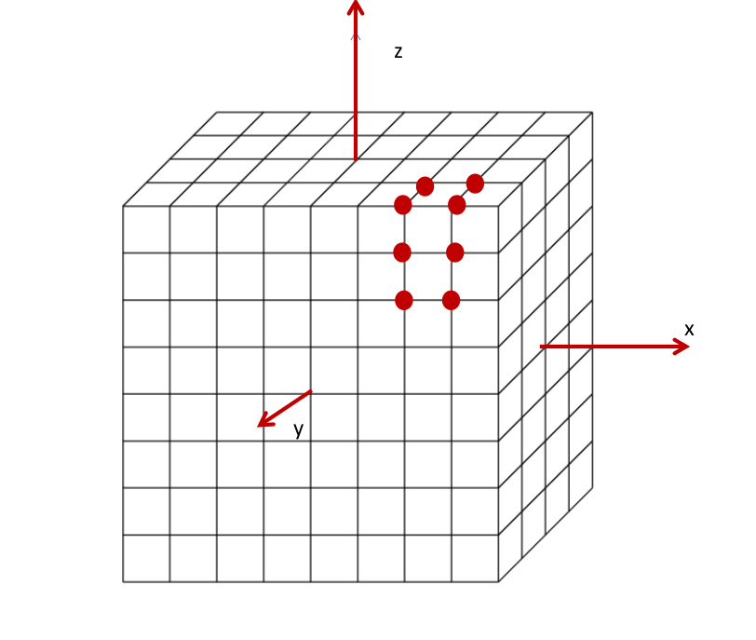
Mesh calculations

Slide 5
Three choices determine the accuracy of the calculation
Box size: must be large enough not to truncate artificially the wave functions
Method used to calculate derivatives: finite difference or Lagrange formulae
Mesh spacing: distance between the equidistant mesh points (the origin is excluded)
Alternative methods: Fourier transformations, Splines, Wavelets

Slide 6
Lagrange mesh
Points of the mesh:
Basis functions: plane wave on the mesh (1-dimension):
Lagrange functions defined on the mesh:
f_{r}(x) is zero at each mesh points except x_{r} where it is 1
D. Baye and P.-H. Heenen (1986)

Slide 7
Any function defined only by its values on the mesh points can be decomposed
using the Lagrange functions.
Derivatives can be calculated explicitly using this expansion
Lagrange formulae for first and second derivatives that are consistent
Usual implementation in our code:
Finite difference formulae during the iterations
After convergence, the EDF is recalculated using Lagrange Formulae

Slide 8
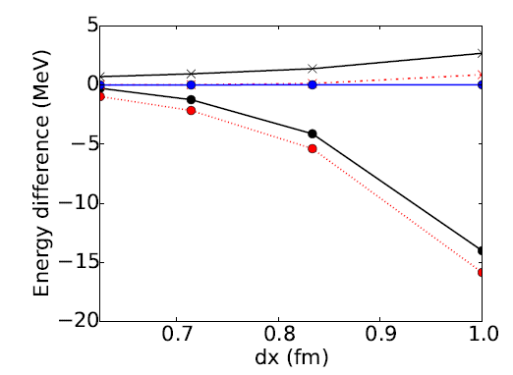
Calculation of derivatives
Finite difference results, no recalculation
X Recalculation with Lagrange derivatives after convergence
Lagrange functions also during the iterations

Slide 9
Size of the box

Slide 10
Mesh distance

Slide 11
Deformation and fission of ²⁴⁰Pu
dx=0.6 fm

Slide 12
Two-neutron separation energy

Slide 13
Density of ³⁴Ne

Slide 14
Convergence as a function of iterations
Imaginary time step is changing!

Slide 15
Some conclusions
Mesh calculations are reliable: accuracy is controlled by a few parameters and does not depend significantly on N, Z, deformation, …
A mesh spacing of 0.8 fm gives an accuracy on energies better than 100 keV
The accuracy can be as low as 1 keV with sufficient box size and a mesh spacing of 0.6 fm
Pairing would require a separate study (as we did with Terasaki in 1996). However is it meaningful to use a pairing adjusted with an oscillator basis in a mesh calculation?

Slide 16
Dimension of box
For ²⁰⁸Pb calculated with N=20, classical turning point is 14 fm for l=0 and 16 for l=20
How stable are states well above the Fermi energy? Can a pairing be used in conditions of calculations different from the ones under which it has been adjusted?
²⁴⁰Pu: size of the box for large deformations up to 34 fm (half side)
oscillator basis (fit of UNEDF1) up to 50 shells –around 1100 wave functions- with a classical turning point at 24 fm for l=0)

