Slide 1

β-Decay Matrix Elements Calculated Using MR-DFT and NCCI Approaches
Collaboration
Maciek Konieczka
Wojciech Satuła
Institut of Theoretical Physics,
University of Warsaw
Jacek Dobaczewski
Paweł Bączyk
The future of multireference DFT
Warszawa, 26.06.2015
Notes:
I'd like to present the NCCI approach with applications to superallowed beta decay and for the first time to Gamow-Teller transitions. The main collaboration consists of

Slide 2
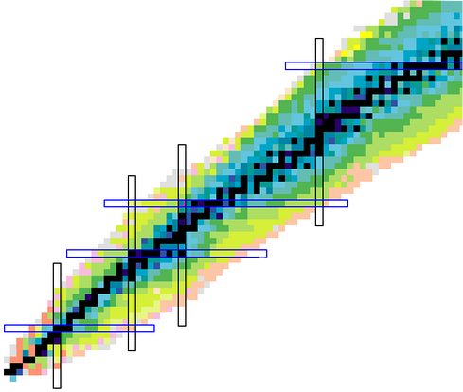
Outline
1 The No-Core Configuration Interaction (NCCI) model
2 Isospin breaking (ISB) corrections to superallowed Fermi beta decay
3 Gamow-Teller matrix elements of transitions in mirror nuclei
4 Short overview of NCCI calculations with SV interaction
Excellent playground to explore
the electroweak sector of the Standard Model
The unitarity of CKM matrix
N≈Z
Coupling constant of
the axial vector current
Notes:
Let me introduce somewhat of the content of this presentation. At first, I’m going to sketch simple picture of how this DFT-rooted model works within the scheme of configuration mixing. Then I will show some of its capacities, which allow for broaden studies within the Standard Model. Our model is based on restoration of angular-momentum and isospin symmetry simultaneously. At the moment, we restrict our calculations to N=Z nuclei, where the violation of the isospin symmetry has the biggest impact. Therefore it's possible within our model to investigate superallowed beta decay in the context of isospin breaking corrections. The model has certain difficulties especially concerned with the hamiltonian-driven interaction. For all that, it gives impressive results in nuclear spectroscopy. Last but not least, I will demonstrate very preliminary work - a first attempt with DFT-rooted method to extract Gamow-Teller matrix elements of transitions in mirror nuclei. Both superallowed beta decay and Gamow-Teller matrix elements give a unique opportunity to explore the electroweak sector of the Standard model. Namely, the unitarity condition of CKM matrix and the quenching effect of the coupling constant of the weak axial vector current.

Slide 3
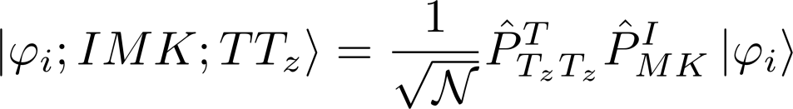





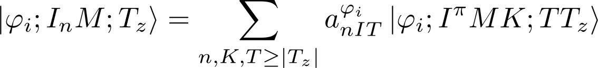






Multireference DFT (MR-DFT)
Simultanous
projection
on good I and T
K and T mixing
SR-DFT ph
Slater determinants
No-Core Configuration Interaction
I
E_{M}
I
E₂
I
E₁
Hill-Wheeler equation

Slide 4








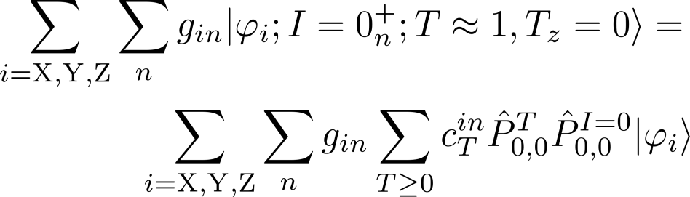
Isospin breaking corrections to superallowed Fermi beta decay
NCCI is a natural consequence of inluding (multi) particle-(multi)hole excitations.
NCCI was introduced as a cure for the problem of the ambiguity of anti-aligned configurations needed to calculate superallowed Fermi beta decay
antialigned configuration
- not uniquely defined!
Breaking of isospin symmetry
or
different current-shape orientation

Slide 5

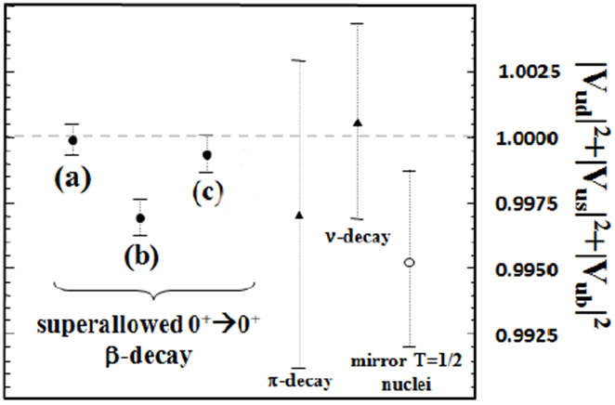
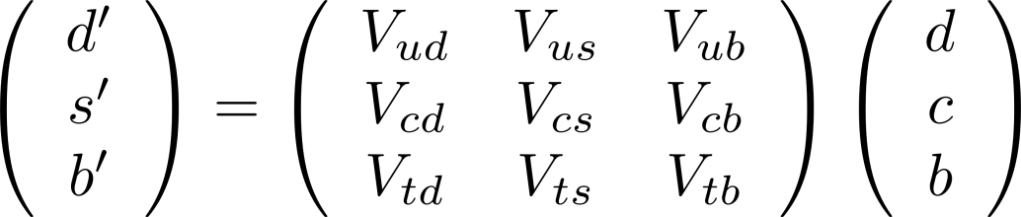
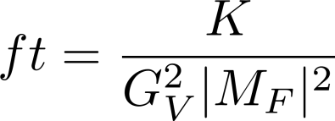
Isospin breaking corrections to superallowed Fermi beta decay
ISOSPIN-BREAKING
CORRECTIONS
MR-DFT, NCCI (for different shape current)
results are fully consistent
weak
eigenstates
mass
eigenstates
NCCI
CKM matrix
The unitarity condition of CKM
(a)
I. Towner , J. Hardy, PRC 77, 025501(2008)
CVC
(b)
H.Liang, et al. PRC 79,064316 (2009)
(c)
W. Satuła et al., PRC 86, 054314 (2012)
W. Satuła, J. Dobaczewski, M. Konieczka, NCCI model rooted in double projected MR-DFT theory – in preparation

Slide 6







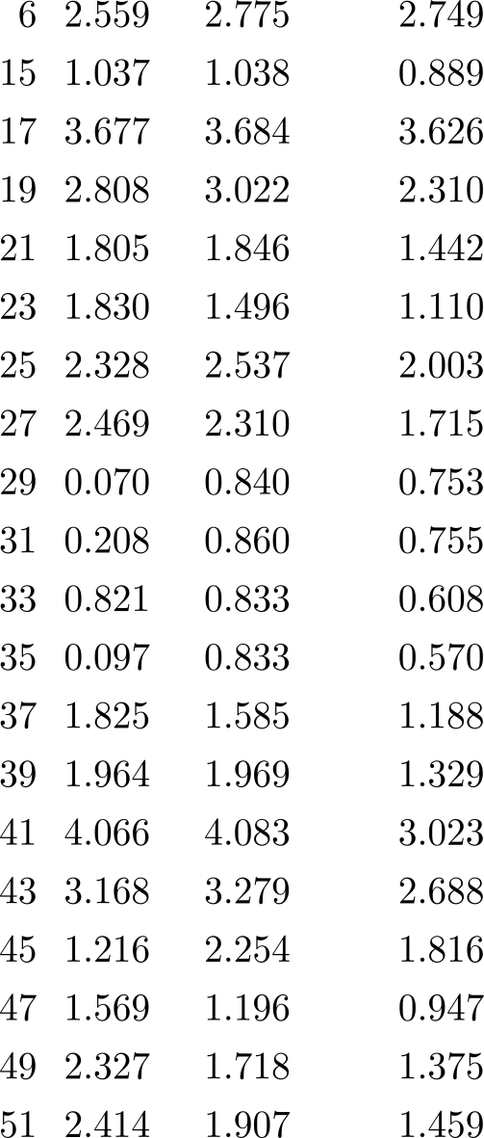
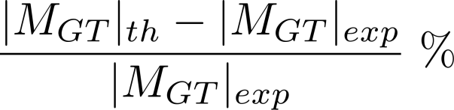
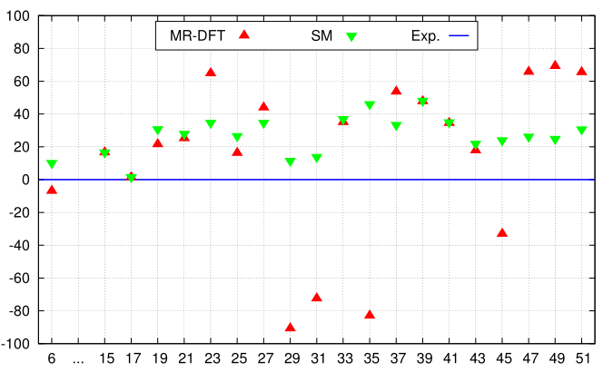

Gamow – Teller matrix elements
calculated in the MR-DFT frame
The quenching effect
does not depend on
the core approximation!!!

Slide 7
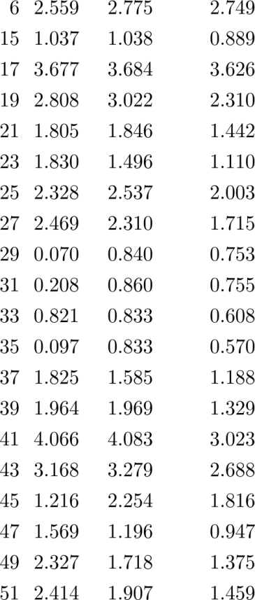

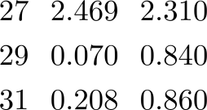



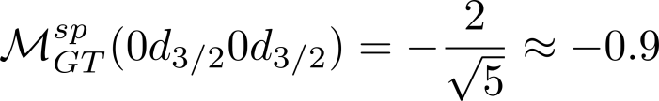
Gamow-Teller matrix elements of transitions in mirror nuclei
In A=29, A=31 and A=35 - destructive interference of 1s_{1/2} and 0d_{3/2} subshell, due to single particle energies reproduced by SV
Single particle energies (sd shell) in ¹⁷O
Inappropriate structure
of spe in sd-shell
d3/2
s1/2
d5/2
Single particle
GT matrix elements

Slide 8
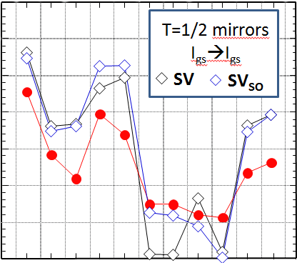
Gamow-Teller matrix elements of transitions in mirror nuclei
Some ideas of how to handle with discrepancies :
3.5
1. Spin-Orbit tunning SV-SO
3.0
Tunned such that it
reproduces masses
2.5
g_{A} |M_{GT}|
2.0
1.5
2. Implementation of zero-range tensor part to the interaction
1.0
EXP
0.5
0
21
25
29
33
37
A
Very preliminary
results !

Slide 9
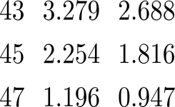
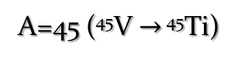
Gamow-Teller matrix elements of transitions in mirror nuclei
Let’s have a look on the f_{7/2} region and start to use NCCI model
A=45 (⁴⁵V $→$ ⁴⁵Ti)
Simple Nilsson
orbits picture of the f_{7/2}
1.6
1.577
1.550
1.595
1.538
1.5
1.4
K=7/2
1.3
1.216
g_{A} |M_{GT}|
K=5/2
1.2
K=3/2
-373
K=1/2
-373.20
-373.29
-373.30
-373.30
-373.34
-374
GS
+EX1
+EX2
+EX3
+EX4
⁴⁵V GS
MeV
Energy of the ⁴⁵V GS
SM Gamow-Teller ME only for ph exciatations
within fp shell: g_{A}M_{GT}=1.217
T. Sekine, B. A. Brown, et al.
Nucl. Phys. A467, 93 (1987)

Slide 10
Summary and outlook
Summary:
Our results on the ISB correction to superallowed Fermi beta decay in NCCI
(diffrent shape current orientation) are fully consistent with those obtained
in multireference frame
Calculated GT matrix elements seem to indicate that quenching effect does
not come from the core polarization
Outlook (some of them in progress):
Continuation of the research on Gamow-Teller matrix elements in NCCI with
zero-range tensor part included in interaction
Restoration of strong force – rooted breaking of the isospin symmetry –
pn mixing included – PhD project of Paweł Bączyk
3-dim projection on isospin from HFB reference states

Slide 11
Thank you for your attention !!!

Slide 12
Short overview of NCCI calculations with SV interaction
Discussion session
K.G. Leach et al.
PRC 88, 031306(R), (2013).
Low-lying 0⁺ excited states in ⁶²Zn
SM
(MSDI3)
SM
(GXPF1)
SM
(GXPF1A)
EXP
(OLD)
EXP
(NEW)
NCCI
SV^{proj}
HF
π₂
π|312 5/2>⁻¹
π|310 1/2>
More examples like
³²Cl, ³²S
5
ν₂
ν|312 3/2>⁻¹
ν|321 1/2>
4
π|312 5/2>⁻²
π|312 3/2> ²
ππ₁
Excitation energy (MeV)
ν₁
ν|312 3/2>⁻¹
ν|310 1/2>
3
2
π₁
π|312 5/2>⁻¹
π|312 3/2>
1
⁶²Zn, I=0⁺ states
There are no free parameter
to adjust !!!
0
0⁺ ground state
W. Satuła, J. Dobaczewski, M. Konieczka, NCCI model rooted in double projected MR-DFT theory – in preparation

Slide 13

Short overview of NCCI calculations with SV interaction
Excited states in two isotopes of Li
reference configurations
simple proton p-h and
neutron p-h excitations
(only p1/2 and p3/2)
2⁺
0⁺
-30
3⁺
⁸Li
Lithium -6
TH
1⁺
The theory clearly disagrees with the
data with the asignement and its energy
EXP
Binding energy [MeV]
4⁺
-35
(0)⁺
⁶Li
1⁺
The model lacks isoscalar
pairing correlations !!!
3⁺
-40
1⁺
2⁺
almost 5 MeV
higher than exp!
EXP
TH
W. Satuła, J. Dobaczewski, M. Konieczka, NCCI model rooted in double projected MR-DFT theory – in preparation

Slide 14
Short overview of NCCI calculations with SV interaction
Discussion session
Excitation energies of isoscalar and isovector multiplets
in Scandium-42 with respect to 0⁺ state
⁴²Sc
3.0
Again:
T=1
2.5
The model lacks the isoscalar
pairing correlations !!!
theory
exp
2.0
Excitation energy [MeV]
The model prefers fully aligned
isoscalar states !
1.5
1.0
T=0
0.5
theory
0
exp
0
1
2
3
4
5
6
7
angular momentum

Slide 15
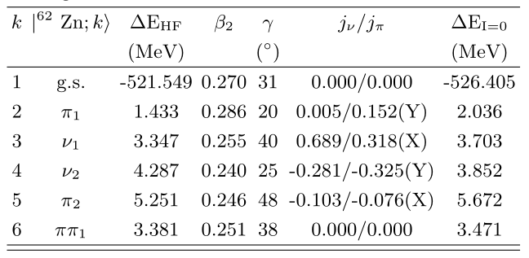
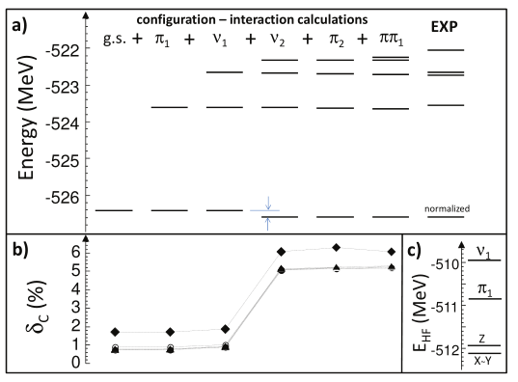
Discussion session
HF energies
HF quadrupole
deformation parameters
neutron/proton alignment
Spectrum of low-lying 0⁺ states in ⁶²Zn
in a function of a number of configurations.
Calculated ISB correction versus a number of configurations in the daughter nucleus.

Slide 16















Truncation in NCCI mixing of diffrent shape-current orientation states
Discussion session
The distribution of eigenvalues of a norm matrix
Truncation the high-unphysical-energy states or the natural states corresponding to small eigenvalues of the norm matrix (or both simultaneously)
1
0.1
0.01
Eigenvalues of norm matrix
mixing X, Y, Z
orientation
0.001
0.0001
10
-5
Cutoff dependence

Slide 17

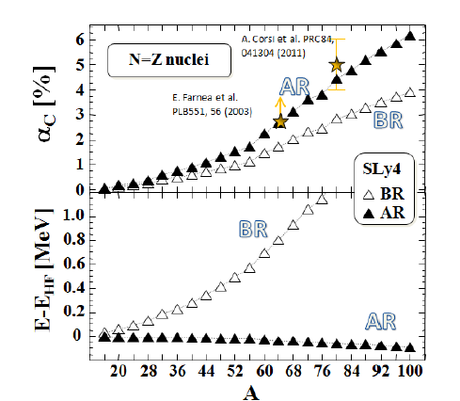

Discussion session
Rediagonalization of entire Hamiltonian in the collective space
natural states – free from
spurious isospin mixing
Isospin mixing coefficient:
Computing isospin mixing coefficients,
one can obtain the scale of isospin
spontaneous symmetry breaking

Slide 18
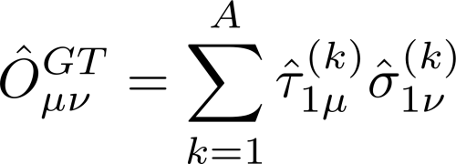
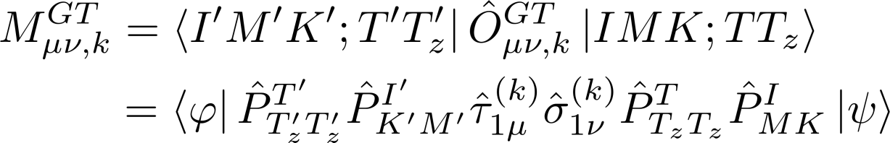
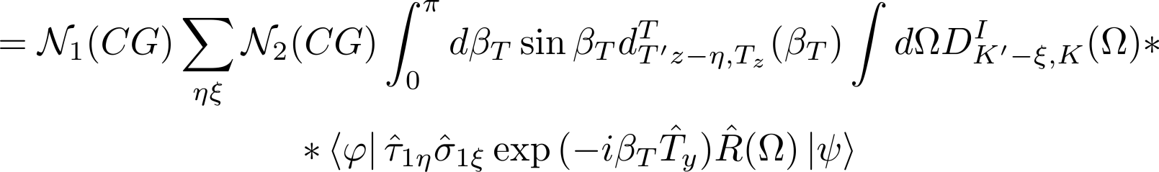
V Gamow-Teller matrix elements of transitions in mirror nuclei
Discussion session
1-dim rotation in isospace
and 3-dim rotation in space
We need to commute them through GT,
which will spit out plenty of CG coeff. and
double rotated DFT state

