Slide 1
“Nuclear Dipole Excitation with Finite Amplitude Method QRPA”
Tomohiro Oishi^{1,2},
Markus Kortelainen^{2,1},
Nobuo Hinohara^{3,4}
¹Helsinki Institute of Phys., Univ. of Helsinki
²Dept. of Phys., Univ. of Jyvaskyla
³Center for Computational Sciences, Univ. of Tsukuba
⁴National Superconducting Cyclotron Laboratory, Michigan State Univ.
Collaboration Workshop “The future of multireference DFT”
25.June.2015, Warsaw, Poland
Notes:
Thank you very much for giving me this opportunity to present our work.
I am Tomohiro OISHI from Jyvaskyla, and my collaborators include M.K. and N.H.
The title of my talk is “XXX”.

Slide 2
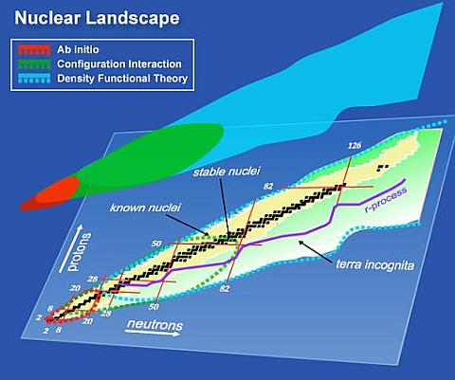
QRPA with Nuclear EDF
G. Bertsch et al., SciDAC Review 6, 42 (2007)
Quasi-particle random phase approximation (QRPA), implemented into the framework of energy density functional (EDF), can be a powerful tool to investigate the nuclear dynamics.
Usually QRPA is formulated in the matrix form (Matrix QRPA):
QRPA equation (matrix formulation)
phonon operator:
Normalization:
Notes:
Historically, QRPA has been implemented into the framework of nuclear energy-density functional.
This figure shows the covering range of EDF, that can cover a large amount of the nuclear ground states throughout the nuclear chart.
And I has been thought that QRPA employed with EDF is a promising method to investigate the nuclear excitations.
By the way, QRPA has been usually formulated in the matrix form, namely as “Matrix-QRPA”.

Slide 3
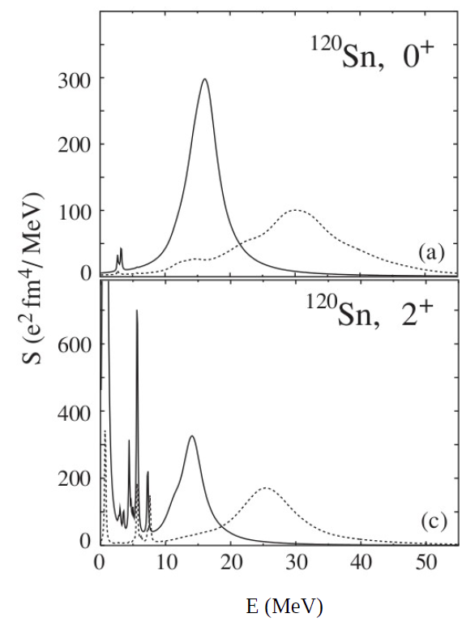
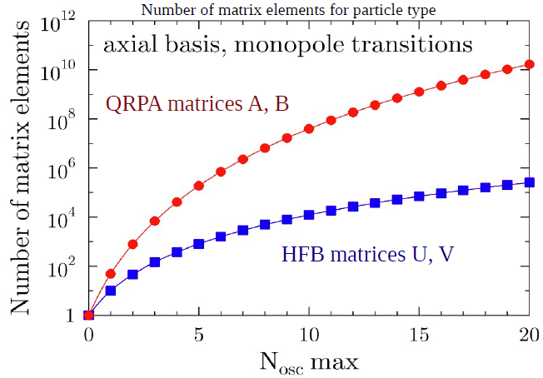
Solving QRPA
J. Terasaki et al., PRC 71, 034310 (2005)
Matrix QRPA:
Problems:
Dimensions of (A,B) increases rapidly when the size of basis is increased.
➔ calculation/diagonalization costs highly.
For practical calculations, one usually needs to employ an additional cut-off to reduce the matrix size.
➔ “Finite Amplitude Method” can be an alternative, low-cost method for QRPA.
Notes:
However, in MQRPA, there is one problem for the practical usage.
It needs a huge size of computer memory and long runtime to finish the calculations.
Especially, QRPA for the deformed nuclei is not practical without an additional cut-off parameter.

Slide 4
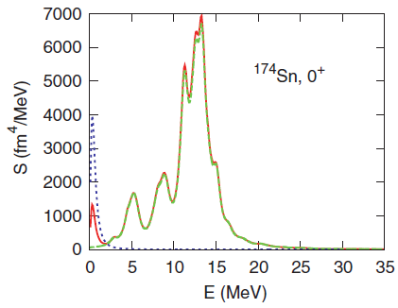
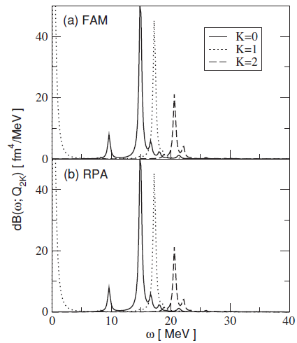
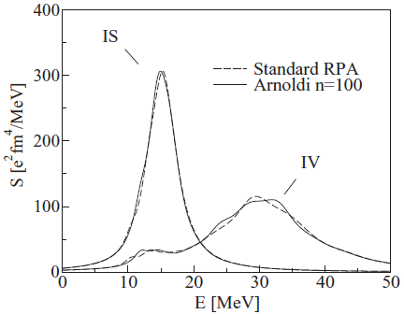
Development of FAM-QRPA
QRPA matrix elements with FAM:
P. Avogadro and T. Nakatsukasa, PRC 84, 014314 (2011)
First introduction of FAM in nuclear RPA:
T. Nakatsukasa et al., PRC 76, 024318 (2007)
Implementation to HFBTHO:
M. Stoitsov, M. Kortelainen, T. Nakatsukasa, C. Losa, and
W. Nazarewicz, PRC 84, 041305(R) (2011)
Low-lying discrete states in deformed nuckei with FAM:
N. Hinohara, M. Kortelainen, W. Nazarewicz, PRC C 87, 064309 (2013)
Arnoldi method for QRPA:
J. Toivanen et al.,
PRC 81, 034312 (2010)
= Another method to solve QRPA without
calculating and storing the QRPA matrices.
Notes:
As we know, the QRPA is a powerful tool to investigate the collective excitations and many other dynamics in atomic nuclei.

Slide 5
FAM-QRPA or Matrix QRPA ?
FAM-QRPA
Matrix QRPA
Merit: it is not necessary to calculate the QRPA matrices, (A,B), directly.
QRPA is solved as a linear response problem with a small time-dependent external filed.
The QRPA amplitudes, (X,Y), are solved iteratively.
The size of QRPA matrices increases rapidly as the larger basis is employed.
Full QRPA is impracticable without the additional cut-off or/and approximations in several cases.
Aim of this work with FAM-QRPA:
To perform the systematic calculations of the dipole modes for deformed nuclei, where the full MQRPA is not practical.
Giant dipole resonance (GDR), with its shape-dependence, has not been fully investigated.
Notes:
※n-halo/skinにはあまり触れない方が良い。今はHO-basisを使ってしまっているので。
Main targets include the heavier isotope-chains including deformed isotopes (with pygmy dipole resonances).

Slide 6
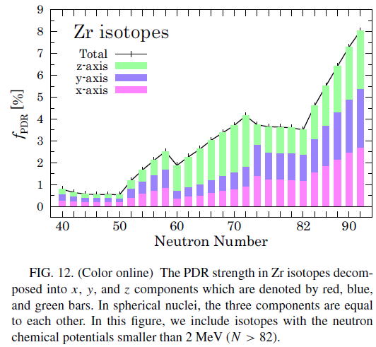
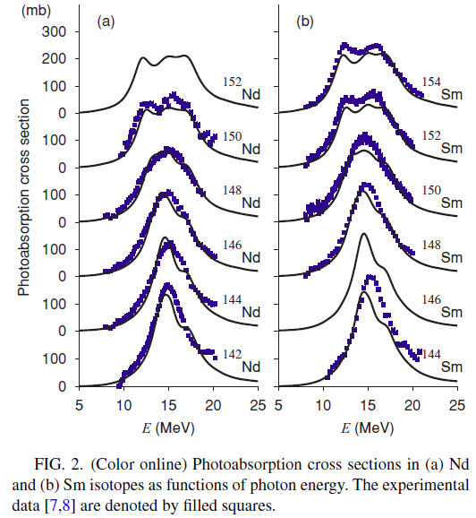
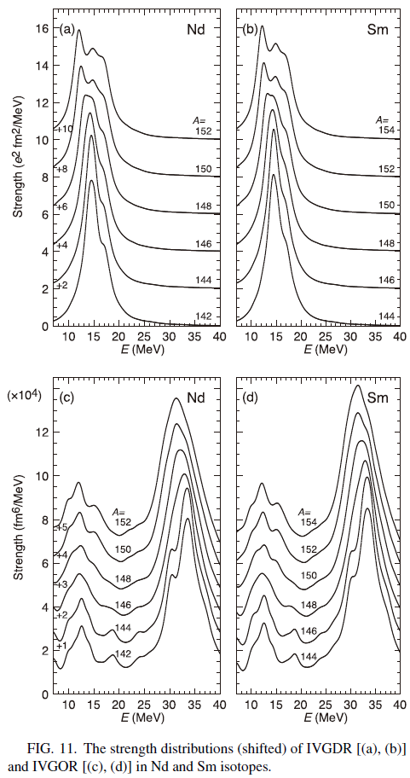
QRPA Approaches to Giant (and pygmy) modes
Systematic investigation of low-lying dipole modes using the CbTDHFB theory: S. Ebata et al, PRC 90, 024303 (2014)
Dipole responses in Nd and Sm isotopes with shape transitions: K. Yoshida and T. Nakatsukasa, PRC 83, 021304 (2011)
Shape evolution of giant resonances in Nd and Sm isotopes: K. Yoshida and T. Nakatsukasa, PRC 88, 034309 (2013)
Testing Skyrme energy-density functionals with the quasiparticle random-phase approximation in low-lying vibrational states of rare-earth nuclei: J. Terasaki and J. Engel, PRC 84, 014332 (2011)
Note that, in all these works, additional truncations or cutoffs have been needed for QRPA calculations.
Notes:
These past studies were based on partial QRPA or/and BCS.
The full QRPA is more sequre for n-rich nuclei.

Slide 7
Methods

Slide 8
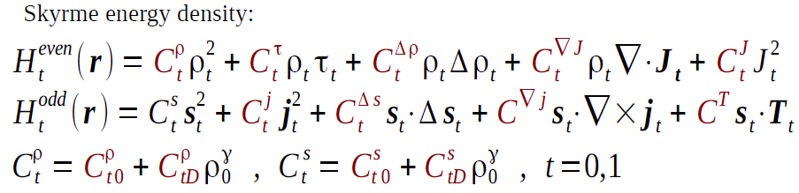
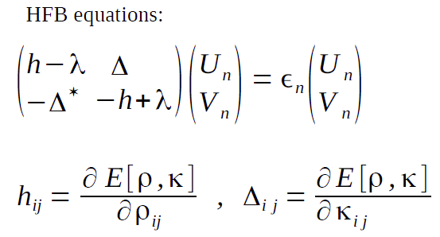
HFB with Skyrme Energy Density Functional (EDF)
The ground state (g.s.) is obtained by HFB with Skyrme EDF + delta pairing, employing H.O. basis with axial symmetry.

Slide 9



QRPA within Finite Amplitude Method
FAM-QRPA equations can be written to solve (X,Y):
Strength function:
P. Avogadro and T. Nakatsukasa, PRC 84, 014314 (2011)
FAM replaces the direct calculation of QRPA matrices with a simpler, iterative calculation of (X,Y).
Energy & smearing width: ω = E + iΓ.
Broyden method essential to get the convergence.
Notes:
“FAM replaces …” is the essential trick of FAM enabling us to perform the full QRPA calculations much easily.
Here there are no rooms for (A,B) to appear.

Slide 10
Results:
Giant Dipole Resonance (GDR) in Rare Isotopes

Slide 11
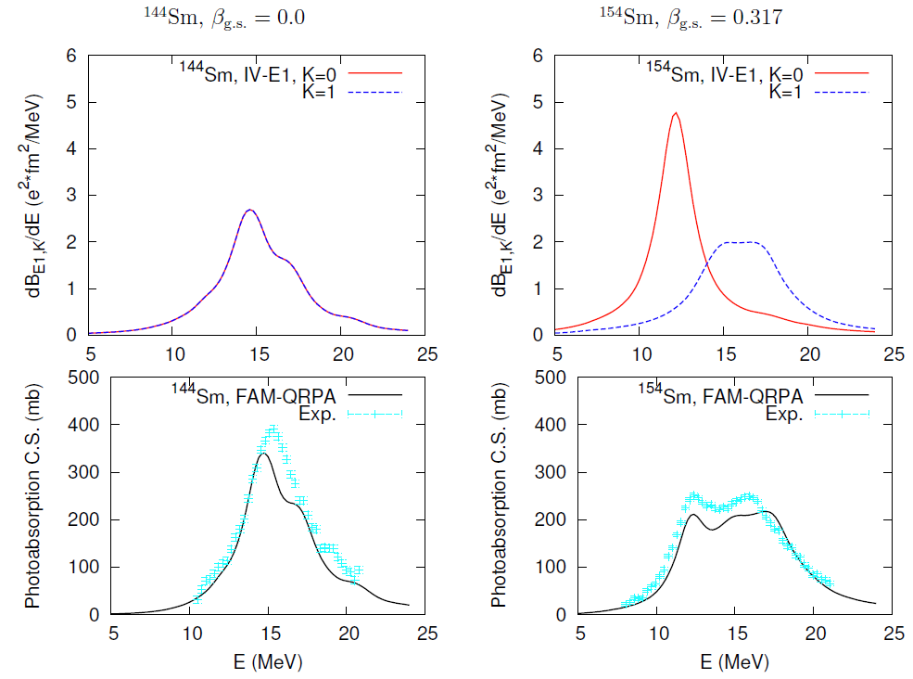
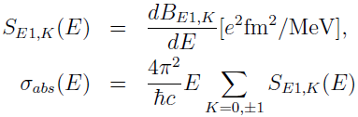
GDR with HFB + FAM-QRPA
HFB solver = HFBTHO, functional = SkM* + mixed delta pairing,
pairing strength ⬅ Δ(n,p) = 1.17 MeV, 0.97 MeV in ¹⁵⁶Dy,
the smearing width: ω = E + iΓ, Γ = 1.0 MeV.
Z
Notes:
Before showing the whole results, I hope to refer to shifting structures of GDR connected to the deformation.
In spherical nuclei like as 144Sm, >>>.
In prolate nuclei, >>>.
``beta’’ is the calculated deformation parameter in the ground state.

Slide 12
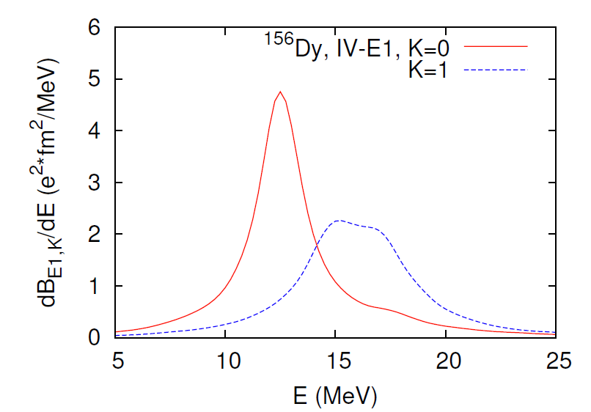
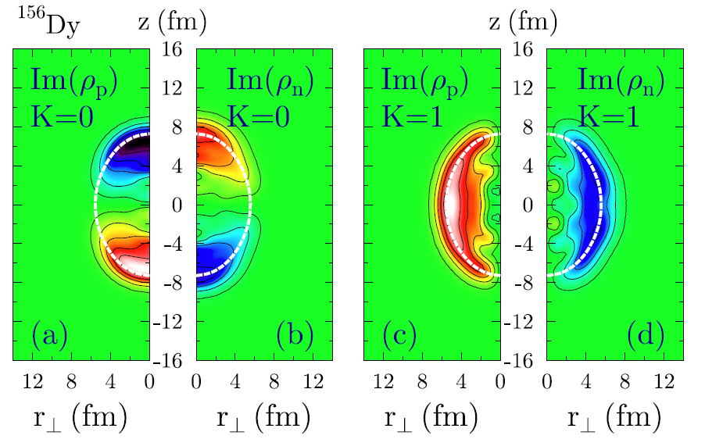
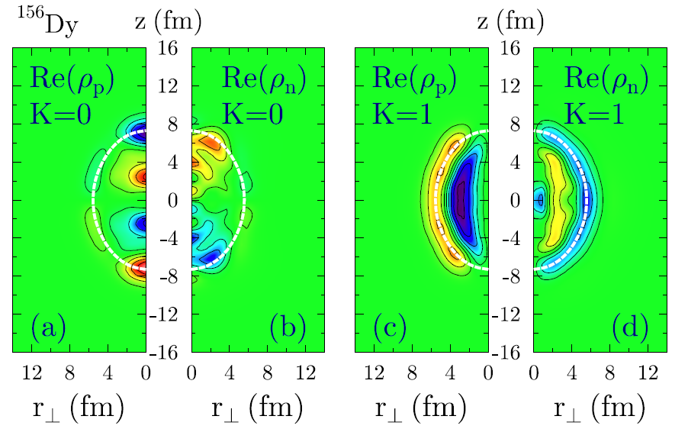
Transition Density of ¹⁵⁶Dy
z
n
r⊥
_{(φ=0)}
p

Slide 13
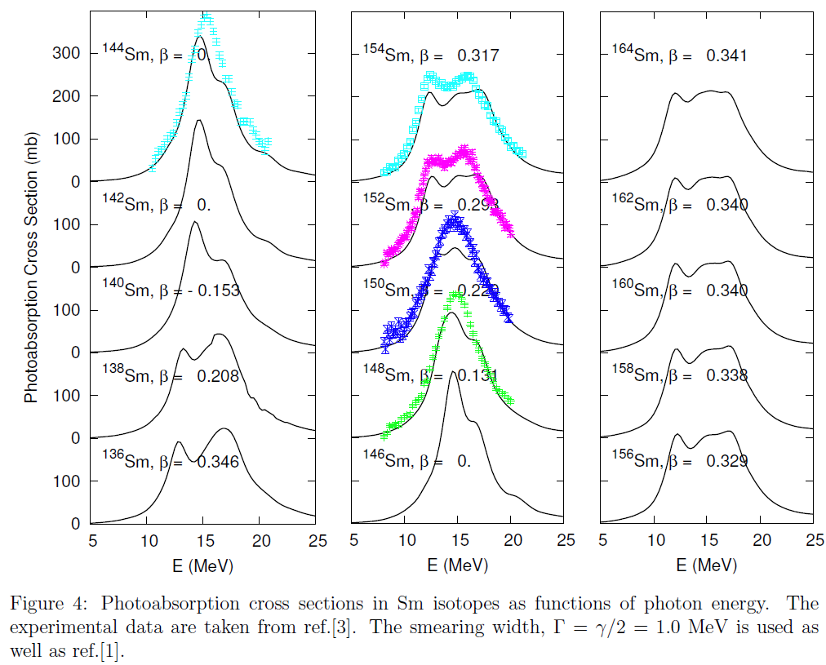
GDR with HFB + FAM-QRPA: Sm
Notes:
Attension please. The left column shows the results in n-less (p-rich) region. The middle is for stable, and the right one is for n-rich and thus unstable nuclei.

Slide 14
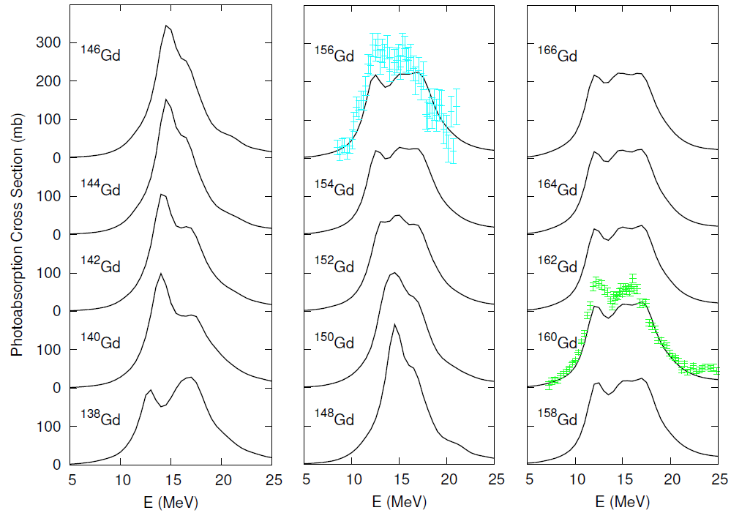
GDR with HFB + FAM-QRPA: Gd
Notes:
``beta’’ is the calculated deformation parameter.

Slide 15
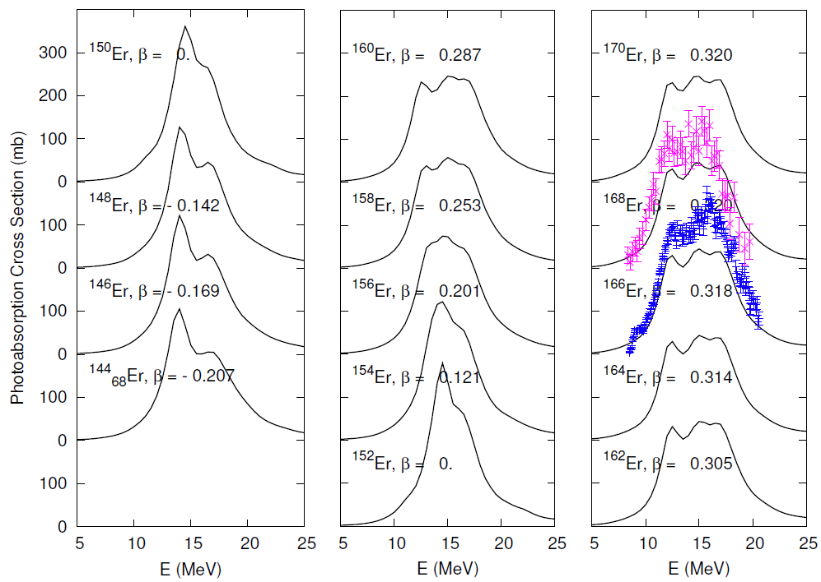
GDR with HFB + FAM-QRPA: Er
Notes:
Even for unstable nuclei with large n-excess, our FAM-QRPA shows a nice agreement !

Slide 16
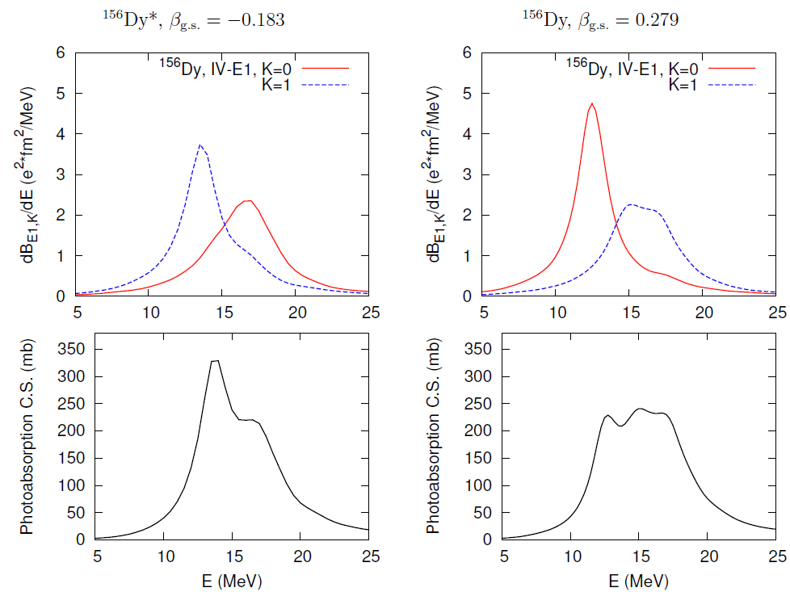

GDR in Oblate/Prolate System
For prolate
oscillators (β > 0),
ω_{z} (K=0) < ω_{x,y} (K=1).
↓
K=0 modes are lowered.
c.f. Enhancement of matrix elements of K=0 modes in prolate nuclei:
S. Ebata, T. Nakatsukasa and . Inakura, PRC 90, 024303 (2014)

Slide 17
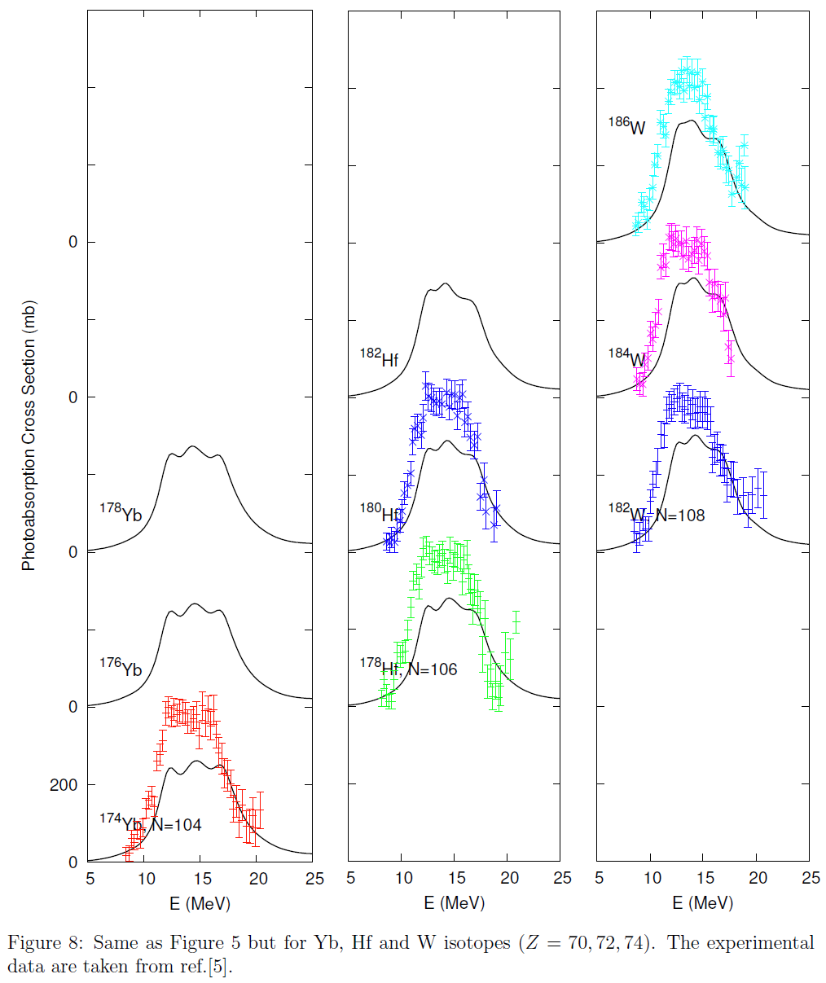
GDR with HFB + FAM-QRPA: Yb, Hf, W
Notes:
In very n-rich and heavier isotopes, theoretical GDR is not enough to exhaust the experimental ph-ab-C.S.

Slide 18
Summary
FAM-QRPA is employed to survey the GDR in rare isotopes including deformed nuclei.
Results are in good agreement with experimental data of stable and unstable isotopes.
A qualitative difference of GDR in prolate and oblate systems is confirmed.
Future Works
In several heavier nuclei (typically Z >= 70, N >=100), photo-absorption C.S. is still underestimated.
➔ functional dependence ? other multi-pole modes ? 2p-2h excitations ?
Further investigations of GDR and shape-evolutions.
Low-lying excitations

Slide 19
App.

Slide 20
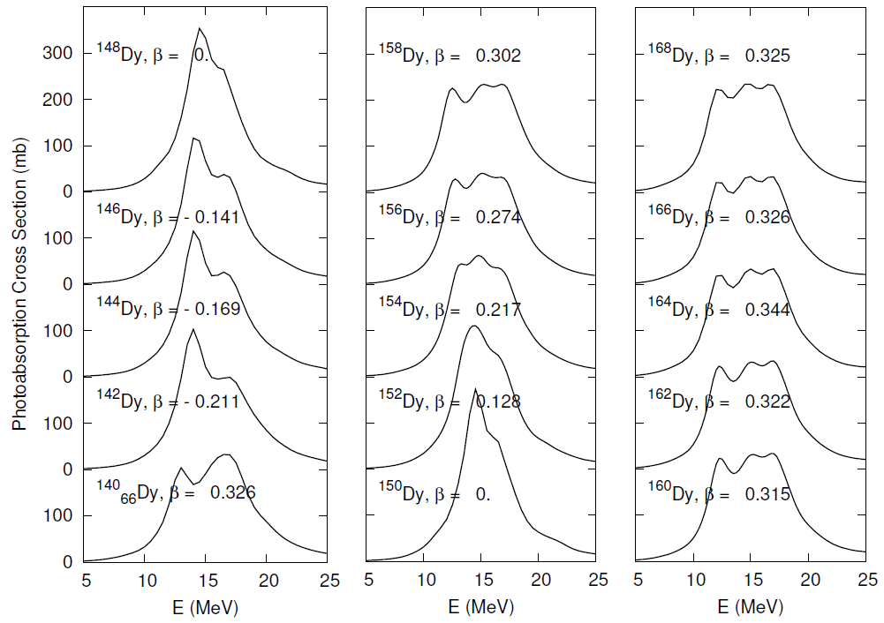
GDR with HFB + FAM-QRPA: Dy
Notes:
``beta’’ is the calculated deformation parameter.
As the g.s. deformation grow up, the K=0 IVD strength becomes sharpened.
I the spherical nuclei, the strength has a two-peak structure.

Slide 21
NOTES
GDR with shape transition in heavy nuclei (typically Z>=60),
with its model-dependence, should be investigated furthermore.
photoabsorption cs, as well as sum rule, is somehow inderestimated.
➔ functional dependence ?

Slide 22
Low-energy Dynamics of Atomic Nuclei
Low-lying, discrete excited states
⬄ shell structure, pairing correlation, deformations
Giant (and pygmy) resonances
⬄ bulk properties including incompressibility, symmetry energy
⬄ information of neutron stars
⬄ neutron-halo or skin, di-neutron correlation
Beta-decay, double beta-decay
⬄ neutrino physics, isospin symmetry
1N-, 2N-radioactiviity (evaporation), pair-transfer reactions
QRPA (Quasi-particle Random Phase Approximation)
= RPA with the nuclear super-fluidity
Notes:
Here I listed several important examples of low-energy dynamics of nuclei.
For example, from low-lying excitations one can obtain the information of xxx, yyy and zzz.
The giant and posssibly pygm resonances can be connected to AAA and BBB.
And also there are other interesting phenomena like these.
To attack these problems, including collective excitations or deformations of neutron-rich nuclei especially, QRPA can be a useful tool.

Slide 23







HFB + FAM-QRPA
(1) Perform the stationary HFB calculation:
(2) Introduce time-dependent q.p. operators.
(3) Assume the time-dependent external fields
and induced oscillations of Hamiltonian as
Here (X,Y) are oscillation amplitudes.
η is a small, real parameter.
(4) From the TDHFB equation,
then FAM-QRPA (linear response) equations
can be obtained as
where η is the common parameter in
time-dependent q.p. operators.
By setting ω → ω + iγ,
we introduce a smearing width.
Notes:
As we know, the QRPA is a powerful tool to investigate the collective excitations in atomic nuclei.

Slide 24
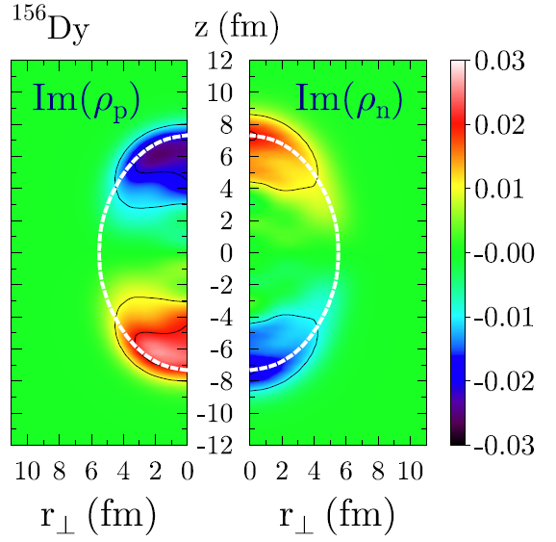
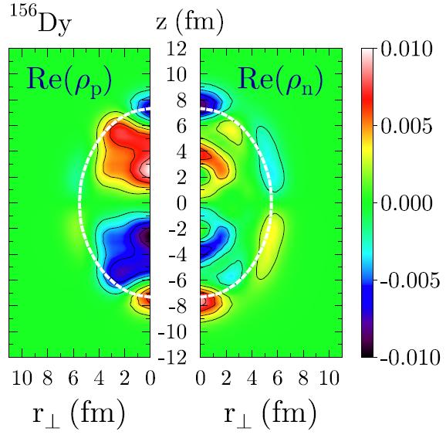
Transition Density of ¹⁵⁶Dy (old)
n
?
Beta=0.287 (g.s.),
E=12.5 MeV
p

Slide 25
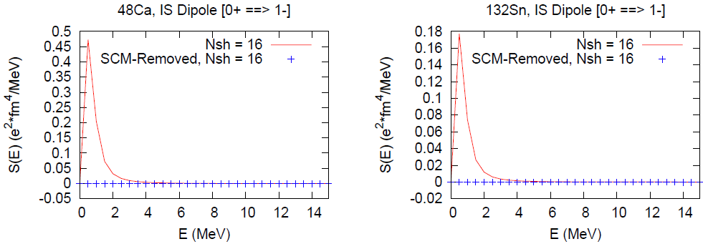
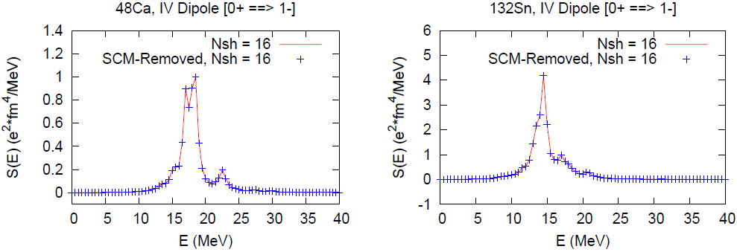
Removal of Spurious Modes
Isoscalar dipole mode ⬄ spurious center-of-mass (SCM) mode
= Nambu-Goldstone mode from the broken symmetry of translation.

